Slide 1
Guideline Update: HHS Adult & Adolescent Antiretroviral Treatment Guidelines
Brian R. Wood, MD Associate Editor, National HIV Curriculum Professor of Medicine, Division of Allergy and Infectious Diseases
University of Washington
Last Updated: October 11, 2024

Slide 2
No conflicts of interest or relationships to disclose.

Slide 3
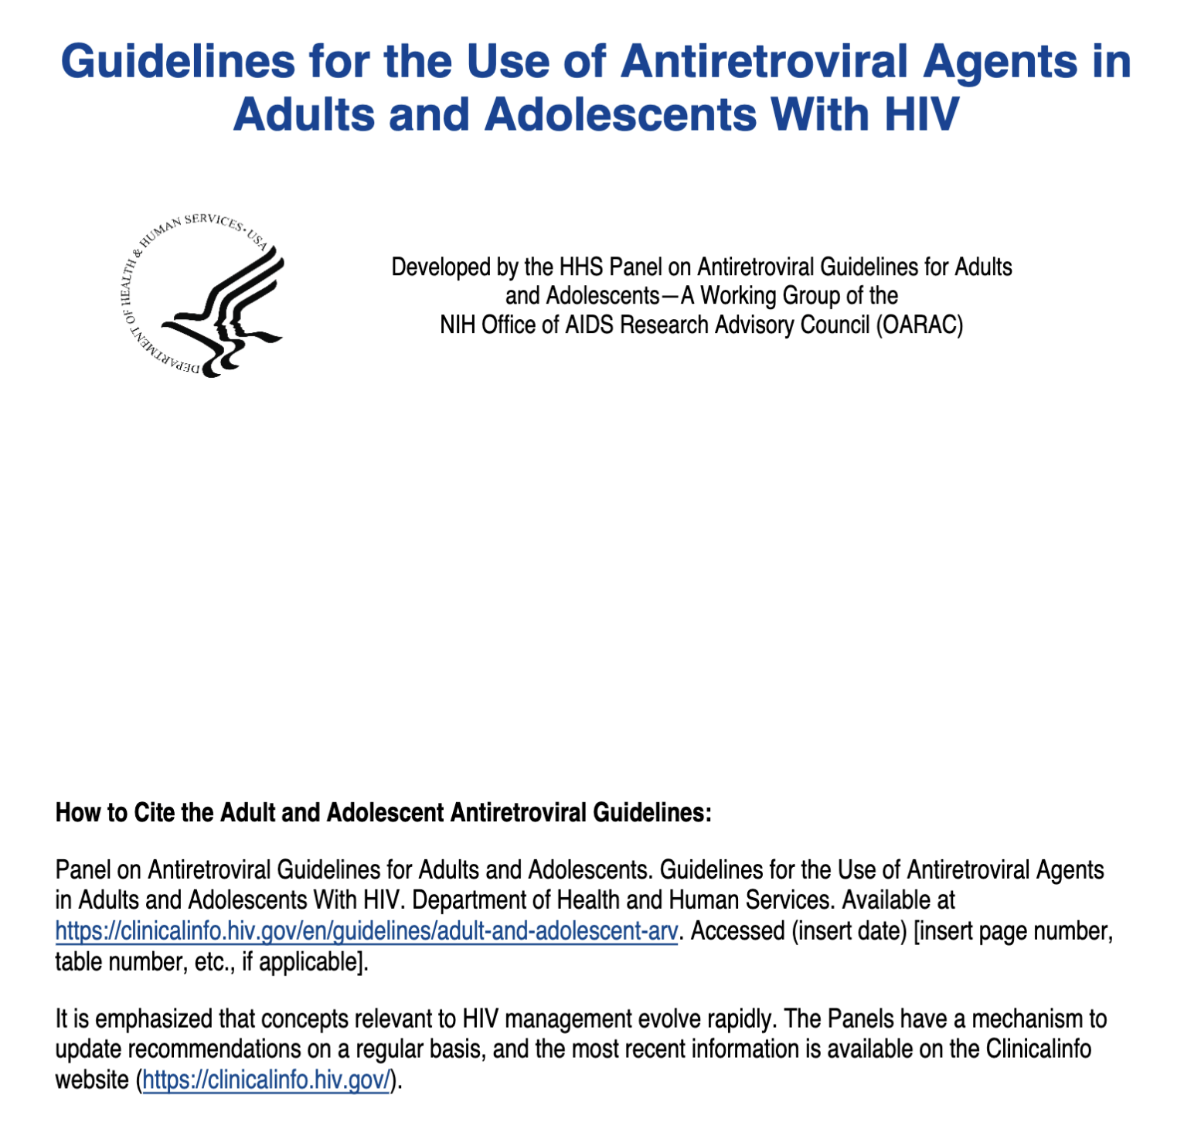
Guidelines for the Use of Antiretroviral Agents in Adults & Adolescents with HIV Updated September 12, 2024
Source: https://clinicalinfo.hiv.gov/en/guidelines

Slide 4
Key Revisions What to Start: Initial Antiretroviral Regimens for People with HIV
Key Revision #1: Dolutegravir/abacavir/lamivudine moved from Recommended Initial Regimens for Most People with HIV to Other Initial Antiretroviral Regimens for Certain Clinical Scenarios
Why? Need for HLA-B*5701 testing, increased risk of cardiovascular events, availability of other options
HHS Guidelines for the Use of Antiretroviral Agents in Adults and Adolescents with HIV. Updated Sept. 12, 2024. (http://www.clinicalinfo.hiv.gov)

Slide 5
Key Revisions What to Start: Initial Antiretroviral Regimens for People with HIV
Key Revision #2: Several regimens no longer recommended as initial therapy due to higher pill burden, more adverse effects, or lower barrier to resistance
Includes: elvitegravir/cobicistat and raltegravir-based regimens, boosted atazanavir-based regimens, efavirenz-based regimens, rilpivirine/TDF/FTC
HHS Guidelines for the Use of Antiretroviral Agents in Adults and Adolescents with HIV. Updated Sept. 12, 2024. (http://www.clinicalinfo.hiv.gov)

Slide 6
HHS Recommended Initial Regimens for Most People with HIV For People Who Do Not Have a History of Cabotegravir PrEP
INSTI + 2 NRTIs | Abbreviation
Bictegravir/tenofovir alafenamide/emtricitabine | BIC/TAF/FTC
Dolutegravir + tenofovir alafenamide/emtricitabine | DTG + TAF/FTC
Dolutegravir + [tenofovir DF/emtricitabine or tenofovir DF/lamivudine] | DTG + [TDF/FTC or TDF/3TC]
INSTI + 1 NRTI | Abbreviation
Dolutegravir/lamivudine (only if HIV RNA <500k, no HBV, have genotype results) | DTG/3TC
HHS Guidelines for the Use of Antiretroviral Agents in Adults and Adolescents with HIV. Updated Sept. 12, 2024. (http://www.clinicalinfo.hiv.gov)

Slide 7
HHS Recommended Initial Regimens for Most People with HIV For People Who Have a History of Using Cabotegravir PrEP
Boosted PI + 2 NRTIs | Abbreviation
Boosted darunavir + (tenofovir alafenamide or tenofovir DF) + (emtricitabine or lamivudine) (pending integrase genotype resistance result) | (DRV/COBI or DRV + RTV) + (TAF or TDF) + (FTC or 3TC)
HHS Guidelines for the Use of Antiretroviral Agents in Adults and Adolescents with HIV. Updated Sept. 12, 2024. (http://www.clinicalinfo.hiv.gov)

Slide 8
HHS Recommended Initial Regimens in Certain Clinical Situations For People Who Do Not Have a History of Using Cabotegravir PrEP
INSTI + 2 NRTIs
Dolutegravir/ABC/3TC (if HLA-B*5701 negative and no hepatitis B coinfection)
Boosted PI + 2 NRTIs
(Darunavir/cobicistat or darunavir + ritonavir) + (TAF or TDF + FTC or 3TC) or + (ABC/3TC) (for ABC/3TC, only if HLA-B*5701 negative and no hepatitis B coinfection)
NNRTI + 2 NRTIs
Doravirine/TDF/3TC or doravirine + TAF/FTC
Rilpivirine/TAF/FTC (only if CD4 count >200 cells/mm³ and HIV RNA <100,000 copies/mL)
Abbreviations: ABC = abacavir, 3TC = lamivudine, TAF = tenofovir alafenamide, TDF = tenofovir disoproxil fumarate, FTC = emtricitabine
HHS Guidelines for the Use of Antiretroviral Agents in Adults and Adolescents with HIV. Updated Sept. 12, 2024. (http://www.clinicalinfo.hiv.gov)

Slide 9
Virologic Failure Added Option After Virologic Failure on NNRTI-Based Regimen
Key revision: after virologic failure with NNRTI + 2 NRTIs, dolutegravir + boosted darunavir added as an option based on data from D²EFT:
Source for D²EFT Study: Lancet HIV. 2024 Jul;11(7):e436-e448.

Slide 10
Virologic Failure Added Statements About Long-Acting Cabotegravir/Rilpivirine
Some people with HIV cannot reach or maintain viral suppression on oral ART despite intensive adherence support
Long-acting injectable cabotegravir/rilpivirine has been used in this situation with some success, but long-term efficacy data are limited
Based on very limited data, Panel recommends use of LA CAB/RPV on a case-by-case basis in select individuals with persistent virologic failure
HHS Guidelines for the Use of Antiretroviral Agents in Adults and Adolescents with HIV. Updated Sept. 12, 2024. (http://www.clinicalinfo.hiv.gov)

Slide 11
Hepatitis B Coinfection Key Updates
Pegylated interferon no longer recommended
Screen for hepatitis D infection in all people with HIV/hepatitis B
When switching to NRTI-sparing or NRTI-limiting ARV regimens:
Screen for HBV before the switch
Vaccinate if non-immune
Ensure active anti-hepatitis B agent in new regimen if hepatitis B coinfection (TAF, TDF, or entecavir)
HHS Guidelines for the Use of Antiretroviral Agents in Adults and Adolescents with HIV. Updated Sept. 12, 2024. (http://www.clinicalinfo.hiv.gov)

Slide 12
Latent Tuberculosis Treatment-Antiretroviral Options Key Update: Dolutegravir BID Option with 1HP
PREFERRED Latent Tuberculosis Treatment-Antiretroviral Options (Per CDC)
Regimen | TB Med(s) | Duration, Dosing | ART Anchor Drug Option*
3HP | INH & rifaPentine | 3 months, weekly | Efavirenz 600 mg daily Raltegravir 400 mg twice-daily Dolutegravir 50 mg daily
3HR | INH & Rifampin | 3 months, daily | Efavirenz 600 mg daily Raltegravir 800 mg twice-daily Dolutegravir 50 mg twice-daily
*TDF/FTC, ABC/3TC, or TAF/FTC can be the NRTI backbone. Rifapentine may lower concentrations of TAF; if used, monitor viral load carefully. **For individuals suppressed on 50 mg daily, increase to 50 mg twice-daily during and for 2 weeks after completing 1HP.
HHS Guidelines for the Use of Antiretroviral Agents in Adults and Adolescents with HIV. Updated Sept. 12, 2024.

Slide 13
Latent Tuberculosis Treatment-Antiretroviral Options Key Update: Dolutegravir BID Option with 1HP
ALTERNATIVE Latent Tuberculosis Treatment-Antiretroviral Options (Per CDC)
Regimen | TB Med(s) | Duration, Dosing | ART Anchor Drug Option*
9H or 6H | INH | 9 or 6 months, daily | No change to ART
4R | Rifampin | 4 months, daily | Efavirenz 600 mg daily Raltegravir 800 mg twice-daily Dolutegravir 50 mg twice-daily
1HP | INH & rifaPentine | 1 month, daily | Efavirenz 600 mg daily Dolutegravir 50 mg twice-daily**
*TDF/FTC, ABC/3TC, or TAF/FTC can be the NRTI backbone. Rifapentine may lower concentrations of TAF; if used, monitor viral load carefully. **For individuals suppressed on 50 mg daily, increase to 50 mg twice-daily during and for 2 weeks after completing 1HP.
HHS Guidelines for the Use of Antiretroviral Agents in Adults and Adolescents with HIV. Updated Sept. 12, 2024.

Slide 14
New Section Transplantation for People with HIV
People with HIV who are eligible for solid organ transplant or hematopoietic cell transplant should have equitable access to transplant
People with HIV should be managed by a multidisciplinary team before, during, and after transplant
Transplant candidates with HIV should be up-to-date on their vaccination schedule
In preparation for transplant, review the ARV history, prior drug resistance, adherence, and potential for drug-drug interactions
HHS Guidelines for the Use of Antiretroviral Agents in Adults and Adolescents with HIV. Updated Sept. 12, 2024. (http://www.clinicalinfo.hiv.gov)

Slide 15
Summary
List of “What to Start” ART options simplified and no longer includes dolutegravir/abacavir/lamivudine
Dolutegravir plus boosted darunavir dual ART added as an option after virologic failure on an NNRTI plus 2 NRTI regimen
Updates emphasize the importance of screening for hepatitis B prior to ART switch, especially if switching off TAF or TDF
Important updates to sections on coinfections, new section on transplantation for people with HIV, and other key revisions

