Slide 1
Guideline Update: Screening for Anal Cancer
Brian R. Wood, MD
Associate Editor, National HIV Curriculum
Professor of Medicine, Division of Allergy and Infectious Diseases
University of Washington
Last Updated: July 26, 2024

Slide 2
No conflicts of interest or relationships to disclose.

Slide 3
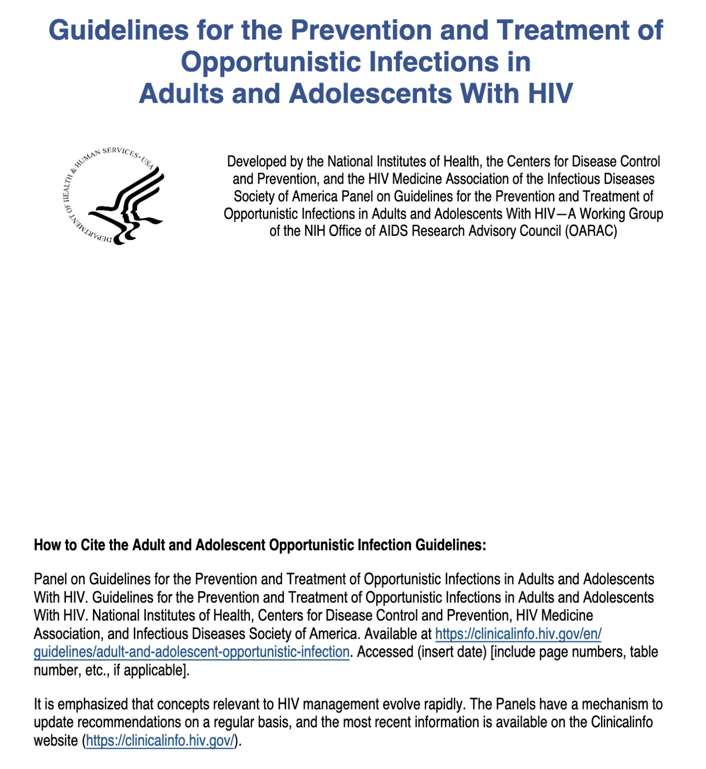
Guidelines for Prevention & Treatment of Opportunistic Infection
Human Papillomavirus (HPV) Disease: Screening for Anal Cancer
Updated July 9, 2024
Source: https://clinicalinfo.hiv.gov/en/guidelines

Slide 4
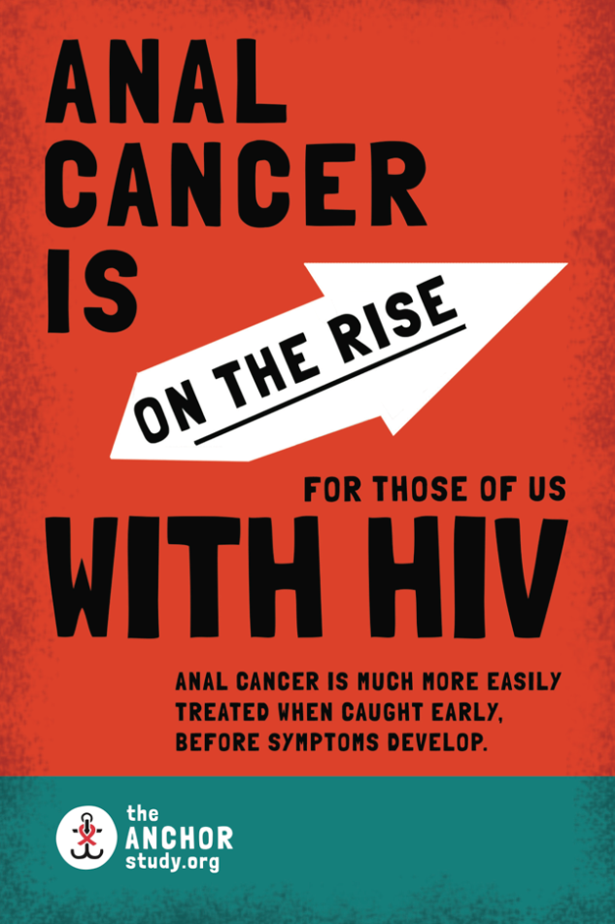
What We Know About Anal Cancer
Anal cancer is more frequent among men and women with HIV than among persons who do not have HIV
MSM with HIV are 80-130x more likely to develop anal cancer than MSM without HIV
Anal cancer incidence is rising among men and women with HIV despite widespread effective ART
Anal cancer is preceded by precancerous cells called "high-grade squamous intraepithelial lesions" = HSIL
Source: Anchorstudy.org (adapted with permission from a slide created by Dr. Jeff Schouten)

Slide 5
Risk Factors for Anal Cancer
Infection with oncogenic strains of HPV (i.e., HPV 16 and 18)
Older age
History low CD4+ T-cell count
Longer duration of HIV and of immune suppression
Smoking
Genital warts
Cervical and vulvar HSIL and cancers
Higher grade of cytologic abnormality
Source: Anchorstudy.org, OI Guidelines (https://clinicalinfo.hiv.gov/en/guidelines)

Slide 6
ANCHOR Study: Design
Background: Phase 3, randomized controlled trial, conducted at 25 sites in the United States
Inclusion Criteria
  Persons with HIV age 35 years or older invited for HSIL screening (cytology & HRA)
  Eligible for randomization if HSIL confirmed
  Excluded if history of anal cancer or anal cancer detected at screening
Treatment Arms
  Monitoring arm (every 6-month DARE, HRA, biopsy if indicated)
  Intervention arm: above plus HSIL removed (ablation, excision, or topical treatments)
Monitoring arm
(n = 2,227)
Intervention arm
(n = 2,219)
Primary outcome: progression to anal cancer
Source: Palefsky JM, et al. Treatment of Anal High-Grade Squamous Intraepithelial Lesions to Prevent Anal Cancer. New Engl J Med 2022;386:2273-82.

Slide 7
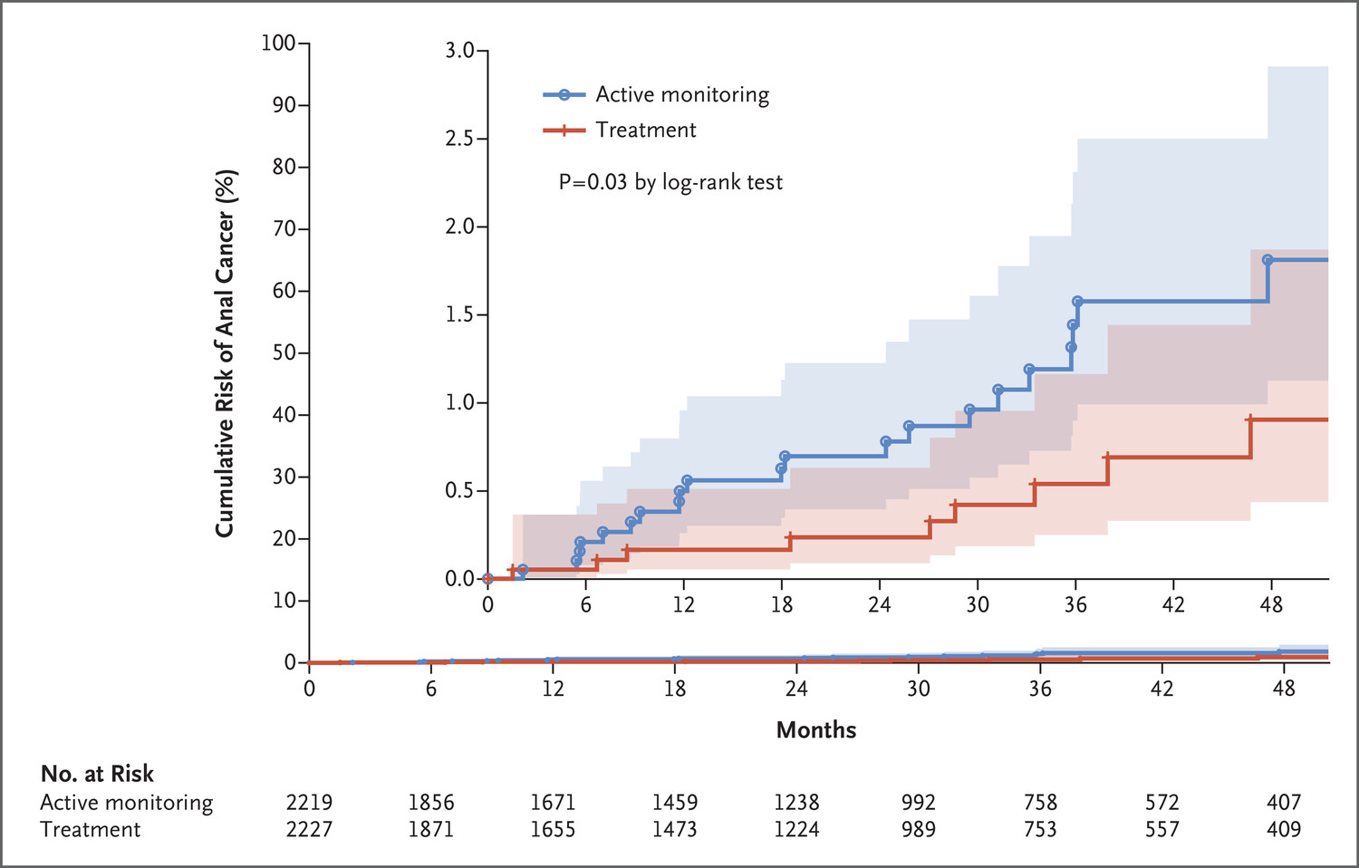
Anchor Study: Results
4,446 PWH in analysis; median follow up 25.8 months
9 developed invasive anal cancer in the treatment arm vs. 21 in the monitoring arm
Cancer incidence in the treatment arm 173/100,000 PYFU, vs. 402/100,000 PYFU in the monitoring arm
57% reduction in anal cancer
(95% CI 6-80%, p= 0.029)
Source: Palefsky JM, et al. Treatment of Anal High-Grade Squamous Intraepithelial Lesions to Prevent Anal Cancer. New Engl J Med 2022;386:2273-82. Figure copyright © (2022) Massachusetts Medical Society. Reprinted with permission from Massachusetts Medical Society.

Slide 8
Rationale Behind the New Guideline
High (and rising) incidence of anal cancer in PWH
High prevalence of anal HSIL in PWH
High progression rate of anal HSIL to cancer in the absence of treatment
Efficacy of treating anal HSIL to reduce progression to anal cancer
Screening for anal HSIL (AII) and treatment of anal HSIL (AI) are recommended for PWH based on age, sex at birth, and risk/exposure group
Source: OI Guidelines (clinicalinfo.nih.gov)

Slide 9
New Anal Cancer Screening Guidelines for PWH
Symptomatic
PWH, regardless of history of anal intercourse, should undergo annual assessment for anal symptoms (e.g., unexplained itching, bleeding, or pain; or presence of perianal lesions)
MSM and transgender women below age 35 and others below age 45 with symptoms should undergo digital anorectal examination (DARE) and standard anoscopy (AIII)
Source: OI Guidelines (clinicalinfo.nih.gov)

Slide 10
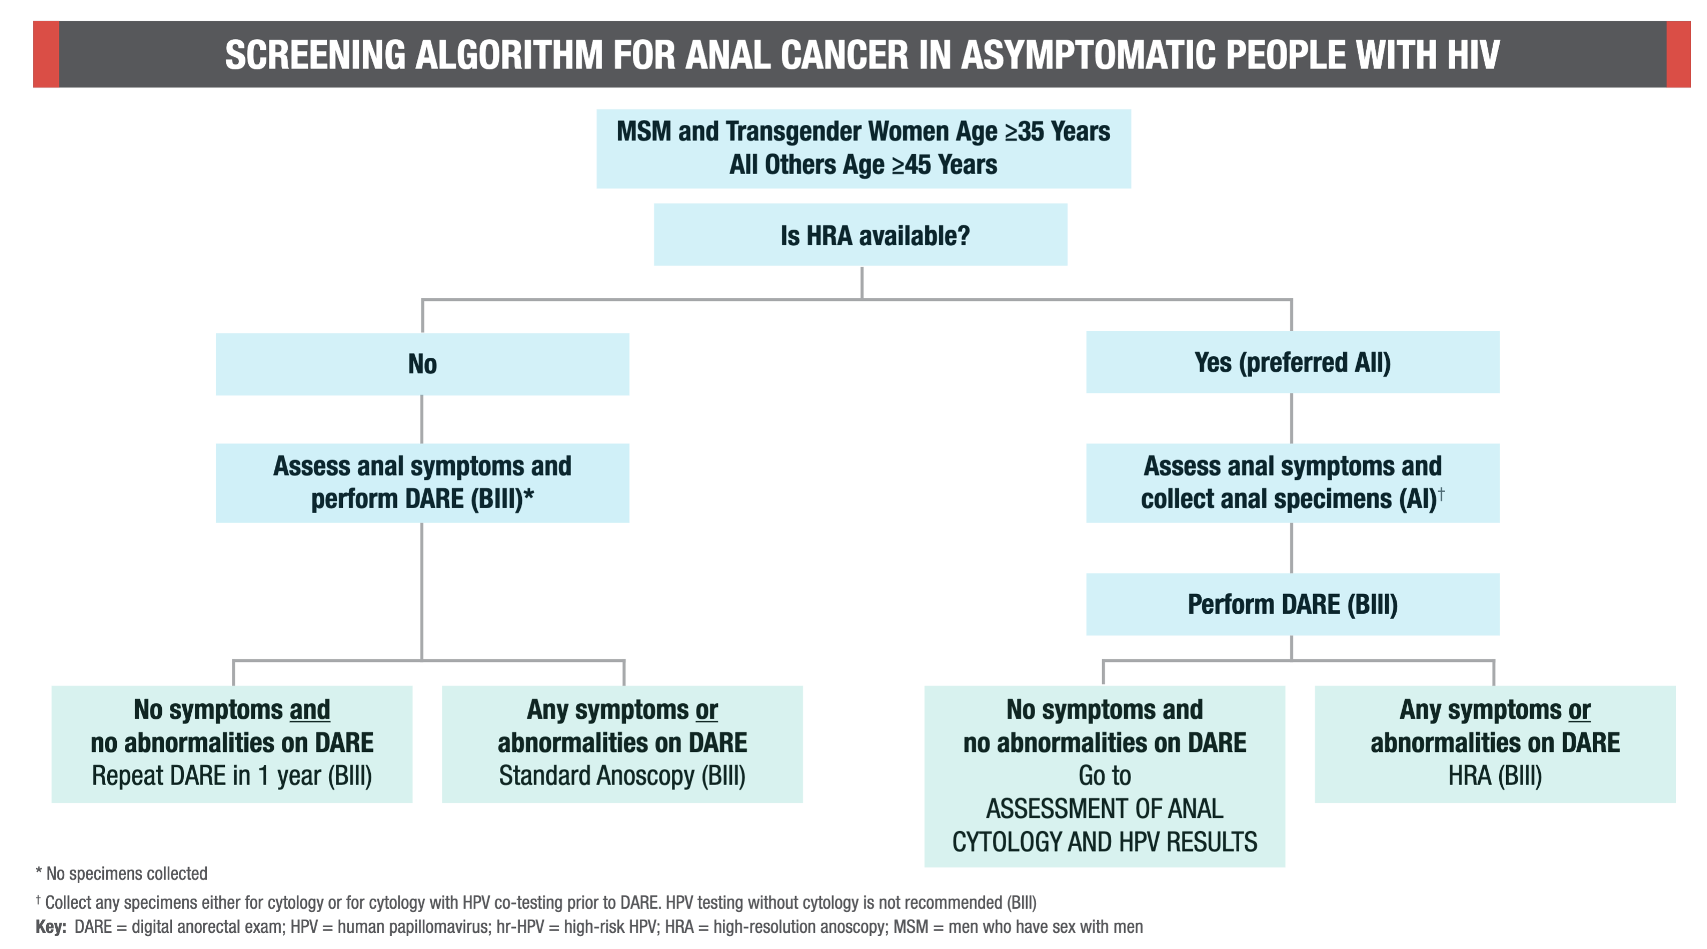
New Anal Cancer Screening Guidelines for PWH
Asymptomatic
Source: OI Guidelines (clinicalinfo.nih.gov)

Slide 11
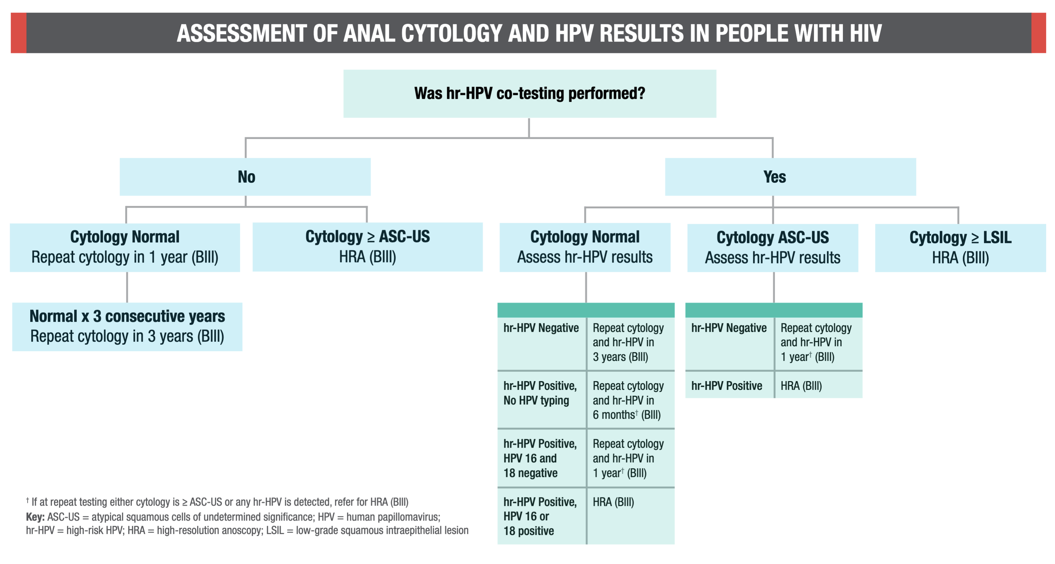
New Anal Cancer Screening Guidelines for PWH
Interpretation of Cytology Results
Source: OI Guidelines (clinicalinfo.nih.gov)

Slide 12
New Anal Cancer Screening Guidelines for PWH
Challenges to Implementation of the New Guidelines
Patient education and integrating anal cancer screening into routine primary care (with many competing priorities)
Limited number of HRA-trained providers

Slide 13
Summary
HPV infection, anal cancer precursor lesions, and anal cancer are more prevalent in persons with HIV and incidence rising
Identification and treatment of precursor lesions prevents anal cancer
New recommendations give guidance on evaluating anal cancer symptoms and screening for anal cancer for asymptomatic PWH
Screening protocols will depend on HRA availability
Don’t forget HPV vaccination as a key part of anal cancer prevention

Slide 14
