Slide 1
HIV Capsid Inhibitors: Mechanism of Action
David H. Spach, MD Editor-in-Chief, National HIV Curriculum Professor of Medicine Division of Allergy and Infectious Diseases
University of Washington
July 9, 2024

Slide 2
Dr. Spach does not have any disclosures.

Slide 3
HIV Antiretroviral Therapy
HIV
Protease Inhibitors
Entry Inhibitors
Capsid Inhibitors
Capsid Inhibitors
INSTIs
Reverse Transcriptase Inhibitors
Capsid Inhibitors
Illustration: Cognition Studio, Inc. and David H. Spach, MD

Slide 4
HIV Antiretroviral Therapy: Capsid Inhibitors
HIV
Protease Inhibitors
Entry Inhibitors
Capsid Inhibitors
Capsid Inhibitors
INSTIs
Reverse Transcriptase Inhibitors
Capsid Inhibitors
Illustration: Cognition Studio, Inc. and David H. Spach, MD

Slide 5
HIV Capsid Structure and Function

Slide 6
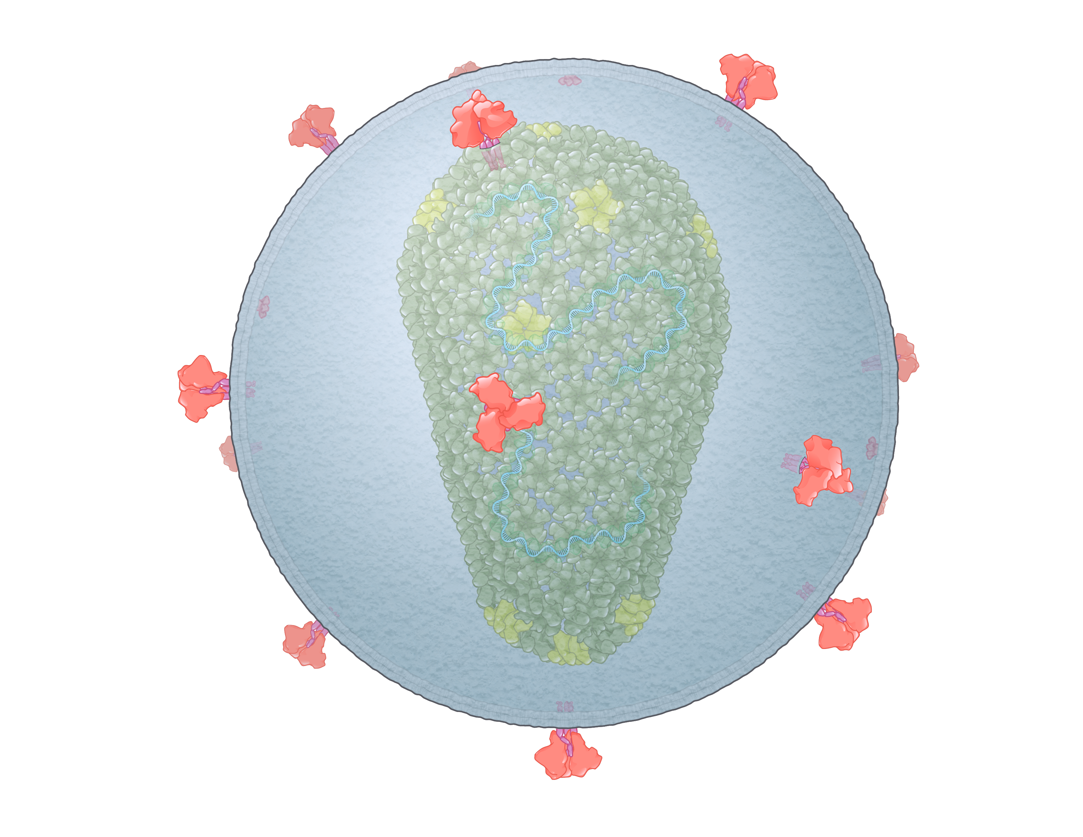
HIV
Illustration: Cognition Studio, Inc. and David H. Spach, MD

Slide 7
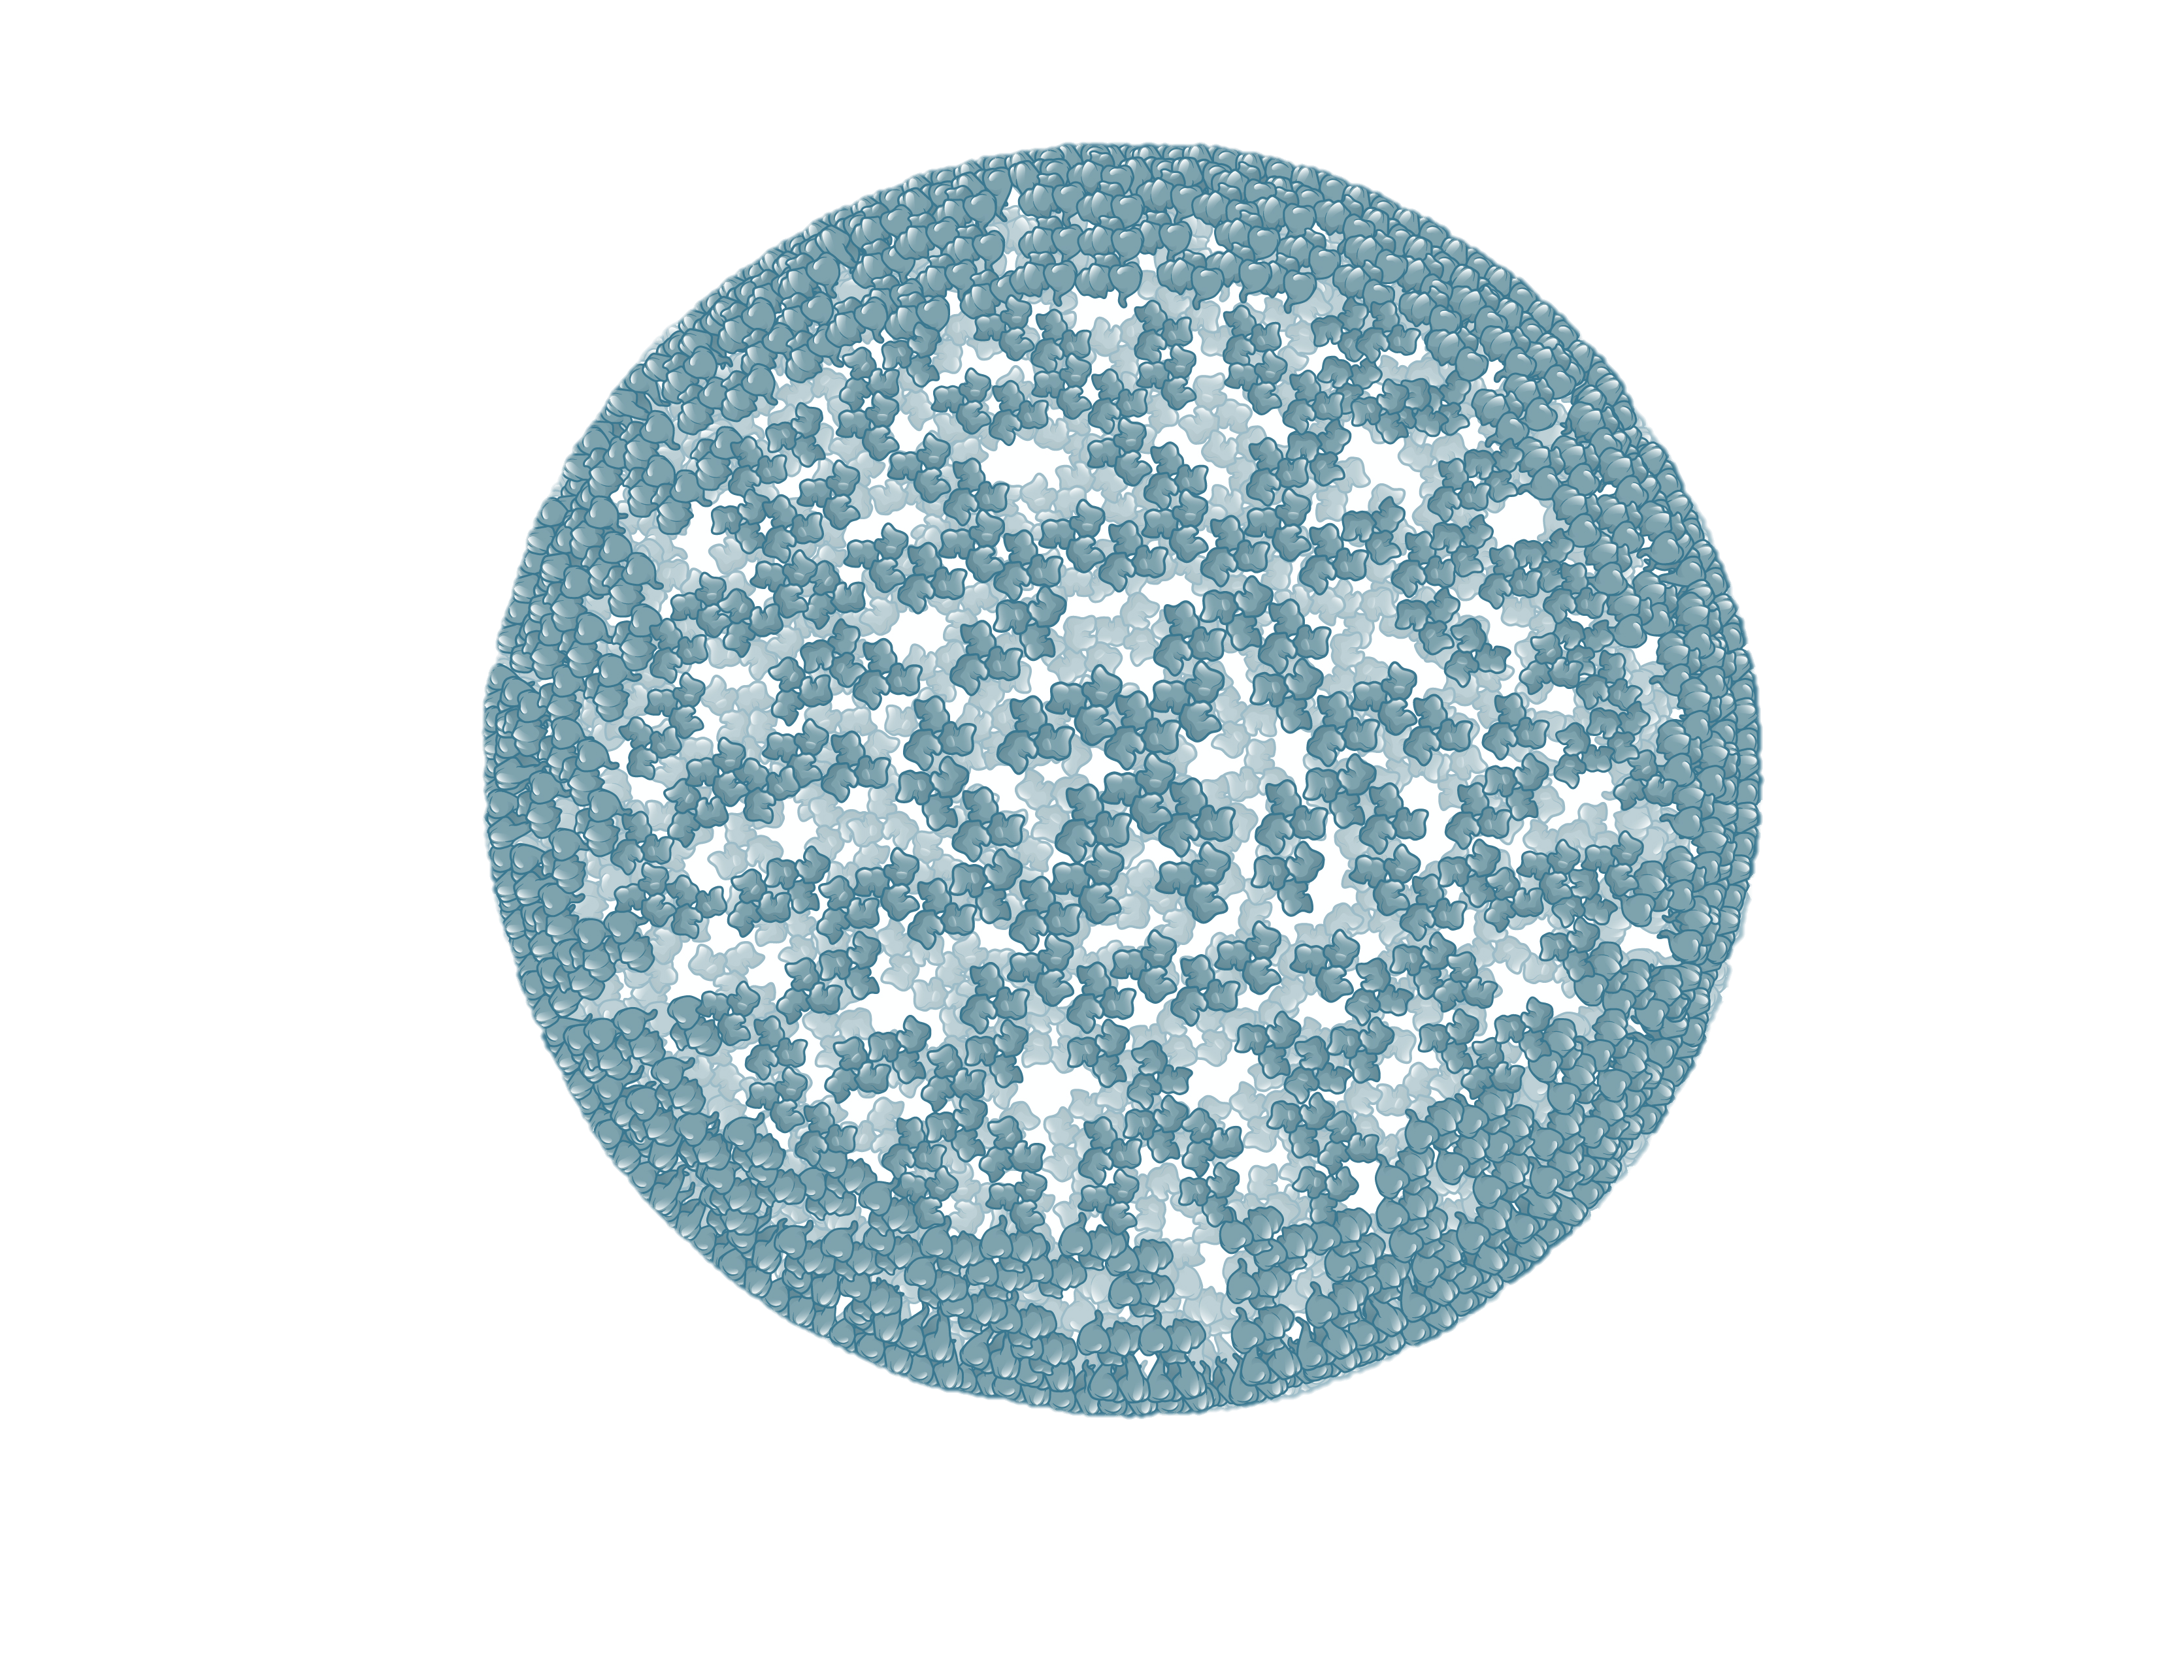
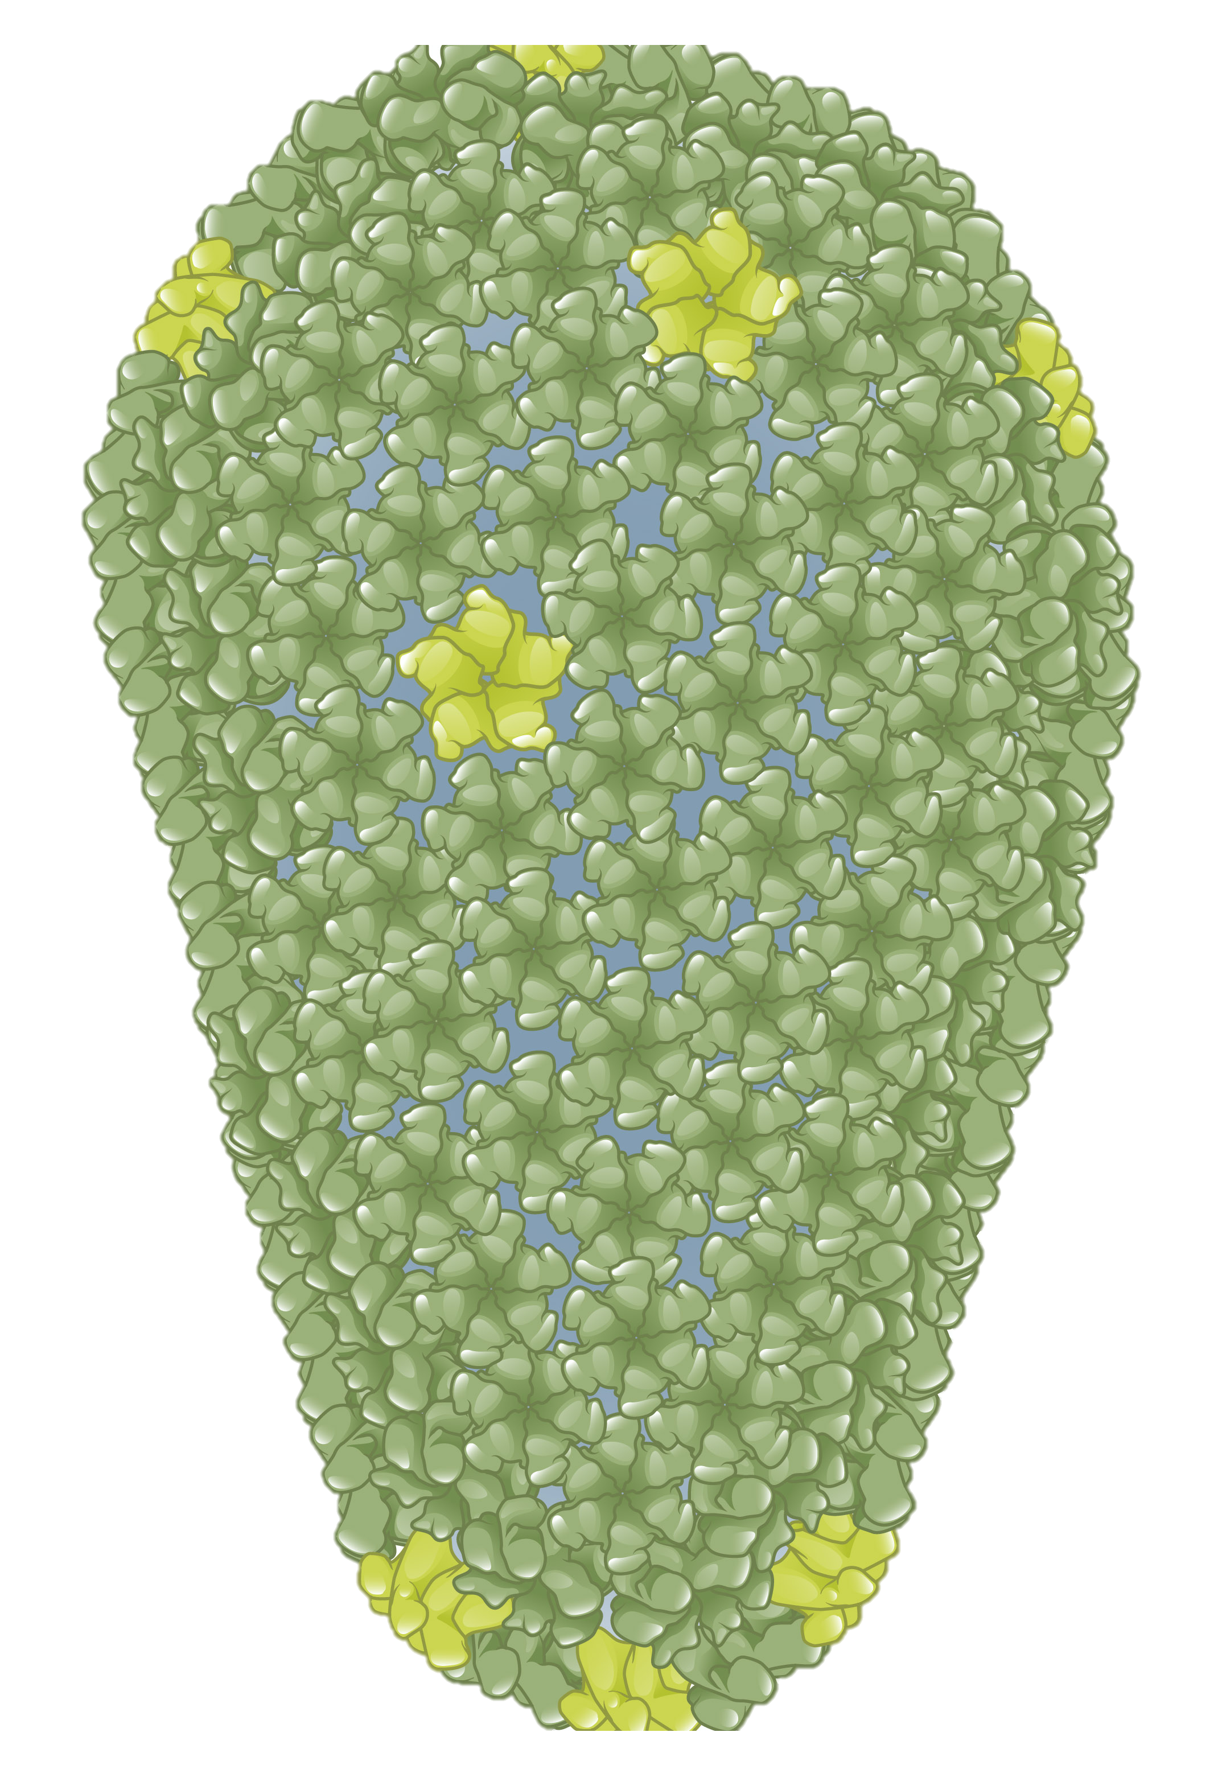
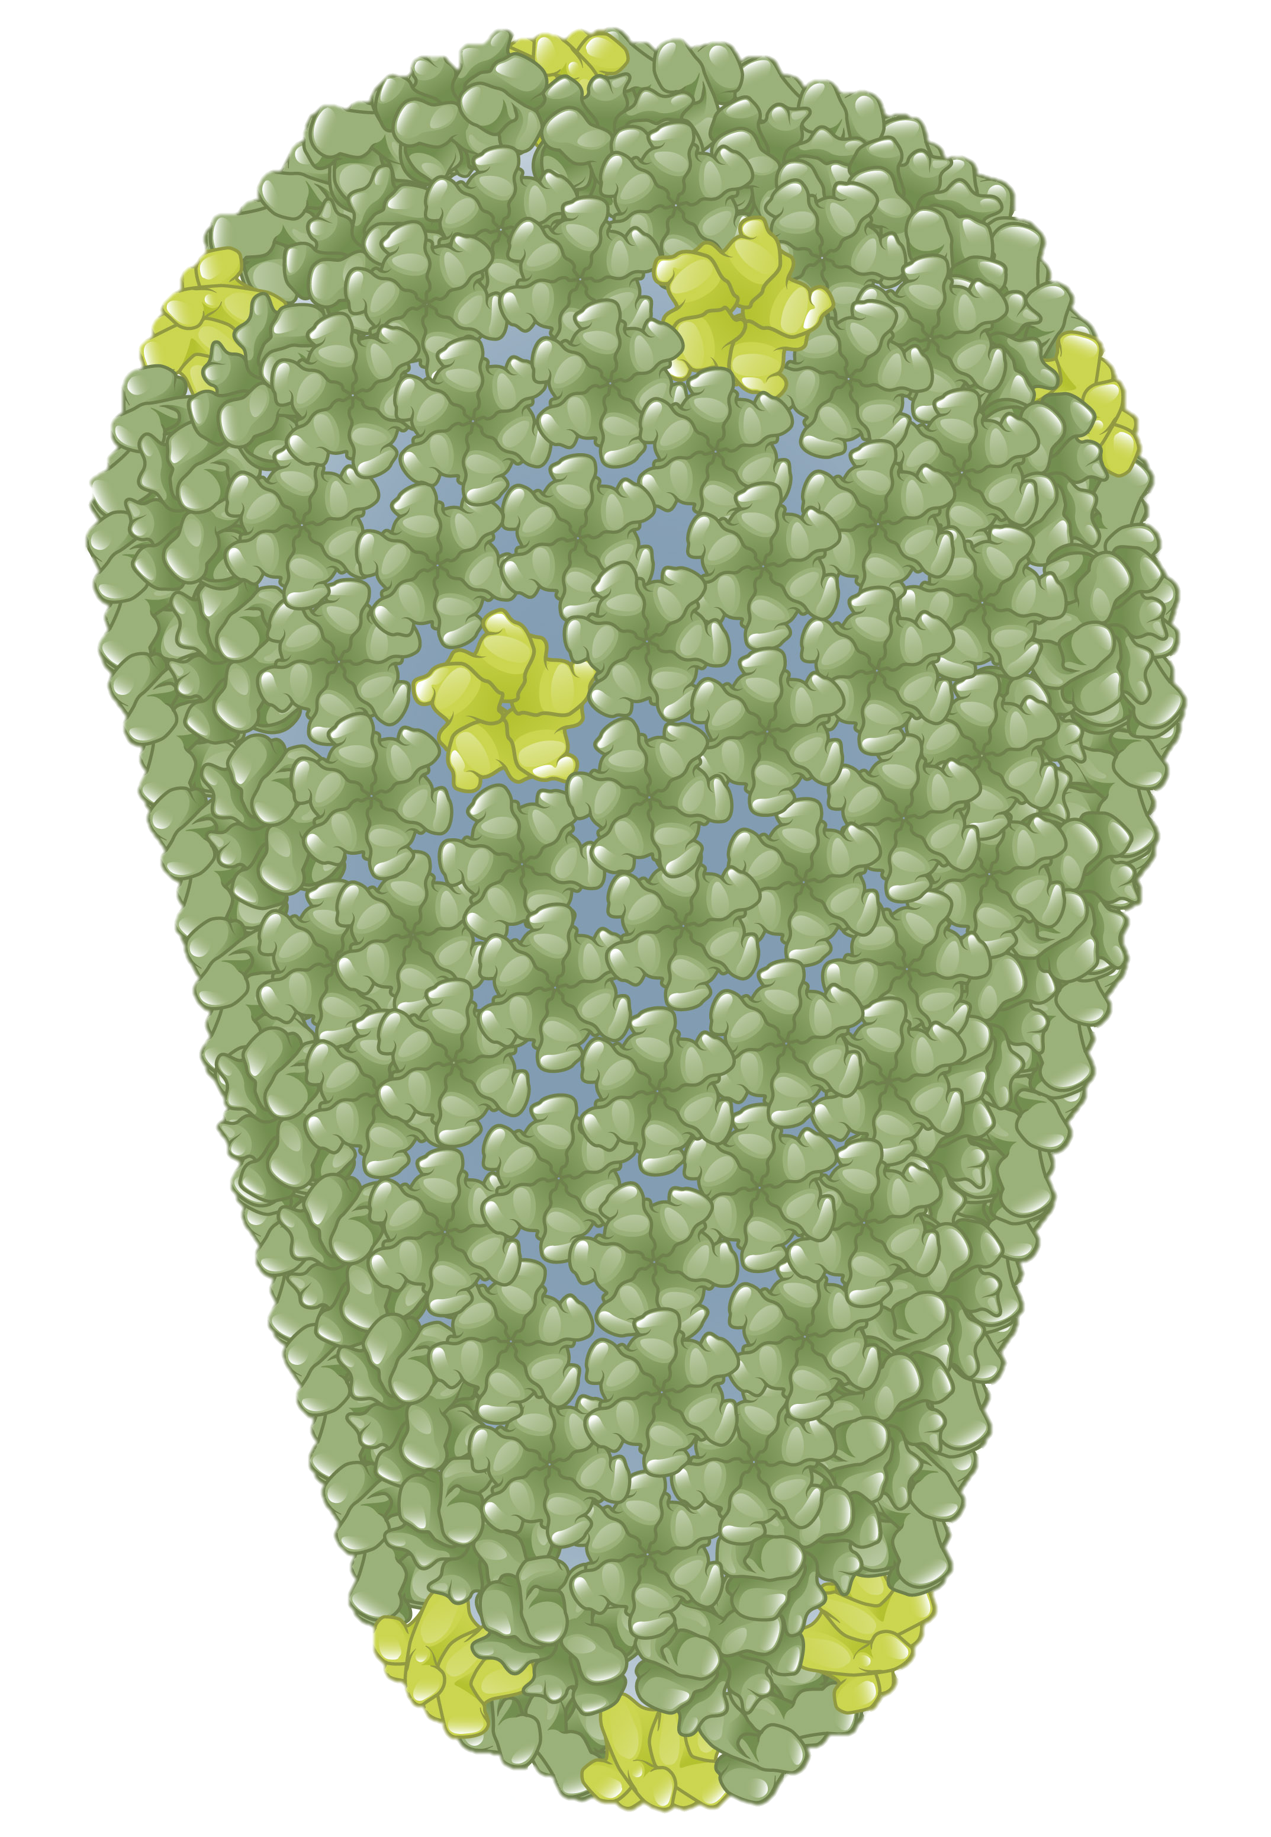
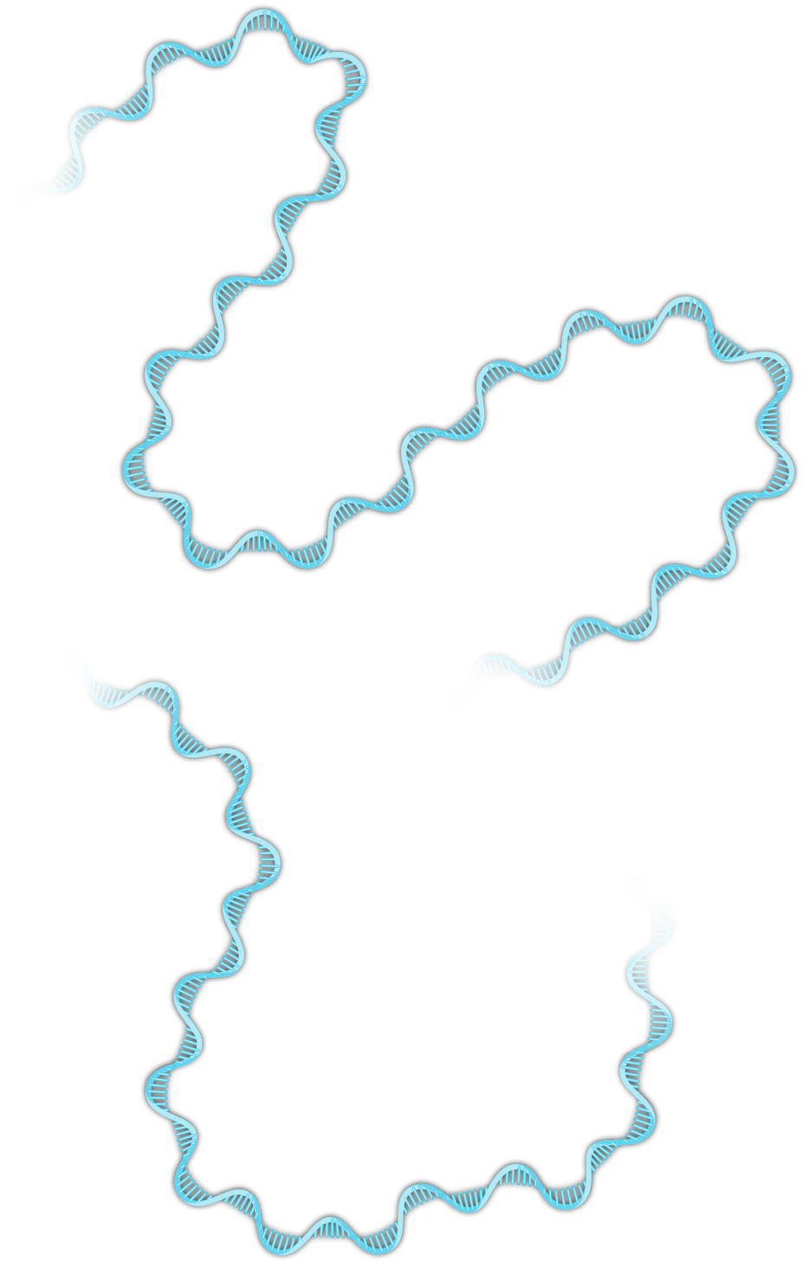
HIV Core
HIV Core
Illustration: Cognition Studio, Inc. and David H. Spach, MD

Slide 8
HIV Core and HIV Capsid
HIV Capsid
HIV Core
Illustration: Cognition Studio, Inc. and David H. Spach, MD

Slide 9
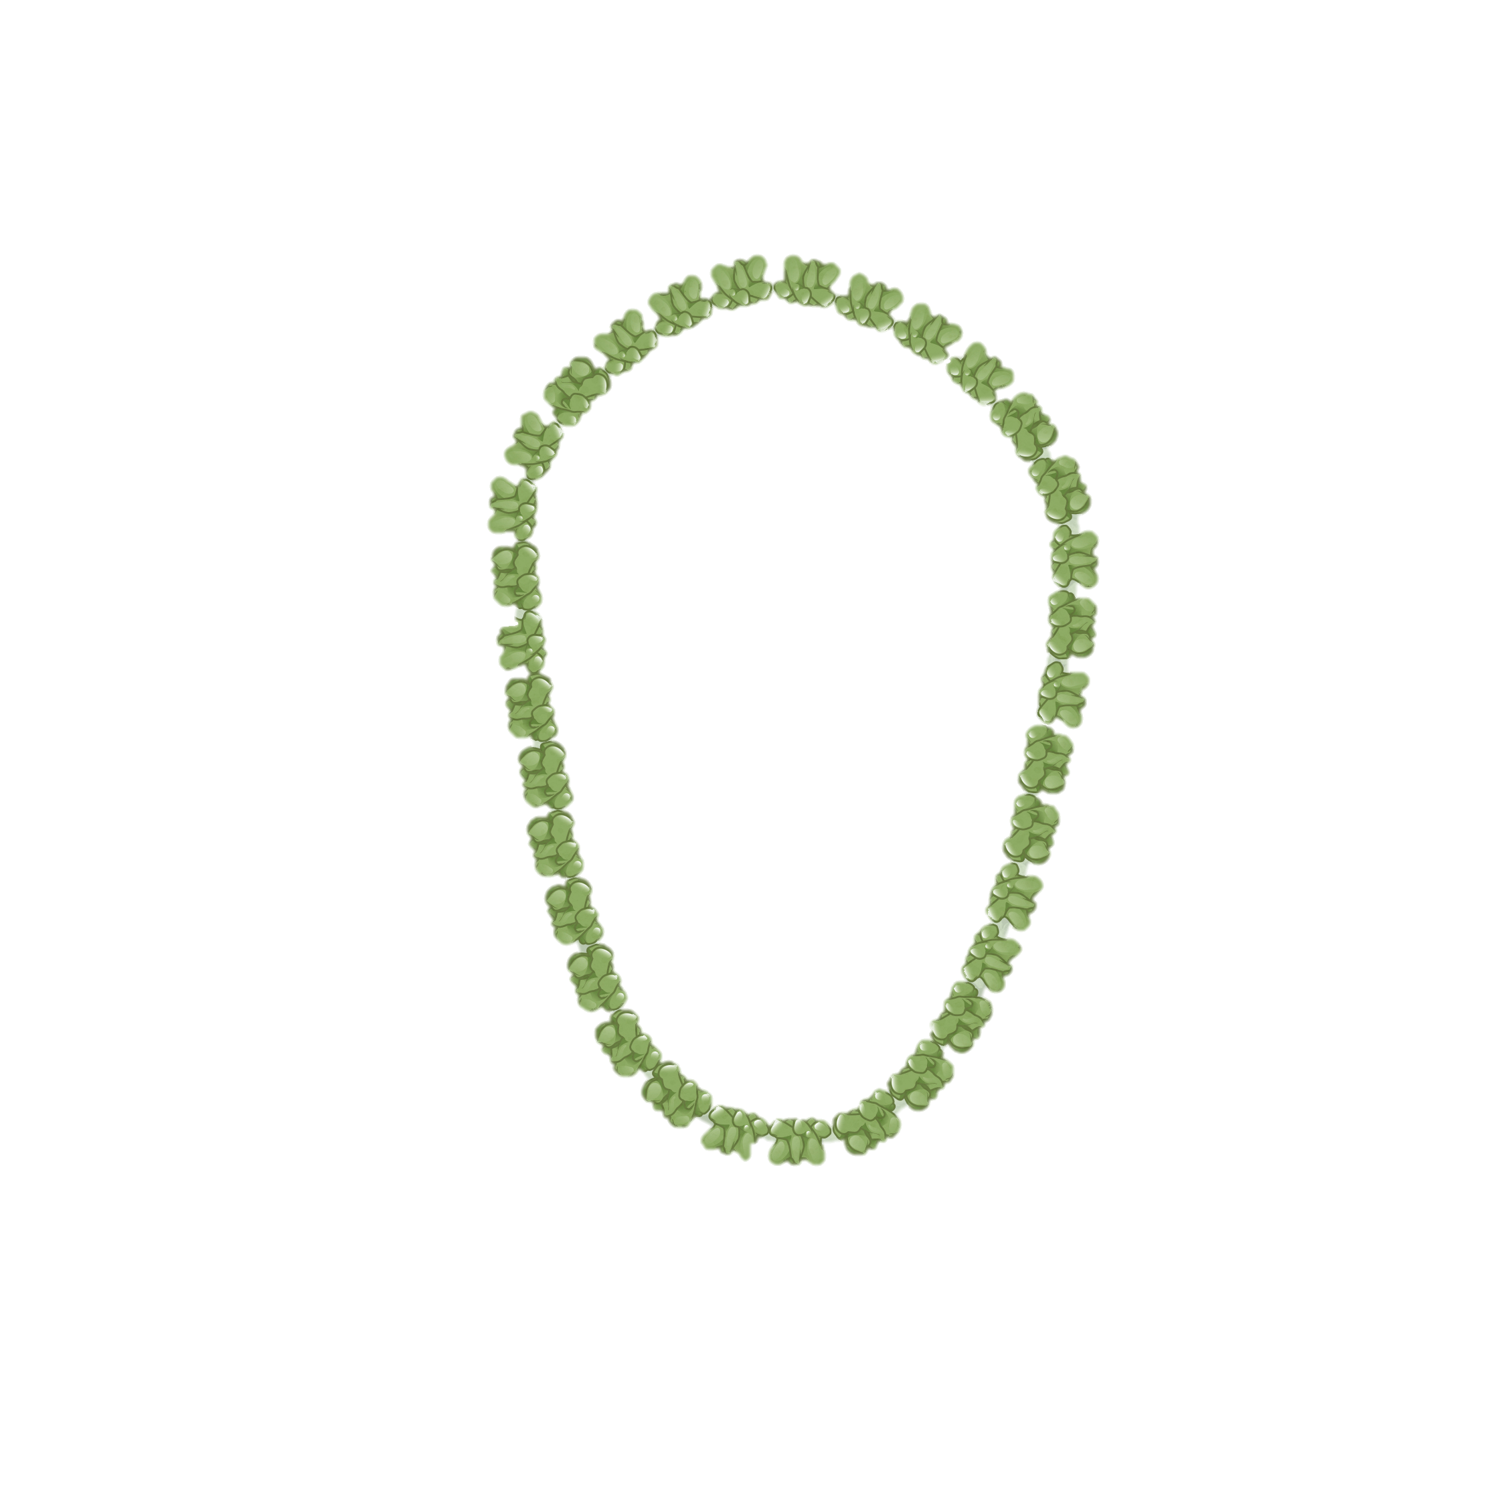
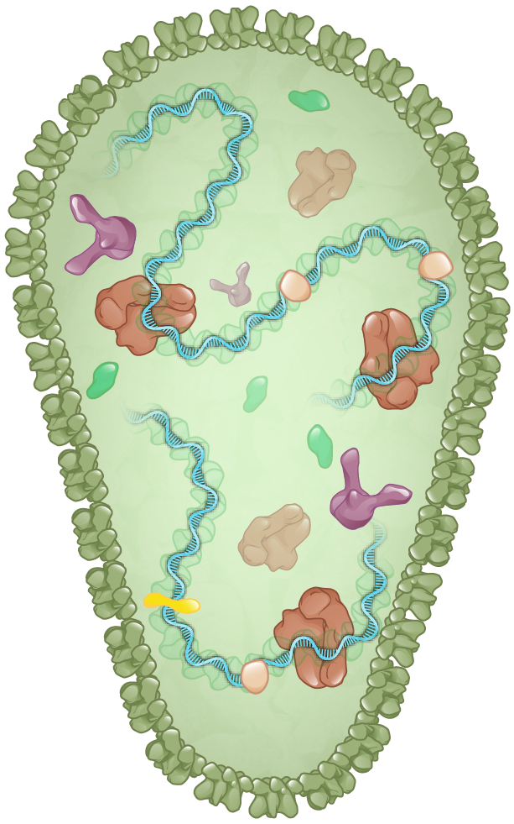
HIV Core and HIV Capsid
HIV Core
HIV Capsid
Illustration: Cognition Studio, Inc. and David H. Spach, MD

Slide 10
HIV Capsid Shell and Capsid Proteins
HIV Capsid
Capsid proteins (p24)
Illustration: Cognition Studio, Inc. and David H. Spach, MD

Slide 11
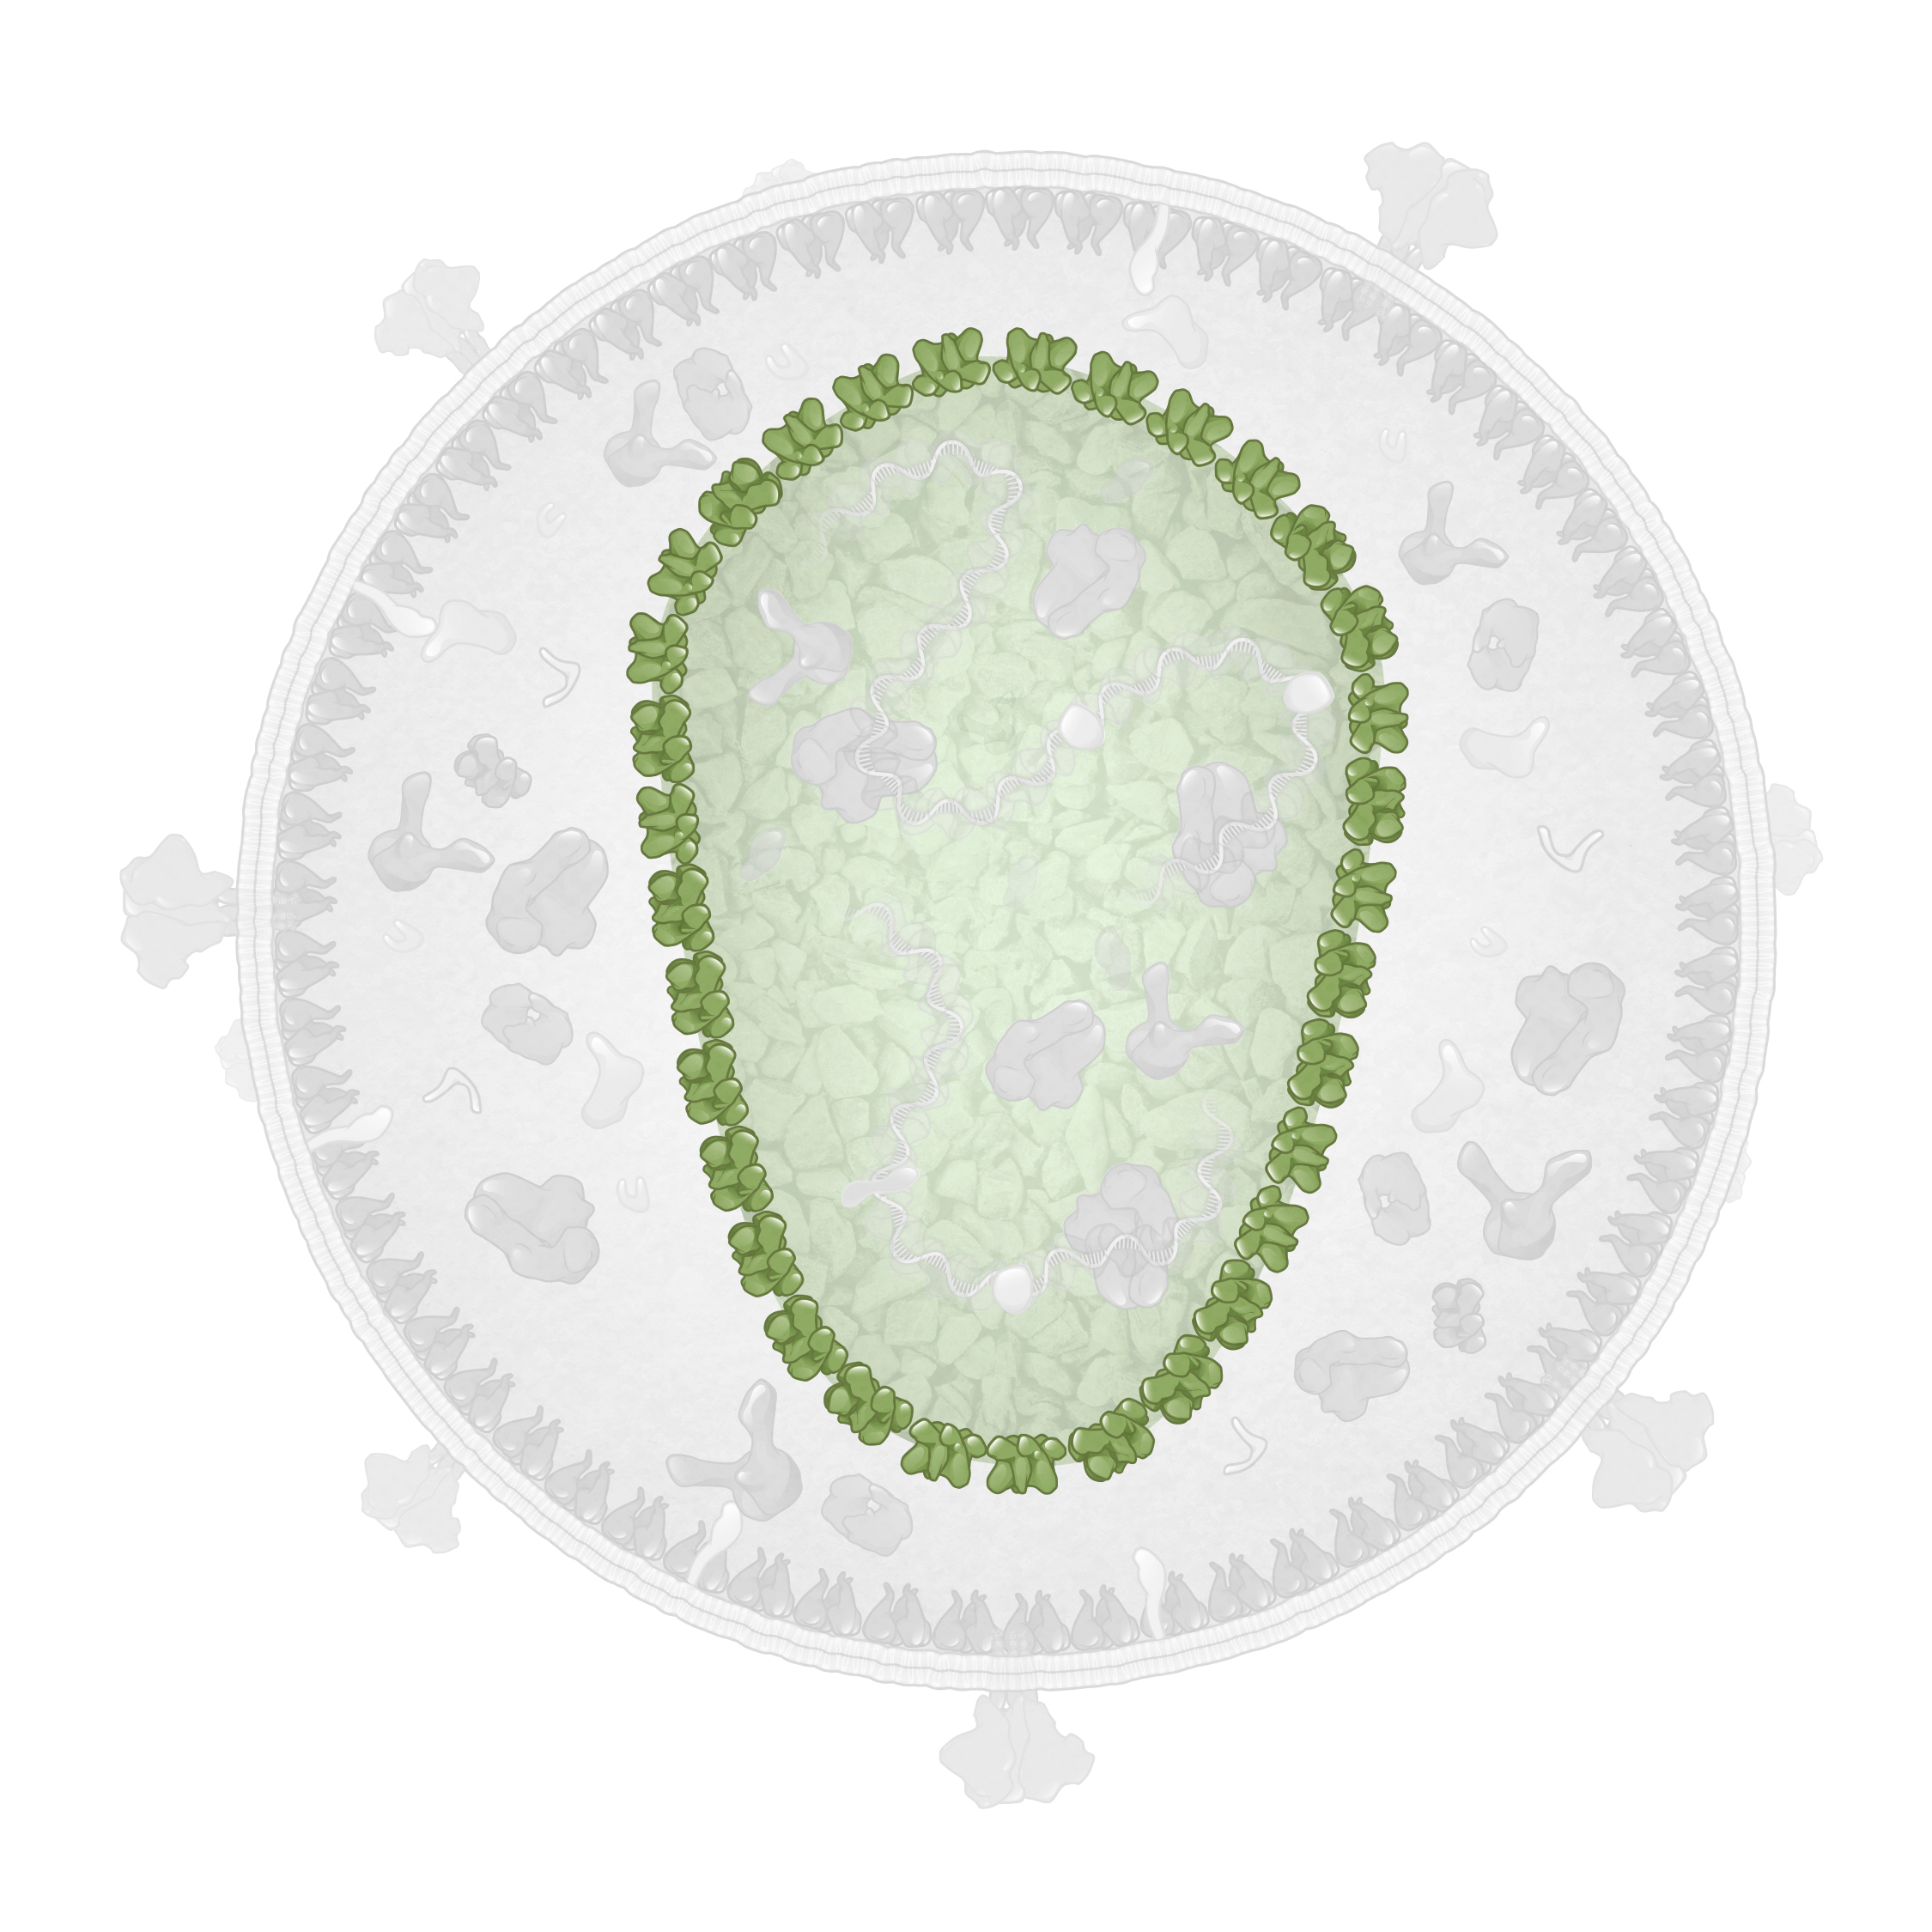
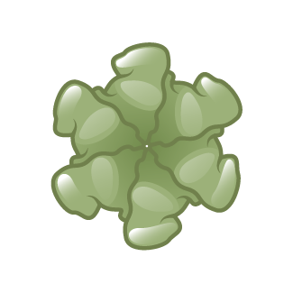
HIV Capsid Hexamers and Pentamers and HIV Capsid Shell
Capsid Hexamer
HIV Capsid shell
Capsid Hexamer
Capsid Pentamer
Capsid Pentamer
Illustration: Cognition Studio, Inc. and David H. Spach, MD

Slide 12
Function of HIV Core and HIV Capsid
HIV Capsid shell
HIV Core
Illustration: Cognition Studio, Inc. and David H. Spach, MD

Slide 13
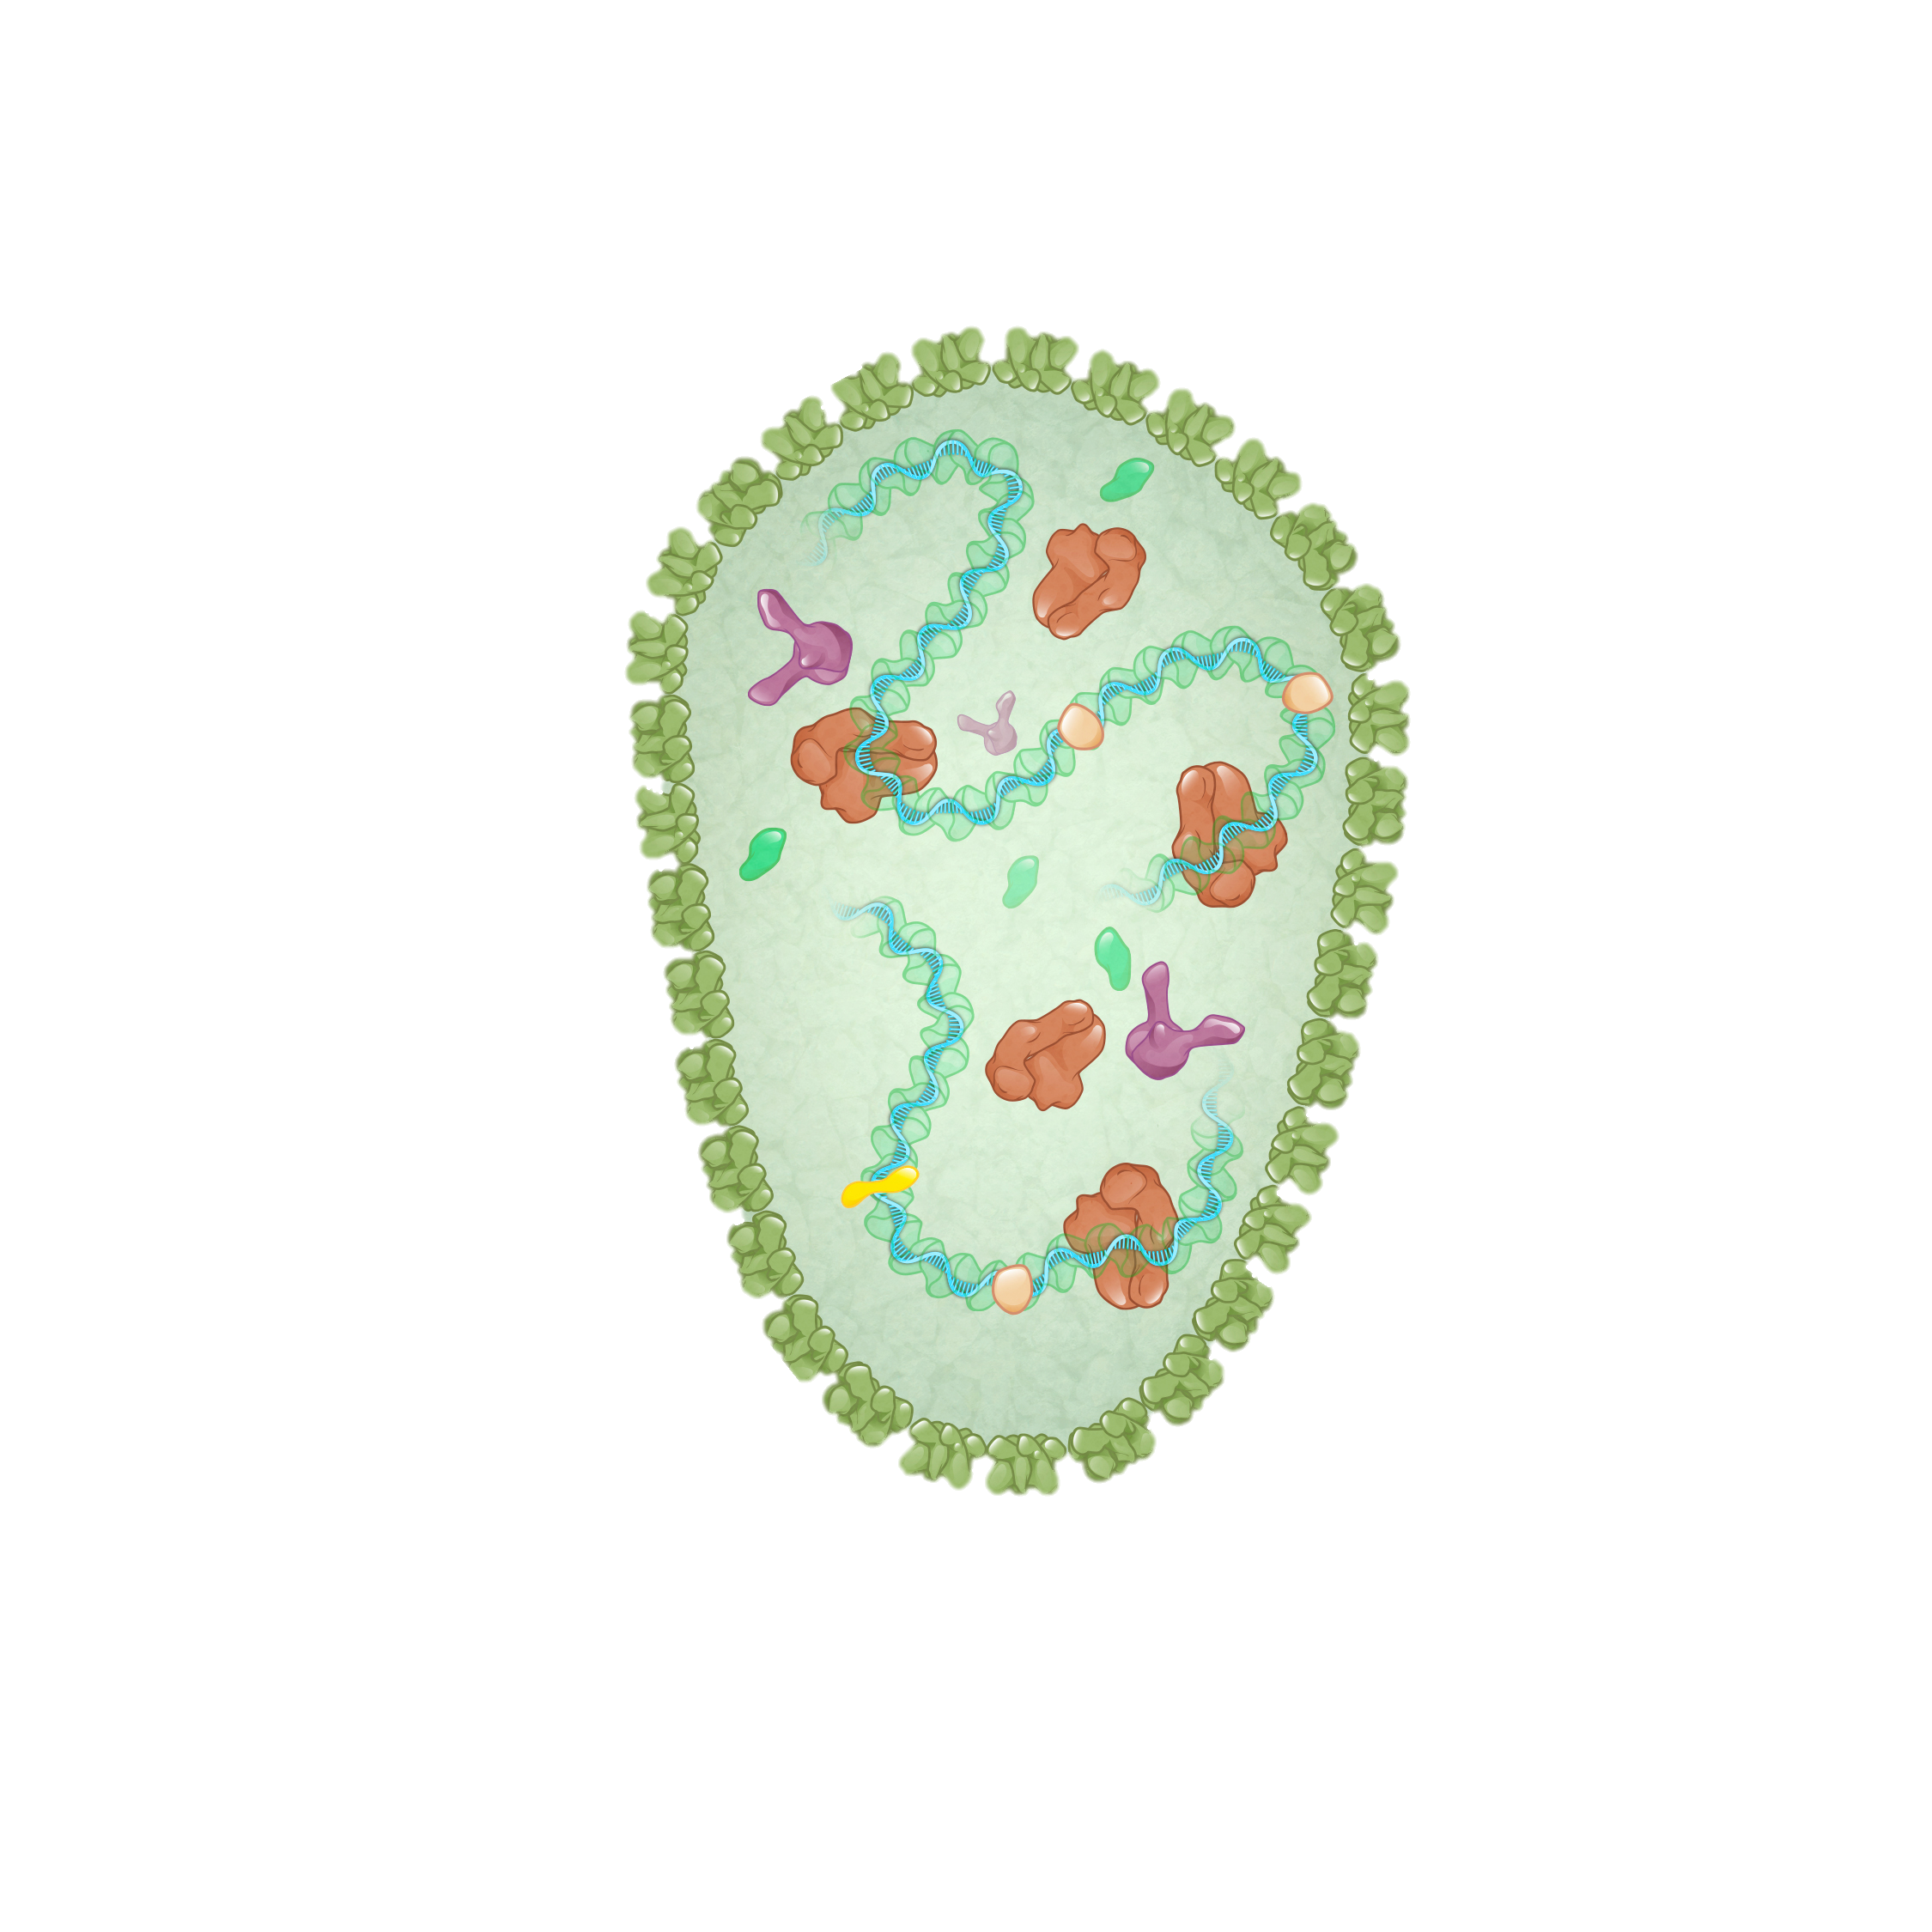
Function of HIV Core and HIV Capsid
HIV Capsid shell
HIV RNA
HIV Capsid (Core)
HIV Reverse Transcriptase
HIV Integrase
Illustration: Cognition Studio, Inc. and David H. Spach, MD

Slide 14
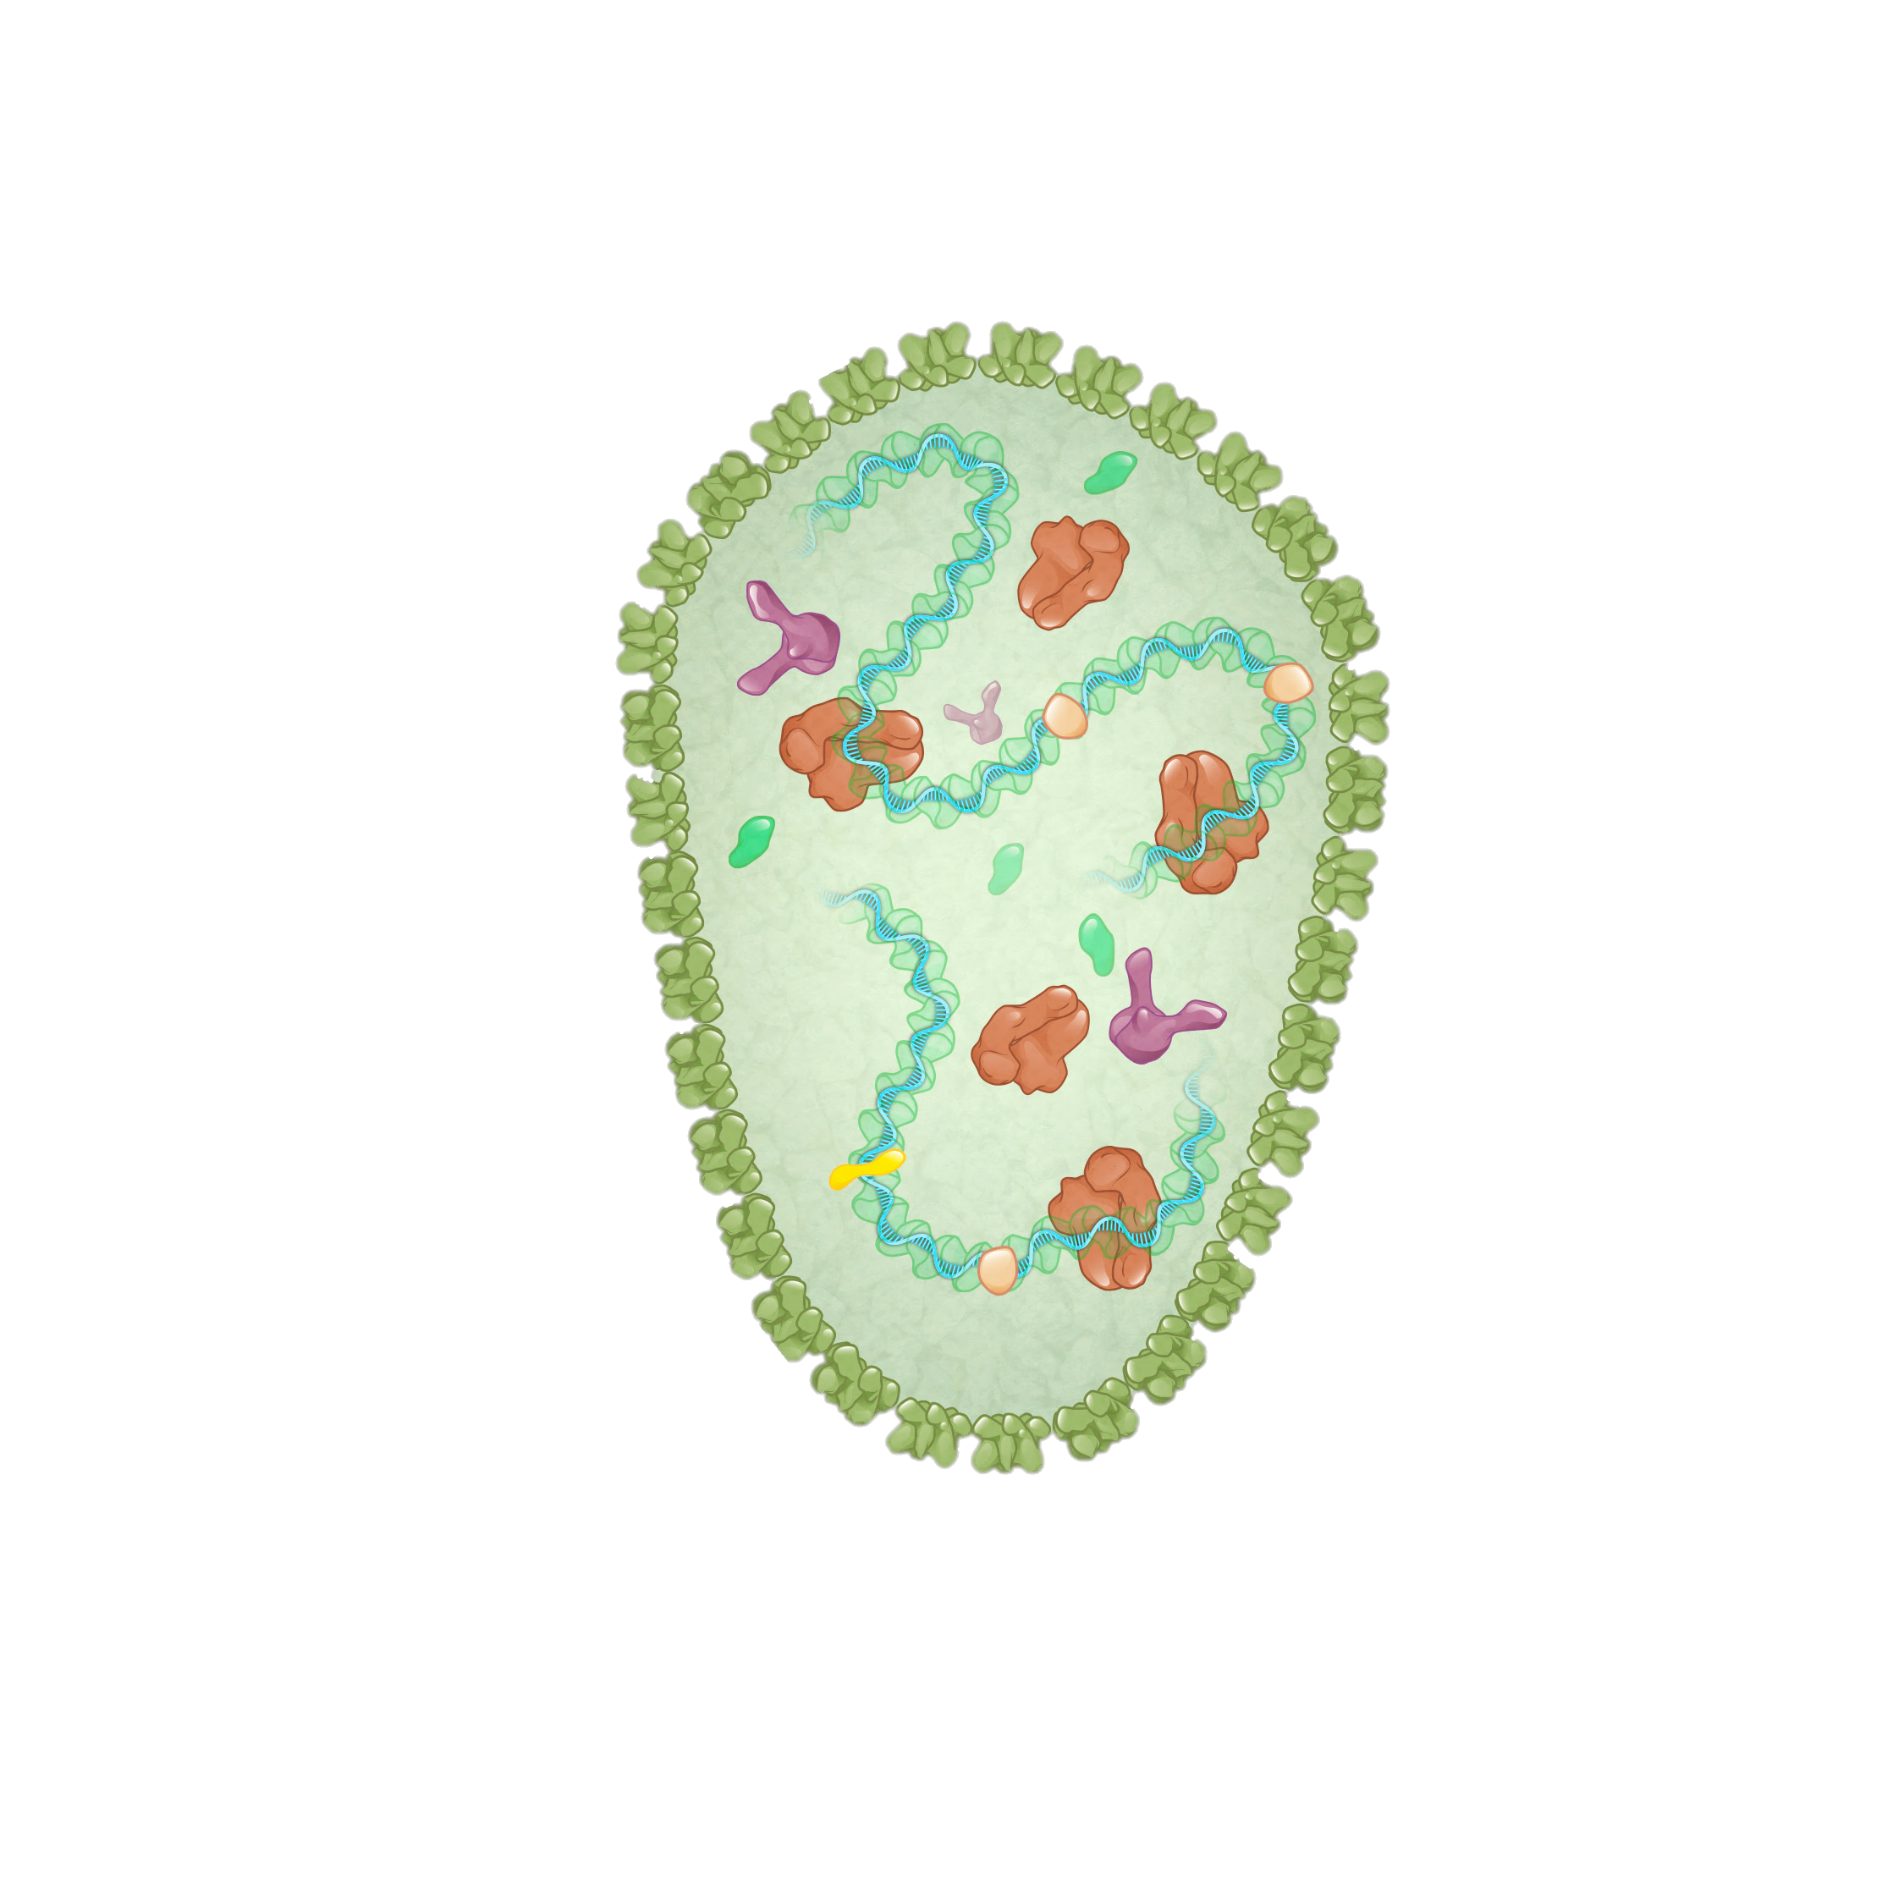
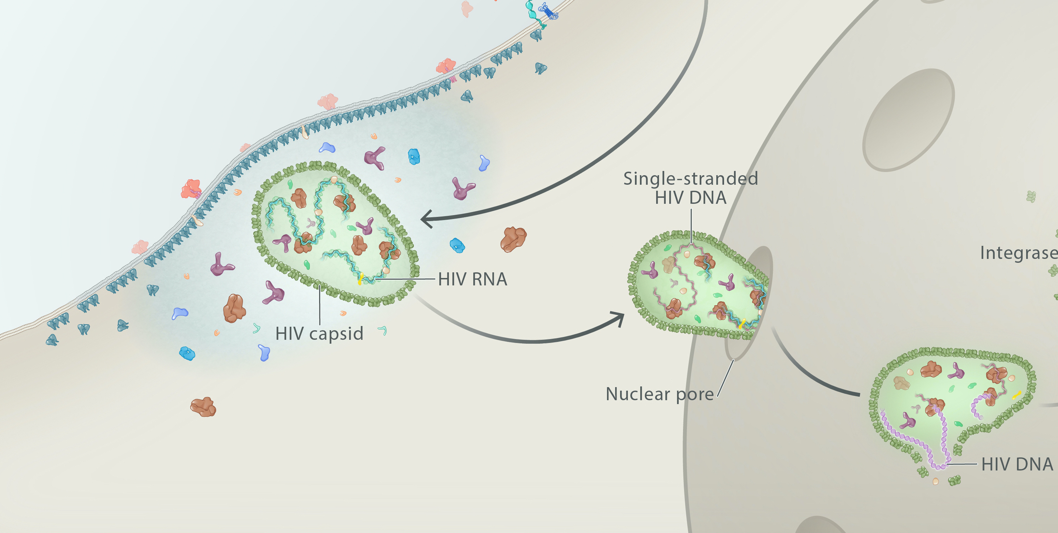
HIV Core Transport Inside Host Cell
HIV core
Cytoplasm
Nucleus
Host Cell
Illustration: Cognition Studio, Inc. and David H. Spach, MD

Slide 15
HIV Core Transport Inside Host Cell
Cytoplasm
Nucleus
Host Cell
Illustration: Cognition Studio, Inc. and David H. Spach, MD

Slide 16
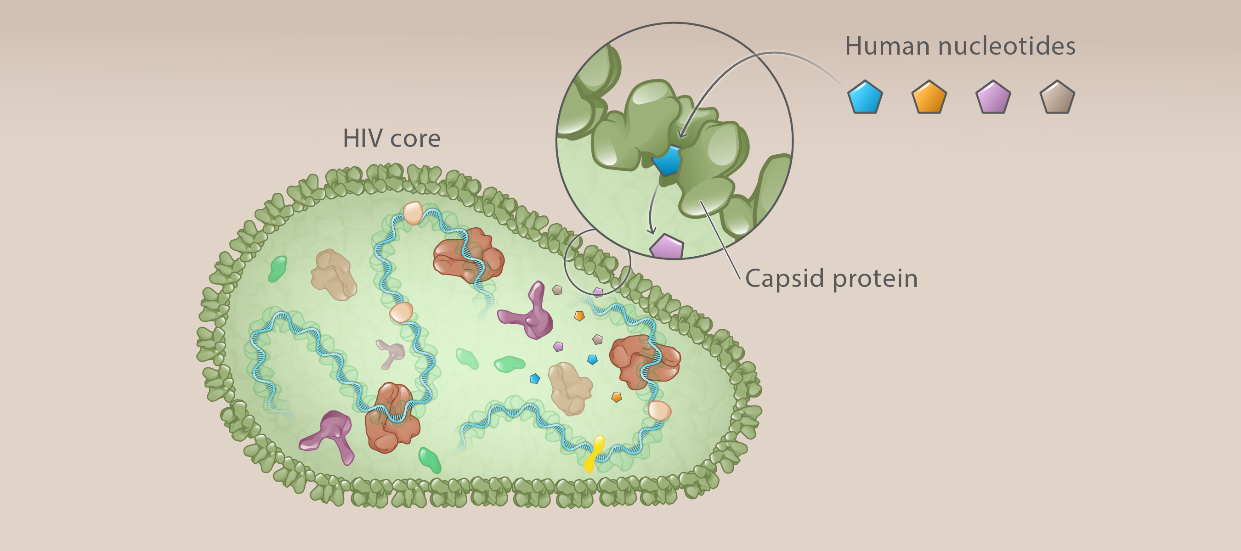
HIV Reverse Transcription
HIV RNA
Host cell
Illustration: Cognition Studio, Inc., and David H. Spach, MD

Slide 17
Lenacapavir and Capsid Binding

Slide 18
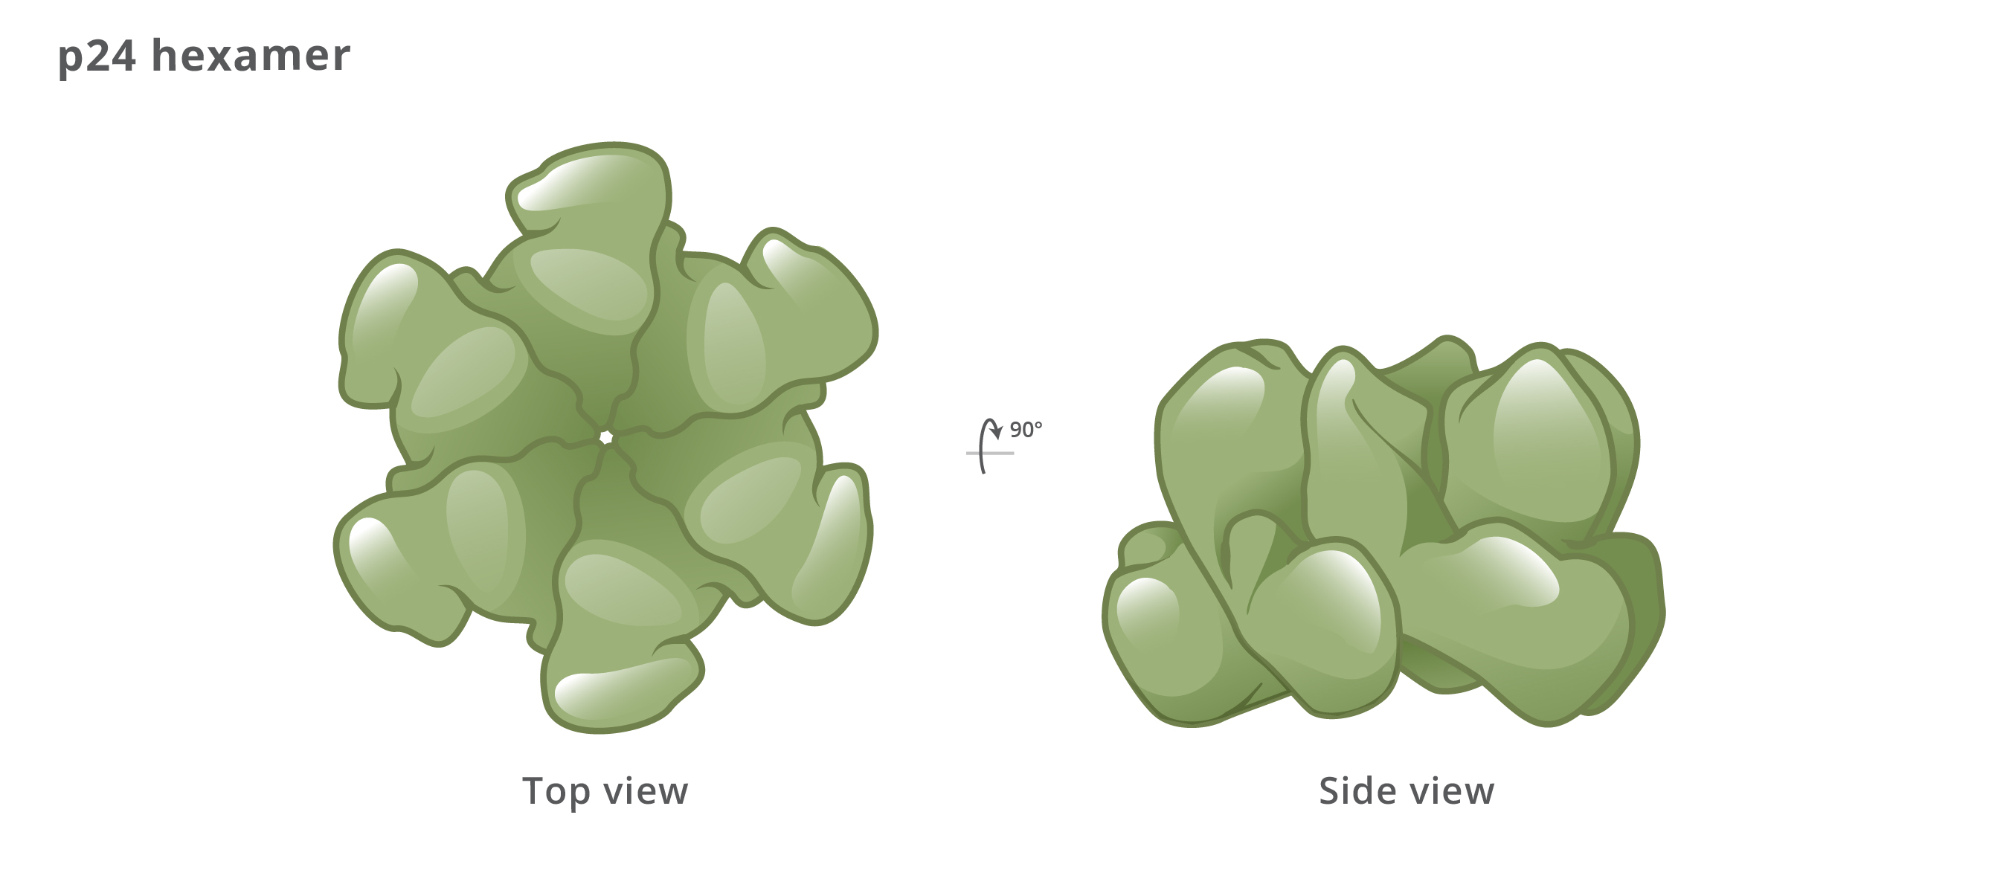
HIV Capsid Hexamer
Illustration: Cognition Studio, Inc. and David H. Spach, MD

Slide 19
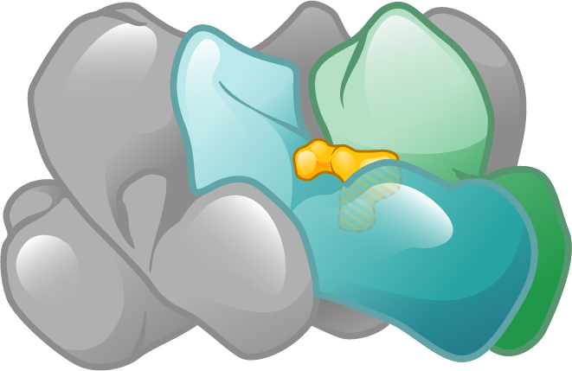
Lenacapavir Capsid Binding Pocket
Capsid monomer
Lenacapavir
Lenacapavir
Capsid hexamer
Illustration: Cognition Studio, Inc. and David H. Spach, MD

Slide 20
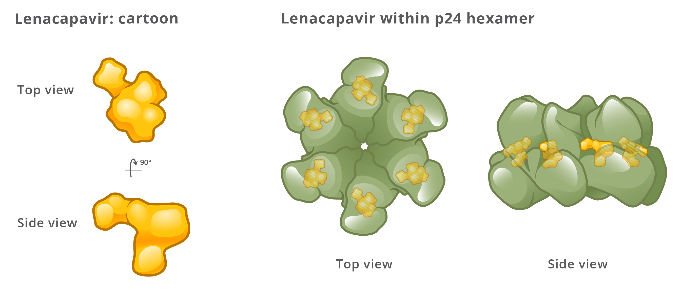
Lenacapavir Binding to Capsid Hexamer
Lenacapavir and Intra-Hexamer Binding
Illustration: Cognition Studio, Inc. and David H. Spach, MD

Slide 21
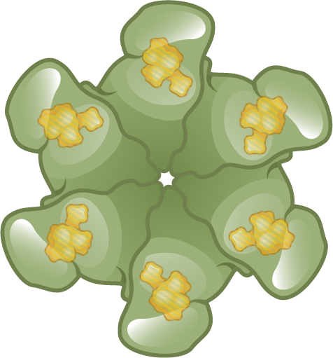
Lenacapavir Capsid Protein Binding Pocket
Lenacapavir
Lenacapavir and Inter-Hexamer Binding
Capsid Hexamers
Illustration: Cognition Studio, Inc. and David H. Spach, MD

Slide 22
Mechanism of Action of HIV Capsid Inhibitors

Slide 23
Capsid Inhibitors: Inhibition of Nuclear Import
HIV
Inhibits Nuclear Import
Illustration: Cognition Studio, Inc. and David H. Spach, MD

Slide 24
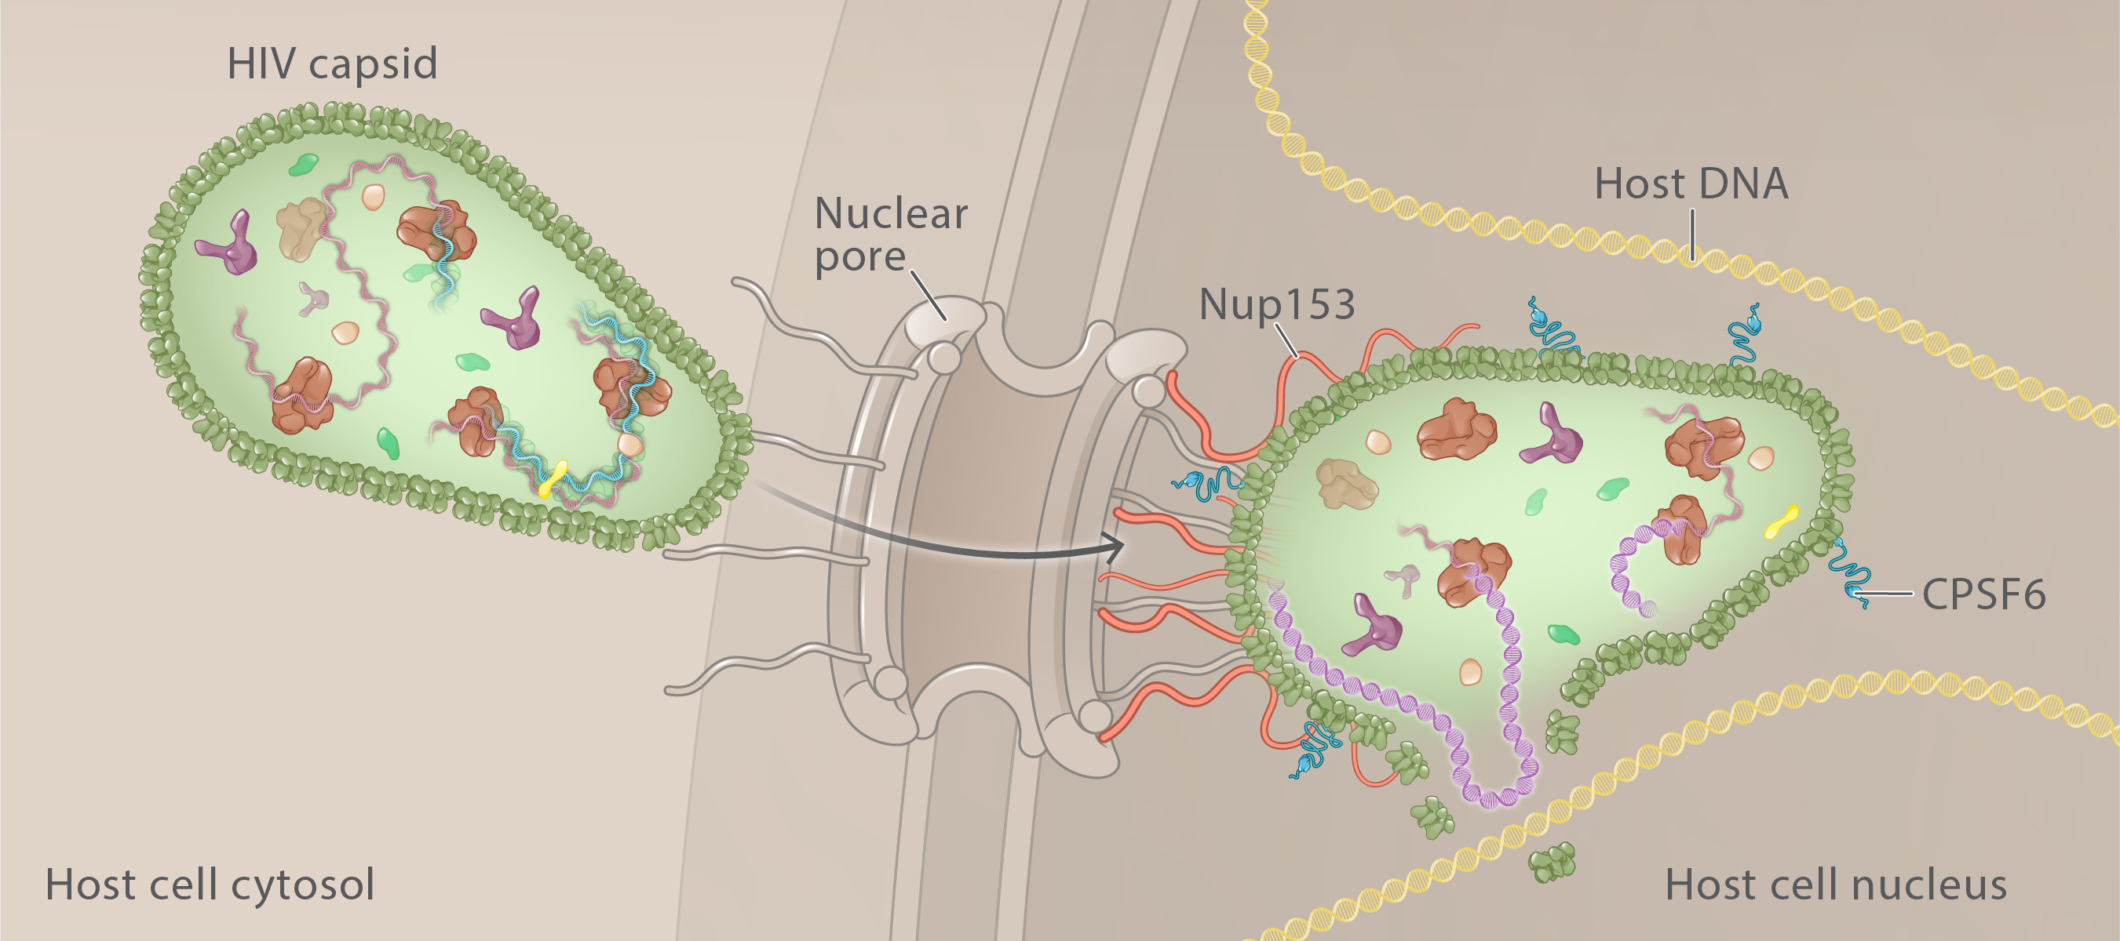
Nuclear Import and Host Proteins
HIV core
HIV capsid shell
Illustration: Cognition Studio, Inc. and David H. Spach, MD

Slide 25
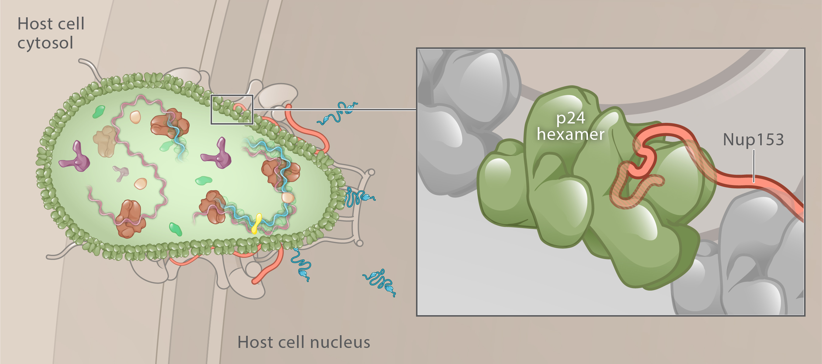
Nup 153 and Capsid Binding
Nuclear pore
Capsid
Illustration: Cognition Studio, Inc. and David H. Spach, MD

Slide 26
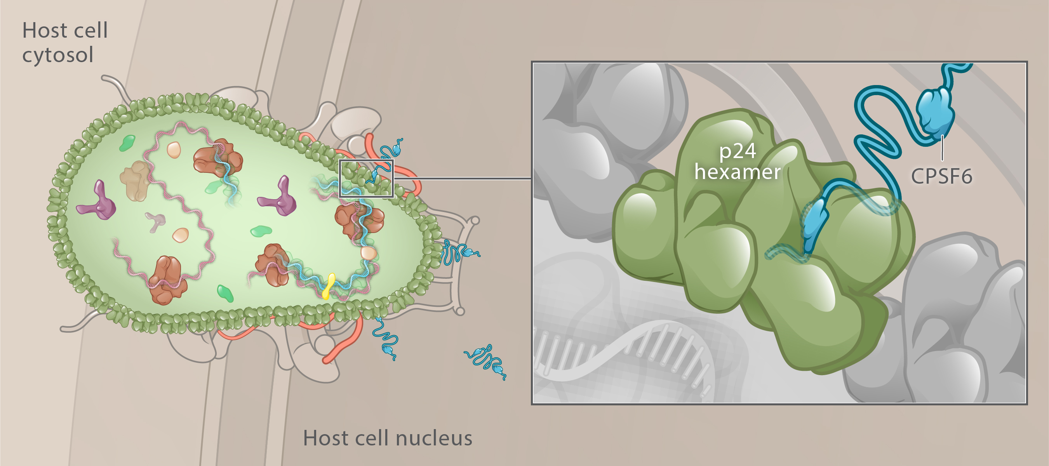
CPSF6 and Capsid Binding
Nuclear pore
Capsid
Illustration: Cognition Studio, Inc. and David H. Spach, MD

Slide 27
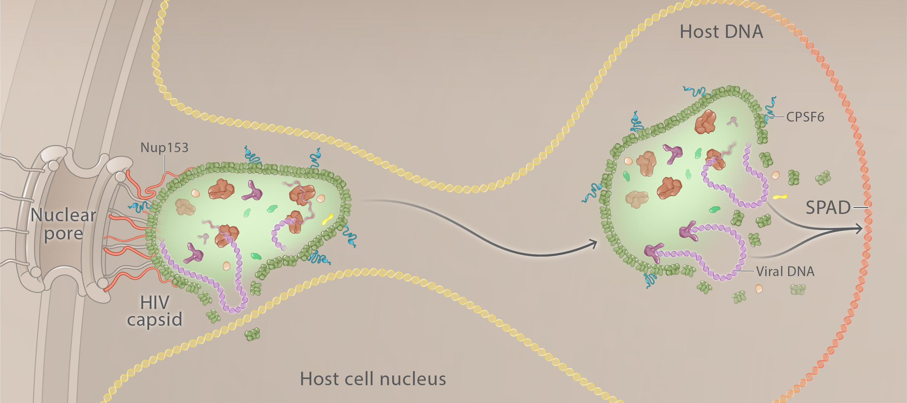
CPSF6 Augmented Capsid Migration to Host DNA SPAD Region
CPSF6
CPSF6
Illustration: Cognition Studio, Inc. and David H. Spach, MD

Slide 28
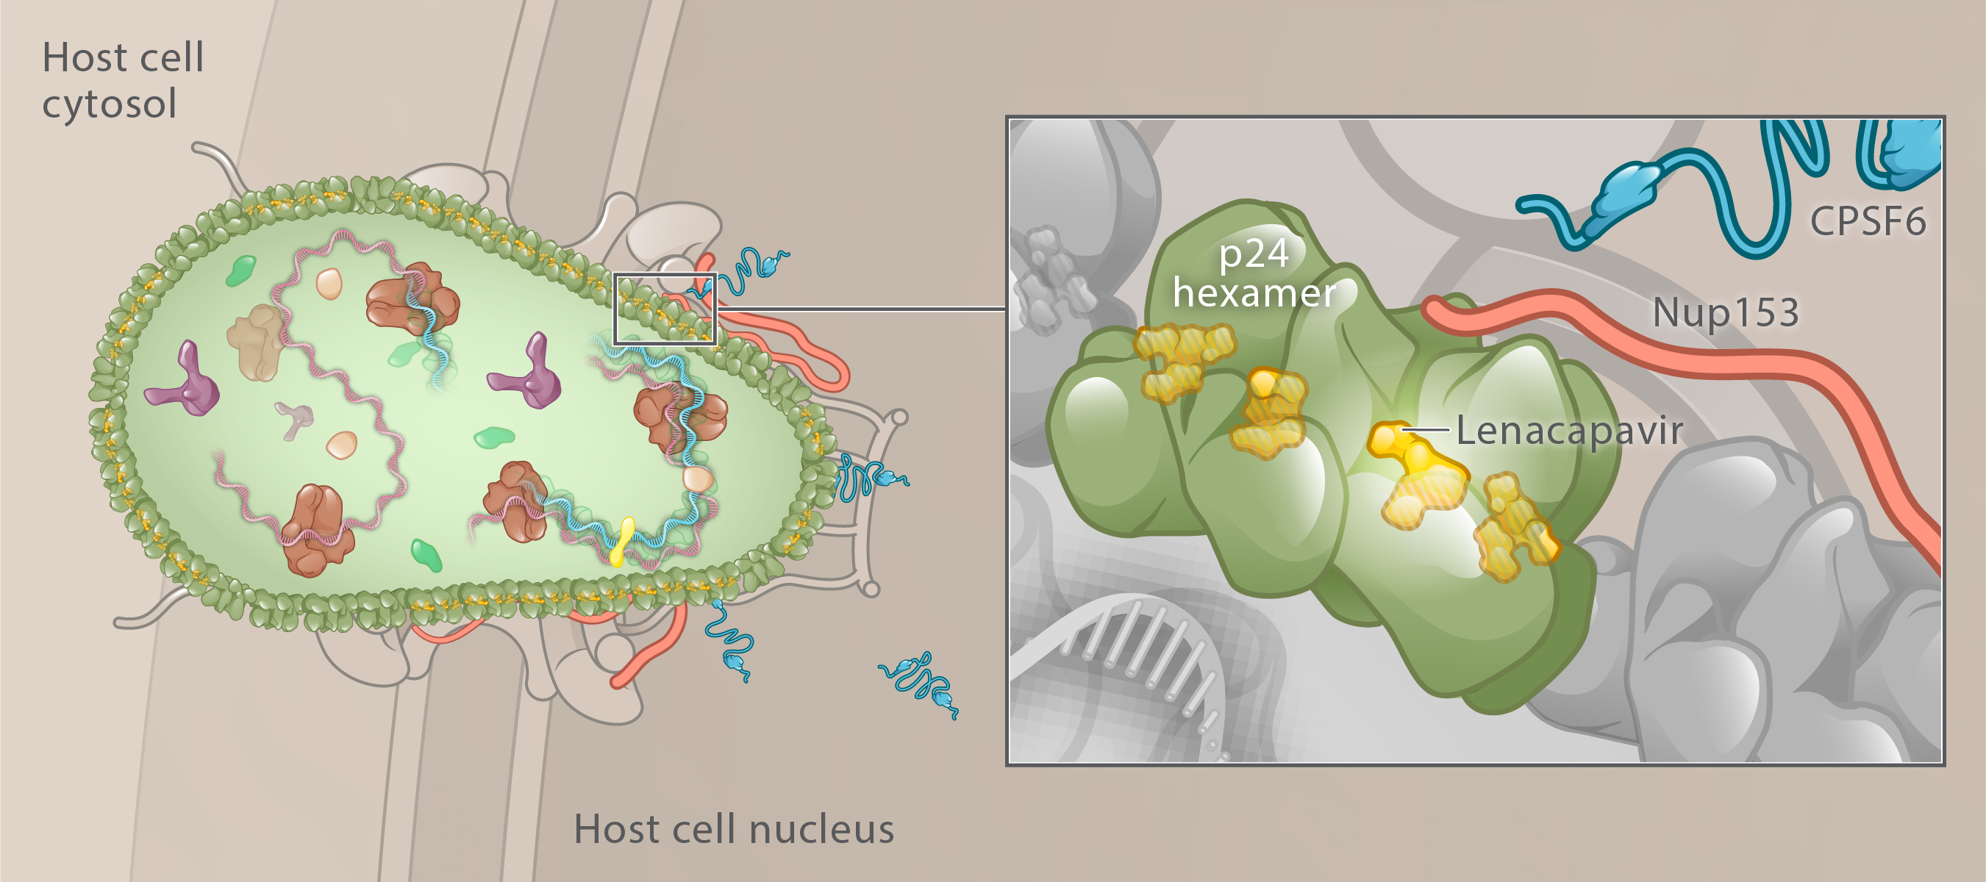
Lenacapavir Inhibition of Nup 153 and CPSF6 Capsid Binding
Nuclear pore
Capsid
Illustration: Cognition Studio, Inc. and David H. Spach, MD

Slide 29
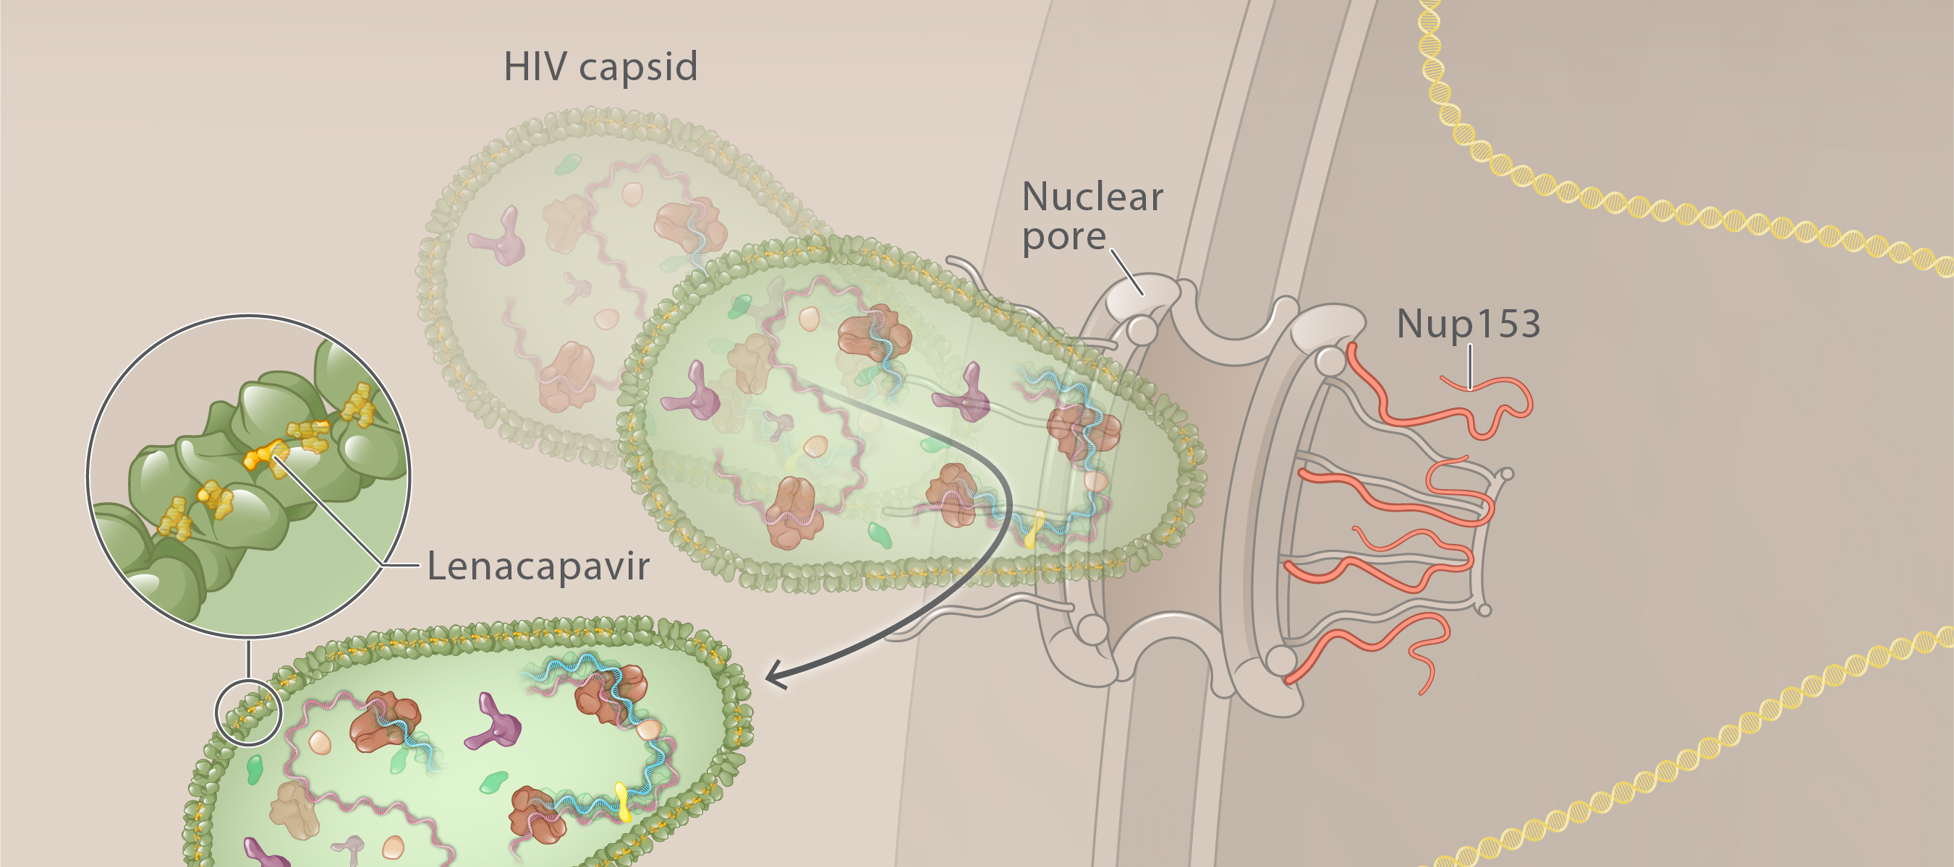
Lenacapavir and Inhibition of Nuclear Pore Transport
HIV core
CPSF6
Nup 153
Illustration: Cognition Studio, Inc. and David H. Spach, MD

Slide 30
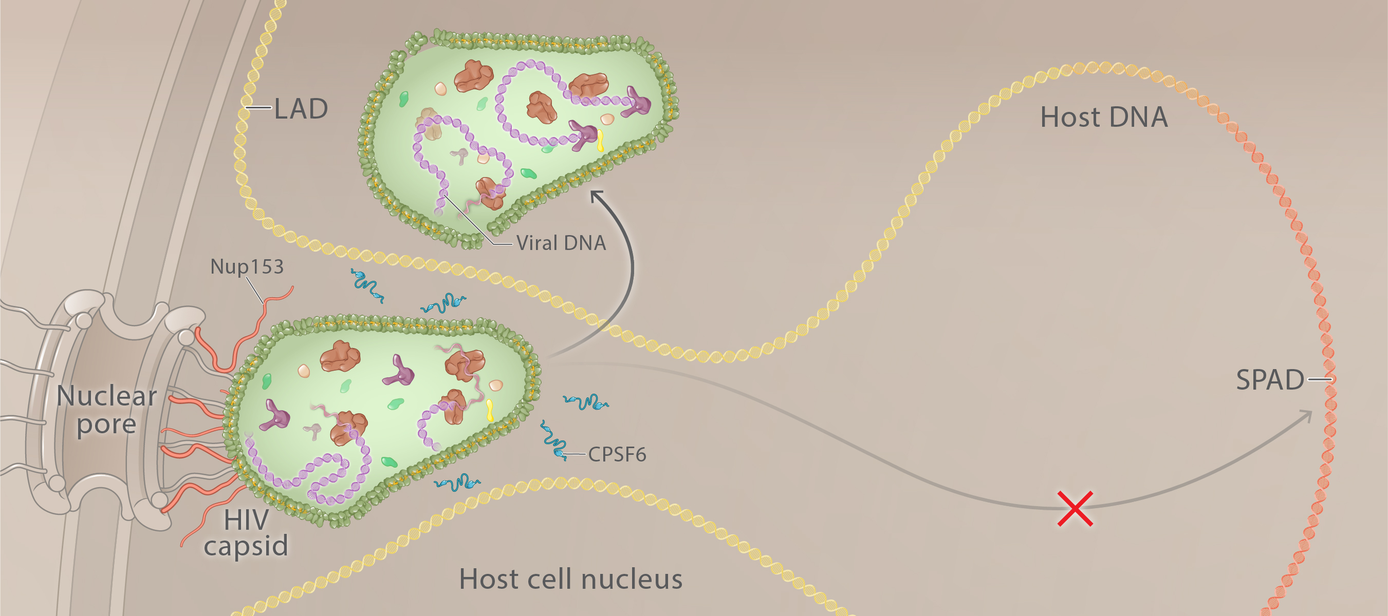
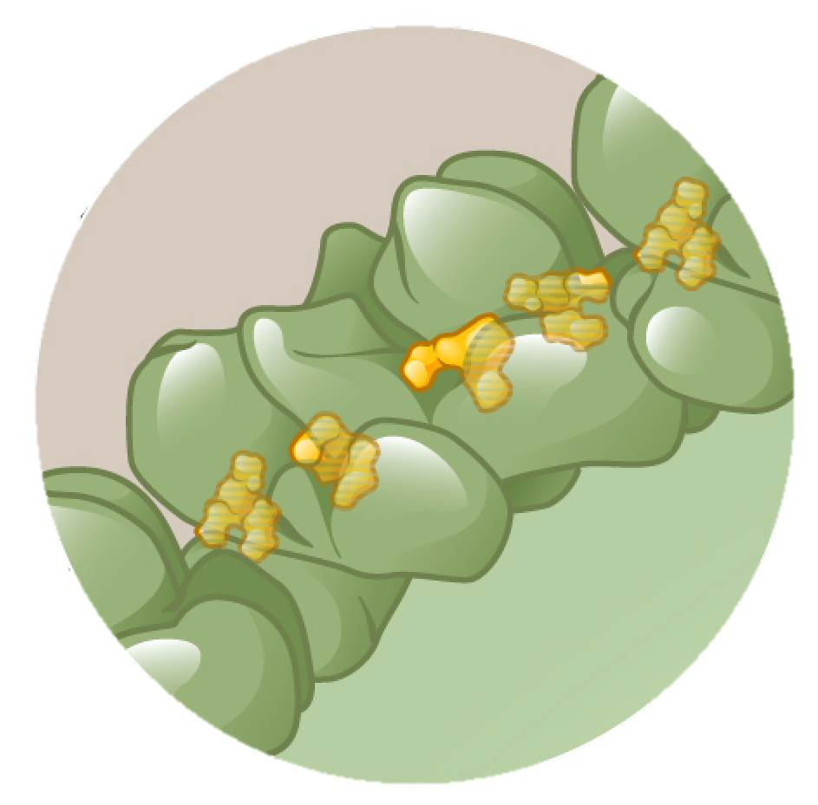
Lenacapavir and Inhibition of Capsid Migration to Host DNA
Lenacapavir
Illustration: Cognition Studio, Inc. and David H. Spach, MD

Slide 31
Capsid Inhibitors: Inhibition of Capsid Uncoating
HIV
Inhibits Capsid Uncoating
Illustration: Cognition Studio, Inc. and David H. Spach, MD

Slide 32
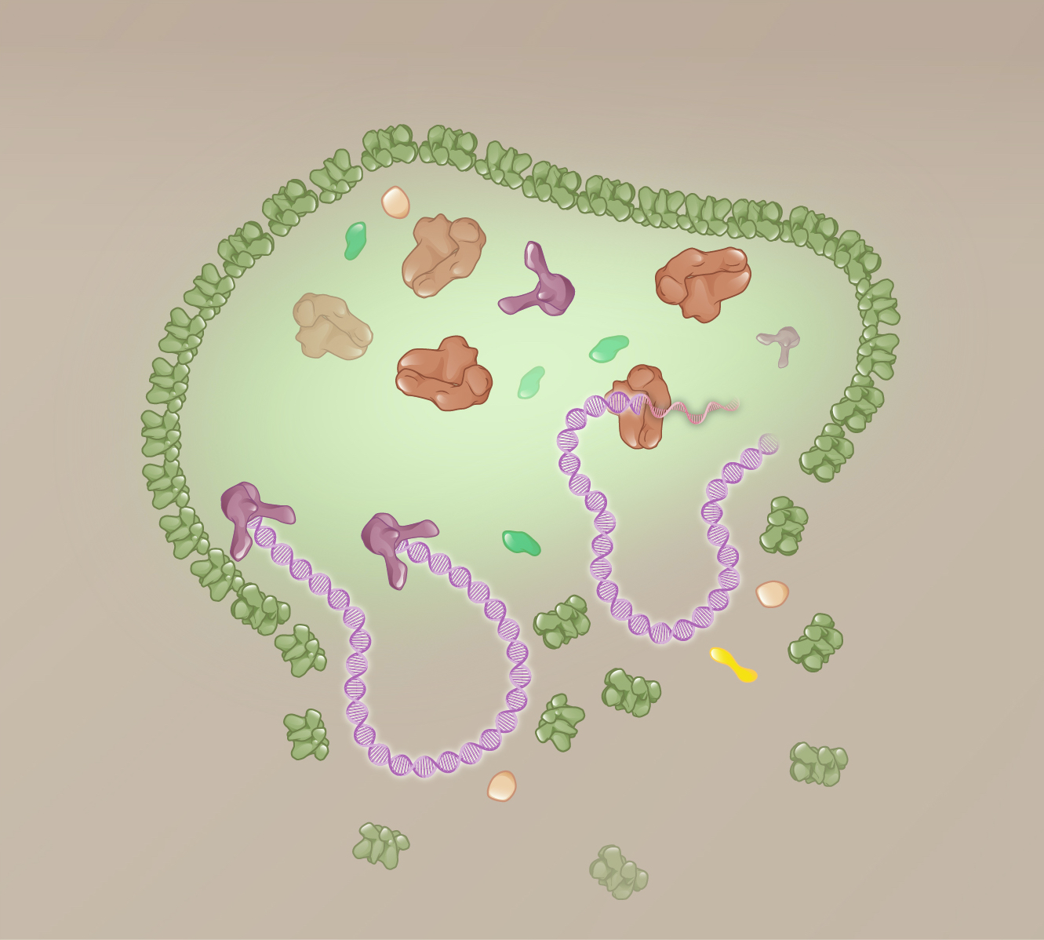
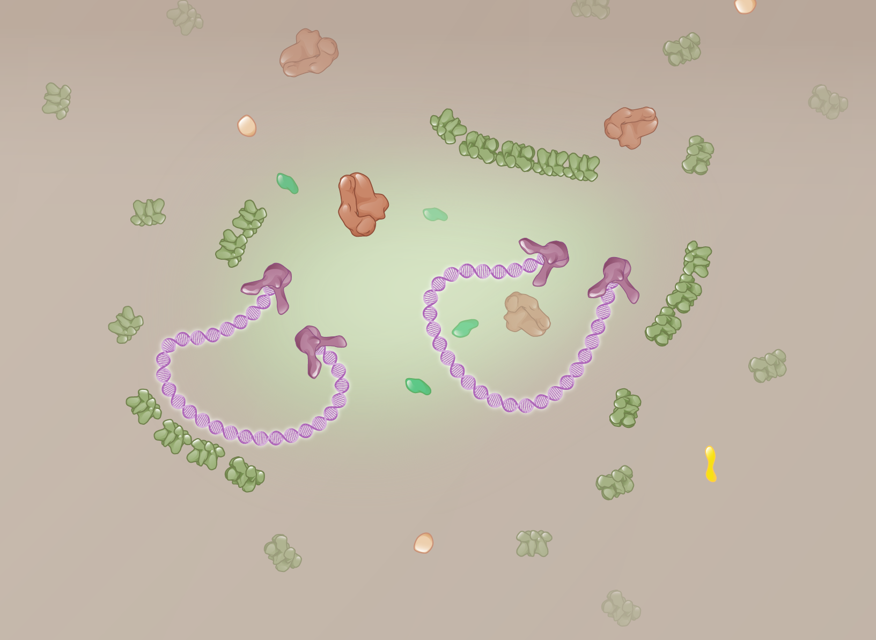
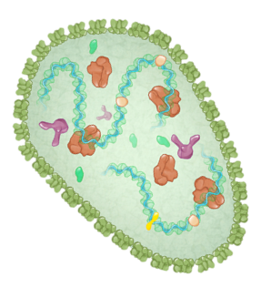
Capsid Uncoating
Intact (Capsid)
Partial Capsid Uncoating
Full Capsid Uncoating
HIV DNA
Cytoplasm
Nucleus
Illustration: David H. Spach, MD and Cognition Studio, Inc.

Slide 33
Lenacapavir and Inhibition of Capsid Uncoating
Lenacapavir Stabilized Capsid
Lenacapavir
Cytoplasm
Illustration: Cognition Studio, Inc. and David H. Spach, MD

Slide 34
Lenacapavir and Inhibition of Capsid Uncoating
Lenacapavir Stabilized Capsid
HIV DNA
Lenacapavir
Cytoplasm
Nucleus
Illustration: Cognition Studio, Inc. and David H. Spach, MD

Slide 35
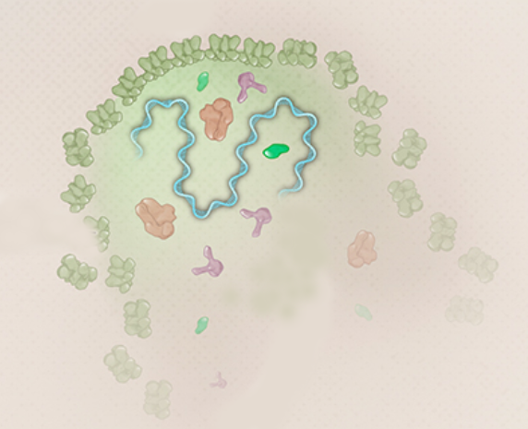
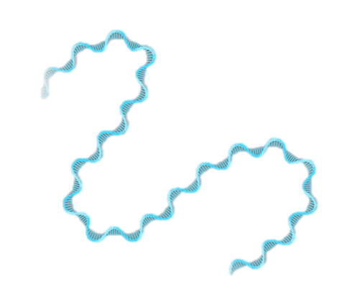
Premature Capsid Disassembly
Lenacapavir Stabilized Capsid
Failure to Convert HIV RNA to HIV DNA
HIV RNA
Premature Capsid Rupture
Lenacapavir
Illustration: Cognition Studio, Inc. and David H. Spach, MD

Slide 36
Capsid Inhibitors: Inhibition of Capsid Assembly
HIV
Inhibits Capsid Assembly
Illustration: Cognition Studio, Inc. and David H. Spach, MD

Slide 37
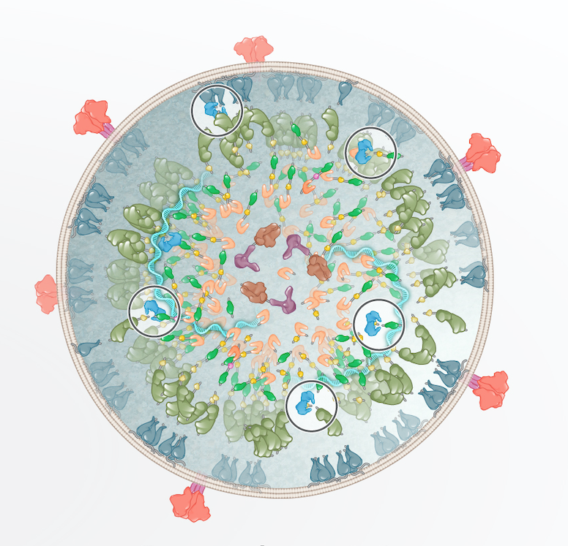
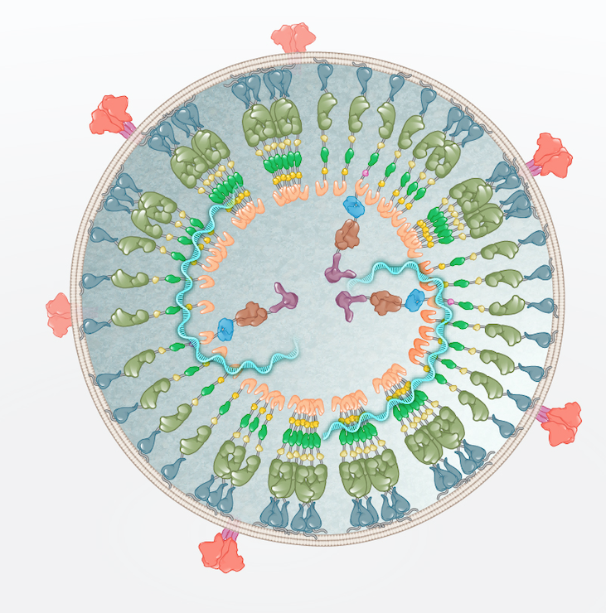
HIV Maturation
HIV Protease
Polyproteins
Host cell
Illustration: David H. Spach, MD and Cognition Studio, Inc.

Slide 38
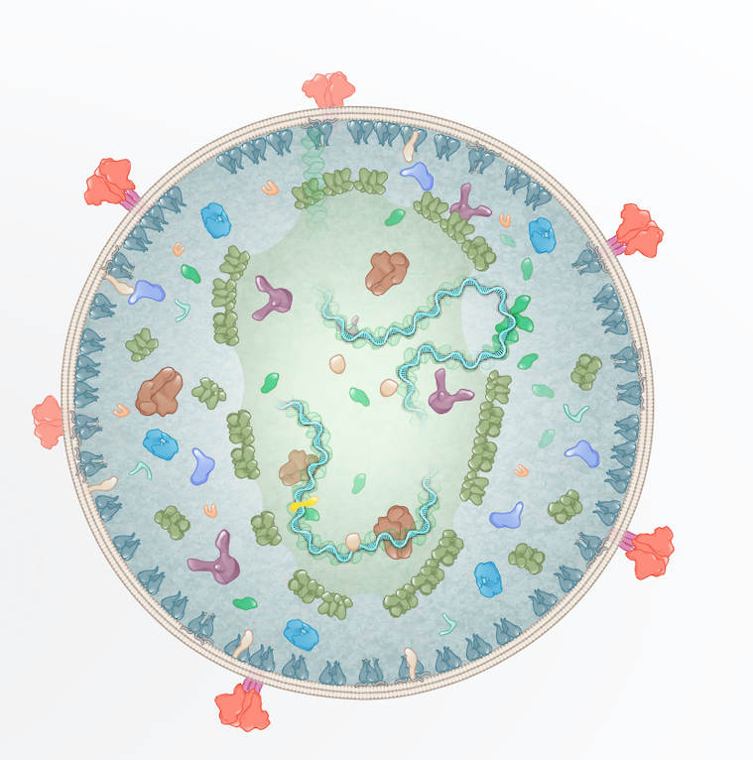
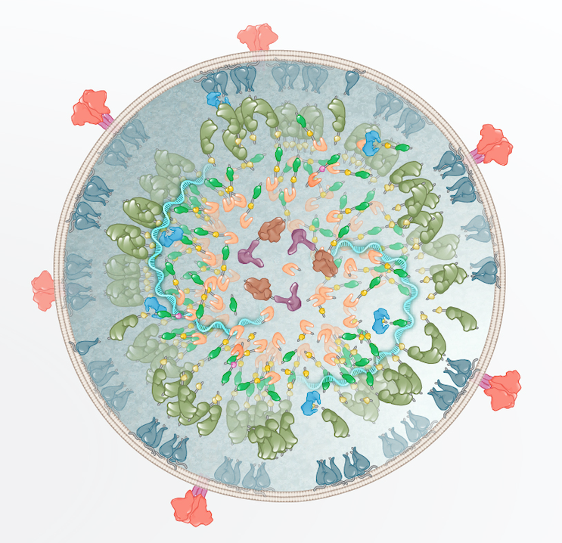
HIV Capsid (Core) Formation
HIV Protease
HIV capsid proteins
Host cell
Illustration: David H. Spach, MD and Cognition Studio, Inc.

Slide 39
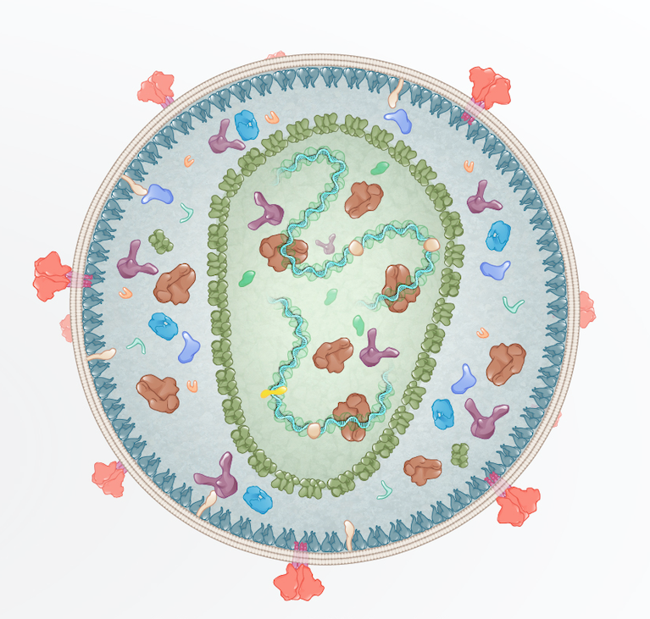
HIV Capsid (Core) Formation
Mature Virion
HIV capsid
Host cell
Illustration: David H. Spach, MD and Cognition Studio, Inc.

Slide 40
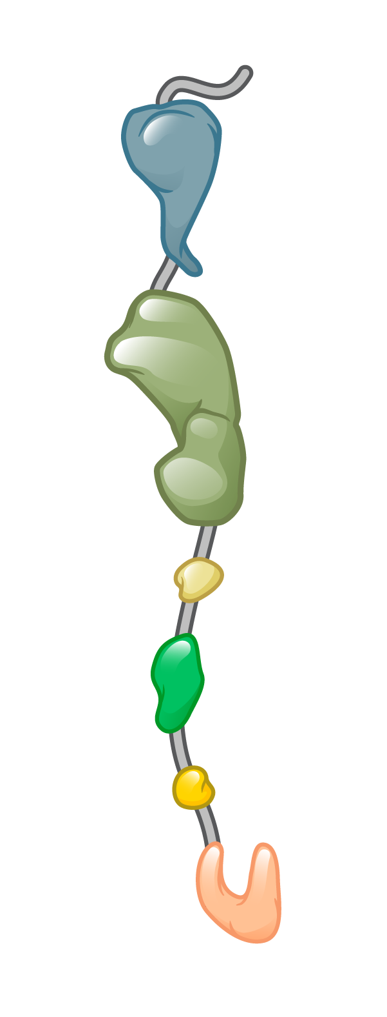
HIV Polyproteins
Gag
Gag-Pol
Capsid Protein
Capsid Protein
Illustration: David H. Spach, MD and Cognition Studio, Inc.

Slide 41
Polyprotein Cleavage
Gag
Gag-Pol
HIV Protease
Capsid Protein
Monomers
Illustration: David H. Spach, MD and Cognition Studio, Inc.

Slide 42
HIV Capsid Formation
Monomers
Polymers
Hexamer
Pentamer
Illustration: David H. Spach, MD and Cognition Studio, Inc.

Slide 43
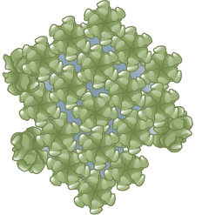
HIV Capsid Formation
Monomers
Polymers
Clusters
Hexamer
Pentamer
Illustration: David H. Spach, MD and Cognition Studio, Inc.

Slide 44
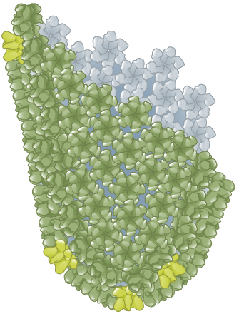
HIV Capsid Formation
Monomers
Polymers
Clusters
Early Capsid Assembly
Hexamer
Pentamer
Illustration: David H. Spach, MD and Cognition Studio, Inc.

Slide 45
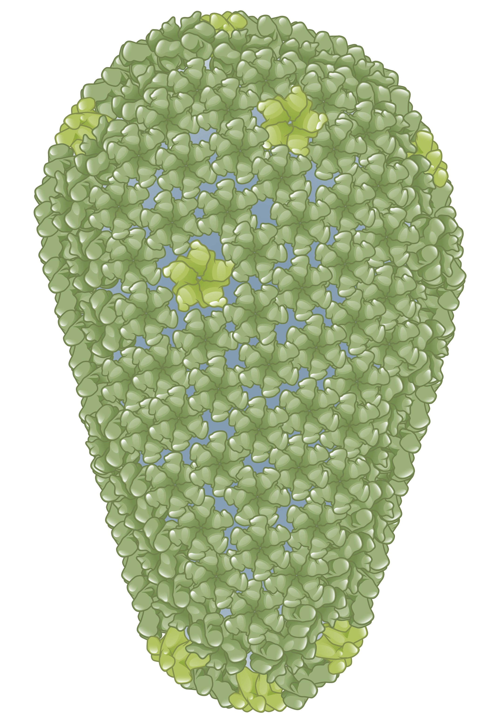
HIV Capsid Formation
Monomers
Polymers
Clusters
Early Capsid Assembly
HIV Capsid
Hexamer
Hexamer
Pentamer
Pentamer
Illustration: David H. Spach, MD and Cognition Studio, Inc.

Slide 46
Lenacapavir Bound to Capsid (p24) Hexamer
Illustration: David H. Spach, MD and Cognition Studio, Inc.

Slide 47
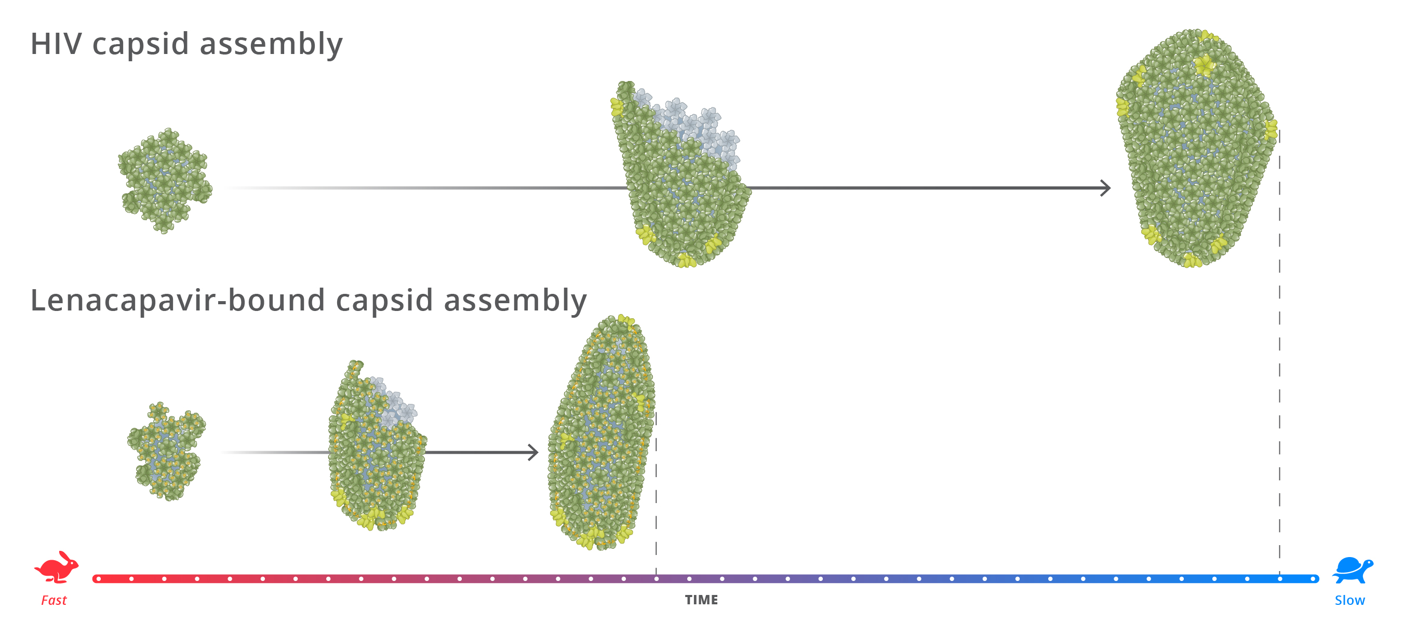
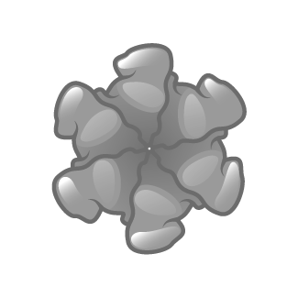
HIV Capsid Assembly: Impact of Lenacapavir
Illustration: David H. Spach, MD and Cognition Studio, Inc.

Slide 48
HIV Capsid Assembly: Impact of Lenacapavir
Illustration: David H. Spach, MD and Cognition Studio, Inc.

Slide 49
HIV Capsid Assembly: Impact of Lenacapavir
Monomers
Polymers
Clusters
Hexamer
Lenacapavir
Pentamer
Illustration: David H. Spach, MD and Cognition Studio, Inc.

Slide 50
Lenacapavir

Slide 51
Lenacapavir (Sunlenca)
Oral Lenacapavir
Subcutaneous Lenacapavir
300 mg tablets
1.5 mL vial = 463.5 mg
Take with or without food
Administer as Subcutaneous Injection

Slide 52
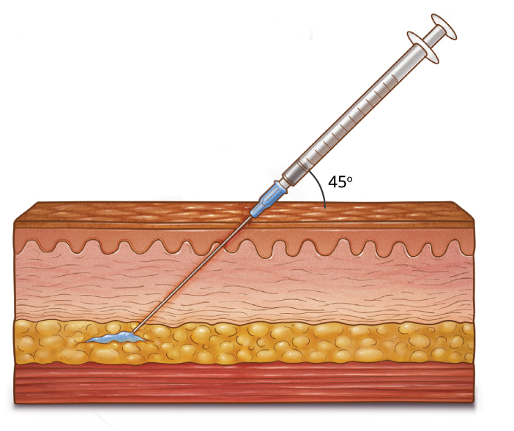
Lenacapavir (Sunlenca)
Dosing (Subcutaneous Injection)
2 x 1.5 mL single dose vials
Inject 2 x 1.5 mL (927 mg total) every 6 months (26 weeks +/- 2 weeks)
Illustration: David H. Spach, MD and Cognition Studio, Inc.

Slide 53
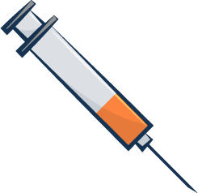
Lenacapavir Dosing for HIV Treatment: Initiation Option 1
Initiation Option 1
Day 1
Day 2
Day 1
600 mg
600 mg
927 mg
Oral lenacapavir 300 mg
Subcutaneous lenacapavir 463.5 mg
Illustration: David H. Spach, MD

Slide 54
Lenacapavir Dosing for HIV Treatment: Initiation Option 1
Initiation Option 1
Maintenance
Day 1
Day 2
Day 1
Month 6
Month 12
Month 18
600 mg
600 mg
6 months
6 months
6 months
927 mg
927 mg
927 mg
927 mg
Oral lenacapavir 300 mg
Subcutaneous lenacapavir 463.5 mg
Illustration: David H. Spach, MD

Slide 55
Lenacapavir Dosing for HIV Treatment: Initiation Option 2
Initiation Option 2
Day 1
Day 2
Day 8
Day 15
600 mg
600 mg
300 mg
927 mg
Oral lenacapavir 300 mg
Subcutaneous lenacapavir 463.5 mg
Illustration: David H. Spach, MD

Slide 56
Lenacapavir Dosing for HIV Treatment: Initiation Option 2
Initiation Option 2
Maintenance
Day 1
Day 2
Day 8
Day 15
6 months
6 months
6 months
600 mg
600 mg
300 mg
927 mg
927 mg
927 mg
927 mg
Oral lenacapavir 300 mg
Subcutaneous lenacapavir 463.5 mg
Illustration: David H. Spach, MD

Slide 57
Lenacapavir Dosing for HIV PrEP
Investigational
Initiation
Maintenance
Day 1
Day 2
Day 1
Month 6
Month 12
Month 18
600 mg
600 mg
6 months
6 months
6 months
927 mg
927 mg
927 mg
927 mg
Oral lenacapavir 300 mg
Subcutaneous lenacapavir 463.5 mg
Illustration: David H. Spach, MD

Slide 58
Summary

Slide 59
Capsid Inhibitors and Multistage Mechanism of Action
1
Inhibits Capsid Nuclear Import
2
Inhibits Capsid Uncoating
3
Inhibits Capsid Assembly

