Slide 1
HIV Entry Inhibitors: Mechanism of Action
David H. Spach, MD Editor-in-Chief, National HIV Curriculum Professor of Medicine Division of Allergy and Infectious Diseases
University of Washington
May 31, 2024

Slide 2
Dr. Spach does not have any disclosures.

Slide 3
HIV Antiretroviral Therapy
HIV
Protease Inhibitors
Entry Inhibitors
Capsid Inhibitors
Capsid Inhibitors
INSTIs
RTIs
NRTI
NNRTI
NRTTI
Illustration: Cognition Studio, Inc. and David H. Spach, MD

Slide 4
HIV Antiretroviral Therapy
HIV
Protease Inhibitors
Entry Inhibitors
Capsid Inhibitors
Capsid Inhibitors
INSTIs
RTIs
NRTI
NNRTI
NRTTI
Illustration: Cognition Studio, Inc. and David H. Spach, MD

Slide 5
Targets for HIV Entry Inhibitors

Slide 6
HIV Envelope Glycoprotein
HIV Envelope Glycoprotein
Illustration: Cognition Studio, Inc. and David H. Spach, MD

Slide 7
HIV Envelope Glycoprotein
HIV Envelope Glycoprotein
Illustration: Cognition Studio, Inc. and David H. Spach, MD

Slide 8
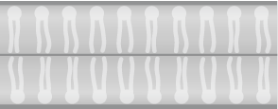
HIV Envelope
gp41
gp120
Illustration: Cognition Studio, Inc. and David H. Spach, MD

Slide 9
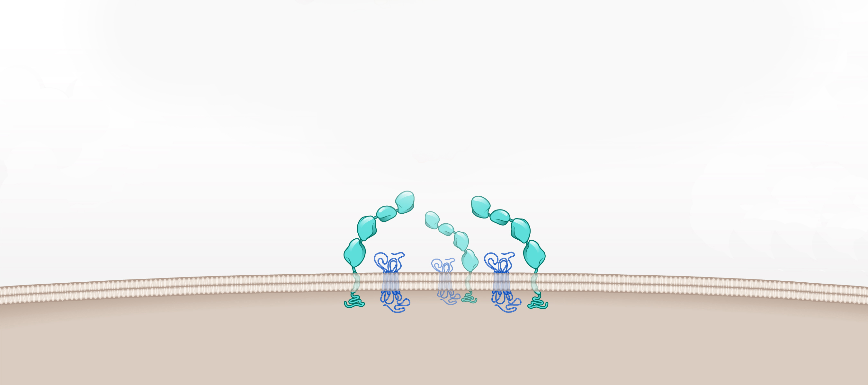
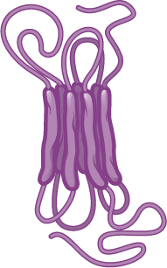
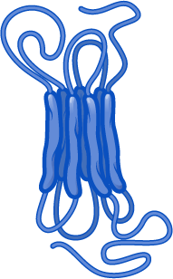
Host Cell Surface Receptors
CD4 receptor
DC-SIGN
CCR5 coreceptor
CXR4 coreceptor
Host cell
Illustration: Cognition Studio, Inc. and David H. Spach, MD

Slide 10
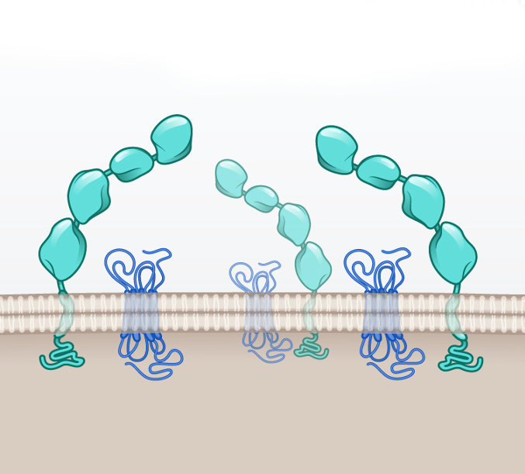
Cell Surface Receptors Targeted by HIV Entry Inhibitors
CD4 receptor
CD4 receptor
CCR5 coreceptor
CCR5 coreceptor
Illustration: Cognition Studio, Inc. and David H. Spach, MD

Slide 11
Subclasses of HIV Entry Inhibitors

Slide 12
Key Steps for HIV Cell Entry
1
Attachment
2
Coreceptor Binding
3
Fusion

Slide 13
HIV Cell Entry and HIV Entry Inhibitors
Key Steps for HIV Entry
HIV Entry Inhibitor Subclasses
1
Attachment
Attachment Inhibitors
2
Coreceptor Binding
CCR5 Antagonists
3
Fusion
Fusion Inhibitors

Slide 14
HIV Cell Entry and HIV Entry Inhibitors
Key Steps for HIV Entry
HIV Entry Inhibitor Subclasses
1
Attachment
Attachment Inhibitors
Post-Attachment Inhibitors
2
Coreceptor Binding
CCR5 Antagonists
3
Fusion
Fusion Inhibitors

Slide 15
HIV Cell Entry and HIV Entry Inhibitors
HIV Entry Inhibitor Subclasses
HIV Entry Inhibitor Medications
Attachment Inhibitors
Fostemsavir
Post-Attachment Inhibitors
Ibalizumab
CCR5 Antagonists
Maraviroc
Fusion Inhibitors
Enfuvirtide

Slide 16
Attachment Inhibitors

Slide 17
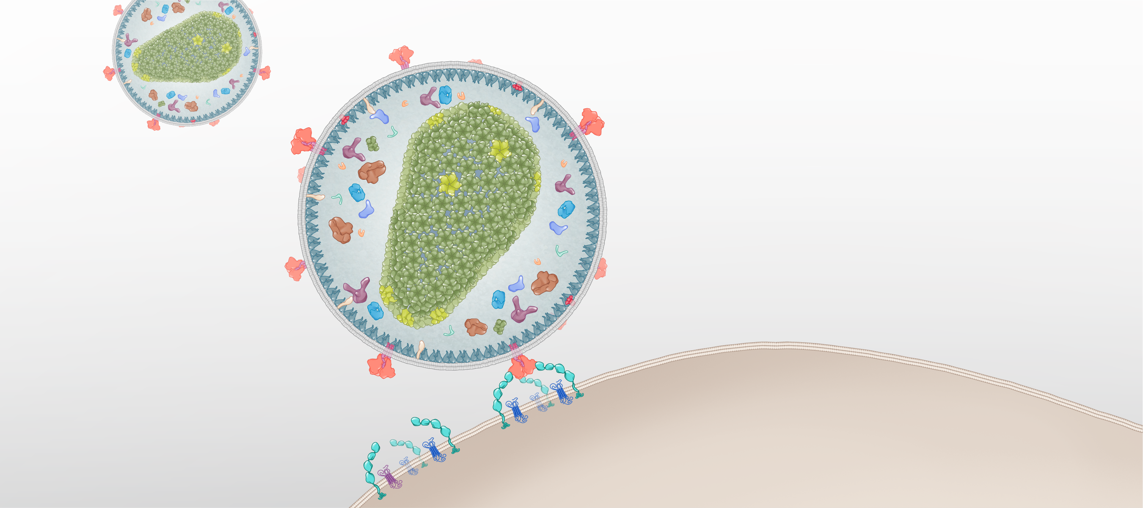
HIV Entry: Attachment
HIV
Attachment
HIV Envelope Glycoprotein
CD4 Receptor
Surface Receptors
Host Cell
Illustration: Cognition Studio, Inc. and David H. Spach, MD

Slide 18
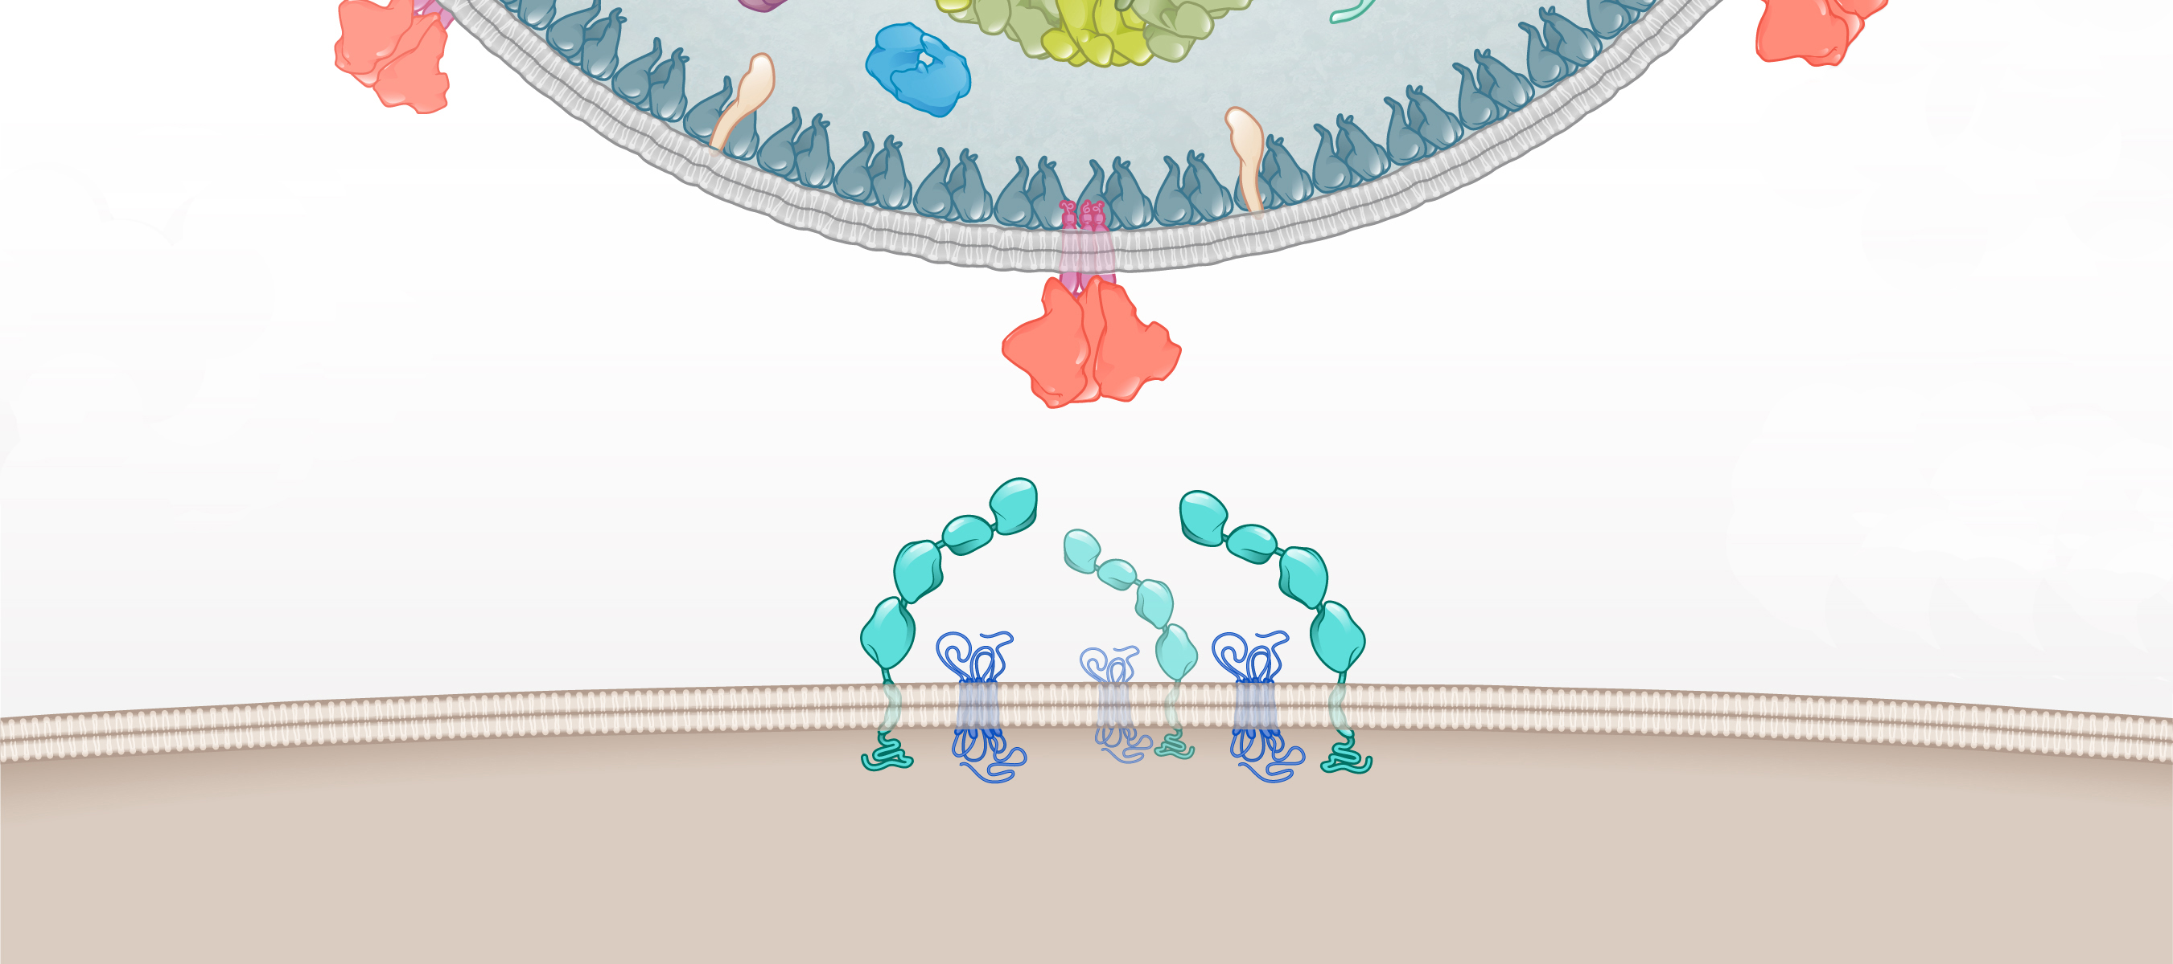
HIV Attachment: HIV CD4 Binding Site and Host CD4 Receptor
HIV
CD4 Binding Site
gp120
CD4 Receptor
Surface Receptors
Host cell
Illustration: Cognition Studio, Inc. and David H. Spach, MD

Slide 19
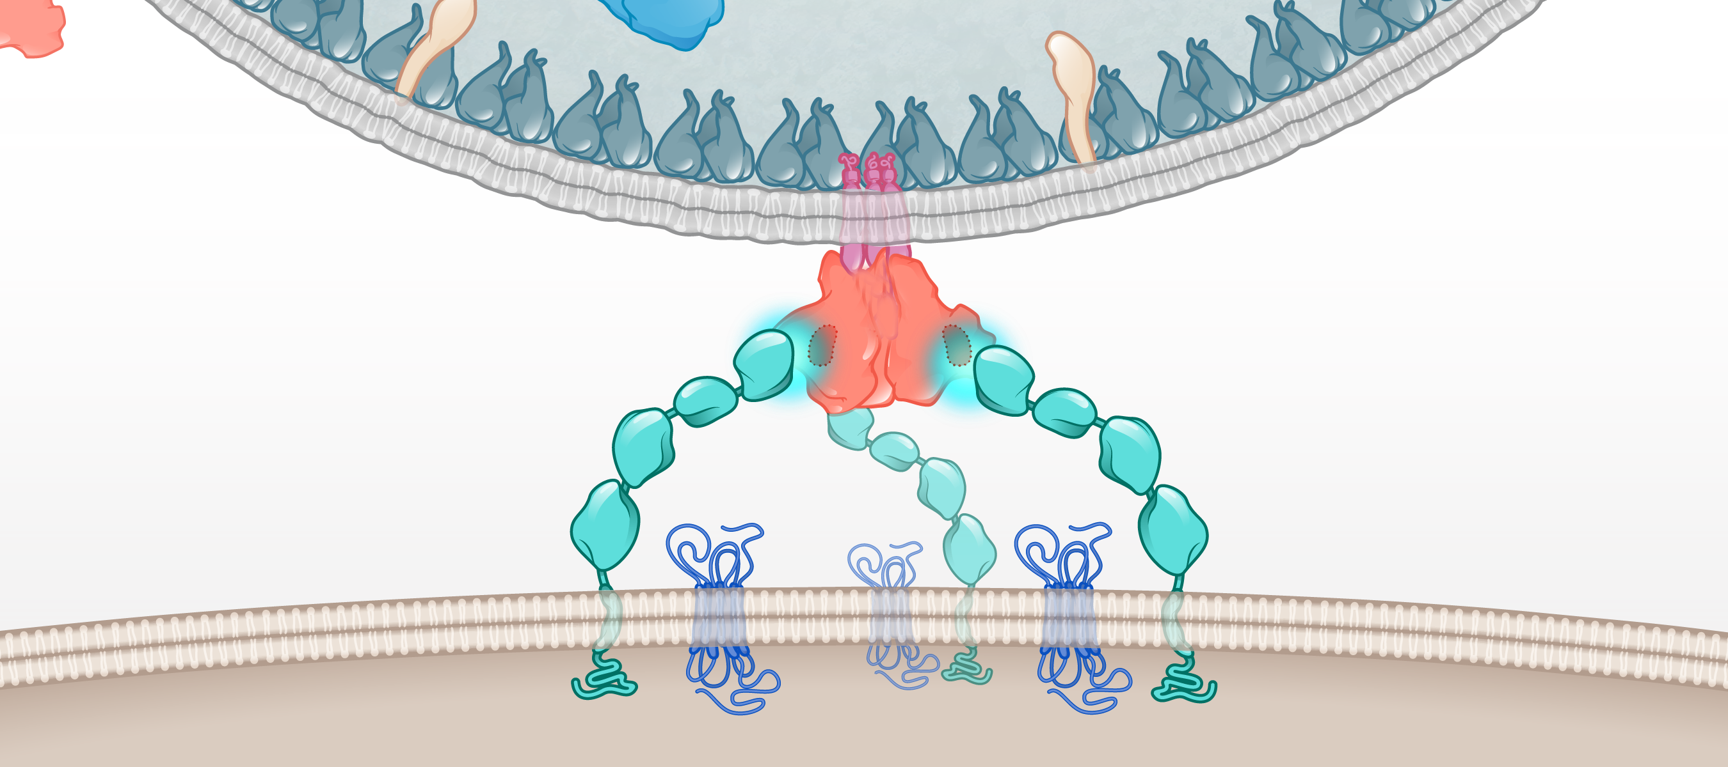
HIV Attachment: CD4 Receptor and CD4 Binding Site
HIV
CD4 Binding Site
HIV gp120
CD4 Receptor
Host cell
CCR5 coreceptors
Illustration: Cognition Studio, Inc. and David H. Spach, MD

Slide 20
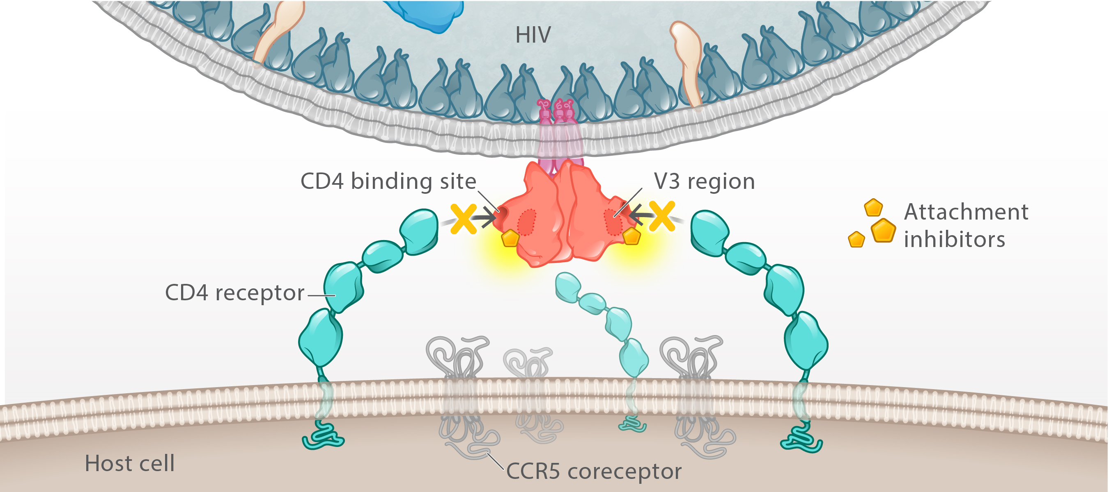
Attachment Inhibitor
Fostemsavir
Temsavir
CD4 binding site
Illustration: Cognition Studio, Inc. and David H. Spach, MD

Slide 21
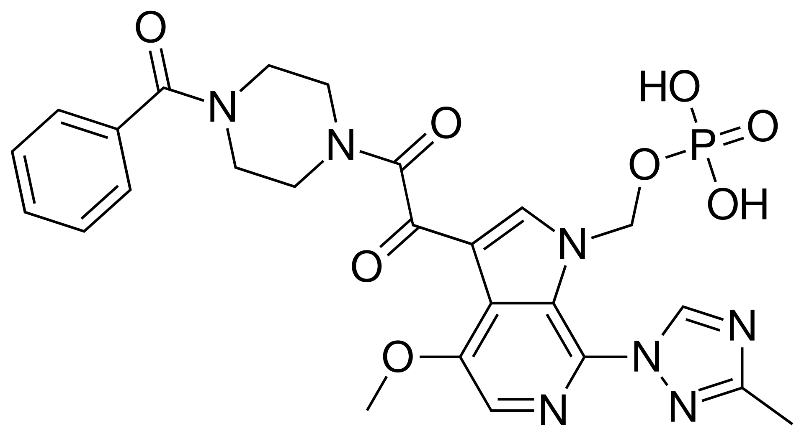
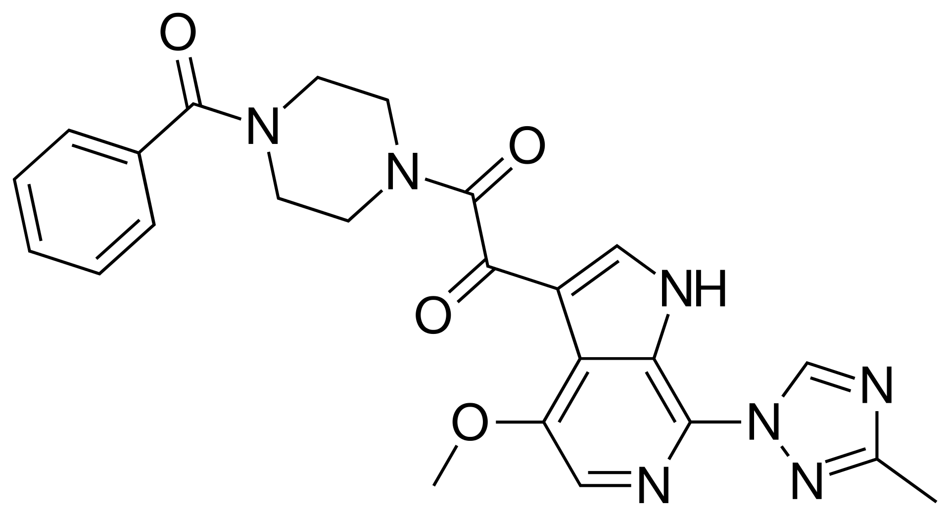
Fostemsavir (Rukobia)
Fostemsavir Dosing (Oral)
600 mg BID
Take with or without food
Temsavir
Prodrug
Active Moiety
Alkaline phosphatase

Slide 22
Post-Attachment Inhibitor

Slide 23
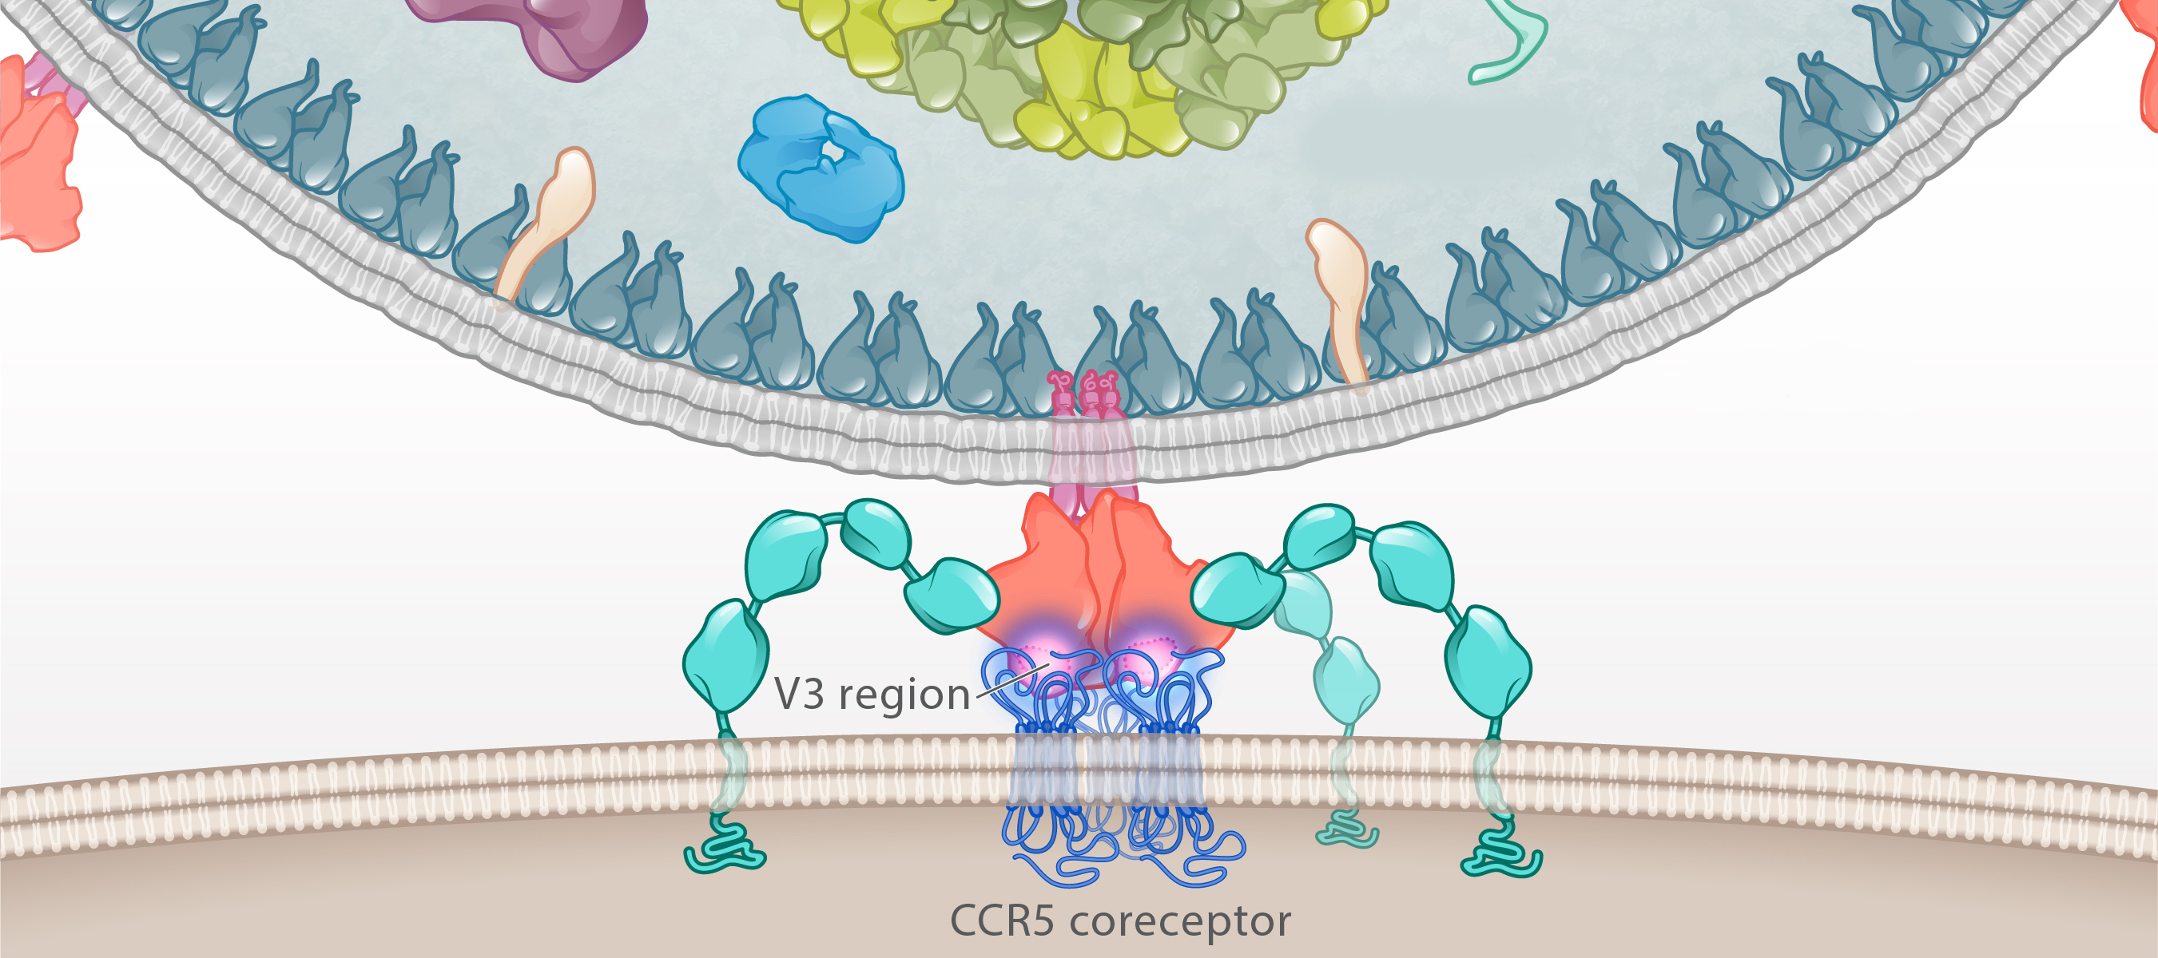
Post Attachment HIV Envelope Conformational Change
HIV
Host cell
CCR5 coreceptor
Illustration: Cognition Studio, Inc. and David H. Spach, MD

Slide 24
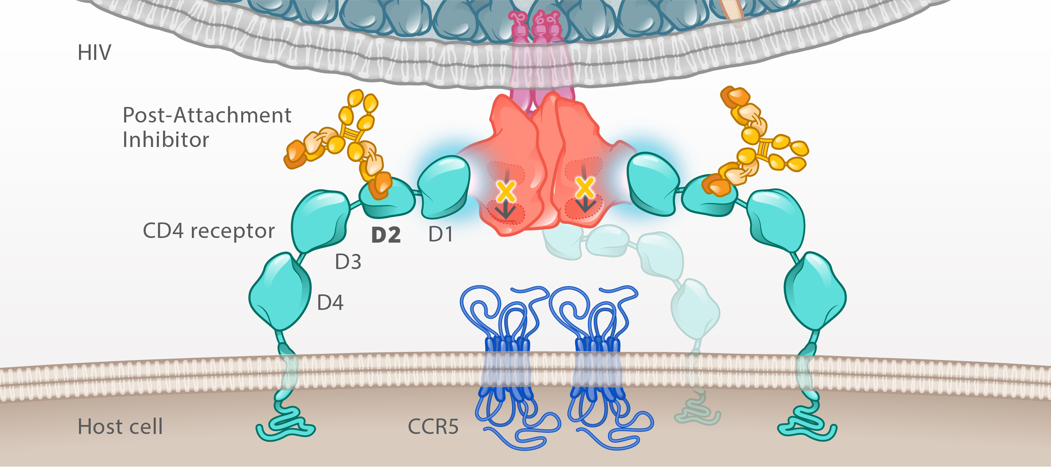
Post Attachment Inhibitor: Ibalizumab
Ibalizumab
CCR5 coreceptor
Illustration: Cognition Studio, Inc. and David H. Spach, MD

Slide 25
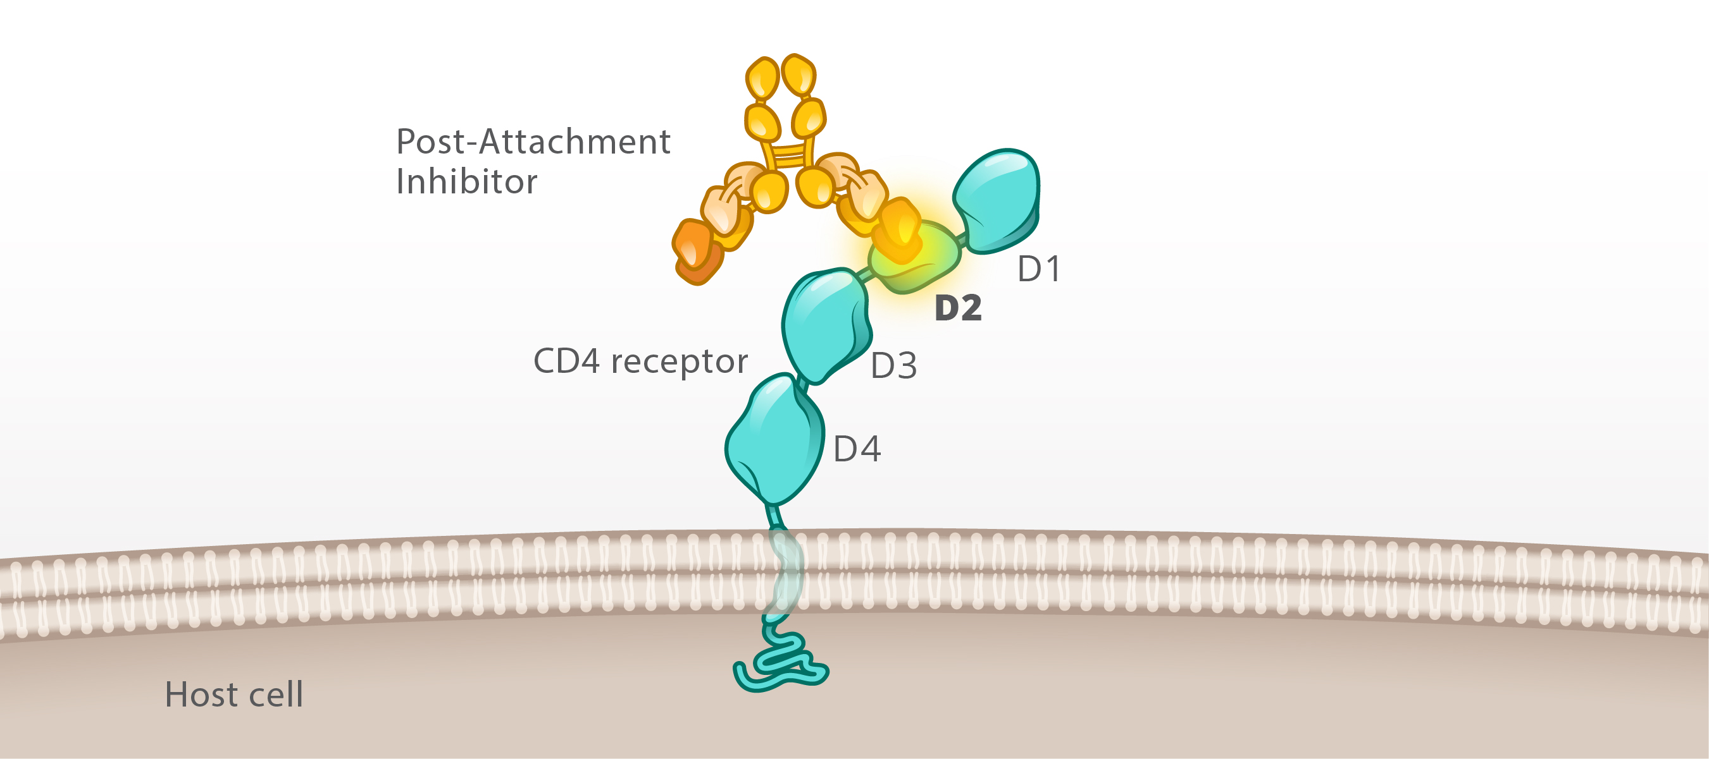
Post Attachment Inhibitor: Ibalizumab
Ibalizumab
MHC class 2 molecules
Illustration: Cognition Studio, Inc. and David H. Spach, MD

Slide 26
Ibalizumab (Trogarzo)
Dosing (Intravenous)
Loading dose: 2,000 mg IV
Maintenance dose: 800 mg IV every 2 weeks
Humanized Monoclonal Antibody
Illustration: David H. Spach, MD

Slide 27
Coreceptor Antagonist

Slide 28
HIV gp120 and Coreceptor Binding
HIV
Coreceptor Binding
Host cell
CCR5 coreceptor
Illustration: Cognition Studio, Inc. and David H. Spach, MD

Slide 29
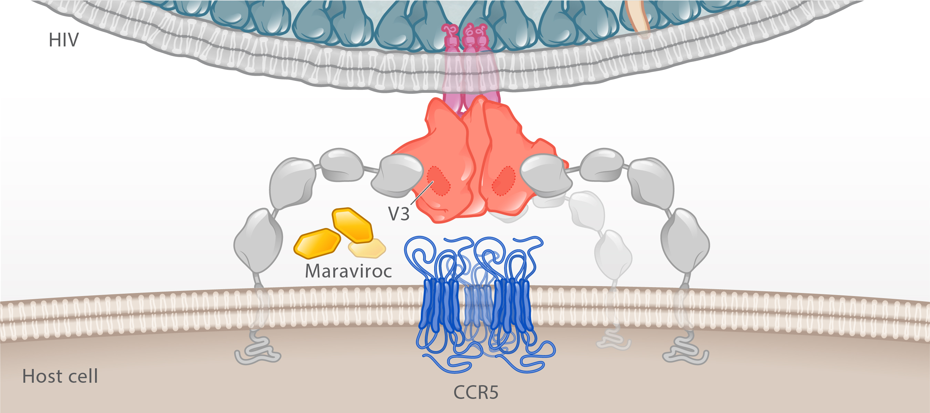
HIV Coreceptor Antagonist: Maraviroc
Maraviroc
CCR5 coreceptor
Illustration: Cognition Studio, Inc. and David H. Spach, MD

Slide 30
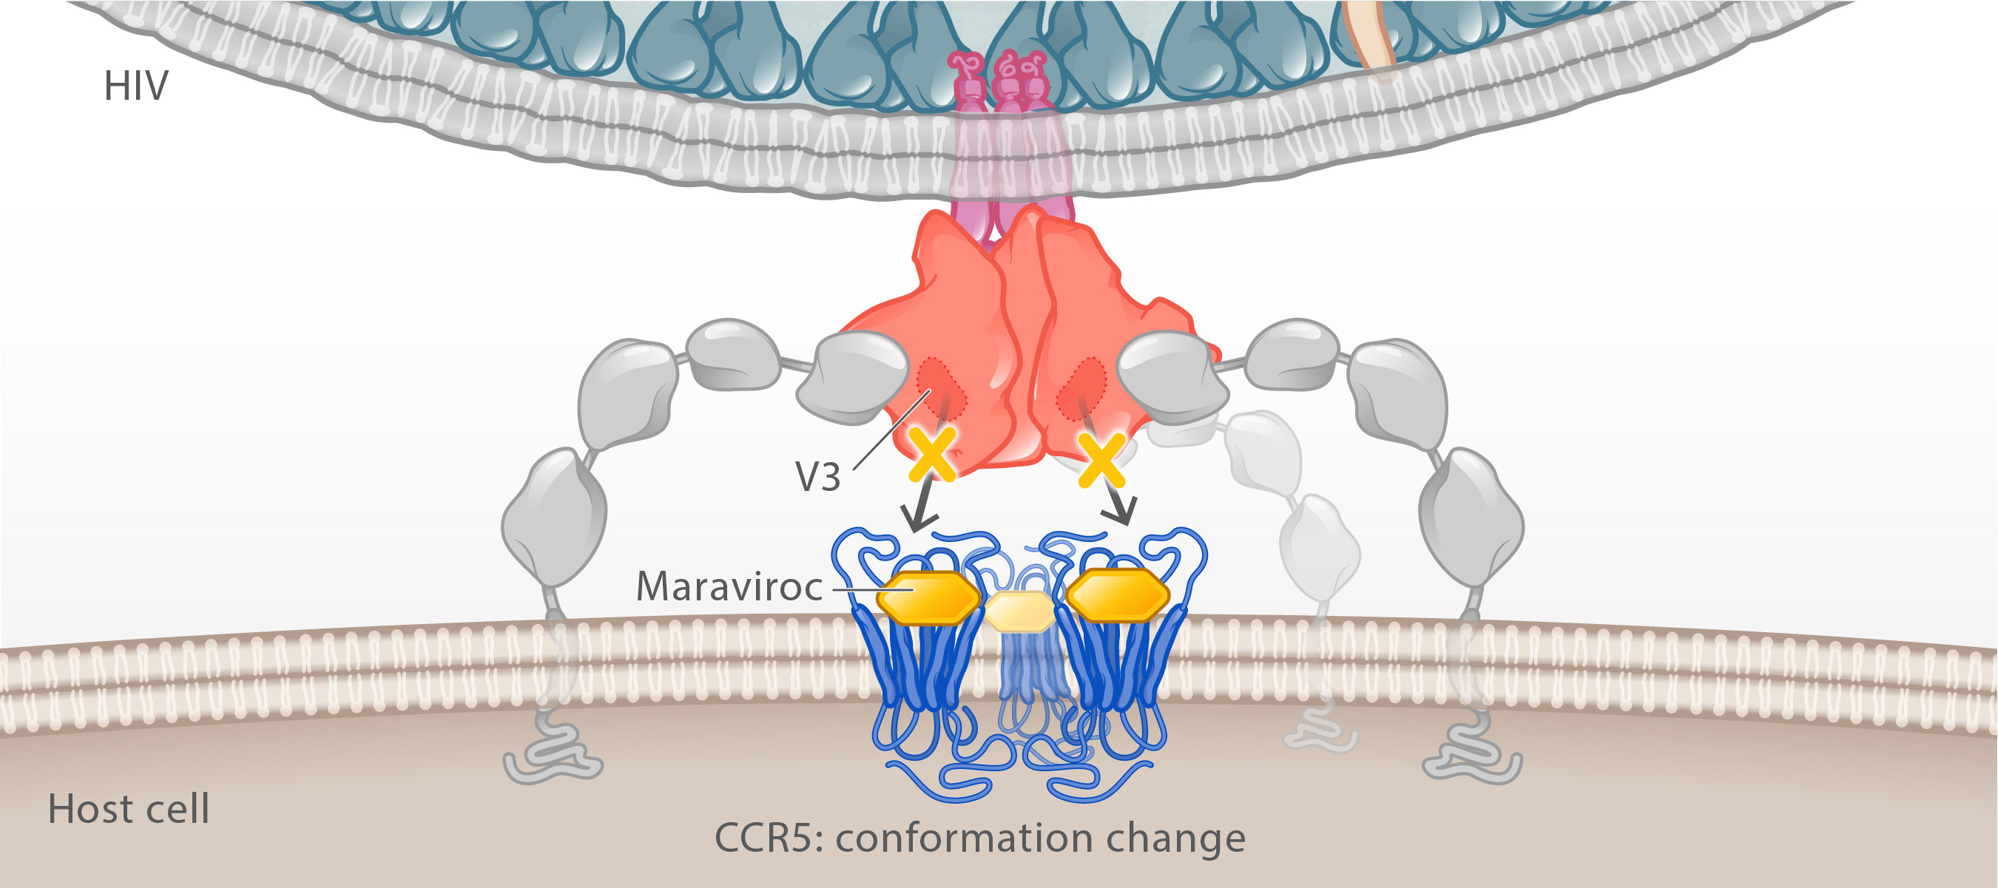
HIV Coreceptor Antagonist: Maraviroc
Maraviroc
Maraviroc
CCR5 coreceptor conformational change
Illustration: Cognition Studio, Inc. and David H. Spach, MD

Slide 31
Maraviroc (Selzentry)
Maraviroc: Recommended Dosage in Adults*
Concomitant Medications | Dose
Noninteracting concomitant medications | 300 mg twice a day
Potent CYP3A inhibitors (+/- potent CYP3A inducer) | 150 mg twice a day
Potent and moderate CYP3A inducers (without a potent CYP3A inhibitor) | 600 mg twice a day
*Take with or without food

Slide 32
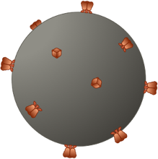
Host Receptors and HIV Entry
HIV
CCR5
CXCR4
CD4
Host Receptors
CD4 Cell
Illustration: David H. Spach, MD

Slide 33
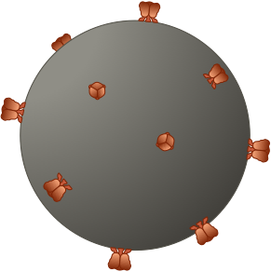
Host Cellular Co-Receptors Involved in HIV Entry
HIV
HIV gp120 determines HIV tropism
CD4
CD4
Coreceptors
CCR5
CXCR4
Illustration: David H. Spach, MD

Slide 34
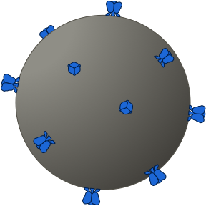
R5-Tropic HIV (R5 HIV)
HIV gp120 determines HIV tropism
CD4
CD4
Coreceptors
CCR5
CXCR4
Illustration: David H. Spach, MD

Slide 35
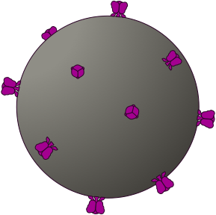
X4-Tropic HIV (X4 HIV)
HIV gp120 determines HIV tropism
CD4
CD4
CCR5
CXCR4
Illustration: David H. Spach, MD

Slide 36
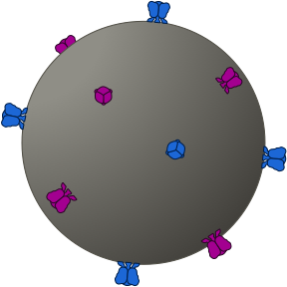
Dual-Tropic HIV
CD4
CD4
Coreceptors
CCR5
CXCR4
Illustration: David H. Spach, MD

Slide 37
Mixed-Tropic HIV
R5-Tropic HIV
X4-Tropic HIV
CD4
CD4
Coreceptors
CCR5
CXCR4
Illustration: David H. Spach, MD

Slide 38
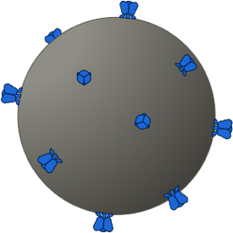
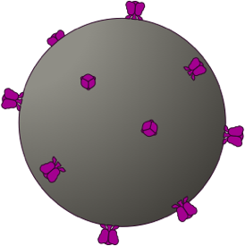
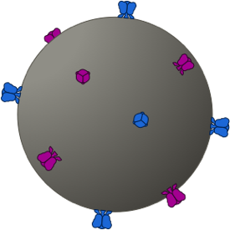
Maraviroc Activity Depends On HIV Tropism
Maraviroc
X4 Tropic
Dual Tropic
Mixed Tropic
R5 Tropic
X4
Dual Tropic
Mixed Tropic
Maraviroc Sensitive
Maraviroc Resistant
CCR5
CXCR4
CCR5
CXCR4
CCR5
CXCR4
CCR5
CXCR4
Illustration: David H. Spach, MD

Slide 39
Fusion Inhibitor

Slide 40
HIV Fusion
HIV
CD4 Receptor
Host cell
Illustration: Cognition Studio, Inc. and David H. Spach, MD

Slide 41
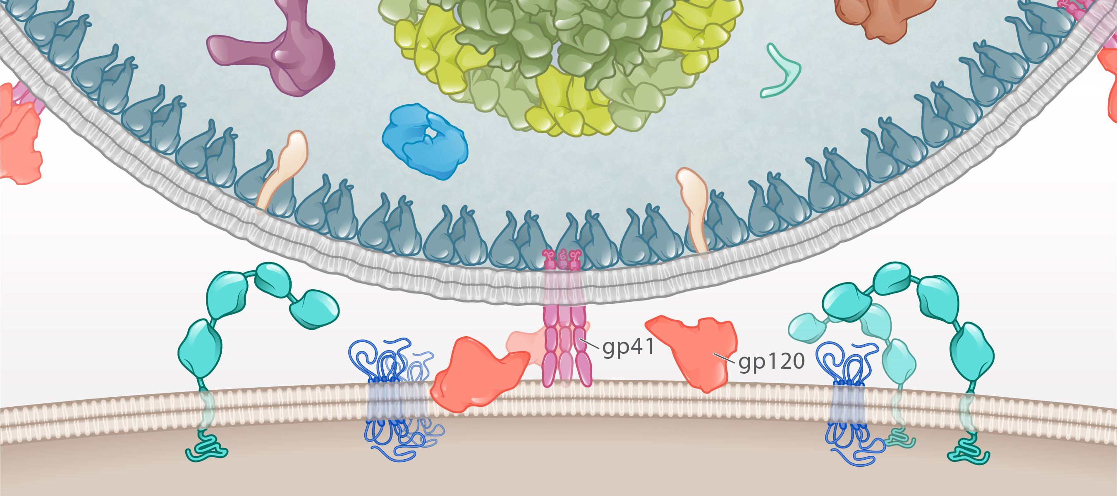
HIV Fusion
HIV
CD4 Receptor
Host cell
Illustration: Cognition Studio, Inc. and David H. Spach, MD

Slide 42
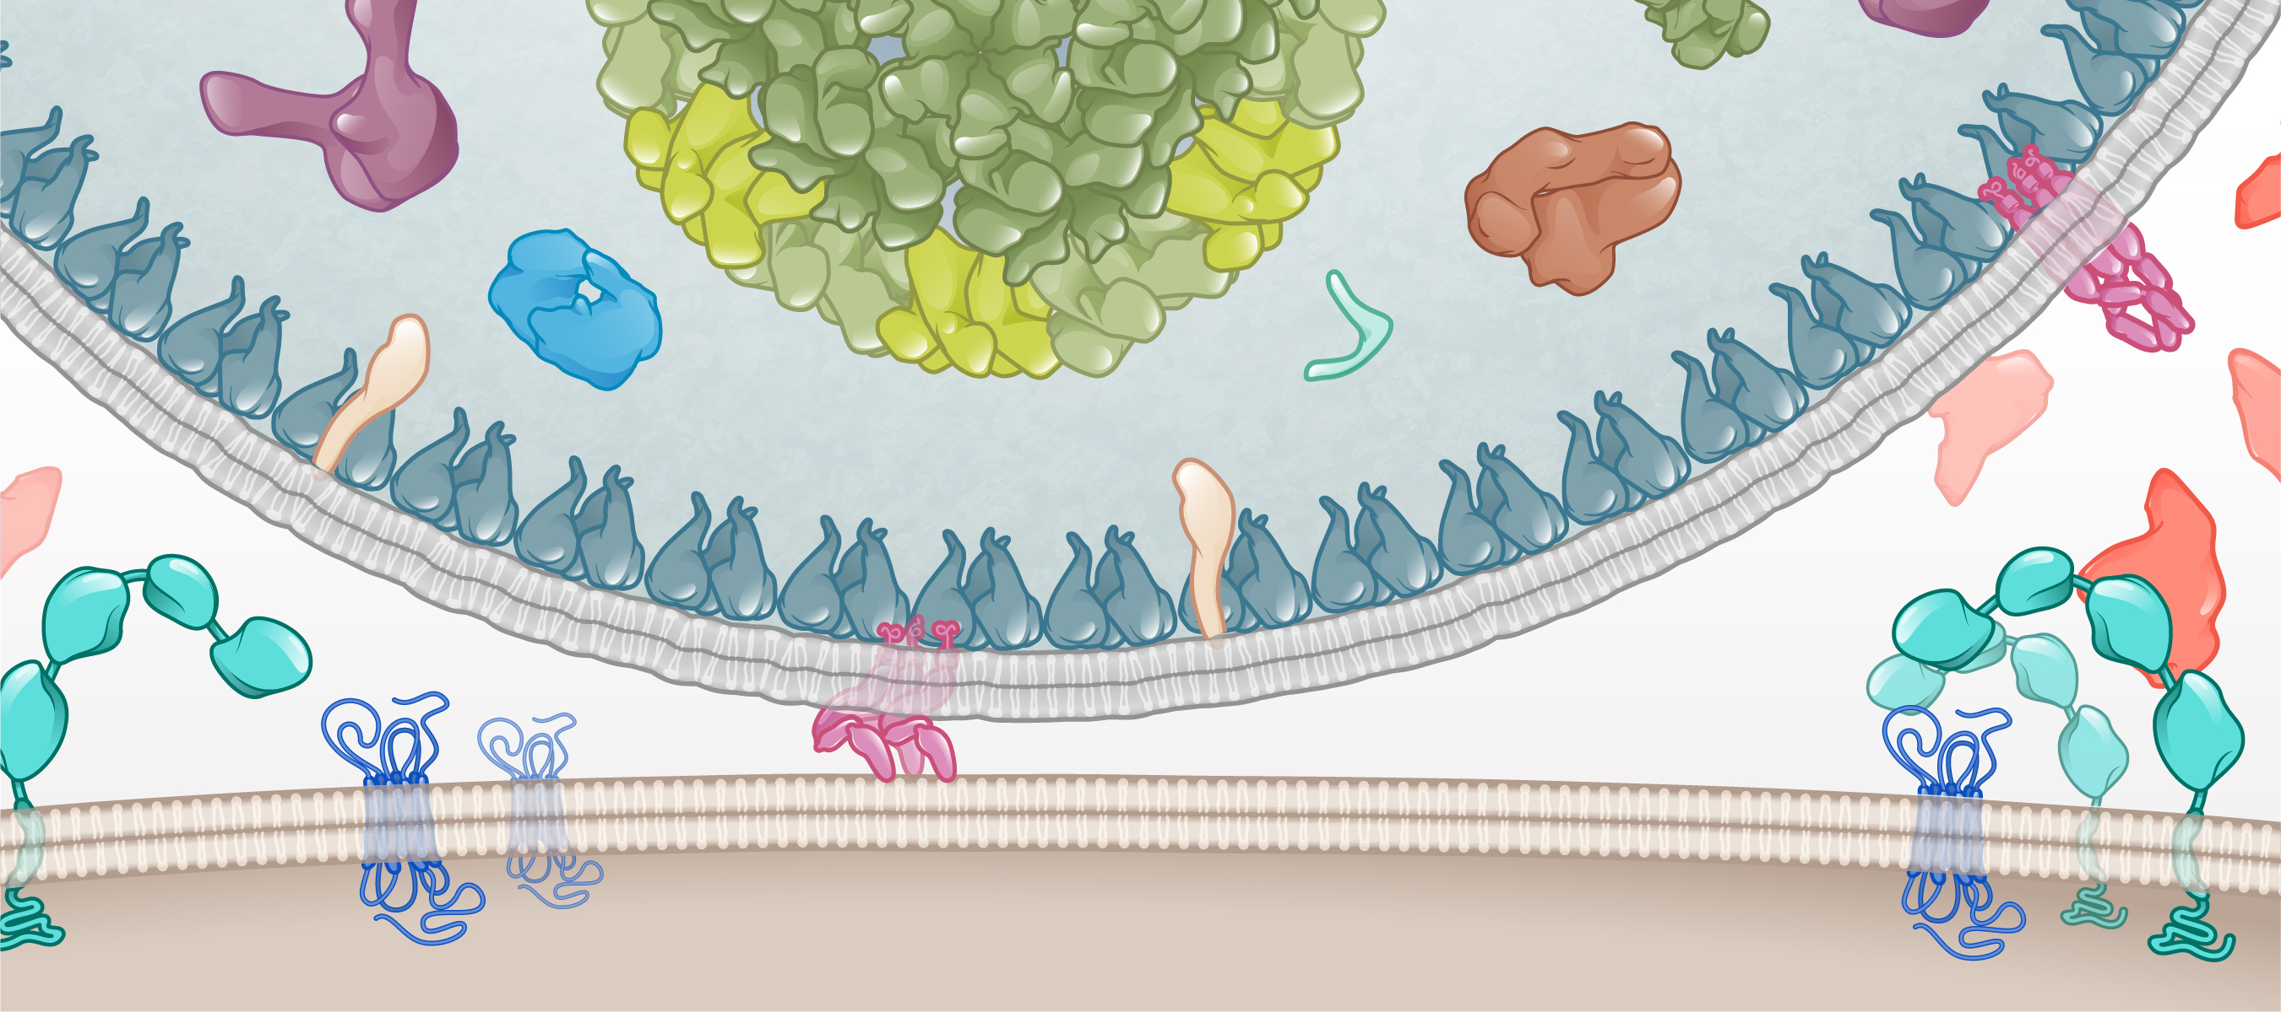
HIV Fusion: Early gp41 Folding
Core
HIV
gp41
Host cell
Illustration: Cognition Studio, Inc. and David H. Spach, MD

Slide 43
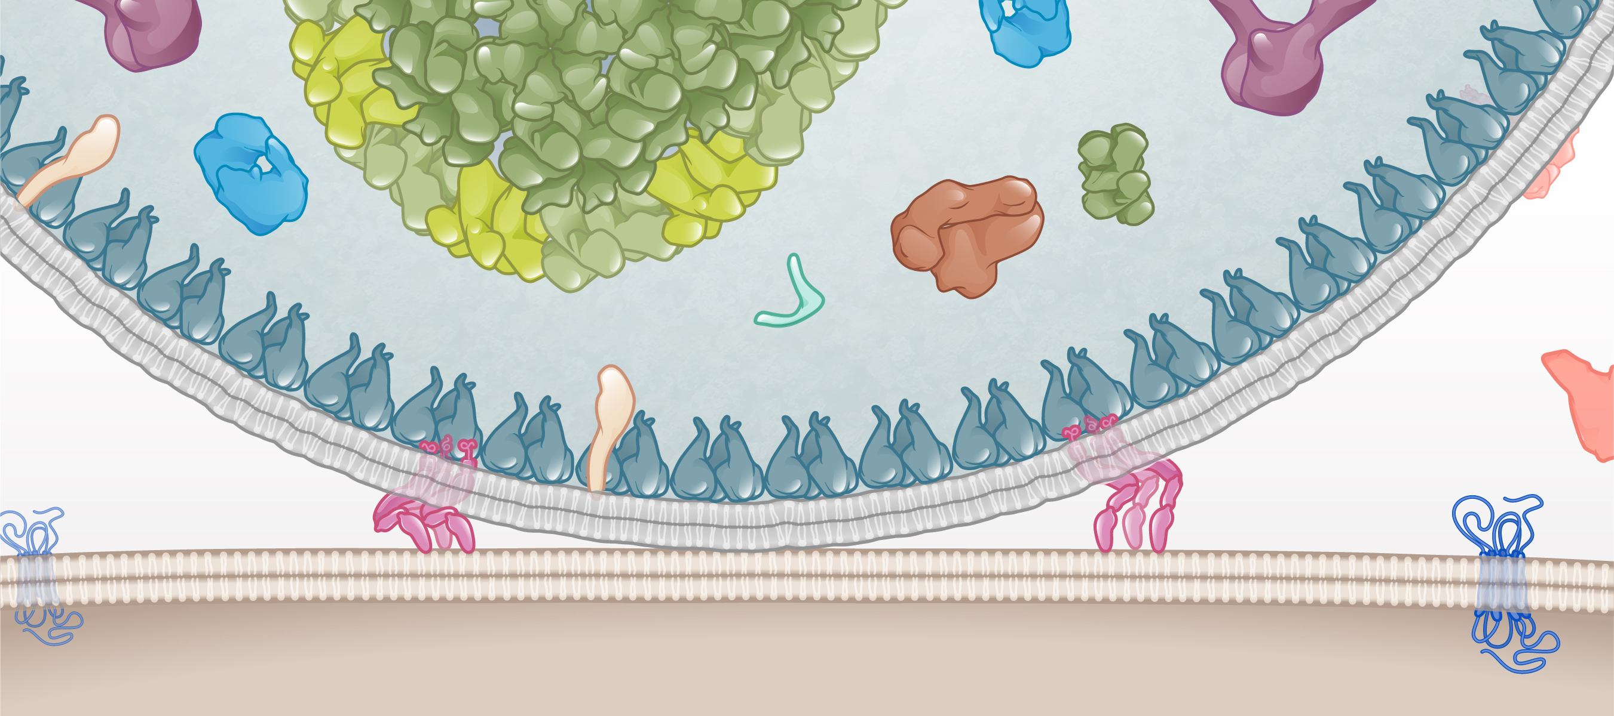
HIV Fusion: Late gp41 Folding
Core
HIV
gp41
gp41
Host cell
Illustration: Cognition Studio, Inc. and David H. Spach, MD

Slide 44
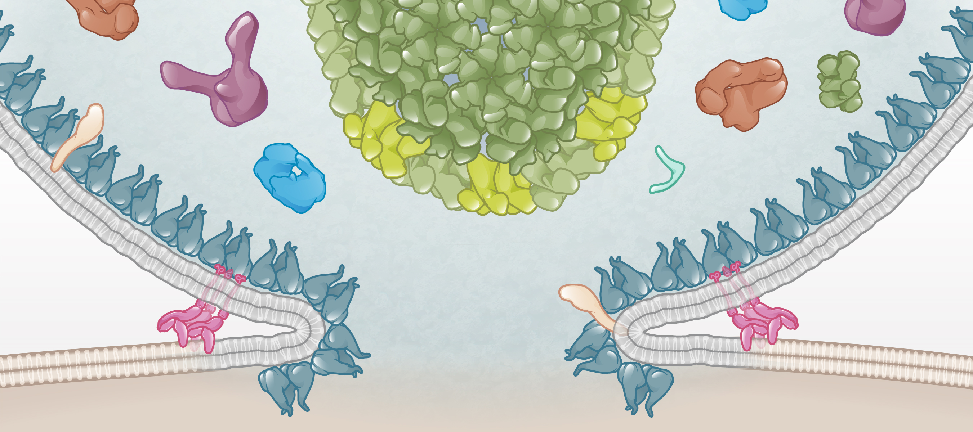
HIV Fusion: Merger of HIV and Host Cell Membranes
HIV
Core
gp41
Host cell
Illustration: Cognition Studio, Inc. and David H. Spach, MD

Slide 45
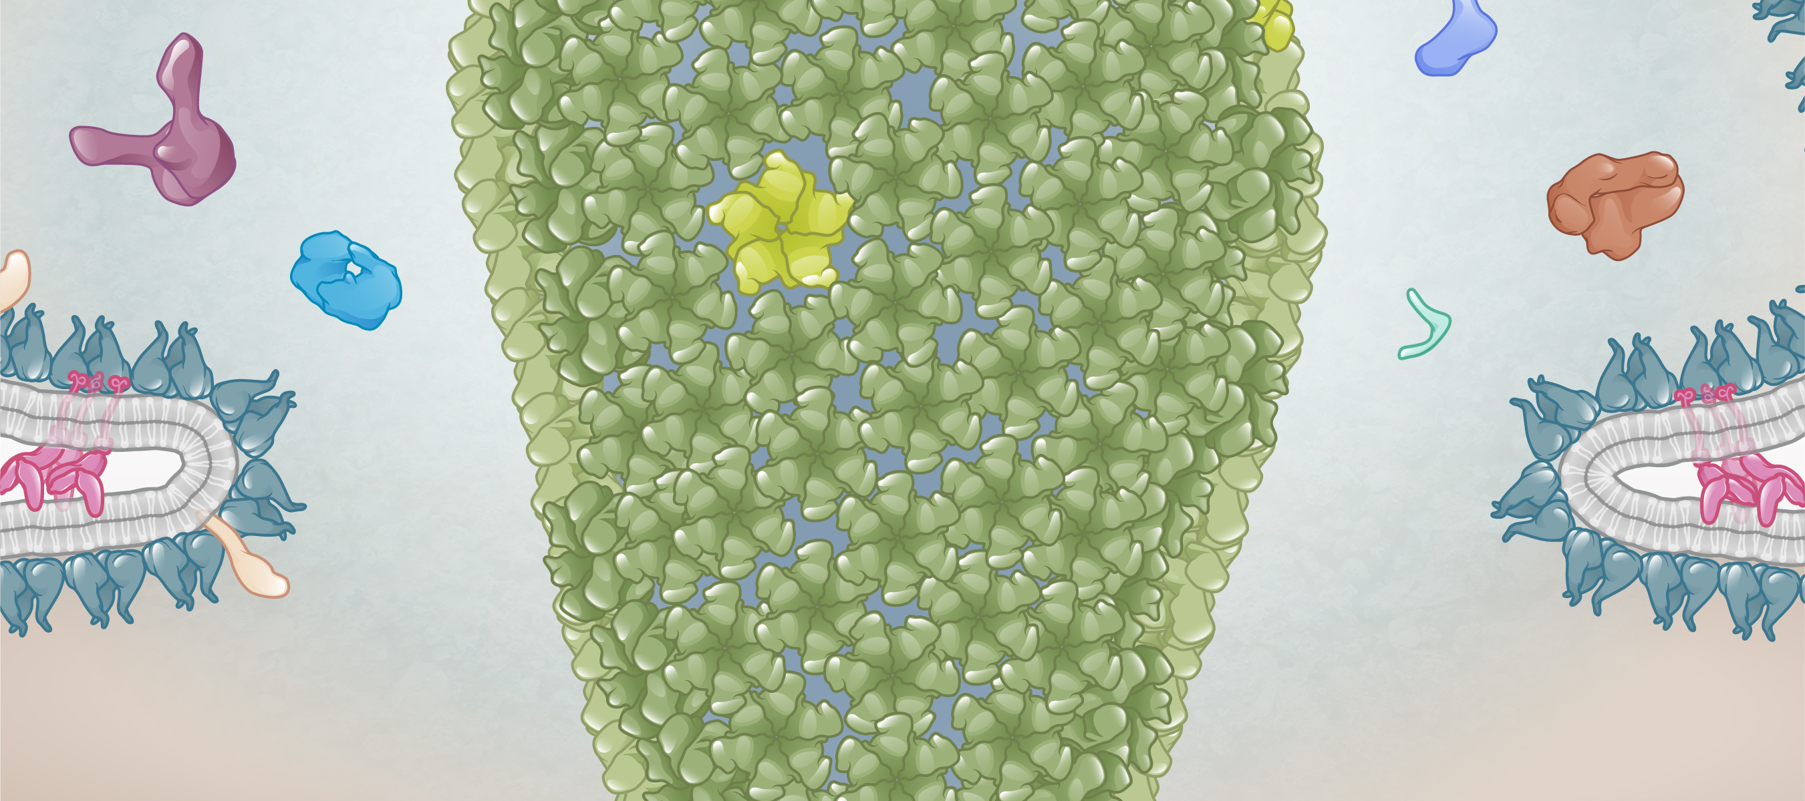
HIV Core Entering Host Cell
Core
Illustration: Cognition Studio, Inc. and David H. Spach, MD

Slide 46
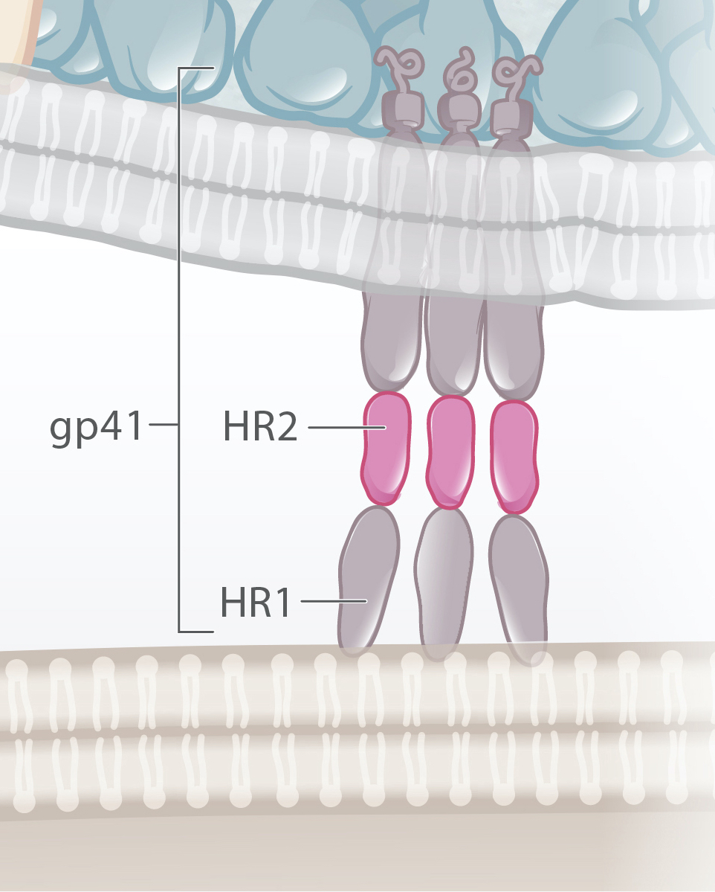
HIV Fusion and gp41 Folding
HIV
Host cell
Illustration: Cognition Studio, Inc. and David H. Spach, MD

Slide 47
HIV Fusion and gp41 Folding
HIV
HR1 and HR2 folding
Host cell
Illustration: Cognition Studio, Inc. and David H. Spach, MD

Slide 48
HIV Fusion and gp41 Folding
HIV
HR1 and HR2 folding
Bound HR1 and HR2
Host cell
Illustration: Cognition Studio, Inc. and David H. Spach, MD

Slide 49
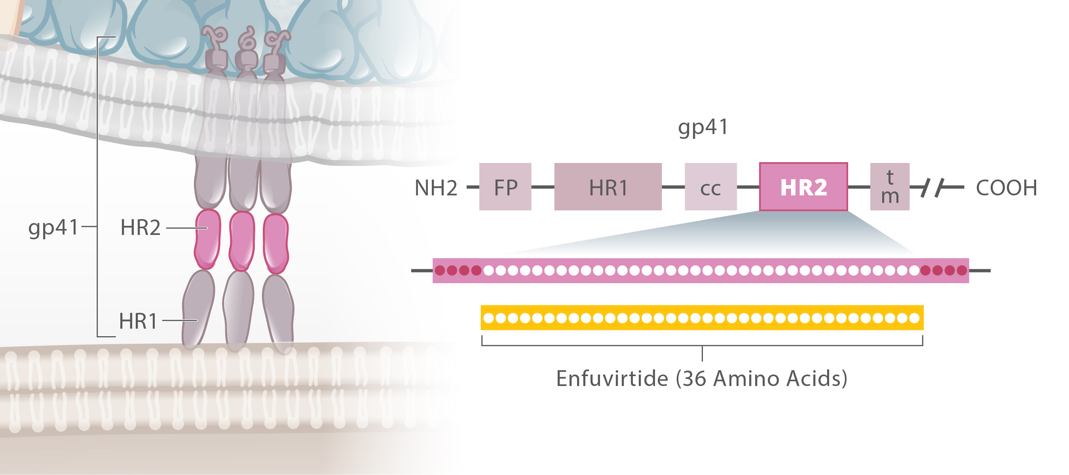
HIV Fusion Inhibitor
HIV
Amino acids
Host cell
Illustration: Cognition Studio, Inc. and David H. Spach, MD

Slide 50
HIV Fusion Inhibitor
HIV
Host cell
Illustration: Cognition Studio, Inc. and David H. Spach, MD

Slide 51
HIV Fusion Inhibitor
HIV
Host cell
Illustration: Cognition Studio, Inc. and David H. Spach, MD

Slide 52
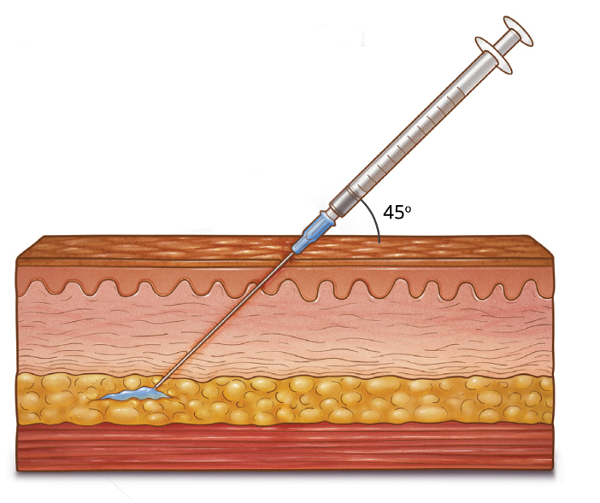
Enfuvirtide (Fuzeon)
Dosing (Subcutaneous)
90 mg (1 mL) bid
Inject into upper arm, anterior thigh or abdomen
Illustration: Cognition Studio, Inc. and David H. Spach, MD

Slide 53
Summary Concepts

Slide 54
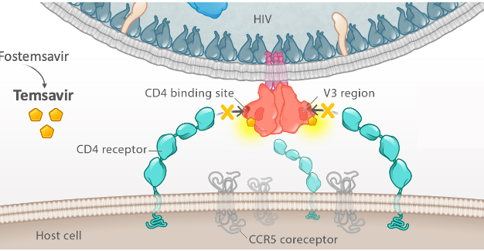
HIV Entry Inhibitors that Bind to HIV
Attachment Inhibitor (binds to HIV gp120)
Fusion Inhibitor (binds to HIV gp41)
Fostemsavir
HIV
Temsavir
gp120
Enfuvirtide
gp41
HR1 and HR2 folding
Host cell
Fostemsavir
Enfuvirtide
Illustration: Cognition Studio, Inc. and David H. Spach, MD

Slide 55
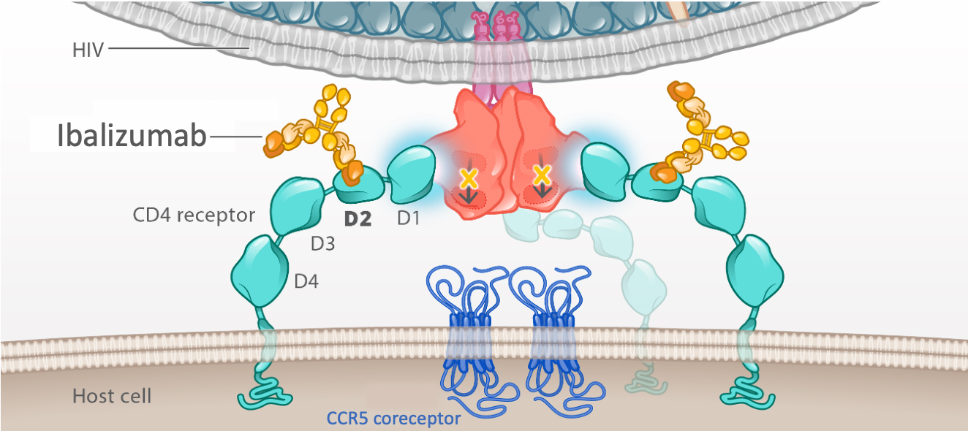
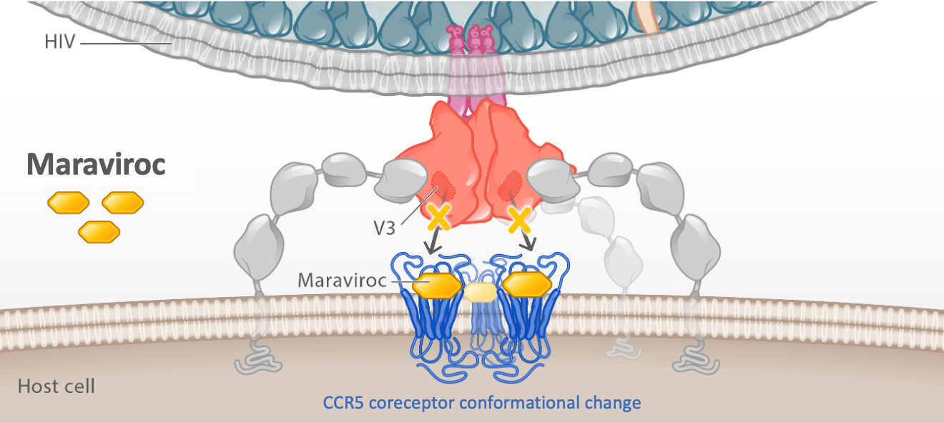
HIV Entry Inhibitors that Bind to Host Cell Receptors
Post-Attachment Inhibitor (binds to Host CD4 Receptor)
CCR5 Receptor Antagonist (binds to Host CCR5 Coreceptor)
Ibalizumab
CD4 receptor
CCR5 coreceptor
Ibalizumab
Maraviroc
Illustration: Cognition Studio, Inc. and David H. Spach, MD

Slide 56
HIV Cell Entry and HIV Entry Inhibitors
Key Steps for HIV Entry
1
CD4 Attachment
2
Coreceptor Binding
3
Fusion

Slide 57
HIV Cell Entry and HIV Entry Inhibitors
Key Steps for HIV Entry
Entry Inhibitor Subclasses
1
CD4 Attachment
Attachment Inhibitors
Post-Attachment Inhibitors
2
Coreceptor Binding
CCR5 Antagonist
3
Fusion
Fusion Inhibitors

Slide 58
HIV Cell Entry and HIV Entry Inhibitors
Key Steps for HIV Entry
Entry Inhibitor Subclasses
Entry Inhibitor Medications
1
CD4 Attachment
Attachment Inhibitors
Fostemsavir
Post-Attachment Inhibitors
Ibalizumab
2
Coreceptor Binding
CCR5 Antagonist
Maraviroc
3
Fusion
Fusion Inhibitors
Enfuvirtide

