Slide 1
2024 HHS Perinatal HIV Guidelines Update
Brian R. Wood, MD
Associate Editor, National HIV Curriculum
Associate Professor of Medicine, Division of Allergy and Infectious Diseases, University of Washington
Last Updated: March 1, 2024

Slide 2
No conflicts of interest or relationships to disclose.

Slide 3
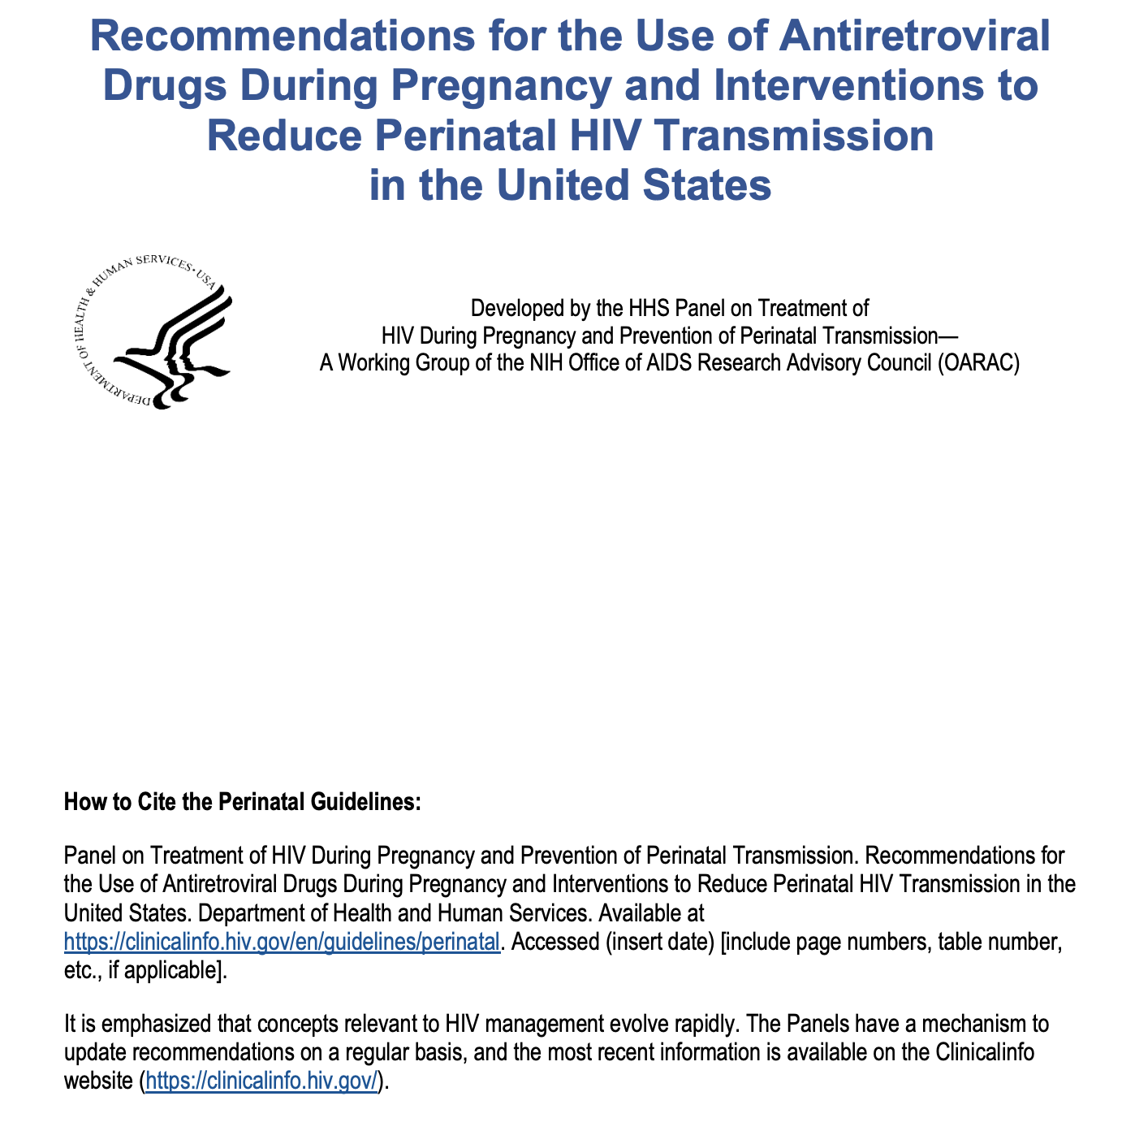
Source: https://clinicalinfo.hiv.gov/en/guidelines/perinatal

Slide 4
Major Updates to Initial ART Regimens For PWH During Pregnancy
HHS Recommendations for the Use of Antiretroviral Drugs During Pregnancy, Updated January 31, 2024
Bictegravir/TAF/FTC now alternative
Darunavir with ritonavir and two NRTIs: ● Preferred if prior cabotegravir PrEP ● Otherwise alternative
Source: https://clinicalinfo.hiv.gov/en/guidelines/perinatal

Slide 5
Preferred Regimens During Pregnancy
HHS Recommendations for the Use of Antiretroviral Drugs During Pregnancy, Updated January 31, 2024
Preferred Initial ART Regimens During Pregnancy (ARV-Naïve)
Dolutegravir + (TAF or TDF) + (FTC or 3TC), or
Dolutegravir/ABC/3TC (if HLA-B*5701 negative and no chronic HBV)
However, if any history of cabotegravir exposure for PrEP, the following are preferred for initial ART due to concerns about INSTI resistance mutations: Darunavir/ritonavir + (TAF or TDF) + (FTC or 3TC) Darunavir/ritonavir + ABC/3TC (if HLA-B*5701 negative and no chronic HBV)
Source: https://clinicalinfo.hiv.gov/en/guidelines/perinatal

Slide 6
Alternative Regimens During Pregnancy
HHS Recommendations for the Use of Antiretroviral Drugs During Pregnancy, Updated January 31, 2024
Alternative ART Regimens During Pregnancy (ARV-Naïve)
Bictegravir/TAF/FTC
Raltegravir + preferred dual-NRTI backbone
Atazanavir/ritonavir + preferred dual-NRTI backbone
Darunavir/ritonavir + preferred dual-NRTI backbone
Efavirenz/TDF/FTC or efavirenz/TDF/3TC or efavirenz + preferred dual-NRTI backbone
Rilpivirine/TDF/FTC or rilpivirine/TAF/FTC or rilpivirine (oral) + preferred dual-NRTI backbone
Source: https://clinicalinfo.hiv.gov/en/guidelines/perinatal

Slide 7
Insufficient Data for Use as Initial Regimen During Pregnancy
HHS Recommendations for the Use of Antiretroviral Drugs During Pregnancy, Updated January 31, 2024
Insufficient Data for Use as Initial Regimen During Pregnancy (ARV-Naïve)
Doravirine or doravirine/TDF/3TC.
Source: https://clinicalinfo.hiv.gov/en/guidelines/perinatal

Slide 8
ART Regimens Not Recommended During Pregnancy
HHS Recommendations for the Use of Antiretroviral Drugs During Pregnancy, Updated January 31, 2024
ART Regimens Not Recommended During Pregnancy (ARV-Naïve)
Cobicistat-boosted atazanavir or darunavir or elvitegravir
Long-acting injectable cabotegravir + rilpivirine
Not recommended except for special circumstances (treatment-experienced): etravirine, fostemsavir, ibalizumab, lenacapavir, maraviroc, enfuvirtide
Source: https://clinicalinfo.hiv.gov/en/guidelines/perinatal

Slide 9
Updates on ART for PWH who are Trying to Conceive
HHS Recommendations for the Use of Antiretroviral Drugs During Pregnancy, Updated January 31, 2024
Insufficient data on efficacy and safety of injectable cabotegravir (CAB) and rilpivirine (RPV) during pregnancy
Injectable CAB and RPV should be stopped at least 1 year before conception to ensure drugs are fully eliminated
If suppressed on long-acting CAB/RPV and wish to conceive, shared decision-making important
Source: https://clinicalinfo.hiv.gov/en/guidelines/perinatal

Slide 10
Updates on PrEP Periconception, Antepartum & Postpartum
HHS Recommendations for the Use of Antiretroviral Drugs During Pregnancy, Updated January 31, 2024
Preferred PrEP for people who have receptive vaginal sex during pregnancy and infant feeding is daily TDF/FTC
For people who become pregnant while receiving PrEP, strongly encourage clinicians to register with the Antiretroviral Pregnancy Registry https://www.apregistry.com/
Source: https://clinicalinfo.hiv.gov/en/guidelines/perinatal

Slide 11
Additional Updates
Changes to align with Adult and Adolescent Antiretroviral guidelines: HIV RNA threshold for resistance testing updated, CD4 count monitoring
Bictegravir added to ARV drugs recommended for treating HIV-2 infection during pregnancy
Source: https://clinicalinfo.hiv.gov/en/guidelines/perinatal

Slide 12
Reminder About Infant Feeding Updates
All PWH should receive evidence-based, patient-centered counseling to support shared decision-making about infant feeding
Begin counseling prior to conception or as early as possible in pregnancy and continue throughout pregnancy
Replacement feeding with properly prepared formula or pasteurized donor human milk from a milk bank eliminates the risk of transmission
Achieving and maintaining viral suppression with ART during pregnancy and postpartum decreases breast/chestfeeding transmission risk to <1%
Source: https://clinicalinfo.hiv.gov/en/guidelines/perinatal

Slide 13
Reminder About Infant Feeding Updates
If not taking ART or viral load not suppressed: replacement feeding with formula or banked pasteurized donor human milk is recommended
If taking ART with sustained undetectable viral load and choose to breast/chestfeed, providers should support the decision
Engaging Child Protective Services or similar agencies is not an appropriate response to infant feeding choices of an individual with HIV
National Perinatal HIV hotline (1-888-448-8765) available for questions about infant feeding by individuals with HIV
Source: https://clinicalinfo.hiv.gov/en/guidelines/perinatal

Slide 14
Summary
Preferred and alternative ART options during pregnancy updated and reflect growing data for bictegravir/TAF/FTC during pregnancy
Additional updates made to guidelines to align with PrEP guidelines and with Adult & Adolescent Antiretroviral Treatment Guidelines
Updates in infant feeding guidelines and considerations remain notable and critical to disseminate to clinicians
Source: https://clinicalinfo.hiv.gov/en/guidelines/perinatal

