Slide 1
PrEP – Stigma and Barriers
Latesha Elopre, MD, MSPH
Associate Professor, Division of Infectious Diseases
Assistant Dean for Diversity and Inclusion, Medical Education
University of Alabama at Birmingham
June 26, 2023

Slide 2
Consultation MedIQ, Practice Point, Clinical Care Options Grants Merck NIH/NIMH/NICHD

Slide 3
Objectives
Understand current disparities in HIV rates and inequities in PrEP access in the U.S.
Review factors associated with inequities in PrEP utilization

Slide 4
HIV Epidemiology and PrEP Inequities

Slide 5
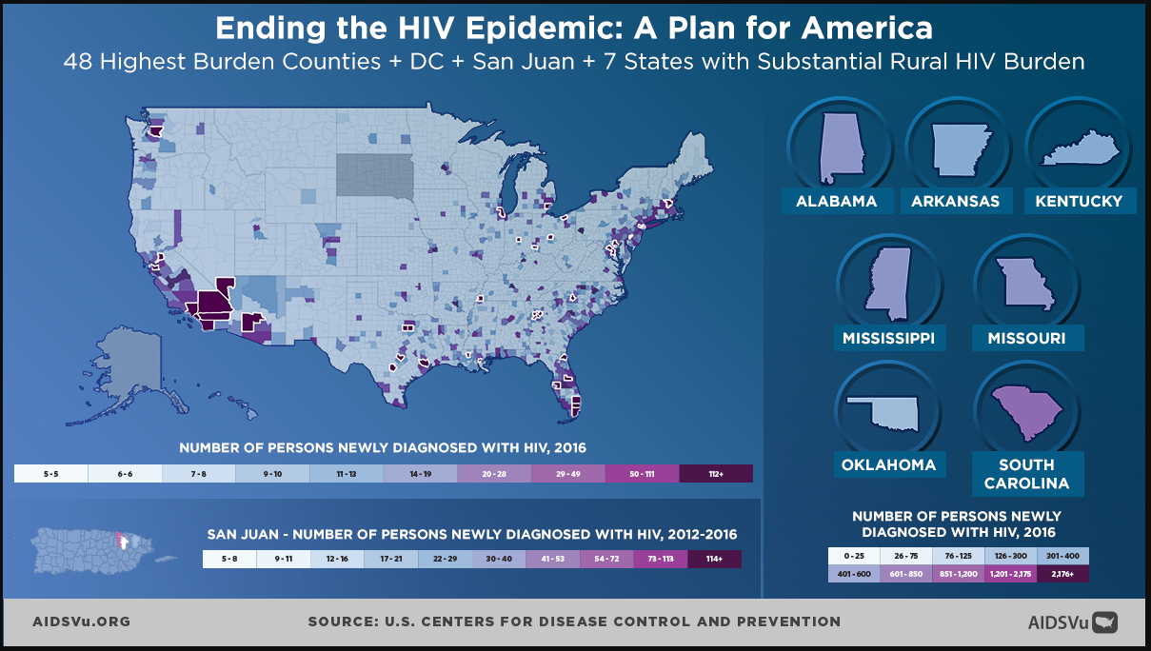
Regions with the Highest HIV Burden
Notes:
The overall number of HIV diagnoses in the United States in 2020 (30,403) was 17% lower than in 2019 (36,585). The steep reduction in diagnoses in 2020 is likely due to disruptions in clinical care services, patient hesitancy in accessing clinical services, and shortages in HIV testing reagents/materials, which causes concern regarding underdiagnosis. One of the approaches the CDC is taking to end the HIV epidemic in the United States is to focus initially on high-incidence geographic areas.^{1,2}
The southeast currently makes up 52% of HIV diagnoses in 202

Slide 6
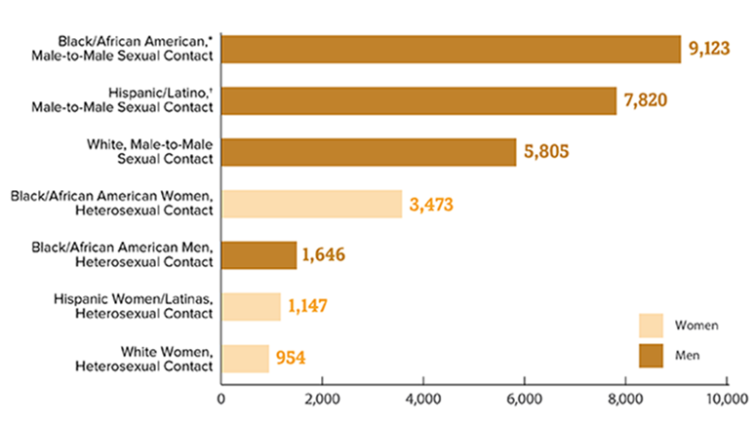
Disparities in HIV Rates due to Inequities
Notes:
These data from the CDC provide a distribution of new HIV cases in the US in 2020 by transmission, gender, and race/ethnicity.¹
HIV diagnosis, mortality and census population data were used to derive lifetime risk estimates of HIV diagnosis for all ages, by sex, race/ethnicity and place of residence. Data on HIV diagnoses were obtained from the National HIV Surveillance System (NHSS). Based on 2017-2019 US data, the lifetime risk of a HIV diagnosis was 1 in 120 overall and 1 in 76 for males and 1 in 309 for females. At every age, males had a higher estimated lifetime risk than females. Lifetime risk for males was 1 in 27 for Black persons and 1 in 50 for Hispanic/Latino persons.¹
The estimated lifetime risk of being diagnosed with HIV was highest among black MSM.²

Slide 7
Status Neutral Continuum of HIV Prevention and Care
https://www.nastad.org/domestic/hiv-prevention-health-equity, Slide courtesy of Hyman Scott

Slide 8
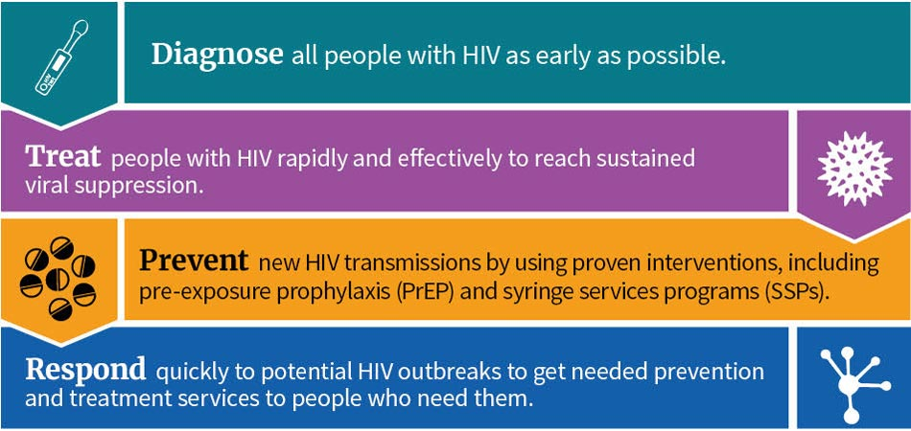
Ending the HIV Epidemic
Federally funded agencies working in a coordinated manner to End the HIV Epidemic, with a goal of reducing HIV diagnoses
≥75% by 2025
≥90% by 2030
Increasing PrEP use for populations vulnerable to HIV diagnosis by at least 50%
DHHS, 2021. HIV National Strategic Plan for the United States: A Roadmap to End the Epidemic 2021-2025. https://files.hiv.gov/s3fs-public/HIV-National-Strategic-Plan-2021-2025.pdf.
Harris NS, et al. MMWR Morb Mortal Wkly Rep. 2019;68:1117-1123.
Notes:
The CDC plan for ending the HIV epidemic in the United States is centered on 4 pillars: focus initially on high-incidence geographic areas; emphasize early diagnosis, immediate treatment, engagement; expand PrEP; and rapid/overwhelming response to emerging HIV clusters.^{1,2}

Slide 9
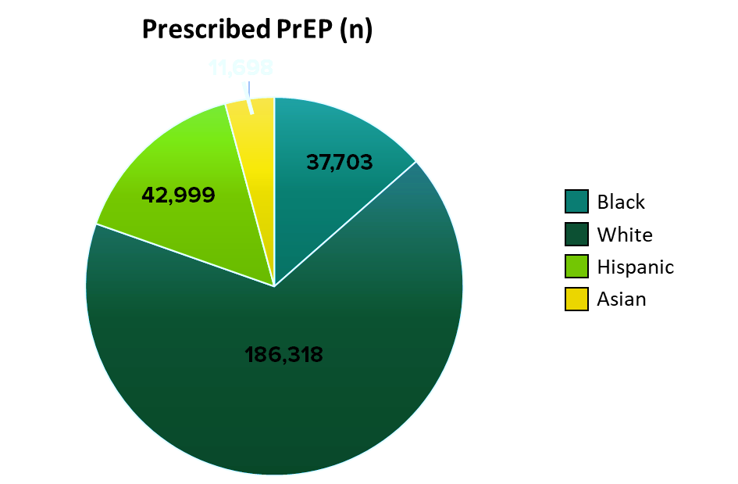
Inequities in PrEP Prescription
1.2 million people are likely to benefit from PrEP
Only 18% of persons with an indication prescribed
Only 28% of males were prescribed PrEP
Only 10% of females
Notes:
Among an estimated 1.2 million persons with indications for use of PrEP, approximately 18% had been prescribed PrEP in 2020.¹⁻⁴

Slide 10
Kaiser Permanente (2012-2019): PrEP Continuum of Care and New HIV Infections
Cohort study (n = 13,906 linked to PrEP care)
Male (95%), White/Hispanic/Asian/Black (49%/22%/15%/7%)
Discontinued PrEP at least once: 52%, of whom 60% restarted
HIV incidence rates per 100 patient-yr:
Linked but not prescribed PrEP (0.87)
Discontinued without restarting (1.28)
Started and persisted with PrEP (0)
Black vs White Patients were significantly:
Less likely to be prescribed PrEP (HR: 0.74)
Less likely to start PrEP (HR: 0.87)
More likely to discontinue PrEP (HR: 1.36)
Notes:
PrEP, pre-exposure prophylaxis.

Slide 11
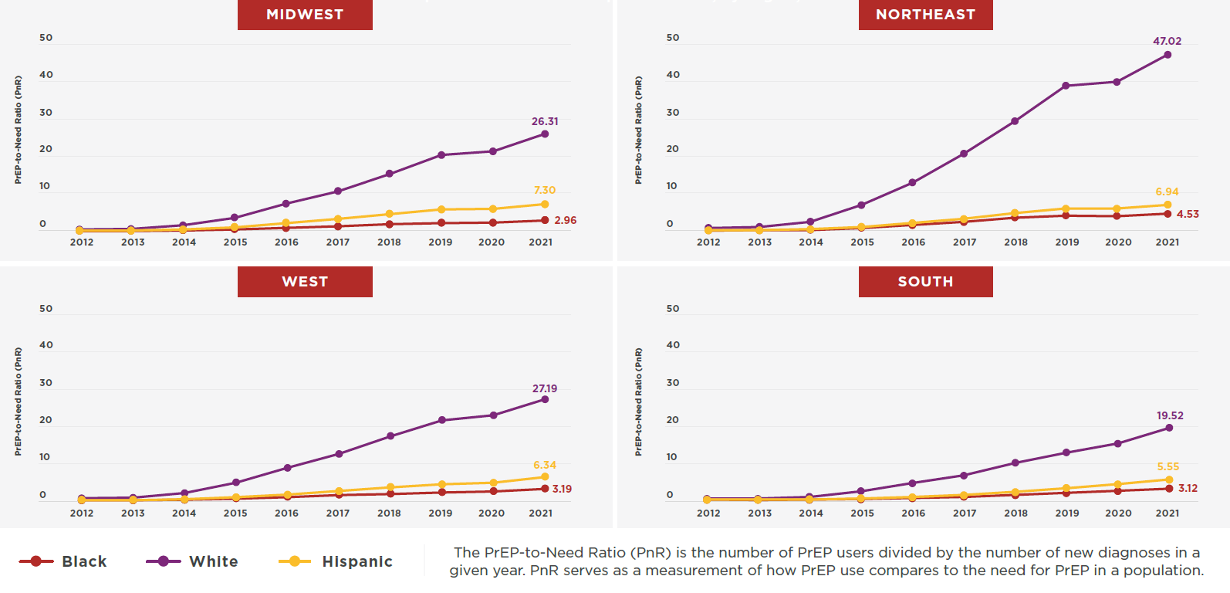
PnR by Race/Ethnicity and US Region, 2012-2021
Sullivan P, et al. AIDS 2022; Montreal, Canada; July 29-Aug 2, 2022; Abst. OALBX0106.
Notes:
PnR increased from 2012-2021 for all races and regions, but levels of PrEP use were not consistent across regions
Levels of PrEP users were also not equitable
Defined by differences in PnR by race/ethnicity
In all regions, PnR was highest for White and lowest for Black people.
By region in 2021, the highest region- and race-specific PnR was for White people in the Northeast in (PnR=47) and the lowest region- and race- specific PnR was for Black people in the Midwest (PnR=3)

Slide 12
Stigma Drives Inequities

Slide 13
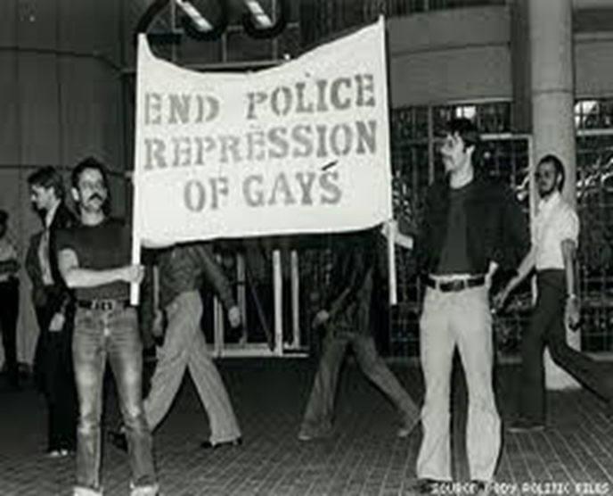
What is Stigma?
A concept rooted in the perception of deviance from community values and social norms.
The identification and labeling of human differences, linking labeled persons to negative stereotypes, and categorization to facilitate discrimination and unequal outcomes.

Slide 14
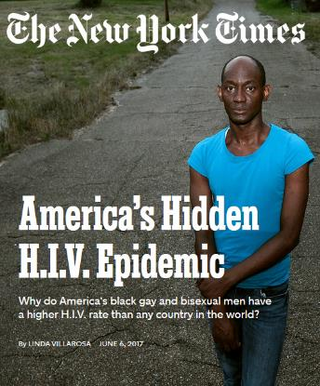
Intersectional Stigma = Intersecting Disparities
Black
Poverty
Education
Employment
Access to care
Chronic diseases
Racism/Profiling
Sexual prejudice
Insurance
Homicide
HIV/STI
Mental health
Homelessness
Incarceration
Alcohol/Substance abuse
MSM/Gay men
Sexual prejudice
Obesity
HIV/STI
Suicide
Alcohol/Substance abuse
Homelessness
Mental health
Access to care
Malebranch, Robinson & Moore, 2015
Notes:
Childhood sexual abuse

Slide 15
“Perceptions of PrEP” among YBMSM
CHARACTERISTICS | Total = 25
Median Age | 24 (18-29)
Has Health Insurance
Yes | 21 (84%)
Regular Source of Healthcare
Yes | 18 (72%)
Self-Described Sexual Identity
Gay/MSM/Same gender loving | 16 (64%)
Aware of PrEP
Yes | 25 (100%)
Willing to take PrEP
Yes | 21 (84%)
On PrEP
No | 21 (84%)
Elopre et al. AIDS Patient Care and STD (2018)
Notes:
While the majority of participants reported to be gay, about a fifth were bisexual. Two reported being gender non-conforming and one participant reported being heterosexual.

Slide 16
Stigma Related to being Black, Gay and Living in the South
“I don’t feel like I’ve ever had true peace of mind in a sexual encounter in my life, which is kind of sad…straight people… They have no idea what that is because there’s no shame associated with their sex. So much shame associated with gay people, gay sex and all that stuff…” – CP120, 29 years old, Gay
Subtheme – Perceived Masculinity among Male Relatives
“So, like, the Black community foundationally, I think has an idea of a conceptualized masculinity that homosexuality naturally seems to kind of not claim – I think a lot of it becomes a fear that you can’t be a man, or something if you’re gay...” – CP 100, 20 years old, Gay
Notes:
A sub-theme emerged from many participants who expressed feeling that being gay was the antithesis of perceived masculinity in the Black community, which also affected their perception of their own masculinity

Slide 17
Gaining Acceptance of Sexual Identity - Themes
Homophobia (internalized, perceived and experienced)
Sub-theme related to the coming out experience and religiosity worsening internalized homophobia
Social-support networks were important in validation of sexual identity
Networks are often complex consisting of other gay men and Black women
Cultural norms in the Black community need to change
Heteronormative ideals
Religious Beliefs
Lack of Black gay and bisexual role models
Elopre and Hussen et al. Behavioral Medicine (2021).
Notes:
Earlier this year, in Huntsville AL a 15 year old teen took his life due to bullying about his sexual identity.
To further explore the topic of acceptance of sexuality among participants, we conducted additional, second-level fine coding that involved axial coding focused on text related to sexual identity, coming out and social networks that either support or hinder acceptance. The majority of these codes mapped to four questions and related probes in our qualitative, in-depth interview guide focused on sexual identity and stigma related to sexual orientation.
Of the 25 participants, 16 (64%) reported having positive feelings about their sexual identity.
Homophobia – Internalized homophobia intensified during early adolescence and often-times associated with rejection during their coming out experience. “I felt like there was something wrong with me growing up”. One participant even reported attempted suicide at a young age. Another subtheme was how religious values related to sexual identity heightened internalized homophobia. Perceived homophobia within networks and varying degrees of experienced homophobia including violence.
“But I cannot change it. I tried. I really tried. I tried praying. I tried going to church. I tried all of this stuff. But it just something that I cannot change.”
Support networks – Often negative network members were other Black males, while supportive networks consisted of Black MSM and Black women (often more so during adolescence almost 2/3rd endorsed)

Slide 18
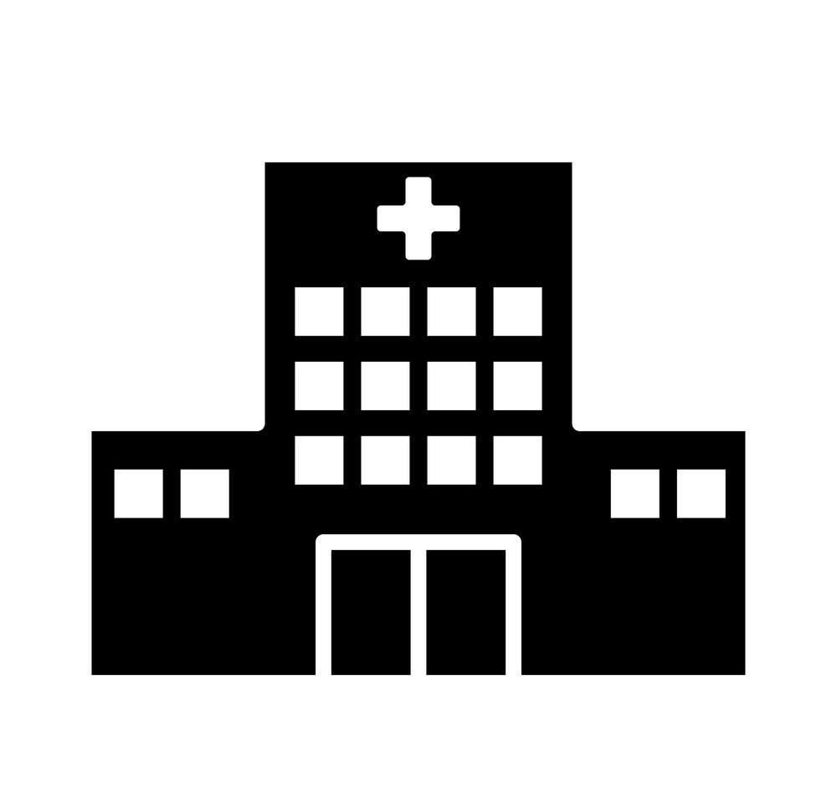
Multi-level Interventions
Public Policy: Laws and policies
Organizational Level: Health care systems
Interpersonal Level: Relationships with significant others, family and friends
Individual Level
Community Level: Churches, Black-owned businesses, fraternities and sororities

Slide 19
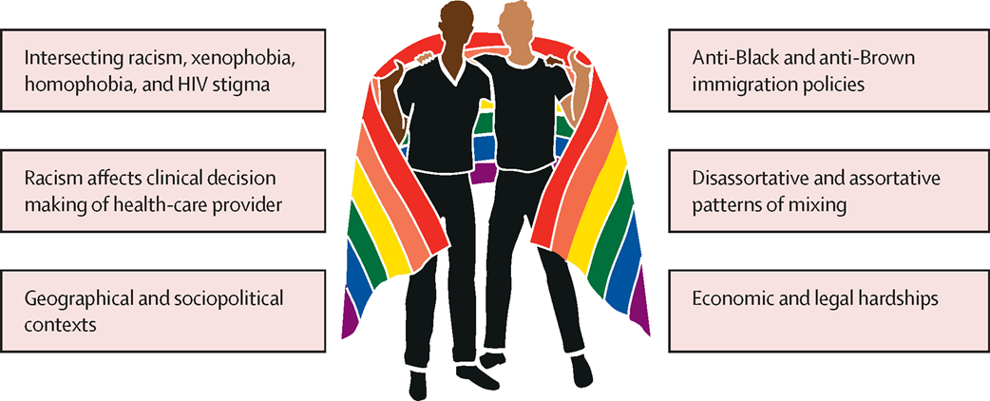
Addressing Outstanding Barriers
Universal access to quality healthcare
Geographical, racial and ethnic disparities in HIV (as well as HIV prevention) services
Address discrimination and racism in health care
Advancing and protecting LGBTQ+ rights, access to services and engagement in the response
Create an enabling environment
Copyright © 2021 Elsevier Ltd Terms and Conditions
The Lancet 2021 3971151-1156DOI: (10.1016/S0140-6736(21)00390-1)
The Lancet 2021 3971116-1126DOI: (10.1016/S0140-6736(21)00321-4)

Slide 20
Additional Multi-level Barriers to Utilization and Implementation

Slide 21
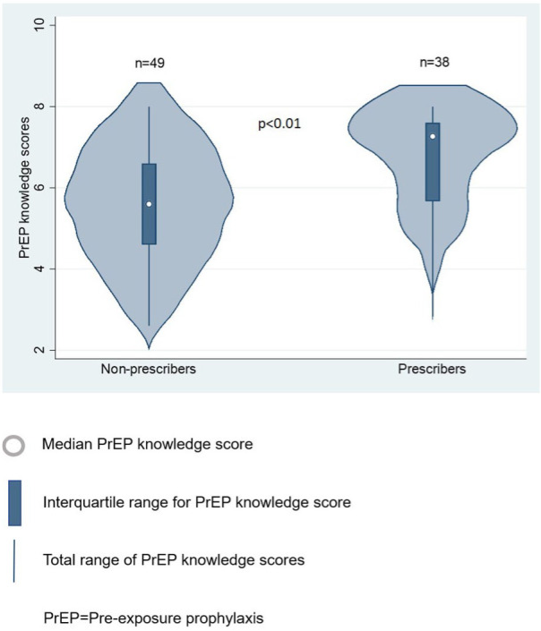
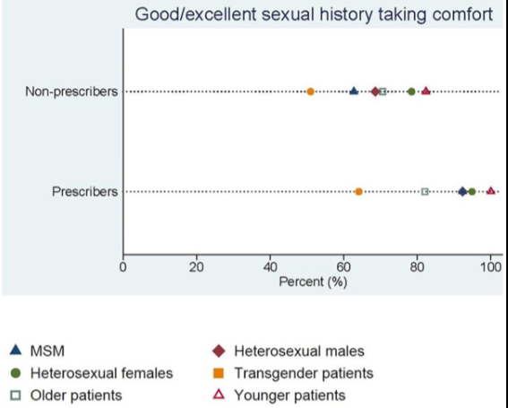
“Purview Paradox” - Neither HIV providers nor PCPs consider PrEP implementation within their clinical domain
Krackower et al. AIDS and Behavior. 2014
Moore et al. J Prim Care Community Health. 2020
Notes:
Methods: We developed an anonymous cross-sectional electronic survey from March to November 2019. Survey development was guided by the Capability, Opportunity, Motivation, and Behavior framework and refined through piloting and interviews. Participants included members of professional society and health center listservs licensed to practice in Tennessee. Respondents were excluded if they did not complete the question regarding PrEP prescription in the previous year or were not in a position to prescribe PrEP (e.g., hospital medicine). Metrics included PrEP prescription in the preceding year, PrEP knowledge scores (range 0-8), provider attitudes about PrEP, and provider and practice characteristics. Knowledge scores and categorical variables were compared across PrEP prescriber status with Wilcoxon rank-sum and Fisher's exact tests, respectively.
Results: Of 147 survey responses, 99 were included and 43 (43%) reported PrEP prescription in the preceding year. Compared with non-prescribers: prescribers had higher median PrEP knowledge scores (7.3 vs 5.6, P < .01), a higher proportion had self-reported patient PrEP inquiries (95% vs 21%, P < .01), and a higher proportion had self-reported good or excellent ability to take a sexual history (83% vs 58%, P = .01) and comfort taking a sexual history (92% vs 63%, P < .01) from men who have sex with men, a subgroup with high HIV risk. Most respondents felt obligated to provide PrEP (65%), and felt all primary care providers should provide PrEP (63%).

Slide 22
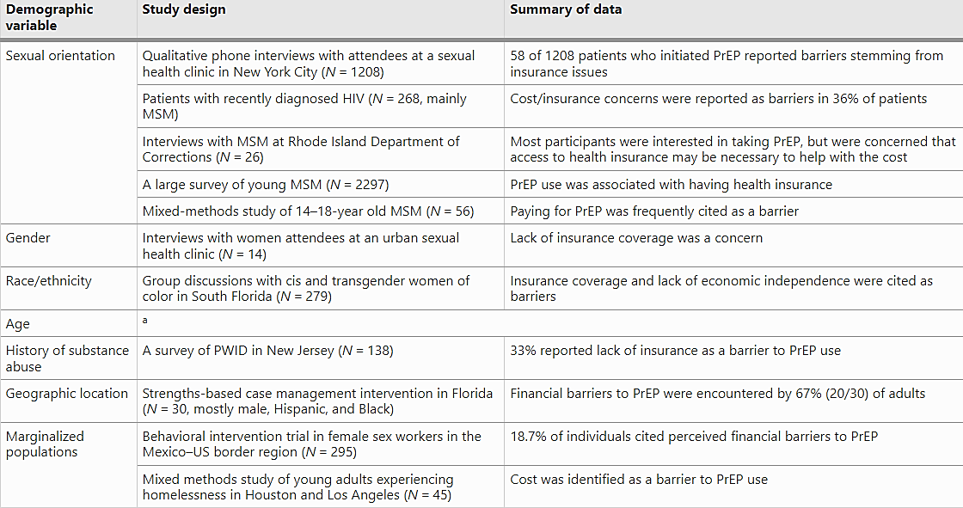
System-Level Barriers
Mayer, Agwu and Malebranche. Advances in Therapy. 2020.
Gollub and Vaughan. AIDS Education and Prevention 2022.
Notes:
Rupa Patel –
2015 STD and HIV clinics looking at PrEP utilization (i.e. taking PrEP at a 3-month f/u apt) and having insurance
Dapivirine Ring inclusion in the WHO prevention guidelines was w/d for FDA approval
The dapivirine monthly vaginal ring—a discreet, anti-HIV microbicide created specifically for women—has received a positive scientific opinion by the European Medicines Agency and is included in the WHO HIV prevention guidelines. It has received regulatory approvals in several countries in southern and eastern Africa. During the review of the New Drug Application that was submitted in December 2020, FDA advised the developer, International Partnership for Microbicides, that it was unlikely to be approved in the United States; the application has since been withdrawn. This commentary will present the case for FDA approval for the dapivirine ring. Advocacy is urgently needed to protect U.S. women's access to user-controlled HIV prevention technologies, consistent with both global regulatory decisions to date and with a reproductive justice framework. Women continue to need the fullest range of HIV prevention methods to integrate into their lives in the most practical and effective way possible.

Slide 23
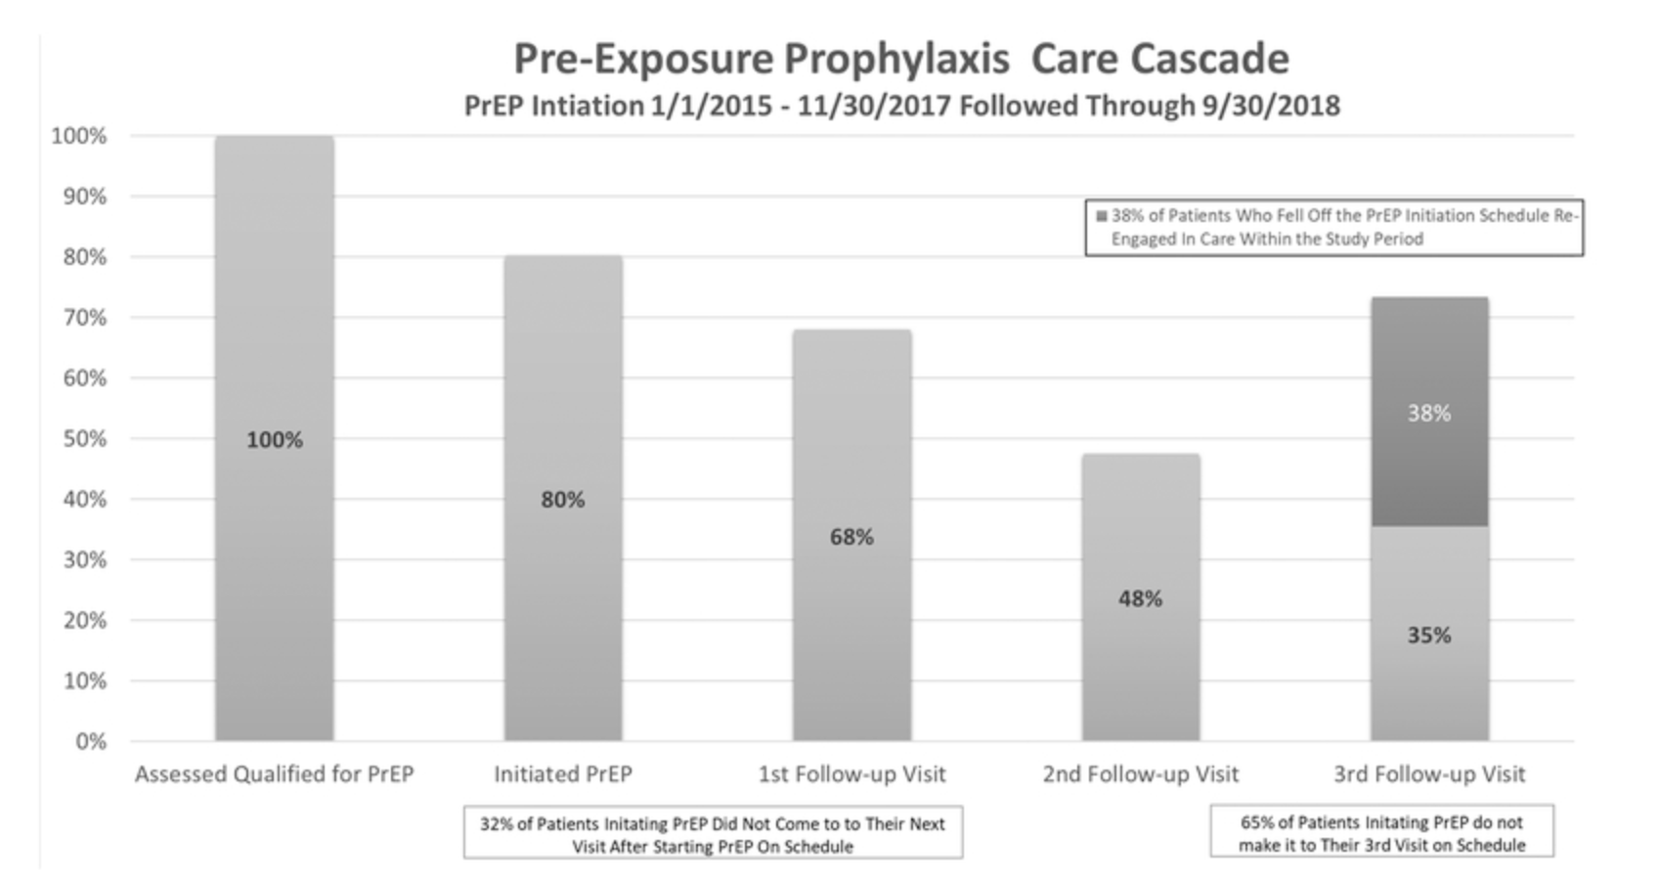
PrEP Care Means Comprehensive Care
Higher retention in PrEP care
Male gender at birth
Transition PEP to PrEP
Participation in mental health services
Zucker et al. JAIDS 2020
Notes:
1/1/2015 through 11/30/2017 and followed through 9/30/2017 for Retention in Care Through the First Three Visits and Re-Engagement at Any Time. *”First follow-up visit” was defined as having a visit between day 14 and day 60 or documentation of enough prescription refills to last within one week of the second follow-up visit.
Retrospective Cohort Analysis
Started TDF/FTC 1/2015 – 11/2017
Primary outcome: adherence to initial three visit schedule
Demographics
23% AA, 46% Hispanic
Lower retention
Age < 30, Same-day PrEP
Initiation in sexual health clinic
Higher retention
Male gender at birth, transition PEP to PrEP, Participation in mental health serivces

Slide 24
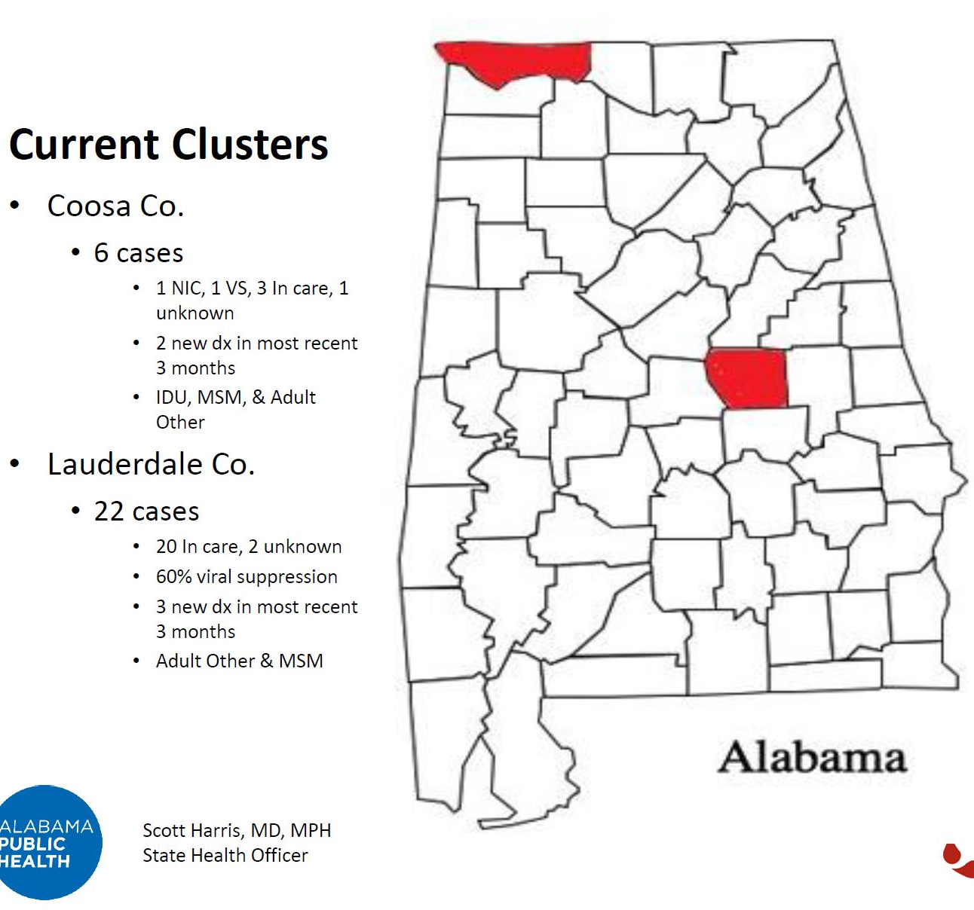
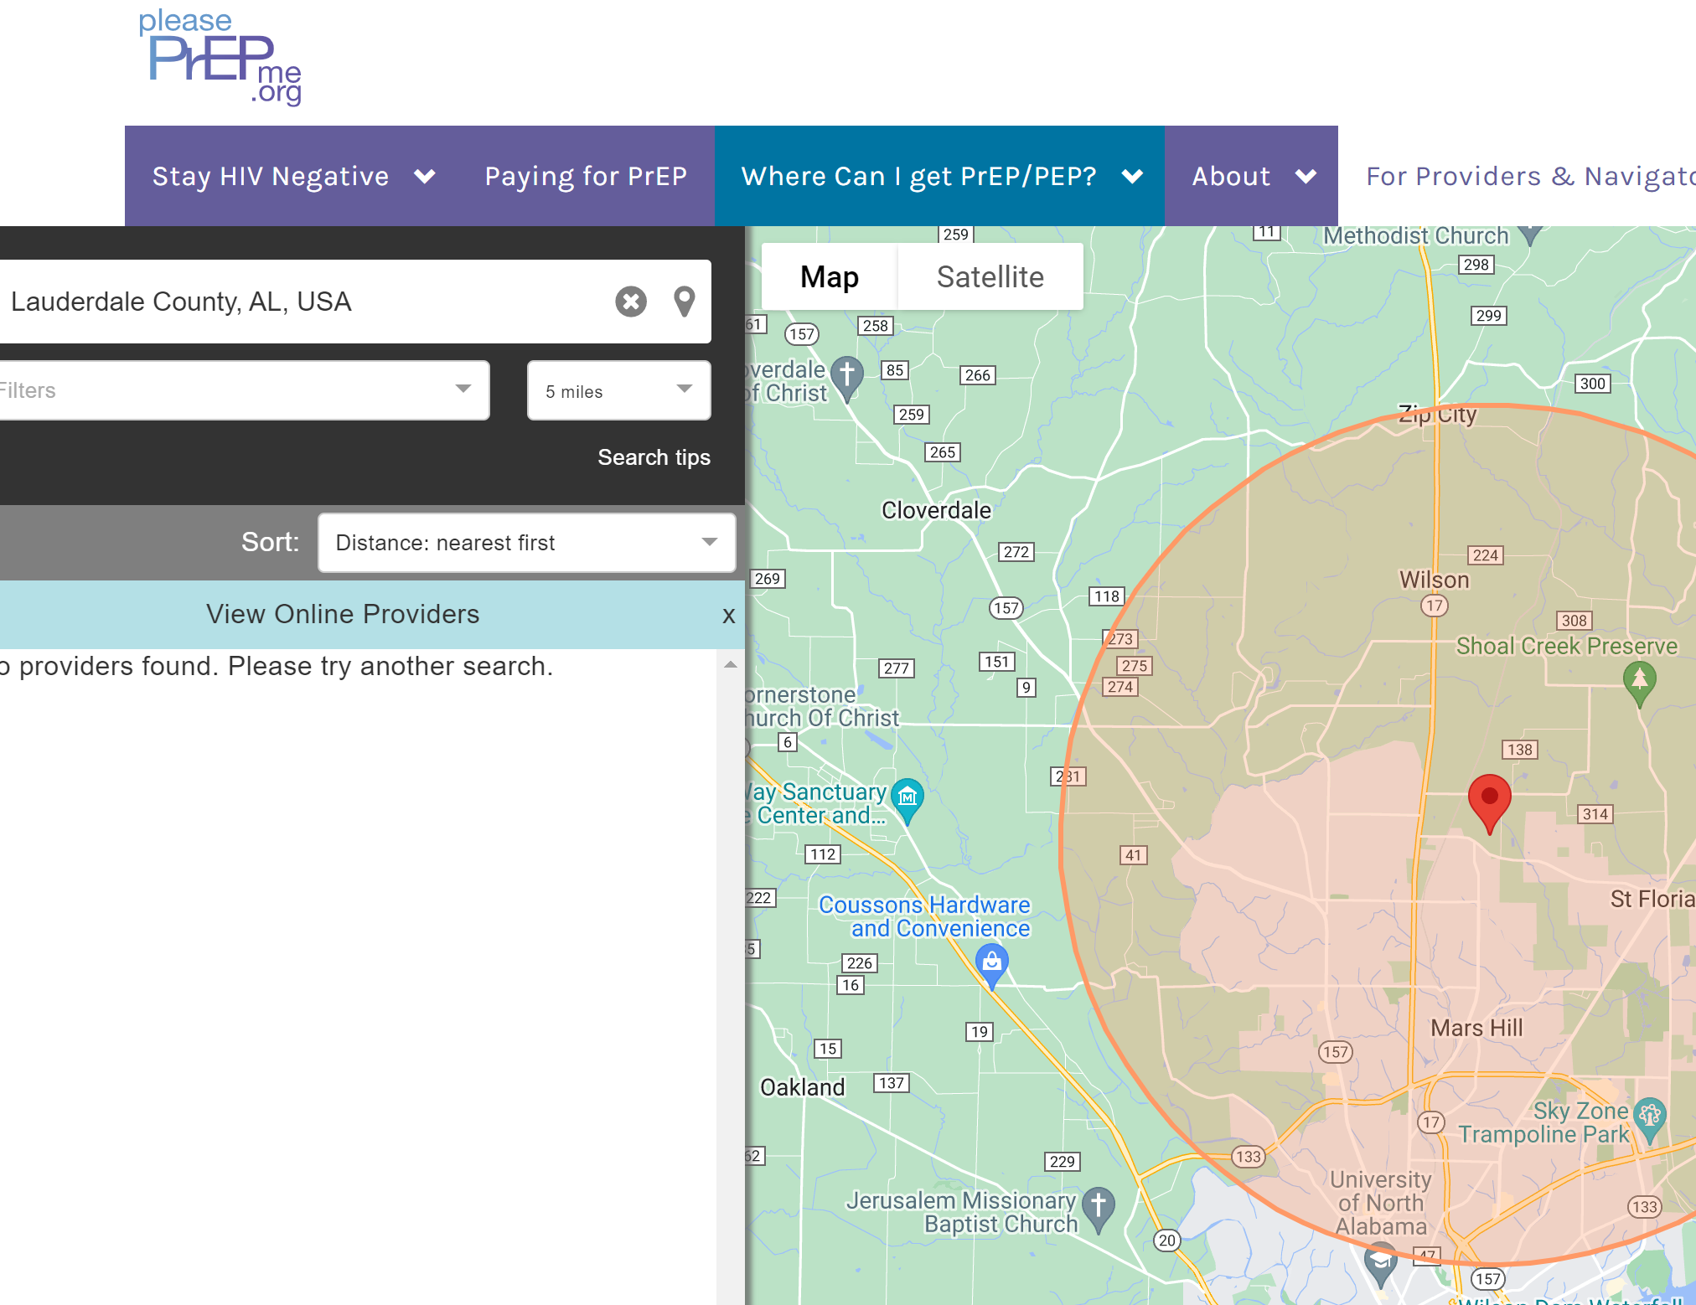
PrEP Deserts

Slide 25
Potential Ways Forward

Slide 26
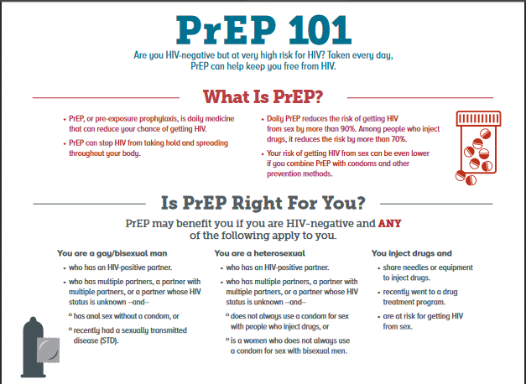
PrEP Messaging
PrEP Messaging that Targets Sexual Pleasure
Systematic Review
16 studies (quant/qual/mixed methods)
PrEP as increasing intimacy
PrEP as increasing sexual options
PrEP as removing barriers to physical closeness
PrEP as reducing sexual anxiety and fears
Dangerfield et al. Archives of Sexual Health. 2021.
Curley et al. The Journal of Sex Research. 2022.
Notes:
This study used latent class analysis to identify HIV risk and PrEP initiation patterns among BSMM in the HPTN 073 Study (n = 226) FOUND THAT PREP USERS WERE MORE LIKELY TO BE IN SERODISCORDANT RELATIONSHIPS. Single, Condomless Partners had the highest conditional probabilities of having greater than three male partners, substance use before sex, and receiving an STI diagnosis. BSMM who initiated PrEP were less likely to be classified as Single, Condomless Partners than Serodiscordant Partners (AOR = 0.07, 95% CI = 0.02, 0.66). PrEP
This systematic review synthesizes the findings and themes from 16 quantitative, qualitative, and mixed methods studies examining PrEP motivations and outcomes focused on sexual satisfaction, sexual pleasure, sexual quality, and sexual intimacy.
PrEP increasing intimacy
Partnered individuals
Increasing sexual options
Liberating, alleviating fear
Removing barriers to physical closeness
Literally removing the need for condoms
Sexual anxiety and fear
Inhiviting the sexual experience
STUDIES ARE NOT FOR ALL POPULATIONS AND WE REALLY NEED THAT!!!!!!!!!!

Slide 27
HIV and HIV Prevention Care is Just One Aspect of Your Overall Wellbeing
Mental Health
Relationships
Sexual Health and Pleasure
Mental Health Wellness
Life Goals and Barriers
HIV Care
Age-Related Changes
https://www.istockphoto.com/vector/love-yourself-vector-illustration-smiling-woman-hug-herself-body-care-design-gm1168922578-322927119

Slide 28
Building a Care Team to Support You
Peer Support Groups
Social Workers
Community-based Organizations
Case Managers
Spiritual or Faith-based Support
Patient Advocates/Peer Navigators
Dietician
Family and Friends
Other Specialists
You
Primary Care Provider
Mental Health Professional
Pharmacist
HIV Provider
You get to decide what is best for you
HIV.gov. Types of Providers. https://www.hiv.gov/hiv-basics/starting-hiv-care/find-a-provider/types-of-providers. Accessed 6/10/22.
Notes:
Dawn Smith (Telehealth) Review
1114 articles identified, 10 studies were eligible. Forty percent (40%) of studies focused on Black or Hispanic/Latino persons and 80% addressed social and structural barriers related to PrEP use such as navigation or access to PrEP. Mobile health designs were more commonly used (50%) compared to telehealth (30%) and e-health (20%) designs. There is a need to increase the development of telecommunications interventions that address the needs of Black and Hispanic/Latino persons often chal
Emphasize how important having a social worker who is aware and can navigate the landscape of billing/insurance claims/and patient assistance programs is so important!!!!
Dear Contracted PrEP Prescribers and Stakeholders,
We are disappointed and sad to notify you that effective December 1, 2022, and until further notice, the Pre-Exposure Prophylaxis Drug Assistance Program (PrEP DAP) will no longer be available. We are examining ways we can support existing clients through this transition.
Patients who receive financial support from PrEP DAP to pay for clinical services and PrEP will be notified about these program changes and will be directed to a HIV Prevention Navigation Organization for assistance.
lenged with uptake and adherent use of PrEP.

Slide 29
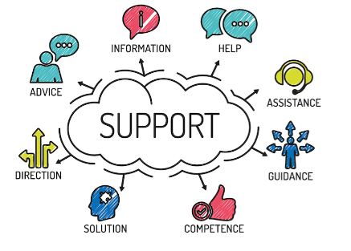
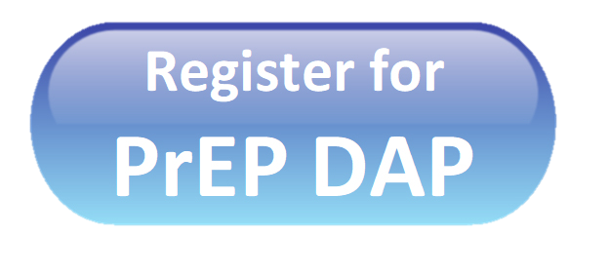
Models of PrEP Care
Service Model Examples
No or low cost for PrEP services | Florida* Washington State San Francisco NYC
Decentralized services | eHealth and Telehealth^{a,b} Mobile health clinics^{b} At-Home^{c} Pharmacy-based PrEP^{b}
Patient-centered | PCPs/Family Clinics^{d,e} Substance Use Facilities
d. Moore et al. J Prim Care Community Health. 2020
e. Sales et al. J Acquir Immune Defic Syndr. 2020
a. Evans et al. AIDS and Behavior 2022.
b. Roussequ et al. Current HIV/AIDS Reports. 2021
c. Siegler et al. AIDS and Behavior 2022

Slide 30
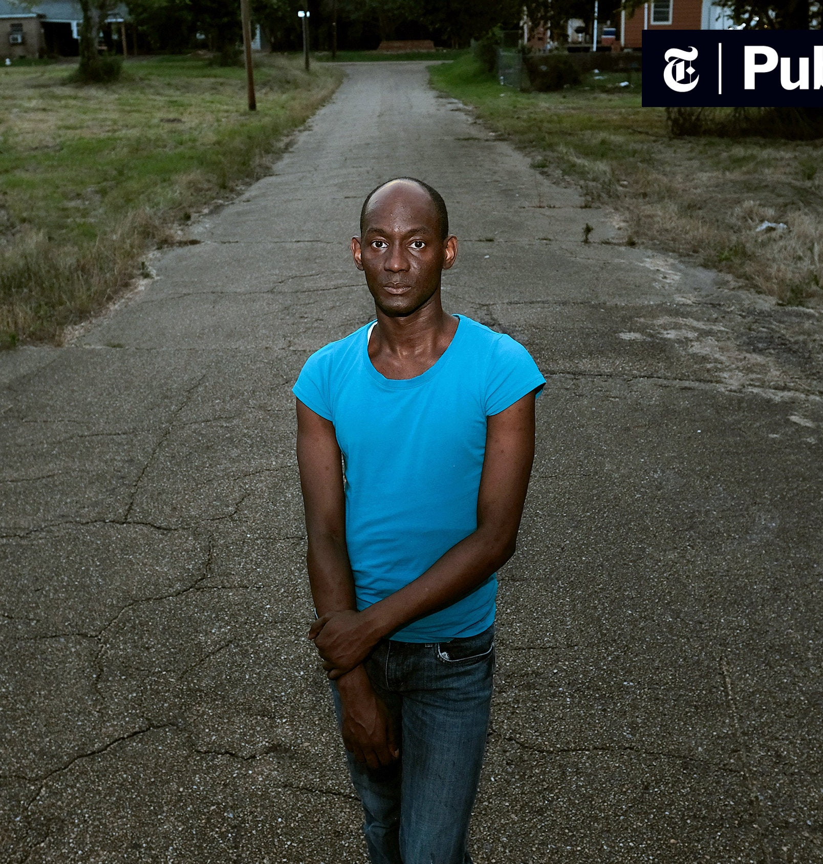
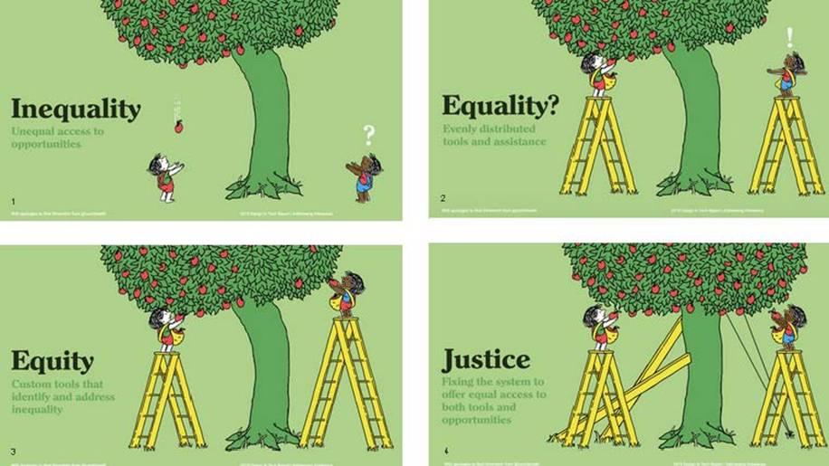
Ending the Epidemic
Notes:
Dare to Hope, because if we do not hope than change will never happen

