Slide 1
HIV PrEP Medications: Mechanism of Action
David H. Spach, MD
Professor of Medicine
Division of Allergy and Infectious Diseases
University of Washington
Last Updated: January 4, 2024

Slide 2
HIV PrEP Medications
Tenofovir disoproxil fumarate-emtricitabine (TDF-FTC)
Tenofovir alafenamide-emtricitabine (TAF-FTC)
Long-acting injectable cabotegravir (CAB-LA)

Slide 3
HIV PrEP Medications
Prodrugs
Drug Form
Tenofovir disoproxil fumarate
Tenofovir
Tenofovir alafenamide

Slide 4
HIV Life Cycle
HIV
HIV

Slide 5
HIV Life Cycle
HIV
8
Budding & Maturation
1
Entry
HIV
Host Cell
7
Assembly
4
Integration
3
Reverse Transcription
2
Cytoplasmic Transport & Nuclear Import
5
6
Transcription
Translation

Slide 6
HIV Life Cycle
HIV
HIV
Integration
Reverse Transcription

Slide 7
HIV Life Cycle: Sites of Action for HIV PrEP Medications
HIV
HIV
Integration
Reverse Transcription
Integrase Strand Transfer Inhibitors INSTIs
Nucleoside Reverse Transcriptase Inhibitors NRTIs

Slide 8
Mechanism of Action of HIV PrEP Medications
Nucleoside Reverse Transcriptase Inhibitors (NRTIs)
Tenofovir
Emtricitabine
Integrase Strand Transfer Inhibitor (INSTI)
Cabotegravir

Slide 9
HIV Reverse Transcription
HIV
HIV
Reverse Transcription
NRTIs Tenofovir / Emtricitabine

Slide 10
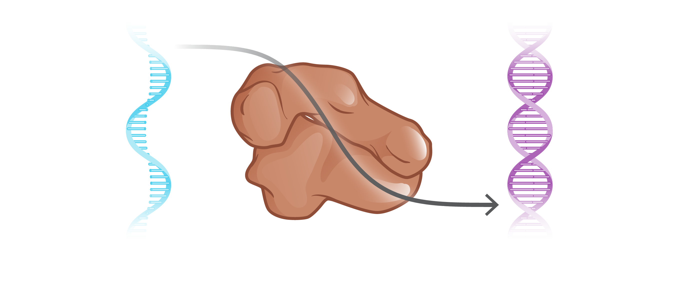
HIV Reverse Transcription
HIV Reverse Transcriptase
HIV RNA
HIV DNA
Illustration: Cognition Studio, Inc. and David H. Spach, MD

Slide 11
HIV Reverse Transcription
Intracellular Pool of Nucleotides
HIV Reverse Transcriptase
HIV RNA
HIV DNA
Illustration: Cognition Studio, Inc. and David H. Spach, MD

Slide 12
HIV Reverse Transcription
Host Cell Nucleotides
HIV RNA Template
Reverse Transcriptase
Host cell
Illustration: David H. Spach, MD

Slide 13
HIV Reverse Transcription
Host Cell Nucleotides
HIV RNA Template
Reverse Transcriptase
Host cell
Illustration: David H. Spach, MD

Slide 14
HIV Reverse Transcription
Host Cell Nucleotides
HIV RNA Template
Reverse Transcriptase
Host cell
Illustration: David H. Spach, MD

Slide 15
HIV Reverse Transcription
Host Cell Nucleotides
HIV DNA
Reverse Transcriptase
Host cell
Host cell
Illustration: Cognition Studio, Inc. and David H. Spach, MD

Slide 16
Nucleoside Reverse Transcriptase Inhibitors (NRTIs)
HIV
Reverse Transcription
X
NRTIs Tenofovir / Emtricitabine

Slide 17
Tenofovir and Emtricitabine: Mechanism of Action
HIV RNA
HIV DNA
Tenofovir Emtricitabine
Illustration: Cognition Studio, Inc. and David H. Spach, MD

Slide 18
Tenofovir and Emtricitabine: Mechanism of Action
Emtricitabine
Tenofovir
Host Cell Nucleotides
HIV RNA Template
Reverse Transcriptase
Host cell
Illustration: David H. Spach, MD

Slide 19
Tenofovir and Emtricitabine: Mechanism of Action
Emtricitabine
Tenofovir
Host Cell Nucleotides
HIV RNA Template
Reverse Transcriptase
Host cell
Illustration: David H. Spach, MD

Slide 20
Tenofovir and Emtricitabine: Mechanism of Action
Emtricitabine
Tenofovir
Host Cell Nucleotides
HIV RNA Template
Reverse Transcriptase
Host cell
Illustration: David H. Spach, MD

Slide 21
Tenofovir and Emtricitabine: Mechanism of Action
Emtricitabine
Tenofovir
Host Cell Nucleotides
Chain Termination
HIV RNA Template
Reverse Transcriptase
Host cell
Illustration: David H. Spach, MD

Slide 22
HIV Integration
HIV
Integration
INSTIs Cabotegravir

Slide 23
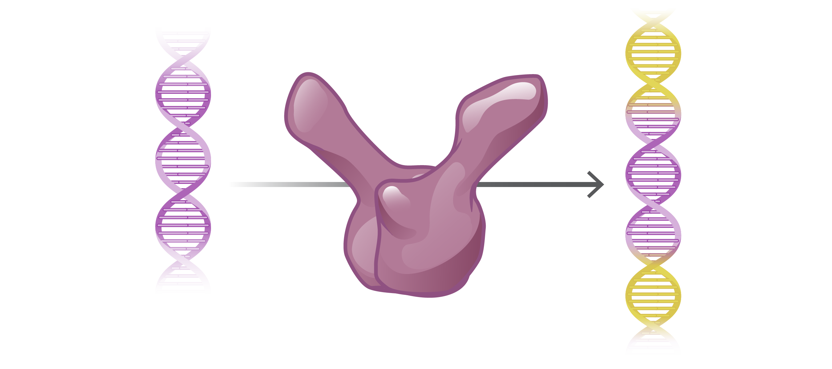
HIV Integration
HIV DNA
HIV DNA Integrated Into Human DNA
HIV Integrase
Illustration: David H. Spach, MD and Cognition Studio, Inc.

Slide 24
HIV Integration
HIV Integrase Monomers
Illustration: David H. Spach, MD and Cognition Studio, Inc.

Slide 25
HIV Integration
HIV Integrase Dimer
Illustration: David H. Spach, MD and Cognition Studio, Inc.

Slide 26
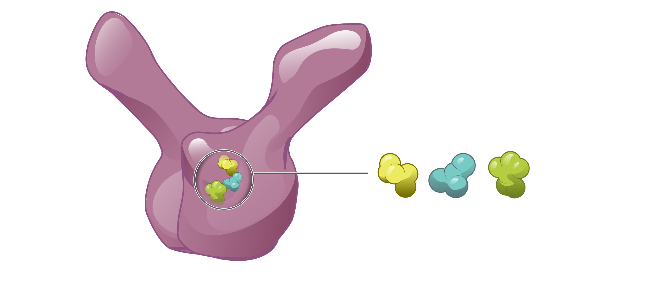
HIV Integration
Catalytic Core Domain
Catalytic Triad
HIV Integrase
Illustration: David H. Spach, MD and Cognition Studio, Inc.

Slide 27
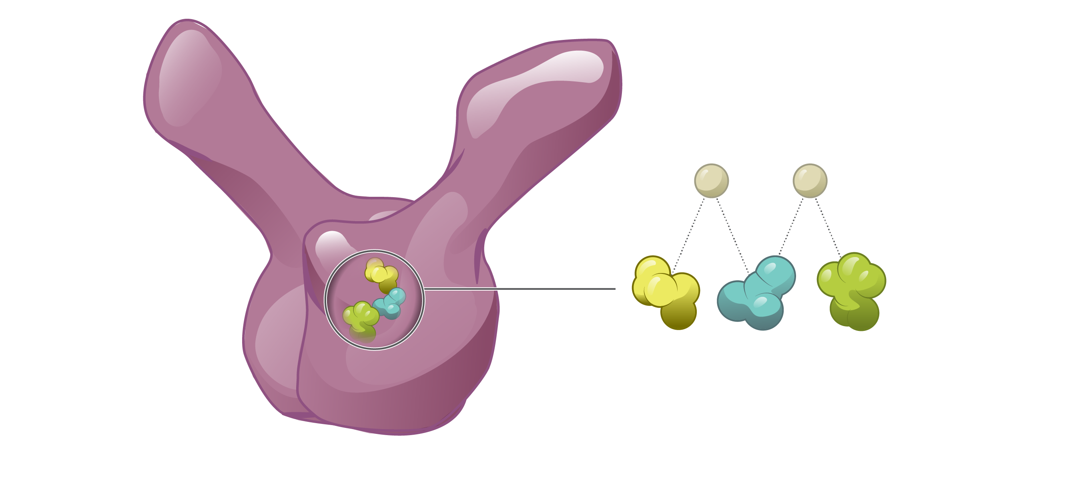
HIV Integration
Mg²⁺
Mg²⁺
Catalytic Triad
HIV Integrase
Illustration: David H. Spach, MD and Cognition Studio, Inc.

Slide 28
HIV Integration
Host DNA
HIV DNA
HIV Integrase
Illustration: David H. Spach, MD and Cognition Studio, Inc.

Slide 29
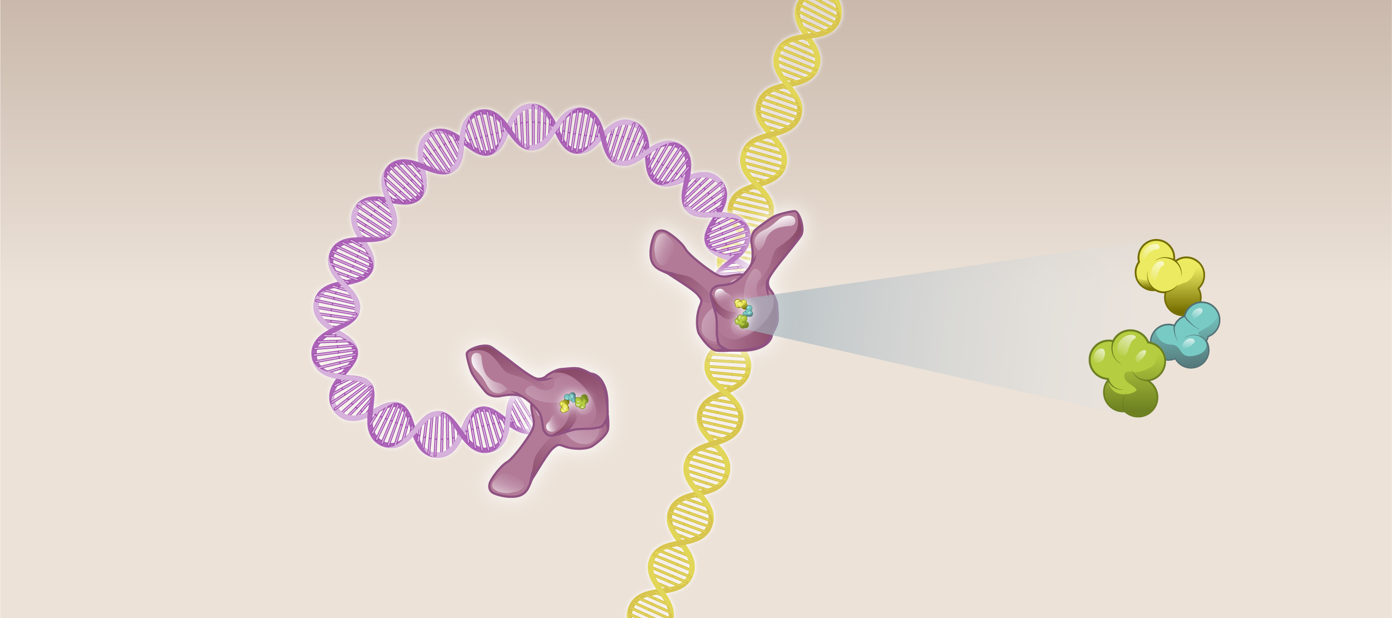
HIV Integration
Host DNA
HIV DNA
HIV Integrase
Catalytic Triad
HIV Integrase
Illustration: David H. Spach, MD and Cognition Studio, Inc.

Slide 30
HIV Integration
Host DNA
HIV DNA
HIV Integrase
Illustration: David H. Spach, MD and Cognition Studio, Inc.

Slide 31
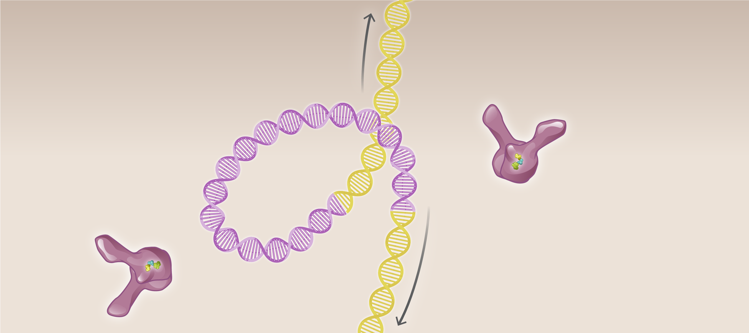
HIV Integration
Host DNA
HIV DNA
HIV Integrase
Illustration: David H. Spach, MD and Cognition Studio, Inc.

Slide 32
HIV Integration
Host DNA
HIV DNA
Host DNA

Slide 33
Integrase Strand Transfer Inhibitors (INSTIs)
HIV
Integration
X
INSTIs Cabotegravir

Slide 34
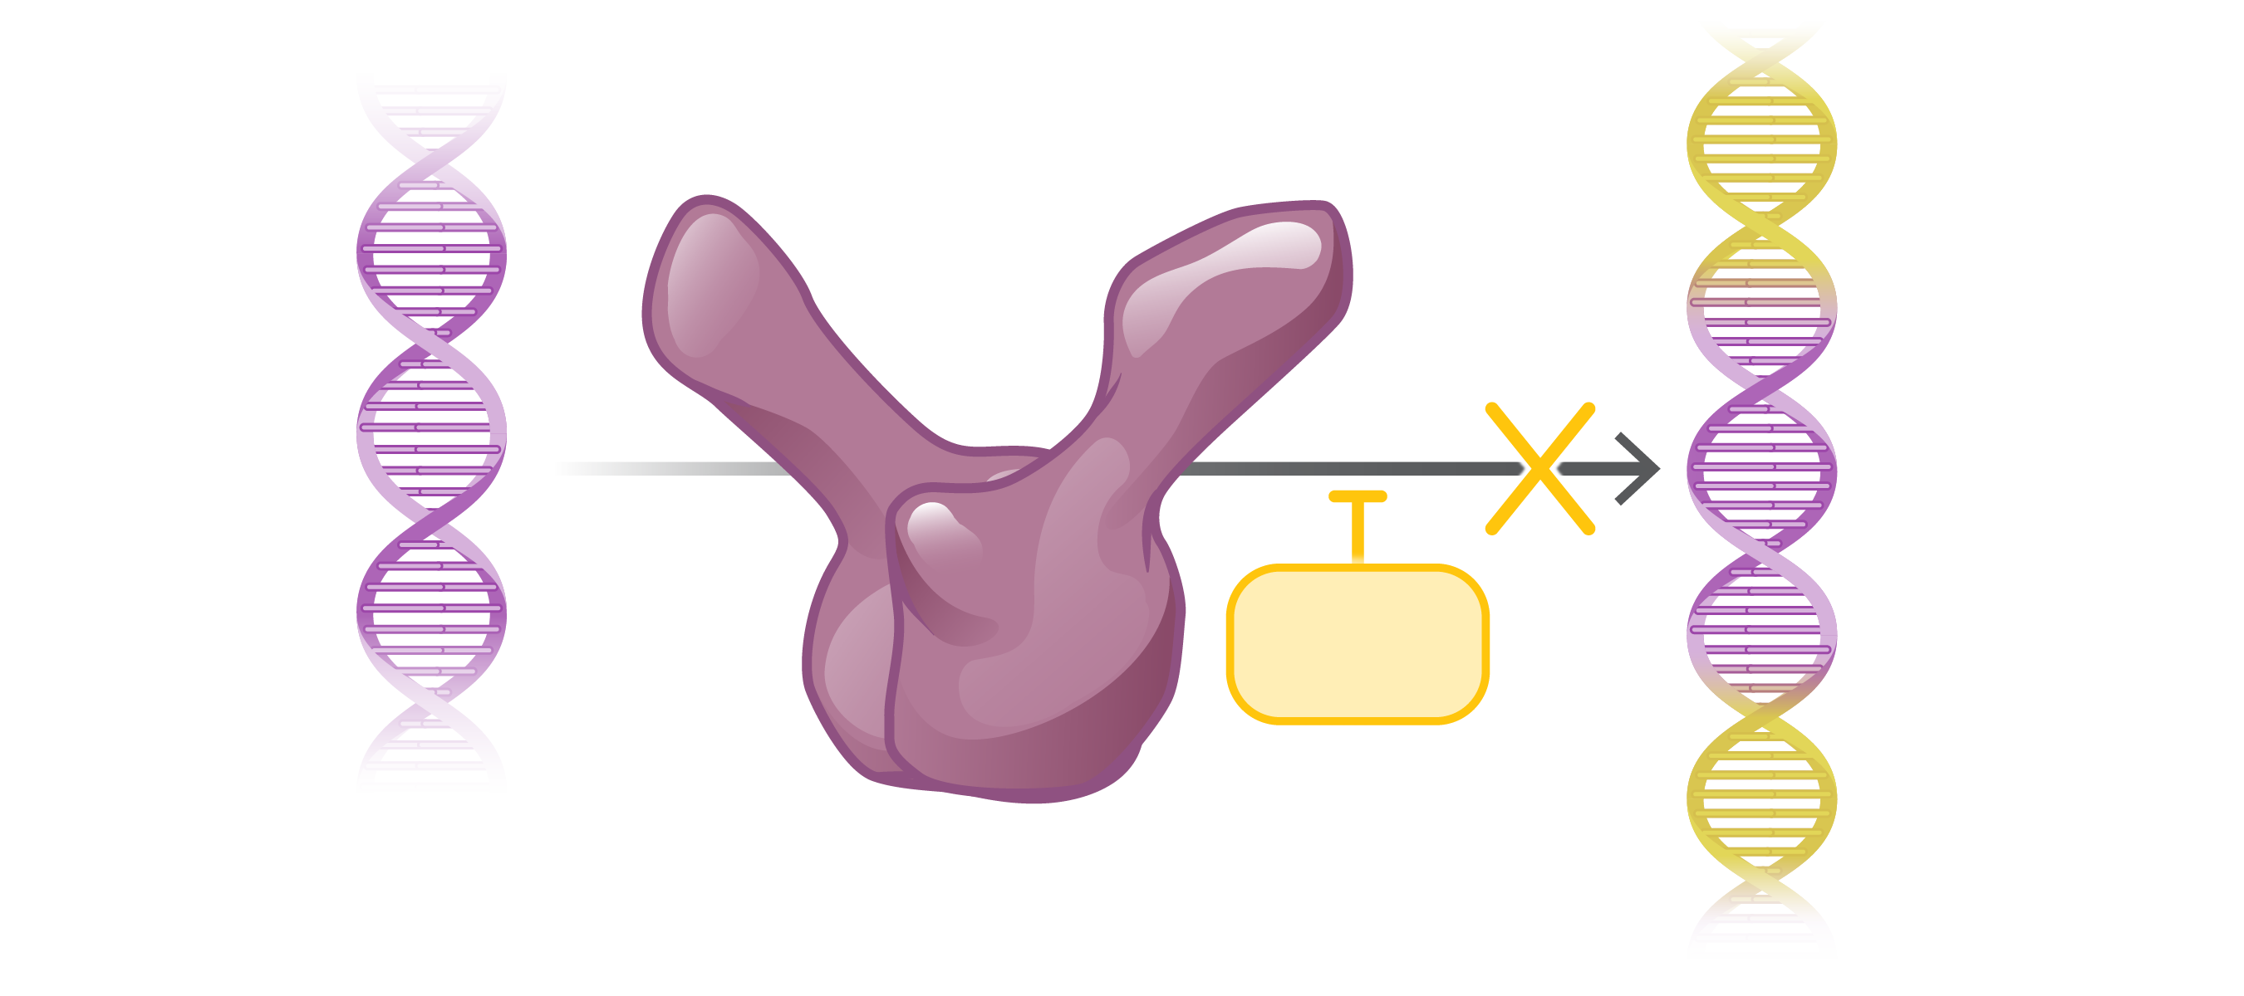
Cabotegravir: Mechanism of Action
HIV DNA
HIV DNA Integrated Into Host DNA
Cabotegravir
Cabotegravir
HIV Integrase
Illustration: David H. Spach, MD and Cognition Studio, Inc.

Slide 35
Cabotegravir: Mechanism of Action
Cabotegravir
Cabotegravir
Cabotegravir
Catalytic Core
HIV Integrase
Illustration: David H. Spach, MD and Cognition Studio, Inc.

Slide 36
Cabotegravir: Mechanism of Action
Cabotegravir
Cabotegravir
Cabotegravir
HIV Integrase
Illustration: David H. Spach, MD and Cognition Studio, Inc.

Slide 37
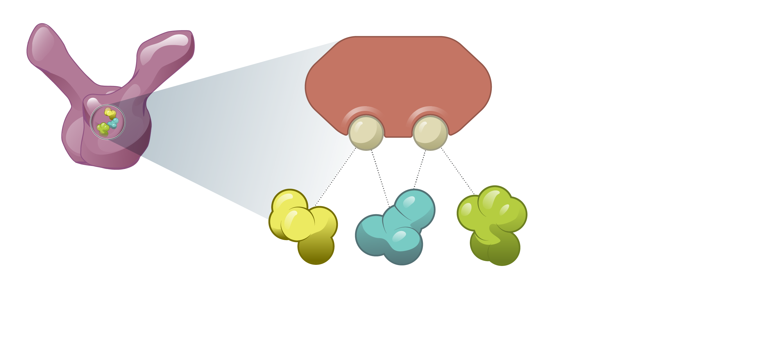
Cabotegravir: Mechanism of Action
Cabotegravir
Mg²⁺
Mg²⁺
HIV Integrase
Catalytic Triad
Illustration: David H. Spach, MD and Cognition Studio, Inc.

Slide 38
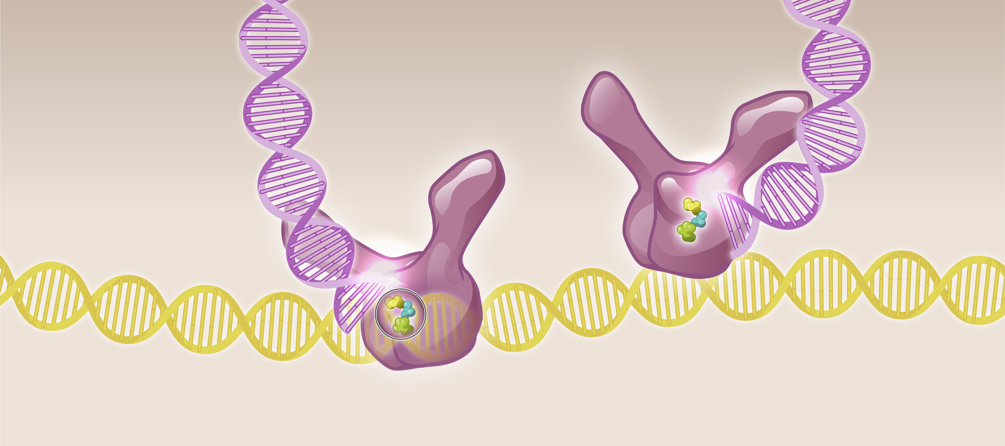
Cabotegravir: Mechanism of Action
HIV DNA
Cabotegravir
Cabotegravir
Host DNA
HIV Integrase
Illustration: David H. Spach, MD and Cognition Studio, Inc.

Slide 39
Cabotegravir: Mechanism of Action
Host DNA
HIV DNA
Cabotegravir
HIV Integrase
Cabotegravir
r
Illustration: David H. Spach, MD and Cognition Studio, Inc.

Slide 40
HIV Life Cycle: Sites of Action for HIV PrEP Medications
HIV
Integration
Reverse Transcription
INSTIs Cabotegravir
NRTIs Tenofovir / Emtricitabine

Slide 41
HIV Life Cycle: Sites of Action for HIV PrEP Medications
HIV
Integration
Reverse Transcription
X
X
INSTIs Cabotegravir
NRTIs Tenofovir / Emtricitabine

Slide 42
HIV Life Cycle: Sites of Action for HIV PrEP Medications
X
X
X
HIV
Integration
Reverse Transcription
X
X
INSTIs Cabotegravir
NRTIs Tenofovir / Emtricitabine

