Slide 1
Same Day (Rapid) Start for HIV PrEP
Sarah E. Rowan, M.D.
Denver Prevention Center Clinical Faculty
Public Health Institute at Denver Health
Associate Professor of Medicine – Infectious Disease
University of Colorado, Anschutz Medical Campus
August 29, 2023

Slide 2
No Disclosures

Slide 3
Overview
Why Consider Rapid PrEP Starts
Evidence
Key Considerations
Logistics

Slide 4
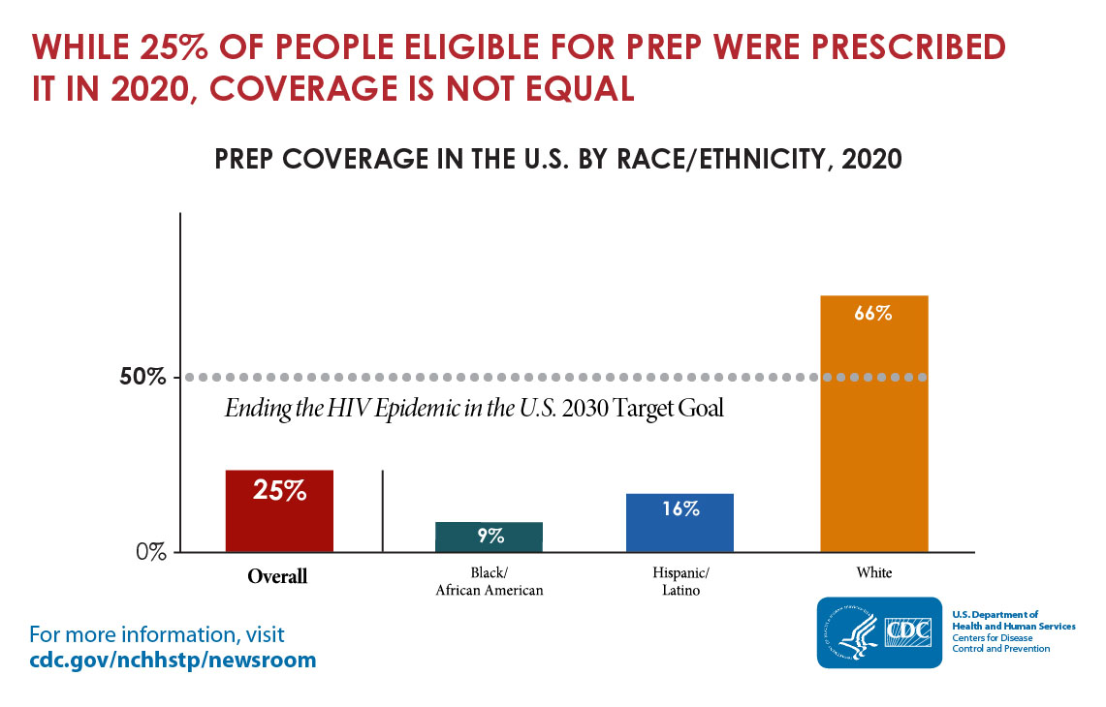
Why Same Day (Rapid) Start for PrEP?
Only 25% of the 1.2 million individuals in U.S. who could benefit from PrEP are taking it.
PrEP use overall has increased but significant inequities in PrEP use remain.
Source: https://aidsvu.org/prep-use-race-ethnicity-launch-22/

Slide 5
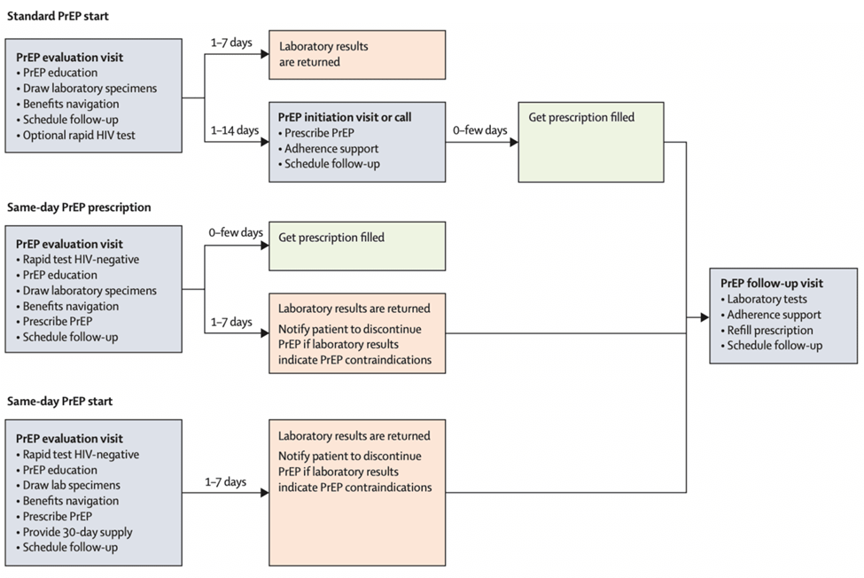
Why Same Day (Rapid) Start for PrEP?
Delays and extra steps while obtaining PrEP may lead to attrition and fewer new starts or restarts.
Rapid Start PrEP decreases barriers to uptake and increases the likelihood that someone will start PrEP.
Rapid PrEP shortens the time an individual is susceptible to HIV.
Source: Rowan SE, et al. Lancet HIV. 2021:8(2): e114-e120.
Notes:
In general, rapid HIV PrEP initiation, and more specifically same-day PrEP, is advantageous in that it can decrease barriers to PrEP uptake and can increase the likelihood that persons will start PrEP.^{[5,6]} Same-day PrEP can also decrease the chance of acquiring HIV, as it minimizes delays in PrEP initiation and promotes faster achievement of protective tenofovir levels in serum and tissues.

Slide 6
Caveats for Same-Day Start for PrEP
Not indicated yet for injectable PrEP
Not studied for 2-1-1 PrEP, but likely applicable if hep B status is negative

Slide 7
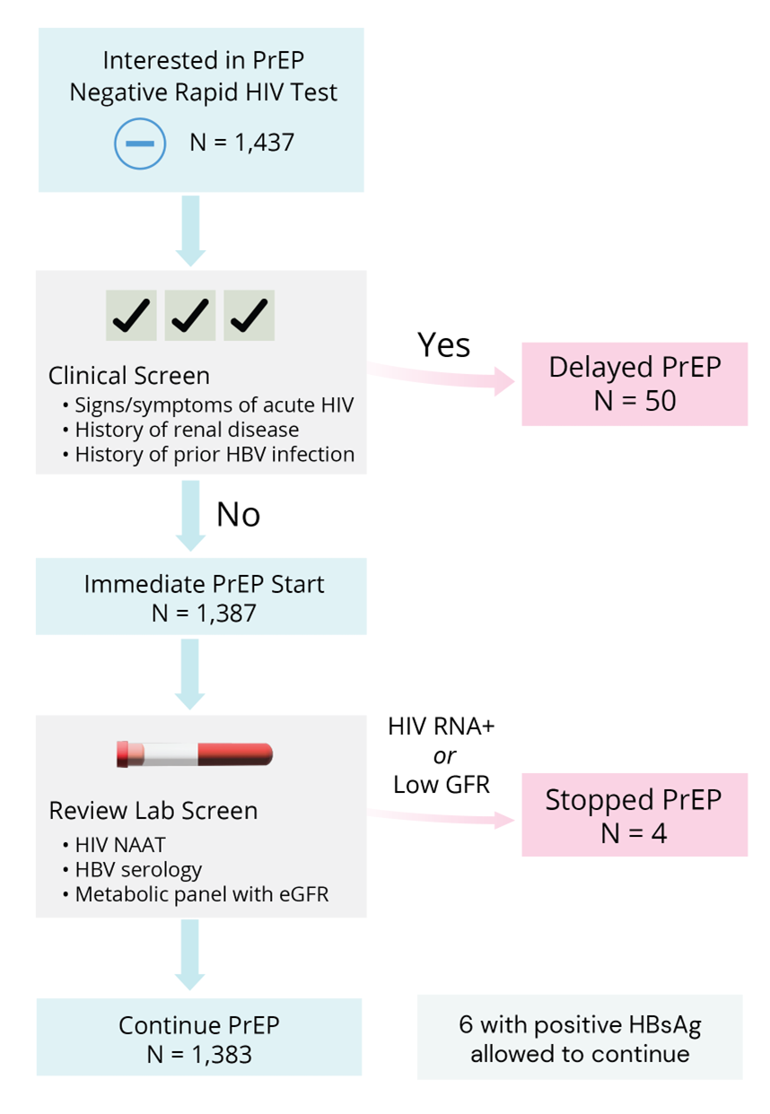
New York City Experience
Individuals offered Same-Day PrEP if they had a negative rapid HIV test and did not meet any criteria for Delayed PrEP.
Only 4 of 1,387 individuals who received Same-Day PrEP were advised to stop PrEP due to a positive HIV test or low GFR.
Among the individuals assigned to delayed PrEP, only 35% of those without medical contraindications (15 individuals) started PrEP within 60 days of the initial visit.
Source: Mikati T, et al. Program and abstracts of CROI; March 2019; Seattle, WA. Abstract 962.

Slide 8
Denver Experience
Individuals with indications for PrEP who received care in the Denver Sexual Health Clinic were offered a 30-day PrEP starter pack if no contraindications to same-day PrEP were identified.
57% of those who started Same-Day PrEP attended at least 2 PrEP follow-up visits.
76%
78%
74%
Source: Kamis KF, et al. Open Forum Infect Dis. 2019;6(7)

Slide 9
Other Sites with Same Day PrEP models
Number and Percentage of Patients Retained along Steps of the Same-Day PrEP Continuum at a community HIV testing venue with an on-site pharmacy
Washington University in St. Louis – adult infectious diseases clinic
Howard Brown Health Centers – network of FQHCs in Chicago, IL
Jackson, MS – pharmacy-led program at an HIV testing site
Seattle & King County Public Health Sexual Health Clinic
100%
77%
43%
Rowan SE, et al. Lancet HIV. 2021:8(2): e114-e120.
Khosropour CM, et al. AIDS Patient Care STDS. 2020:34: 1-6
Ramchandani MS, et al. J Acquir Immune Defic Syndr. 2022:90: 530-7

Slide 10
Definitions
Standard HIV PrEP: When a person is evaluated and an HIV PrEP prescription is provided after laboratory results have returned, typically within 7 days of initial visit.
Same-day HIV PrEP Prescription: When HIV PrEP is prescribed the same day of the initial visit, but the person does not start PrEP medications until the initial HIV test results have returned.
Same-day HIV PrEP Start: When HIV PrEP is prescribed the same day of the initial visit and the person initiates PrEP that day, either by picking up the medication at a pharmacy or through a clinic-dispensed starter-pack.

Slide 11
Requirements
Point-of-care HIV testing*
Ability to draw blood for creatinine, HIV, & hepatitis B
Ability to write prescription
Plan for referral to ongoing PrEP care
Support for enrollment in payment assistance programs
*not necessary if negative HIV test in the prior 7 days; oral swabs not acceptable for Same-Day PrEP starts
Notes:
may need partnership with pharmacy or patient navigator to support enrollment in cost assistance programs and insurance

Slide 12
Optional/Preferred Elements
Ability to screen for STIs and hepatitis serologies
Chlamydia
Gonorrhea
Syphilis
Hep C antibodies and RNA
Hep B antibodies
Ability to prescribe Post-Exposure Prophylaxis if indicated

Slide 13
Contraindications to Same Day PrEP
Acute HIV symptoms
History of renal disease
Inability to get blood drawn that day
(unless recent labs available)
No contact info for follow-up
No mechanism for coverage of PrEP prescriptions
Caution
History of Hep B (stopping PrEP could lead to Hep B flare)
Risk factors for renal disease

Slide 14
Possible Settings
Community Health Centers
Sexual Health Clinics
Syringe Service Providers
Pharmacies
Others

Slide 15
Tests for Same Day PrEP
Tests required prior to prescribing Same Day PrEP
Rapid HIV (ideally 4th generation)
Urine pregnancy (if needed)
Tests to be ordered and drawn (but not resulted) prior to prescribing PrEP
Lab-based 4th generation HIV test
Creatinine
Hep B surface antigen
HIV-1 RNA assay if any of the following
Patient has taken oral PrEP or PEP in past 3 months
Patient has received cabotegravir injection in past 12 months
Patient has symptoms that suggest acute HIV
Optional additional tests
Syphilis, GC/CT (all relevant sites)
Hepatitis B and C serologies

Slide 16
Logistical Considerations
Dispense 30-90 pills
Follow up in 4-6 weeks, in person or remote

