Slide 1
Toxoplasma Encephalitis: Prevention
Aley Kalapila, MD, PhD Associate Editor, National HIV Curriculum Associate Professor of Medicine Division of Infectious Diseases
Emory University School of Medicine & Grady Health System
Last Updated: January 9, 2023

Slide 2
Dr. Kalapila has no financial conflicts of interest or disclosures.

Slide 3
Toxoplasma Prevention: Outline
Background and Rationale
Screening
Prevention
Criteria for starting and stopping prophylaxis
Prophylaxis options
Medication side-effects
Summary

Slide 4
Background and Rationale

Slide 5
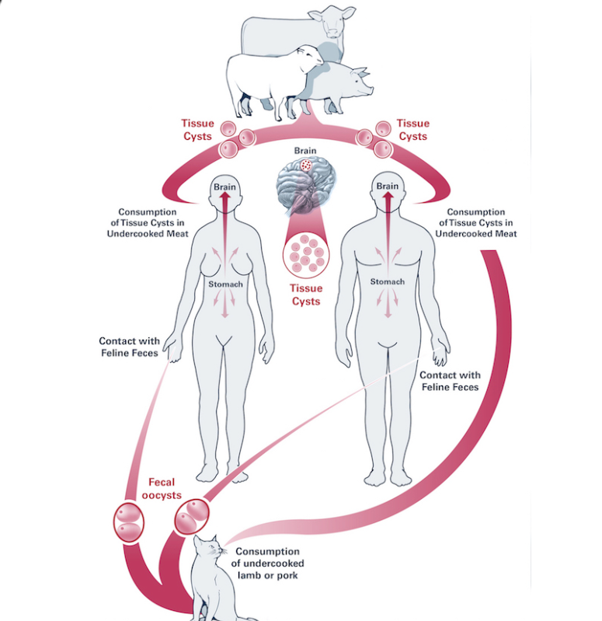
Background: Toxoplasma encephalitis
Toxoplasma gondii is a protozoal parasite
Accidental ingestion risk factors include contact with cat feces or eating undercooked red meat or raw shellfish
Disease occurs from reactivation of latent cysts when CD4 <100 cells/mm³
Symptoms include fever, headache, seizures, encephalitis
Source: HHS. Opportunistic Infections Guidelines. Toxoplasma Gondii. January 2023.

Slide 6
Screening

Slide 7
Screening for Latent Toxoplasma Infection in People with HIV
All PWH should be tested for IgG antibodies to T. gondii at the time of initial diagnosis
PWH who are seronegative for T. gondii Ab, should undergo repeat testing:
IF their CD4 count decreases to <100 cells/mm³ AND
They are not already taking medication that provides prophylaxis for Toxoplasma encephalitis

Slide 8
Counseling Persons with Negative Toxoplasma IgG: Dos & Don’ts
Don’t change cat litter box Don’t eat undercooked meat or raw shellfish
Don’t consume unpasteurized dairy products
Do wear gloves if you have to change cat litter and wash hands thoroughly after Do wash raw fruits and vegetables well before eating them
Do wear gloves and wash hands after handling soil

Slide 9
Prevention

Slide 10
Indications for Primary Prophylaxis for Toxoplasma Encephalitis
Seropositive for Toxoplasma IgG
and
CD4 cell count < 100 cells/mm³
Source: HHS. Opportunistic Infections Guidelines. Toxoplasma Gondii encephalitis. January 2023.

Slide 11
Toxoplasma Prevention: Options for Prophylaxis
Trimethoprim-sulfamethoxazole
(preferred) 1 double-strength tab daily
1 double strength tablet 3 times per week also effective
Dapsone
Atovaquone
Check G6PD level, expensive regimen due to cost of pyrimethamine
50 mg po daily + (Pyrimethamine 50 mg + leucovorin 25 mg) po weekly
Liquid; bad taste; expensive
1 single strength tablet daily effective & may be better tolerated
200 mg po daily + (Pyrimethamine 75 mg + leucovorin 25 mg) po weekly)
1500 mg po daily +/- (Pyrimethamine 25 mg + leucovorin 10 mg) po daily
Source: HHS. Opportunistic Infections Guidelines. Pneumocystis pneumonia. January 2023.

Slide 12
When to Discontinue Primary Prophylaxis for Toxoplasma Encephalitis
CD4 cell count >200 cells/mm³ for at least 3 months after ART initiation
Can consider if CD4 between 100-200 cells/mm³ + viral suppression on ART for at least 3-6 months
Source: HHS. Opportunistic Infections Guidelines. Toxoplasma Gondii Encephalitis. January 2023.

Slide 13
When to Restart Primary Prophylaxis for Toxoplasma Encephalitis
CD4 cell count < 100 cells/mm³ regardless of viral load or
CD4 is between 100-200 cells/mm³ + detectable viral load
Source: HHS. Opportunistic Infections Guidelines. Pneumocystis pneumonia. January 2023.

Slide 14
Medication Side-Effects

Slide 15
Side effects of medications used for Toxoplasma prophylaxis
Medication | Potential common side effects
TMP-SMX | Renal dysfunction Hyperkalemia Leukopenia Steven Johnson syndrome Rash Hepatitis
Dapsone | Hemolytic anemia (if used in PWH with G6PD deficiency) Methemoglobinemia Contains sulfonamide*
Atovaquone | Bad taste
Pyrimethamine | Expensive Nausea & vomiting Bone marrow suppression (if not co-administered with leucovorin)
*Potential cross-reactivity with other sulfa-containing drugs, but dapsone not contraindicated in patients with sulfonamide allergy

Slide 16
Summary

Slide 17
Toxoplasma Prophylaxis: Summary
Prophylaxis indicated in all PWH with CD4 <100 cells/mm³ who are Toxoplasma IgG seropositive
The preferred drug for prophylaxis is TMP-SMX
Alternative therapies include:
Dapsone + pyrimethamine and leucovorin OR
Atovaquone +/- pyrimethamine and leucovorin
Always check G6PD level prior to dapsone use
Use of dapsone in someone intolerant of TMP-SMX depends on severity of TMP-SMX reaction
Prophylaxis can be discontinued once immune reconstitution has occurred on ART
Source: HHS. Opportunistic Infections Guidelines. Toxoplasma Gondii encephalitis. January 2023.

