Slide 1
Treatment of Toxoplasma Encephalitis
Aley Kalapila, MD, PhD Associate Editor, National HIV Curriculum Associate Professor of Medicine Division of Infectious Diseases
Emory University School of Medicine & Grady Health System
Last Updated: January 22, 2024

Slide 2
Dr. Kalapila has no financial conflicts of interest or disclosures.

Slide 3
Treatment of Toxoplasma Encephalitis (TE): Outline
Background
Clinical Manifestations & Diagnosis
Treatment
Medication Side Effects
Summary

Slide 4
Background

Slide 5
Background: Toxoplasma Encephalitis
Etiologic agent is Toxoplasma gondii, a protozoal parasite
Disease in PWH occurs from reactivation of latent organisms when CD4 <100 cells/mm³
Typical clinical presentation is focal encephalitis
Atypical manifestations include retinitis, pneumonitis, and disseminated disease
Rates of disease have decreased with wider use of ART and TMP-SMX for prophylaxis
Source: HHS. Opportunistic Infections Guidelines. Toxoplasma Gondii. January 2023.

Slide 6
Clinical Manifestations and Diagnosis

Slide 7
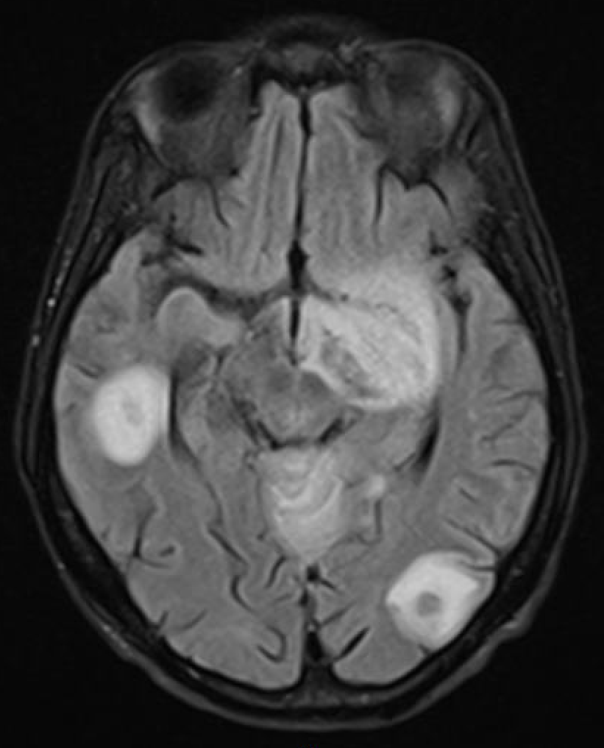
Clinical Manifestations of Toxoplasma Encephalitis
Common symptoms include fever, headache, seizures, encephalitis
Extracerebral disease is less common
CT / MRI of brain shows ring enhancing lesions in brain parenchyma
MRI (with contrast) is more sensitive than CT
MRI should be obtained in patients with equivocal or negative brain CT
Brain MRI
Source: HHS. Opportunistic Infections Guidelines. Toxoplasma Gondii encephalitis. January 2023.

Slide 8
Diagnosis of Toxoplasma Encephalitis
Presumptive diagnosis is made based on presentation, symptoms, CT/MRI brain imaging, and positive serum Toxoplasma Ab
Initial work up should include head imaging and lumbar puncture (if feasible), with CSF studies including T. gondii PCR and other relevant infectious work up
T. gondii PCR on CSF fluid is specific but not sensitive
Gold standard for definitive diagnosis is detection of T. gondii on pathology via brain biopsy
TE diagnosis is almost always presumptive and brain biopsy is not usually required
Source: HHS. Opportunistic Infections Guidelines. Toxoplasma Gondii encephalitis. January 2023.

Slide 9
Treatment

Slide 10
Toxoplasma Encephalitis: Acute Treatment ( > 6 weeks)
PREFERRED REGIMEN | ALTERNATIVE REGIMENS
Pyrimethamine + Sulfadiazine + Leucovorin (all PO) | TMP-SMX (IV or PO) ª or Pyrimethamine PO + Leucovorin PO + Clindamycin (IV or PO)^{bc} or Atovaquone + pyrimethamine + leucovorin (all PO) or Atovaquone + sulfadiazine (all PO) or Atovaquone + pyrimethamine + leucovorin (all PO) or Atovaquone PO
NOTES: ª If pyrimethamine is not available, TMP-SMX should be used instead of pyrimethamine-sulfadiazine ^{b} Additional PCP prophylaxis agent must be added to this regimen ^{c} Preferred alternative regimen for sulfa-intolerant individuals Consider sulfa-desensitization for individuals with sulfa-allergies especially for those with severe disease Acute treatment for Toxoplasma encephalitis should be administered for at least 6 weeks, with longer duration for severe clinical or radiologic disease After completion of acute treatment, all patients should be continued on chronic maintenance therapy
Source: HHS. Opportunistic Infections Guidelines. Toxoplasma Gondii encephalitis. January 2023.

Slide 11
Toxoplasma Encephalitis: Treatment Algorithm
Clinical symptoms, imaging on CT/MRI, Positive serum Toxo IgG consistent with Toxoplasma Encephalitis (TE)
Initiate empiric acute treatment for TE
Evaluate for clinical and radiologic response in 14 days
If there is a response, presumptive diagnosis of TE made, continue acute treatment followed by chronic maintenance therapy
If no response, then consider brain biopsy to make a definitive diagnosis and treat accordingly

Slide 12
MRI has Enhanced Sensitivity for Detecting TE Lesions
Non-contrast Head CT At time of TE diagnosis
MRI Brain with contrast At time of TE diagnosis

Slide 13
Image of MRI brain of patient with TE at time of diagnosis and after 2 week TE treatment course
MRI Brain with contrast At time of TE diagnosis
MRI Brain with contrast After 2 weeks of empiric TE treatment

Slide 14
Timing of Neurologic Response in Patients with Toxoplasma Encephalitis
Day 14
Reproduced from Luft BJ, Hafner R, Korzun AH, et al. Toxoplasmic encephalitis in patients with the acquired immunodeficiency syndrome. Members of the ACTG 077p/ANRS 009 Study Team. N Engl J Med. 1993;329:995-1000. Copyright ©1993 Massachusetts Medical Society. All rights reserved.

Slide 15
Toxoplasma Encephalitis: Chronic Maintenance Therapy (PO Regimens)
PREFERRED | ALTERNATIVE
Pyrimethamine + Sulfadiazine + Leucovorin | TMP-SMX ª or Pyrimethamine + Leucovorin + Clindamycin ^{b} or Atovaquone + pyrimethamine + leucovorin or Atovaquone + sulfadiazine or Atovaquone + pyrimethamine + leucovorin or Atovaquone
NOTES: ª If pyrimethamine is not available, TMP-SMX should be used instead of pyrimethamine-sulfadiazine ^{b} Additional PCP prophylaxis agent must be added to this regimen Discontinue chronic maintenance when patient is asymptomatic and has CD4 > 200 cells/mm³ on combination ART for > 6 months Resume secondary prophylaxis / chronic maintenance therapy when CD4 < 200 cells/mm³
Source: HHS. Opportunistic Infections Guidelines. Toxoplasma Gondii encephalitis. January 2023.

Slide 16
Discontinuation of Chronic Maintenance Therapy for TE
Successful completion of initial therapy for TE
No signs or symptoms of TE
Increase in CD4 >200 cells/mm³ for >6 months on ART
Some experts also recommend full resolution of brain lesions
Source: HHS. Opportunistic Infections Guidelines. Toxoplasma Gondii Encephalitis. January 2023.

Slide 17
When to Restart Chronic Maintenance for TE
Resume secondary prophylaxis if CD4 <200 cells/mm³
Source: HHS. Opportunistic Infections Guidelines. Pneumocystis pneumonia. January 2023.

Slide 18
When to Initiate Antiretroviral Therapy
Optimal timing is unknown
Typically within 2-3 weeks of the diagnosis of TE
IRIS with treatment of TE rare
Source: HHS. Opportunistic Infections Guidelines. Pneumocystis pneumonia. January 2023.

Slide 19
Medication Side Effects

Slide 20
Side Effects of Medications Used for TE Treatment
Medication | Potential Side Effects
TMP-SMX | Renal dysfunction, hyperkalemia, leukopenia, Steven Johnson syndrome, rash, hepatitis
Pyrimethamine | Rash, GI upset, bone marrow suppression (if leucovorin is not co-administered)
Sulfadiazine | Rash, leukopenia, crystalluria
Atovaquone | Tastes bad
Clindamycin | Diarrhea

Slide 21
Summary

Slide 22
Toxoplasma Encephalitis: Summary
TE occurs from reactivation of latent cysts when CD4 <100 cells/mm³
Acute treatment is empiric based on clinical symptoms, characteristic brain lesions on CT/MRI imaging, and positive serum Toxo IgG
Preferred acute treatment is pyrimethamine with sulfadiazine and leucovorin
Cost of pyrimethamine often makes preferred regimen less feasible, in which case TMP/SMX should be used
If no clinical improvement after 14 days, consider brain biopsy for definitive diagnosis
After acute treatment, continue with chronic maintenance therapy until the patient has immune reconstitution on ART
ART can be initiated within 2-3 weeks of TE diagnosis

