Slide 1
2022 IAS-USA HIV Treatment and Prevention Guidelines
Brian R. Wood, MD
Associate Editor, National HIV Curriculum
Associate Professor of Medicine,
Division of Allergy and Infectious Diseases University of Washington
Last Updated: November 27, 2023

Slide 2
No conflicts of interest or relationships to disclose.

Slide 3
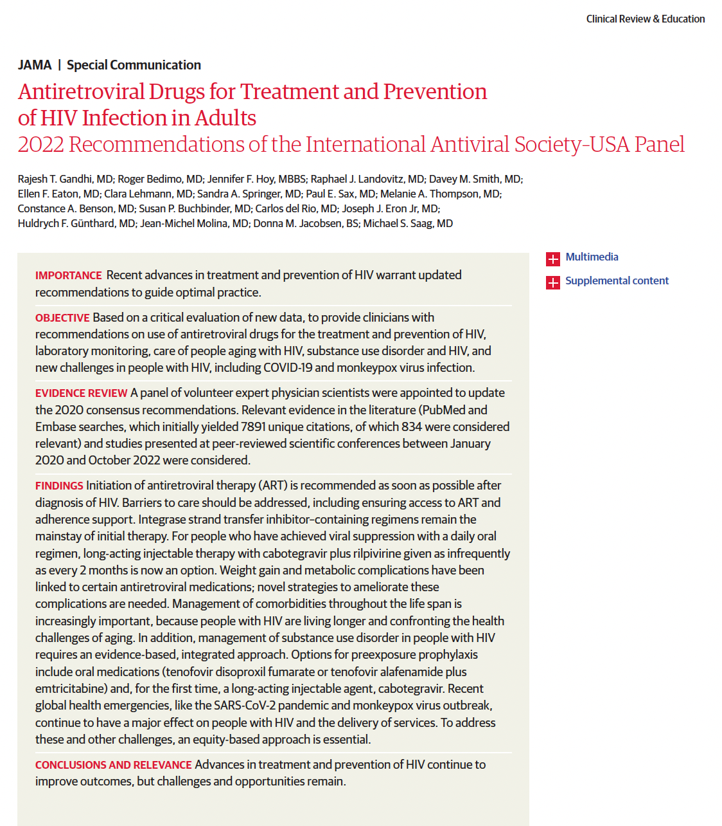
Source: Gandhi RT, et al. JAMA. 2023;329:63-84.

Slide 4
Recommendations for Timing of ART Initiation
2022 IAS-USA HIV Treatment and Prevention Guidelines
As soon as possible after diagnosis, ideally within 7 days
Includes same day as diagnosis or first visit, if no suspicion for an OI (AIII)
At time of diagnosis of acute HIV (AIIa)
If diagnosed during pregnancy, begin ART immediately (AIa)
Elite controllers: theoretical benefits, so treatment “reasonable”
Source: Gandhi RT, et al. JAMA. 2023;329:63-84.

Slide 5
Recommendations for ART Timing with an Opportunistic Infection (OI)
2022 IAS-USA HIV Treatment and Prevention Guidelines
Generally, start ART within 2 weeks of starting OI treatment
OI Scenario | Specific Considerations for ART Initiation Timing
TB without meningitis | Within 2 weeks after starting TB treatment, especially if CD4 <50 (AIa)
TB with meningitis | Within 2 weeks of starting TB treatment and corticosteroids (BIa)
Cryptococcal meningitis | 2-4 weeks after starting antifungal treatment (BIIb)
Cryptococcal antigenemia | Start ART immediately (BIII)
New cancer diagnosis | Start ART immediately, with attention to drug interactions (BIIa)
Source: Gandhi RT, et al. JAMA. 2023;329:63-84.

Slide 6
Recommended Initial Regimens for Most People with HIV
2022 IAS-USA HIV Treatment and Prevention Guidelines
Initial Regimens (Listed in Alphabetical Order)
Bictegravir/TAF/FTC (AIa)
Dolutegravir + TXF/XTC (AIa) (TXF/XTC = TAF or TDF with FTC or 3TC)
Dolutegravir/3TC (AIa) – only if HIV RNA <500,000 copies/mL and no HBV (should not be used for rapid initiation when genotype, HIV RNA, HBV serology pending)
“Although INSTIs and [TAF] have been implicated in weight gain for some individuals and preliminary data raise concern about metabolic adverse effects with INSTIs, such concerns do not override the potential benefit…(AIII).”
Source: Gandhi RT, et al. JAMA. 2023;329:63-84.

Slide 7
Recommended Initial Regimens After PrEP Exposure
2022 IAS-USA HIV Treatment and Prevention Guidelines
Acquire HIV while receiving oral PrEP (TXF/XTC)
Draw blood for genotype; ok to start DTG or BIC + TXF/XTC prior to result (AIII)
Acquire HIV after exposure to cabotegravir
Draw blood for genotype (with integrase); start boosted PI + TXF/XTC if initiate ART prior to result (AIII)
Source: Gandhi RT, et al. JAMA. 2023;329:63-84.

Slide 8
Recommended Regimens During Pregnancy
2022 IAS-USA HIV Treatment and Prevention Guidelines
Recommended ART Regimens During Pregnancy
Dolutegravir + TAF/FTC (AIa)
Dolutegravir + TDF/XTC is a suitable alternative (AIa)
If dolutegravir not an option, may replace with: Raltegravir 400 mg BID (AIIa) Atazanavir plus ritonavir (BIIa) Darunavir plus ritonavir (BIIa) Rilpivirine (BIIa)
If already taking a bictegravir or doravirine 3-drug regimen or 2-drug regimen of dolutegravir/rilpivirine or dolutegravir/3TC, ok to continue, but counsel about uncertainties and monitor HIV RNA more frequently. Avoid cobicistat-containing regimens during pregnancy (AIIb).
Source: Gandhi RT, et al. JAMA. 2023;329:63-84.

Slide 9
Other ART Regimens and Considerations
2022 IAS-USA HIV Treatment and Prevention Guidelines
Regimen | Potential Uses and Cautions
Darunavir/cobicistat/TAF/FTC | Preferred if prior CAB PrEP exposure but INSTI genotype not available
Boosted darunavir + TXF/XTC | Potential use for known or suspected multidrug resistance or INSTI resistance or if high risk of poor adherence
Doravirine/TDF/3TC or doravirine + TXF/XTC | May be useful for persons who do not tolerate INSTIs
Rilpivirine/TAF/FTC | Small pill size, but only use if current HIV RNA <100,000 and CD4 >200 cells/mm³ (and no PPI and can adhere to meal requirement)
Raltegravir + TXF/XTC | Potential use for HIV-TB coinfection or if pregnancy, pregnancy intention, or high risk of drug interactions
Source: Gandhi RT, et al. JAMA. 2023;329:63-84.

Slide 10
Switching ART Regimens
2022 IAS-USA HIV Treatment and Prevention Guidelines
Guidelines emphasize efficacy of bictegravir/TAF/FTC or dolutegravir + TXF/XTC in setting of NRTI resistance (M184V +/- K65R) if viral suppression
Switching to long-acting, injectable cabotegravir/rilpivirine:
Not recommended in setting of viremia outside of research setting
Administered by clinic staff, so requires more resources (and visits) than oral ART
With on-time injections, still small risk of treatment failure and resistance (1-2%)
Collect proviral genotype before switching if don’t have pre-ART genotype results
Source: Gandhi RT, et al. JAMA. 2023;329:63-84.

Slide 11
Virologic Failure
2022 IAS-USA HIV Treatment and Prevention Guidelines
Virologic Failure Scenario | Recommended ART Options
At least one active NRTI | Dolutegravir + TXF/XTC Bictegravir/TAF/FTC
No active NRTI | Boosted darunavir + TXF/XTC Boosted darunavir + dolutegravir +/- additional agents Alternative: dolutegravir + TXF/XTC (4% risk of emergent dolutegravir resistance)
Low-level INSTI resistance | Dolutegravir BID + 1 or preferably 2 active drugs from classes not previously used (fostemsavir, lenacapavir, maraviroc if R5-tropic, ibalizumab, enfuvirtide) +/- recycled NRTIs
High-level INSTI resistance + PI resistance | At least 2 fully active agents + recycled NRTIs
Source: Gandhi RT, et al. JAMA. 2023;329:63-84.

Slide 12
Laboratory Monitoring
2022 IAS-USA HIV Treatment and Prevention Guidelines
Lab | At HIV diagnosis/ Start of ART | During ART | At virologic failure
HIV RNA | Yes | Within 6 weeks of starting; once suppressed: every 3 months for 1 year then every 6 months | Yes
CD4 | Yes | Every 6 months until >250 cells/mm³ for 1 year, then stop | Yes
RT genotype | Yes | N/A | Yes
INSTI genotype | If partner known to have failing ART regimen that includes an INSTI, or patient received CAB for PrEP | N/A | If failing ART regimen includes an INSTI
Cryptococcal antigen test | If CD4 <100 cells/mm³ | N/A | N/A
Source: Gandhi RT, et al. JAMA. 2023;329:63-84.

Slide 13
Weight Gain and Metabolic Complications
2022 IAS-USA HIV Treatment and Prevention Guidelines
Weight gain generally occurs within first year following start of any ART
Greater weight gain associated with INSTI or TAF vs. EFV, PI, TDF
Can occur with switch to INSTI +/- TAF
More likely for individuals born female and Black or Hispanic individuals
Use of EFV or TDF associated with weight suppression
INSTIs may be associated with incident CVD, DM, hyperglycemia, HTN, MASLD; more data on long-term complications & management needed
Source: Gandhi RT, et al. JAMA. 2023;329:63-84.

Slide 14
Weight Gain and Metabolic Complications
2022 IAS-USA HIV Treatment and Prevention Guidelines
1) Counsel about possible weight gain and cardiometabolic complications when initiating or switching ART (AIII)
2) Document weight and BMI at baseline and every 6 months (AIIa)
3) Yearly diabetes screen and CVD risk score if receiving INSTI (BIII)
5) Until there are data proving benefit, switching ART because of weight gain not recommended (BIIa)
4) Lifestyle changes if gain greater than 5% body weight change (AIII)
Source: Gandhi RT, et al. JAMA. 2023;329:63-84.

Slide 15
Summary
2022 IAS-USA HIV Treatment and Prevention Guidelines
Generally preferred to start ART as soon as possible
Most PWH should start bictegravir or dolutegravir-based ART
If at least one NRTI remains active, bictegravir or dolutegravir-based options generally remain effective, especially if the viral load suppressed
With multiclass drug resistance and no NRTI options, need salvage ARV options to create an effective regimen
INSTIs, especially dolutegravir and bictegravir, may lead to greater weight gain than other classes, especially if combined with TAF; the mechanisms, predictors, and optimal management require further study
Source: Gandhi RT, et al. JAMA. 2023;329:63-84.

