Slide 1
Long-Acting, Injectable Cabotegravir-Rilpivirine
Brian R. Wood, MD Associate Editor, National HIV Curriculum Associate Professor of Medicine Division of Allergy and Infectious Diseases
University of Washington
Last Updated: January 24, 2023

Slide 2
Dr. Wood has no financial conflicts of interest or disclosures.

Slide 3
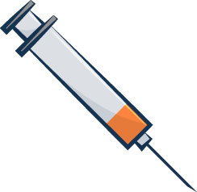
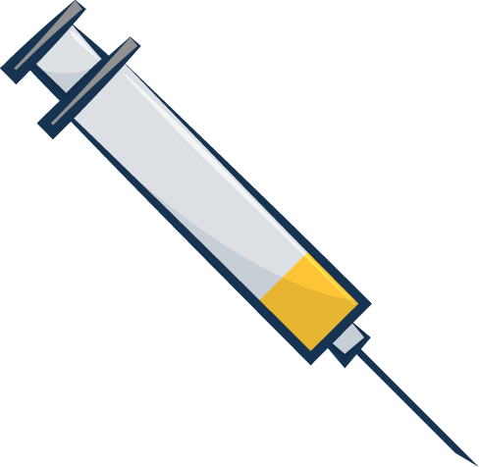
Cabotegravir and Rilpivirine Oral and Injectable Preparations
Optional Lead-In Oral Components
Intramuscular Injection Components
Cabotegravir
Rilpivirine
Rilpivirine
Cabotegravir + Rilpivirine
Cabotegravir + Rilpivirine
30 mg
25 mg
200 mg/mL
300 mg/mL
INSTI
NNRTI
INSTI
NNRTI

Slide 4
Cabotegravir and Rilpivirine Extended Release Injectable Suspension Indications
Complete regimen to treat HIV-1
For adults and adolescents (≥12 years who weigh ≥35 kg)
Replace antiretroviral regimen in persons with HIV RNA <50 copies/mL
On stable antiretroviral regimen
No history of treatment failure
No known or suspected resistance to cabotegravir or rilpivirine
Oral Lead-In
Lead-in is optional
Continuation Phase Injections
Approved for every 1-month and every 2-month injections
Doses are different with every 1-month and every 2-month injections
Injections may be given up to 7 days before or after the scheduled date
Source: Cabotegravir-Rilpivirine Prescribing Information

Slide 5
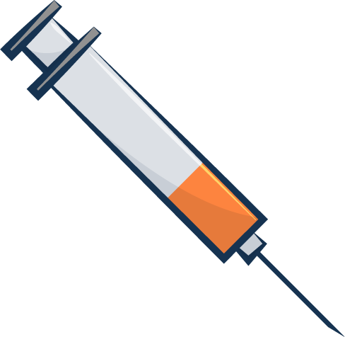
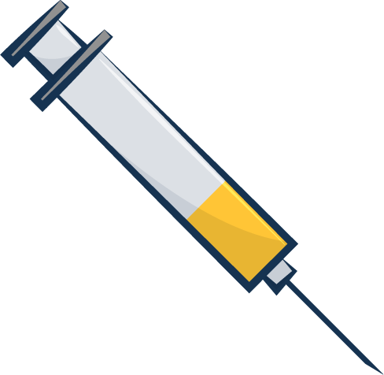
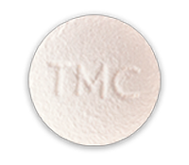
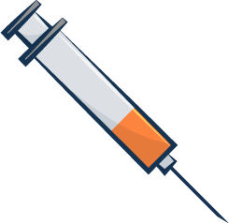
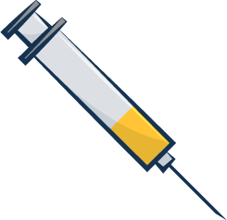
Schedule for Every 1-Month Injectable Cabotegravir and Rilpivirine
Schedule for Injections*: One-time initiation phase injections then monthly continuation phase injections thereafter
Administer first injections on the last day of current fully suppressive antiretroviral therapy or last day of oral lead-in (if used)
Optional Oral Lead-In
Initiation Phase
Continuation Phase
1 Month
1 Month
1 Month
1 Month
1 Month
1 Month
1 Month
1 Month
1 Month…
Cabotegravir
Optional Oral Lead-In Dosing: Cabotegravir 30 mg PO daily and Rilpivirine 25 mg PO daily
*Dosing for 1-time Initiation Phase Injections = LA Cabotegravir (600 mg): 3 mL IM and Rilpivirine (900 mg): 3 mL IM
Rilpivirine
*Dosing for Continuation Phase Injections = LA Cabotegravir (400 mg): 2 mL IM and Rilpivirine (600 mg): 2 mL IM
Injections of rilpivirine and cabotegravir given as 2 separate IM injections at separate gluteal sites (opposite sites or 2 cm apart on same site) Injections may be given up to 7 days before or after the scheduled date
Source: Cabotegravir-Rilpivirine Prescribing Information; Illustration: David H. Spach, MD

Slide 6
Management of Missed Injections in Persons on Every 1-Month Dosing
Management for Planned and Unplanned Missed Injections in Patients on Every 1-Month Dosing
Time Since Last Injection | Recommendation for Oral Bridging
Planned Missed Injection Time to miss a scheduled injection >7 days | Two oral options are are available: - Take daily oral therapy with cabotegravir 30 mg plus rilpivirine 25 mg for up to 2 months to replace missed injection visits. - Take any fully suppressive antiretroviral regimen until injections resume Start oral therapy with either option above approximately 1 month (+/- 7 days) after the last injection dose of cabotegravir and rilpivirine. Continue oral therapy until the day injection dosing is restarted.
Unplanned Missed Injection Time from last injections is >1 month + 7 days | If oral therapy has not been taken, reassess patients clinically to ensure resumption of injections remains appropriate.
Source: Cabotegravir-Rilpivirine Prescribing Information

Slide 7
Recommendations for Restarting Injection Doses after Missed Injections with Every 1-Month Dosing Schedule
Injection Dosing Recommendations after Missed Injections with Every-1-Month Dosing Schedule
Time Since Last Injection | Recommendation
Less than or equal to 2 months | Resume with cabotegravir 400 mg (2 mL) and rilpivirine 600 mg (2 mL) monthly injections as soon as possible.
Greater than 2 months | Reinitiate with with cabotegravir 600 mg (3 mL) and rilpivirine 900 mg (3 mL) then continue to follow the monthly cabotegravir 400 mg (2 mL) and rilpivirine 600 mg (2 mL) monthly injection dosing schedule.
Source: Cabotegravir-Rilpivirine Prescribing Information

Slide 8
Schedule for Every 2-Month Injectable Cabotegravir and Rilpivirine
Schedule for Injections*: First two injections given 1 month apart then every 2 months thereafter
Administer first injections on the last day of current antiretroviral therapy or last day of oral lead-in (if used)
Optional Oral Lead-In
Initiation Phase
Continuation Phase
1 Month
1 Month
2 Months
2 Months
2 Months
2 Months…
Optional Oral Lead-In Dosing: Cabotegravir 30 mg PO daily and Rilpivirine 25 mg PO daily
Cabotegravir
*First Two Injections (Initiation Phase): given 1 month apart, before transitioning to every 2-month dosing
Rilpivirine
*Dosing for All Injections = LA Cabotegravir (600 mg): 3 mL IM and Rilpivirine (900 mg): 3 mL IM
Injections of rilpivirine and cabotegravir given as 2 separate IM injections at separate gluteal sites (opposite sites or 2 cm apart on same site) Injections may be given up to 7 days before or after the scheduled date
Source: Cabotegravir-Rilpivirine Prescribing Information; Illustration: David H. Spach, MD

Slide 9
Management of Missed Injections in Persons on Every 2-Month Dosing
Oral Bridge Therapy for Planned and Unplanned Missed Injections in Patients on 2-Month Dosing
Time Since Last Injection | Recommendation for Oral Bridging
Planned Missed Injection Time to miss a scheduled injection >7 days | Two oral options are are available: - Take daily oral therapy with cabotegravir 50 mg plus rilpivirine 25 mg for up to 2 months to replace missed injection visits. - Take any fully suppressive antiretroviral regimen until injections resume Start oral therapy with either option above approximately 2 months (+/- 7 days) after the last injection doses. Continue oral therapy until the day injection dosing is restarted.
Unplanned Missed Injection Time for scheduled injection is missed or delayed by >7 days | If oral therapy has not been taken, reassess patients clinically to ensure resumption of injections remains appropriate.
Source: Cabotegravir-Rilpivirine Prescribing Information

Slide 10
Recommendations for Restarting Injection Doses after Missed Injections with Every 2-Month Dosing Schedule
Injection Dosing Recommendations after Missed Injections with Every-2-Month Dosing Schedule
Missed Injection Visit | Recommendation
Injection 2 | Time since last injection ≤2 months: Resume with cabotegravir 600 mg (3 mL) and rilpivirine 900 mg (3 mL) as soon as possible, then continue to follow the every-2-month injection dosing schedule. Time since last injection >2 months: Re-initiate the patient with cabotegravir 600 mg (3 mL) and rilpivirine 900 mg (3 mL) followed by the second initiation injection dose 1 month later. Then continue to follow the every-2-month injection dosing schedule thereafter.
Injection 3 or Later | Time since last injection ≤3 months: Resume with cabotegravir 600 mg (3 mL) and rilpivirine 900 mg (3 mL) as soon as possible and continue with the every-2-month injection dosing schedule. Time since last injection >3 months: Re-initiate the patient with cabotegravir 600 mg (3 mL) and rilpivirine 900 mg (3 mL) followed by the second initiation injection dose 1 month later. Then continue with the every-2-month injection dosing schedule thereafter.
Source: Cabotegravir-Rilpivirine Prescribing Information

Slide 11
Cabotegravir and Rilpivirine Extended-Release Injectable Suspension Switching from Every 1-Month to Every 2-Month Cabotegravir and Rilpivirine
Switch
Every 1-Month Injections
Every 2-Month Injections
1 Month
1 Month
1 Month
1 Month
2 Months
2 Months
2 Months…
Cabotegravir
*Dosing for Every 1-Month Injections = LA Cabotegravir (400 mg): 2 mL IM and Rilpivirine (600 mg): 2 mL IM
Rilpivirine
*Dosing for Every 2-Month Injections = LA Cabotegravir (600 mg): 3 mL IM and Rilpivirine (900 mg): 3 mL IM
Injections of rilpivirine and cabotegravir given as 2 separate IM injections at separate gluteal sites (opposite sites or 2 cm apart on same site)
Source: Cabotegravir-Rilpivirine Prescribing Information; Illustration: David H. Spach, MD

Slide 12
Cabotegravir and Rilpivirine Extended-Release Injectable Suspension Switching from Every 2-Month to Every 1-Month Cabotegravir and Rilpivirine
Switch
Every 2-Month Injections
Every 1-Month Injections
2 Months
2 Months
1 Month
1 Month
1 Month
1 Month
1 Month…
Cabotegravir
*Dosing for Every 2-Month Injections = LA Cabotegravir (600 mg): 3 mL IM + Rilpivirine (900 mg): 3 mL IM
Rilpivirine
*Dosing for Every 1-Month Injections = LA Cabotegravir (400 mg): 2 mL IM + Rilpivirine (600 mg): 2 mL IM
Injections of rilpivirine and cabotegravir given as 2 separate IM injections at separate gluteal sites (opposite sites or 2 cm apart on same site)
Source: Cabotegravir-Rilpivirine Prescribing Information; Illustration: David H. Spach, MD

Slide 13
Long-Acting IM Cabotegravir and IM Rilpivirine for HIV Maintenance ATLAS Study

Slide 14
Long-Acting IM Cabotegravir and IM Rilpivirine for HIV Maintenance ATLAS Study: Design
Background: Phase 3, randomized, open-label trial assessing IM cabotegravir plus IM rilpivirine after oral induction for adults taking a 3-drug oral antiretroviral therapy regimen
Inclusion Criteria
Age ≥18 years
Taking 2 NRTIs + INSTI, NNRTI, or PI
Stable ARV regimen ≥6 months
HIV RNA <50 copies/mL ≥6 months
No history of virologic failure
No INSTI or NNRTI resistance mutations allowed, except for K103N
No chronic hepatitis B
Lead-In
Maintenance
Week
Week
4
48
Oral CAB + RPV
IM CAB + RPV every 4 weeks (n = 308)
Continue 3-drug Oral Antiretroviral Therapy (n = 308)
Abbreviations: CAB = cabotegravir; RPV = rilpivirine
Source: Swindells S, et al. N Engl J Med. 2020;382:1112-23.

Slide 15
Long-Acting IM Cabotegravir and IM Rilpivirine for HIV Maintenance ATLAS Study: Results
Weeks 48: Virologic Response by FDA Snapshot Analysis
285/308
294/308
30/33
HIV RNA ≥50 copies/mL at 48 weeks: 2 % CAB + RPV, 1% 3-drug oral ART
Source: Swindells S, et al. N Engl J Med. 2020;382:1112-23.

Slide 16
Long-Acting IM Cabotegravir and IM Rilpivirine for HIV Maintenance ATLAS Study: Results
Participants in the IM CAB-RPV arm with Viral Rebound Meeting Protocol-Defined Criteria for Genotype Resistance Testing
Country, HIV-1 Subtype | At Baseline |  | At Virologic Failure
 | INSTI RAMs | NNRTI RAMs | HIV RNA | INSTI RAMs
Russia, A/A1 | L74I | E138E/A | 25,745 copies/mL | L74I
F, France, AG | None | V108V/I, E138K | 258 copies/mL | None
M, Russia, A/A1 | L74I | None | 1841 copies/mL | N155H, L74I
There were also 4 virologic failures in the oral ART arm; new RAMs detected included one G190S, one M184I, and one M230M/I. Abbreviations: RAMs = resistance associated mutations
Source: Swindells S, et al. N Engl J Med. 2020;382:1112-23..

Slide 17
Long-Acting IM Cabotegravir and IM Rilpivirine for HIV Maintenance ATLAS Study: Adverse Events
Injection Site Reactions (ISRs)
Type of Reactions | Participants (%) with Reaction
Participants who received injections, n | 303
Any reaction, n (%) | 250 (81)
Pain, n (%) | 231 (75)
Grade 3 pain, n, (%) | 10 (3)
Pain leading to withdrawal | 4 (1)
Nodule, n (%) | 37 (12)
Induration, n (%) | 30 (10)
Swelling, n (%) | 23 (7)
Median duration of reaction, days | 3
The majority of ISRs (99%) were grade 1-2; 88% resolved within 7 days.
Source: Swindells S, et al. N Engl J Med. 2020;382:1112-23.

Slide 18
IM Cabotegravir and IM Rilpivirine Every 2 Months for HIV Maintenance ATLAS-2M

Slide 19
IM Cabotegravir and IM Rilpivirine Every 2 Months for HIV Maintenance ATLAS-2M Study: Design
Background: Phase 3, randomized, open-label trial assessing IM CAB plus IM RPV maintenance ART administered every 8 weeks versus every 4 weeks
Inclusion Criteria
Age ≥18 years
Taking an uninterrupted first or second oral standard of care ART regimen for ≥6 months
HIV RNA <50 copies/mL ≥6 months at screening and >2x in prior year
No history of virologic failure
No INSTI or NNRTI resistance, except that K103N mutation allowed
Lead-In
Maintenance
Week 4
Week 48
Oral CAB + RPV
CAB 600 mg (3 mL) + RPV 900 mg (3 mL) 3 mL IM injections Every 8 weeks^ (n = 522)
Oral CAB + RPV
CAB 400 mg (2 mL) + RPV 600 mg (2 mL) 2 mL IM Injections Every 4 weeks# (n = 523)
*Some individuals enrolled from ATLAS trial; those already receiving IM CAB + RPV through ATLAS did not require oral lead-in for ATLAS-2M
^Participants first received loading doses of CAB 600 mg (3 mL) + RPV 900 mg (3 mL) 3 mL IM injections given at study weeks 4 and 8
#Participants first received loading dose of CAB 600 mg (3 mL) + RPV 900 mg (3 mL) 3 mL IM injections given at study week 4
Source: Overton ET, et al. Lancet. 2020:396:1994-2005.

Slide 20
IM Cabotegravir and IM Rilpivirine Every 2 Months for HIV Maintenance ATLAS-2M Study: Results
Weeks 48: Virologic Response by FDA Snapshot Analysis
491/522
484/523
HIV RNA ≥50 copies/mL at 48 weeks: 9/522 (2%) in q8-week arm, 5/523 (1%) in q4-week arm
Source: Overton ET, et al. Lancet. 2020:396:1994-2005.

Slide 21
IM Cabotegravir and IM Rilpivirine Every 2 Months for HIV Maintenance ATLAS-2M Study: Results
Participants with Viral Rebound Meeting Protocol-Defined Criteria for Genotype Resistance Testing
 | Total Number of Participants | Archived (Baseline) RPV RAMs* | Archived (Baseline) INSTI RAMs* | RPV RAMs Detected at Time of VF | INSTI RAMs Detected at Time of VF
Q8 Weeks | 8 | 5/8 | 1/8 | 6/8 | 5/8
Q4 Weeks | 2 | 0/2 | 0/2 | 1/2** | 2/2
*Detected by archive (DNA) genotype **One participant had RPV RAMs; the other an NNRTI polymorphism that reduced RPV activity >100-fold Abbreviations: RAMs = resistance associated mutations; VF = virologic failure
Source: Overton ET, et al. Lancet. 2020:396:1994-2005.

Slide 22
IM Cabotegravir and IM Rilpivirine Every 2 Months for HIV Maintenance ATLAS-2M Study: Results
Injection Site Reactions (ISRs)*
Types of Reactions | IM CAB + RPV Every 8 Weeks, n (%) | IM CAB + RPV Every 4 Weeks, n, %
Participants who received injections, n | 516 | 517
Any reaction, n (%) | 392 (76) | 390 (75)
Serious reaction, n (%) | 1 (<10) | 0 (0)
Reaction leading to discontinuation, n (%) | 6 (1) | 11 (2)
Pain, n (%) | 371 (72) | 363 (70)
Nodule, n (%) | 54 (10) | 89 (17)
Induration, n (%) | 41 (8) | 39 (8)
Swelling, n (%) | 32 (6) | 27 (5)
*The majority of ISRs (98%) were grade 1-2.
Source: Overton ET, et al. Lancet. 2020:396:1994-2005.

Slide 23
Long-Acting Cabotegravir-Rilpivirine Considerations if Adherence Challenges or Virologic Failure

Slide 24
Long-Acting Cabotegravir-Rilpivirine (CAB-RPV) Considerations if Significant Adherence or Retention in Care Challenges
“The panel recommends against long-acting, intramuscular CAB and RPV in people who have detectable viral load due to suboptimal adherence to ART and who have ongoing challenges with retention in HIV care, except in a clinical trial.” (AIII)
HHS Guidelines for Use of Antiretroviral Agents in Adults and Adolescents with HIV
Source: HHS Guidelines for Use of Antiretroviral Agents in Adults and Adolescents with HIV. Sept 21, 2022.

Slide 25
Long-Acting Cabotegravir-Rilpivirine (CAB-RPV) and Virologic Failure
Guidelines previously recommended checking resistance assay(s) within 4 weeks ART stoppage
Injectable CAB and RPV have very long half-lives
Resistance tests now recommended with virologic failure after CAB-RPV stoppage, regardless of time since last dose
Source: HHS Guidelines for Use of Antiretroviral Agents in Adults and Adolescents with HIV. Sept 21, 2022.

Slide 26
Summary
Intramuscular cabotegravir-rilpivirine (CAB-RPV) is the first approved long-acting antiretroviral treatment regimen
Eligible patients are those taking a stable oral regimen with suppressed HIV RNA, no HBV, no CAB or RPV resistance
Must attend visits every 1 or 2 months for injections administered by a healthcare professional
Usage has been limited thus far due to clinical factors, insurance coverage, and logistical barriers

