Slide 1
Boosted Darunavir
Aley Kalapila, MD, PhD Associate Editor, National HIV Curriculum Associate Professor of Medicine Division of Infectious Diseases
Emory University School of Medicine & Grady Health System
Last Updated: January 19, 2022

Slide 2
Dr. Kalapila has no financial conflicts of interest or disclosures.

Slide 3
Boosted Darunavir Basics
Medication
Oral protease inhibitor (PI)
Administration
Co-administered with Ritonavir (DRV/r) OR
Co-administered with Cobicistat as a fixed dose combination tablet (DRV/c)
Several drug-drug interactions due to ritonavir and cobicistat CYP3A inhibition
Indication
Once daily DRV/r or DRV/c is indicated for the treatment of HIV-1 in adult and pediatric patients
Twice daily DRV/r can be used in treatment-experienced adults with certain PI resistance mutations
Source: Darunavir Prescribing Information and Darunavir-Cobicistat Prescribing Information.

Slide 4
Boosted Darunavir Basics
Testing Prior to Initiation
Liver function tests if using DRV/r
Renal function if using DRV/c
Genotype especially for treatment experienced individuals
With Renal Impairment
DRV/c is not recommended for severe renal impairment
With Hepatic Impairment
DRV/c is not recommended for severe hepatic impairment
Close monitoring of liver function tests are recommended if using DRV/r
Source: Darunavir Prescribing Information and Darunavir-Cobicistat Prescribing Information.

Slide 5
Darunavir
Darunavir
+
Ritonavir
Darunavir
+
Ritonavir
800 mg
100 mg
600 mg
100 mg
PI
Booster
PI
Booster
Dosing: Once daily with food
Dosing: Twice daily with food

Slide 6
Darunavir-Cobicistat
Darunavir
Cobicistat
800 mg
150 mg
PI
Booster
Dosing: Once daily with food

Slide 7
Recommended Darunavir Dosing in Adult Patients
Treatment-Naïve and Treatment Experienced with no Darunavir Resistance-Associated Mutations
Darunavir
+
Ritonavir
Darunavir-Cobicistat
800 mg
100 mg
800 mg-150 mg
Dosing: Once daily with food
Dosing: Once daily with food
Treatment Experienced with ≥1 Darunavir Resistance-Associated Mutations
Darunavir
+
Ritonavir
600 mg
100 mg
Dosing: Twice daily with food
Source: Darunavir Prescribing Information and Darunavir-Cobicistat Prescribing Information.

Slide 8
Darunavir: Mechanism of Action

Slide 9
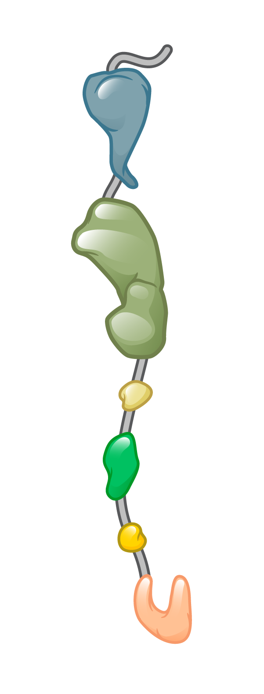
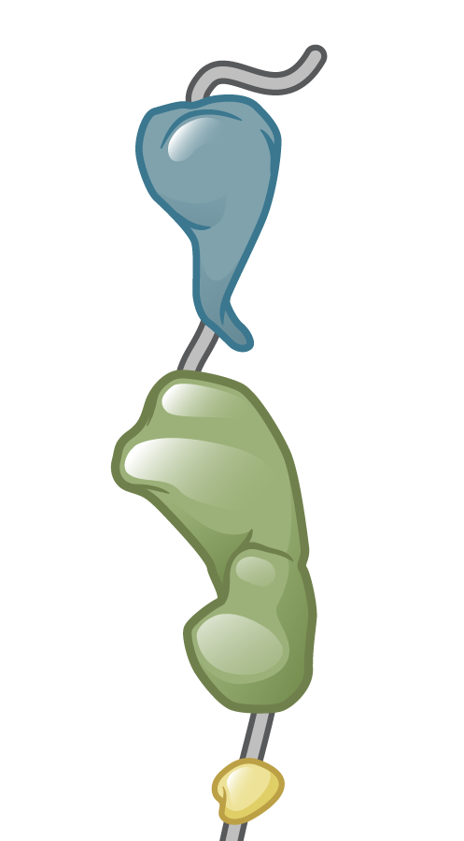
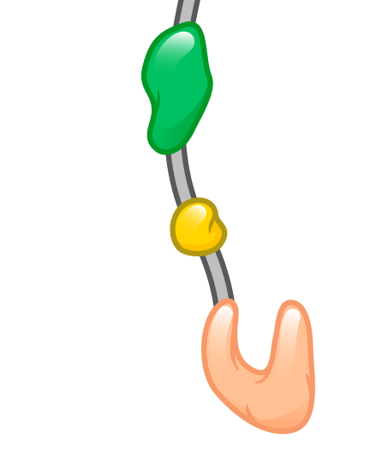
HIV Protease and Polypeptide Cleavage
HIV Gag
HIV Gag
HIV Protease
Illustration: Cognition Studio, Inc. and David H. Spach, MD

Slide 10
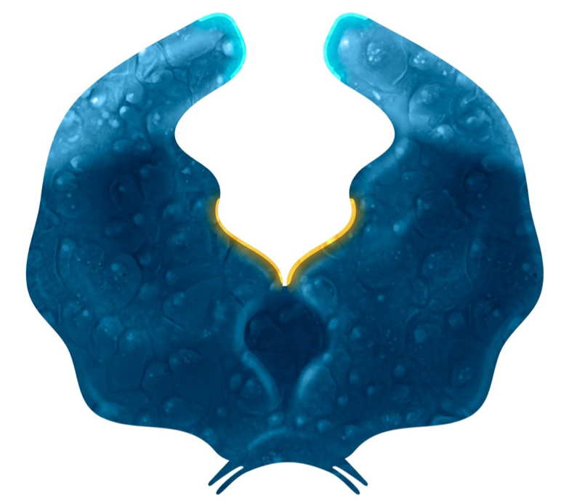
Protease Inhibitors: Mechanism of Action
Darunavir
Active Site
HIV Protease
Illustration: Cognition Studio, Inc. and David H. Spach, MD

Slide 11
Resistance

Slide 12
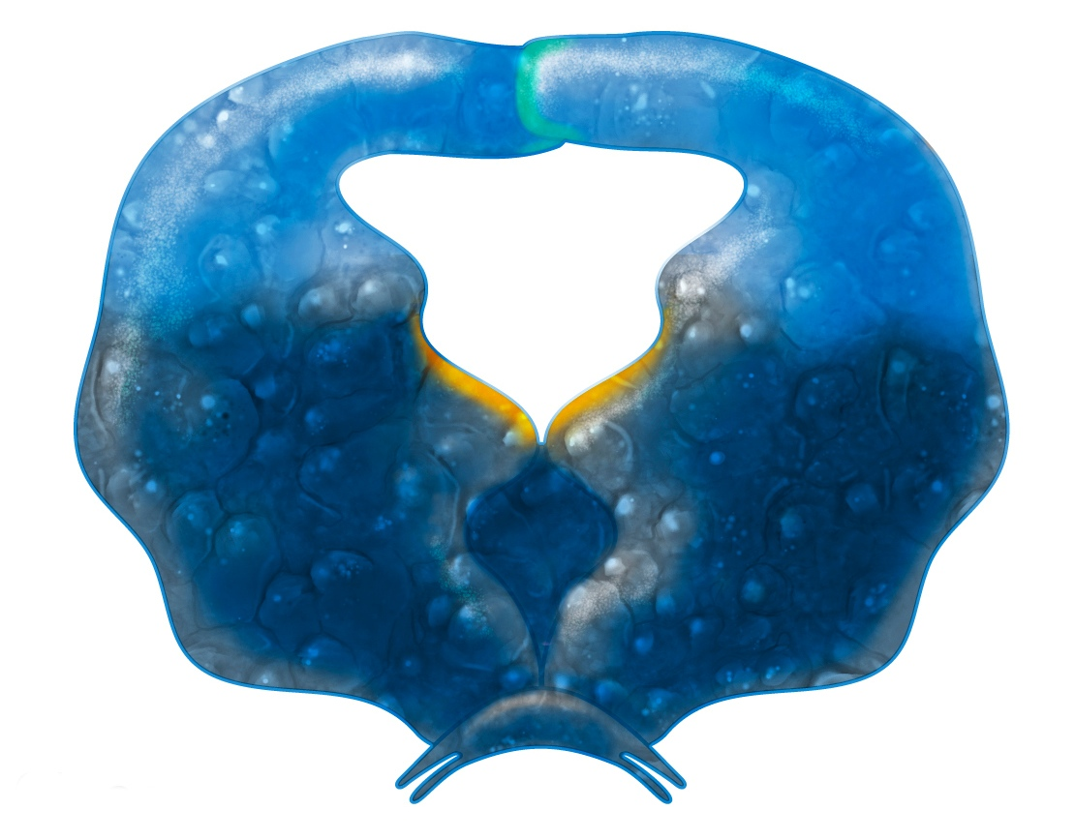
HIV Protease and Darunavir Amino Acid Mutations
Darunavir Resistance-Associated Mutations V11I V32I L33F I47V I50V I54L I54M T74P L76V I84V L89V
54
54
50
50
47
47
32
76
32
76
Active Site
33
33
84
84
74
74
11
11
89
89
HIV Protease
Illustration: David H. Spach, MD and Cognition Studio, Inc.

Slide 13
Key Clinical Trials

Slide 14
Once Daily Darunavir/r versus Lopinavir/r in Treatment-Naïve ARTEMIS: Study Design
Background: Randomized, open-label phase 3 trial comparing the efficacy and safety of once-daily darunavir + ritonavir with lopinavir-ritonavir in treatment-naïve persons with HIV
Inclusion Criteria (n = 689)
Age >18 years
Antiretroviral-naïve
HIV RNA ≥5000 copies/mL
No AIDS-defining illness
Treatment Arms
DRV 800 mg QD + RTV 100 mg QD + TDF-FTC
LPV/r 800/200 mg QD (or 400 mg bid) + TDF-FTC
Darunavir + Ritonavir + TDF-FTC (n = 343)
Lopinavir-ritonavir + TDF-FTC
(n = 346)
Source: Ortiz R, et al. AIDS. 2008;22:189-97.

Slide 15
Once Daily Darunavir/r versus Lopinavir/r in Treatment-Naïve ARTEMIS: Results at 48 Weeks
Week 48: Virologic Response (Intent-to-Treat Analysis)
Baseline HIV RNA
Source: Ortiz R, et al. AIDS. 2008;22:189-97.

Slide 16
Once Daily Darunavir/r versus Lopinavir/r in Treatment-Naïve ARTEMIS: Results at 96 Weeks
Week 96: Virologic Response (Intent-to-Treat Analysis)
P = 0.012
P = 0.174
P = 0.023
Source: Mills AM, et al. AIDS. 2009;23:1679-88.

Slide 17
Once Daily Darunavir/r versus Lopinavir/r in Treatment-Naïve ARTEMIS: Results at 96 Weeks
Week 96: Analysis of Lipids
Source: Mills AM, et al. AIDS. 2009;23:1679-88.

Slide 18
Boosted Darunavir Summary of Key Studies
Trials in Treatment Naïve Adults
^{1,2}ARTEMIS: DRV/r versus LPV/r
Once-daily DRV/r was superior in virologic response to LPV/r, with a more favorable safety, gastrointestinal and lipid profile, in antiretroviral-naive patients
Efficacy of Darunavir-cobicistat is based on clinical trials establishing the efficacy of using DRV/r once daily in treatment naïve individuals
1Ortiz R, et al. AIDS. 2008;22:189-97.
2Mills AM, et al. AIDS. 2009;23:1679-88

Slide 19
Darunavir/r versus other PIs in Treatment-Experienced POWER 1 and 2: Study Design
Background: Two randomized, phase 2b trials to compare the efficacy and safety of ritonavir-boosted darunavir with other protease inhibitors in treatment-experienced adults with HIV and PI resistance
Inclusion Criteria (n = 155)
Age ≥18 years
HIV RNA >1000 copies/mL
On PI-containing regimen
Took>1 NRTI, and ≥1 NNRTI as part of failing regimen
At least 1 primary PI mutation at screening
Treatment Arms
Darunavir 600 mg BID + Ritonavir 100 mg bid + OBR*
Investigator-selected control PI + OBR*
Darunavir BID + RTV BID + OBR (n = 131)
Control PI + RTV + OBR (n =124)
*OBR = Optimized background regimen: ≥2 NRTIs +/- enfuvirtide
Source: Clotet B, et al. Lancet. 2007;369:1169-78.

Slide 20
Darunavir/r versus other PIs in Treatment-Experienced POWER 1 and 2: Result
Week 48: Virologic Response
67/110
18/120
50/110
12/120
Source: Clotet B, et al. Lancet. 2007;369:1169-78.

Slide 21
Darunavir/r versus other PIs in Treatment-Experienced POWER 1 and 2: Result
Week 48: Virologic Response ( ITT-TLOVR)
Baseline HIV RNA (copies/mL)
Source: Clotet B, et al. Lancet. 2007;369:1169-78.

Slide 22
Darunavir/r versus other PIs in Treatment-Experienced POWER 1 and 2: Result
Week 48: Virologic Response, by Primary PI Mutations at Baseline
Source: Clotet B, et al. Lancet. 2007;369:1169-78.

Slide 23
Darunavir/r versus other PIs in Treatment-Experienced POWER 1 and 2: Result
Week 48: Virologic Response, by DRV Resistance-Associated Mutations at Baseline
Source: Clotet B, et al. Lancet. 2007;369:1169-78.

Slide 24
Once-daily versus Twice-daily Darunavir in Treatment-Experienced ODIN: Study Design
Background: Randomized, open-label phase 3 trial to compare once daily versus twice-daily dosing of ritonavir-boosted darunavir in treatment-experienced patients with HIV
Inclusion Criteria (n = 590)
Age ≥18 years
On stable antiretroviral regimen for >12 weeks
HIV RNA >1000 copies/mL
CD4 count >200 cells/mm³
No darunavir resistance-associated mutations
Treatment Arms
Darunavir 800 mg QD + RTV 100 mg QD + OBR*
Darunavir 600 mg BID + RTV 100 mg BID + OBR
Darunavir 800 mg QD + Ritonavir 100 mg QD + OBR (n = 294)
Darunavir 600 mg BID + Ritonavir 100 mg BID + OBR (n = 296)
ODIN = Once-daily Darunavir In treatment-experieNced *OBR = Optimized background regimen: ≥2 nucleoside reverse transcriptase inhibitors, investigator-selected
Source: Cahn P, et al. AIDS. 2011;25:929-39.

Slide 25
Once Daily versus Twice Daily Darunavir in ARV-Experienced ODIN: Result
Week 48: Virologic Response ( ITT-TLOVR)
Baseline HIV RNA
Source: Cahn P, et al. AIDS. 2011;25:929-39.

Slide 26
Once-Daily versus Twice Daily Darunavir in ARV-Experienced ODIN: Result (Impact on Lipids)
Week 48: Changes in Lipids from Baseline
Source: Cahn P, et al. AIDS. 2011;25:929-39.

Slide 27
Once Daily versus Twice Daily Darunavir in ARV-Experienced ODIN: Result
Adverse Events Possibly Related to Darunavir + Ritonavir (≥ 2% incidence in either arm)
Symptom | DRV + RTV + Once Daily + OBR (n = 294) | DRV + RTV + Twice Daily + OBR (n = 296)
Nausea | 10.9% | 10.5%
Vomiting | 9.9% | 15.2%
Diarrhea | 3.1% | 5.4%
Rash | 2.7% | 2.7%
Headache | 1.4% | 2.0%
Source: Cahn P, et al. AIDS. 2011;25:929-39.

Slide 28
Boosted Darunavir: Summary of Key Studies
Trials in Treatment Naïve Adults
^{1,2}ARTEMIS: DRV/r versus LPV/r
Once-daily DRV/r was superior in virologic response to LPV/r, with a more favorable safety, gastrointestinal and lipid profile, in antiretroviral-naive patients
Trials In Treatment Experienced Adults with PI resistance
³POWER 1 and 2: Switch to DRV-COBI-TAF-FTC or stay on PI + TDF-FTC
Using DRV/r 600/100 mg twice daily with OBR, had more effective virologic response plus favorable safety and tolerability, up to week 48, in treatment-experienced patients
⁴ODIN: Switch to DRV-COBI-TAF-FTC or stay on PI + TDF-FTC
Once-daily DRV/r 800/100 mg was non-inferior in virologic response to twice-daily DRV/r 600/100 mg at 48 weeks in treatment-experienced patients with no DRV RAMs
Source: ¹ Ortiz R, et al. AIDS. 2008;22:189-97.
² Mills AM, et al. AIDS. 2009;23:1679-88.
³ Clotet B, et al. Lancet. 2007;369:1169-78.
⁴ Cahn P, et al. AIDS. 2011;25:929-39.

Slide 29
Boosted Darunavir: Adverse Effects
Gastrointestinal
Diarrhea and nausea
Hepatotoxicity
Risk increased with pre-existing liver dysfunction, including chronic HBV or HCV
Skin Reactions
Darunavir contains a sulfonamide moiety
Rash in approximately 8%
Stevens-Johnson syndrome in 0.1% of persons taking darunavir with cobicistat
Prior Sulfonamide Allergy
Incidence and severity of rash similar with or without a history of sulfonamide allergy
History of sulfonamide allergy not a contraindication but monitoring recommended

Slide 30
Boosted Darunavir: Editor’s Summary
Oral PI available to be given with ritonavir or, in a fixed dose combination with cobicistat
High genetic barrier to resistance
DRV/c should not be used in patients with severe renal or severe hepatic impairment, but DRV/r remains an option
Mostly associated with gastrointestinal adverse effects, such as diarrhea and nausea
As an inhibitor of CYP3A, Cobicistat and Ritonavir can cause problematic interactions with drugs metabolized by CYP3A or drugs that induce or inhibit CYP3A

