Slide 1
Immunizations for Persons with HIV: Recent Updates
David H. Spach, MD
Editor-in-Chief, National HIV Curriculum
Professor of Medicine
Division of Allergy and Infectious Diseases
University of Washington
Last Updated: December 9, 2022

Slide 3
Dr. Spach has no financial conflicts of interest or disclosures.

Slide 4
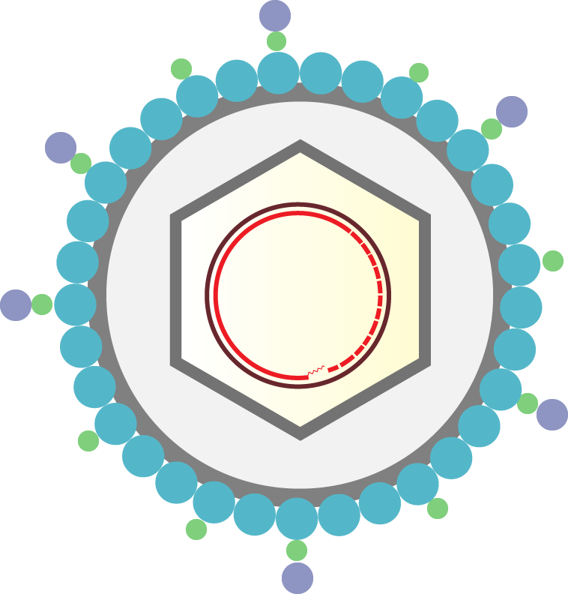
New Immunization Recommendations for Persons with HIV
Pneumococcal
Hepatitis B Virus (HBV)
Herpes zoster (shingles)

Slide 5
Pneumococcal Immunization

Slide 6
Pneumococcal Vaccines
Polysaccharide Vaccine
Conjugate Vaccines
PPSV23 (Pneumovax 23)
PCV13 (Prevnar-13)
PCV15 (Vaxneuvance)
PCV20 (Prevnar-20)

Slide 7
Pneumococcal Conjugate Vaccine (PCV-13)
1
3
4
5
6A
6B
7F
PCV13 Serotypes
9V
14
18C
19A
19F
23F
1
3
4
5
6A
6B
7F
9V
PCV15 Serotypes
14
18C
19A
19F
22F
23F
33F
1
3
4
5
6A
6B
7F
8
9V
10A
PCV20 Serotypes
11A
12F
14
15B
18C
19A
19F
22F
23F
33F
Illustration: David H. Spach, MD

Slide 8
Pneumococcal Immunization Recommendations for Pneumococcal Vaccine-Naïve Adults with HIV

Slide 9
Adult Opportunistic Infections Guidelines Pneumococcal Immunization in Adults with HIV
New
Pneumococcal Vaccine-Naïve Adults
PCV-15 (Vaxneuvance)
≥ 8 weeks
PPSV23 (Pneumovax)
AII
or
PCV20 (Prevnar 20)
AII
Administer PCV (15 or 20) to PWH, on ART with CD4 count >50 cells/mm³.
AII
Source: HHS. Opportunistic Infections Guidelines. September 7, 2022.

Slide 10
What do you do if you have already started the pneumococcal vaccine series with PCV13?

Slide 11
Adult Opportunistic Infections Guidelines Pneumococcal Immunization in Adults with HIV
Prior Receipt of PCV13 without Completing Vaccine Schedule*
≥ Age 65
≥ 8 weeks
≥ 5 years
≥ 5 years
PCV13
PPSV23
PPSV23
PPSV23
Complete Schedule
Source: HHS. Opportunistic Infections Guidelines. September 7, 2022.

Slide 12
Hepatitis B Immunization

Slide 13
Hepatitis B Virus Surface Proteins
preS1 antigen
preS2 antigen
S antigen
HBV DNA
core
Illustration: Peter E. Harrison, MPH and David H. Spach, MD

Slide 14
Recombinant Hepatitis B Vaccines
Old (Single Antigen)
Newer (Single Antigen)
New (Triple Antigen)
Aluminum Adjuvant
CpG1018 Adjuvant
Aluminum Adjuvant
S Antigen
S Antigen
CpG1018 Adjuvant
S Antigen
pre-S1 Antigen
pre-S2 Antigen
rHBsAg (Recombivax-HB) rHBsAg (Engerix-B)
HBsAg-CpG1018 (Heplisav-B)
3-AgHB (PreHevbrio)
S
S
S
preS1
ssDNA
preS2
Illustration: David H. Spach, MD

Slide 15
New Hepatitis B Vaccine Recommendations in Persons with HIV

Slide 16
Adult Opportunistic Infections Guidelines Hepatitis B Immunization In Persons with HIV
New
Month
0
1
2
3
4
5
6
DD
Engerix-B (40 μg HBsAg/dose)
1
2
3
AII
DD
Recombivax-HB (20 μg HBsAg/dose)
1
2
3
AII
SD
Heplisav-B (20 μg HBsAg/dose)
1
2
CIII
SD = standard dose; DD = double dose
Source: Opportunistic Infections Guidelines. September 7, 2022.

Slide 17
Adult Opportunistic Infections Guidelines Hepatitis B Immunization In Persons with HIV
New
Month
0
1
2
3
4
5
6
DD
Engerix-B (40 μg HBsAg/dose)
1
2
3
AII
DD
Recombivax-HB (20 μg HBsAg/dose)
1
2
3
AII
SD
Heplisav-B (20 μg HBsAg/dose)
1
2
CIII
SD
Twinrix* (720 ELISA units HAV/dose) (20 μg HBsAg/dose)
1
2
3
AII
*Combined hepatitis A and B vaccine, with same components used in Havrix (HAV vaccine) and Engerix-B (Hepatitis B vaccine)
SD = standard dose; DD = double dose
Source: Opportunistic Infections Guidelines. September 7, 2022.

Slide 18
Should you defer starting the series in persons with HIV and a low CD4 cell count?

Slide 19
Timing of Hepatitis B Vaccination
Although vaccine response is better in patients with CD4 >350 cells/mm³, vaccination should not be deferred in patients with a lower CD4 count because some people with CD4 <350 cells/mm³ do respond to vaccination (AII).
Source: Opportunistic Infections Guidelines. September 7, 2022.

Slide 20
How to Manage HBV Vaccine Non-Responders?

Slide 21
Adult Opportunistic Infections Guidelines Recommendations for Hepatitis B Vaccine Non-Responders In Persons with HIV
New
Month
0
1
2
3
4
5
6
DD
Engerix-B (40 μg HBsAg/dose)
1
2
3
BIII
DD
Recombivax-HB (20 μg HBsAg/dose)
1
2
3
BIII
SD
Heplisav-B (20 μg HBsAg/dose)
1
2
BIII
DD
Engerix-B (40 μg HBsAg/dose)
1
2
3
4
Consider
DD
Recombivax-HB (20 μg HBsAg/dose)
1
2
3
4
Consider
SD = standard dose; DD = double dose
Source: Opportunistic Infections Guidelines. September 7, 2022.

Slide 22
Varicella Zoster Immunization

Slide 23
Zoster Vaccines
OLD
NEW
VZV
Attenuated VZV
Glycoprotein E
AS01_{B} Adjuvant
VZV
Varicella-Zoster Virus
+
Zoster Vaccine Live (ZVL): Zostavax
Recombinant Zoster Vaccine (RZV): Shingrex
Illustration: David H. Spach, MD

Slide 24
Zoster Vaccines
OLD
NEW
VZV
Attenuated VZV
X
Glycoprotein E
AS01_{B} Adjuvant
VZV
No longer available in US
+
Zoster Vaccine Live (ZVL)
Recombinant Zoster Vaccine (RZV)
Illustration: David H. Spach, MD

Slide 25
HHS Opportunistic Infections Guidelines Recombinant Zoster Vaccine (RZV) in Persons with HIV
New
Zoster Vaccine in Persons with HIV
RZV
2 to 6 months
RZV
Give 2 Doses to Persons with HIV Age ≥18 Years (AIII)
Source: Opportunistic Infections Guidelines. September 7, 2022.

Slide 26
HHS Opportunistic Infections Guidelines Recombinant Zoster Vaccine (RZV) in Persons with HIV
New
Zoster Vaccine in Persons with HIV
RZV
2 to 6 months
RZV
Give 2 Doses to Persons with HIV Age ≥18 Years (AIII)
There are no CD4 restrictions for giving RZV but consider delaying vaccination until the patient is virologically suppressed on ART (CIII) or until the CD4 count >200 cells/mm³ to ensure a robust vaccine response (CIII).
Source: Opportunistic Infections Guidelines. September 7, 2022.

Slide 27
Should you give zoster vaccine if a person has shingles?

Slide 28
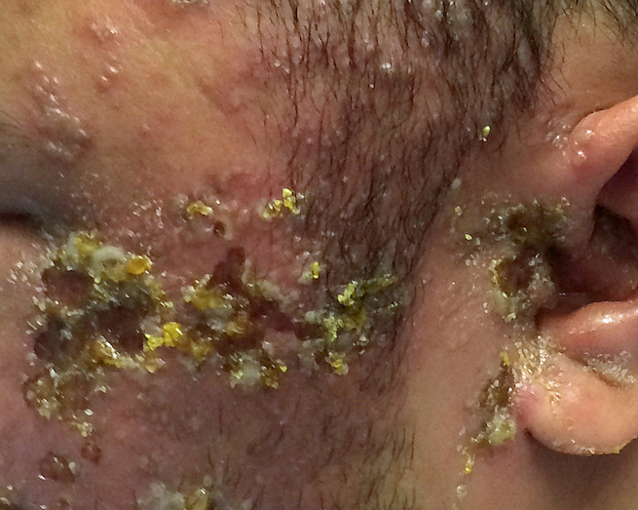
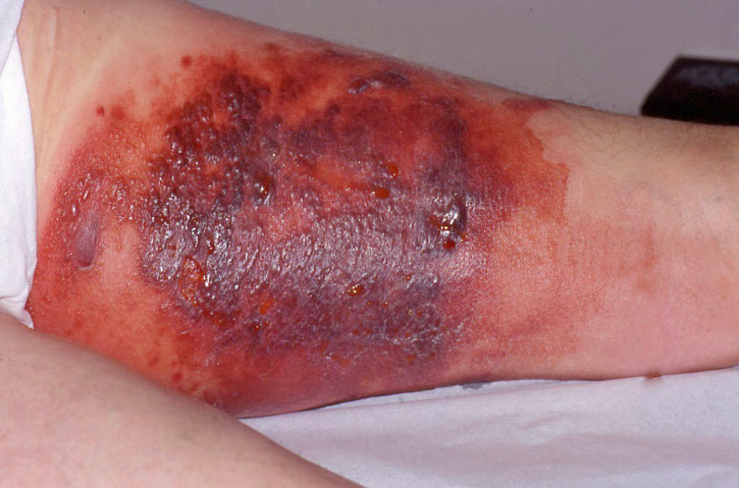
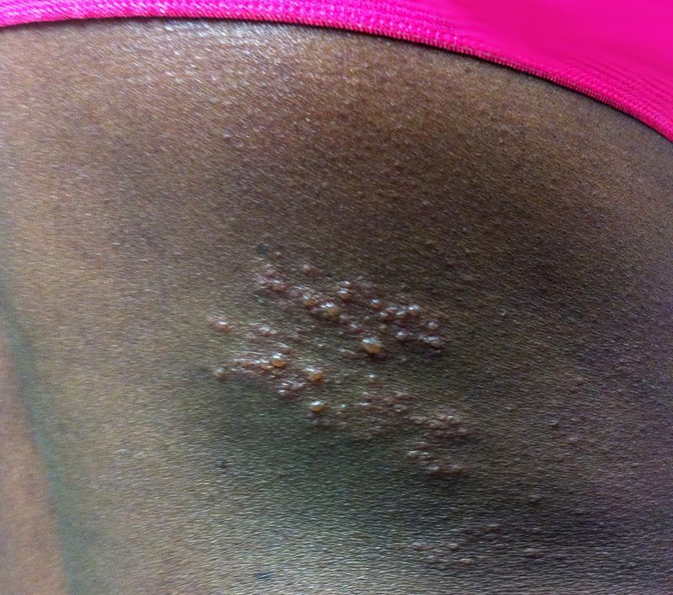
HHS Opportunistic Infections Guidelines Recombinant Zoster Vaccine (RZV) in Persons with HIV
“Do not give RZV (Shingrix) during an acute episode of herpes zoster” (AIII).
Opportunistic Infections Guidelines. September 7, 2022.
Photographs from David H. Spach, MD

Slide 29
Should you give the RZV vaccine if a person previously received ZVL?

Slide 30
HHS Opportunistic Infections Guidelines Recombinant Zoster Vaccine (RZV) in Persons with HIV
ZVL
RZV
2 to 6 months
RZV
“Those who previously received ZVL should be revaccinated with RZV.”
Source: Opportunistic Infections Guidelines. September 7, 2022.

Slide 31
Immunizations for Persons with HIV: Key Updates
New simplified pneumococcal vaccine schedule (1 and done or 1 +1)
New HBV vaccine recommendation (double-dose, 3 doses)
Administer zoster vaccine for all adults ≥18 years of age

