Slide 1
Overview of the HIV Life Cycle
David H. Spach, MD Editor-in-Chief, National HIV Curriculum Professor of Medicine Division of Allergy and Infectious Diseases
University of Washington
Last Updated: November 22, 2022

Slide 2
Dr. Spach does not have any disclosures.

Slide 3
HIV Life Cycle
HIV
Host Cell
Illustration: Cognition Studio, Inc. and David H. Spach, MD

Slide 4
HIV Life Cycle
HIV
8
Budding & Maturation
1
Entry
Host Cell
7
Assembly
4
Integration
2
Cytoplasmic Transport & Nuclear Import
3
5
6
Reverse Transcription
Transcription
Translation
Illustration: Cognition Studio, Inc. and David H. Spach, MD

Slide 5
HIV Life Cycle Entry
1
Illustration: Cognition Studio, Inc. and David H. Spach, MD

Slide 6
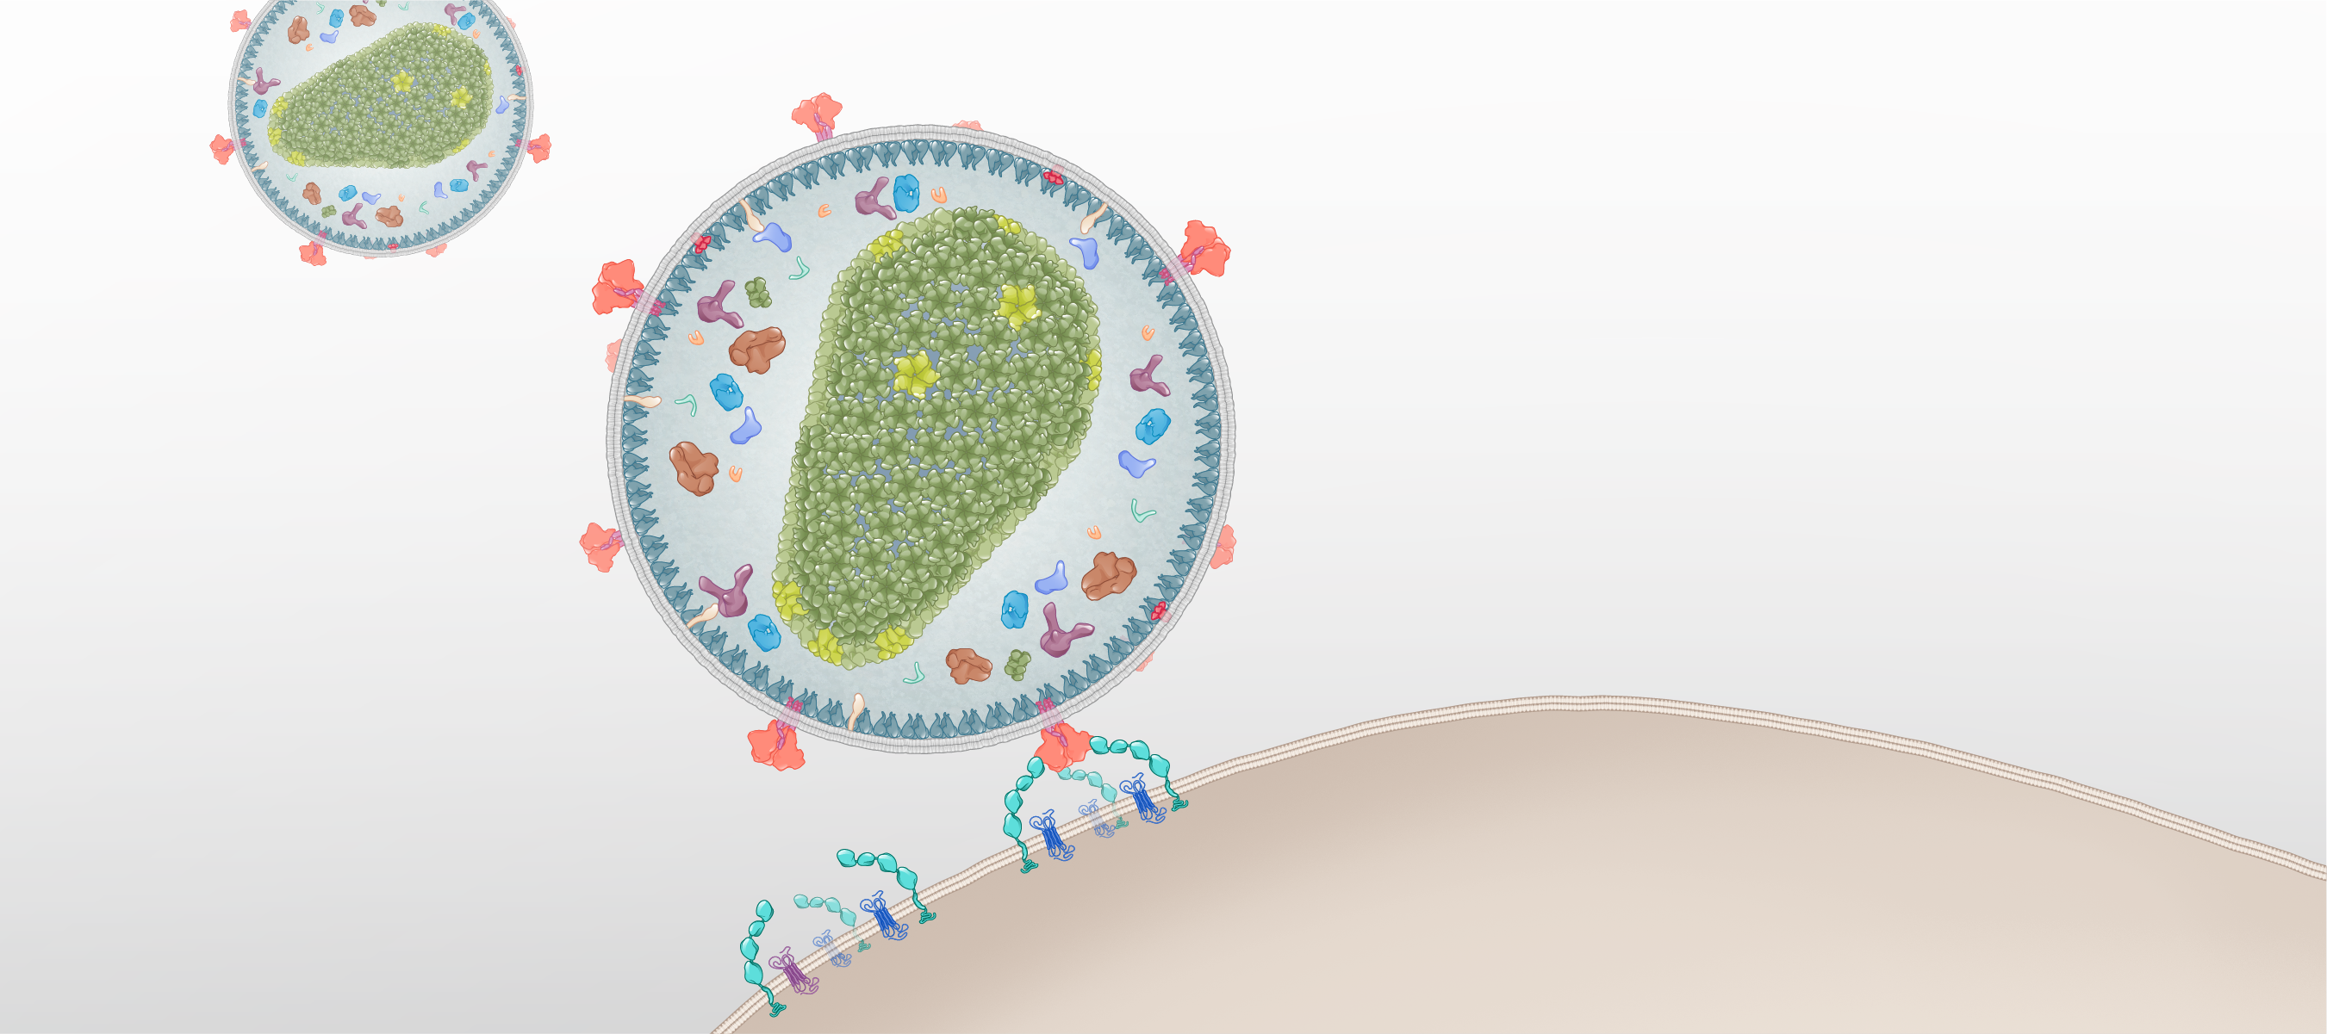
Entry
HIV
HIV Envelope Glycoprotein
Surface Receptors
Host Cell
Illustration: Cognition Studio, Inc. and David H. Spach, MD

Slide 7
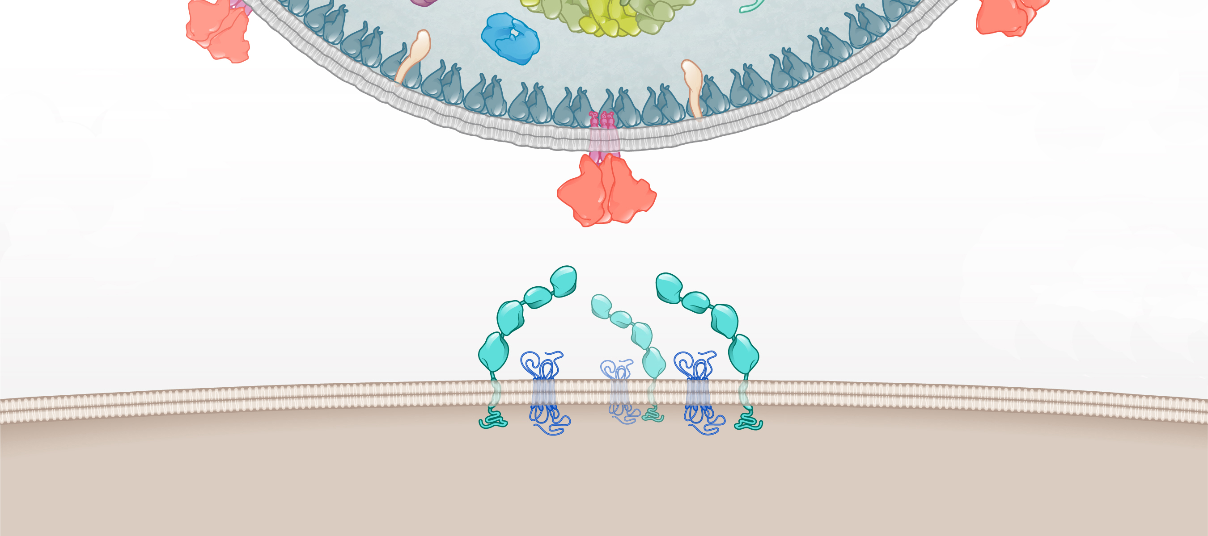
Entry
HIV
Envelope glycoprotein
Surface Receptors
Host cell
Illustration: Cognition Studio, Inc. and David H. Spach, MD

Slide 8
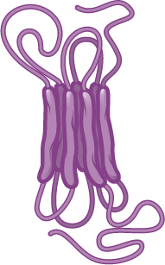
Entry
HIV
Envelope glycoprotein
CD4 receptor
CCR5 coreceptor
CXCR4 coreceptor
Host cell
Surface Receptors
Illustration: Cognition Studio, Inc. and David H. Spach, MD

Slide 9
Entry
HIV
Envelope glycoprotein
gp41
gp120
Surface Receptors
Host cell
Illustration: Cognition Studio, Inc. and David H. Spach, MD

Slide 10
Entry
HIV
V3 Region
Envelope glycoprotein
CD4 Binding Site
Surface Receptors
Host cell
Illustration: Cognition Studio, Inc. and David H. Spach, MD

Slide 11
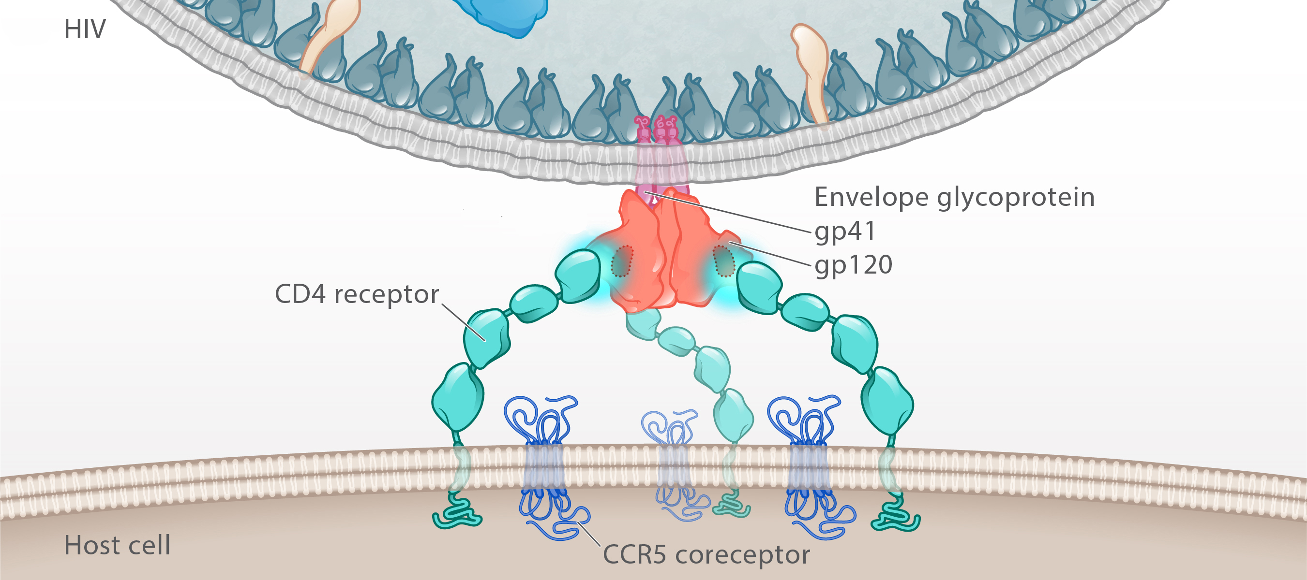
Entry
CD4 binding site
CD4 receptor
Illustration: Cognition Studio, Inc. and David H. Spach, MD

Slide 12
Entry: Attachment
CD4 receptor
Illustration: Cognition Studio, Inc. and David H. Spach, MD

Slide 13
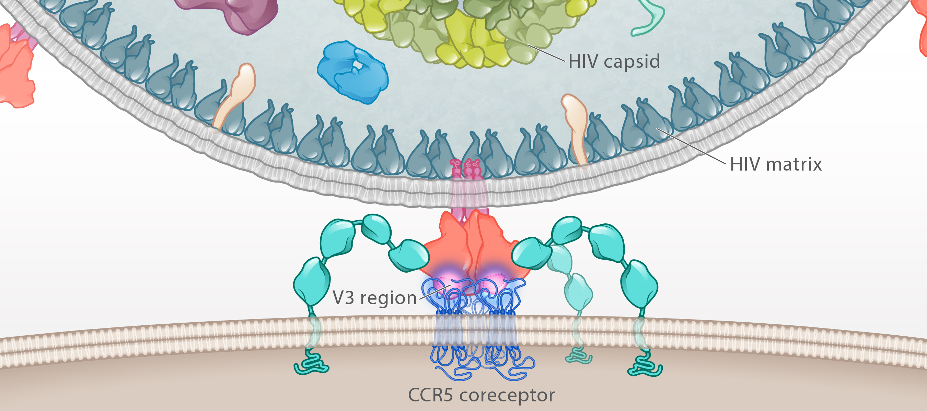
Entry
HIV
V3 Region
Host cell
CCR5 coreceptor
Illustration: Cognition Studio, Inc. and David H. Spach, MD

Slide 14
Entry: Coreceptor Binding
HIV
V3 Region
Host cell
CCR5 coreceptor
Illustration: Cognition Studio, Inc. and David H. Spach, MD

Slide 15
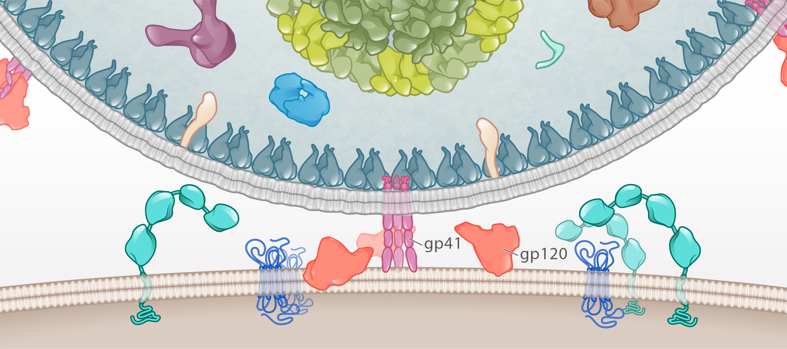
Entry
HIV
gp41
Host cell
CD4 Receptor
CCR5 Coreceptor
Illustration: Cognition Studio, Inc. and David H. Spach, MD

Slide 16
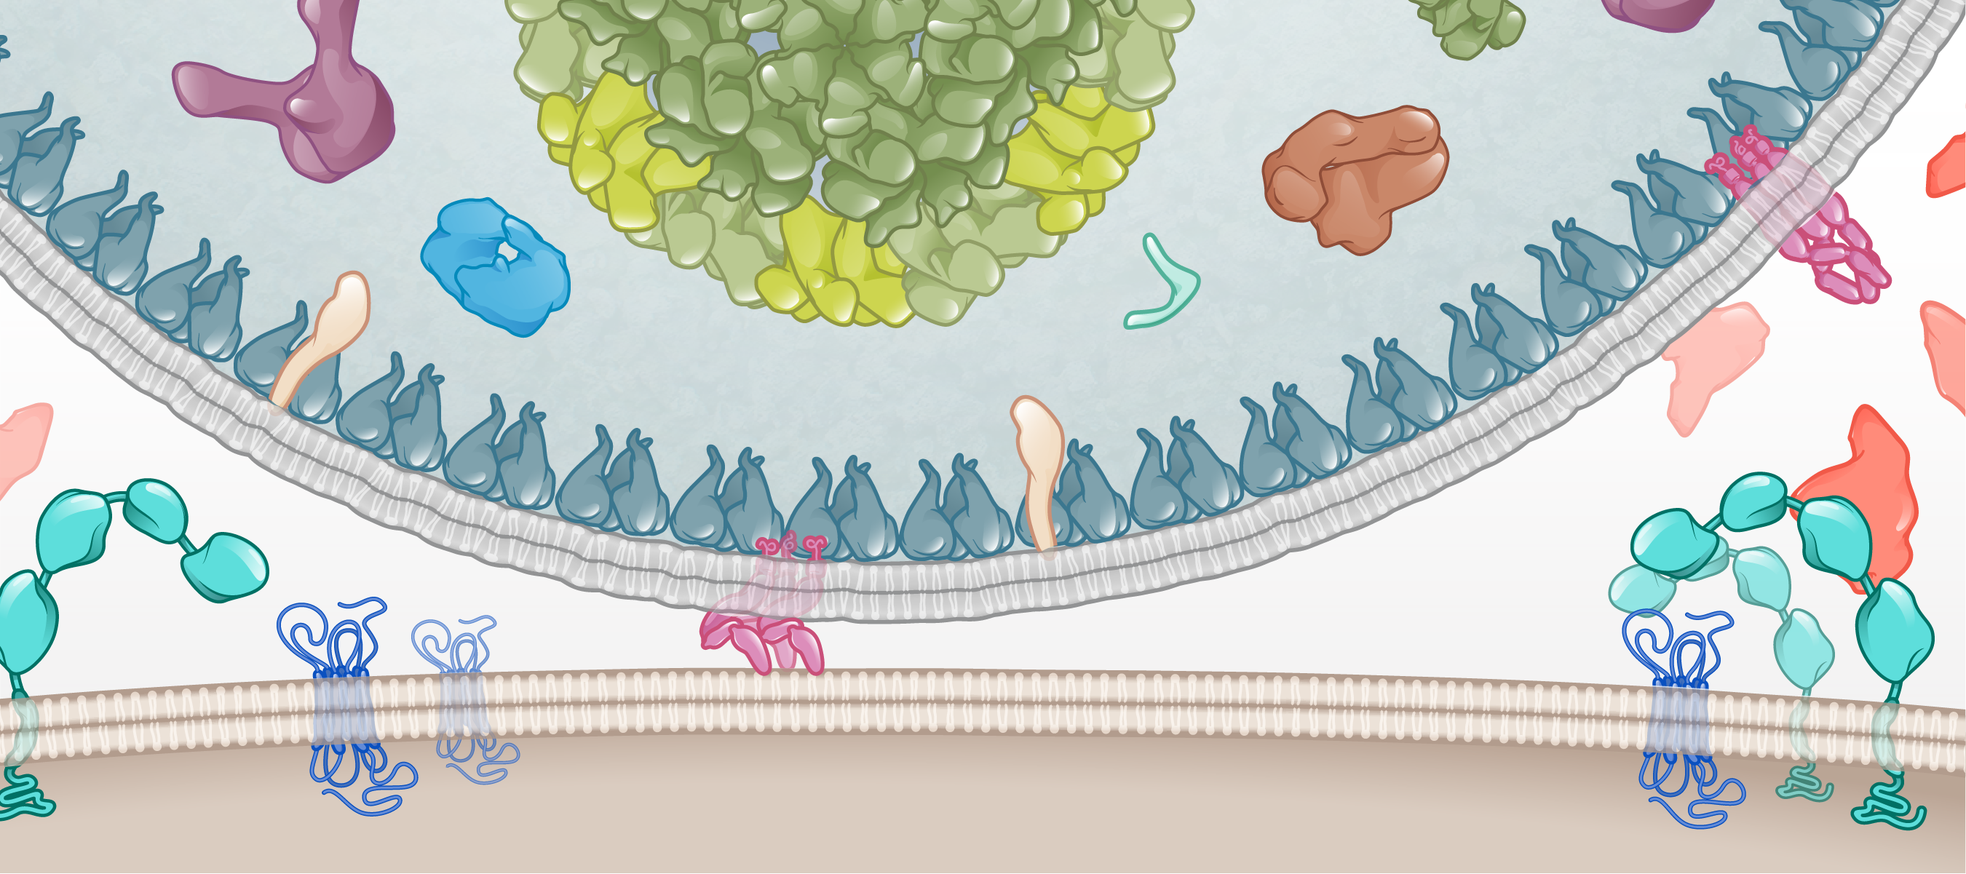
Entry
HIV
gp41
gp41
Host cell
Illustration: Cognition Studio, Inc. and David H. Spach, MD

Slide 17
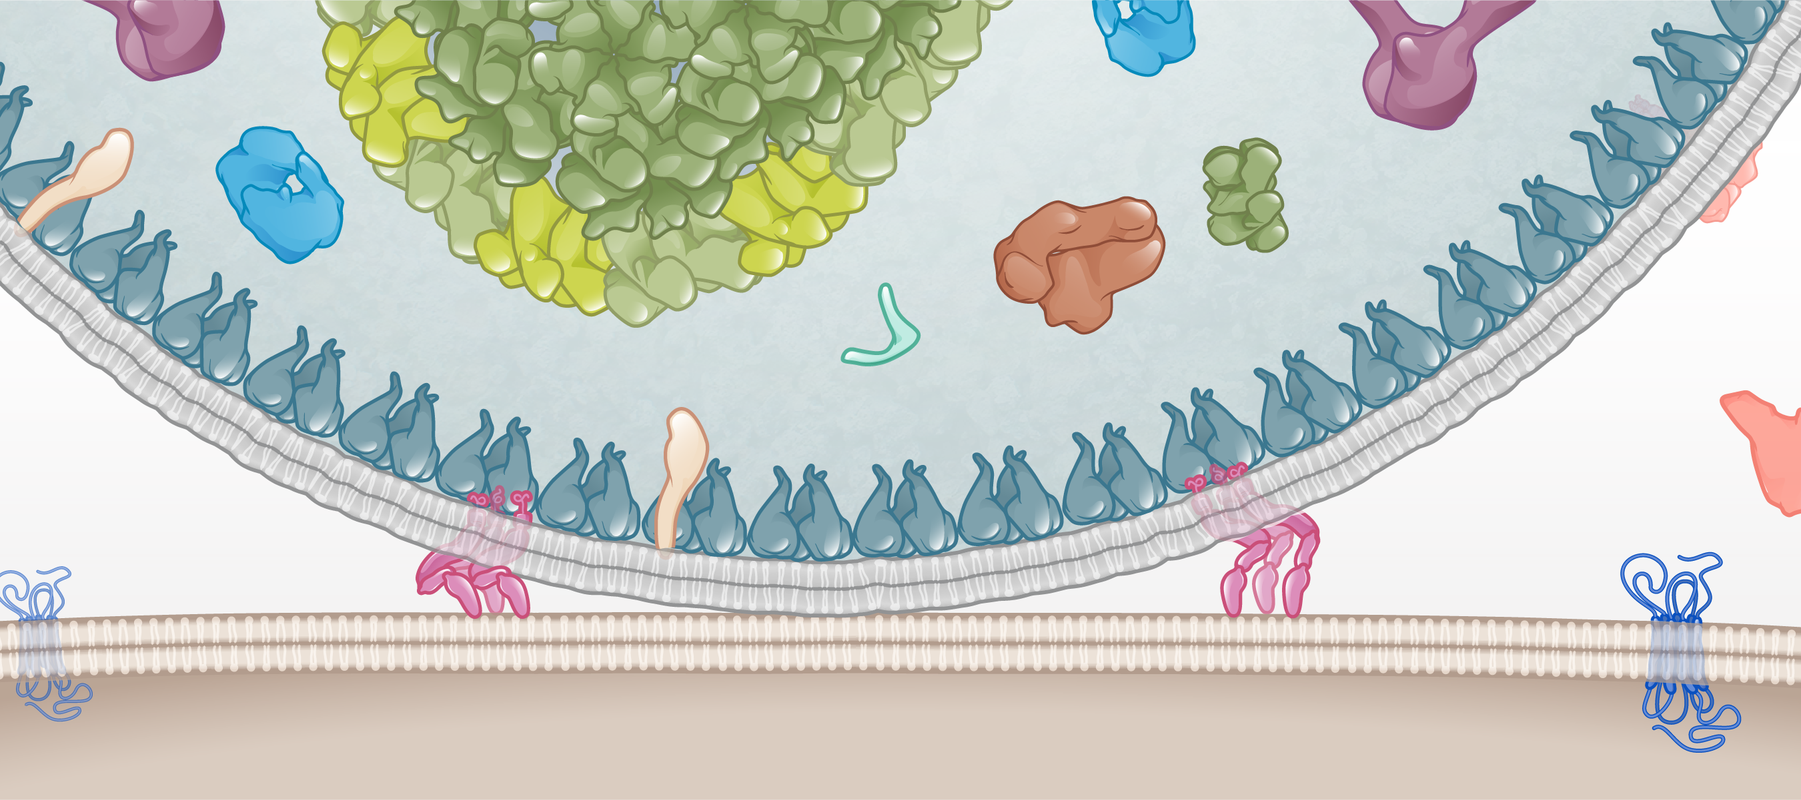
Entry
HIV
gp41
Host cell
Illustration: Cognition Studio Inc., and David H. Spach, MD

Slide 18
Entry
HIV
gp41
Host cell
Illustration: Cognition Studio Inc., and David H. Spach, MD

Slide 19
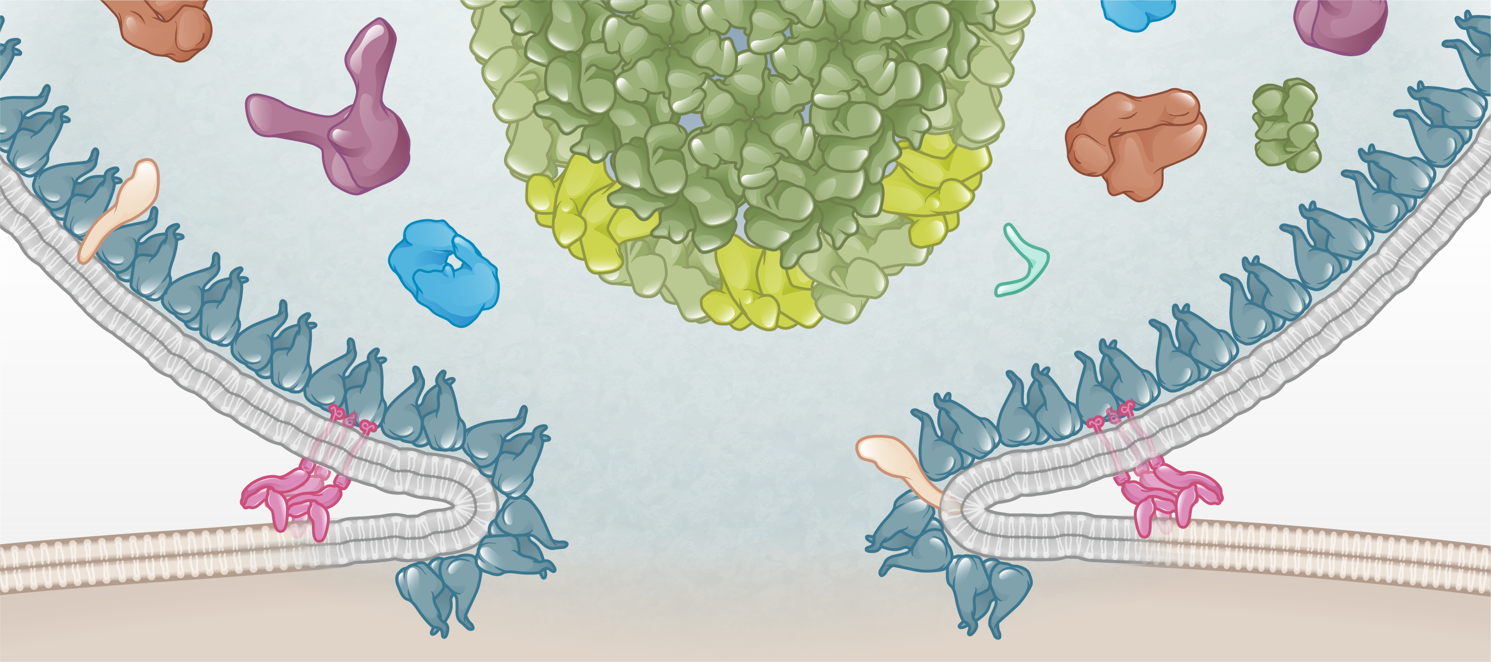
Entry
HIV
HIV core
Matrix shell
HIV membrane
HIV membrane
gp41
gp41
Host membrane
Host membrane
Host cell
Illustration: Cognition Studio, Inc. and David H. Spach, MD

Slide 20
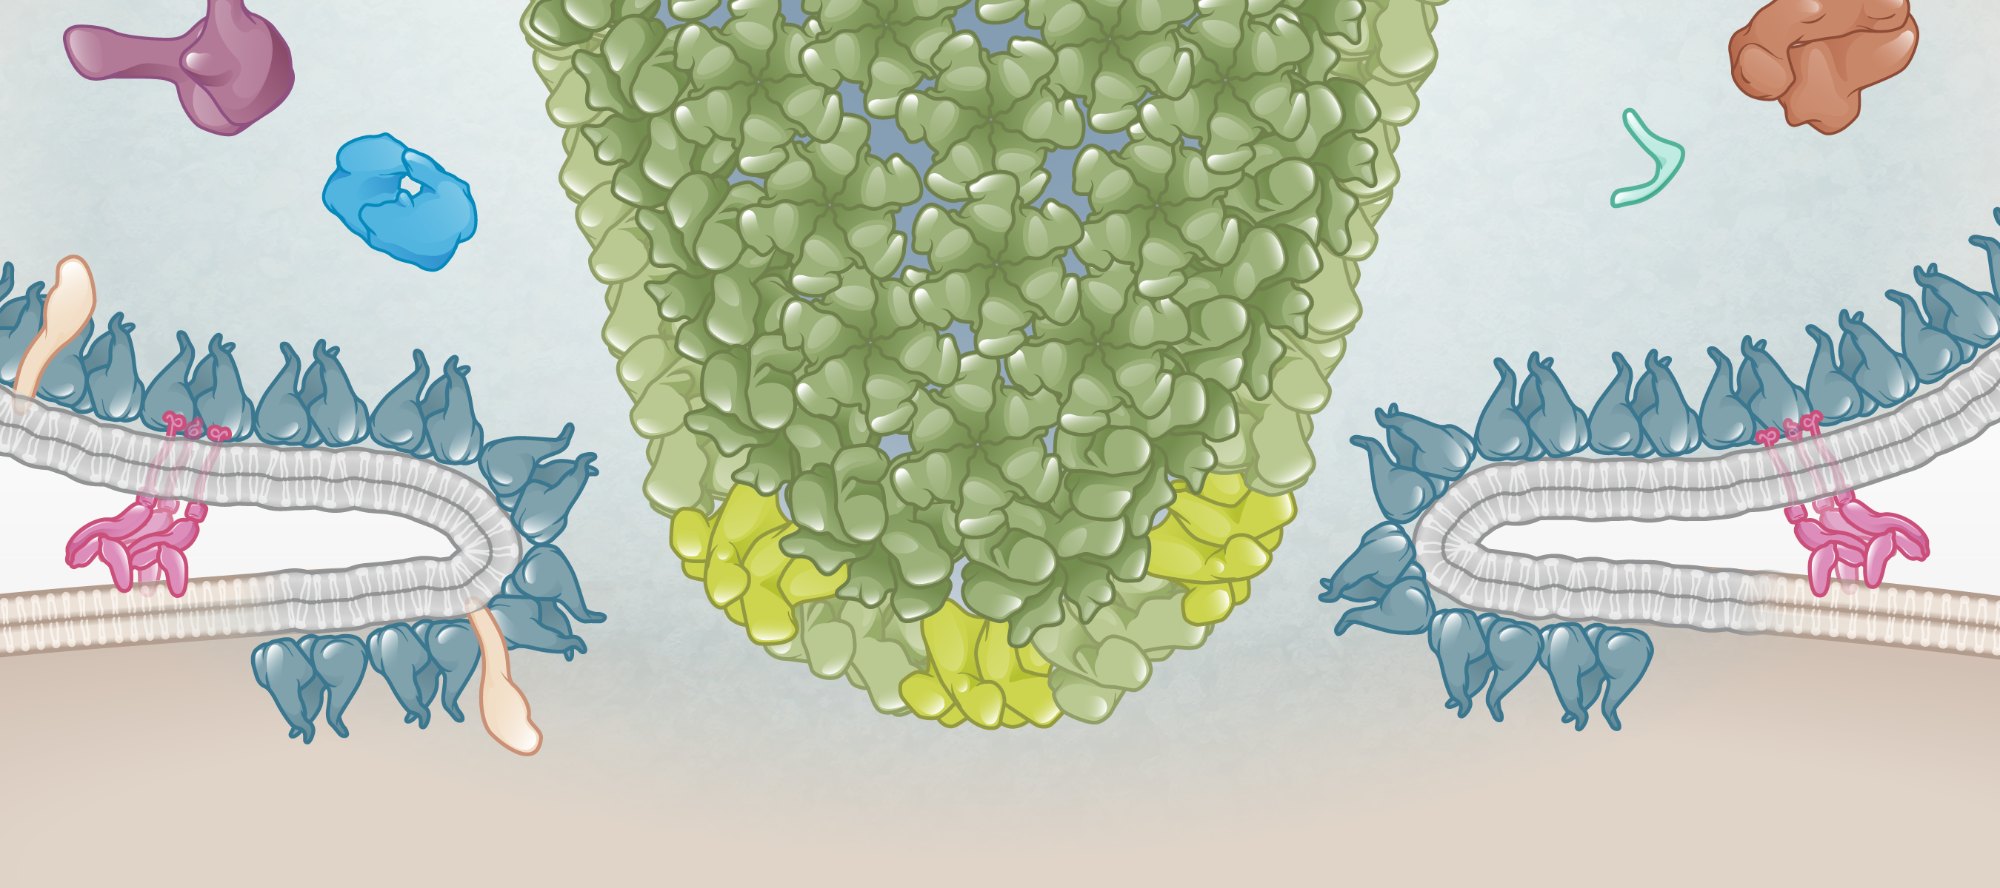
Entry
HIV
gp41
HIV matrix
HIV core
Host cell
Illustration: Cognition Studio, Inc. and David H. Spach, MD

Slide 21
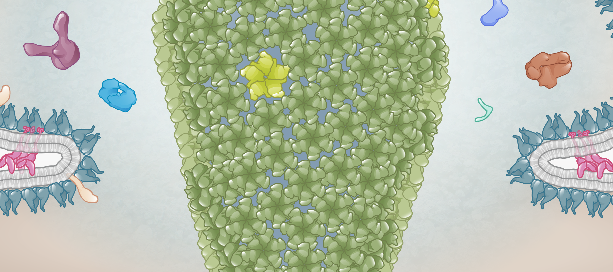
Entry
HIV
HIV core
HIV matrix
Host cell
Illustration: Cognition Studio, Inc. and David H. Spach, MD

Slide 22
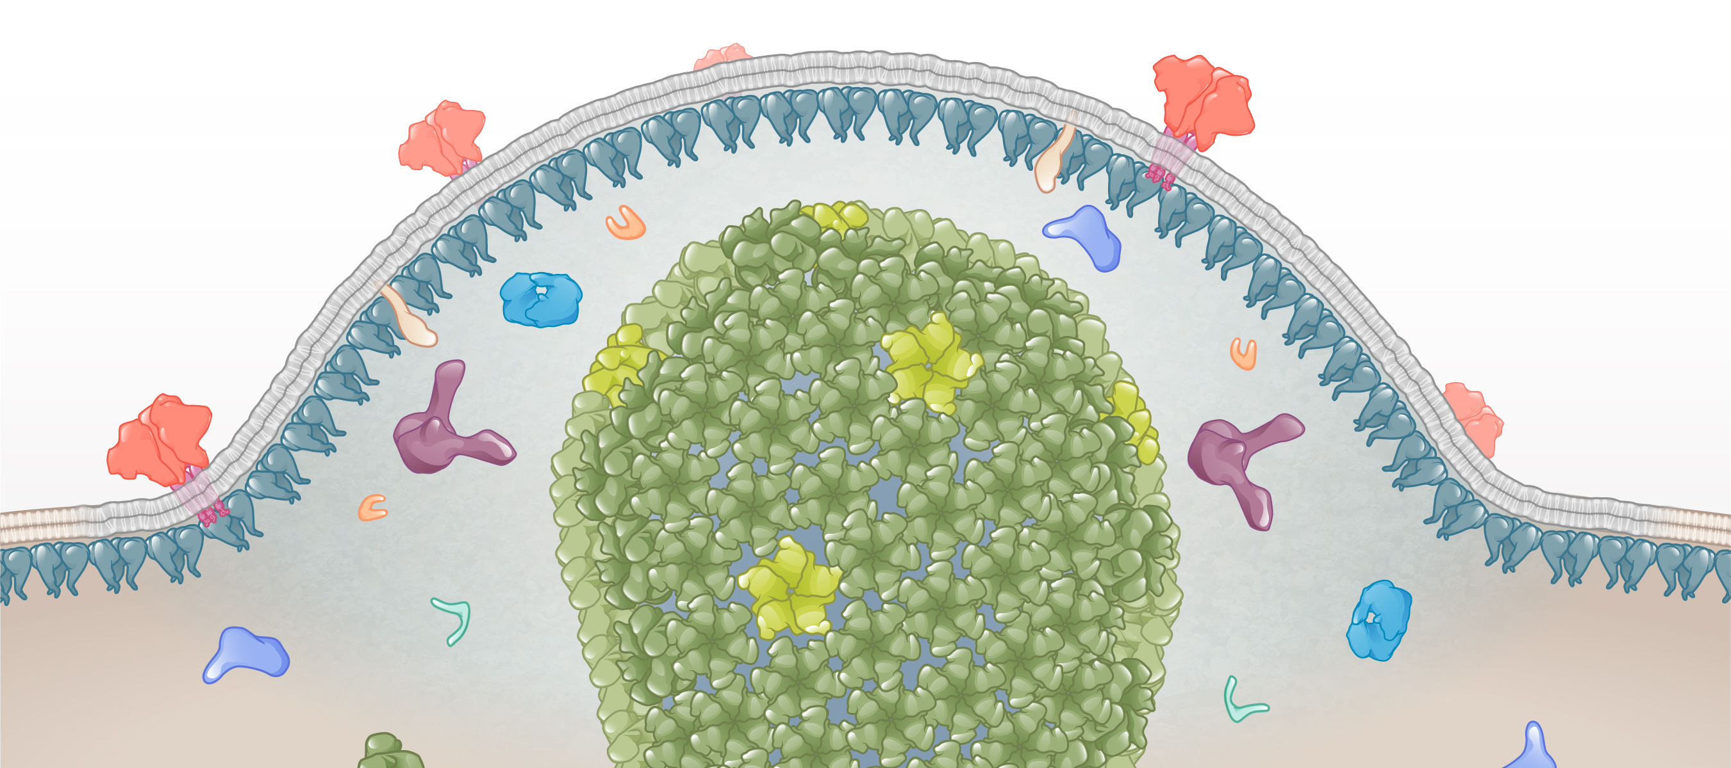
Entry
HIV
HIV matrix shell
HIV core
Host cell
Illustration: Cognition Studio, Inc. and David H. Spach, MD

Slide 23
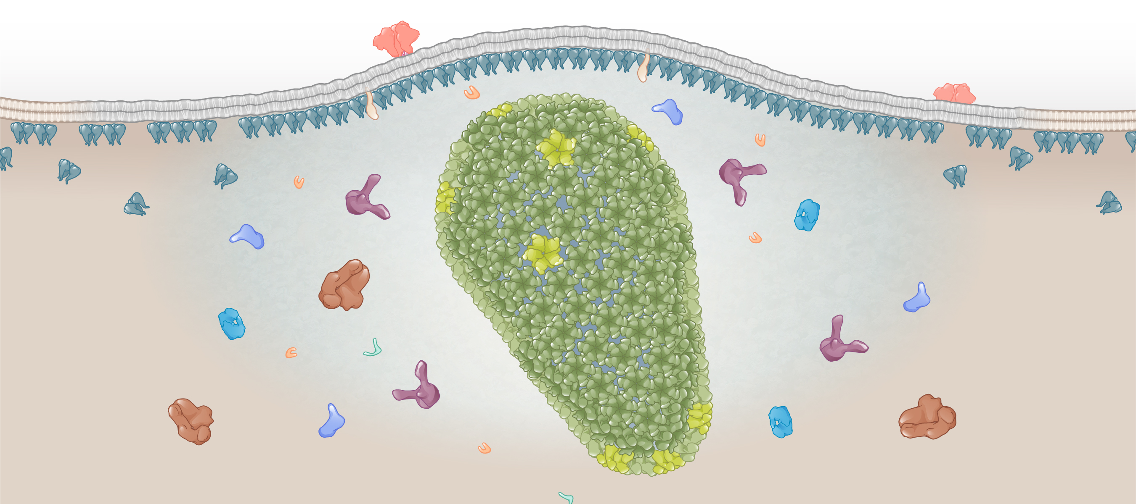
Entry: Fusion
HIV core
Illustration: Cognition Studio, Inc. and David H. Spach, MD

Slide 24
HIV Life Cycle Cytoplasmic Transport and Nuclear Import
2
Cytoplasmic Transport & Nuclear Import
Illustration: Cognition Studio, Inc. and David H. Spach, MD

Slide 25
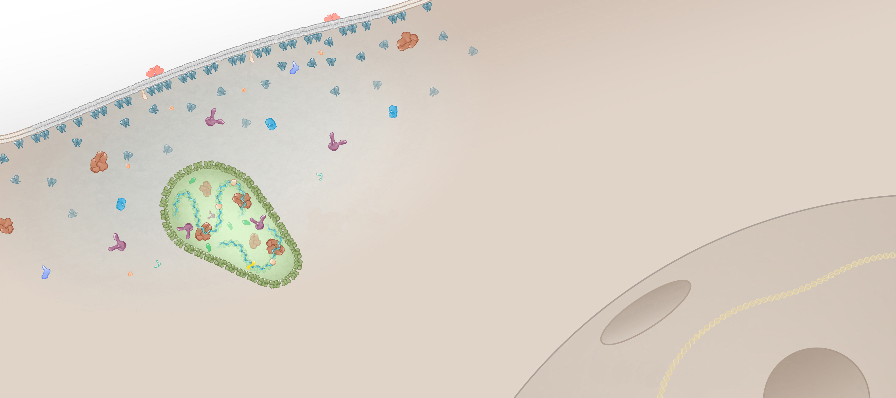
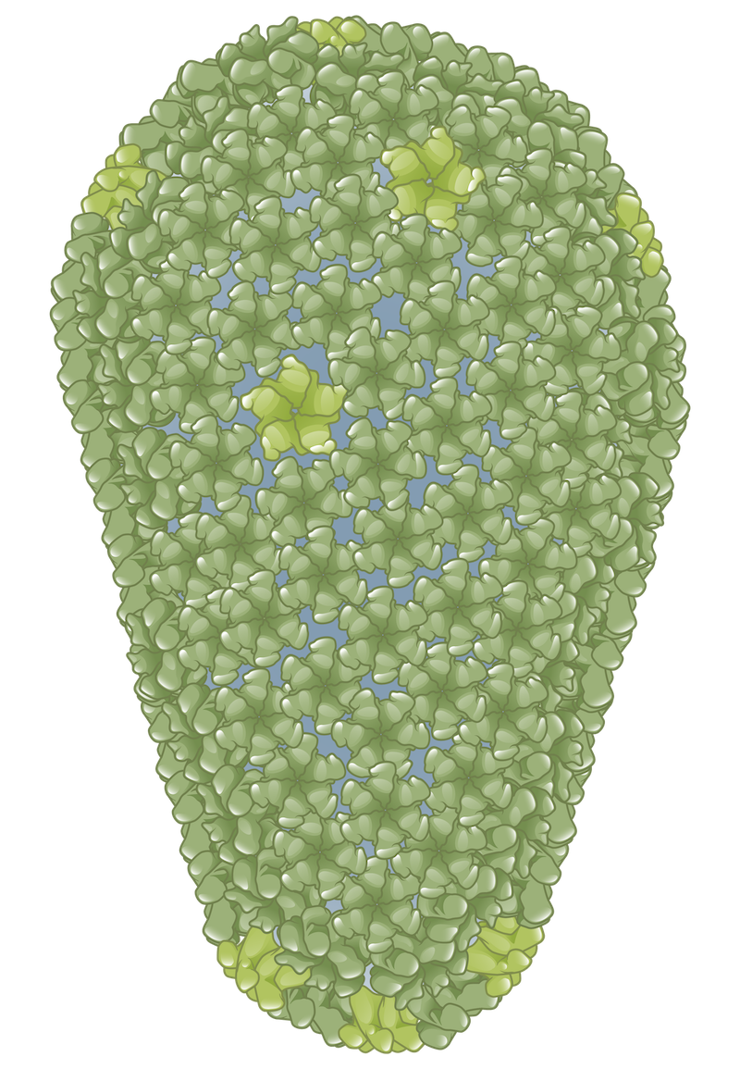
Cytoplasmic Transport and Nuclear Import
HIV core
Host cell
Nucleus
Illustration: Cognition Studio, Inc. and David H. Spach, MD

Slide 26
Cytoplasmic Transport and Nuclear Import
genomic HIV RNA
Integrase
Reverse transcriptase
HIV core
Host cell
Nucleus
Illustration: Cognition Studio, Inc. and David H. Spach, MD

Slide 27
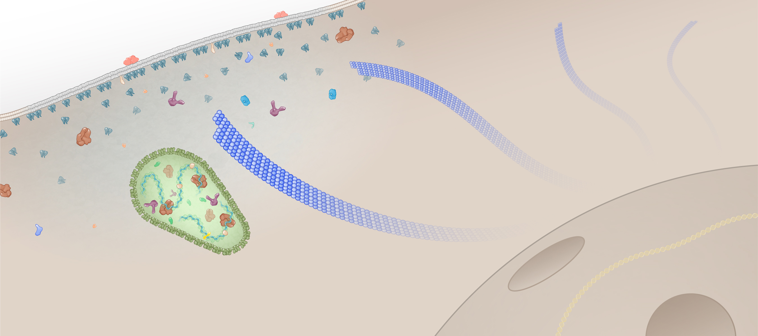
Cytoplasmic Transport and Nuclear Import
Microtubule
HIV core
Microtubule
Host cell
Nucleus
Illustration: Cognition Studio, Inc. and David H. Spach, MD

Slide 28
Cytoplasmic Transport and Nuclear Import
Dynein
Kinesin
HIV core
Host cell
Nucleus
Illustration: Cognition Studio, Inc. and David H. Spach, MD

Slide 29
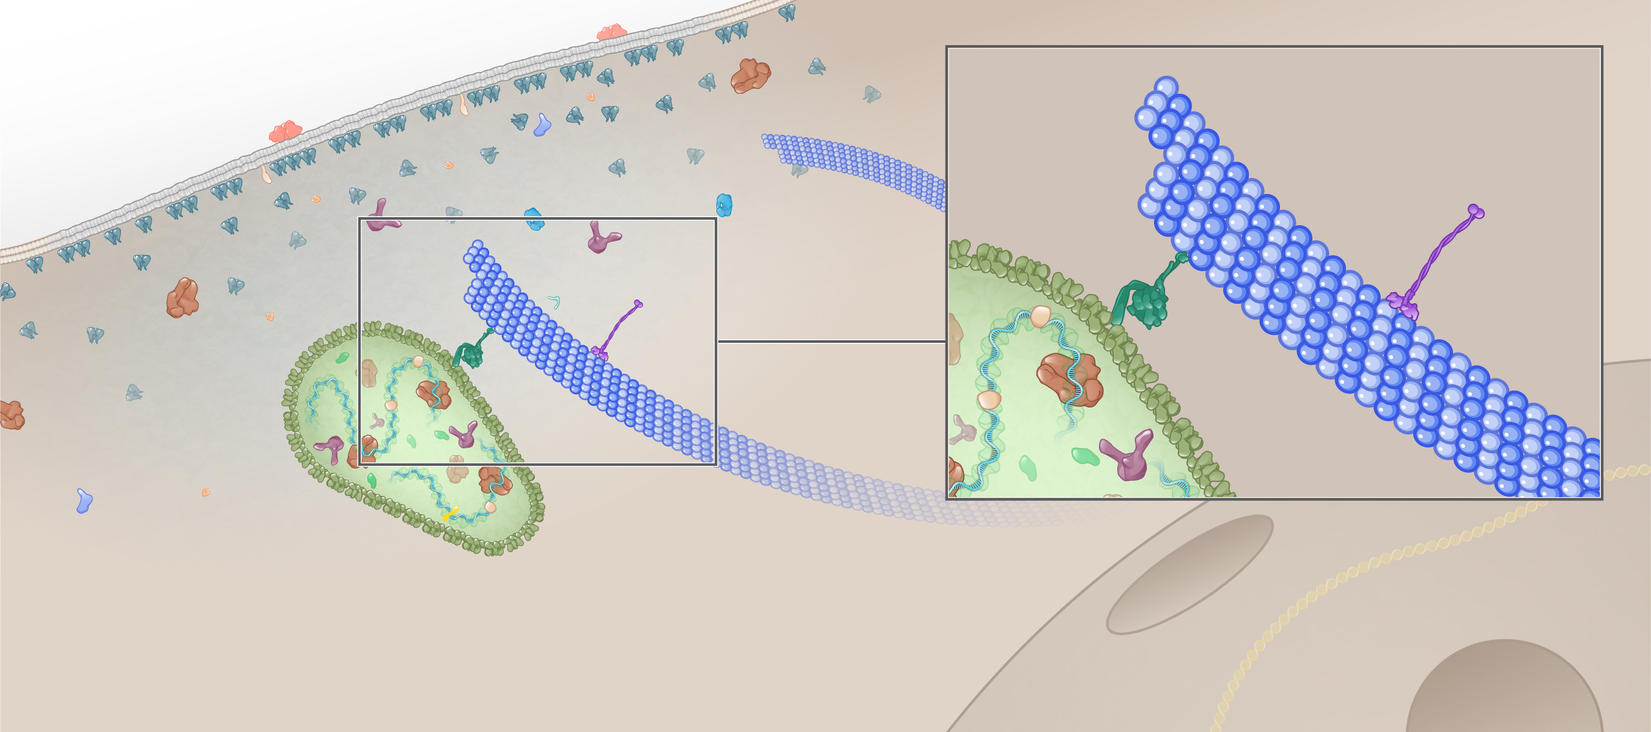
Cytoplasmic Transport and Nuclear Import
Dynein
Kinesin
HIV core
Host cell
Nucleus
Illustration: Cognition Studio, Inc. and David H. Spach, MD

Slide 30
Cytoplasmic Transport and Nuclear Import
Dynein
Kinesin
Microtubule
HIV core
Host cell
Nucleus
Illustration: Cognition Studio, Inc. and David H. Spach, MD

Slide 31
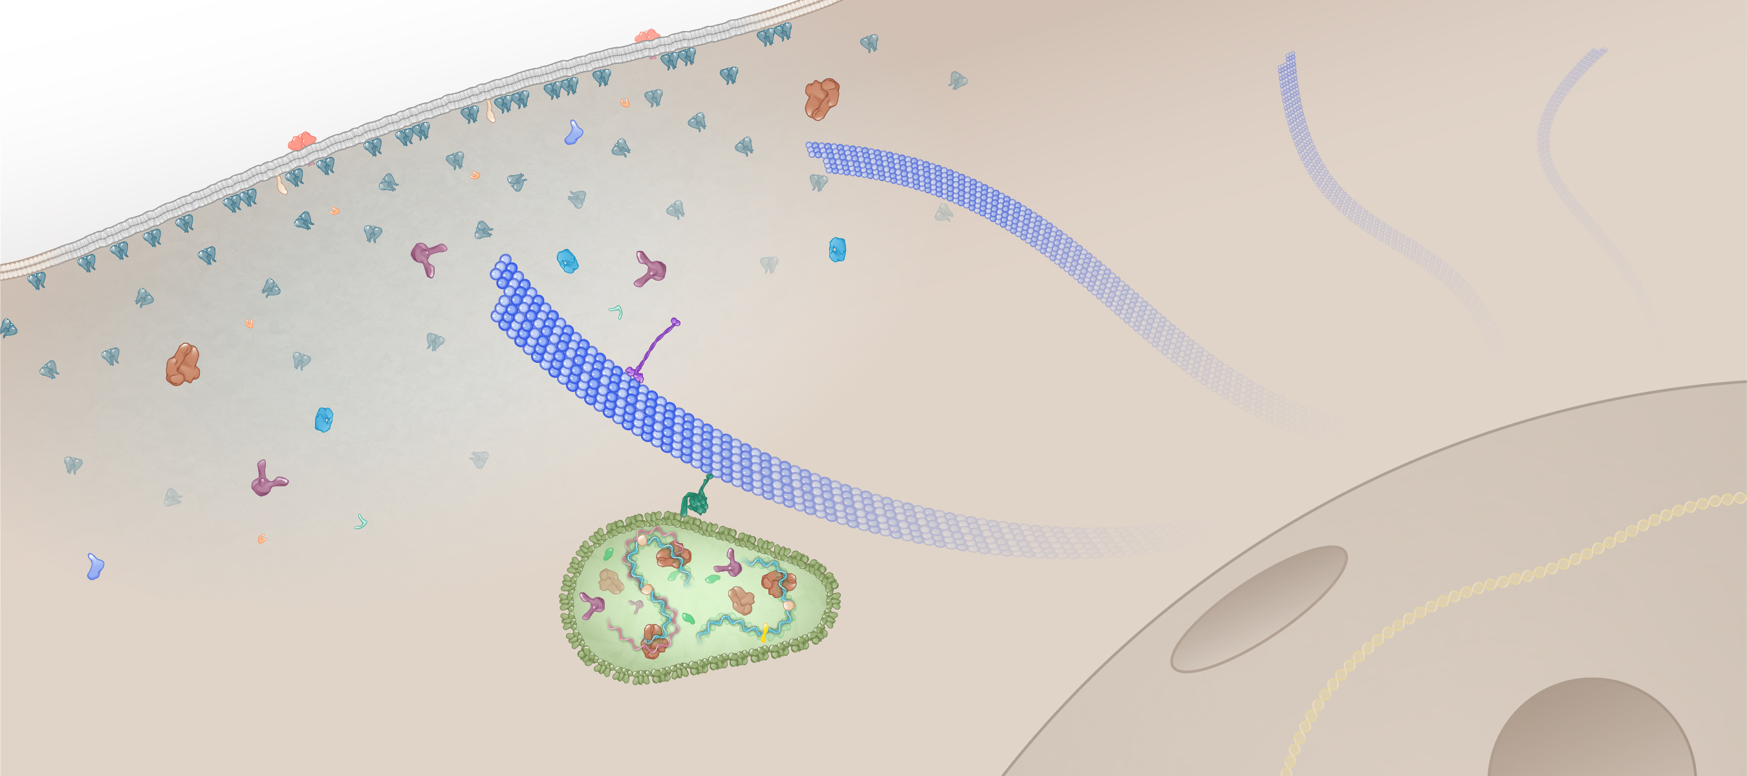
Cytoplasmic Transport and Nuclear Import
Microtubule
Host cell
Nucleus
Illustration: Cognition Studio, Inc. and David H. Spach, MD

Slide 32
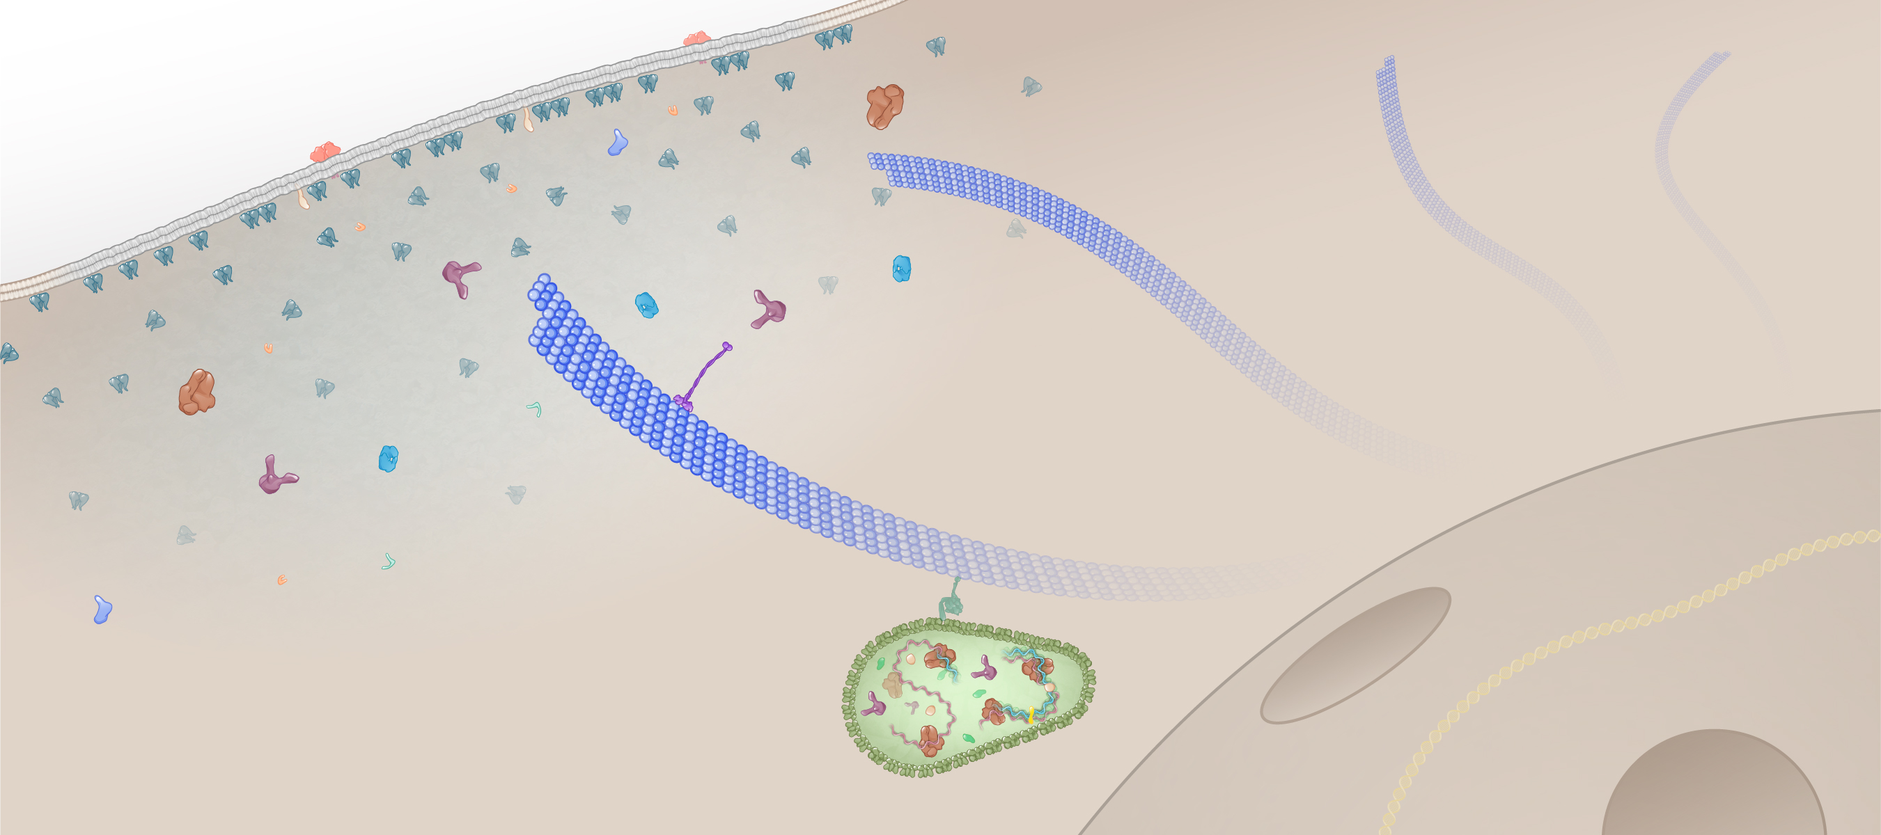
Cytoplasmic Transport and Nuclear Import
Microtubule
Host cell
Nucleus
Illustration: Cognition Studio, Inc. and David H. Spach, MD

Slide 33
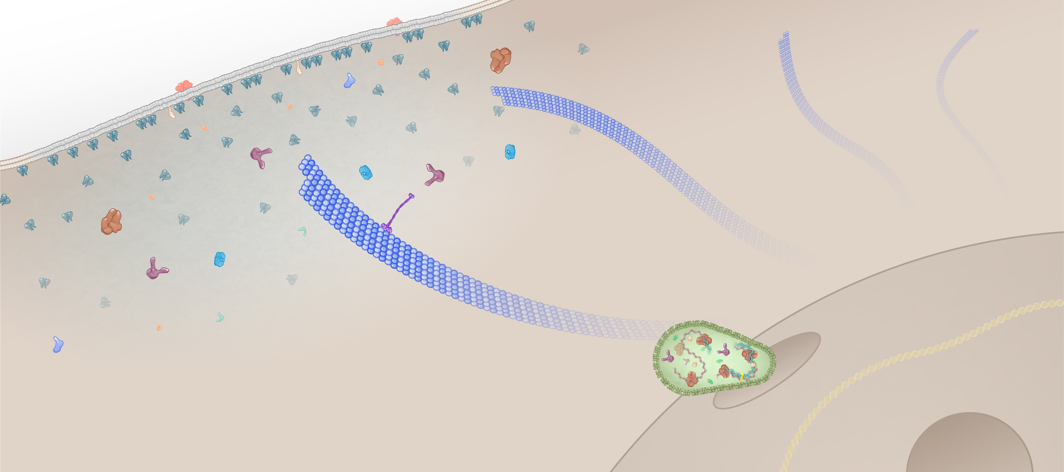
Cytoplasmic Transport and Nuclear Import
Microtubule
Host cell
Nucleus
Illustration: Cognition Studio, Inc. and David H. Spach, MD

Slide 34
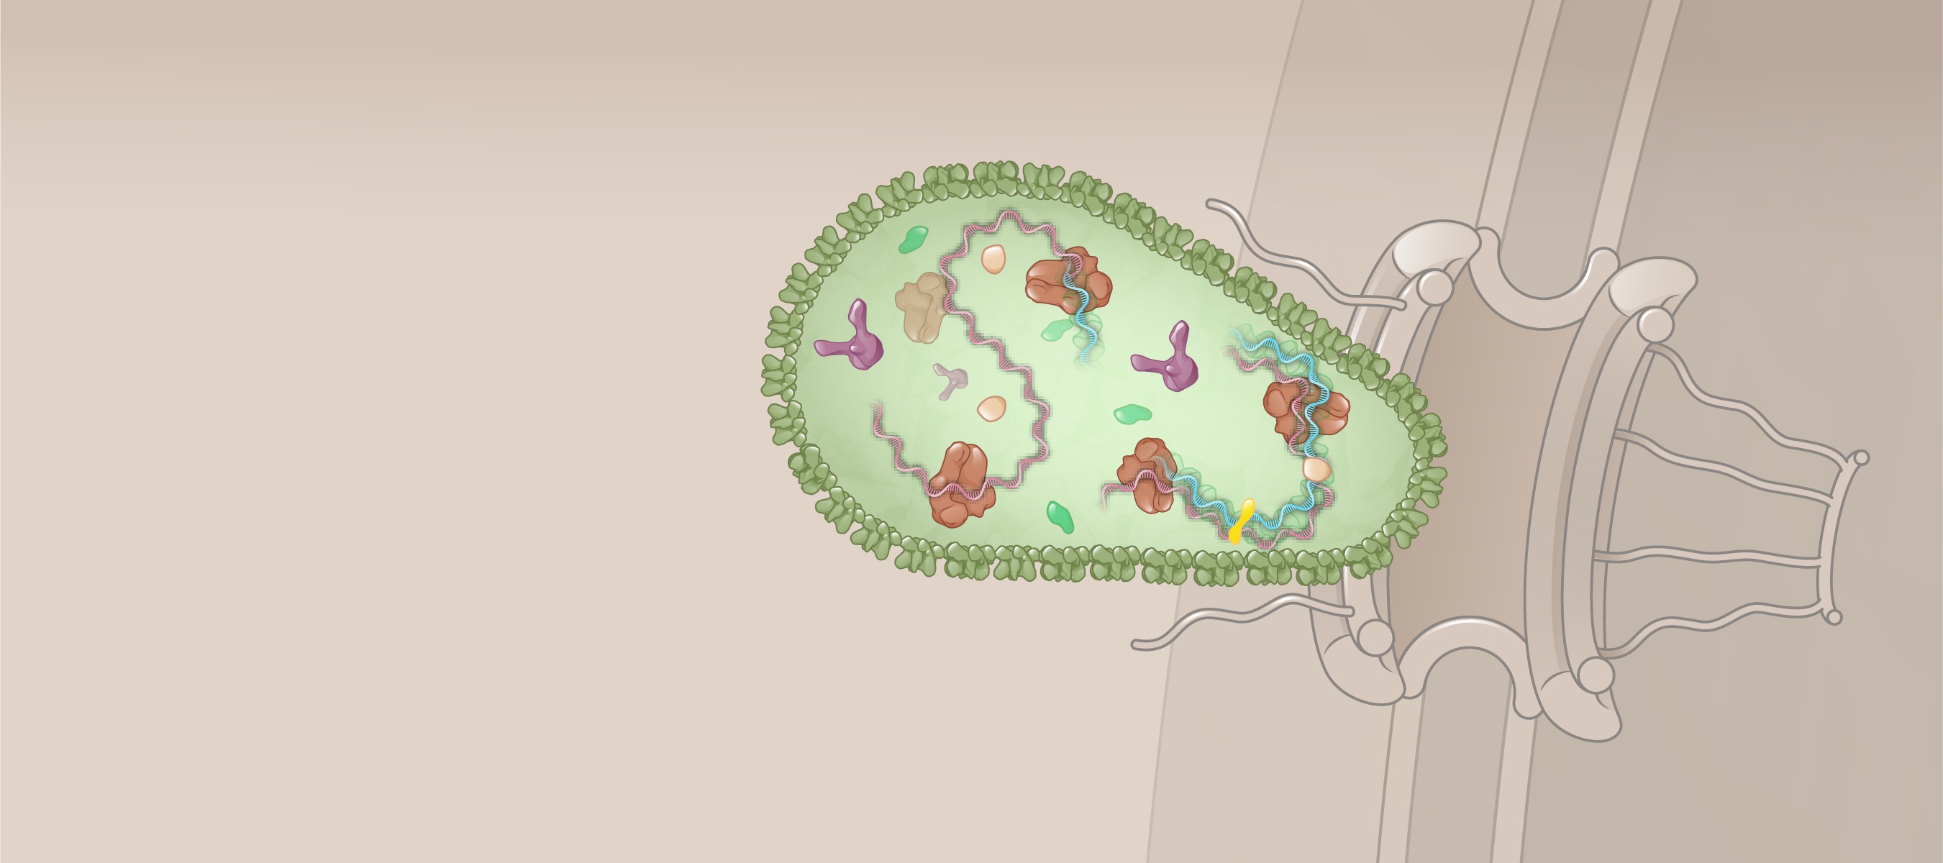
Cytoplasmic Transport and Nuclear Import
Nuclear pore
HIV Core
Host cell
Cytoplasm
Nucleus
Illustration: Cognition Studio, Inc. and David H. Spach, MD

Slide 35
Cytoplasmic Transport and Nuclear Import
Nuclear Pore Complex
Cytoplasmic ring
Central channel
HIV Core
Nuclear ring
Nuclear basket
Host cell
Cytoplasm
Nucleus
Illustration: Cognition Studio, Inc. and David H. Spach, MD

Slide 36
Cytoplasmic Transport and Nuclear Import
Nuclear Pore Complex
HIV Core
NUP 358
Host cell
Cytoplasm
Nucleus
Illustration: Cognition Studio, Inc. and David H. Spach, MD

Slide 37
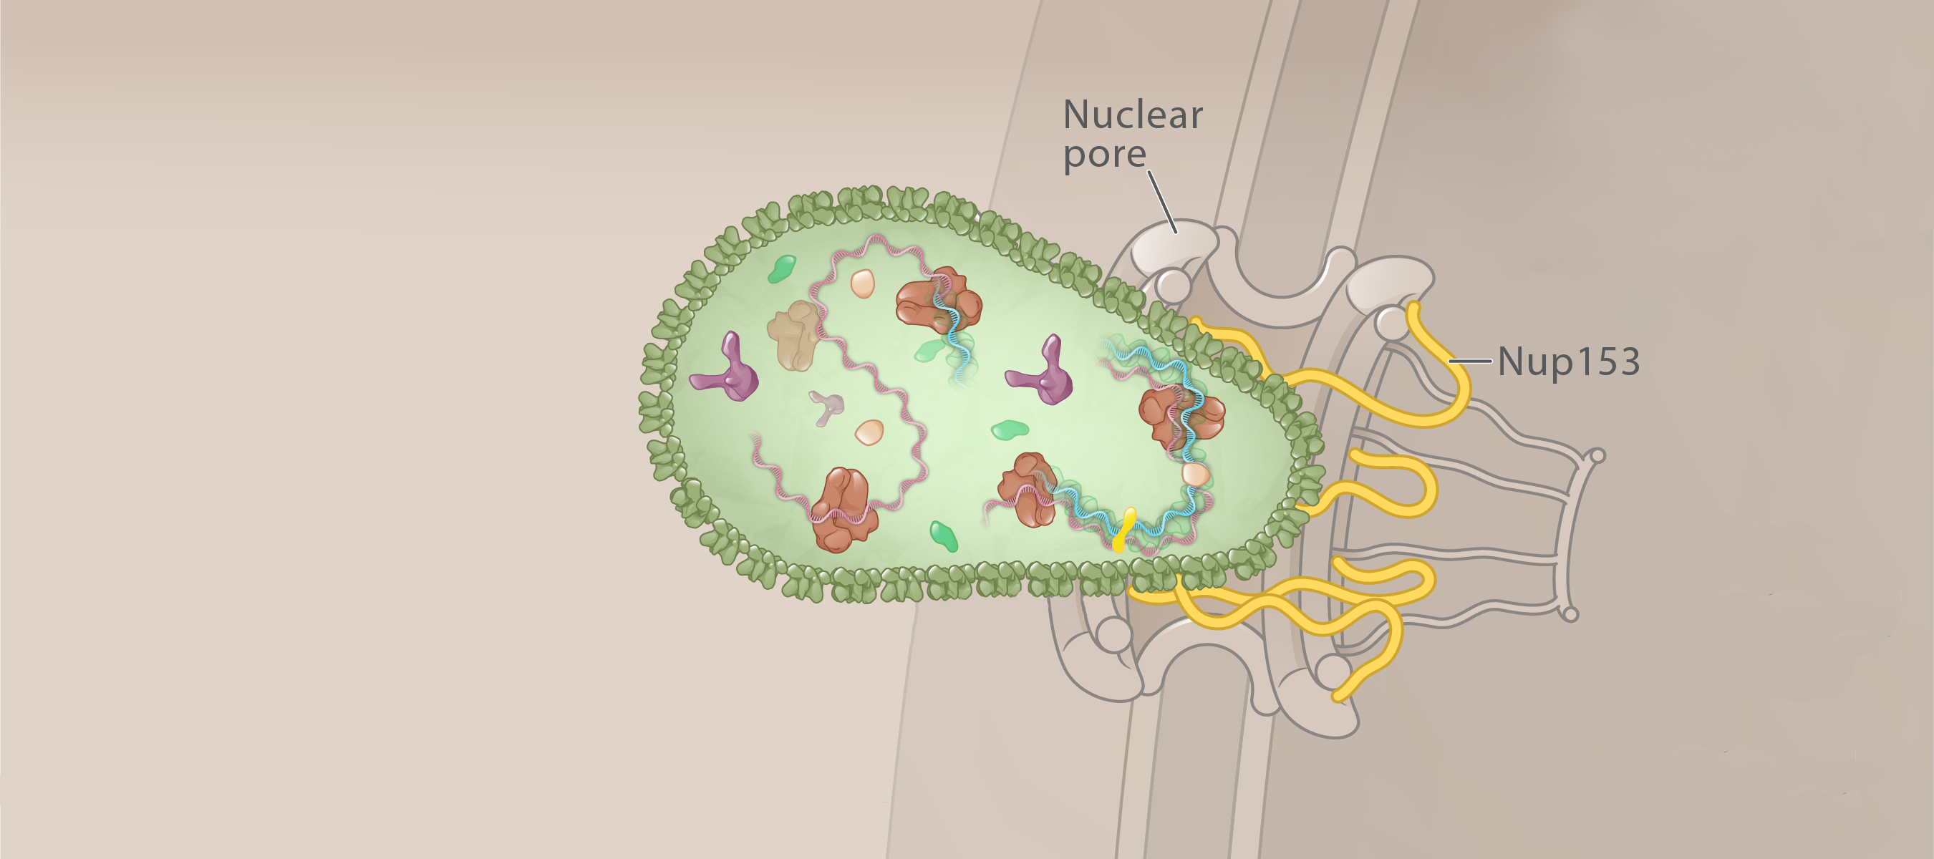
Cytoplasmic Transport and Nuclear Import
Central Channel
NUP 153
Nuclear Basket
NUP 358
NUP 62
Host cell
Cytoplasm
Nucleus
Illustration: Cognition Studio, Inc. and David H. Spach, MD

Slide 38
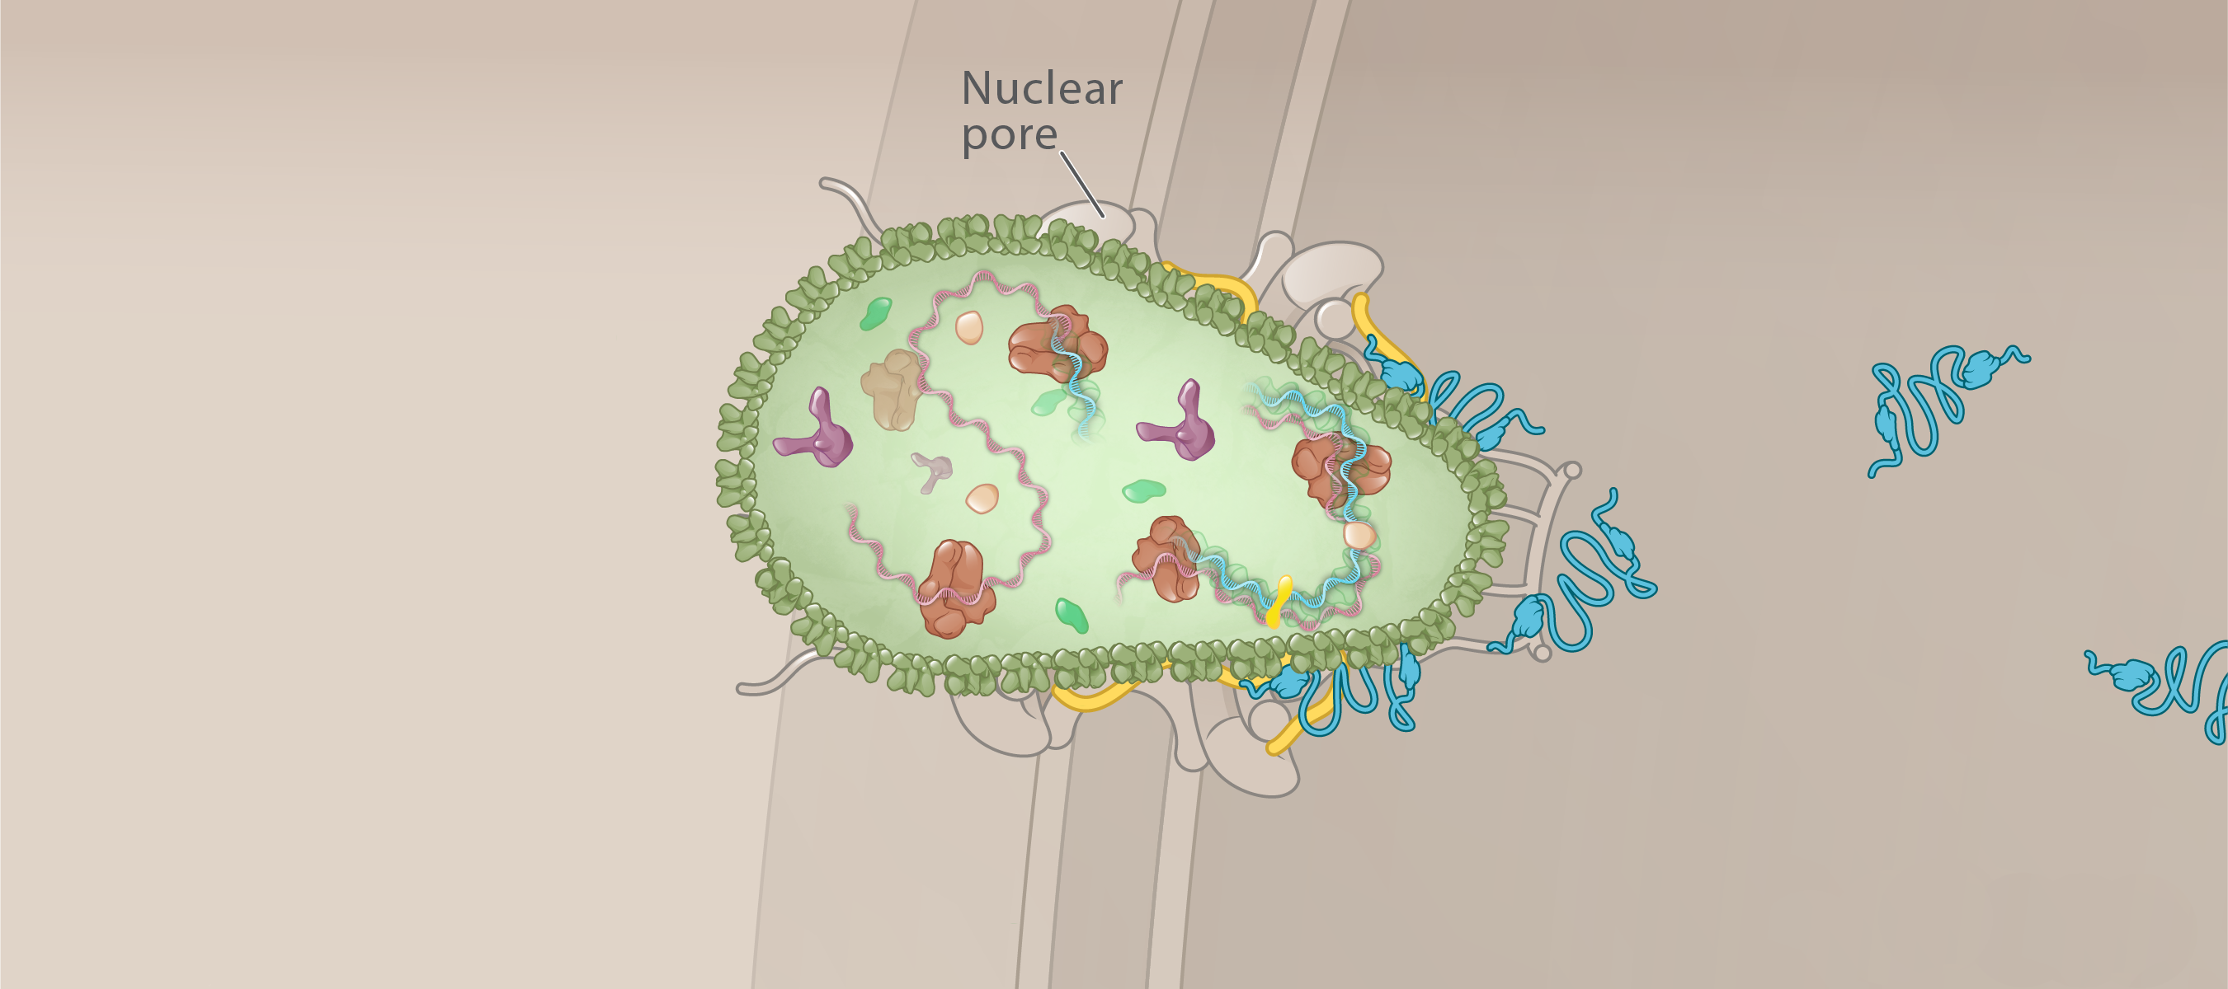
Cytoplasmic Transport and Nuclear Import
Central Channel
CPSF6
CPSF6
Host cell
Cytoplasm
Nucleus
Illustration: Cognition Studio, Inc. and David H. Spach, MD

Slide 39
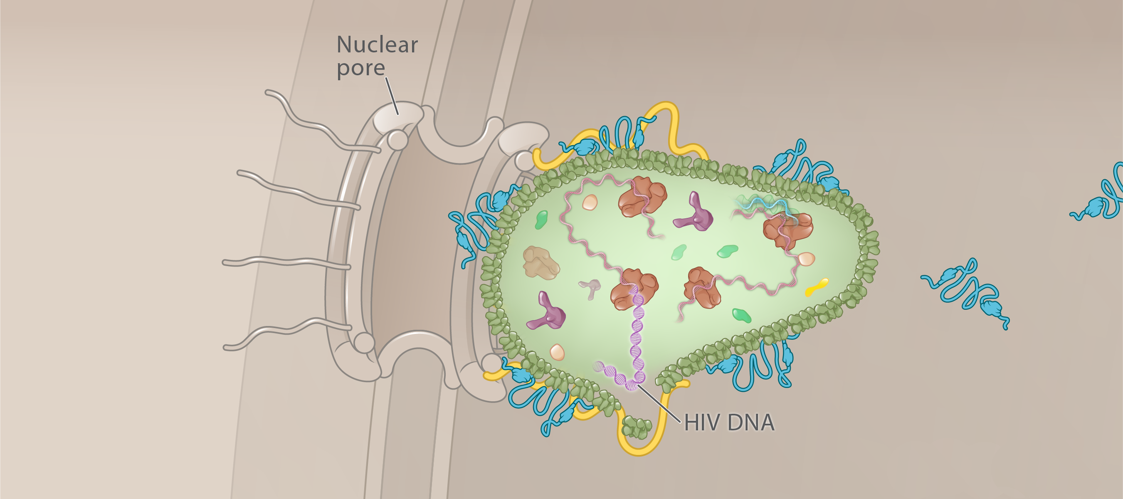
Cytoplasmic Transport and Nuclear Import
NUP 153
CPSF6
Host cell
Nucleus
Illustration: Cognition Studio, Inc. and David H. Spach, MD

Slide 40
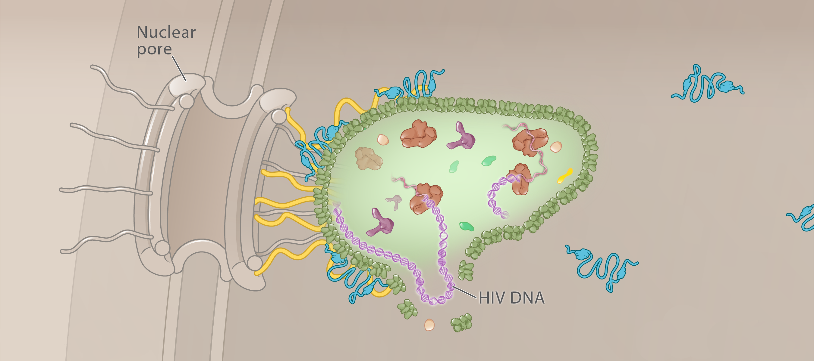
Cytoplasmic Transport and Nuclear Import
Nuclear basket
NUP 153
CPSF6
Host cell
Nucleus
Illustration: Cognition Studio, Inc. and David H. Spach, MD

Slide 41
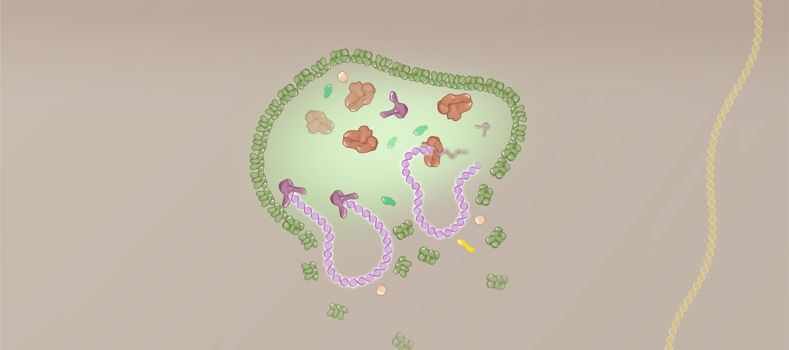
Cytoplasmic Transport and Nuclear Import
Host DNA
CPSF6
Nucleus
Illustration: Cognition Studio, Inc. and David H. Spach, MD

Slide 42
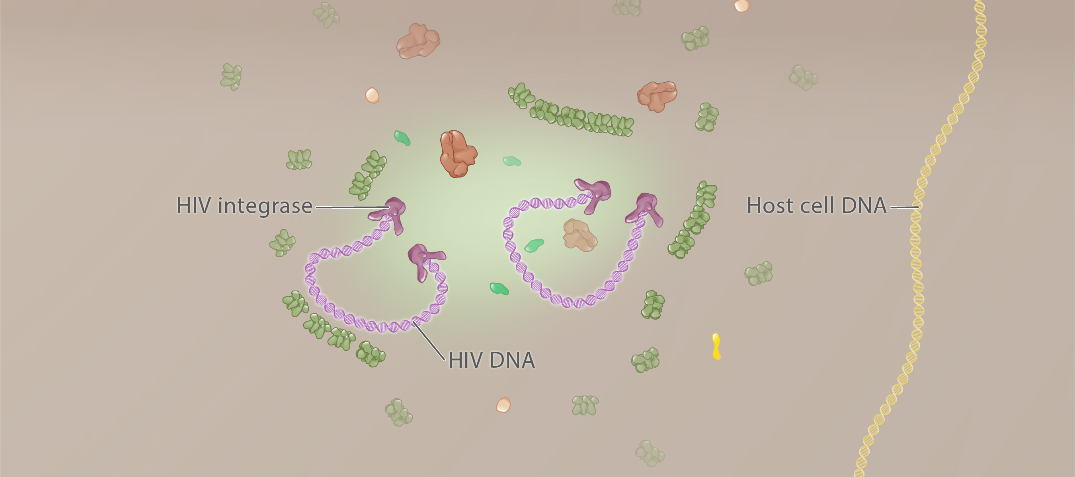
Cytoplasmic Transport and Nuclear Import
Nucleus
Illustration: Cognition Studio, Inc. and David H. Spach, MD

Slide 43
HIV Life Cycle Reverse Transcription
3
Illustration: Cognition Studio, Inc. and David H. Spach, MD

Slide 44
Reverse Transcription
genomic HIV RNA
HIV core
Host cell
Nucleus
Illustration: Cognition Studio, Inc. and David H. Spach, MD

Slide 45
Reverse Transcription
HIV RNA
HIV DNA
Illustration: Cognition Studio, Inc. and David H. Spach, MD

Slide 46
Reverse Transcription
HIV RNA
HIV DNA
Reverse Transcriptase
Illustration: Cognition Studio, Inc. and David H. Spach, MD

Slide 47
Reverse Transcription
Polymerase Active Site
Ribonuclease H (RNase H) Active Site
Reverse Transcriptase
Illustration: Cognition Studio, Inc. and David H. Spach, MD

Slide 48
Reverse Transcription
Intracellular Pool of Nucleotides
C
T
A
A
G
T
C
G
HIV RNA
HIV DNA
Illustration: Cognition Studio, Inc. and David H. Spach, MD

Slide 49
Reverse Transcription
Intracellular Pool of Nucleotides
Phosphate
Nitrogenous Base
Pentose
HIV RNA
HIV DNA
Illustration: Cognition Studio, Inc. and David H. Spach, MD

Slide 50
Reverse Transcription
Human Nucleotides
DNA and RNA
DNA Only
RNA Only
Adenine
Guanine
Cytosine
Thymidine
Uracil
A
G
C
T
U
Illustration: David H. Spach, MD

Slide 51
Reverse Transcription
Adenine
Guanine
Cytosine
Thymidine
Uracil
A
G
C
T
U
Adenine
Guanine
Cytosine
Thymidine
Uracil
Illustration: David H. Spach, MD

Slide 52
Reverse Transcription
Host Cell Nucleotides
HIV RNA Template
Reverse Transcriptase
Host cell
Illustration: David H. Spach, MD

Slide 53
Reverse Transcription
Host Cell Nucleotides
HIV RNA Template
Reverse Transcriptase
Host cell
Illustration: David H. Spach, MD

Slide 54
Reverse Transcription
Host Cell Nucleotides
HIV RNA Template
Reverse Transcriptase
Host cell
Illustration: David H. Spach, MD

Slide 55
Reverse Transcription
Host Cell Nucleotides
HIV RNA Template
Reverse Transcriptase
Host cell
Illustration: David H. Spach, MD

Slide 56
Reverse Transcription
Host Cell Nucleotides
HIV RNA Template
Reverse Transcriptase
Host cell
Illustration: David H. Spach, MD

Slide 57
Reverse Transcription
Host Cell Nucleotides
HIV RNA Template
Reverse Transcriptase
Host cell
Illustration: Cognition Studio, Inc. and David H. Spach, MD

Slide 58
Reverse Transcription
Host Cell Nucleotides
HIV RNA Template
Reverse Transcriptase
Host cell
Illustration: Cognition Studio, Inc. and David H. Spach, MD

Slide 59
Reverse Transcription
Host Cell Nucleotides
Primer
Template
Reverse Transcriptase
Host cell
Host cell
Illustration: Cognition Studio, Inc. and David H. Spach, MD

Slide 60
Reverse Transcription
genomic HIV RNA
Reverse transcriptase
HIV core
Host cell
Nucleus
Illustration: Cognition Studio, Inc. and David H. Spach, MD

Slide 61
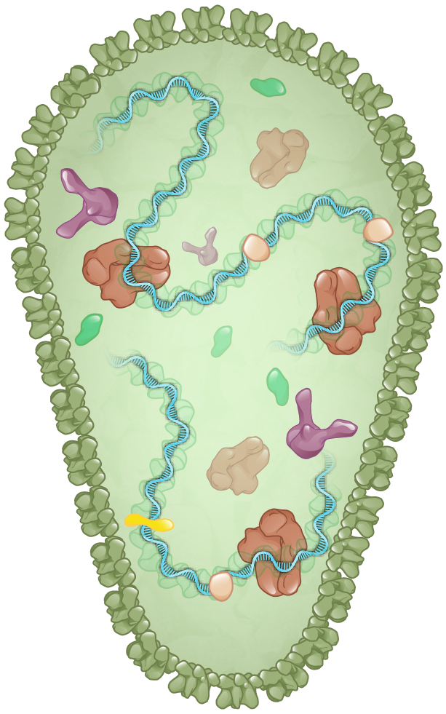
Reverse Transcription
HIV RNA
HIV Reverse Transcriptase
Host cell
Illustration: Cognition Studio, Inc., and David H. Spach, MD

Slide 62
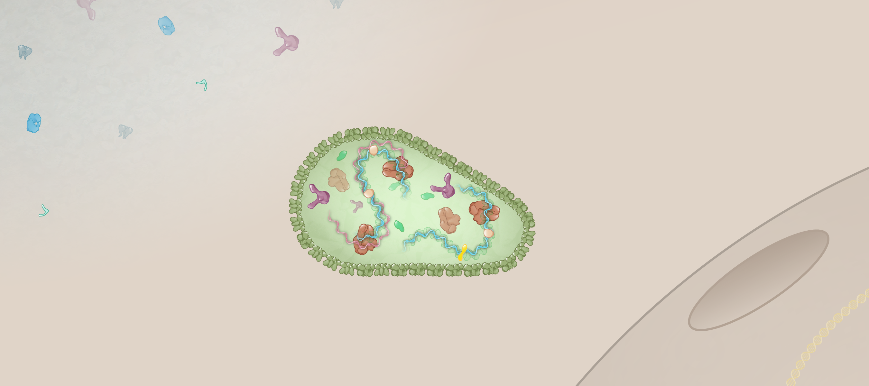
Reverse Transcription
HIV RNA-DNA Hybrid
HIV RNA
Nuclear pore
HIV Reverse Transcriptase
HIV core
Host cell
Host cell nucleus
Illustration: Cognition Studio, Inc., and David H. Spach, MD

Slide 63
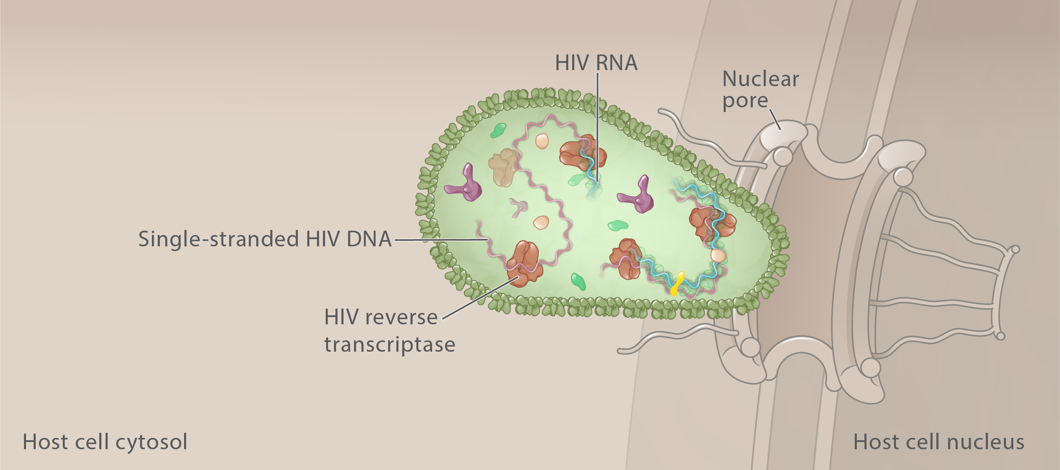
Reverse Transcription
Single-Stranded HIV DNA
Illustration: Cognition Studio, Inc., and David H. Spach, MD

Slide 64
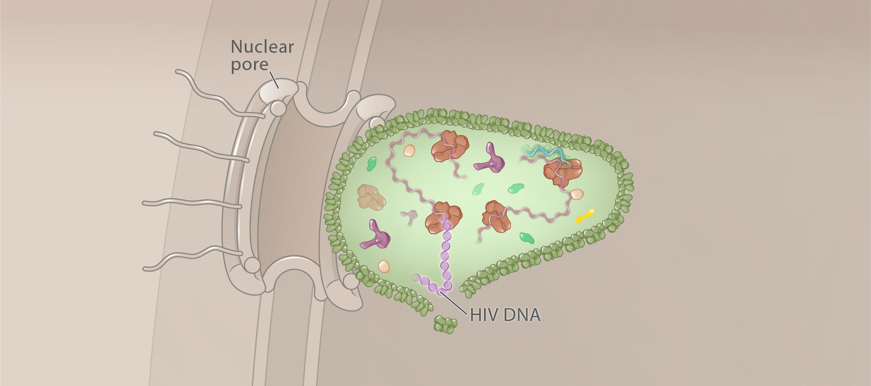
Reverse Transcription
HIV core
Double-Stranded HIV DNA
Host cell nucleus
Illustration: Cognition Studio, Inc. and David H. Spach, MD

Slide 65
Reverse Transcription
HIV core
Double-Stranded HIV DNA
Host cell nucleus
Illustration: Cognition Studio, Inc. and David H. Spach, MD

Slide 66
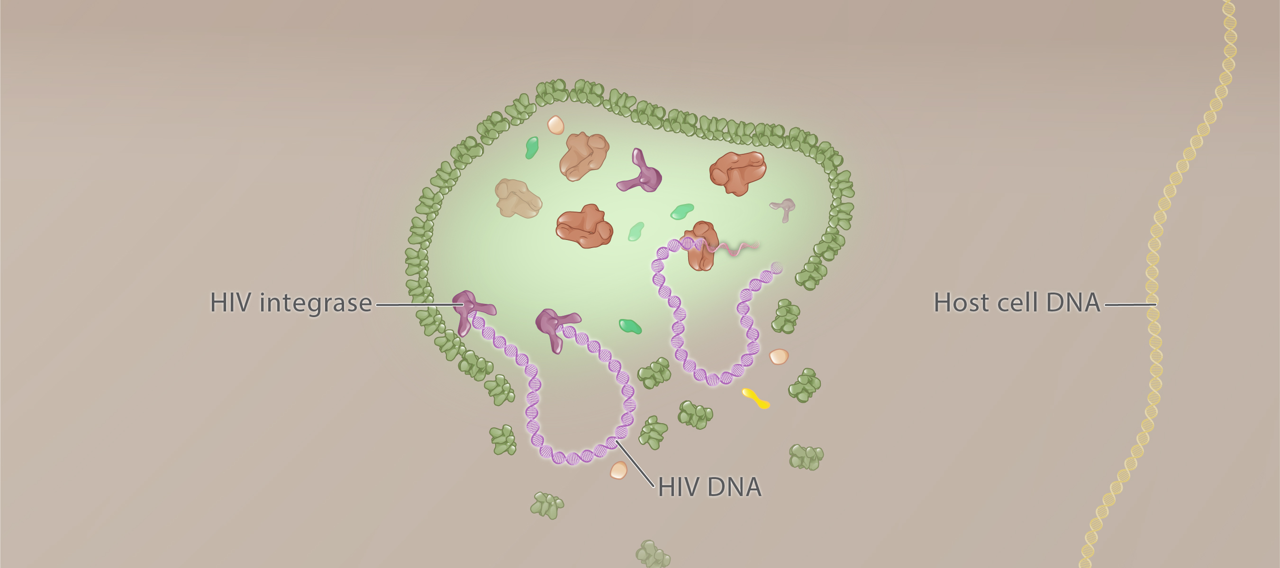
Nuclear Transport and Reverse Transcription
HIV DNA
Host cell nucleus
Illustration: Cognition Studio, Inc. and David H. Spach, MD

Slide 67
HIV Life Cycle Integration
4
Illustration: Cognition Studio, Inc. and David H. Spach, MD

Slide 68
Integration
Nucleus
Illustration: Cognition Studio, Inc. and David H. Spach, MD

Slide 69
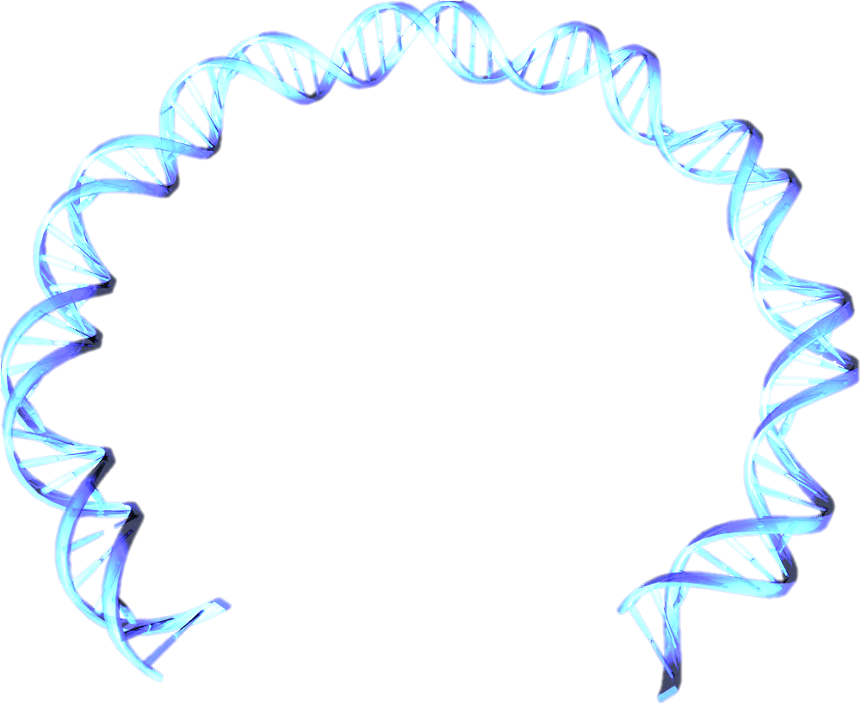
Integration
HIV DNA
HIV Integrase
Intasome
Nucleus
Illustration: Cognition Studio, Inc. and David H. Spach, MD

Slide 70
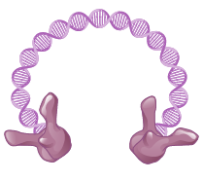
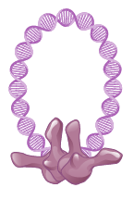
Integration
HIV DNA
Dimer
Dimer
HIV Integrase
Intasome
Tetramer
Illustration: Cognition Studio, Inc. and David H. Spach, MD

Slide 71
Integration
HIV DNA
3ʹ
HIV Integrase
3ʹ
Nucleus
Illustration: Cognition Studio, Inc. and David H. Spach, MD

Slide 72
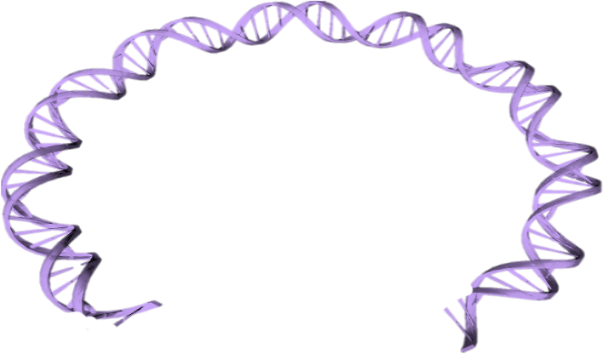
Integration
HIV DNA
HIV Integrase
Nucleotides
Nucleus
Illustration: Cognition Studio, Inc. and David H. Spach, MD

Slide 73
Integration
HIV DNA
3ʹOH
3ʹOH
HIV Integrase
Nucleus
Illustration: Cognition Studio, Inc. and David H. Spach, MD

Slide 74
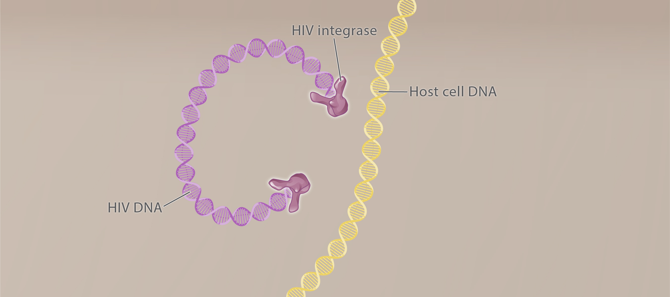
Integration
Nucleus
Illustration: Cognition Studio, Inc., and David H. Spach, MD

Slide 75
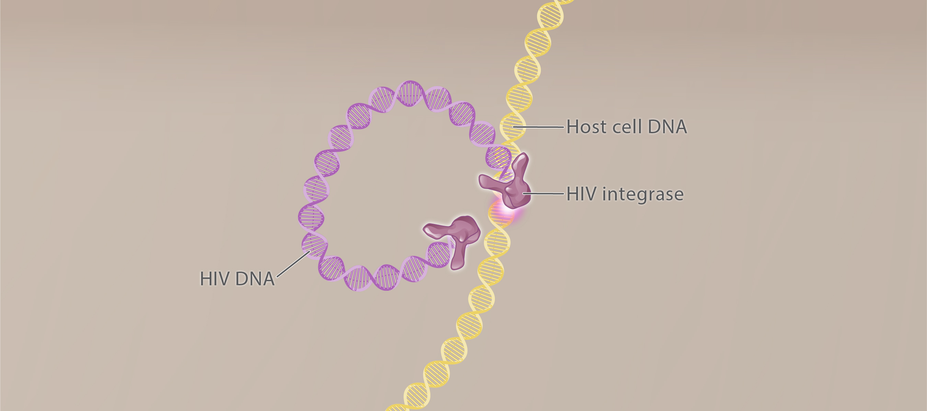
Integration
Intasome
Nucleus
Illustration: Cognition Studio, Inc., and David H. Spach, MD

Slide 76
Integration
Catalytic core
Nucleus
Illustration: Cognition Studio, Inc., and David H. Spach, MD

Slide 77
Integration
HIV DNA
d
3’OH
Host cell DNA
Catalytic core region
Nucleus
Illustration: Cognition Studio, Inc., and David H. Spach, MD

Slide 78
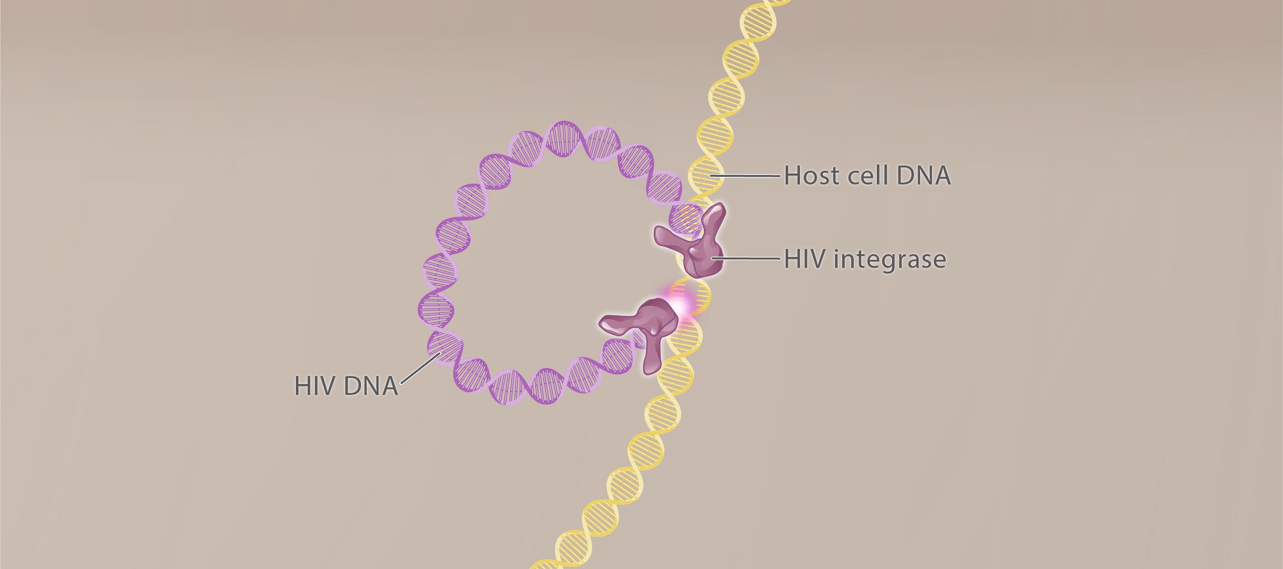
Integration
Nucleus
Illustration: Cognition Studio, Inc., and David H. Spach, MD

Slide 79
Integration
Host cell DNA
HIV DNA
Nucleus
Illustration: Cognition Studio, Inc., and David H. Spach, MD

Slide 80
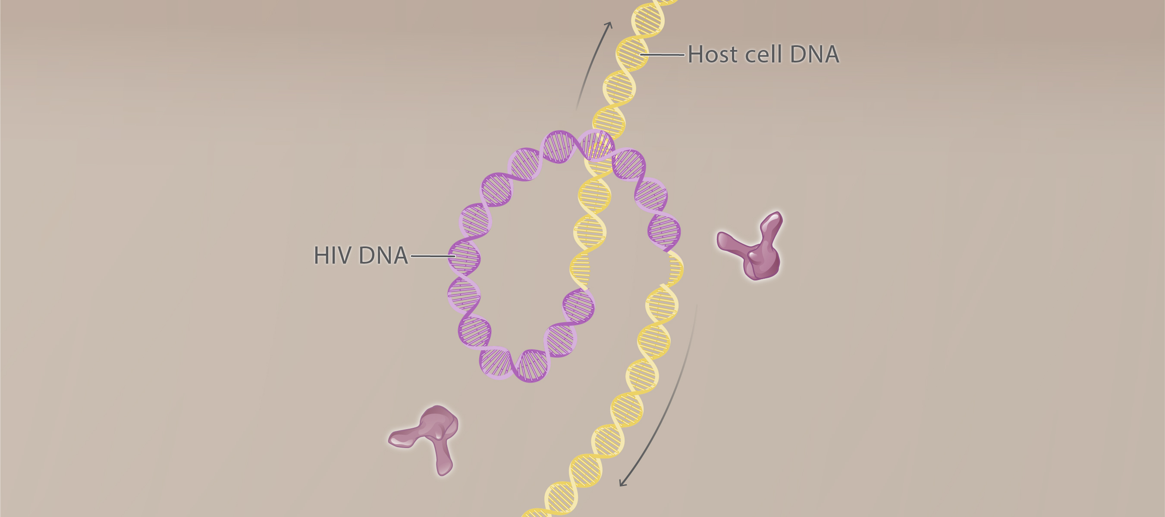
Integration
Nucleus
Illustration: Cognition Studio, Inc., and David H. Spach, MD

Slide 81
Integration
Host cell DNA
HIV DNA
Nucleus
Illustration: Cognition Studio, Inc., and David H. Spach, MD

Slide 82
Integration
Host cell DNA
Host nucleotides
Host nucleotides
Nucleus
Illustration: Cognition Studio, Inc., and David H. Spach, MD

Slide 83
Integration
Host cell DNA
HIV provirus
Nucleus
Illustration: Cognition Studio, Inc., and David H. Spach, MD

Slide 84
HIV Life Cycle Transcription
5
Illustration: Cognition Studio, Inc. and David H. Spach, MD

Slide 85
Transcription
Host cell DNA
Host Cell RNA Polymerase
HIV DNA
Nucleus
Nucleus
Illustration: Cognition Studio, Inc. and David H. Spach, MD

Slide 86
Transcription
Host cell DNA
Host Cell Nucleotides
HIV DNA
Nucleus
Nucleus
Illustration: Cognition Studio, Inc. and David H. Spach, MD

Slide 87
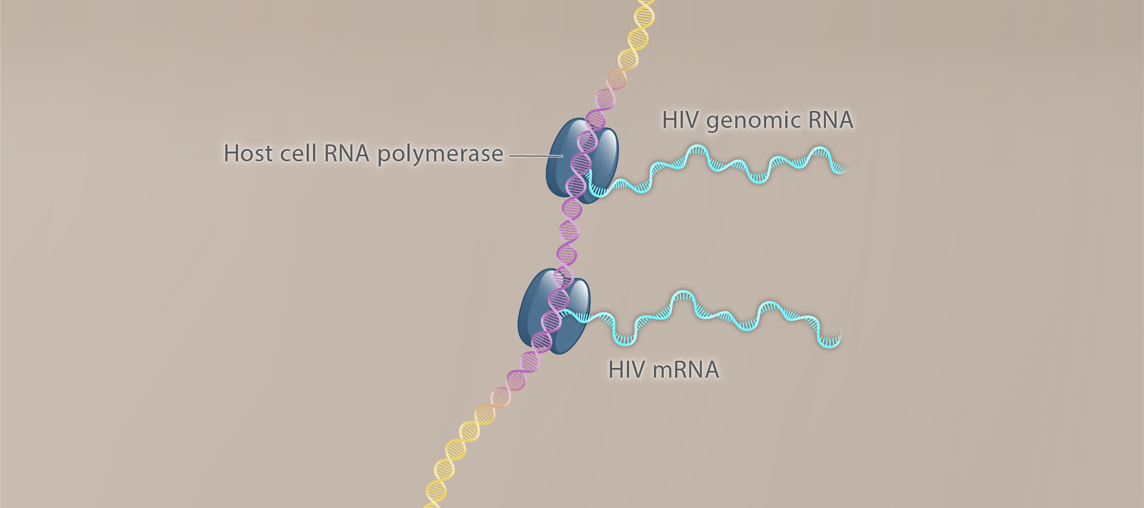
Transcription
HIV genomic RNA
HIV DNA
HIV mRNA
Nucleus
Nucleus
Illustration: Cognition Studio, Inc. and David H. Spach, MD

Slide 88
Transcription
Promoter region
HIV genomic RNA
HIV DNA
HIV mRNA
Nucleus
Illustration: Cognition Studio, Inc. and David H. Spach, MD

Slide 89
Transcription
HIV genomic RNA
HIV DNA
HIV mRNA
Nucleus
Illustration: Cognition Studio, Inc. and David H. Spach, MD

Slide 90
Transcription
HIV genomic RNA
HIV DNA
HIV Tat
HIV mRNA
Nucleus
Illustration: Cognition Studio, Inc. and David H. Spach, MD

Slide 91
Transcription
HIV genomic RNA
HIV DNA
HIV Tat
HIV mRNA
Nucleus
Illustration: Cognition Studio, Inc. and David H. Spach, MD

Slide 92
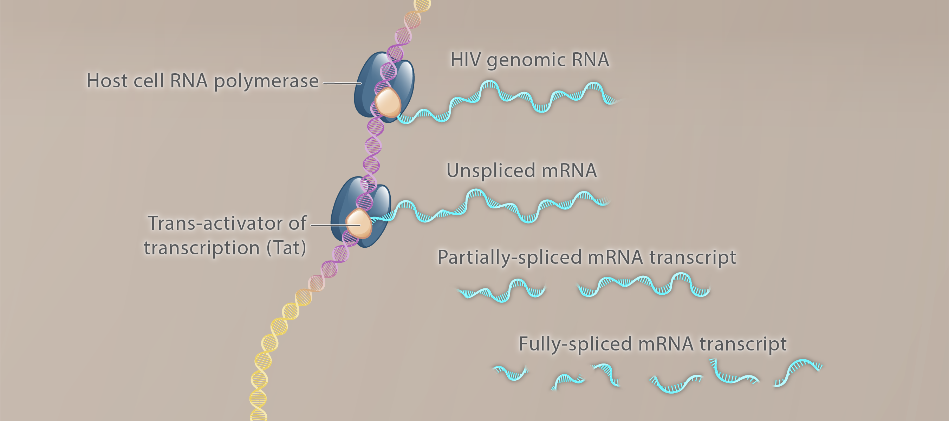
Transcription
Full-Length RNA transcript
1
2
3
Nucleus
Illustration: Cognition Studio, Inc. and David H. Spach, MD

Slide 93
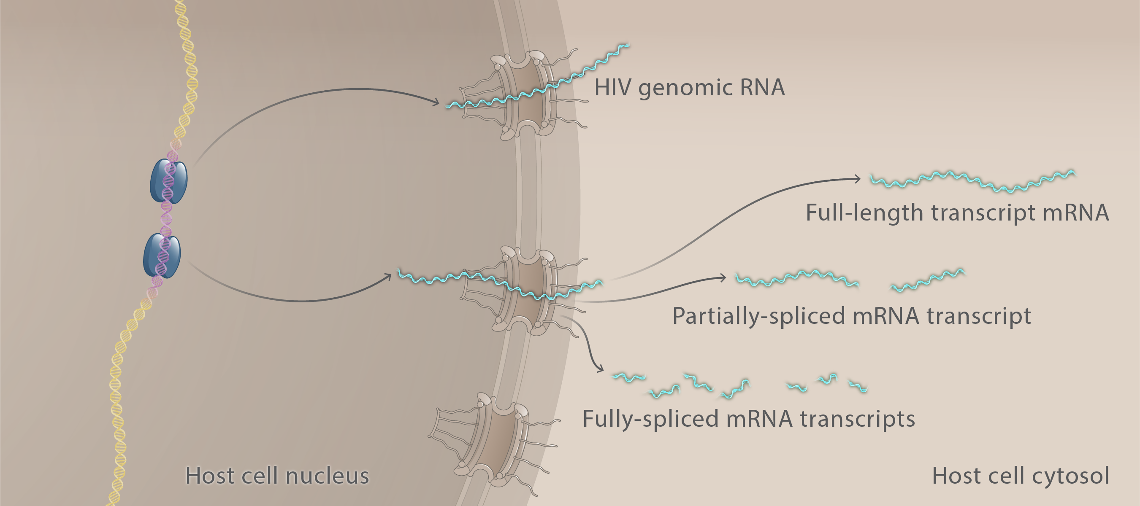
Transcription
Illustration: Cognition Studio, Inc. and David H. Spach, MD

Slide 94
HIV Life Cycle Translation
6
Illustration: Cognition Studio, Inc. and David H. Spach, MD

Slide 95
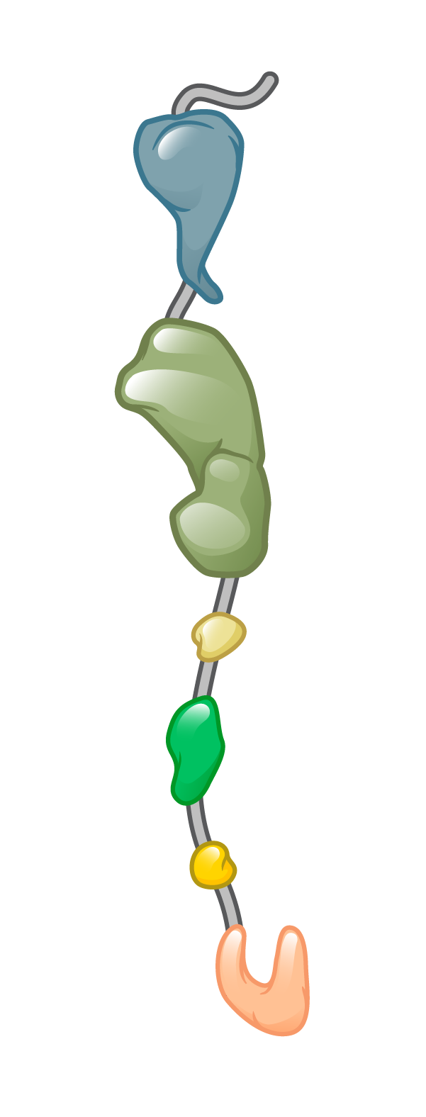
Translation
Amino Acids
Ribosome
tRNA
Nucleus
Host cell cytosol
mRNA
Illustration: Cognition Studio, Inc., and David H. Spach, MD

Slide 96
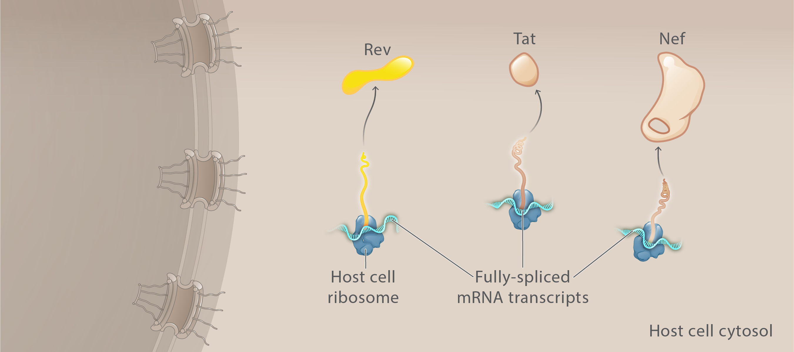
Translation
Nucleus
Illustration: Cognition Studio, Inc., and David H. Spach, MD

Slide 97
Translation
Nucleus
Illustration: Cognition Studio, Inc. and David H. Spach, MD

Slide 98
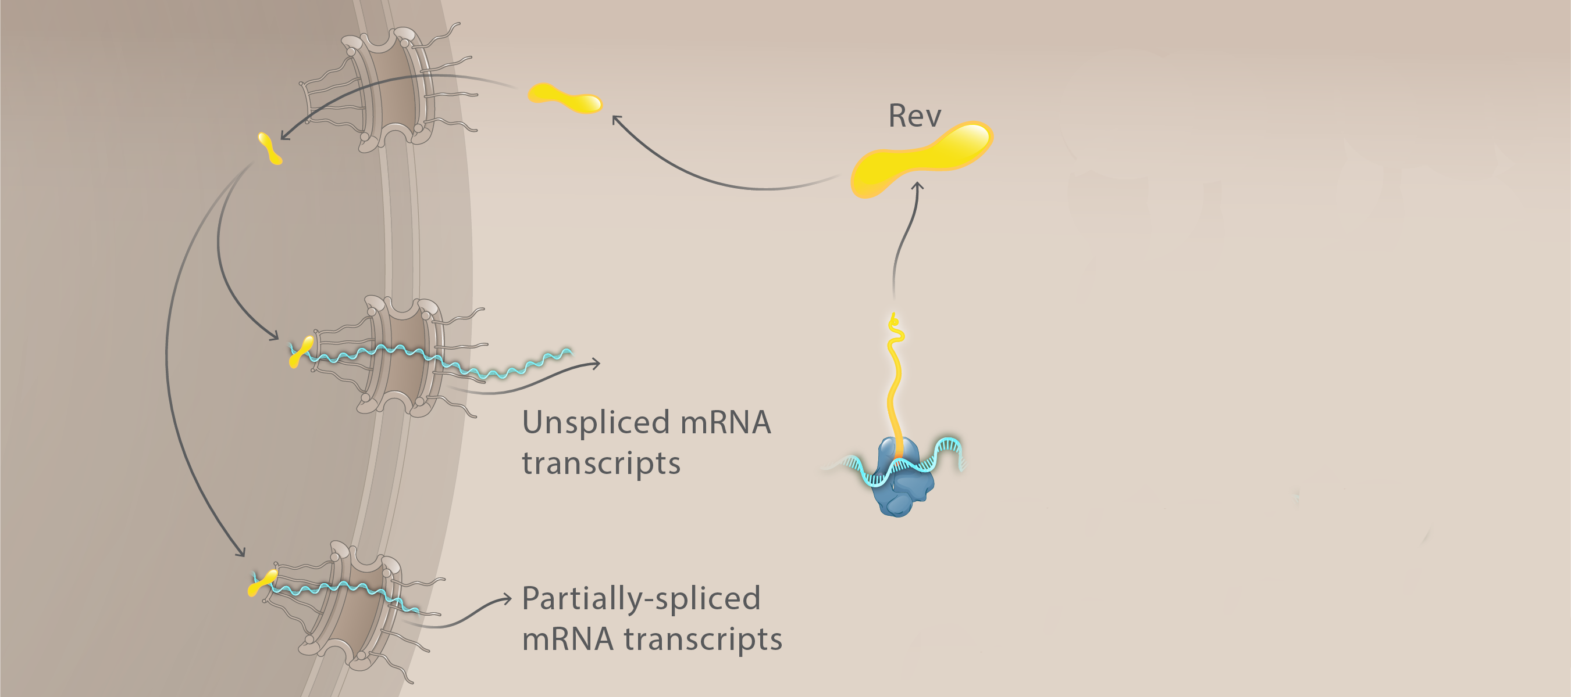
Translation
Rev
Nucleus
Host cell cytosol
Illustration: Cognition Studio, Inc. and David H. Spach, MD

Slide 99
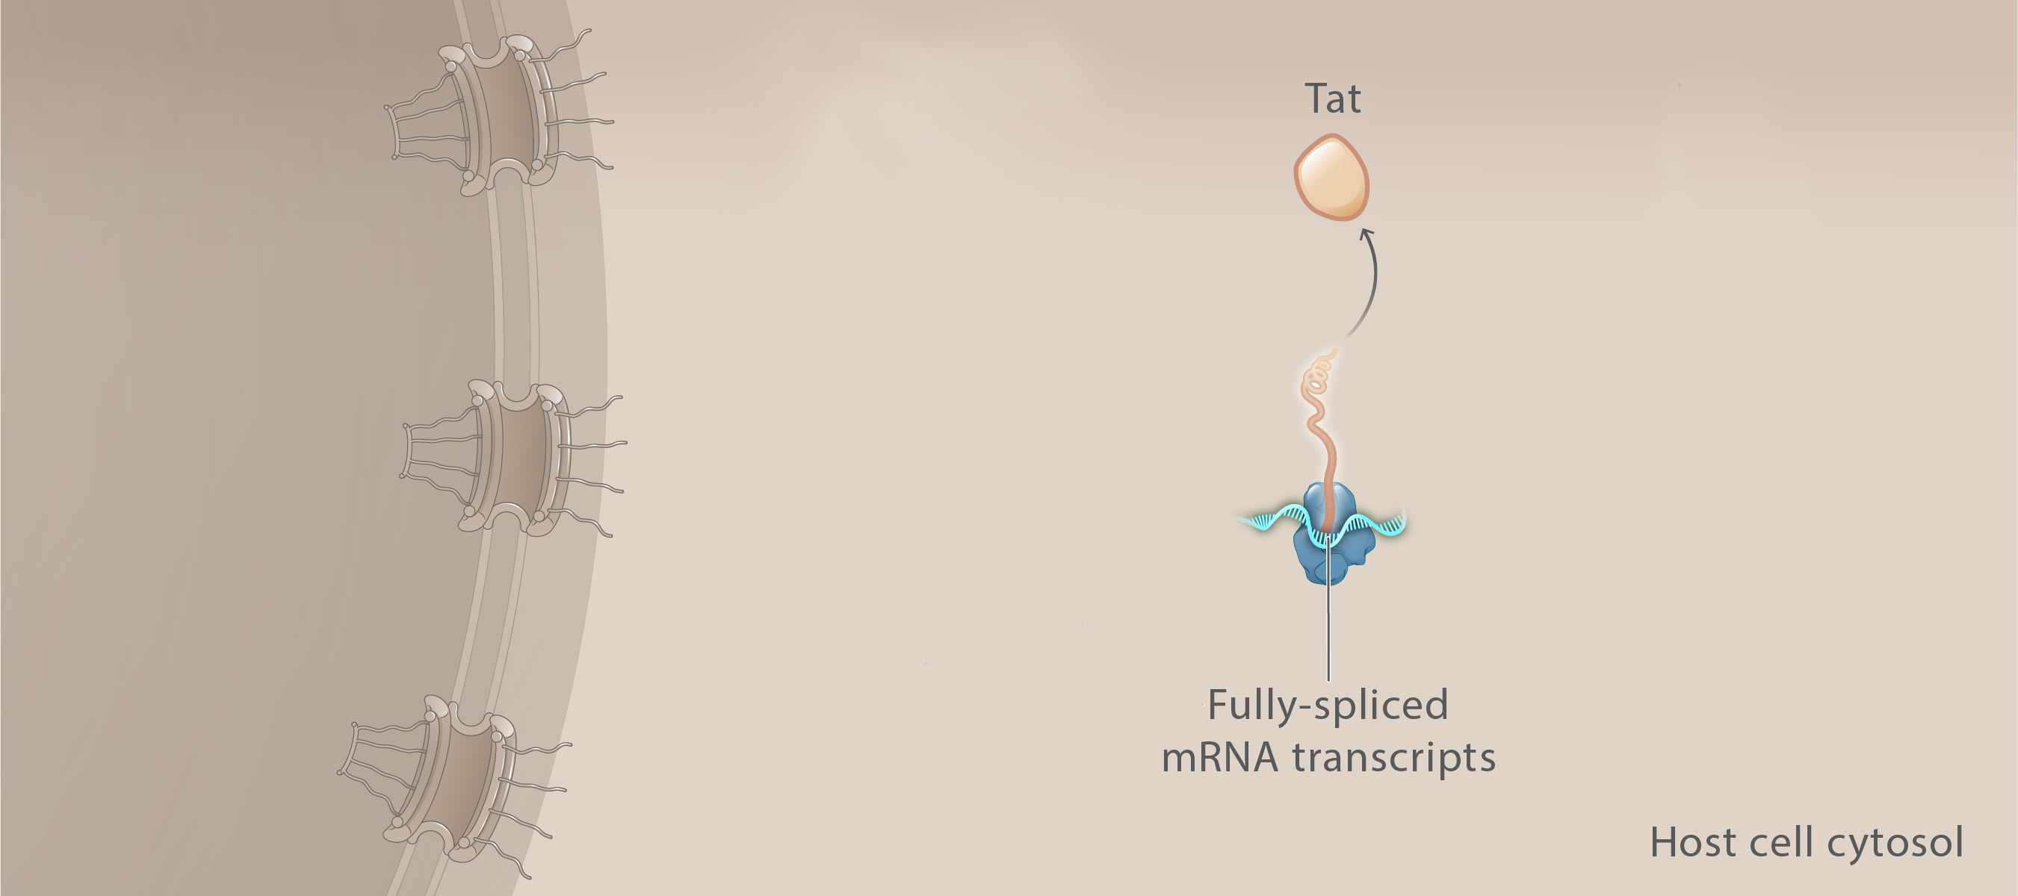
Translation
Tat
Nucleus
Illustration: Cognition Studio, Inc., and David H. Spach, MD

Slide 100
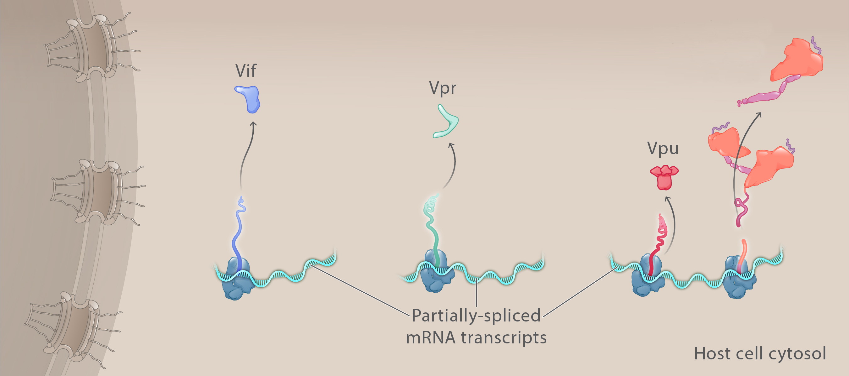
Translation
HIV glycoprotein precursor
(gp160)
Nucleus
Illustration: Cognition Studio, Inc., and David H. Spach, MD

Slide 101
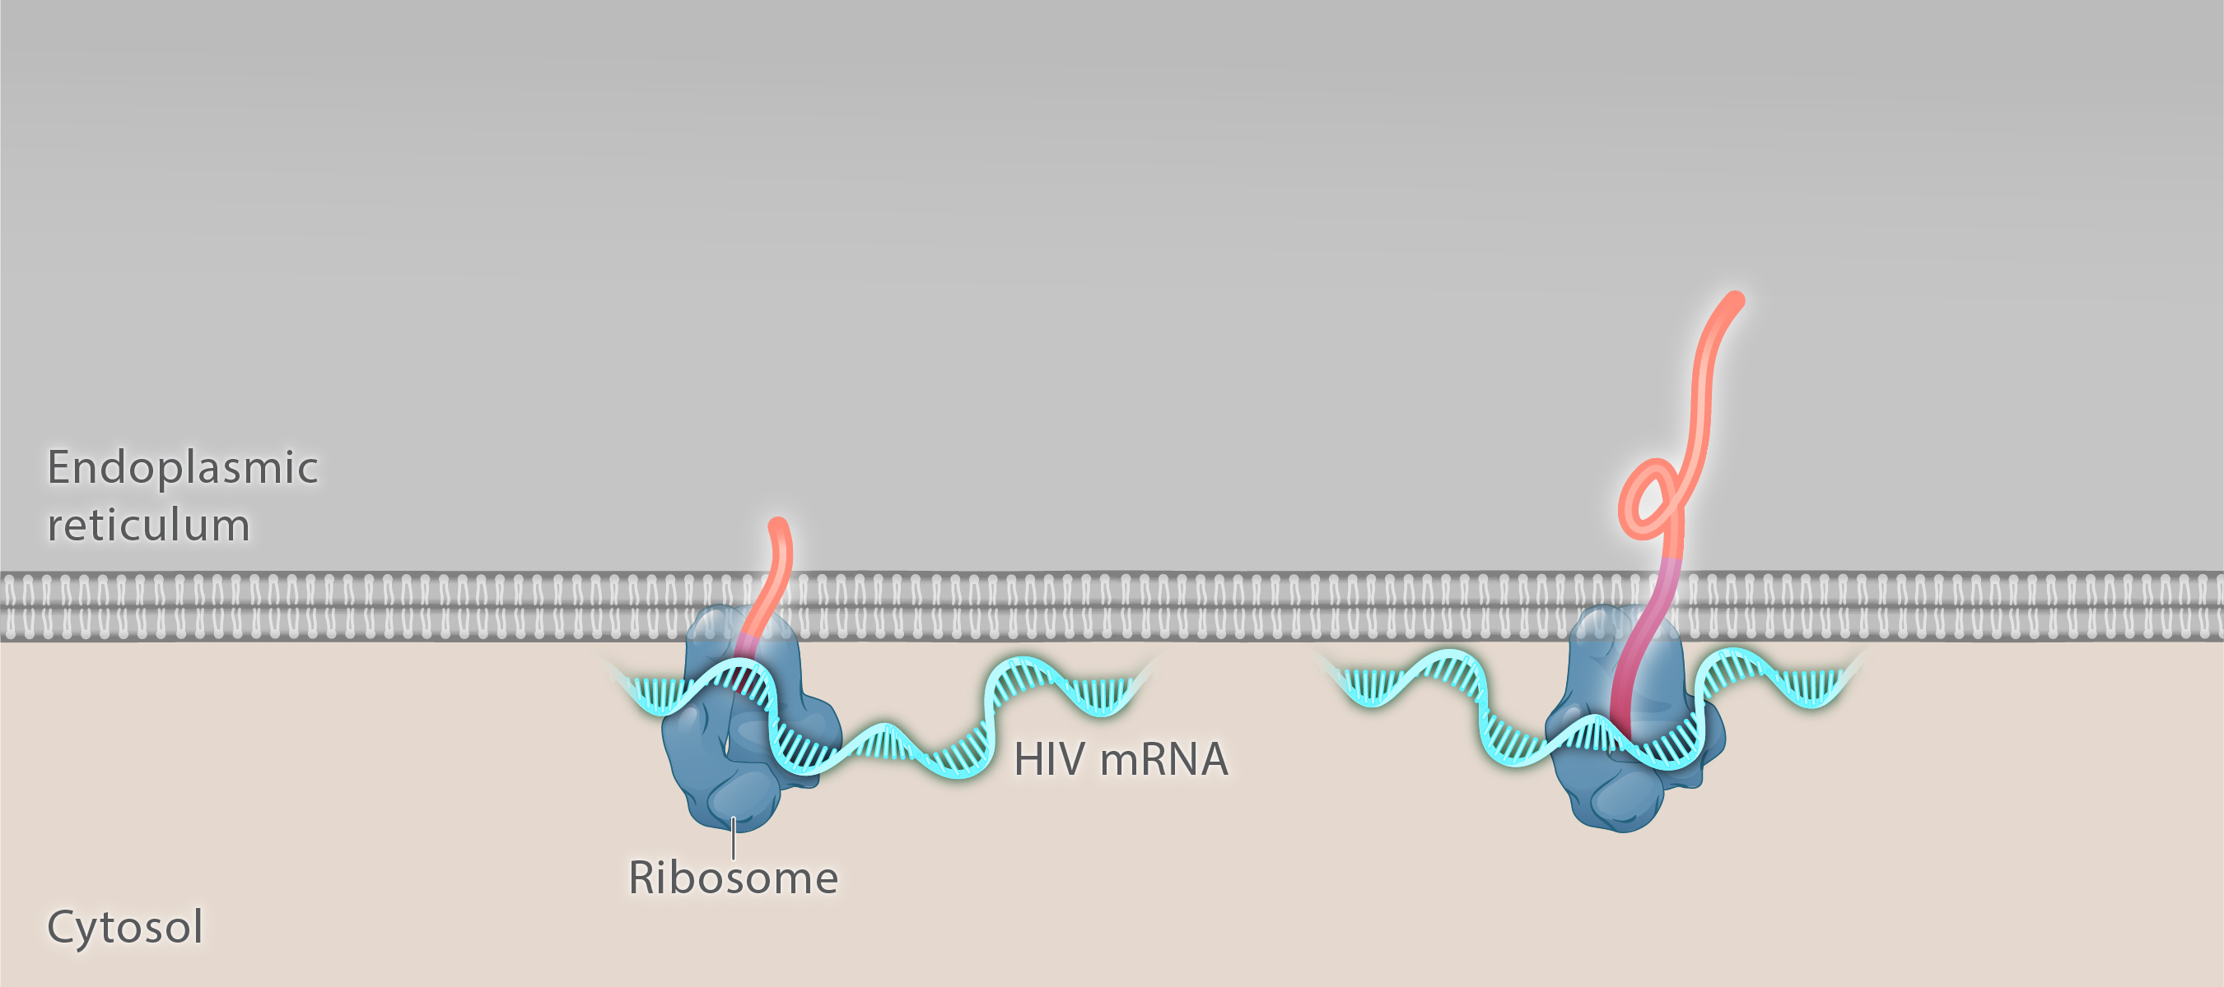
Translation
Illustration: Cognition Studio, Inc., and David H. Spach, MD

Slide 102
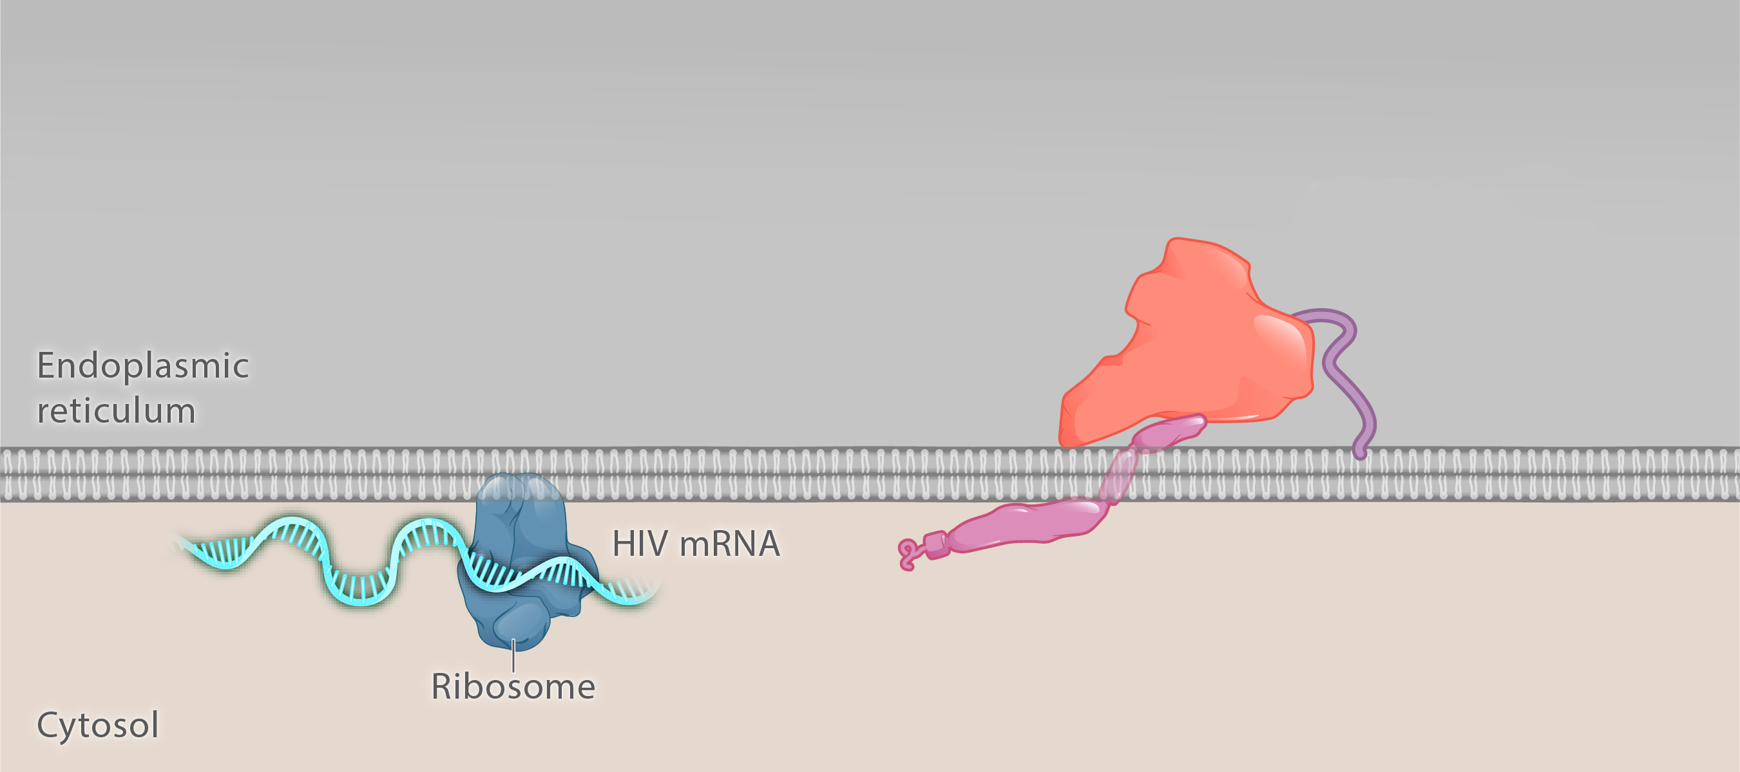
Translation
Vpu
HIV envelope precursor protein (gp160)
Signal peptide
Illustration: Cognition Studio, Inc., and David H. Spach, MD

Slide 103
Translation
HIV envelope precursor protein (gp160)
Oligosaccharides
Signal peptide
Illustration: Cognition Studio, Inc., and David H. Spach, MD

Slide 104
Translation
HIV envelope precursor protein (gp160)
Glycan Shield
Signal peptide
Illustration: Cognition Studio, Inc., and David H. Spach, MD

Slide 105
Translation
HIV envelope precursor protein (gp160)
Signal peptidase
Signal peptide
Illustration: Cognition Studio, Inc., and David H. Spach, MD

Slide 106
Translation
HIV gp160
Illustration: Cognition Studio, Inc., and David H. Spach, MD

Slide 107
Translation
Illustration: Cognition Studio, Inc., and David H. Spach, MD

Slide 108
Translation
HIV gp160
Illustration: Cognition Studio, Inc., and David H. Spach, MD

Slide 109
Translation
Furin
Illustration: Cognition Studio, Inc., and David H. Spach, MD

Slide 110
Translation
Illustration: Cognition Studio, Inc., and David H. Spach, MD

Slide 111
Translation
HIV Envelope
Illustration: Cognition Studio, Inc., and David H. Spach, MD

Slide 112
Translation
Trimer
1
2
3
gp120-gp41 pair
gp120
Noncovalent bond
gp41
Illustration: Cognition Studio, Inc., and David H. Spach, MD

Slide 113
Translation
Host cell cytosol
Illustration: Cognition Studio, Inc., and David H. Spach, MD

Slide 114
Translation
Illustration: David H. Spach, MD

Slide 115
Translation
Illustration: David H. Spach, MD

Slide 116
HIV Life Cycle Assembly
7

Slide 117
Assembly
Host Cell Membrane
Host cell cytosol
Illustration: Cognition Studio, Inc., and David H. Spach, MD

Slide 118
Assembly
Host cell nucleus
Host cell cytosol
Illustration: Cognition Studio, Inc., and David H. Spach, MD

Slide 119
Assembly
HIV Envelope
Illustration: Cognition Studio, Inc., and David H. Spach, MD

Slide 120
Assembly
Illustration: Cognition Studio, Inc., and David H. Spach, MD

Slide 121
Assembly
Illustration: Cognition Studio, Inc., and David H. Spach, MD

Slide 122
Assembly
New Virion
1
Illustration: Cognition Studio, Inc., and David H. Spach, MD

Slide 123
Assembly
Recycling
2
Illustration: Cognition Studio, Inc., and David H. Spach, MD

Slide 124
Assembly
Recycling
2
Illustration: Cognition Studio, Inc., and David H. Spach, MD

Slide 125
Assembly
Host Cell Membrane
Host cell nucleus
Host cell cytosol
Illustration: Cognition Studio, Inc., and David H. Spach, MD

Slide 126
Assembly
Host Cell Membrane
HIV Matrix
Illustration: Cognition Studio, Inc., and David H. Spach, MD

Slide 127
Assembly
Host Cell Membrane
HIV Matrix
Illustration: Cognition Studio, Inc., and David H. Spach, MD

Slide 128
Assembly
Host Cell Membrane
Myristyl Group (sequestered)
HIV Matrix
Illustration: David H. Spach, MD

Slide 129
Assembly
phosphatidylinositol-4,5-bisphosphate
Host Cell Membrane
Myristyl Group (sequestered)
Basic domain
HIV Matrix
Illustration: David H. Spach, MD

Slide 130
Assembly
phosphatidylinositol-4,5-bisphosphate
Host Cell Membrane
Myristyl Group (sequestered)
Basic domain
HIV Matrix
Illustration: David H. Spach, MD

Slide 131
Assembly
phosphatidylinositol-4,5-bisphosphate
Host Cell Membrane
Myristyl Group (exposed)
HIV Matrix
Illustration: David H. Spach, MD

Slide 132
Assembly
phosphatidylinositol-4,5-bisphosphate
Host Cell Membrane
Myristyl Group (exposed)
HIV Matrix
Illustration: David H. Spach, MD

Slide 133
Assembly
HIV Envelope
HIV Envelope
Host Cell Membrane
HIV Matrix
Illustration: Cognition Studio, Inc., and David H. Spach, MD

Slide 134
Assembly
HIV Envelope
HIV Envelope
Host Cell Membrane
HIV Matrix
HIV p6
HIV Vpr
Illustration: Cognition Studio, Inc., and David H. Spach, MD

Slide 135
HIV Life Cycle Budding and Maturation
8

Slide 136
Budding and Maturation
HIV Gag
HIV Matrix
Host cell cytosol
Illustration: Cognition Studio, Inc., and David H. Spach, MD

Slide 137
Budding and Maturation
p6
Illustration: Cognition Studio, Inc. and David H. Spach, MD

Slide 138
Budding and Maturation
p6
N-terminal
7 8 9 10
p6
Illustration: Cognition Studio, Inc. and David H. Spach, MD

Slide 139
Budding and Maturation
p6
N-terminal
7 8 9 10
PTAP Sequence (Pro-Thr-Ala-Pro)
p6
Illustration: Cognition Studio, Inc. and David H. Spach, MD

Slide 140
Budding and Maturation
Host cell cytosol
Illustration: Cognition Studio, Inc., and David H. Spach, MD

Slide 141
Budding and Maturation
Gag Clustering
Host cell cytosol
Illustration: Cognition Studio, Inc., and David H. Spach, MD

Slide 142
Budding and Maturation
Capsid-Capsid Binding
Host cell cytosol
Illustration: Cognition Studio, Inc., and David H. Spach, MD

Slide 143
Budding and Maturation
HIV RNA
HIV RNA
Nucleocapsid
Host cell cytosol
Illustration: Cognition Studio, Inc., and David H. Spach, MD

Slide 144
Budding and Maturation
HIV membrane
Capsid hexamer
(cross-section view)
Illustration: Cognition Studio, Inc., and David H. Spach, MD

Slide 145
Budding and Maturation
HIV membrane
Matrix trimer
Illustration: Cognition Studio, Inc., and David H. Spach, MD

Slide 146
Budding and Maturation
Illustration: Cognition Studio, Inc., and David H. Spach, MD

Slide 147
Budding and Maturation
Gag and Gag-Pol polyprotein processing
Illustration: Cognition Studio, Inc., and David H. Spach, MD

Slide 148
Budding and Maturation
Processing of Gag Polyprotein
Matrix
Capsid
2
Spacer Protein 1
5
1
Nucleocapsid
Spacer Protein 2
4
p6
3
Gag Polyprotein
Illustration: Cognition Studio, Inc., and David H. Spach, MD

Slide 149
Budding and Maturation
Processing of Gag Polyprotein
Gag and Gag-Pol polyprotein processing
Illustration: Cognition Studio, Inc., and David H. Spach, MD

Slide 150
Budding and Maturation
Capsid (p24)
Illustration: Cognition Studio, Inc., and David H. Spach, MD

Slide 151
HIV Capsid and Core Formation
Monomers
Polymers
Hexamer
Pentamer
Illustration: Cognition Studio, Inc. and David H. Spach, MD

Slide 152
HIV Capsid and Core Formation
Monomers
Polymers
Assembly of Core
Hexamer
Pentamer
Illustration: Cognition Studio, Inc. and David H. Spach, MD

Slide 153
HIV Capsid and Core Formation
Monomers
Polymers
Assembly of Core
HIV Core
Polymers
Hexamer
Hexamer
Pentamer
Pentamer
Illustration: Cognition Studio, Inc. and David H. Spach, MD

Slide 154
Budding and Maturation
Illustration: Cognition Studio, Inc., and David H. Spach, MD

Slide 155
HIV
Illustration: Cognition Studio, Inc. and David H. Spach, MD

Slide 156
Summary

Slide 157
HIV Life Cycle
HIV
Human T-cell Lymphocyte
Source for T-cell Image: NIAID/HIH

Slide 158
HIV Life Cycle
HIV
Human T-cell Lymphocyte
Source for T-cell Image: NIAID/HIH

Slide 159
HIV Life Cycle
HIV
Human T-cell Lymphocyte
Source for T-cell Image: NIAID/HIH

Slide 160
HIV Life Cycle
HIV
Human T-cell Lymphocyte

Slide 161
HIV Life Cycle
8
Budding & Maturation
1
Entry
7
Assembly
4
Integration
2
Cytoplasmic Transport & Nuclear Import
3
Reverse Transcription
5
Transcription
6
Translation

