Slide 1
Introduction to the Biology of HIV-1
David H. Spach, MD Editor-in-Chief, National HIV Curriculum Professor of Medicine Division of Allergy and Infectious Diseases
University of Washington
Last Updated: November 9, 2022

Slide 2
Dr. Spach does not have any disclosures.

Slide 3
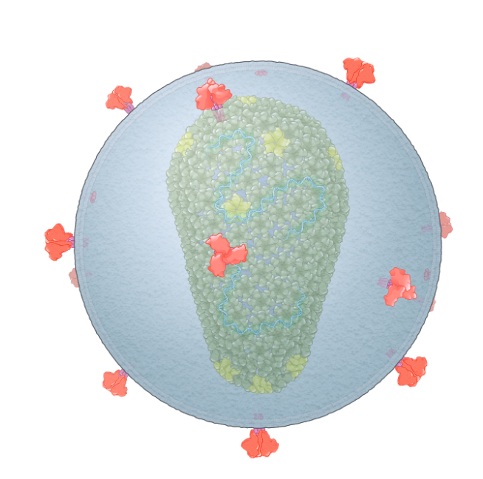
Introduction to the Biology of HIV-1: Outline
Structure

Slide 4
Introduction to the Biology of HIV-1: Outline
Genome
HIV-1 Genomic RNA
tat
gag
vif
rev
pol
vpr
env
vpu
nef

Slide 5
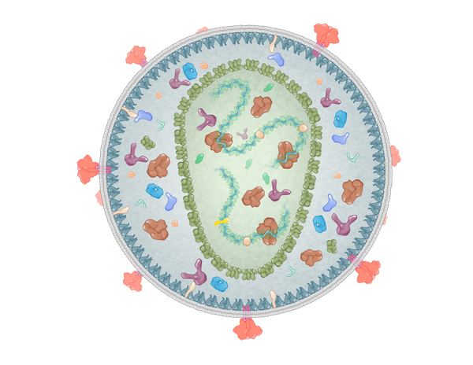
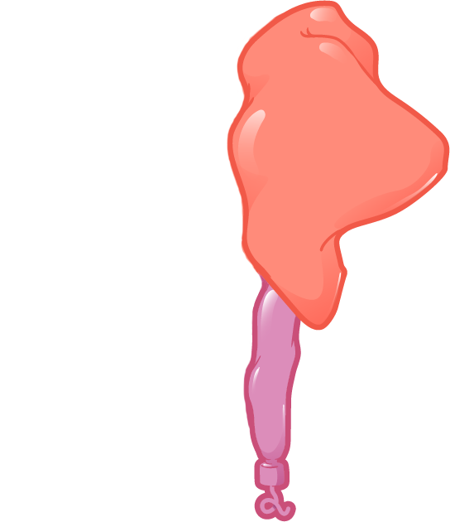
Introduction to the Biology of HIV-1: Outline
Structural Proteins
Envelope
Matrix
Capsid
Nucleocapsid
p6

Slide 6
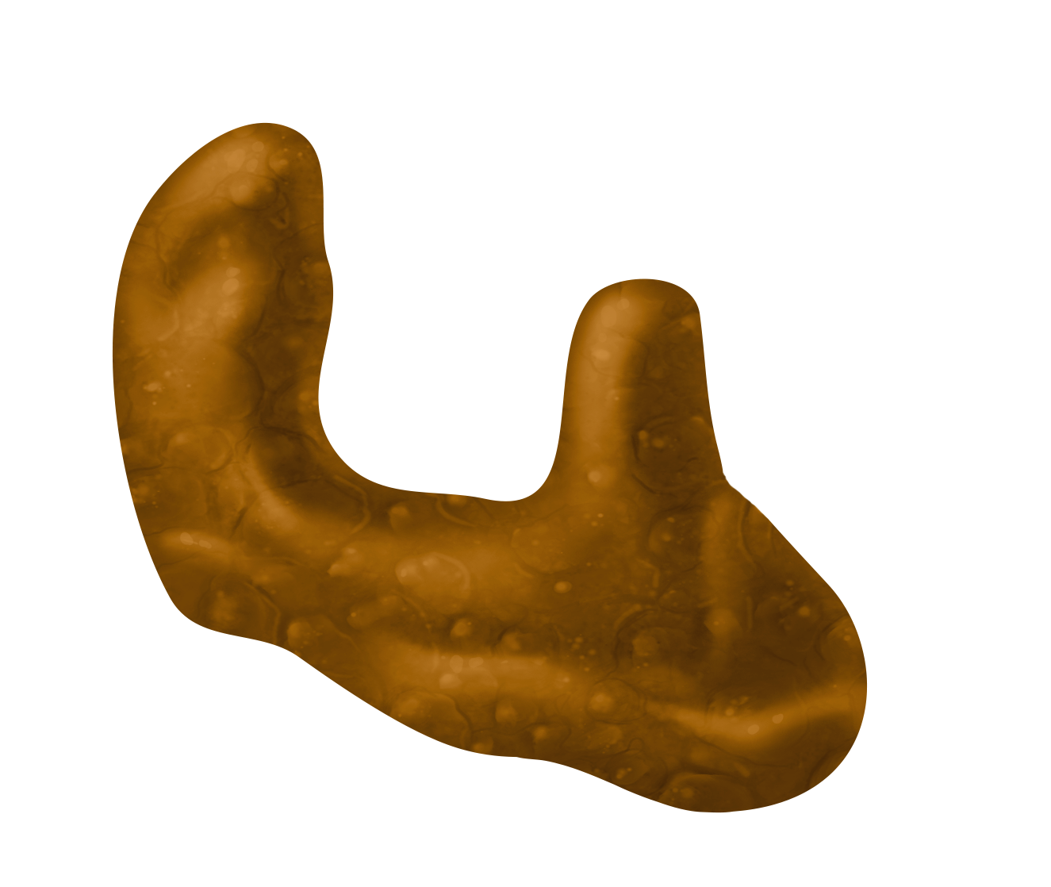
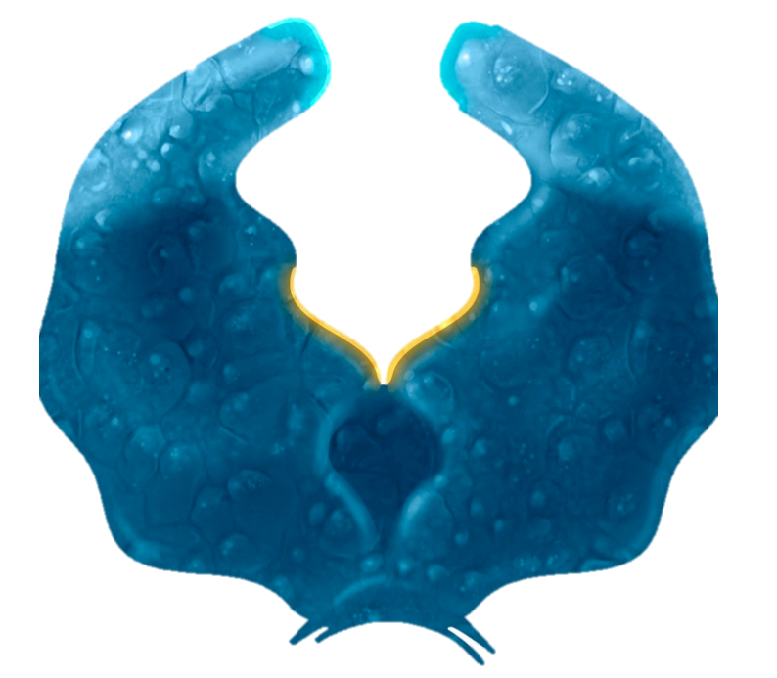
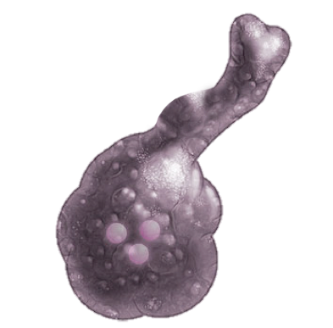
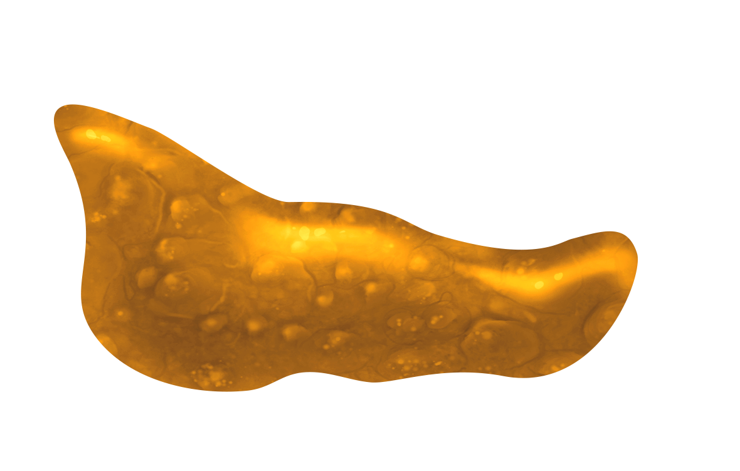
Introduction to the Biology of HIV-1: Outline
Enzymes
Protease
Reverse Transcriptase
Integrase

Slide 7
Introduction to the Biology of HIV-1: Outline
Vpr
Vpu
Accessory and Regulatory Proteins
Nef
Vif
Rev
Tat

Slide 8
Introduction to the Biology of HIV-1: Outline
Structure
Genome
Structural Proteins
Enzymes
Accessory and Regulatory Proteins

Slide 9
HIV Structure

Slide 10
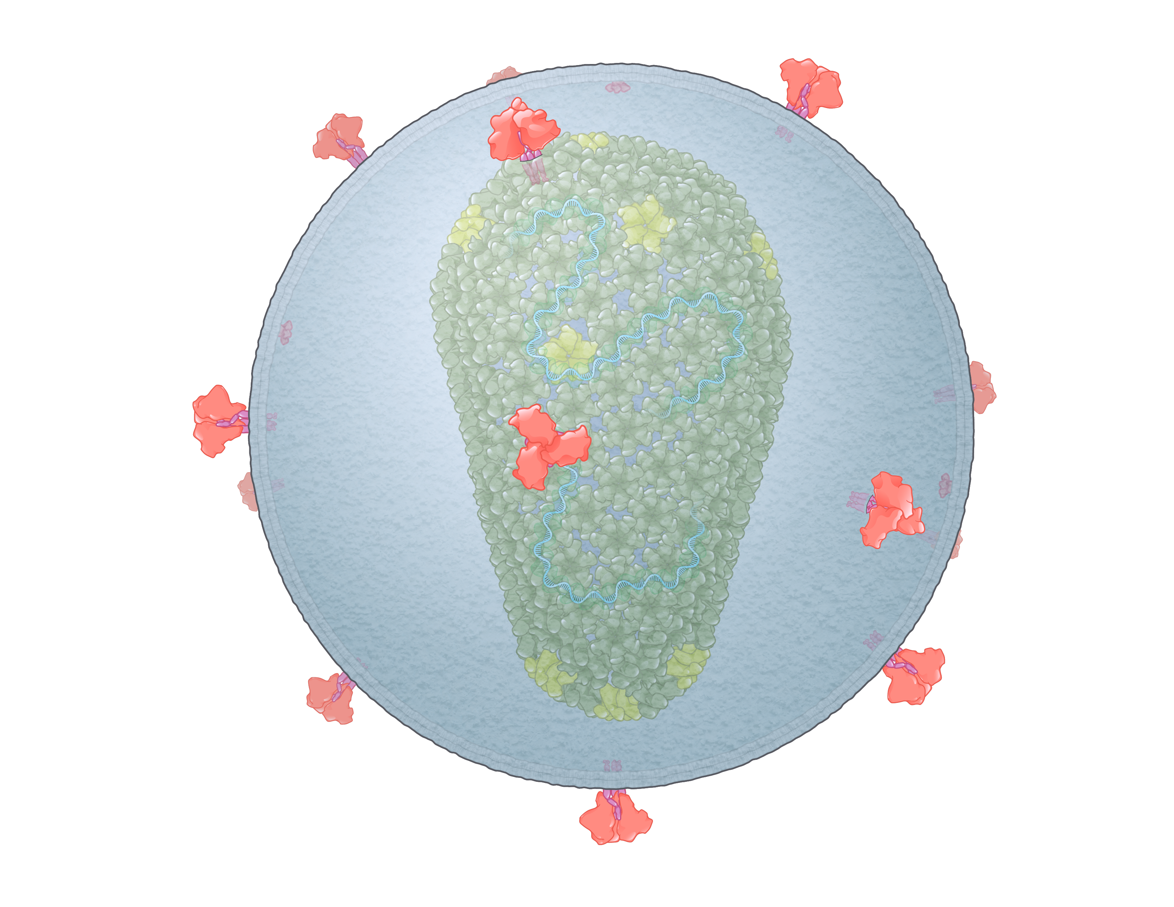
HIV
HIV = Human Immunodeficiency Virus
100-150 nm
Illustration: Cognition Studio, Inc. and David H. Spach, MD

Slide 11
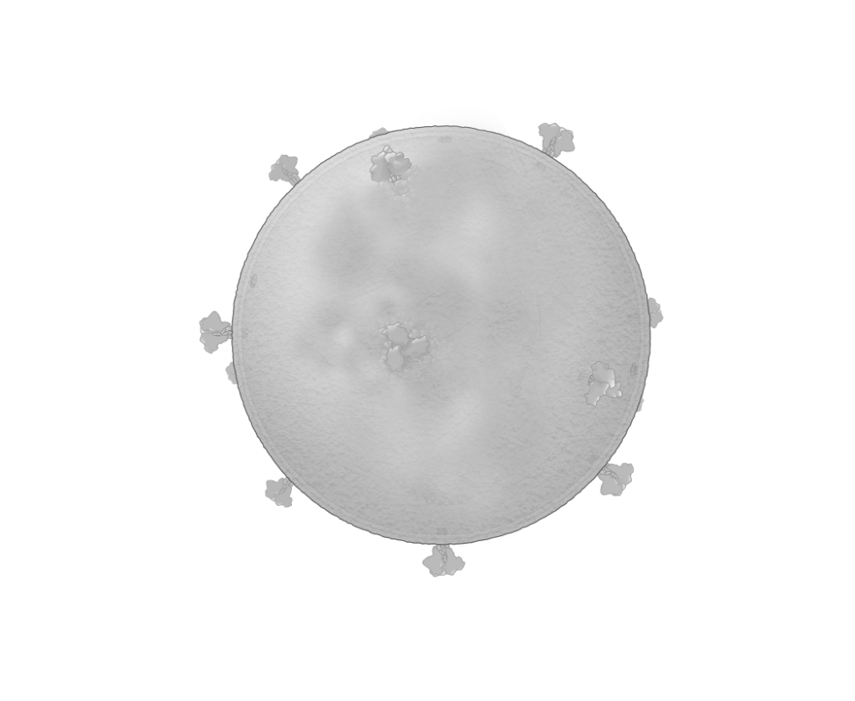
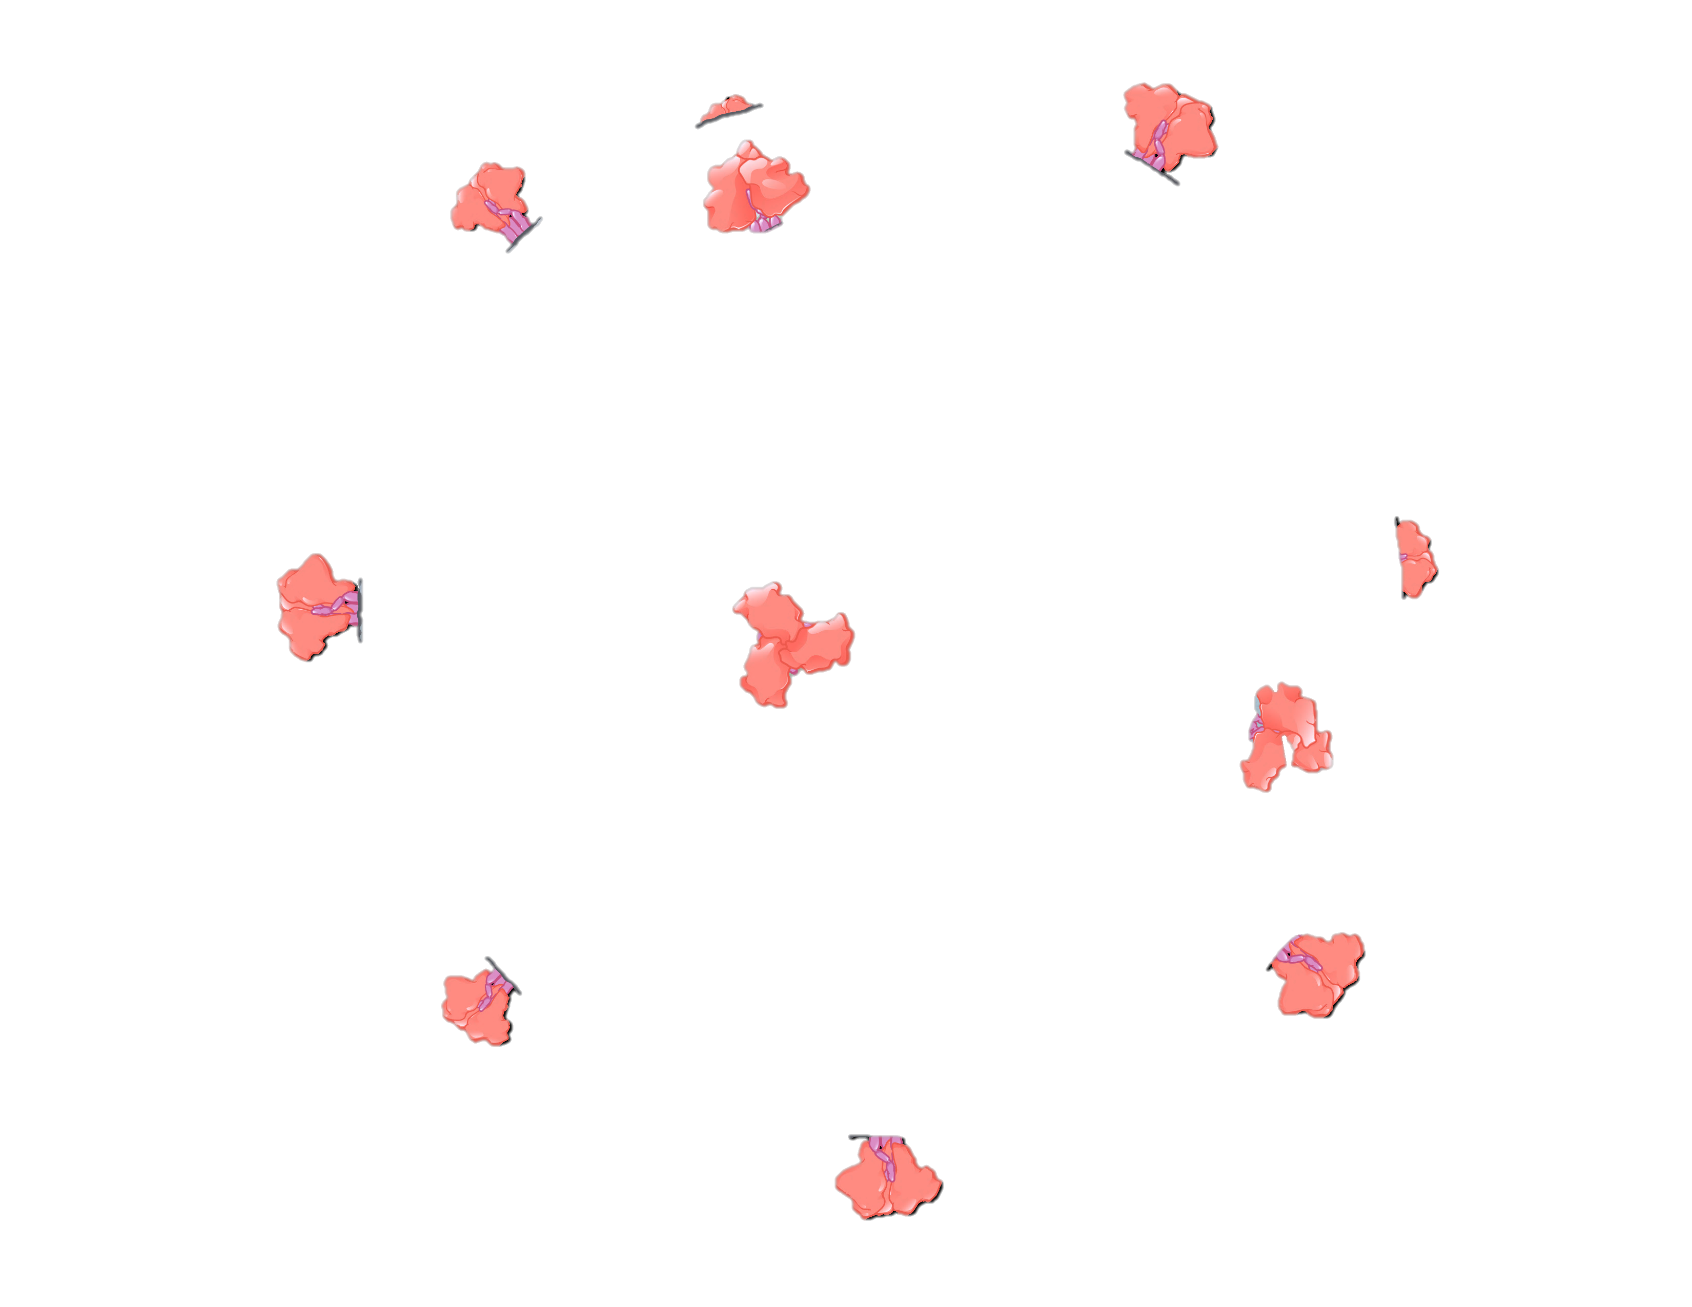
HIV Envelope
Envelope glycoprotein
Lipid Membrane
Illustration: Cognition Studio, Inc. and David H. Spach, MD

Slide 12
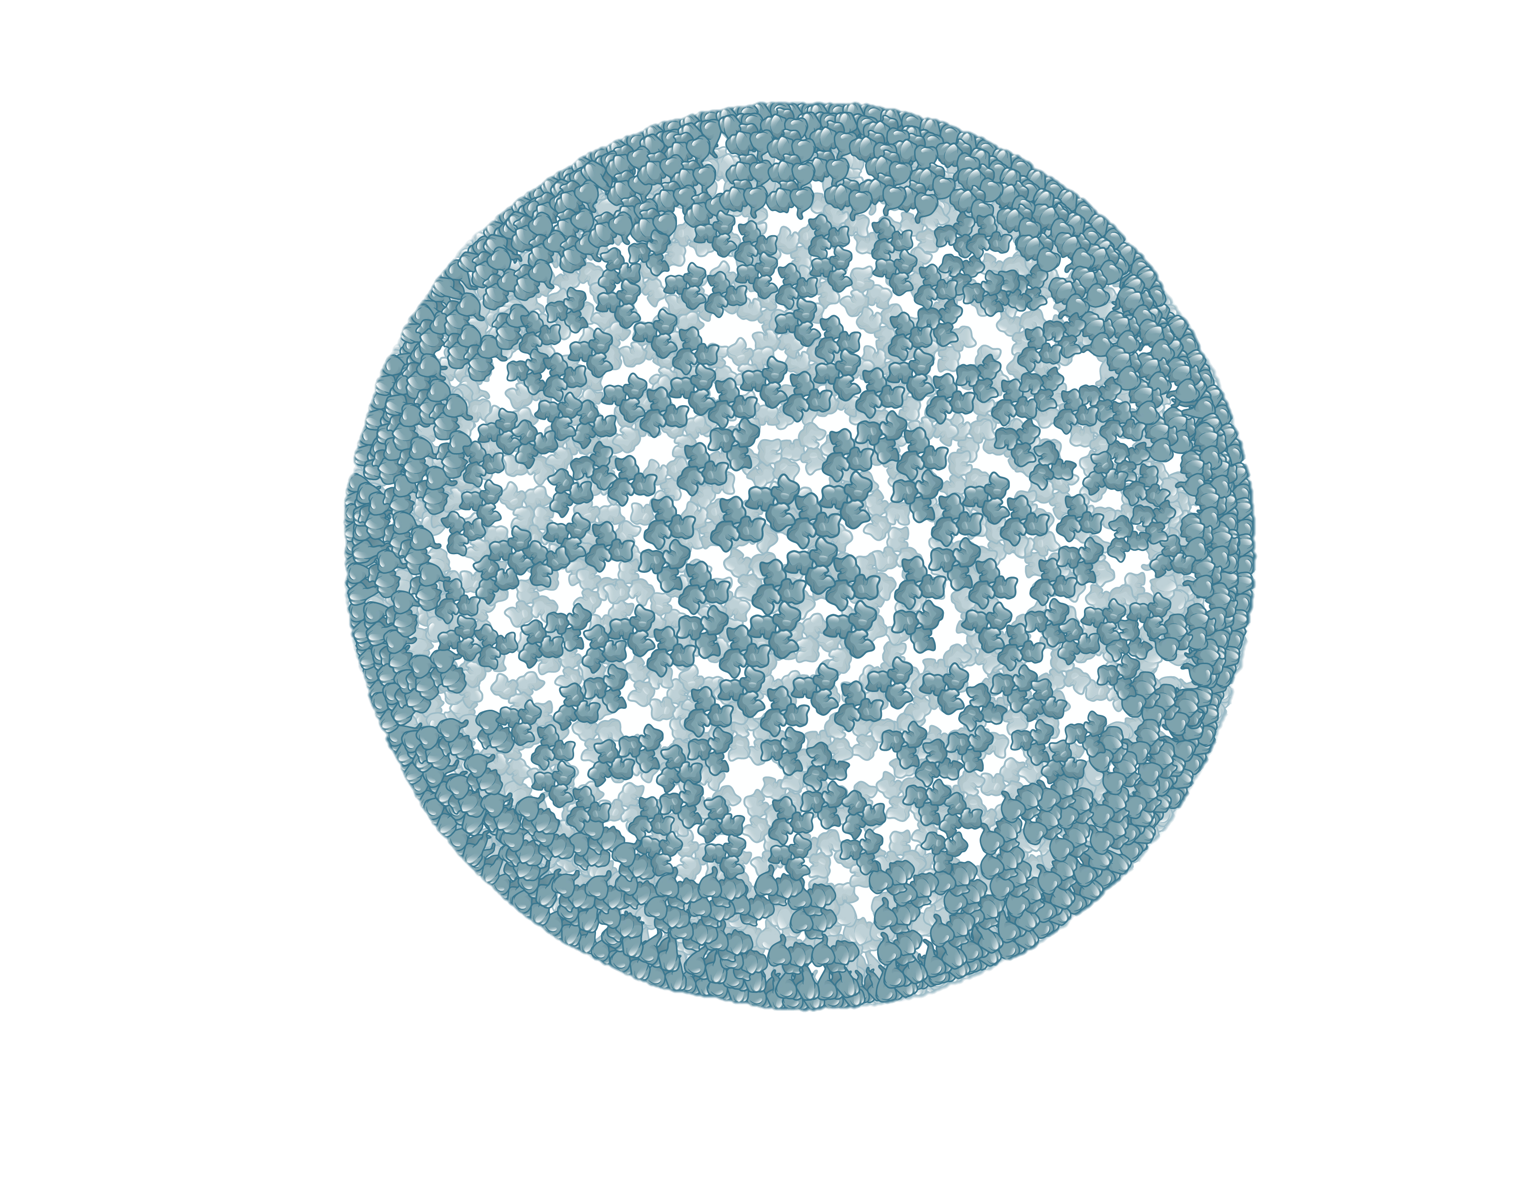
HIV Matrix Shell
Matrix proteins
100-150 nm
Illustration: Cognition Studio, Inc. and David H. Spach, MD

Slide 13
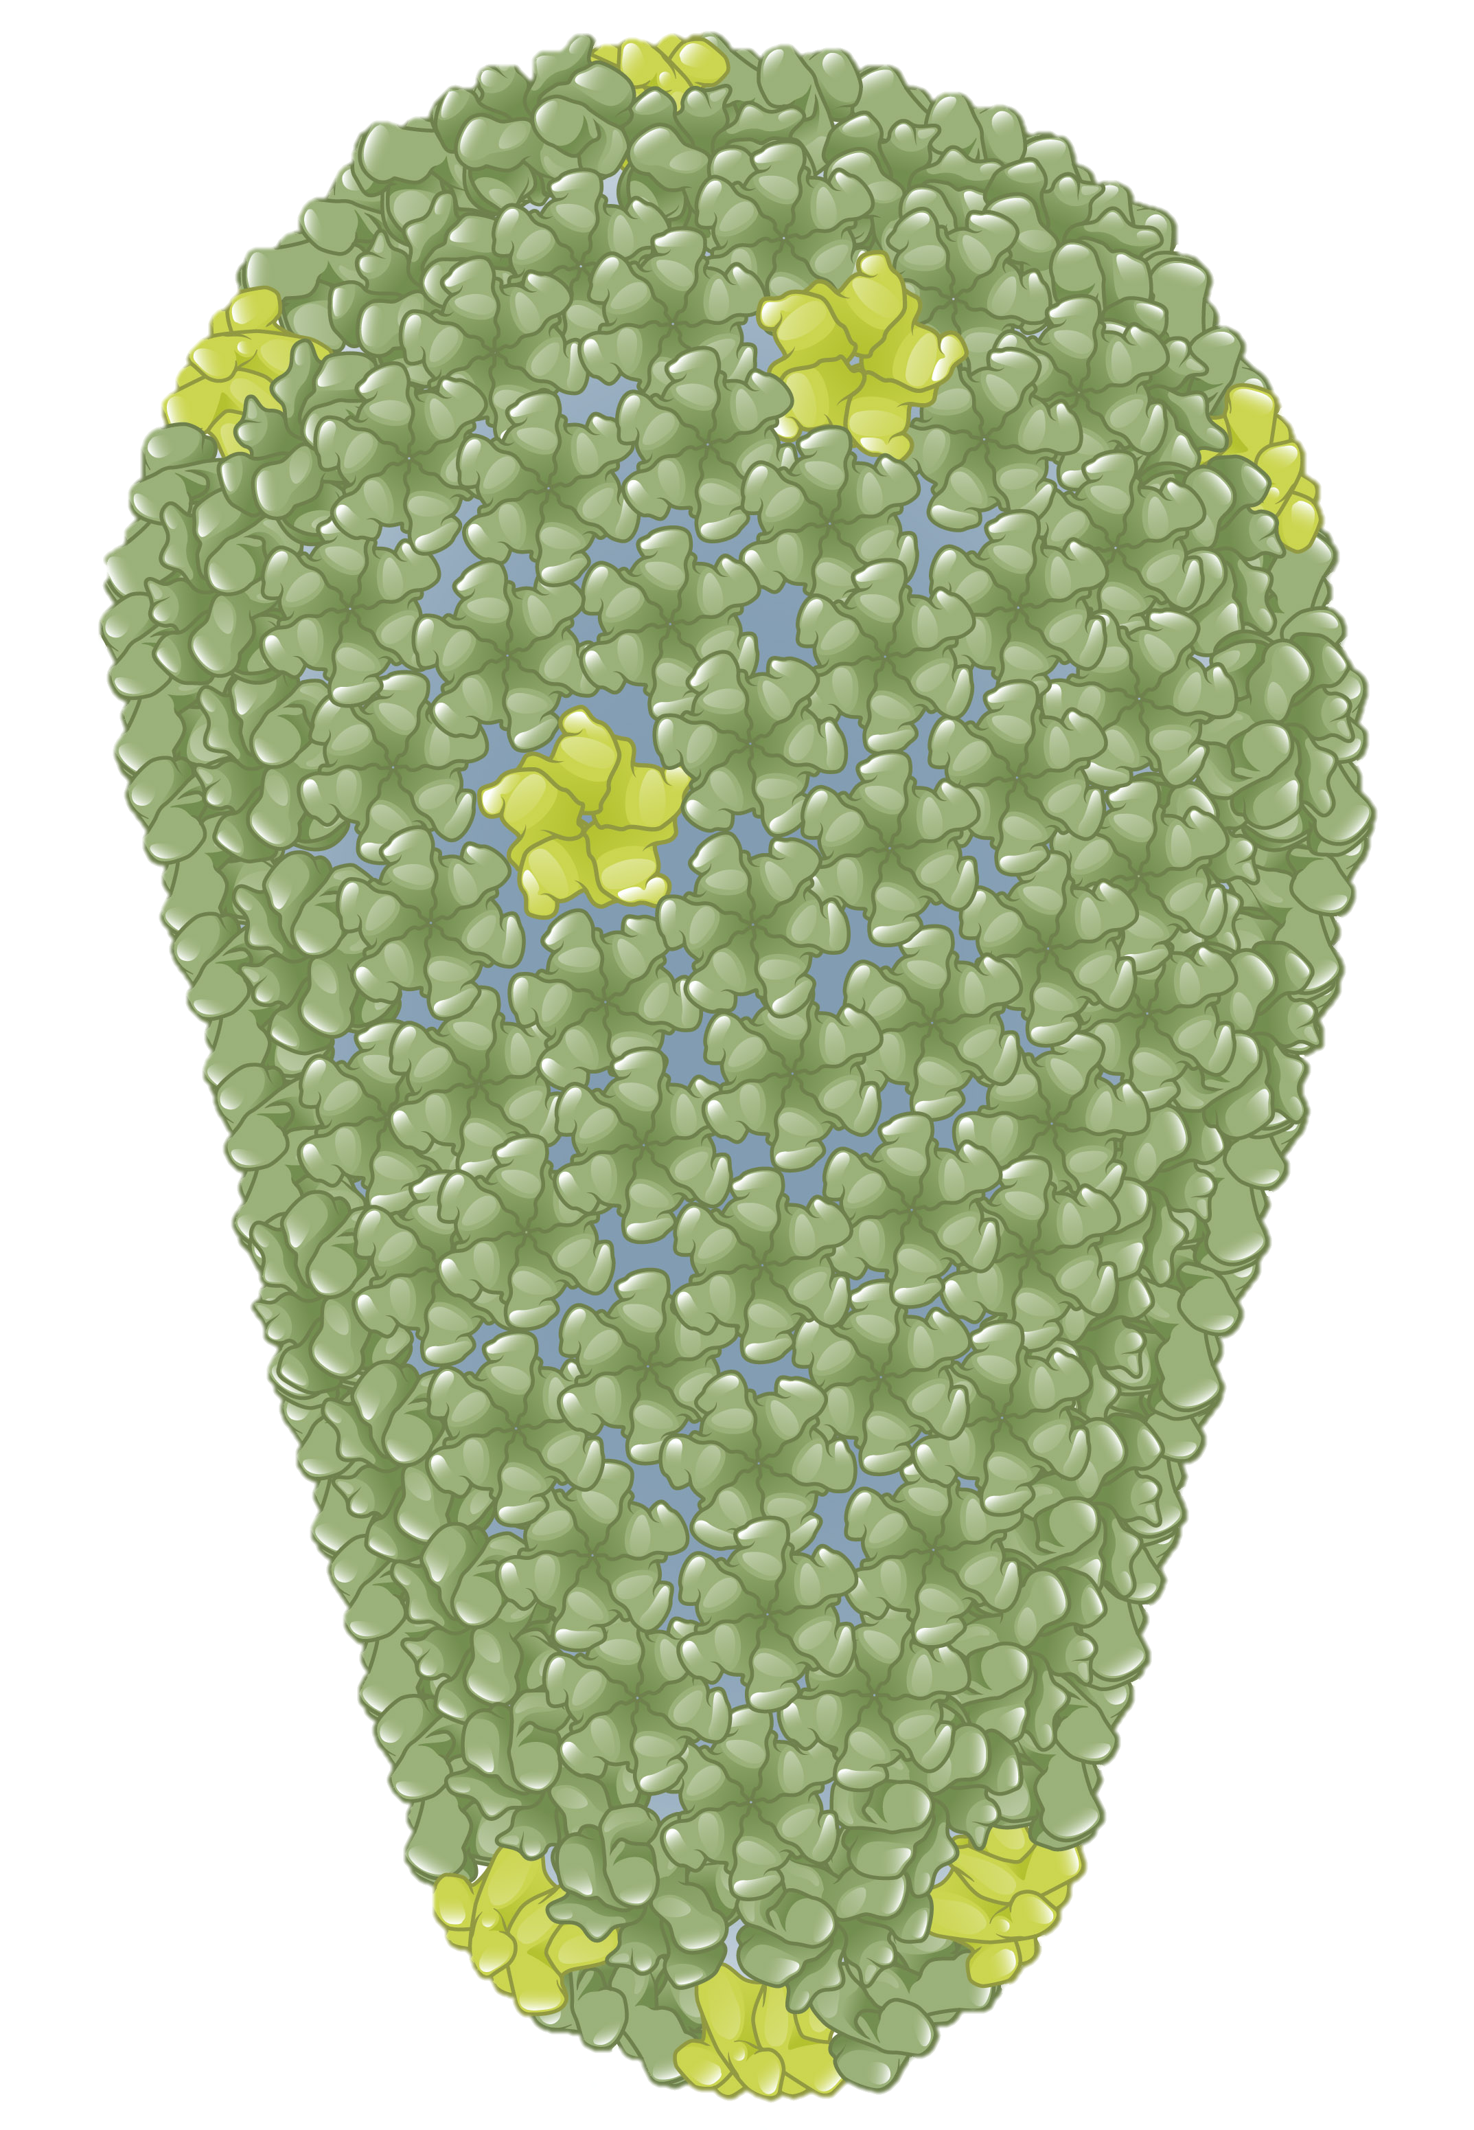
HIV Core (Capsid)
Core (capsid)
Capsid proteins
100-150 nm
Illustration: Cognition Studio, Inc. and David H. Spach, MD

Slide 14
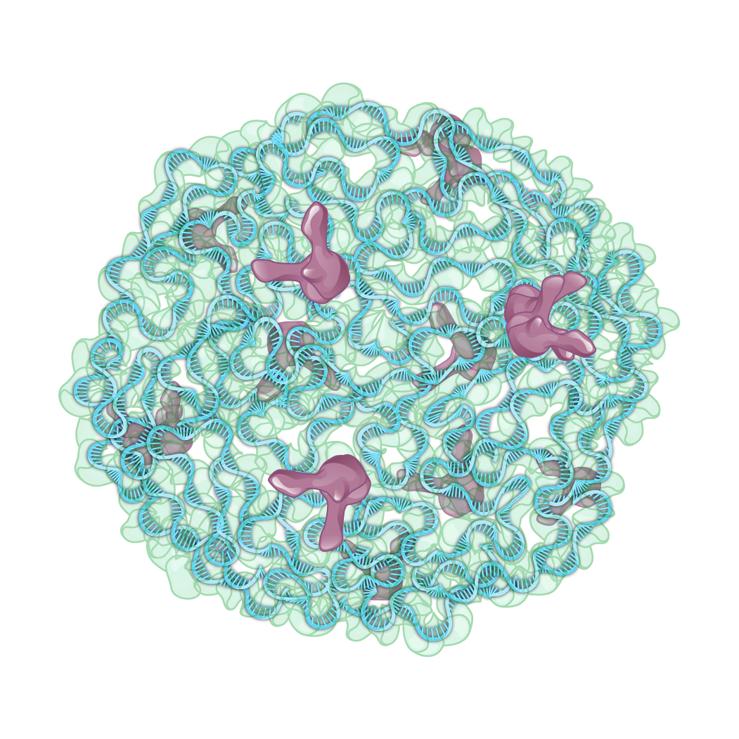
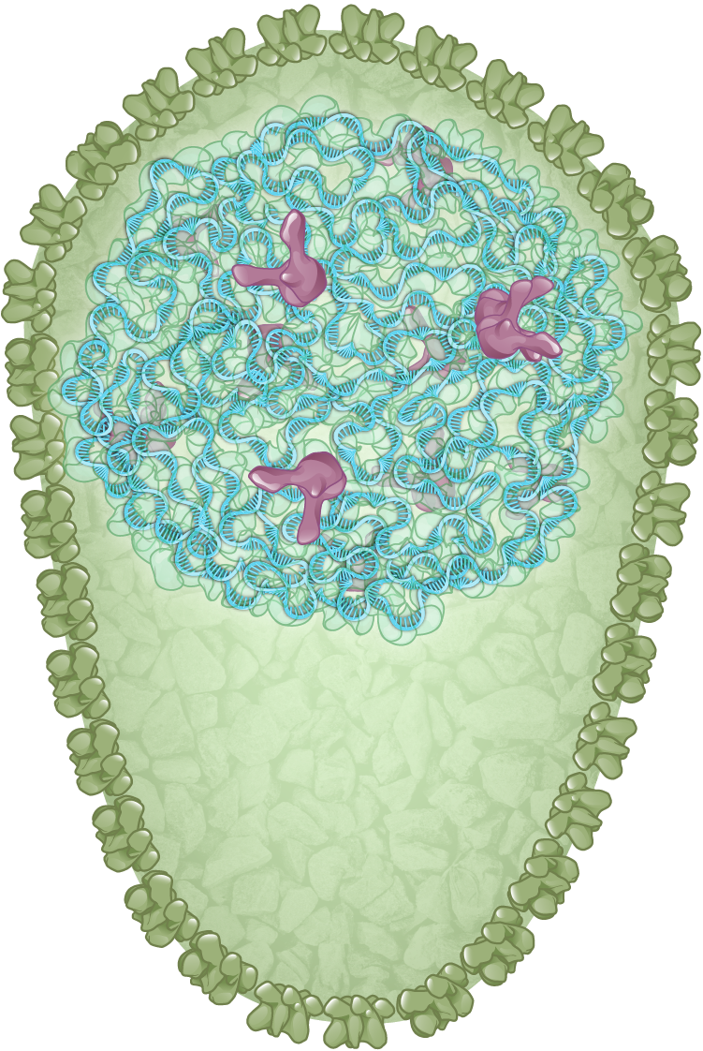
HIV Nucleocapsid Complex
Nucleocapsid complex
100-150 nm
Illustration: Cognition Studio, Inc. and David H. Spach, MD

Slide 15
HIV Genome

Slide 16
HIV-1 Genome
HIV RNA
HIV RNA
Illustration: Cognition Studio, Inc. and David H. Spach, MD

Slide 17
HIV-1 RNA Genome
5´ LTR
3´ LTR
5’
R
U5
U3
R
3’
Positive-sense, single strand RNA, ≈ 9,750 base pairs
LTR = long terminal repeat; U = unique; R = Repeat
Illustration: David H. Spach, MD

Slide 18
HIV-1 Genome: 9 Genes
5’
R
U5
U3
R
3’
tat
gag
vif
rev
pol
vpr
env
vpu
nef
Illustration: David H. Spach, MD

Slide 19
HIV-1 Genome Contains 9 Genes that Encode 15 Viral Proteins
Genes
tat
gag
vif
rev
gp120
pol
vpr
env
RT
gp41
vpu
nef
Proteins
MA
CA
PR
IN
NC
p6
Tat
Rev
Nef
Vif
Vpr
Vpu
Illustration: David H. Spach, MD

Slide 20
HIV Proteins

Slide 21
HIV-1 Proteins (n =15)
Structural (6)
Enzymes (3)
Accessory (4)
Regulatory (2)

Slide 22
Structural Proteins
Structural (6)
Enzymes (3)
Accessory (4)
Regulatory (2)
gp120
gp41
Matrix (p17)
Capsid (p24)
Nucleocapsid (p7)
p6

Slide 23
Enzymes
Structural (6)
Enzymes (3)
Accessory (4)
Regulatory (2)
gp120
Protease
gp41
Reverse Transcriptase
Matrix (p17)
Integrase
Capsid (p24)
Nucleocapsid (p7)
p6

Slide 24
Accessory Proteins
Structural (6)
Enzymes (3)
Accessory (4)
Regulatory (2)
gp120
Protease
Vif
gp41
Reverse Transcriptase
Vpr
Matrix (p17)
Integrase
Vpu
Capsid (p24)
Nef
Nucleocapsid (p7)
p6

Slide 25
Regulatory Proteins
Structural (6)
Enzymes (3)
Accessory (4)
Regulatory (2)
gp120
Protease
Vif
Tat
gp41
Reverse Transcriptase
Vpr
Rev
Matrix (p17)
Integrase
Vpu
Capsid (p24)
Nef
Nucleocapsid (p7)
p6

Slide 26
HIV-1 Proteins (n =15)
Structural (6)
Enzymes (3)
Accessory (4)
Regulatory (2)
gp120
Protease
Vif
Tat
gp41
Reverse Transcriptase
Vpr
Rev
Matrix (p17)
Integrase
Vpu
Capsid (p24)
Nef
Nucleocapsid (p7)
p6

Slide 27
HIV-1 Proteins by Relative Size (aa = amino acid)
Reverse Transcriptase (1,000 aa)
Env (gp120/gp41) (835 aa)
Integrase (288 aa)
Capsid (231aa)
Nef (206 aa)
Protease (198 aa)
Vif (192 aa)
480 aa
560 aa
440 aa
345 aa
Matrix (132 aa)
Rev (116 aa)
Vpr (96 aa)
Tat (86-101 aa)
Vpu (81 aa)
Nucleocapsid (55 aa)
P6 (52 aa)
Illustration: Cognition Studio, Inc. and David H. Spach, MD

Slide 28
HIV Structural Proteins

Slide 29
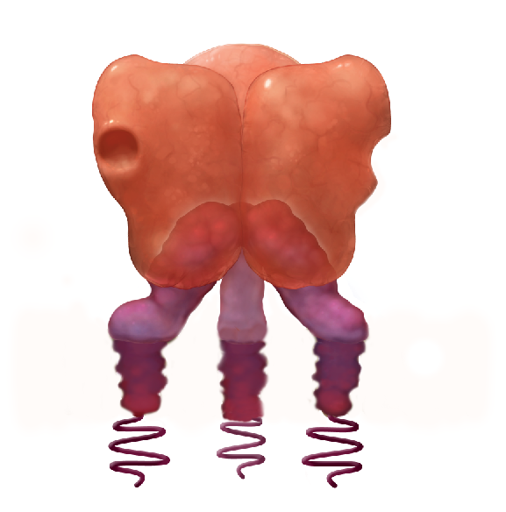
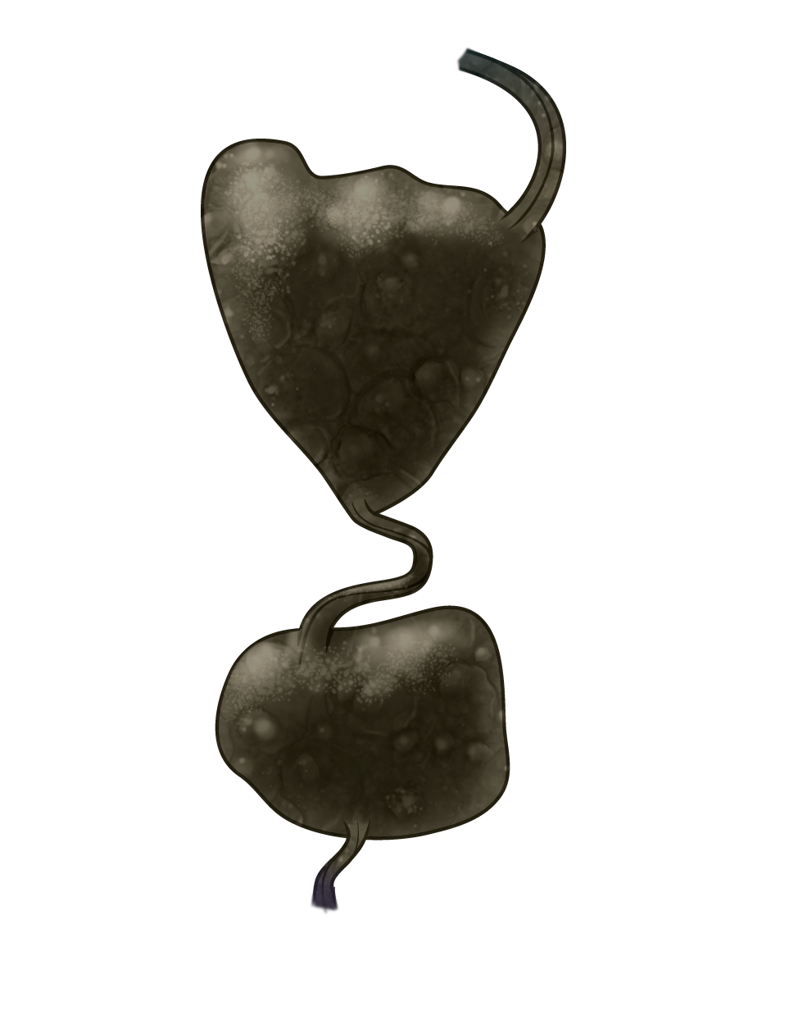
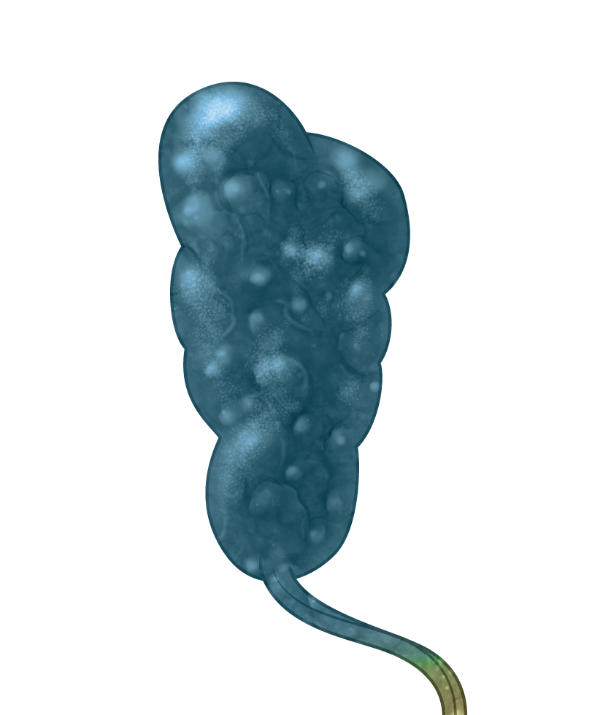
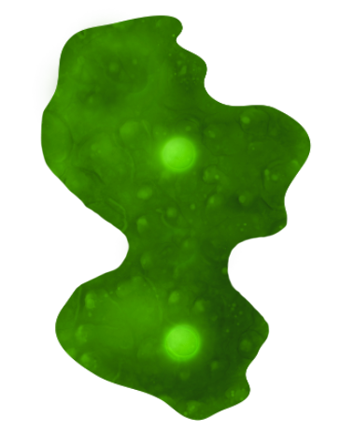
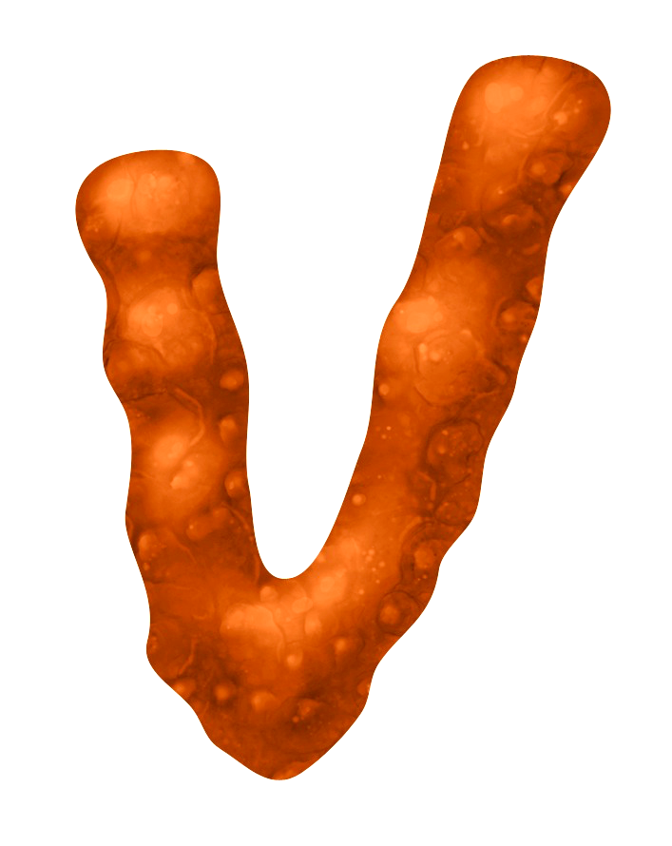
HIV Structural Proteins
Envelope (gp120/gp41)
Matrix (p17)
Capsid (p24)
Nucleocapsid (p7)
p6
Illustration: Cognition Studio, Inc. and David H. Spach, MD

Slide 30
HIV Envelope Glycoprotein
HIV Envelope Glycoprotein
Illustration: Cognition Studio, Inc. and David H. Spach, MD

Slide 31
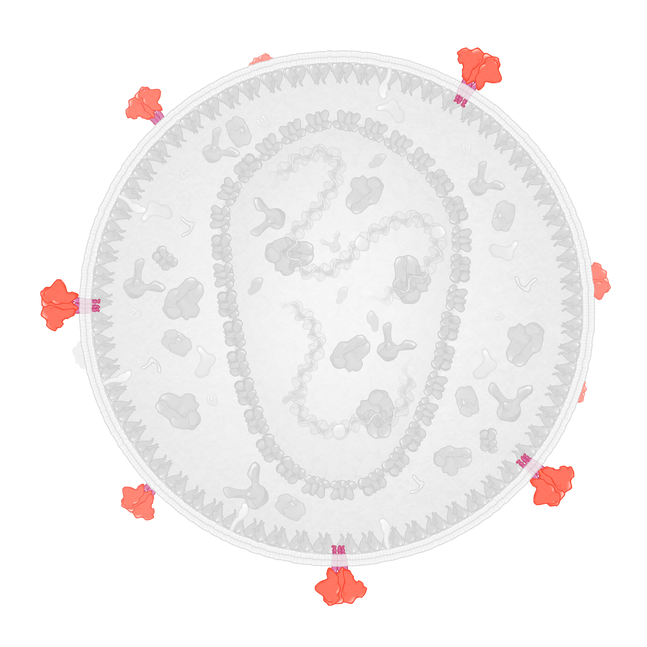
HIV Envelope Glycoprotein
Structural Protein
gp120
HIV Envelope Glycoprotein
gp41
Illustration: Cognition Studio, Inc. and David H. Spach, MD

Slide 32
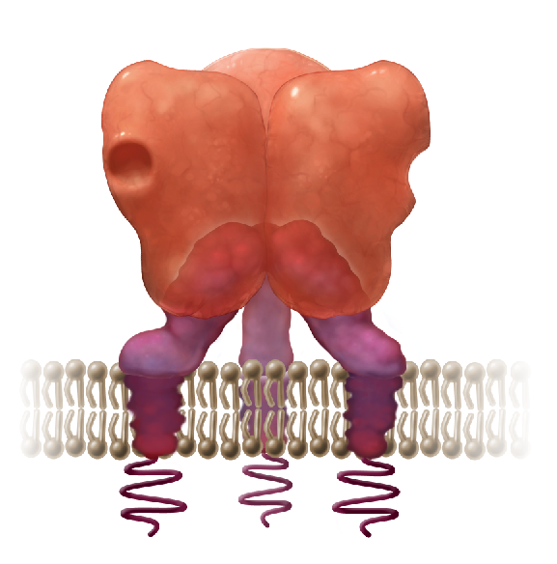
HIV Envelope Glycoproteins: gp120 and gp41 Subunits
HIV Envelope Trimer
gp120 (surface)
HIV Membrane
gp41 (transmembrane)
Illustration: Cognition Studio, Inc. and David H. Spach, MD

Slide 33
HIV Envelope Glycoprotein: Trimer Structure
Envelope Trimer
gp120 (surface)
HIV Membrane
gp41 (transmembrane)
Illustration: Cognition Studio, Inc. and David H. Spach, MD

Slide 34
HIV Envelope Glycoprotein: Trimer Structure
Trimter
Envelope Trimer
Trimer
gp120 (surface)
1
2
3
gp120-gp41 pair
gp120
Noncovalent bond
gp41
HIV Membrane
gp41 (transmembrane)
Illustration: Cognition Studio, Inc. and David H. Spach, MD

Slide 35
HIV Envelope Glycoprotein: Regions Involved in Cell Entry
CD4 Binding Region
V3
V3
gp120 (surface)
V3 Region
HIV Membrane
gp41
Illustration: Cognition Studio, Inc. and David H. Spach, MD

Slide 36
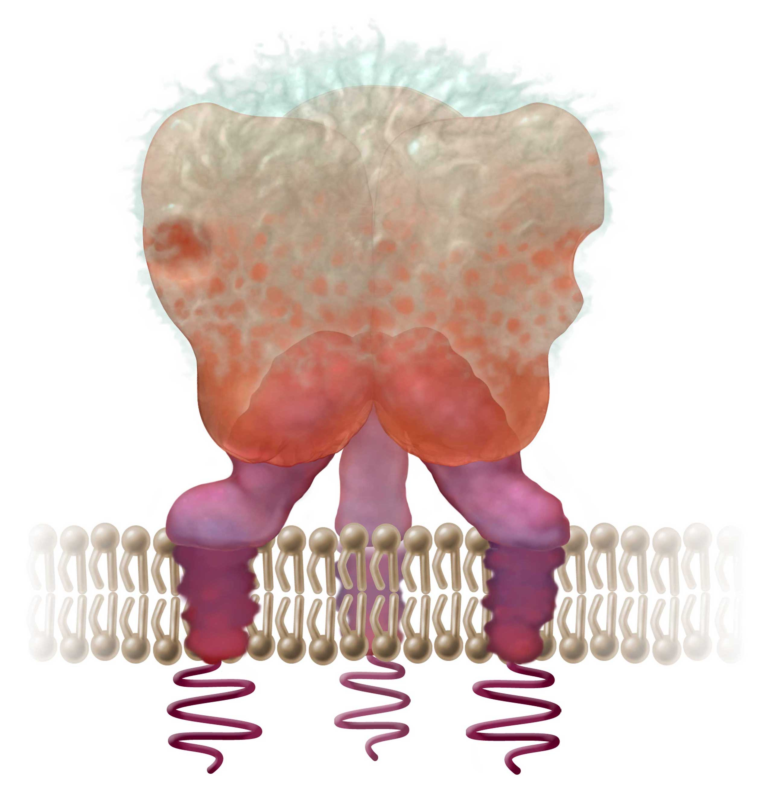
HIV Envelope Glycoprotein: Glycan Shield
Glycan Shield
gp120 (surface)
HIV Membrane
gp41(transmembrane)
Illustration: Cognition Studio, Inc. and David H. Spach, MD

Slide 37
HIV Matrix (p17)
HIV Matrix (p17)
Illustration: Cognition Studio, Inc. and David H. Spach, MD

Slide 38
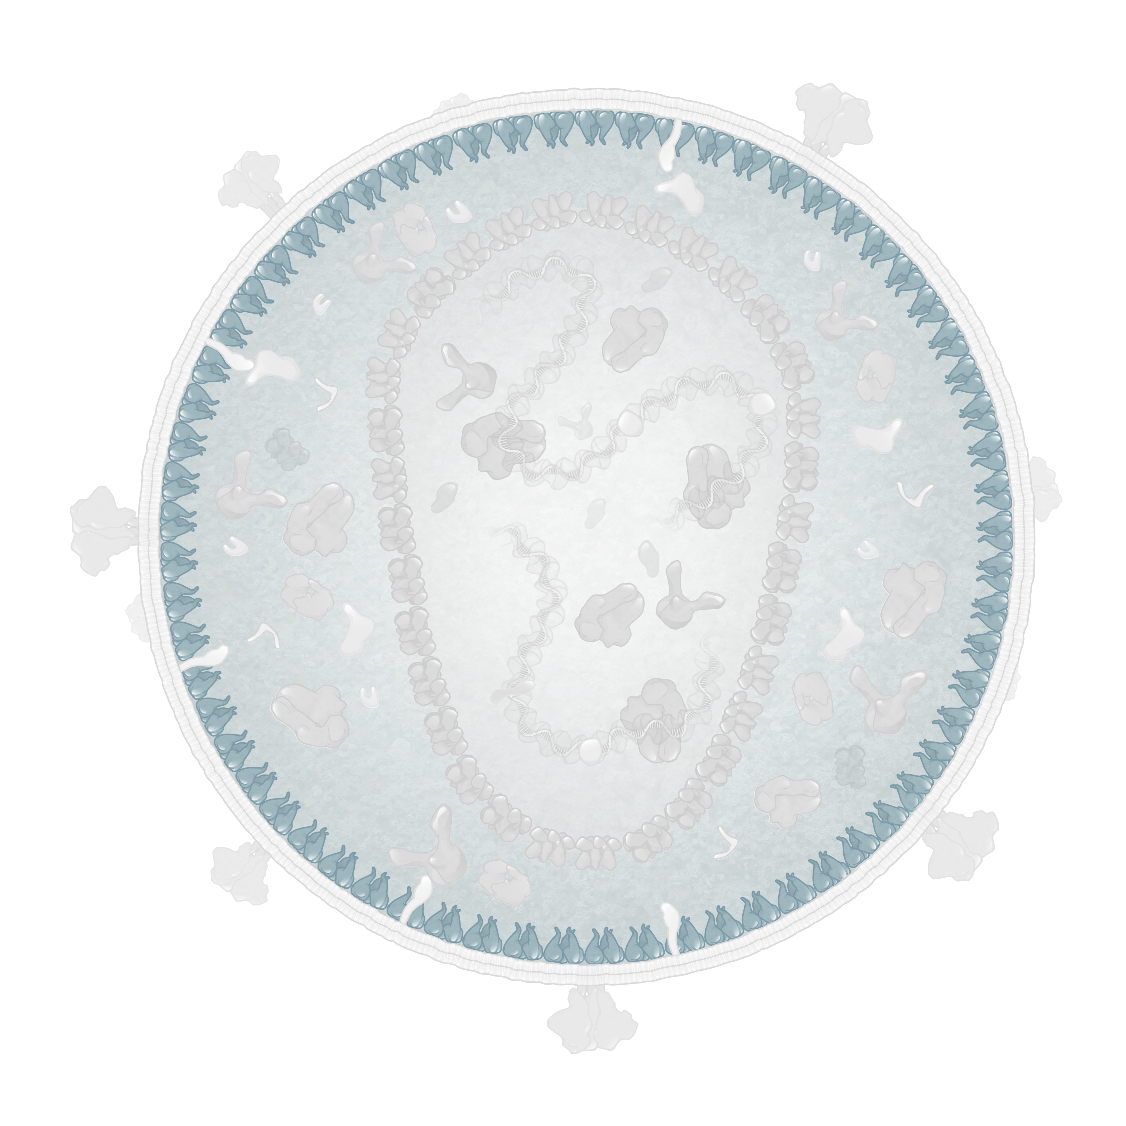
HIV Matrix
Structural Protein
HIV Matrix (p17)
Illustration: Cognition Studio, Inc. and David H. Spach, MD

Slide 39
HIV Matrix: Monomer Structure
HIV Matrix Monomer
N-terminal domain (NTD)
C-terminal domain (CTD)
Illustration: Cognition Studio, Inc. and David H. Spach, MD

Slide 40
HIV Matrix: Basic Region
Basic Region
N-terminal domain (NTD)
Illustration: Cognition Studio, Inc. and David H. Spach, MD

Slide 41
HIV Matrix: Myristyl Group
Myristyl Group
N-terminal domain (NTD)
Illustration: Cognition Studio, Inc. and David H. Spach, MD

Slide 42
HIV Matrix: Myristyl Group Sequestered Conformation
Sequestered Conformation
Myristyl Group
Illustration: Cognition Studio, Inc. and David H. Spach, MD

Slide 43
HIV Matrix: Myristyl Group Exposed Conformation
Exposed Conformation
Myristyl Group
Illustration: Cognition Studio, Inc. and David H. Spach, MD

Slide 44
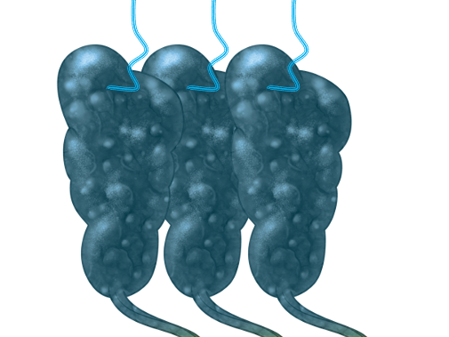
HIV Matrix: Membrane Bound Trimers
HIV Membrane
HIV Matrix Trimer
Illustration: Cognition Studio, Inc. and David H. Spach, MD

Slide 45
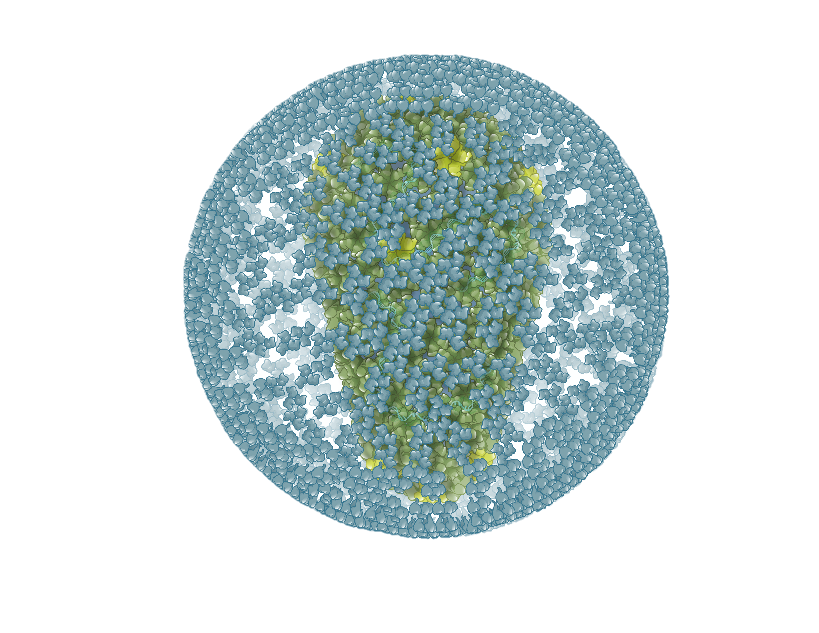
HIV Matrix: Trimers Forming Matrix Shell
Illustration: Cognition Studio, Inc. and David H. Spach, MD

Slide 46
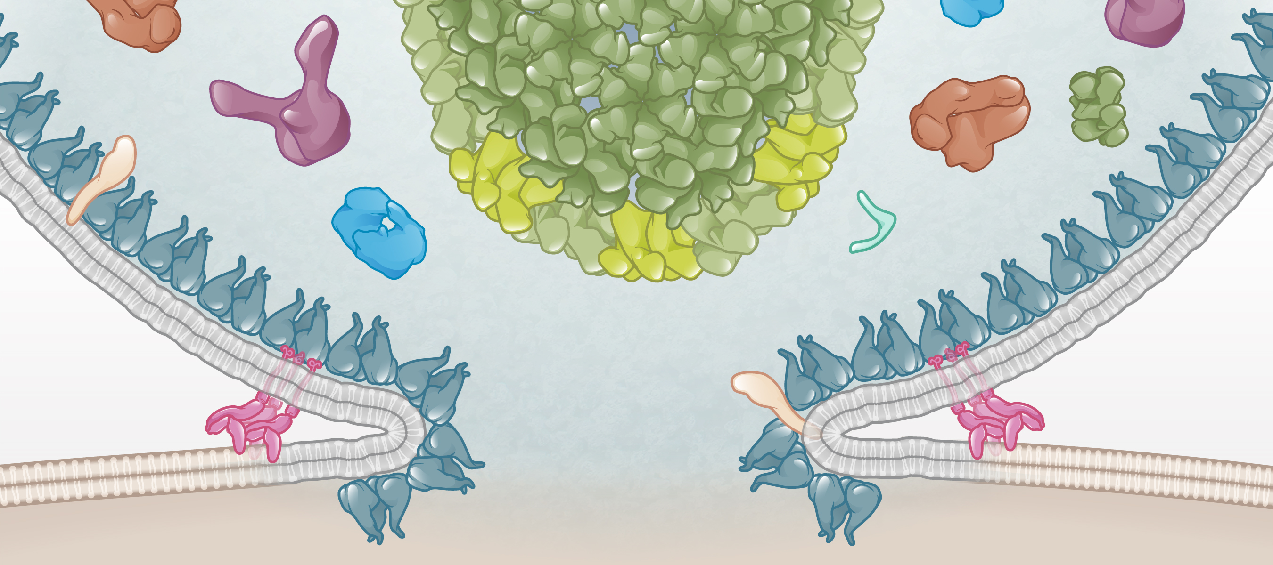
HIV Matrix: Role in Cell Entry
HIV
Matrix shell
Matrix shell
Matrix
Host Cell
Illustration: Cognition Studio, Inc. and David H. Spach, MD

Slide 47
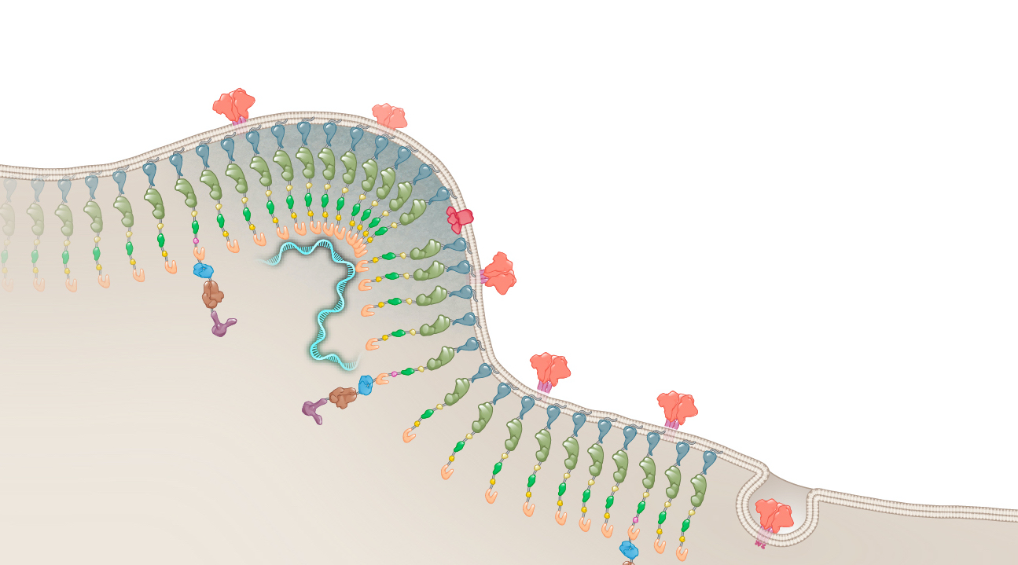
HIV Matrix: Role Late in Viral Assembly
Host Cell Membrane
Matrix
Host Cell
Illustration: Cognition Studio, Inc. and David H. Spach, MD

Slide 48
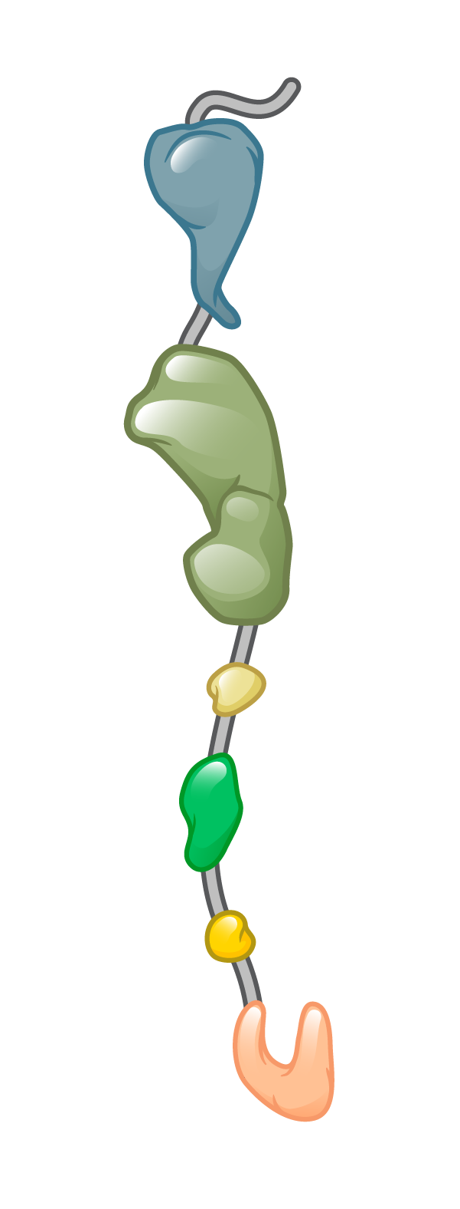
HIV Matrix: Role Anchoring HIV Gag and Gag-Pol
HIV Gag
HIV Gag-Pol
Host Cell Membrane
Matrix
Matrix
HIV Gag-Pol
Matrix
HIV Gag
Host Cell
Illustration: Cognition Studio, Inc. and David H. Spach, MD

Slide 49
HIV Capsid (p24)
HIV capsid (p24)
Illustration: Cognition Studio, Inc. and David H. Spach, MD

Slide 50
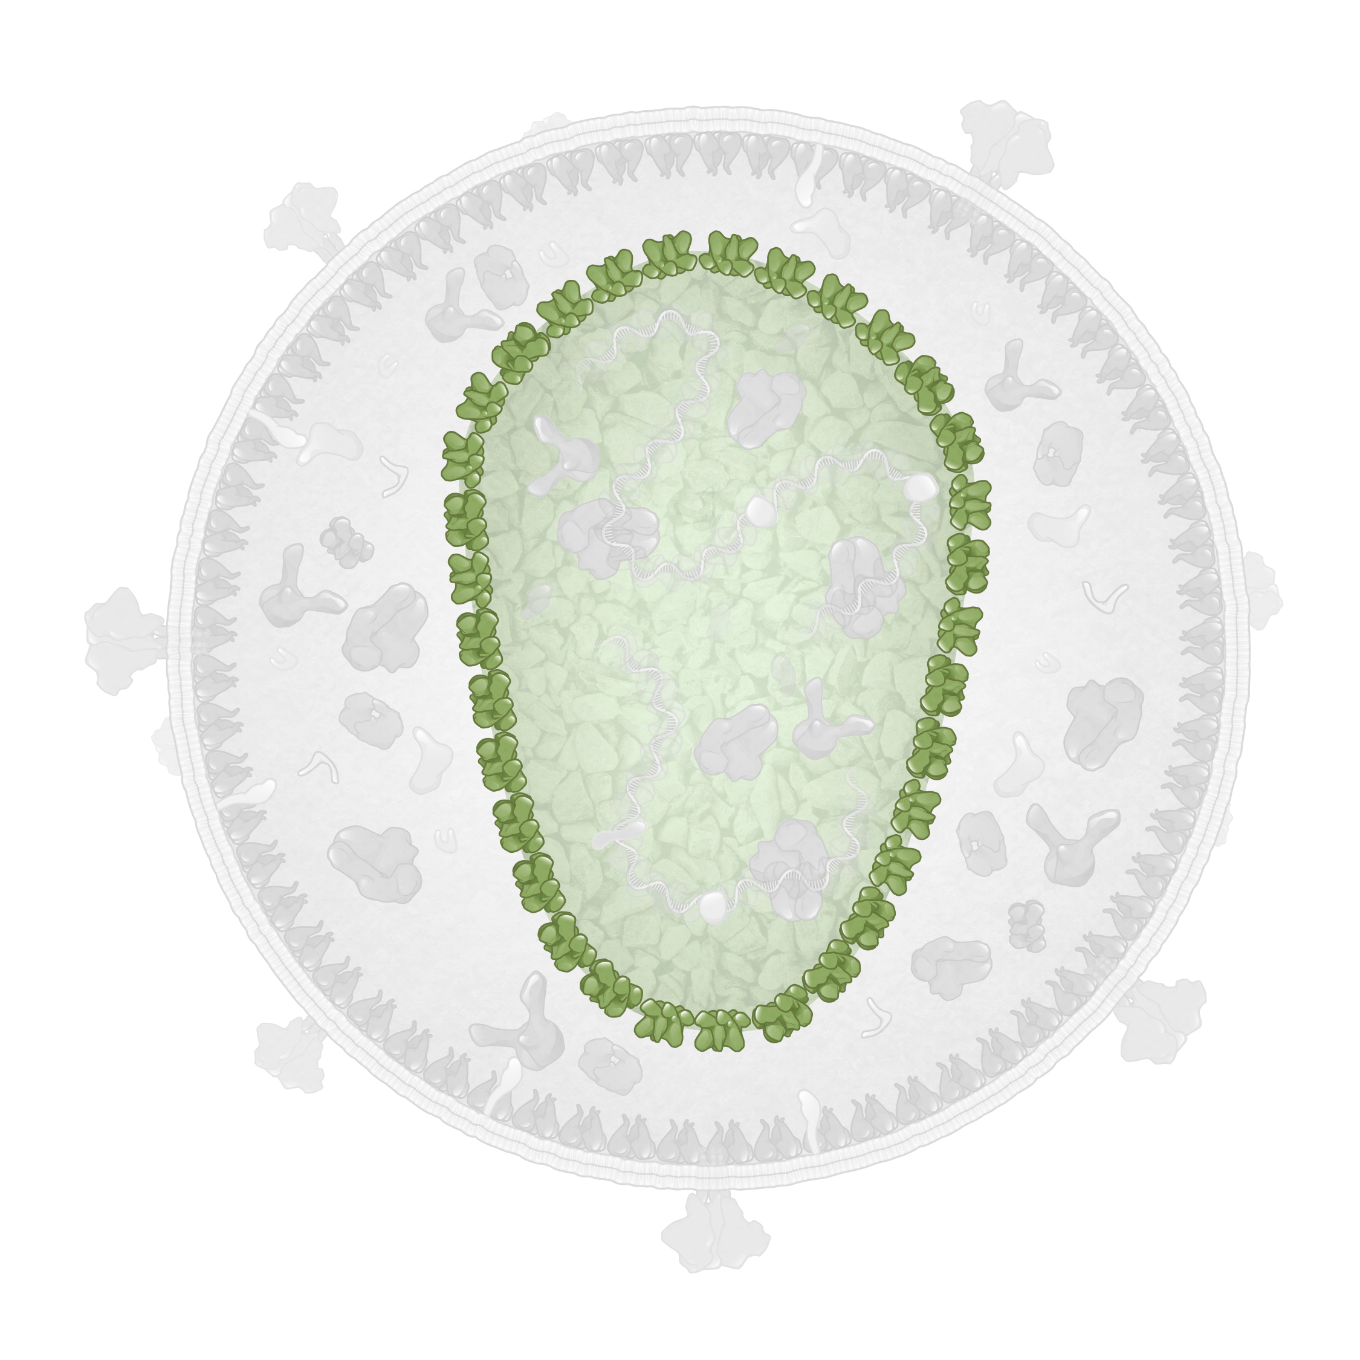
HIV Capsid and HIV Core
Structural Protein
HIV Core (capsid)
HIV capsid (HIV capsid core)
Illustration: Cognition Studio, Inc. and David H. Spach, MD

Slide 51
HIV Capsid: Monomer Structure
HIV Capsid Monomer
N-terminal domain (NTD)
Flexible Linker
C-terminal domain (CTD)
Illustration: Cognition Studio, Inc. and David H. Spach, MD

Slide 52
HIV Capsid: Monomers and Polmyers
HIV Capsid
Monomers
Polymers
Illustration: Cognition Studio, Inc. and David H. Spach, MD

Slide 53
HIV Capsid: Hexamers and Pentamers
Capsid Hexamer
Capsid Pentamer
Illustration: Cognition Studio, Inc. and David H. Spach, MD

Slide 54
HIV Capsid: Hexamers and Pentamers
Capsid Hexamer
Capsid Hexamer
Capsid Pentamer
Capsid Pentamer
Illustration: Cognition Studio, Inc. and David H. Spach, MD

Slide 55
HIV Capsid: Cone-Shaped Structure of HIV Core
HIV Core (capsid)
Capsid Hexamer
Capsid Pentamer
Illustration: Cognition Studio, Inc. and David H. Spach, MD

Slide 56
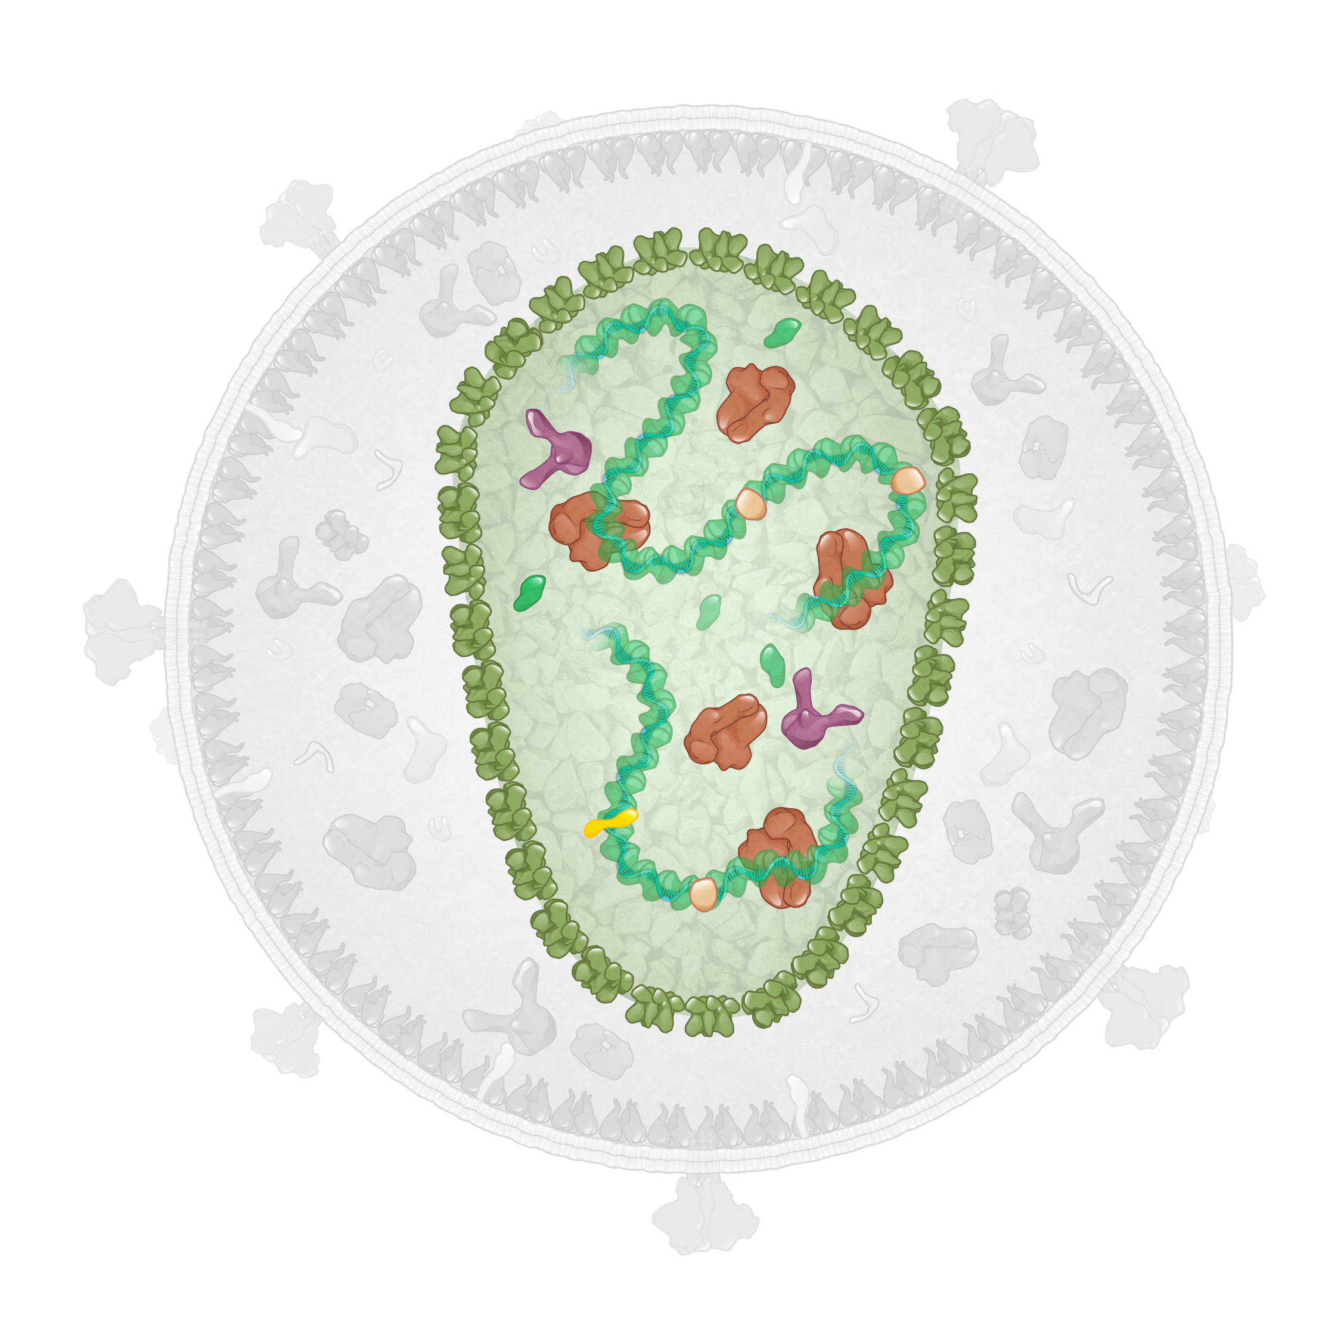
HIV Core: Structural Barrier
HIV Core (capsid)
HIV RNA
Illustration: Cognition Studio, Inc. and David H. Spach, MD

Slide 57
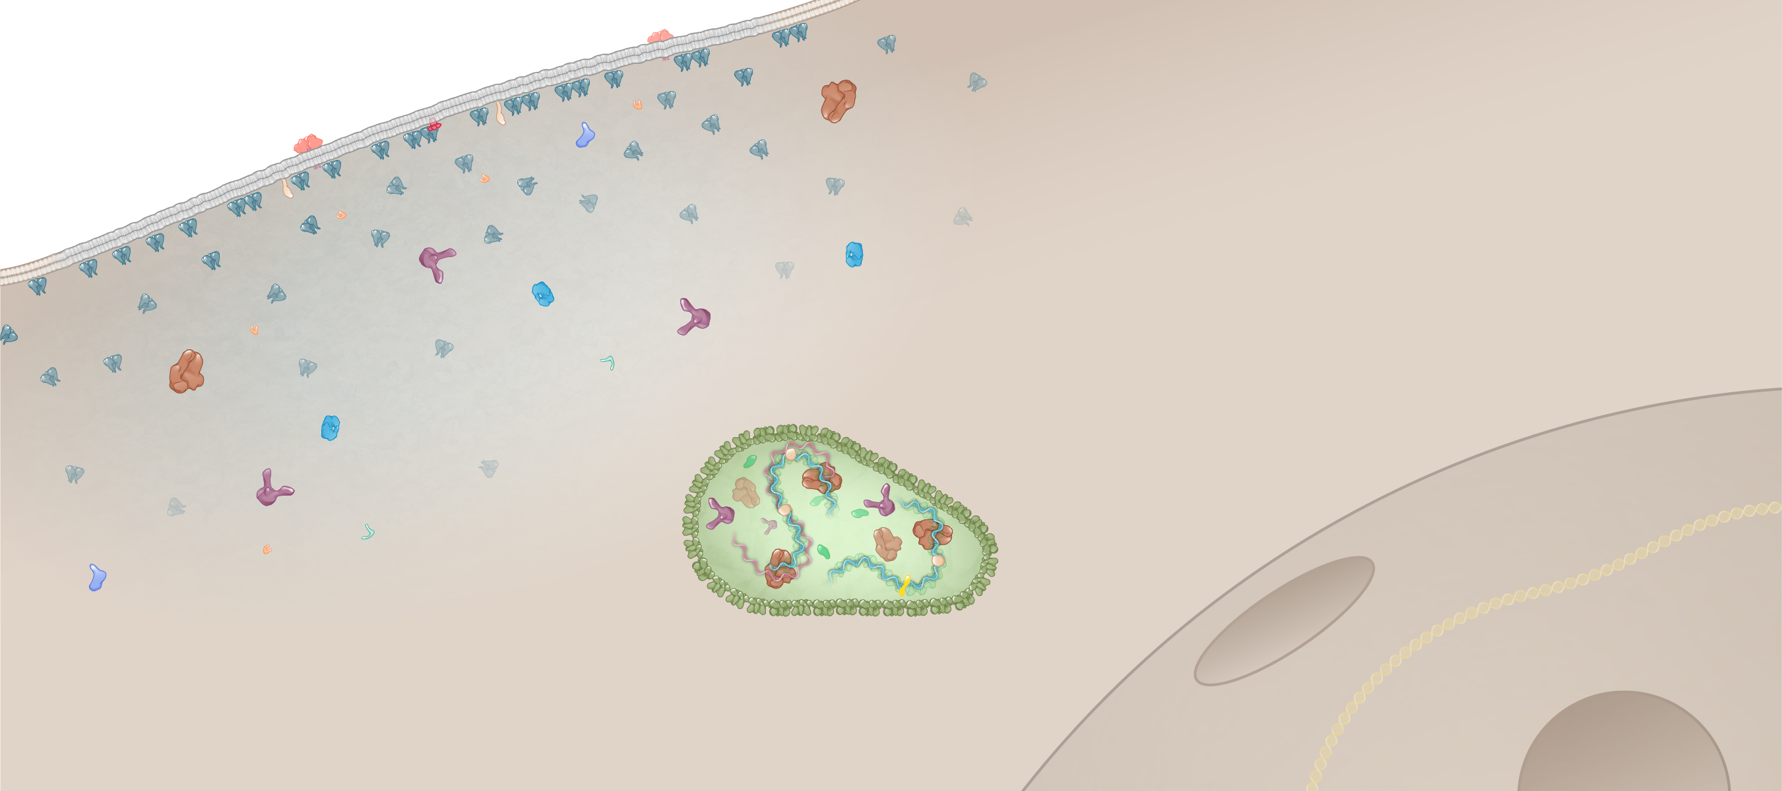
HIV Core: Role in Migration to Host Cell Nucleus
Host DNA
Cytoplasm
HIV core
Nucleus
Host cell
Illustration: Cognition Studio, Inc., and David H. Spach, MD

Slide 58
HIV Nucleocapsid (p7)
HIV Nucleocapsid (p7)
Illustration: Cognition Studio, Inc. and David H. Spach, MD

Slide 59
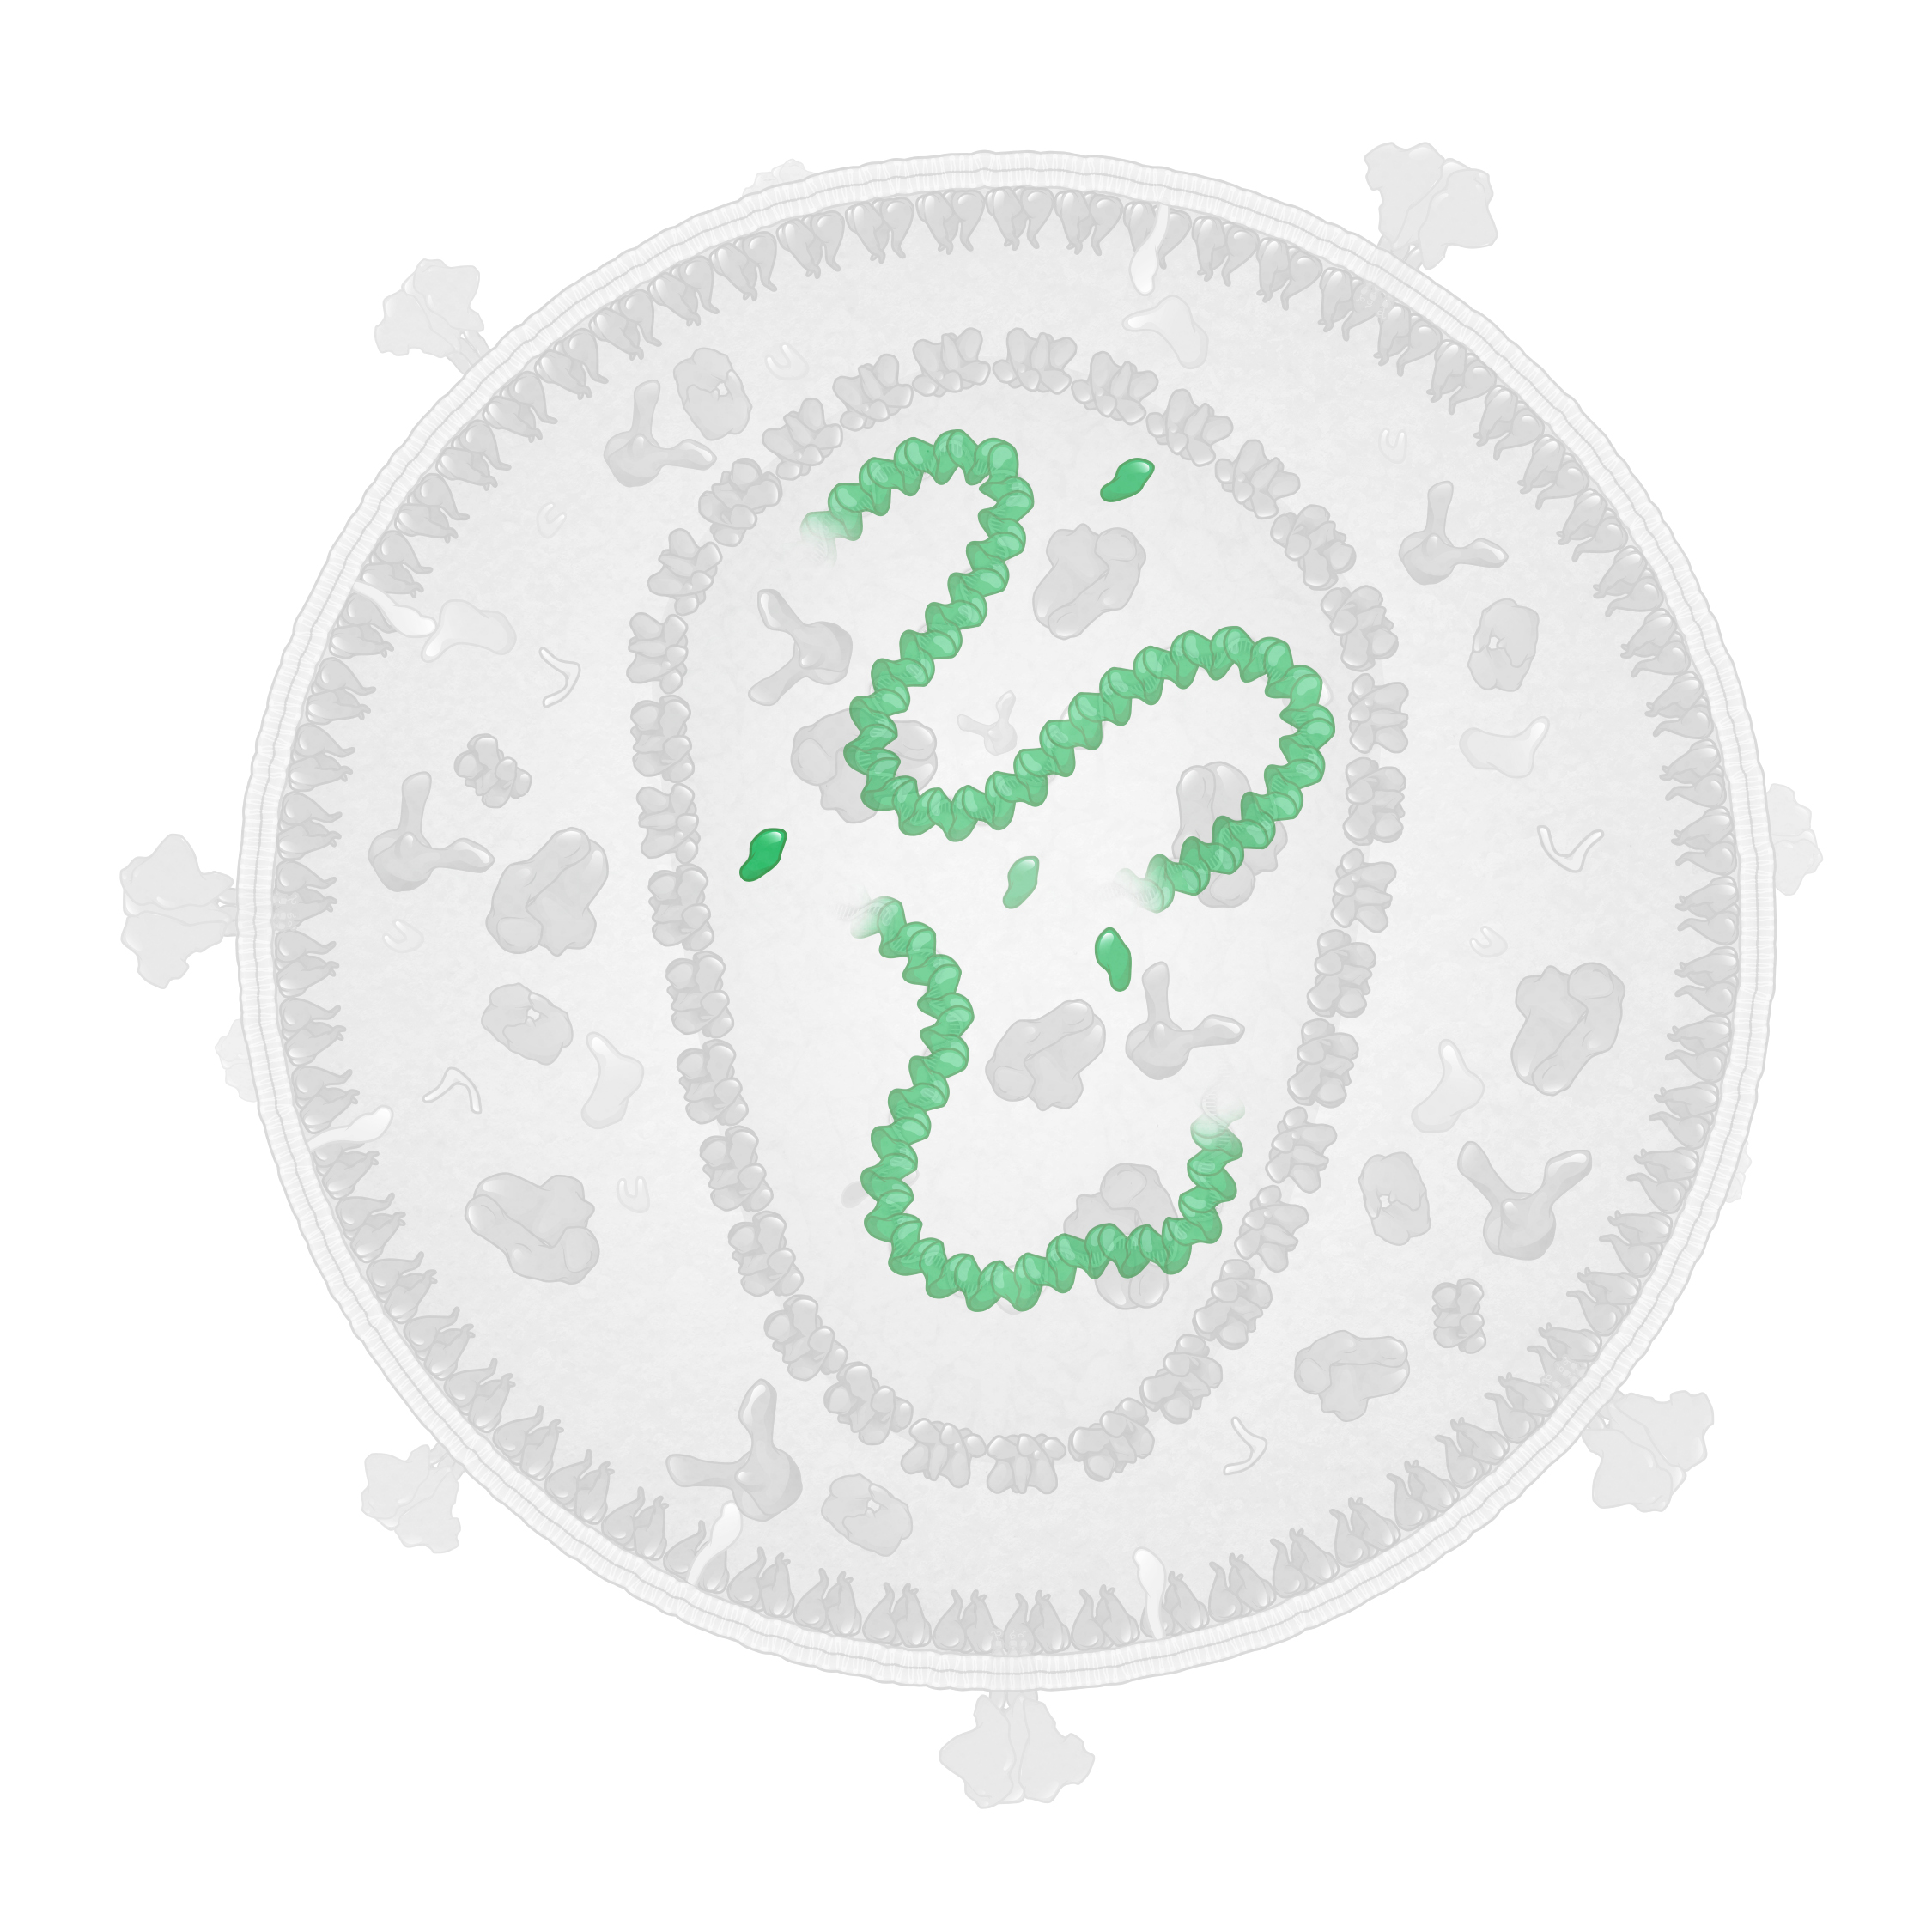
HIV Nucleocapsid (p7)
Structural Protein
HIV Nucleocapsid (p7)
HIV RNA
Illustration: Cognition Studio, Inc. and David H. Spach, MD

Slide 60
HIV Nucleocapsid (p7): HIV RNA Coating
Nucleocapsid
HIV RNA
Illustration: Cognition Studio, Inc. and David H. Spach, MD

Slide 61
HIV Nucleocapsid: Structure
HIV Nucleocapsid Monomer
N-terminal region
C-terminal region
Illustration: Cognition Studio, Inc. and David H. Spach, MD

Slide 62
HIV Nucleocapsid: Zinc-Binding Domains
HIV Nucleocapsid Monomer
N-terminal region
Zinc binding domain
Zn²⁺
Zinc binding domain
Zn²⁺
C-terminal region
Illustration: Cognition Studio, Inc. and David H. Spach, MD

Slide 63
HIV Nucleocapsid: Complexed with HIV RNA
HIV Nucleocapsid
HIV RNA
Illustration: Cognition Studio, Inc. and David H. Spach, MD

Slide 64
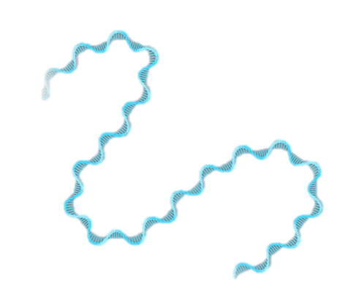
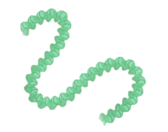
HIV Ribonucleoprotein Complex
HIV Genomic RNA
Nucleocapsid Proteins
Ribonucleoprotein Complex
+
=
Illustration: Cognition Studio, Inc. and David H. Spach, MD

Slide 65
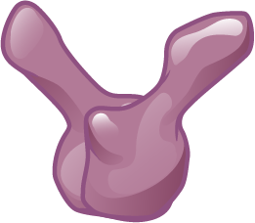
HIV Ribonucleoprotein Complex with Integrase
HIV Genomic RNA
Nucleocapsid Proteins
Integrase
Ribonucleoprotein Complex
+
+
=
Illustration: Cognition Studio, Inc. and David H. Spach, MD

Slide 66
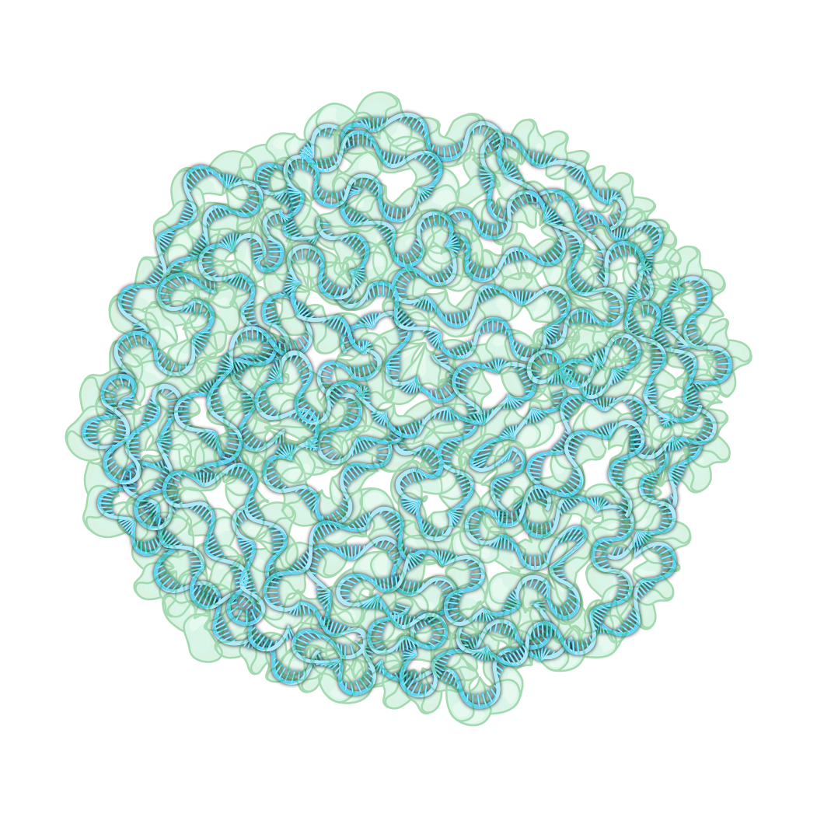
HIV Ribonucleoprotein Complex
(-) Integrase
(+) Integrase
Illustration: Cognition Studio, Inc. and David H. Spach, MD

Slide 67
HIV Nucleocapsid Protein: Role in Reverse Transcription
HIV Nucleocapsid
Illustration: Cognition Studio, Inc. and David H. Spach, MD

Slide 68
HIV p6
HIV p6
Illustration: Cognition Studio, Inc. and David H. Spach, MD

Slide 69
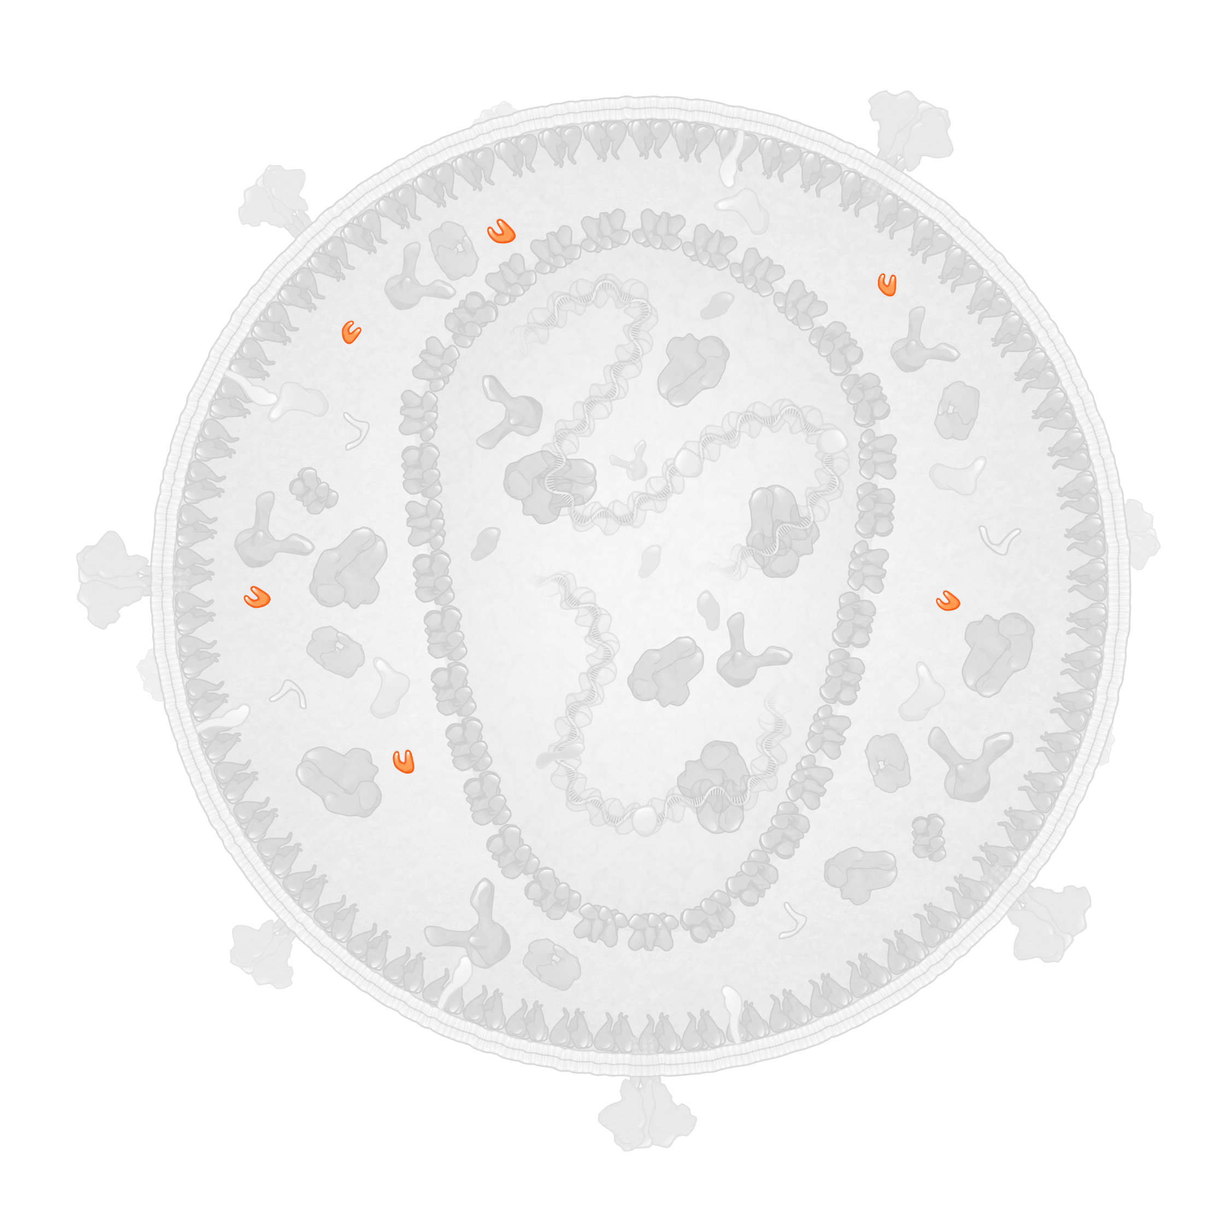
HIV p6
Structural Protein
HIV p6
Illustration: Cognition Studio, Inc. and David H. Spach, MD

Slide 70
HIV p6: Structure
HIV p6 Monomer
C-terminal region
N-terminal region
Flexible region
Illustration: Cognition Studio, Inc. and David H. Spach, MD

Slide 71
HIV p6: Role
Gag Polyproteins
p6
Illustration: Cognition Studio, Inc. and David H. Spach, MD

Slide 72
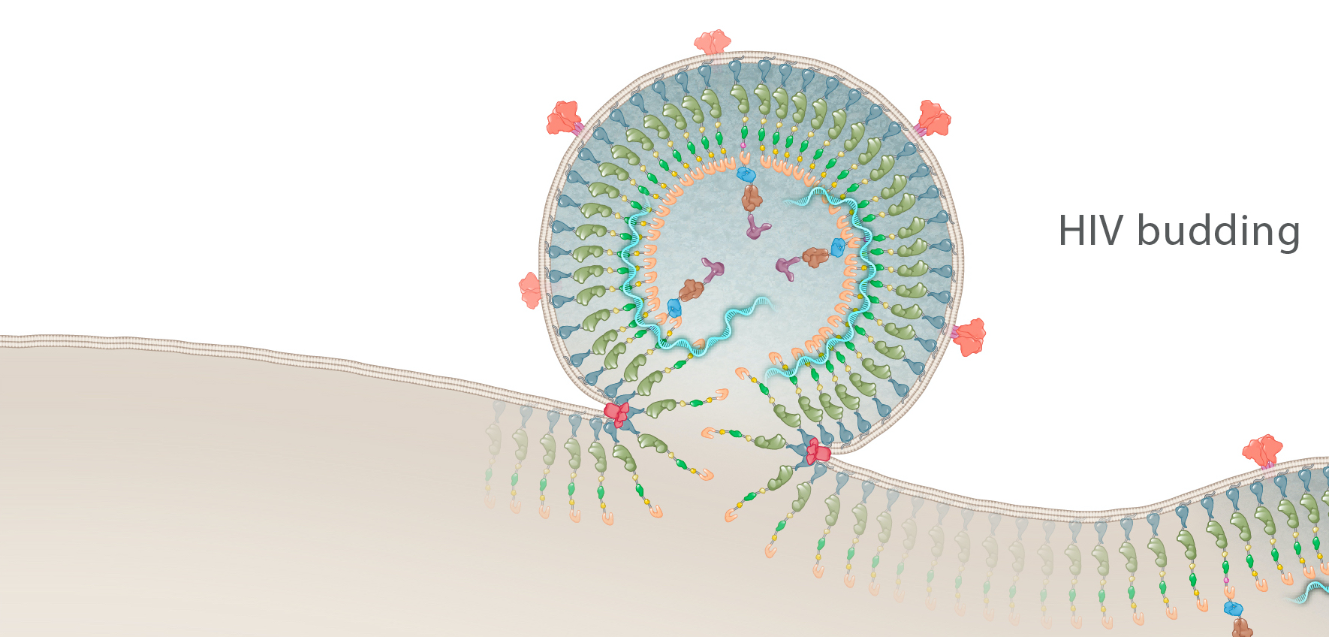
HIV p6: Role in HIV Budding
p6
Illustration: Cognition Studio, Inc. and David H. Spach, MD

Slide 73
HIV p6: Role as Docking Site for Vpr
HIV Gag Polyproteins
p6
Vpr
p6
Vpr
Illustration: Cognition Studio, Inc. and David H. Spach, MD

Slide 74
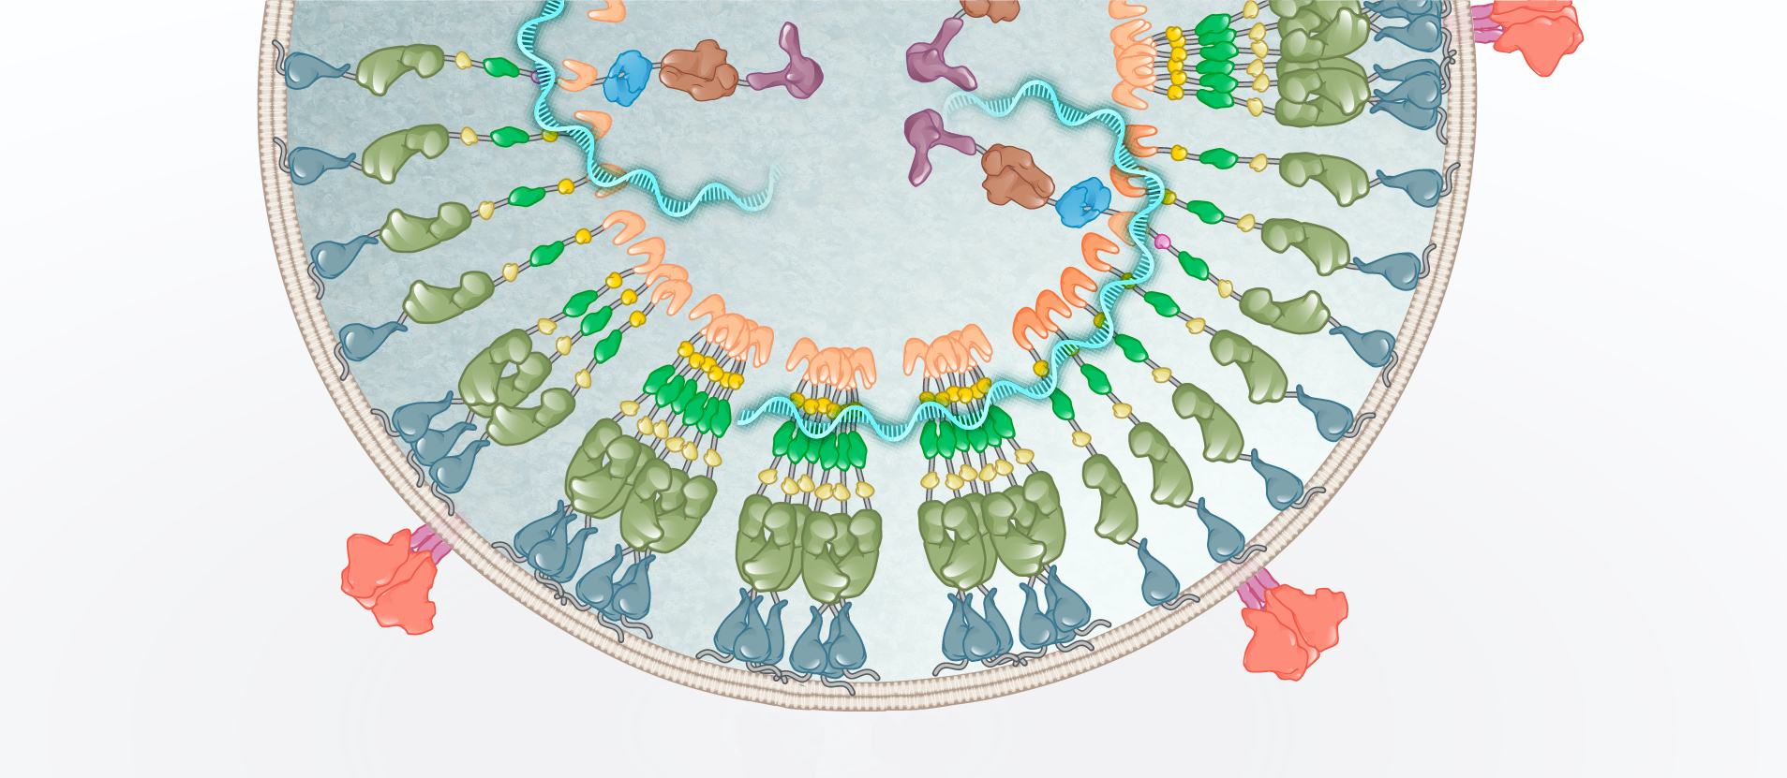
HIV p6: Facilitates Incorporation of Vpr
Vpr
Vpr
Illustration: Cognition Studio, Inc. and David H. Spach, MD

Slide 75
HIV Enzymes

Slide 76
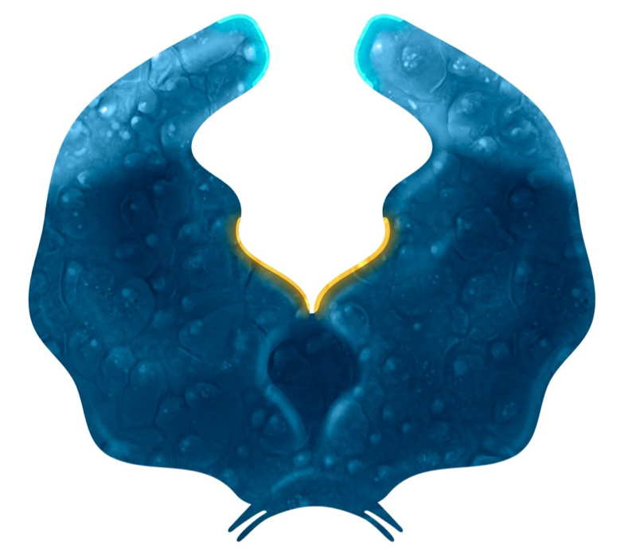
HIV Enzymes
Protease
Reverse Transcriptase
Integrase
Illustration: Cognition Studio, Inc. and David H. Spach, MD

Slide 77
HIV Protease
HIV Protease
Illustration: Cognition Studio, Inc. and David H. Spach, MD

Slide 78
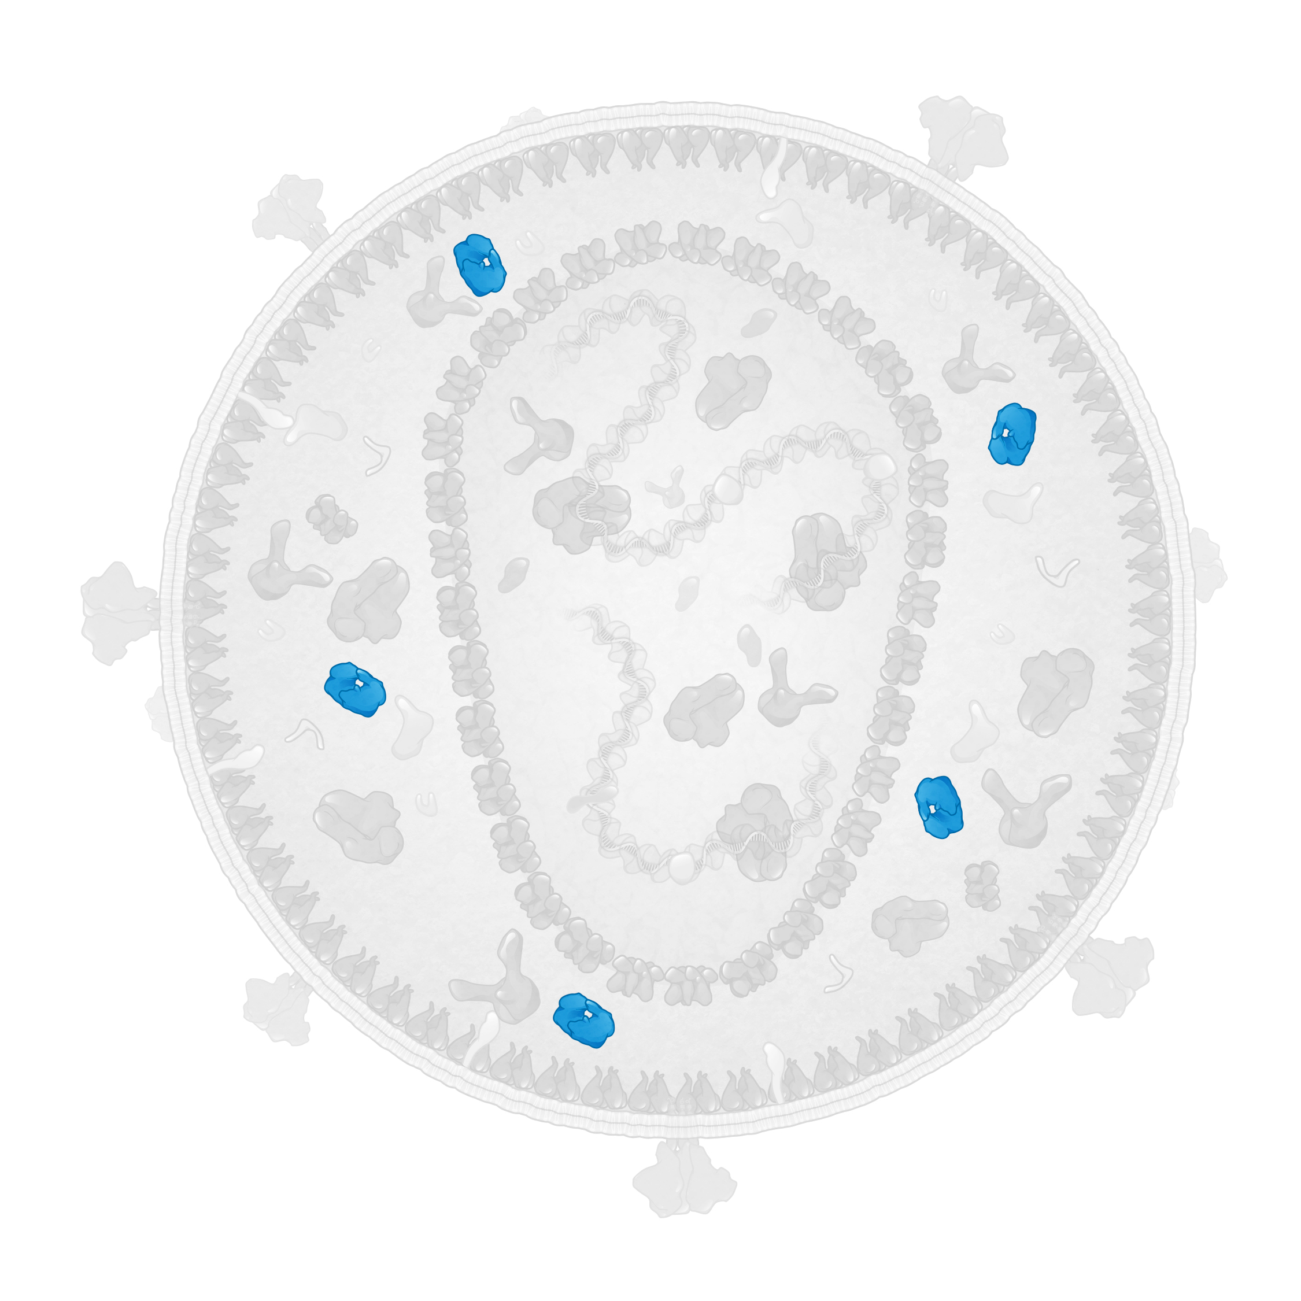
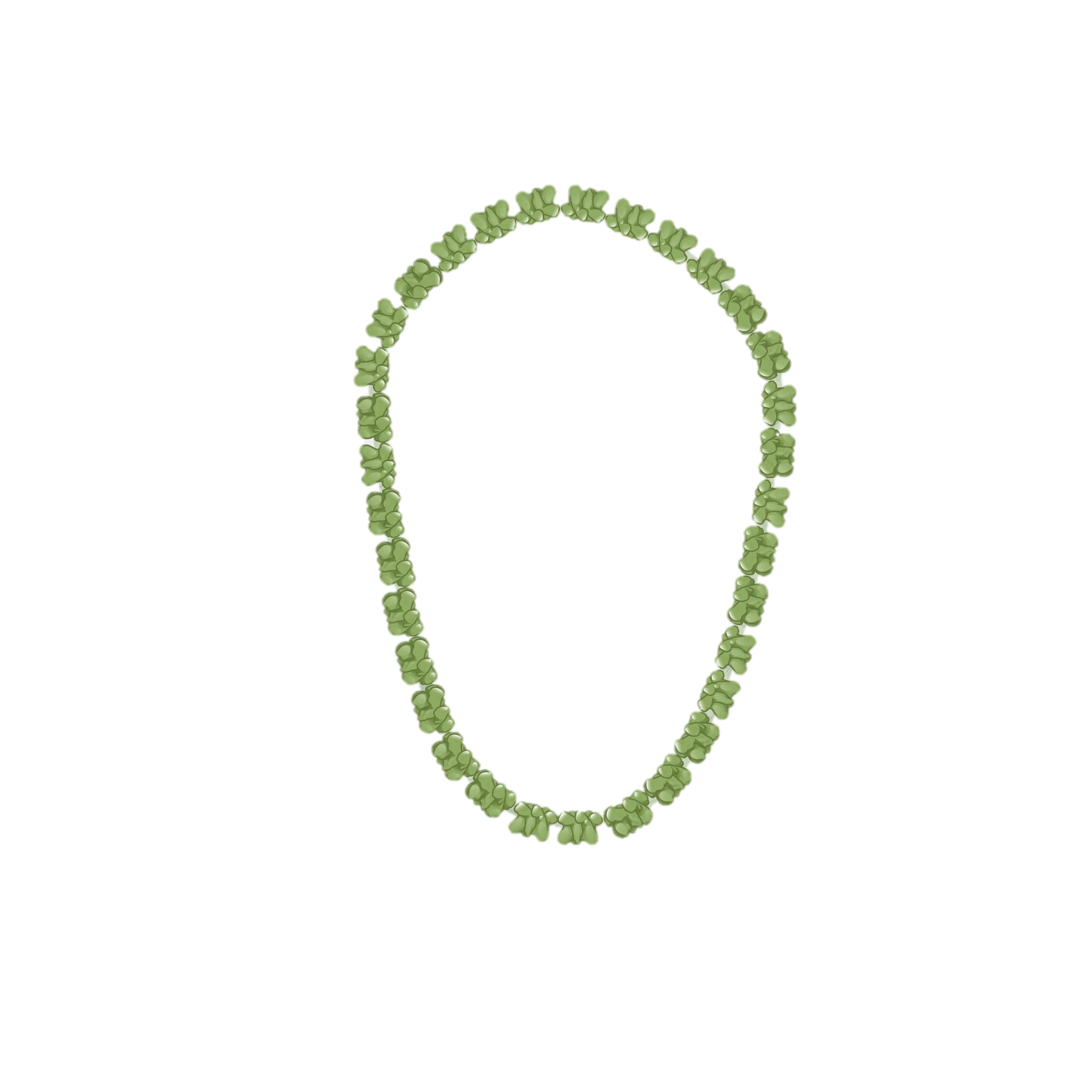
HIV Protease
Enzyme
HIV Protease
HIV Core
Illustration: Cognition Studio, Inc. and David H. Spach, MD

Slide 79
HIV Protease: Homodimer Structure
Illustration: Cognition Studio, Inc. and David H. Spach, MD

Slide 80
HIV Protease: Structural Domains
Flap domain
Core domain
Terminal domain
Illustration: Cognition Studio, Inc. and David H. Spach, MD

Slide 81
HIV Protease: Active Site
Active Site
Core domain
Illustration: Cognition Studio, Inc. and David H. Spach, MD

Slide 82
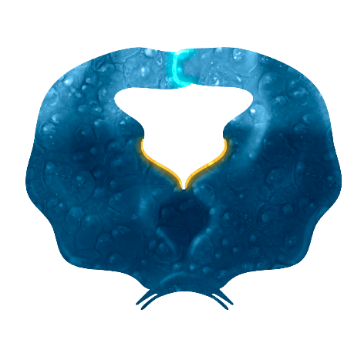
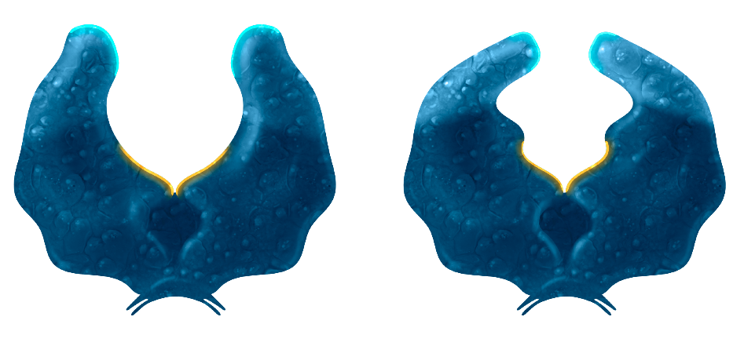
HIV Protease: Conformations
Open
Semi-Open
Closed
Active Site
Illustration: Cognition Studio, Inc. and David H. Spach, MD

Slide 83
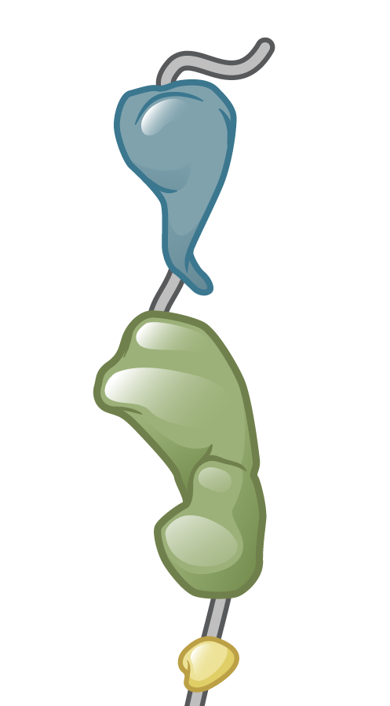
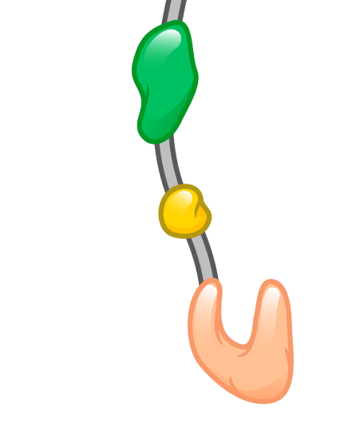
HIV Protease: Polypeptide Cleavage
HIV Gag
HIV Gag
HIV Protease
Illustration: Cognition Studio, Inc. and David H. Spach, MD

Slide 84
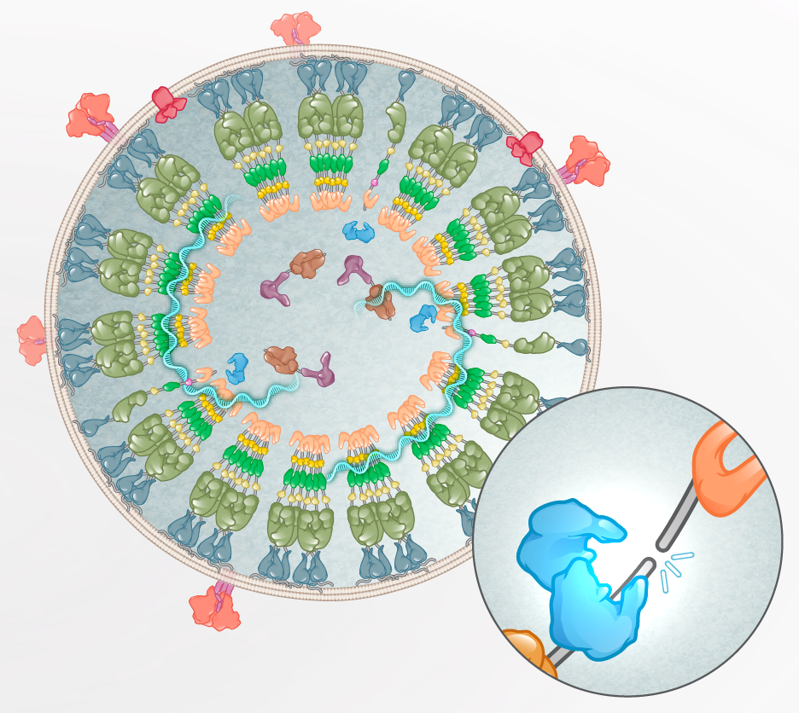
HIV Protease: Polypeptide Cleavage
HIV Maturation
HIV Gag
HIV Gag-Pl
Illustration: Cognition Studio, Inc. and David H. Spach, MD

Slide 85
HIV Reverse Transcriptase
HIV Reverse Transcriptase
Illustration: Cognition Studio, Inc. and David H. Spach, MD

Slide 86
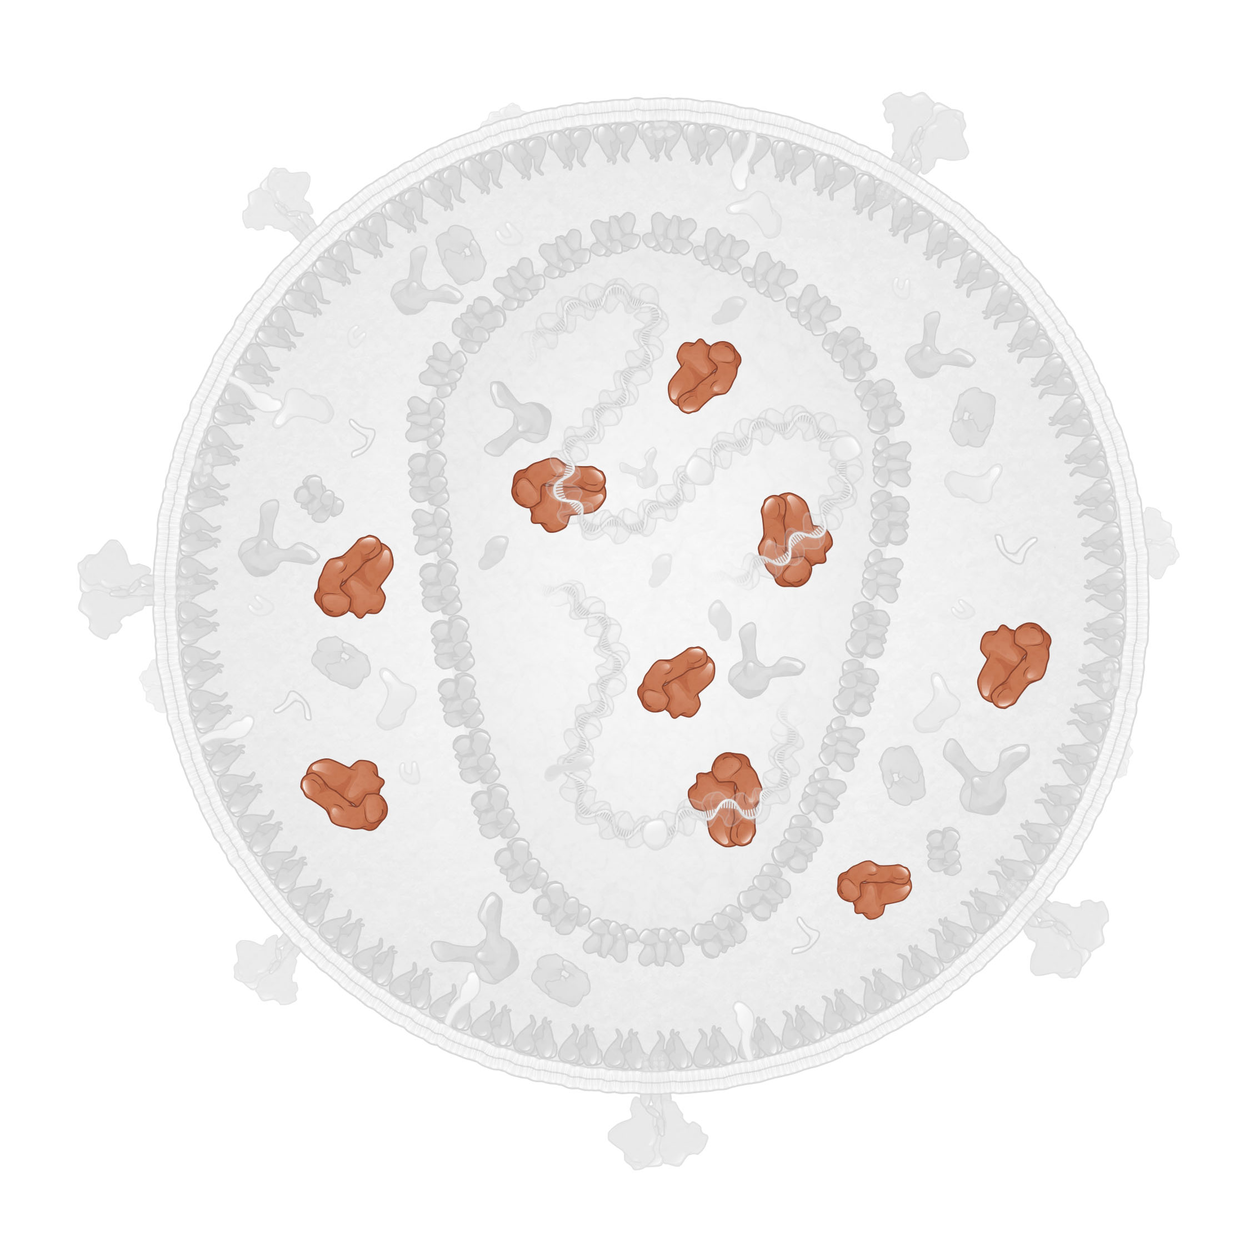
HIV Reverse Transcriptase
Enzyme
HIV Reverse Transcriptase
HIV Core
Illustration: Cognition Studio, Inc. and David H. Spach, MD

Slide 87
HIV Reverse Transcriptase: Subunits
Illustration: Cognition Studio, Inc. and David H. Spach, MD

Slide 88
HIV Reverse Transcriptase: Subunits
p66 subunit
p51 subunit
Illustration: Cognition Studio, Inc. and David H. Spach, MD

Slide 89
HIV Reverse Transcriptase: Enzymatic Domains
Polymerase Domain
p66 subunit
Ribonuclease H (RNase H) Domain
p51 subunit
Illustration: Cognition Studio, Inc. and David H. Spach, MD

Slide 90
HIV Reverse Transcriptase: Enzyme Active Sites
Polymerase Active Site
p66 subunit
Ribonuclease H (RNase) Active Site
Illustration: Cognition Studio, Inc. and David H. Spach, MD

Slide 91
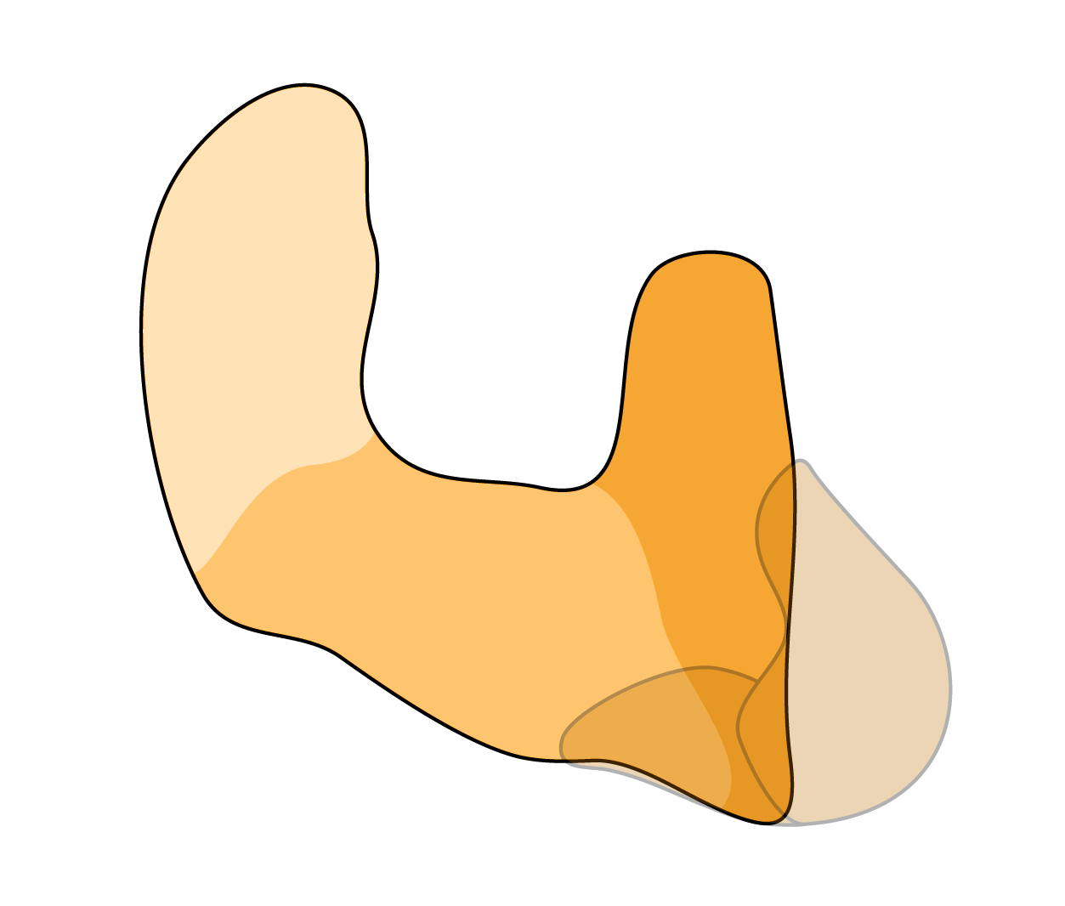
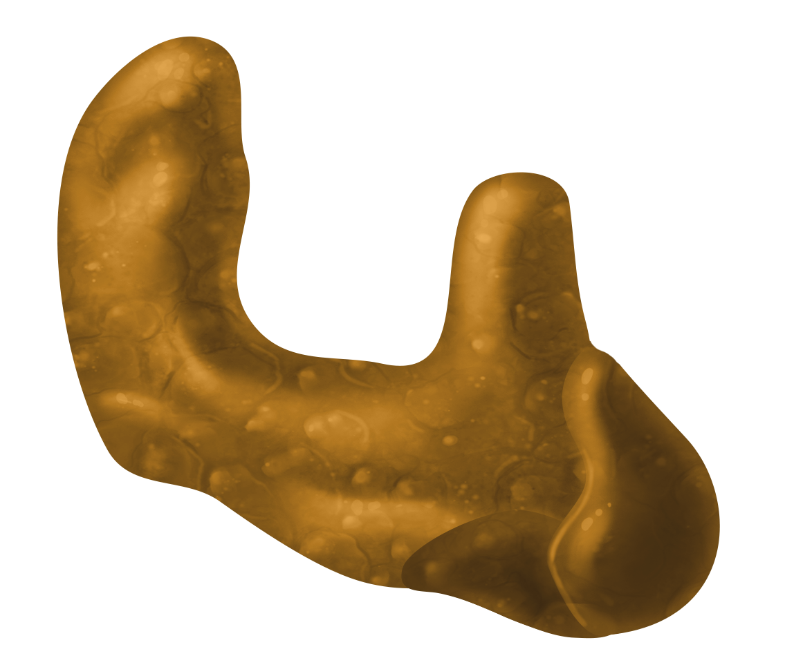
HIV Reverse Transcriptase: p66 Subunit Right Hand Structure
Fingers
Fingers
Fingers
Thumb
Thumb
Thumb
Palm
Palm
Palm
Illustration: Cognition Studio, Inc. and David H. Spach, MD

Slide 92
HIV Reverse Transcriptase: Reverse Transcription
HIV RNA
HIV DNA
Reverse Transcriptase
Illustration: Cognition Studio, Inc. and David H. Spach, MD

Slide 93
HIV Integrase
HIV Integrase
Illustration: Cognition Studio, Inc. and David H. Spach, MD

Slide 94
HIV Integrase
Enzyme
HIV Integrase
HIV Core
Illustration: Cognition Studio, Inc. and David H. Spach, MD

Slide 95
HIV Integrase: Component of Ribonucleoprotein Complex
HIV Ribonucleoprotein Complex
Integrase
Illustration: Cognition Studio, Inc. and David H. Spach, MD

Slide 96
HIV Integrase: Complexes
Monomer
Dimer
Tetramer
Illustration: Cognition Studio, Inc. and David H. Spach, MD

Slide 97
HIV Integrase: Dimer Structure
C-terminal domain (CTD)
N-terminal domain (NTD)
Catalytic core domain (CCD)
Illustration: Cognition Studio, Inc. and David H. Spach, MD

Slide 98
HIV Integrase: Catalytic Core Domain
Catalytic triad (DDE)
Catalytic core domain (CCD)
Illustration: Cognition Studio, Inc. and David H. Spach, MD

Slide 99
HIV Integrase: Catalytic Core Domain
Mg2+
Mg2+
Catalytic triad (DDE)
D116
D64
E152
Catalytic triad
Illustration: Cognition Studio, Inc. and David H. Spach, MD

Slide 100
HIV Integrase: Active Enzymatic Region
Active Enzymatic Region
Catalytic core domain (CCD)
Illustration: Cognition Studio, Inc. and David H. Spach, MD

Slide 101
HIV Integrase: Intasome Formation
HIV DNA
HIV Integrase
Intasome
Illustration: Cognition Studio, Inc. and David H. Spach, MD

Slide 102
HIV Integrase: 3ʹ Processing of HIV DNA
HIV DNA
HIV Integrase
3ʹ
3ʹ
Illustration: Cognition Studio, Inc. and David H. Spach, MD

Slide 103
HIV Integrase: 3ʹ Processing of HIV DNA
HIV DNA
HIV Integrase
Illustration: Cognition Studio, Inc. and David H. Spach, MD

Slide 104
HIV Integrase: Strand Transfer
HIV DNA
HIV Integrase (tetramer)
Host DNA
Illustration: Cognition Studio, Inc. and David H. Spach, MD

Slide 105
HIV Accessory and Regulatory Proteins

Slide 106
HIV Accessory Proteins
Vif
Vpr
Vpu
Nef

Slide 107
Viral Infectivity Factor (Vif)
Accessory Protein
Vif
Illustration: Cognition Studio, Inc. and David H. Spach, MD

Slide 108
Vif and Host Restriction Factor APOBEC3G
Accessory Protein
Host Restriction Factor
Vif
APOBEC3G
Illustration: Cognition Studio, Inc. and David H. Spach, MD

Slide 109
APBOPEC3G Conversion of Cytosine to Uracil
APOBEC3G
Cytosine
Uracil
C
U
Illustration: Cognition Studio, Inc. and David H. Spach, MD

Slide 110
APBOPEC3G-Induced Altered Base Pairing
APOBEC3G
Cytosine
Uracil
C
U
G
A
Guanine
Adenine
Illustration: Cognition Studio, Inc. and David H. Spach, MD

Slide 111
APBOPEC3G-Induced “G to A” Hypermutation
APOBEC3G
APOBEC3G
Cytosine
Uracil
C
U
G
A
Guanine
Adenine
G ➞A Hypermutation
Illustration: Cognition Studio, Inc. and David H. Spach, MD

Slide 112
Vif: Clustering at Host Cell Membrane
Cell Membrane
Cytosol
APOBEC3G
Vif
Vif
Illustration: Cognition Studio, Inc. and David H. Spach, MD

Slide 113
Vif: Binding to APOBEC3G at Host Cell Membrane
Cell Membrane
Cytosol
APOBEC3G
Vif
Vif
Illustration: Cognition Studio, Inc. and David H. Spach, MD

Slide 114
Vif: Neutralizing Action of APOBEC3G
Cell Membrane
Cytosol
APOBEC3G
Vif
Vif
Illustration: Cognition Studio, Inc. and David H. Spach, MD

Slide 115
Viral Protein R (Vpr)
Accessory Protein
Vpr
Illustration: Cognition Studio, Inc. and David H. Spach, MD

Slide 116
Vpr: Component of HIV Core
HIV core
Vpr
Host cell
Nucleus
Illustration: Cognition Studio, Inc. and David H. Spach, MD

Slide 117
Vpr: Role in HIV Reverse Transcription
Vpr
HIV RNA
Reverse Transcriptase
Nucleocapsid (p7)
Integrase
Illustration: Cognition Studio, Inc. and David H. Spach, MD

Slide 118
Vpr: Role in Nuclear Import
HIV Core
Nuclear pore
Vpr
Nucleus
Illustration: Cognition Studio, Inc. and David H. Spach, MD

Slide 119
Viral Protein U (Vpu)
Accessory Protein
Illustration: Cognition Studio, Inc. and David H. Spach, MD

Slide 120
Vpu and Host Restriction Factor Tetherin
Accessory Protein
Host Restriction Factor
Vpu
dimer
Tetherin (BST-2)
Illustration: Cognition Studio, Inc. and David H. Spach, MD
Notes: Vpu 81 aa; Tetherin 160 aa (dimer 320)

Slide 121
Tetherin: Prevention of Budding
HIV
Tetherin
Host cell Membrane
Illustration: Cognition Studio, Inc. and David H. Spach, MD

Slide 122
Tetherin: Synthesis in Endoplasmic Reticulum and Golgi
Cell Membrane
Tetherin
Cytosol
Golgi
Endoplasmic Reticulum
Tetherin
Illustration: Cognition Studio, Inc. and David H. Spach, MD

Slide 123
Tetherin: Bound to Endoplasmic Reticulum Membrane
Tetherin
Tetherin
Cytosol
Endoplasmic Reticulum
Illustration: Cognition Studio, Inc. and David H. Spach, MD

Slide 124
Vpu: Synthesis
Tetherin
Tetherin
Cytosol
Endoplasmic Reticulum
Vpu
Vpu
Vpu
Vpu
Illustration: Cognition Studio, Inc. and David H. Spach, MD

Slide 125
Vpu: Accumulation at Endoplasmic Reticulum Membrane
Tetherin
Tetherin
Cytosol
Endoplasmic Reticulum
Vpu
Vpu
Illustration: Cognition Studio, Inc. and David H. Spach, MD

Slide 126
Vpu: Binding to Tetherin
Tetherin
Tetherin
Cytosol
Endoplasmic Reticulum
Illustration: Cognition Studio, Inc. and David H. Spach, MD

Slide 127
Vpu: Destruction of Tetherin
Tetherin
Vpu
Cytosol
Endoplasmic Reticulum
Lysosomal degradation
Illustration: Cognition Studio, Inc. and David H. Spach, MD

Slide 128
Vpu: Blocked Recycling of Tetherin
Tetherin
Tetherin
Vpu
Vpu
Cytosol
Endoplasmic Reticulum
Lysosomal degradation
Recycling
Illustration: Cognition Studio, Inc. and David H. Spach, MD

Slide 129
Vpu: Neutralizating Action of Tetherin
HIV
Host Membrane
Illustration: Cognition Studio, Inc. and David H. Spach, MD

Slide 130
Vpu: Downregulation of Host Cell CD4 Receptor
CD4 Receptors
X
X
Cell Membrane
Cytosol
Illustration: Cognition Studio, Inc. and David H. Spach, MD

Slide 131
Vpu and CD4 Interaction
CD4
CD4
Cytosol
Endoplasmic Reticulum
Vpu
Vpu
Illustration: Cognition Studio, Inc. and David H. Spach, MD

Slide 132
Vpu: Interaction with Host CD4 Receptor
CD4
CD4
Cytosol
Endoplasmic Reticulum
Vpu
Vpu
Illustration: Cognition Studio, Inc. and David H. Spach, MD

Slide 133
Vpu: Destruction of CD4 Molecule
CD4
CD4
Cytosol
Endoplasmic Reticulum
Vpu
Vpu
Illustration: Cognition Studio, Inc. and David H. Spach, MD

Slide 134
CD4 Trapping of HIV Envelope in Endoplasmic Reticulum
Cytosol
Endoplasmic Reticulum
CD4
CD4
CD4
CD4
gp160
Illustration: Cognition Studio, Inc. and David H. Spach, MD

Slide 135
Vpu: Production Correlates with Amount of CD4
Cytosol
Endoplasmic Reticulum
Vpu
Vpu
CD4
CD4
CD4
CD4
gp160
Illustration: Cognition Studio, Inc. and David H. Spach, MD

Slide 136
Vpu Production: Reduces Amount of CD4
Cytosol
Endoplasmic Reticulum
Vpu
Vpu
CD4
gp160
Illustration: Cognition Studio, Inc. and David H. Spach, MD

Slide 137
Vpu: Augments HIV Envelope Migration to Cell Surface
gp160
gp160
Cytosol
Endoplasmic Reticulum
Vpu
Vpu
CD4
CD4
Illustration: Cognition Studio, Inc. and David H. Spach, MD

Slide 138
Negative Regulatory Factor (Nef)
Accessory Protein
Illustration: Cognition Studio, Inc. and David H. Spach, MD

Slide 139
Nef: Myristyl Group
Myristyl Group
Illustration: Cognition Studio, Inc. and David H. Spach, MD

Slide 140
Nef: Downregulation of Cellular Receptors
CD4 Receptor
CD8 Receptor
X
X
Cell Membrane
Cytosol
Illustration: Cognition Studio, Inc. and David H. Spach, MD

Slide 141
Nef: Binding to Host Cell Receptors
CD4 Receptor
CD8 Receptor
Cell Membrane
Cytosol
Illustration: Cognition Studio, Inc. and David H. Spach, MD

Slide 142
Nef: Destruction of Host Cell Receptors
CD4 Receptor
CD8 Receptor
Cell Membrane
Cytosol
Illustration: Cognition Studio, Inc. and David H. Spach, MD

Slide 143
HIV Regulatory Proteins
HIV Transcription
HIV Translation
Tat
Rev
Illustration: Cognition Studio, Inc. and David H. Spach, MD

Slide 144
Transactivator of Transcription (Tat)
Regulatory Protein
Illustration: Cognition Studio, Inc. and David H. Spach, MD

Slide 145
Latent Proviral HIV DNA
Host Cell Nucleus
Host DNA
HIV Proviral DNA
Host DNA
Illustration: Cognition Studio, Inc. and David H. Spach, MD

Slide 146
Activation of Transcription
Host Cell Nucleus
Host DNA
Host cell RNA polymerase
HIV genomic RNA
HIV Proviral DNA
HIV mRNA
Illustration: Cognition Studio, Inc. and David H. Spach, MD

Slide 147
Tat: Activation of Transcription
Host Cell Nucleus
Host DNA
Host cell RNA polymerase
HIV genomic RNA
HIV Proviral DNA
HIV Tat
HIV mRNA
Illustration: Cognition Studio, Inc. and David H. Spach, MD

Slide 148
Regulator of Expression of Virion Proteins (Rev)
Regulatory Protein
Illustration: Cognition Studio, Inc. and David H. Spach, MD

Slide 149
Rev: Early Synthesis
Nucleus
Cytoplasm
Illustration: Cognition Studio, Inc. and David H. Spach, MD

Slide 150
Rev: Migration into Nucleus
Nucleus
Cytoplasm
Illustration: Cognition Studio, Inc. and David H. Spach, MD

Slide 151
Rev: Enhanced Shuttling of mRNA to Cytoplasm
Nucleus
Cytoplasm
Illustration: Cognition Studio, Inc. and David H. Spach, MD

Slide 152
Summary

Slide 153
Introduction to the Biology of HIV-1: Summary
Structure
Genome
Structural Proteins
Enzymes
Accessory and Regulatory Proteins

