Slide 1
Evaluation and Management of Latent Tuberculosis Infection (LTBI): Recent Updates
Aley Kalapila, MD, PhD Associate Editor, National HIV Curriculum Associate Professor of Medicine Division of Infectious Diseases
Emory University School of Medicine & Grady Health System
Last Updated: November 4, 2022

Slide 2
Dr. Kalapila has no financial conflicts of interest or disclosures.

Slide 3
Latent TB Update: Outline
Background
New Preferred LTBI Regimens
Alternative LTBI Regimens
Summary

Slide 4
LTBI and HIV: Background

Slide 5
When should you screen for LTBI in people with HIV?

Slide 6
When to Screen Persons with HIV for LTBI
Screen all persons at the time of HIV diagnosis
If LTBI (-) and CD4 count <200, rescreen when CD4 count ≥200
Screen annually if high risk for repeated or ongoing exposure*
*(e.g., during incarceration, travel to a high-TB incidence country, homelessness, living in a congregate setting).
Source: HHS. Opportunistic Infections Guidelines. Mycobacterium tuberculosis Infection and Disease. Feb 17, 2022.

Slide 7
How to screen for LTBI in people with HIV?

Slide 8
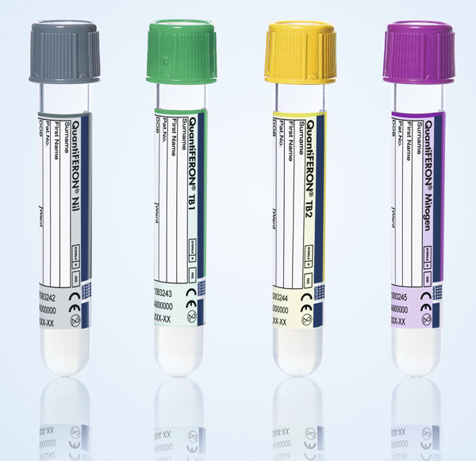
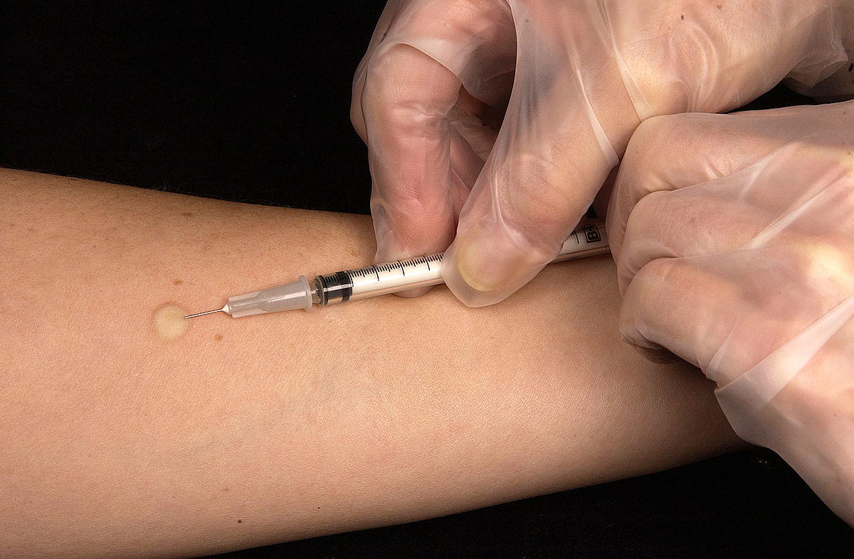
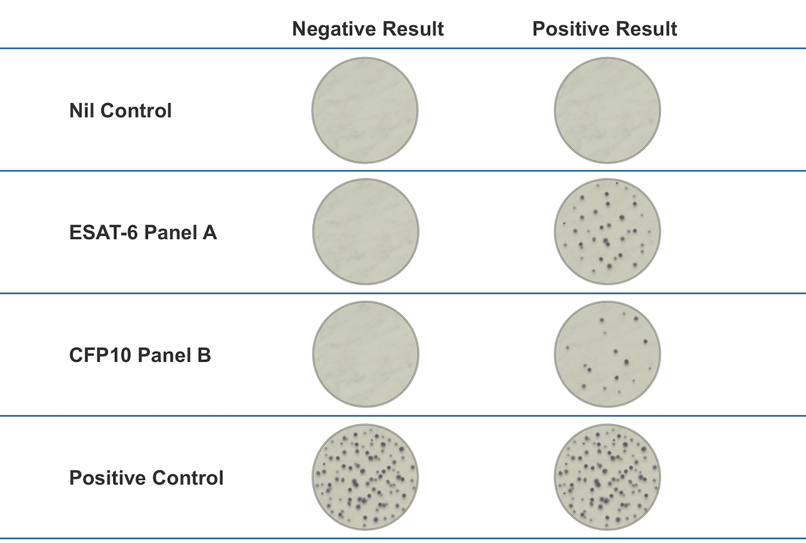
Screening for LTBI in Persons with HIV
Tuberculin Skin Test
Interferon-Gamma Release Assay
Source: Qiagen
Source: CDC
Source: Oxford Immunotec

Slide 9
When should you treat LTBI in people with HIV?

Slide 10
Indication for Treating LTBI in People with HIV
Positive LTBI screening test (TST or IGRA) AND
No evidence of active TB disease
No prior treatment for active disease or latent TB infection
Significant Exposure
Recent exposure or close contact with a person with infectious TB, regardless of screening test result
Source: HHS. Opportunistic Infections Guidelines. Mycobacterium tuberculosis Infection and Disease. Feb 17, 2022.

Slide 11
LTBI Treatment in people with HIV: New Preferred Regimens

Slide 12
Preferred Treatment of LTBI in Persons with HIV
Old Recommendation
NEW Recommendation
6H (Isoniazid* x 6 months)
9H (Isoniazid* x 9 months)
3HP (Isoniazid* + Rifapentine x 3 months)
3HR (Isoniazid* + Rifampin x 3 months)
*Pyridoxine is given with Isoniazid to prevent isoniazid-related neuropathy
Source: HHS. Opportunistic Infections Guidelines. Mycobacterium tuberculosis Infection and Disease. Feb 17, 2022.

Slide 13
Preferred Therapy for LTBI in Persons with HIV
3HP: Weekly Isoniazid* plus Rifapentine for 3 Months
Dosing is weight-based.
Recommended only if virally-suppressed and receiving ART regimen that has one of the following anchor drugs — efavirenz, raltegravir, or once daily dolutegravir.
Tenofovir alafenamide with rifapentine is not recommended
3HR: Daily Isoniazid* plus Rifampin for 3 Months
When using rifampin for LTBI treatment, either dose adjustment or substitution of antiretroviral medications may be needed
*Pyridoxine is given with isoniazid to prevent isoniazid-related neuropathy
Source: HHS. Opportunistic Infections Guidelines. Mycobacterium tuberculosis Infection and Disease. Feb 17, 2022.

Slide 14
STUDIES SUMMARY
^{1,2} Clinical trials of 3HP in persons with HIV, have demonstrated:
Equal efficacy and better tolerability compared to daily INH monotherapy
Better adherence and treatment completion compared to daily INH
³⁻⁵ Clinical trials of 3HR in persons with and without HIV, have demonstrated:
Comparable decreased risk of developing active TB compared to daily INH
Lower rates of hepatotoxicity compared to daily INH
Source:
Sterling TR, et al. AIDS. 2016;30:1607-15.
Churchyard G, Cárdenas V, Chihota V, et al. Ann Intern Med. 2021;174:1367-76.
Ena J, Valls V. Clin Infect Dis. 2005;40:670-6.
Rivero A, Lopez-Cortes L, Castillo R, et al. Enferm Infecc Microbiol Clin. 2007;25:305-10.
Whalen CC, Johnson JL, Okwera A, et al. N Engl J Med. 1997;337:801-8.

Slide 15
LTBI Treatment in people with HIV: Alternative Regimens

Slide 16
Alternative Therapy for LTBI in Persons with HIV
6H/9H: Daily Isoniazid* for 6 to 9 Months
Fewer drug interactions with antiretroviral drugs compared to the rifamycins
4R: Daily Rifampin for 4 Months
When using rifampin for LTBI treatment, either dose adjustment or substitution of antiretroviral medications may be needed
1HP: Daily Isoniazid* plus Rifapentine for 1 Month
Rifapentine dosing is weight-based.
Recommended only with ART regimen consisting of efavirenz combined with either tenofovir disoproxil fumarate-emtricitabine or abacavir-lamivudine
*Pyridoxine is given with isoniazid to prevent isoniazid-related neuropathy
Source: HHS. Opportunistic Infections Guidelines. Mycobacterium tuberculosis Infection and Disease. Feb 17, 2022.

Slide 17
LTBI: Summary
All individuals with HIV should be screened for LTBI
LTBI treatment is indicated for those with positive LTBI screening tests and/or recent exposure to active tuberculosis case
Two newly recommended preferred regimens for LTBI treatment in persons with HIV:
3HP: Weekly isoniazid plus pyridoxine plus rifapentine for 3 months
3HR: Daily isoniazid plus pyridoxine plus rifampin for 3 months
There are 3 alternative LTBI treatment regimens, if preferred regimens are not feasible
When selecting LTBI treatment, consider drug interactions between the LTBI drugs, rifapentine and rifampin, with antiretroviral medications

