Slide 1
Darunavir-Cobicistat-Tenofovir Alafenamide-Emtricitabine
Aley Kalapila, MD, PhD Associate Editor, National HIV Curriculum Associate Professor of Medicine Division of Infectious Diseases
Emory University School of Medicine & Grady Health System
Last Updated: October 4, 2022

Slide 2
Dr. Kalapila has no financial conflicts of interest or disclosures.

Slide 3
Darunavir-Cobicistat-Tenofovir alafenamide-Emtricitabine (DRV-COBI-TAF-FTC)
Darunavir
Cobicistat
Tenofovir alafenamide
Emtricitabine
800 mg
150 mg
10 mg
200 mg
PI
Booster
NRTI
NRTI
Dosing: Once daily with food

Slide 4
Darunavir-Cobicistat-Tenofovir Alafenamide-Emtricitabine Single-Tablet Regimen
Indication: Complete regimen for treatment of HIV-1 in persons weighing ≥40 kg:
No prior antiretroviral treatment history, or
Virologically suppressed (HIV-1 RNA < 50 copies/mL) on a stable ART for ≥6 months and have no known resistance to darunavir or tenofovir
Testing Prior to Initiation
Renal function
Serologic testing for hepatitis B (HBV) virus infection
With Renal or Hepatic Impairment
Not recommended if estimated CrCl <30 mL/min
Not recommended with severe hepatic impairment (Child-Pugh C)

Slide 5
Darunavir-Cobicistat-Tenofovir Alafenamide-Emtricitabine Mechanism of Action

Slide 6
Nucleoside Reverse Transcriptase Inhibitors (NRTIs): Mechanism of Action
Human Nucleotides
NTRIs
Tenofovir alafenamide
Emtricitabine
HIV DNA
Chain Termination
HIV RNA
Reverse Transcriptase
Illustration: David H. Spach, MD

Slide 7
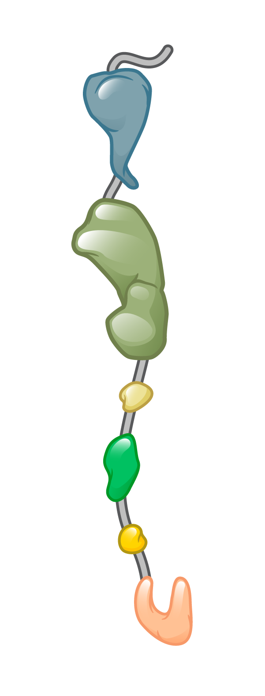
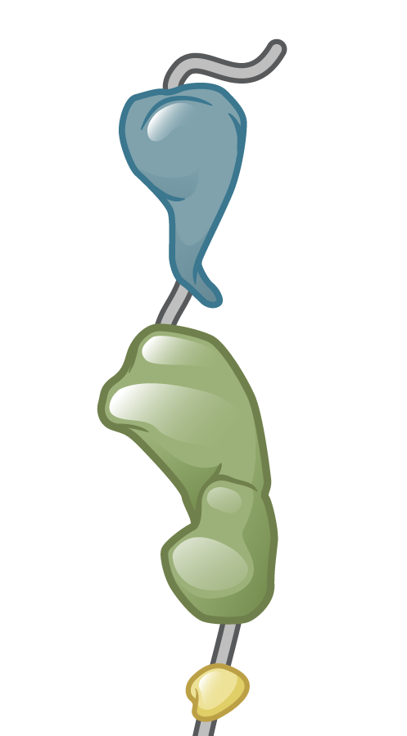
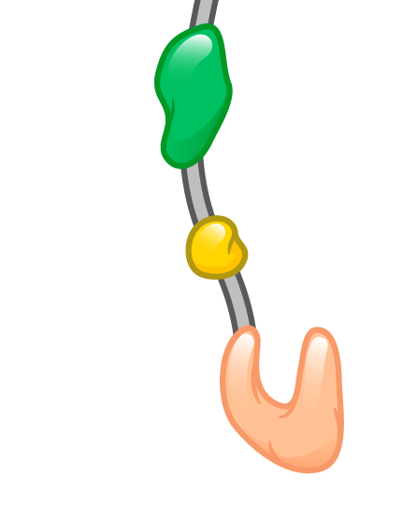
HIV Protease and Polypeptide Cleavage
HIV Gag
HIV Gag
HIV Protease
Illustration: Cognition Studio, Inc. and David H. Spach, MD

Slide 8
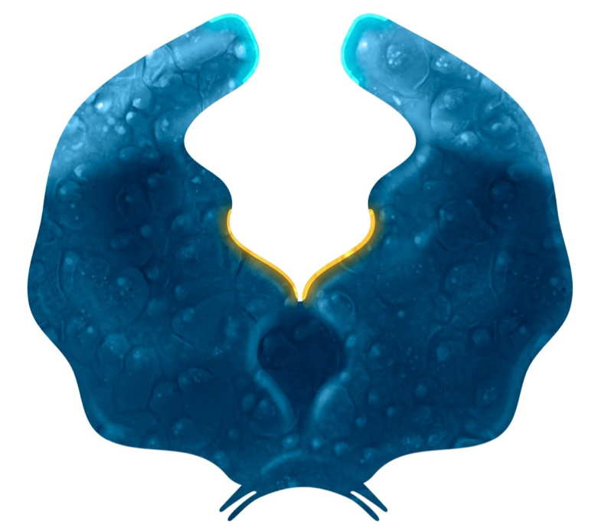
Protease Inhibitors: Mechanism of Action
Darunavir
Active Site
HIV Protease
Illustration: Cognition Studio, Inc. and David H. Spach, MD

Slide 9
Key Clinical Trials

Slide 10
DRV-COBI-TAF-FTC vs DRV-COBI + TDF-FTC as Initial ART AMBER: Design
Background: Randomized, double-blind, active-controlled, international, phase 3 study evaluating the efficacy and safety of the single-tablet regimen DRV-COBI-TAF-FTC compared with DRV-COBI + TDF-FTC for treatment-naïve individuals
Inclusion Criteria (n = 725)
Age ≥18 years
Antiretroviral naïve
CD4 count >50 cells/mm³
HIV RNA ≥1,000 copies/mL
eGFR ≥70 mL/min
Genotypic sensitivity to DRV, TDF, and FTC
No hepatitis B or C
Not pregnant
No AIDS-defining condition within 30 days
DRV-COBI-TAF-FTC + 2 placebo tabs
(n = 362)
1x
1x
DRV-COBI + TDF-FTC + placebo tab
(n = 363)
Source: Eron JJ, et al. AIDS. 2018;32:1431-42.

Slide 11
DRV-COBI-TAF-FTC vs DRV-COBI + TDF-FTC as Initial ART AMBER: Results
Week 48: Virologic Response by FDA Snapshot Analysis, ITT
331/362
321/363
278/303
265/293
53/59
56/70
Source: Eron JJ, et al. AIDS. 2018;32:1431-42.

Slide 12
DRV-COBI-TAF-FTC vs DRV-COBI + TDF-FTC as Initial ART AMBER: Results
Week 48: Change in Serum Creatinine and Estimated GFR
Abbreviations: Cr = creatinine (measured in µmol/L); eGFR = estimated glomerular filtration rate (measured in mL/min/1.73m², calculated using CKD-EPI); Cyst = cystatin C
Source: Eron JJ, et al. AIDS. 2018;32:1431-42.

Slide 13
DRV-COBI-TAF-FTC vs DRV-COBI + TDF-FTC as Initial ART AMBER: Results
Week 48: Change in Urinary Markers of Tubular Dysfunction
Mean Change in Markers of Proximal Tubulopathy at Week 48
 | DRV-COBI-TAF-FTC (n = 362) | DRV-COBI + TDF-FTC (n = 363)
UPCR (mg/g) | -22.42 | -10.34
UACR (mg/g) | -2.45 | -0.58
RBP:Cr (μg/g) | 16.84 | 401.12
β2M:Cr (μg/g) | -100.58 | 837.63
UPCR = urine protein to creatinine ratio; UACR = urine albumin to creatinine ratio
RBP:Cr = retinol binding protein to creatinine ratio; β2M:Cr = beta-2-microglobulin to creatinine ratio
Source: Eron JJ, et al. AIDS. 2018;32:1431-42.

Slide 14
DRV-COBI-TAF-FTC vs DRV-COBI + TDF-FTC as Initial ART AMBER: Results
Week 48: Percentage Change in Bone Mineral Density*
*This is from a bone mineral density substudy (n = 113 participants in TAF arm, 99 in control arm)
Source: Eron JJ, et al. AIDS. 2018;32:1431-42.

Slide 15
DRV-COBI-TAF-FTC vs DRV-COBI + TDF-FTC as Initial ART AMBER: Results
Median Change in Fasting Lipid Parameters at Week 48
 | DRV-COBI-TAF-FTC (n = 362) | DRV-COBI + TDF-FTC (n = 363)
TC (mg/dL) | 28.6 | 10.4
LDL (mg/dL) | 17.4 | 5.0
HDL (mg/dL) | 4.3 | 1.5
TC:HDL ratio | 0.2 | 0.08
Triglycerides (mg/dL) | 23.9 | 14.2
TC = total cholesterol; LDL = low density lipoprotein; HDL = high density lipoprotein
Source: Eron JJ, et al. AIDS. 2018;32:1431-42.

Slide 16
Darunavir-Cobicistat-Tenofovir alafenamide-Emtricitabine Summary of Key Studies
Trials in Treatment Naïve Adults
AMBER: DRV-COBI-TAF-FTC versus DRV-COBI + TDF-FTC
DRV-COBI-TAF-FTC achieved a high virologic suppression rate and was non-inferior to DRV-COBI + TDF-FTC
¹Eron JJ, et al. AIDS. 2018;32:1431-42.

Slide 17
DRV-COBI-TAF-FTC vs Continue Boosted PI + TDF-FTC EMERALD: Design
Background: Randomized, open-label, active-controlled, international, phase 3 study evaluating the efficacy and safety of switching to the single-tablet regimen DRV-COBI-TAF-FTC versus continuing a boosted PI + TDF-FTC
Inclusion Criteria (n = 1,141)
Age ≥18 years
Antiretroviral experienced
HIV RNA ≤50 copies/mL for >2 months*
Taking a PI plus ritonavir or cobicistat
Regimen stable for ≥6 months
eGFR ≥50 mL/min
No prior virologic failure on a DRV-based regimen
Virologic failure on non-DRV-based regimen allowed
Not pregnant or breastfeeding
Switch Group DRV-COBI-TAF-FTC
(n = 763)
2x
1x
Continue Group Boosted PI + TDF-FTC
(n = 378)
*One HIV RNA 50-200 copies/mL within prior 12 months allowed
Source: Orkin C, et al. Lancet HIV. 2018;5:e23-e34.

Slide 18
DRV-COBI-TAF-FTC vs Continue a Boosted PI + TDF-FTC EMERALD: Baseline Characteristics
EMERALD Study: Baseline Characteristics
 | DRV-COBI-TAF-FTC Switch Group (n = 763) | Boosted PI + TDF-FTC Continue Group (n = 378)
CD4 Count (cells/mL) | 630 | 624
Time since HIV diagnosis (years) | 9.3 | 8.9
Time since first ART (years) | 6.2 | 5.8
Previous use of >5 ARV’s | 59 | 58
Previous virologic failure | 15 | 14
Boosted darunavir at screening (%) | 70 | 70
Boosted atazanavir at screening (%) | 22 | 22
Boosted lopinavir at screening (%) | 8 | 8
Source: Orkin C, et al. Lancet HIV. 2018;5:e23-e34.

Slide 19
DRV-COBI-TAF-FTC vs Continue a Boosted PI + TDF-FTC EMERALD: Results
Week 48: Virologic Response by FDA Snapshot Analysis, ITT
724/763
354/378
Source: Orkin C, et al. Lancet HIV. 2018;5:e23-e34.

Slide 20
DRV-COBI-TAF-FTC vs Continue a Boosted PI + TDF-FTC EMERALD: Results
Week 48: Virologic Outcomes
EMERALD Study Virologic Outcomes
 | DRV-COBI-TAF-FTC Switch Group (n = 763) | Boosted PI + TDF-FTC Continue Group (n = 378)
Virologic rebound rate through 48 weeks* | 2.5% | 2.1%
HIV RNA <50 copies/mL at 48 weeks | 94.9% | 93.7%
HIV RNA >50 copies/mL at 48 weeks | 0.8% | 0.5%
No virologic data at 48 weeks | 4.3% | 5.8%
724/763
354/378
*HIV RNA ≥50 copies/mL or premature discontinuation with last HIV RNA ≥50copies/mL
Source: Orkin C, et al. Lancet HIV. 2018;5:e23-e34.

Slide 21
DRV-COBI-TAF-FTC vs Continue a Boosted PI + TDF-FTC EMERALD: Results
Week 48: Change in Serum Creatinine and Estimated GFR
Cr = creatinine (measured in µmol/L)
eGFR = estimated glomerular filtration rate (measured in mL/min/1.73 m², calculated using CKD-EPI)
Cyst = cystatin C
Source: Orkin C, et al. Lancet HIV. 2018;5:e23-e34.

Slide 22
DRV-COBI-TAF-FTC vs Continue a Boosted PI + TDF-FTC EMERALD: Results
Week 48: Change in Urinary Markers of Tubular Dysfunction
Mean Change in Markers of Proximal Tubulopathy at Week 48
 | DRV-COBI-FTC-TAF Switch Group (n = 763) | Boosted PI + TDF-FTC Continue Group (n = 378)
UPCR (mg/g) | -33.9 | -6.43
UACR (mg/g) | -3.2 | 1.3
RBP:Cr (mg/g) | -630.5 | 1037.1
β2M:Cr (mg/g) | -1454.7 | 1371.3
UPCR = urine protein to creatinine ratio; UACR = urine albumin to creatinine ratio
RBP:Cr = retinol binding protein to creatinine ratio; β2M:Cr = beta-2-microglobulin to creatinine ratio
Source: Orkin C, et al. Lancet HIV. 2018;5:e23-e34.

Slide 23
DRV-COBI-TAF-FTC vs Continue a Boosted PI + TDF-FTC EMERALD: Results
Week 48: Change in Bone Mineral Density
This is from a bone mineral density substudy (n = 209 participants in switch arm, 108 in control arm)
Source: Orkin C, et al. Lancet HIV. 2018;5:e23-e34.
Notes:
**Substudy – 209 pts study drug, 108 control

Slide 24
DRV-COBI-TAF-FTC vs Continue a Boosted PI + TDF-FTC EMERALD: Results
Median Change in Fasting Lipid Parameters at Week 48
 | DRV-COBI-FTC-TAF Switch Group (n = 763) | Boosted PI + TDF-FTC Control Group (n = 378)
TC (mg/dL) | 19.7 | 1.3
LDL (mg/dL) | 15.7 | 1.9
HDL (mg/dL) | 3.0 | -1.0
TC:HDL ratio | 0.2 | 0.1
Triglycerides (mg/dL) | 6.0 | 5.0
TC = total cholesterol; LDL = low density lipoprotein; HDL = high density lipoprotein
Source: Orkin C, et al. Lancet HIV. 2018;5:e23-e34.

Slide 25
Darunavir-Cobicistat-Tenofovir alafenamide-Emtricitabine Summary of Key Studies
Trials in Treatment Naïve Adults
¹AMBER: DRV-COBI-TAF-FTC versus DRV-COBI + TDF-FTC
DRV-COBI-TAF-FTC achieved a high virologic suppression rate and was non-inferior to DRV-COBI + TDF-FTC
Trials In Adults with Virologic Suppression
²EMERALD: Switch to DRV-COBI-TAF-FTC or stay on PI + TDF-FTC
DRV-COBI-TAF-FTC is safe and efficacious as a potential switch option for the treatment of HIV-1 infection in adults with viral suppression, if a single tablet regimen is needed
¹Eron JJ, et al. AIDS. 2018;32:1431-42. ²Orkin C, et al. Lancet HIV. 2018;5:e23-e34.

Slide 26
Darunavir-Cobicistat-Tenofovir Alafenamide-Emtricitabine Adverse Effects
Gastrointestinal
Diarrhea (9%) and nausea (6%) in persons taking taking darunavir with cobicistat
Hepatotoxicity
Risk increased with pre-existing liver dysfunction, including chronic HBV or HCV
Skin Reactions
Darunavir contains a sulfonamide moiety
Rash in approximately 8%
Stevens-Johnson syndrome in 0.1% of persons taking darunavir with cobicistat
Prior Sulfonamide Allergy
Incidence and severity of rash similar with or without a history of sulfonamide allergy
History of sulfonamide allergy not a contraindication but monitoring recommended

Slide 27
Darunavir-Cobicistat-Tenofovir Alafenamide-Emtricitabine Editor’s Summary
Oral, once-daily single tablet combination antiretroviral therapy with a high genetic barrier to resistance
It is a large pill which, some individuals may find difficult to swallow
It should not be used in patients with severe renal or severe hepatic impairment
The medication is mostly associated with gastrointestinal adverse effects, such as diarrhea and nausea
As an inhibitor of CYP3A, COBI can cause problematic interactions with drugs metabolized by CYP3A or drugs that induce or inhibit CYP3A

