Slide 1
Doravirine
Jehan Budak, MD
Associate Editor, National HIV Curriculum
Assistant Professor of Medicine
Division of Allergy and Infectious Diseases
University of Washington
Last Updated: August 25, 2022

Slide 2
Dr. Budak has no financial conflicts of interest or disclosures.

Slide 3
Doravirine Basics
Medication
Oral, once daily, non-nucleoside reverse transcriptase inhibitor (NNRTI)
Administration
Few drug-drug interactions, can give with proton pump inhibitors, and no food requirements
With Renal Impairment
No adjustment with mild, moderate, or severe renal impairment
With Hepatic Impairment
No dose adjustment for Child-Pugh A or B; insufficient data for C
Pregnancy
Insufficient data for use in pregnancy
Common Adverse Effects (≥5%)
Nausea, dizziness, headache, fatigue, diarrhea, abdominal pain, abnormal dreams

Slide 4
Doravirine
100 mg
NNRTI
Dose: 1 tablet once daily with or without food

Slide 5
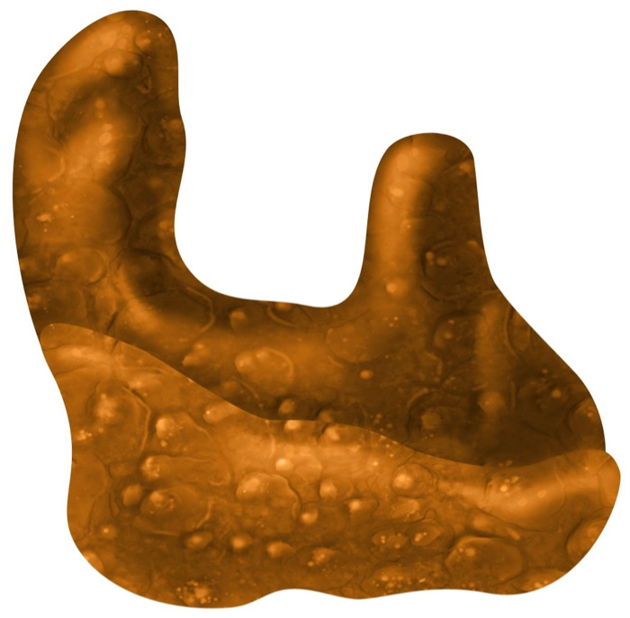
Doravirine: NNRTI Mechanism of Action
Doravirine
Polymerase Active Site
NNRTI Binding Pocket
HIV Reverse Transcriptase
Illustration: Cognition Studio, Inc. and David H. Spach, MD

Slide 6
Doravirine: Key Studies

Slide 7
Key Doravirine Studies
DRIVE FORWARD
DRIVE AHEAD
DRIVE SHIFT

Slide 8
Doravirine + 2 NRTIs vs. Darunavir + Ritonavir + 2 NRTIs DRIVE FORWARD: Design
Design
Randomized, double-blind, phase 3 study comparing doravirine plus 2 NRTIs with darunavir, boosted with ritonavir, in combination with 2 NRTIs as initial antiretroviral therapy
Inclusion Criteria
Antiretroviral-naïve adults
HIV RNA ≥1,000 copies/mL
No resistance to any study drug
Regimens (all once daily)
Doravirine (100 mg) + 2 NRTIs
Darunavir (800 mg) + Ritonavir (100 mg) + 2 NRTIs
Doravirine + 2 NRTIs
(n = 385)
Darunavir + Ritonavir + 2 NRTIs
(n = 384)
Source: Molina J-M, et al. Lancet HIV. 2018;5:e211-20.

Slide 9
Doravirine + 2 NRTIs vs. Darunavir + Ritonavir + 2 NRTIs DRIVE FORWARD: 48 Week Results
Week 48 Virologic Response (Intention-to-Treat Analysis)
Source: Molina J-M, et al. Lancet HIV. 2018;5:e211-20.

Slide 10
Doravirine-TDF-3TC versus Efavirenz-TDF-FTC as Initial Therapy DRIVE AHEAD: Design
Design
Randomized, double-blind, phase 3 study comparing fixed dose doravirine-tenofovir DF-lamivudine with fixed dose efavirenz-tenofovir DF-emtricitabine as initial antiretroviral therapy
Inclusion Criteria
Antiretroviral-naïve adults
HIV RNA ≥1,000 copies/mL
No resistance to any study drug
Regimens
Doravirine-TDF-3TC (100/300/300 mg) daily
Efavirenz-TDF-FTC (600/300/200 mg) daily
Doravirine-TDF-3TC
(n = 364)
Efavirenz-TDF-FTC
(n = 364)
Source: Orkin C, et al. Clin Infect Dis. 2019;68:535-44.

Slide 11
Doravirine-TDF-3TC versus Efavirenz-TDF-FTC as Initial Therapy DRIVE AHEAD: 48 Week Results
Week 48 Virologic Response (Observed Failure)
Source: Orkin C, et al. Clin Infect Dis. 2019;68:535-44.

Slide 12
Switch to Doravirine-TDF-3TC versus Continued Baseline Regimen DRIVE SHIFT: Design
Design
Open-label, non-inferiority trial
Adults with suppressed HIV RNA while taking 2 NRTIs plus anchor drug, randomized (2:1) to immediately switch to fixed-dose doravirine-tenofovir-DF-lamivudine or continue the baseline regimen with delayed switch at 24 weeks
Inclusion Criteria
Adults with suppressed HIV RNA ≥6 months
No history of virologic failure
Baseline Regimen
2 NRTIs + (boosted protease inhibitor, boosted elvitegravir, or NNRTI)
Immediate Switch
Doravirine-TDF-3TC (n = 447)
2x
1x
Delayed Switch
Baseline Regimen to Week 24, then Doravirine-TDF-3TC
(n = 223)
Source: Johnson M, et al. J Acquir Immun Defic Syndr. 2019;81:463-72.

Slide 13
Switch to Doravirine-TDF-3TC versus Continued Baseline Regimen DRIVE SHIFT: Baseline Antiretroviral Regimens
DRIVE SHIFT Baseline Antiretroviral Regimens
Anchor Agent, n (%) | Immediate Switch (n = 447) | Delayed Switch (n = 223)
Boosted PI | 316 (70.7) | 156 (70.0)
Darunavir | 166 (37.1) | 82 (36.8)
Atazanavir | 96 (21.5) | 43 (19.3)
Lopinavir | 54 (12.1) | 31 (13.9)
Elvitegravir-cobicistat | 25 (5.6) | 12 (5.4)
NNRTI | 106 (23.7) | 55 (24.7)
Efavirenz | 78 (17.4) | 36 (16.1)
Nevirapine | 17 (3.8) | 12 (5.4)
Rilpivirine | 11 (2.5) | 7 (3.1)
*Most common NRTI backbone in both arms: TDF/FTC (73.8% in immediate switch, 69.1% in delayed switch)
Source: Johnson M, et al. J Acquir Immun Defic Syndr. 2019;81:463-72.

Slide 14
Switch to Doravirine-TDF-3TC versus Continued Baseline Regimen DRIVE SHIFT: Results
Week 48 Doravirine-TDF-3TC vs Week 24 Baseline Regimen (FDA snapshot)
Source: Johnson M, et al. J Acquir Immun Defic Syndr. 2019;81:463-72.

Slide 15
Summary of Phase 3 Doravirine Trials
Study | Population | Outcome
DRIVE-FORWARD¹ | Treatment-Naïve | Doravirine + 2 NRTIs is non-inferior to Darunavir + Ritonavir + 2 NRTIs
DRIVE-AHEAD² | Treatment-Naïve | Doravirine-TDF-3TC is non-inferior to Efavirenz-TDF-FTC
DRIVE-SHIFT³ | Treatment-Experienced | Immediate or delayed switch to Doravirine-TDF-3TC is non-inferior to baseline ART
¹Molina J-M, et al. Lancet HIV. 2018;5:e211-20. ²Orkin C, et al. Clin Infect Dis. 2019:68:535-44. ³Johnson M, et al. J Acquir Immun Defic Syndr. 2019;81:463-72.

Slide 16
Doravirine is Weight Neutral
Weight gain over 96 weeks was low with doravirine use¹
Two clinical trials looking into switch to doravirine after weight gain
²Do IT (A5391): Doravirine for Persons With Excessive Weight Gain on INSTIs and TAF
³DeLiTE: Can INSTI-associated Weight Gain be Halted or Reversed With a Switch to DOR/3TC/TDF?
Consider doravirine in persons who have experienced or are hesitant about the potential of antiretroviral-related weight gain
Source ¹Orkin C, et al. AIDS. 2021;35:91-9. ²DO IT: https://clinicaltrials.gov/ct2/show/NCT04636437 ³DeLiTE: https://clinicaltrials.gov/ct2/show/NCT04665375

Slide 17
Doravirine: Resistance

Slide 18
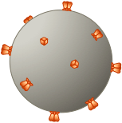
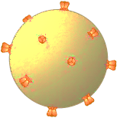
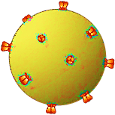
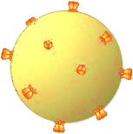
Doravirine In Vitro Resistance Pathways with HIV Subtype B
Doravirine
V106A
V106A
F227L
L234I
F227L
V106A/F227L
V106A/L234I
V106A/L234I/F227L
Source: Feng M, et al. Antimicrob Agents Chemother. 2015;59:590-8.

Slide 19
Doravirine: Development of Drug Resistance with Virologic Failure
Available data suggest doravirine has high genetic barrier to resistance¹
In four doravirine clinical trials <1% of participants experienced treatment failure with doravirine resistance¹
With virologic failure on doravirine in clinical trials, the most prevalent treatment-emergent mutations were at positions 106 (V106A/I/M) and 227 (F227C/L)^{2,3}
Source ¹Asante-Appiah E, et al. Antimicrob Agents Chemother. 2021;65:e0121621. ²Martin EA, et al. J Acquir Immune Defic Syndr. 2020;85:635-42. ³Johnson M, et al. J Acquir Immune Defic Syndr. 2019;81:463-72.

Slide 20
Impact of Doravirine Resistance
Impact of Most Common Resistance Mutations that Develop with Doravirine Virologic Failure
NNRTI | Resistance Associated Mutation
NNRTI | V106A | V106I | V106M | F227C
Doravirine | High-Level | Low level | Intermediate | High-Level
Efavirenz | Intermediate | Susceptible | High-Level | Intermediate
Etravirine | Susceptible | Low level | Susceptible | Susceptible
Rilpivirine | Susceptible | Low level | Susceptible | Susceptible
Source: Stanford Resistance Database

Slide 21
Doravirine Activity with Prior NNRTI Virologic Failure Resistance
Common mutations K103N and G190A have no impact on doravirine
DRIVE BEYOND study showed good virologic response with doravirine-TDF-3TC in 10 persons with baseline K103N or G190A
Single mutations with V106A, Y188L, G190E, or M230L confer high-level resistance to doravirine
Avoid doravirine with mutations that confer intermediate or high-level resistance
Source Martin EA, et al. J Acquir Immune Defic Syndr. 2020;85:635-42. Asante-Appiah E, et al. Antimicrob Agents Chemother. 2021;65:e0121621 Wong A, et al. J Acquir Immune Defic Syndr. 2019;82:e47-e49.

Slide 22
Impact of NNRTI RAMs on Doravirine
No Impact on Doravirine
K103N; G190A
Potential Low-level Doravirine Resistance
Low-level Doravirine Resistance
K101P; E138K; Y181C
K101E; Y181C; K103N + Y181C; H221Y
Intermediate-level Doravirine Resistance
L100I + K103N; V106M; P225H; F227L; Y318F
High-level Doravirine Resistance
V106A; Y188L; G190E; M230L
Source: Stanford Resistance Database

Slide 23
Doravirine: Summary
Oral, once-daily NNRTI available alone or in a fixed dose combination
Typically used in treatment experienced or to address ART weight gain
Most common treatment emergent mutations were V106I and F227L
Retains full activity with a K103N and G190A mutations
Well-tolerated with few drug-drug interactions
Can take with or without food and can take with proton pump inhibitors

