Slide 1
Fostemsavir
Brian R. Wood, MD Associate Editor, National HIV Curriculum Associate Professor of Medicine Division of Allergy and Infectious Diseases
University of Washington
Last Updated: July 12, 2022

Slide 2
Dr. Wood has no financial conflicts of interest or disclosures.

Slide 3
Fostemsavir
600 mg
Attachment Inhibitor
Dose: 1 tablet twice daily with or without food

Slide 4
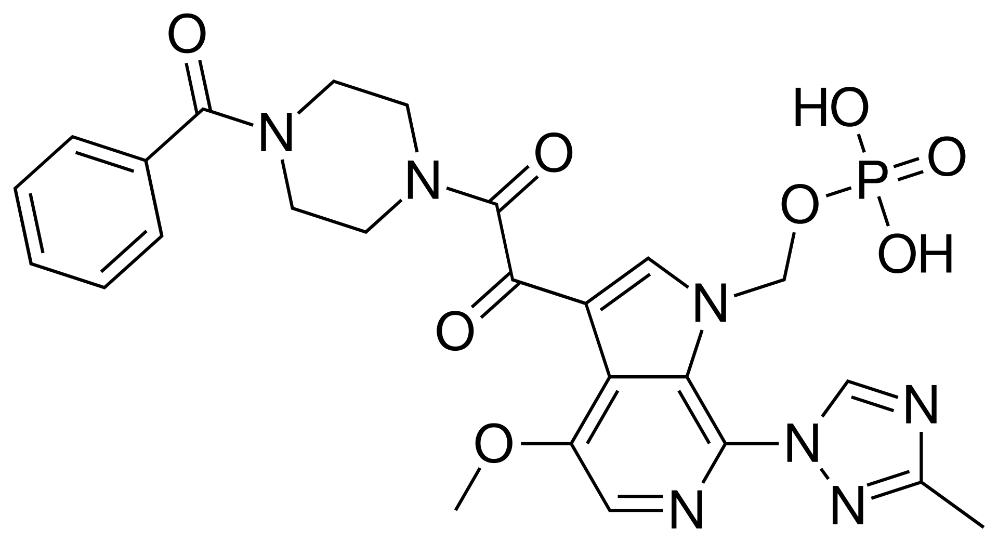
Fostemsavir
Fostemsavir is a prodrug of temsavir

Slide 5
Fostemsavir: Hydrolysis by Alkaline Phosphatase
Alkaline phosphatase
Fostemsavir undergoes hydrolysis on the luminal surface of the small intestine brush border membranes

Slide 6
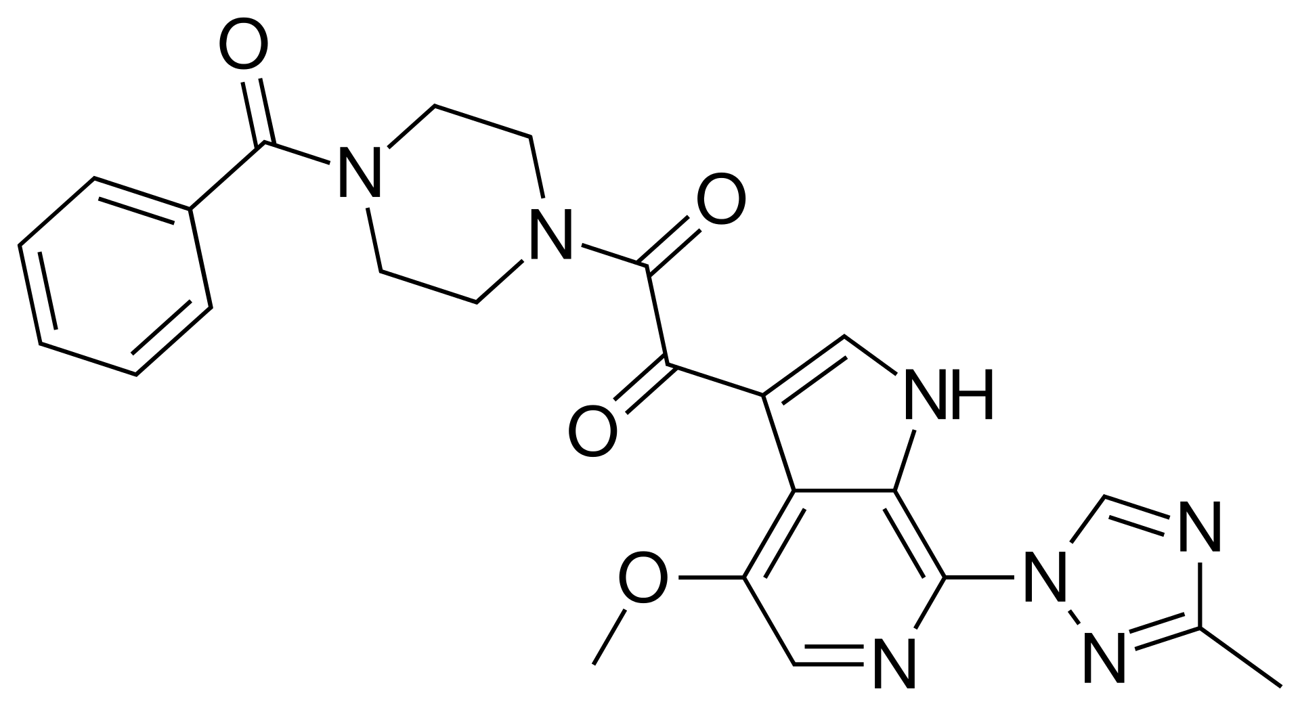
Temsavir (Active Drug)

Slide 7
HIV Entry Inhibitors Fostemsavir: Attachment Inhibitor
HIV
Fostemsavir
CD4 binding site
Temsavir
Binds near CD4 binding site and prevents gp120 conformational change required for attachment
gp120
gp120
Temsavir
CD4
CD4
CCR5
CCR5
Illustration: David H. Spach, MD

Slide 8
Fostemsavir
Indication
Heavily treatment-experienced adults with multidrug-resistant HIV-1
Drug-drug interactions
Avoid: strong CYP3A4 inducers (e.g., rifampin, phenytoin, carbamazepine, St. John’s wort), grazoprevir, voxilaprevir, >30 mcg/day ethinyl estradiol
Use with caution if prolonged QTc or taking meds known to cause torsade de pointes
Consider statin dose adjustment (use lowest possible statin starting dose)
Use during pregnancy
Insufficient data
Source: Fostemsavir Prescribing Information

Slide 9
Fostemsavir for Heavily Treatment-Experienced Individuals BRIGHTE Study (Week 48 Data)

Slide 10
Fostemsavir for Heavily Treatment-Experienced Individuals BRIGHTE Study (Week 48): Background
Day 8
Week 96
Background
Phase 3, randomized, placebo-controlled, non-inferiority trial evaluating fostemsavir (FTR) in salvage ART
Enrollment Criteria:
Highly ART-experienced adults
Virologic failure on current ART
HIV RNA >400 copies/mL
Multiclass ART resistance
At least one fully active agent (for randomized cohort)
Randomized Cohort
FTR 600 mg BID + failing regimen (n = 203)
FTR 600 mg BID + OBR (n = 272)
3x
1x
Placebo BID + failing regimen (n = 69)
Nonrandomized Cohort
FTR 600 mg BID + OBR (n = 99)
*OBR = optimized background regimen
Source: Kozal M, et al. N Engl J Med. 2020;382:1232-43.

Slide 11
Fostemsavir for Heavily-Treatment Experienced Individuals BRIGHTE Study (Week 48): Baseline Characteristics
Baseline Characteristics | Randomized (n = 272) | Non-Randomized (n = 99)
Age, years, median (range) | 48 (18-73) | 50 (17-72)
Male sex, n (%) | 200 (74) | 89 (90)
White, n (%) | 184 (68) | 74 (74)
Black/African American, n (%) | 60 (22) | 23 (23)
HIV RNA 1,000-100,000 copies/mL, n (%) | 161 (59) | 75 (76)
HIV RNA >100,000 copies/mL, n (%) | 80 (29) | 15 (15)
CD4 count—cells/mm³, median (range) | 99 (0-1160) | 41 (0-641)
2 fully active agents in OBR*, % | 42 | 0
1 fully active agent in OBR*, % | 52 | 19
0 fully active agents in OBR*, % | 6 | 81
*Most common ARV’s in OBR: dolutegravir, boosted darunavir, tenofovir DF, etravirine, maraviroc, enfuvirtide, ibalizumab
Source: Kozal M, et al. N Engl J Med. 2020;382:1232-43.

Slide 12
Fostemsavir for Heavily Treatment-Experienced Individuals BRIGHTE Study (Week 48): Results
Baseline to Day 8 Change in HIV RNA Level (Randomized Cohort)
Source: Kozal M, et al. N Engl J Med. 2020;382:1232-43.

Slide 13
Fostemsavir for Heavily Treatment-Experienced Individuals BRIGHTE Study (Week 48): Results
Virologic Response Through Week 48 (HIV RNA <40 copies/mL)
Source: Kozal M, et al. N Engl J Med. 2020;382:1232-43.

Slide 14
Fostemsavir for Heavily Treatment-Experienced Individuals BRIGHTE Study (Week 96 Data)

Slide 15
Fostemsavir for Heavily Treatment-Experienced Individuals BRIGHTE Study (Week 96): Results
Virologic Response Through Week 96 (HIV RNA <40 copies/mL)
Source: Lataillade M, et al. Lancet HIV. 2020;7:e740-51.

Slide 16
Fostemsavir for Heavily Treatment-Experienced Individuals BRIGHTE Study (Week 96): Results
Mean Change in CD4 T-Cell Count Through Week 96
Source: Lataillade M, et al. Lancet HIV. 2020;7:e740-51.

Slide 17
Fostemsavir for Heavily Treatment-Experienced Individuals BRIGHTE Study (Week 96): Results
Adverse Events (AEs) | Randomized (n = 272) | Non-Randomized (n = 99)
Any AE, n (%) | 249 (92) | 98 (99)
Drug-related grade 2-4 AEs, n (%) | 57 (21) | 22 (22)
Nausea | 9 (3) | 5 (5)
Diarrhea | 6 (2) | 3 (3)
Headache | 6 (2) | 1 (1)
Vomiting | 4 (1) | 2 (2)
Fatigue | 3 (1) | 2 (2)
Asthenia | 2 (<1) | 2 (2)
Drug-related AE leading to discontinuation, n (%) | 7 (3) | 7 (3)
Drug-related serious AE, n (%) | 9 (3) | 3 (3)
Source: Lataillade M, et al. Lancet HIV. 2020;7:e740-51.

Slide 18
Fostemsavir Resistance

Slide 19
Fostemsavir for Heavily Treatment-Experienced Individuals BRIGHTE Study (Week 96): Virologic Failures
 | Randomized (n = 272) | Non-Randomized (n = 99)
Number of virologic failures | 69/272 (25%) | 50/99 (51%)
With gp120 RAPs at screening (of those with genotypic data) | 43/68 (63%) | 26/48 (54%)
Virologic failures with post-baseline data | 53 | 45
With emergent gp120 (env) RAS | 29/53 (55%) | 33/45 (73%)
S375H/I/M/N/T | 19/53 (36%) | 21/45 (47%)
M426L/I | 18/53 (34%) | 23/45 (51%)
M434I/L | 6/53 (11%) | 5/45 (11%)
M475I/L/V | 8/53 (15%) | 5/45 (11%)
Abbreviation: RAPs = Resistance-associated polymorphisms; RAS = Resistance-associated substitutions
Source: Fostemsavir Prescribing Information

Slide 20
Fostemsavir (FTR): Resistance Testing & Cross Resistance
FTR can be used regardless of HIV-1 tropism
Standard genotype testing does not give FTR resistance information
Certain viral subtypes, such as AE, may have reduced susceptibility, but are rare
HIV with resistance mutations in the gp120 envelope subunit due to virologic failure on ibalizumab or maraviroc may have reduced susceptibility to FTR, but are rare
Viruses resistant to the gp41 inhibitor enfuvirtide typically retain susceptibility to FTR
Other entry inhibitors tend to retain activity in the presence of FTR resistance mutations
Source: Fostemsavir Prescribing Information

Slide 21
Fostemsavir: Summary
Oral, twice-daily, CD4 attachment inhibitor
Typically used as part of salvage antiretroviral therapy for heavily-treatment experienced individuals
Can be combined with other entry inhibitors (ibalizumab, enfuvirtide, maraviroc if R5-tropic), other salvage antiretrovirals, and/or optimized background regimen
Overall, well tolerated with few drug-drug interactions, though need to consider interactions with strong CYP3A4 inducers, estradiol, statins, and drugs that may prolong the QTc or cause torsade de pointes
Resistance mutations in the gp120 envelope subunit may develop with virologic failure

