Slide 1
Maraviroc
Aley Kalapila, MD, PhD Associate Editor, National HIV Curriculum Associate Professor of Medicine Division of Infectious Diseases
Emory University School of Medicine & Grady Health System
Last Updated: July 12, 2022

Slide 2
Dr. Kalapila has no financial conflicts of interest or disclosures.

Slide 3
Maraviroc
150 mg and 300 mg
Entry Inhibitor
Dosing: twice daily dosing, with or without food

Slide 4
Marviroc: Indications and Dosing
Indication
In combination with other antiretroviral agents for adults (and children ≥2 kgs) who have only CCR5-tropic HIV-1
Requires HIV Tropism Assay testing before use
Not recommended for initial treatment of HIV-1 infection
Preparations
Tablets: 25-mg, 75-mg, 150-mg, and 300-mg
Oral Solution: 20 mg per mL clear, colorless, strawberry-flavored
Dosing
Twice daily dosing, with dose dependent on interactions with other medications
Take with or without food
Source: Maraviroc Prescribing Information

Slide 5
Maraviroc: Dosing Adjustments with Concomitant Medications
Maraviroc: Recommended Dosage in Adults
Concomitant Medications | Dose
Potent cytochrome P450 (CYP)3A inhibitorsª (+/- potent CYP3A inducer) | 150 mg twice a day
Noninteracting concomitant medications^{b} | 300 mg twice a day
Potent and moderate CYP3A inducers (without a potent CYP3A inhibitor)^{c} | 600 mg twice a day
ª Potent CYP3A inhibitors (+/- potent CYP3A inducer) including: clarithromycin, cobicistat, elvitegravir/ritonavir, itraconazole, ketoconazole, nefazodone, protease inhibitors (except tipranavir/ritonavir), telithromycin.
^{b} Noninteracting concomitant medications include all medications that are not potent CYP3A inhibitors or inducers such as: dolutegravir, enfuvirtide, nevirapine, all nucleoside reverse transcriptase inhibitors (NRTIs), raltegravir, and tipranavir/ritonavir.
^{c} Potent and moderate CYP3A inducers (without a potent CYP3A inhibitor) including: carbamazepine, efavirenz, etravirine, phenobarbital, phenytoin, and rifampin.
Source: Maraviroc Prescribing Information

Slide 6
Maraviroc: Dosing Based on Renal Function
Recommended Maraviroc Dosage in Adults Based on Renal Function
Concomitant Medications | Dosage of Maraviroc Based on Renal Function
 | CrCl ≥30 mL/min | CrCl <30 mL/min | End-Stage Renal Disease on Regular Hemodialysis
Potent CYP3A inhibitors (with or without a CYP3A inducer)ª | 150 mg twice daily | Contraindicated | Contraindicated
Noninteracting concomitant medications^{b} | 300 mg twice daily | 300 mg twice daily | 300 mg twice daily^{d}
Potent and moderate CYP3A inducers (without a potent CYP3A inhibitor)^{c} | 600 mg twice daily | Contraindicated | Contraindicated
ª Potent CYP3A inhibitors (with or without a CYP3A inducer) including: clarithromycin, cobicistat, elvitegravir/ritonavir, itraconazole, ketoconazole, nefazodone, protease inhibitors (except tipranavir/ritonavir), telithromycin. ^{b} Noninteracting concomitant medications include all medications that are not potent CYP3A inhibitors or inducers such as: dolutegravir, enfuvirtide, nevirapine, all NRTIs, raltegravir, and tipranavir/ritonavir. ^{c} Potent and moderate CYP3A inducers (without a potent CYP3A inhibitor) including: carbamazepine, efavirenz, etravirine, phenobarbital, phenytoin, and rifampin.
^{d} Maraviroc dosing should be decreased to 150 mg twice daily if patients experience symptoms of postural hypotension
Source: Maraviroc Prescribing Information

Slide 7
Maraviroc: Mechanism of Action

Slide 8
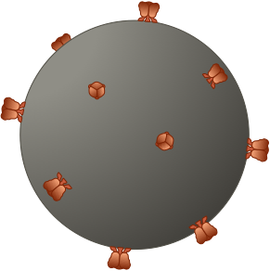
Host Cellular Co-Receptors Involved in HIV Entry
HIV
CD4
CD4
Coreceptors
CCR5
CXCR4
Illustration: David H. Spach, MD

Slide 9
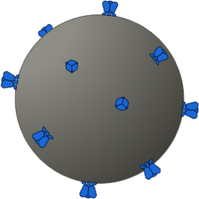
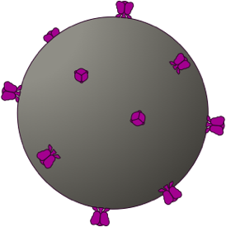
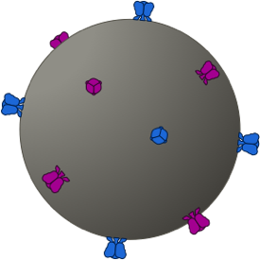
HIV Tropism
R5-Tropic
X4-Tropic
Dual Tropic
Mixed Tropic
R5
X4
R5 / X4
R5
X4
CCR5
CXCR4
CCR5
CXCR4
CXCR4
CCR5
CXCR4
CCR5
Illustration: David H. Spach, MD

Slide 10
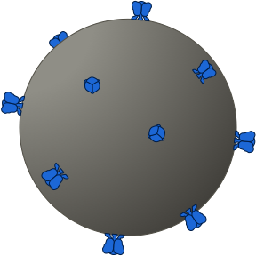
Maraviroc: Mechanism of Action
R5-Tropic HIV (R5)
R5-Tropic HIV (R5)
Maraviroc
CCR5
CCR5 Receptor Conformation Change
Illustration: David H. Spach, MD

Slide 11
HIV Entry Inhibitor: CCR5 Antagonist
Maraviroc
Maraviroc
Maraviroc
Binds to host CCR5 coreceptor, causing conformational changes that prevents binding of HIV gp120 to the CCR5 coreceptor
R5 HIV
gp120
gp120
Extracellular Space
CD45
CCR5 Receptor Conformation Change
CCR5
CCR5

Slide 12
Coreceptor Tropism Results: Maraviroc Indication
Maraviroc
R5
X4
Dual Tropic
Mixed Tropic
d
No
No
No
R5
X4
R5 / X4
R5
X4
CCR5
CXCR4
CCR5
CXCR4
CXCR4
CCR5
CXCR4
CCR5
Illustration: David H. Spach, MD

Slide 13
Key Clinical Trials

Slide 14
Maraviroc: Summary of Key Studies
Trials in Treatment Naïve
¹MERIT: Maraviroc (QD or BID + ZDV-3TC versus Efavirenz + ZDV-3TC)
Maraviroc inferior to efavirenz for virologic suppression
Trials In Treatment-Experienced Persons
²MOTIVATE 1 & MOTIVATE 2: Maraviroc (QD or BID) + OBT
Maraviroc + OBT significantly greater virologic suppression than OBT alone
Switch Trials
³ROCnRal (ARNS 157): Switch to 2-drug Maraviroc + Raltegravir
In treatment-experienced patients, maraviroc + raltegravir lacked virological robustness
¹Cooper DA, et al. J Infect Dis. 2010;201:803-13. ²Gulick RM, et al. N Engl J Med. 2008;359:1429-41. ³Katlama C, et al. J Antimicrob Chemother. 2014;69:1648-52.

Slide 15
Maraviroc in Patients with Multiclass Antiretroviral Drug Resistance MOTIVATE 1 and 2: Study Design
Background: Two parallel, randomized, double-blind, placebo-controlled, phase 3 trials comparing 2 does of maraviroc in treatment-experience persons
Inclusion Criteria
Age ≥16 years
Treatment experienced
Resistance to ≥ 3 ARV classes
Only R5-tropic HIV
Stable ARV regimen or no regimen for ≥4 weeks with HIV RNA ≥ 5,000 copies/mL
Maraviroc* once daily + OBT
(n = 414)
2x
Maraviroc* twice daily + OBT
(n = 426)
2x
1x
Placebo + OBT
(n = 200)
*MVC dosing: - 300 mg daily or BID with PI-containing regimens - 150 mg daily or BID with all other regimens
OBT = Optimized Background Therapy (3-6 agents)
MOTIVATE = Maraviroc versus Optimized Therapy in Viremic Antiretroviral Treatment-Experienced Patients
Source: Gulick RM, et al. N Engl J Med. 2008;359:1429-41.

Slide 16
Maraviroc in Patients with Multiclass Antiretroviral Drug Resistance MOTIVATE 1 and 2: Results
Week 48: Virologic Response (ITT, missing=nonresponse)
97/232
109/235
19/118
82/182
85/191
16/91
Source: Gulick RM, et al. N Engl J Med. 2008;359:1429-41.

Slide 17
Maraviroc in Patients with Multiclass Antiretroviral Drug Resistance MOTIVATE 1 and 2: Results
Week 48: Change in CD4 Cell Count from Baseline
Change in CD4 count (cells/mm³)
Source: Gulick RM, et al. N Engl J Med. 2008;359:1429-41.

Slide 18
Maraviroc in Patients with Multiclass Drug Resistance MOTIVATE 1 and 2: Adverse Events
Grade 2-4 Adverse Events (all causes) Occurring in ≥ 5% of Patients MOTIVATE 1 and MOTIVATE 2 Study Populations Combined
Adverse Event | Maraviroc QD + OBT (n = 414) | Maraviroc BID + OBT (n = 426) | Placebo (n = 219)
Diarrhea | 43 (10%) | 32 (8%) | 20 (10%)
Fatigue | 13 (3%) | 21 (4%) | 13 (6%)
Fever | 9 (2%) | 24 (6%) | 9 (4%)
Headache | 22 (5%) | 9 (2%) | 12 (6%)
Nausea | 25 (6%) | 25 (6%) | 15 (7%)
Upper respiratory infection | 16 (4%) | 20 (5%) | 3 (1%)
Abbreviations: OBT = optimized background therapy; QD = once daily; BID = twice daily
Source: Gulick RM, et al. N Engl J Med. 2008;359:1429-41.

Slide 19
Adverse Effects

Slide 20
Maraviroc: Potential Severe Drug Reactions
Hepatotoxicity (Black Box Warning)
Maraviroc can cause severe hepatotoxicity +/-severe skin & hypersensitivity reactions
Severe skin rash or systemic allergic reactions may develop prior to hepatotoxicity
Skin rash or systemic allergic reactions
Maraviroc may cause severe severe skin and hypersensitivity reactions +/- hepatoxicity
Reactions include fever, eosinophilia, elevated IgE, or other systemic symptoms
Timing and Evaluation of Severe Maraviroc-Related Drug Reaction
Timing of severe reactions is approximately 1 month after starting maraviroc
Persons taking maraviroc should have immediate evaluation if they develop any of the following: sign or symptoms of hepatitis, a severe skin rash or systemic allergic reaction
Source: Maraviroc Prescribing Information

Slide 21
Resistance

Slide 22
Resistance to Maraviroc: Change in Viral Tropism
Maraviroc
R5
X4
Dual Tropic
Mixed Tropic
X4
Dual Tropic
Mixed Tropic
Maraviroc Sensitive
Maraviroc Resistant
R5
X4
R5 / X4
R5
X4
CCR5
CXCR4
CCR5
CXCR4
CCR5
CXCR4
CCR5
CXCR4
Illustration: David H. Spach, MD

Slide 23
Resistance to Maraviroc: HIV Binds to CCR5 in Presence of Maraviroc
R5 HIV
CD4
gp120
gp120
Extracellular Space
CCR5
CCR5
Illustration: David H. Spach, MD

Slide 24
Maraviroc: Summary
Oral, twice-daily HIV entry inhibitor that selectively binds to human C-C chemokine receptor 5 (CCR5)
Need to perform HIV tropism assay prior to use
Typically used as part of salvage antiretroviral therapy for heavily-treatment experienced individuals
Can be combined with other entry inhibitors (ibalizumab, enfuvirtide, fostemsavir), and other salvage antiretroviral medications
Generally well tolerated with few long-term adverse effects or drug interactions, though rarely
Rarely may cause hepatotoxicity and/or severe skin and allergic reactions

