Slide 1
Maraviroc (Selzentry)
Prepared by:
David H. Spach, MD
Brian R. Wood, MD
Last Updated: July 25, 2020

Slide 2
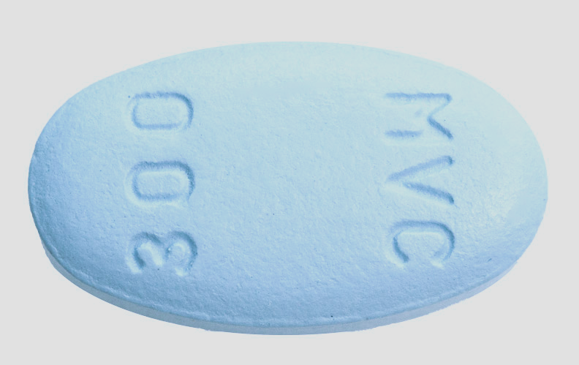
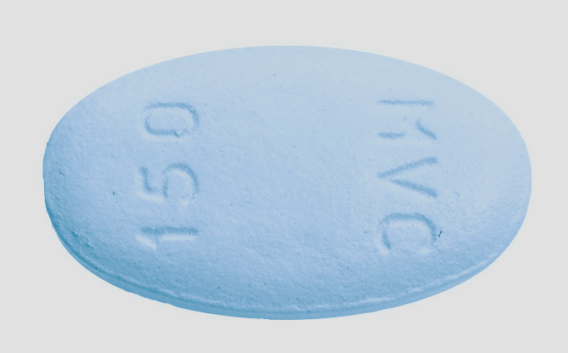
Maraviroc (Selzentry)
Selzentry [sell-ZEN-tree]
300 mg
150 mg

Slide 3
CCR5 Receptor Antagonists
Antiretroviral Therapy

Slide 4
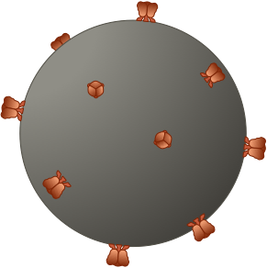
Host Cellular Receptors Involved in HIV Entry
HIV
CD4
CD4
Coreceptors
Intracellular Space
Host Cell
CCR5
CXCR4

Slide 5
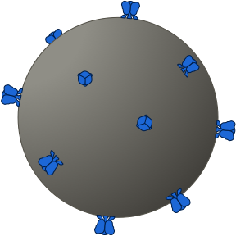
CCR5 Tropic (R5) HIV-1
R5 HIV
CD4
CD4
Coreceptors
Intracellular Space
Host Cell
CCR5
CXCR4

Slide 6
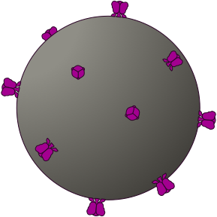
CXCR4 Tropic (X4) HIV-1
X4 HIV
CD4
CD4
Intracellular Space
Host Cell
CCR5
CXCR4

Slide 7
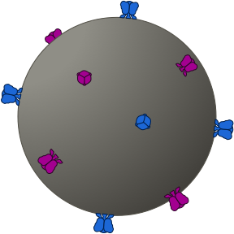
Dual Tropic HIV-1
Dual-Tropic HIV
CD4
CD4
Coreceptors
Intracellular Space
Host Cell
CCR5
CXCR4

Slide 8
Mixed Tropic HIV-1
Mixed-Tropic HIV
R5 HIV
X4 HIV
CD4
CD4
Coreceptors
Intracellular Space
Host Cell
CCR5
CXCR4

Slide 9
Maraviroc: Mechanism of Action
R5-Tropic HIV
R5-Tropic HIV
Maraviroc
CCR5
CCR5 Receptor Conformation Change
Intracellular Space
Host Cell

Slide 10
Trofile Coreceptor Tropism Assay
Plasma
HIV RNA
Reverse Transcription
HIV DNA
PCR Amplification
HIV Genes
HIV
HIV Envelope Gene
Vector
Envelope Gene (inserted in vector

Slide 11
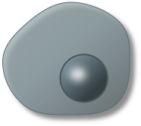
HIV Coreceptor Tropism Assays (Trofile) Standard and DNA Tropism Assays
Trofile Coreceptor Tropism Assay
Trofile DNA Coreceptor Tropism Assay
HIV
Cells
Plasma
Whole Blood
HIV RNA
HIV DNA
HIV DNA
HIV
Cells
HIV Envelope Gene
HIV Envelope Gene

Slide 12
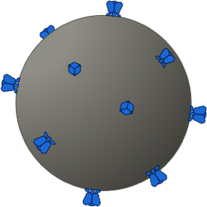
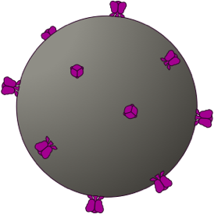
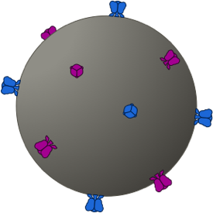
Coreceptor Tropism
R5
X4
Dual Tropic
Mixed Tropic

Slide 13
Pure R5 HIV Result with Coreceptor Tropism Testing
R5
X4
Dual/Mixed Tropic
Dual-Tropic HIV
Mixed-Tropic HIV
Pure R5 Tropic HIV

Slide 14
HIV Genotypic Coreceptor Tropism Assay
Genotypic analysis of gp120 V3 loop sequences
Commercially available through Quest Diagnostics
If initial test shows X4 or R5/X4 then no further analysis
If initial test shows only R5 then reflexes to Ultradeep sequencing
Detection of 0.5% minority X4 clones with Ultradeep sequencing
Result available in 7-10 days
Proviral HIV genotypic tropism assay available (if HIV RNA < 1,000 copies/ml)
Source: Quest Diagnostics: http://education.questdiagnostics.com/faq/FAQ86

Slide 15
HIV Envelope
gp120
N’
C1
V1
V2
C2
V3
C3
V4
C4
V5
C5
C’
V3
Codon 11
Codon 25
Source: Tilton JC, Doms RW. Antiviral Research. 2010;85:91-100.

Slide 16
HHS Antiretroviral Therapy Guidelines: October 25, 2018 Recommendation for Co-receptor Tropism Assays
HHS Panel’s Recommendation for Co-receptor Tropism Assays
Recommendation | Rating
A co-receptor tropism assay should be performed whenever the use of a CCR5 co-receptor antagonist is being considered | AI
Co-receptor tropism testing is also recommended for patients who exhibit virologic failure on a CCR5 antagonist | BIII
A phenotypic assay is preferred to determine HIV-1 co-receptor usage | AI
A genotypic tropism assay should be considered as an alternative test to predict HIV-1 co-receptor usage | BII
A proviral DNA tropism assay can be utilized for patients with undetectable HIV-1 RNA when a CCR5 antagonist is considered in a new regimen (e.g., as part of a regimen switch or simplification) | BII
Source: HHS Antiretroviral Guidelines (October 25, 2018).

Slide 17
Maraviroc Summary of Key Studies
Trials in Treatment Naïve - MERIT: Maraviroc + ZDV-3TC versus Efavirenz + ZDV-3TC - A5303: [Maraviroc or Tenofovir DF] + DRV + RTV + FTC - A4001078: [Maraviroc or TDF-FTC] + Ritonavir-Boosted Atazanavir
Trials in Acute HIV - OPTIPRIM-ARNS147: 5-Drug versus 3-Drug Regimen for Acute HIV
Trials in Treatment Experienced - MOTIVATE 1 and MOTIVATE 2: Maraviroc [QD or BID] + OBR - A4001029: Maraviroc in Treatment-Experienced with non-R5 HIV

Slide 18
Maraviroc Summary of Key Studies
Switch Trials - Study 121 (Strategy NNRTI): NNRTI Switch to EVG-COBI-TDF-FTC - MARCH: Switch to of Maraviroc from RTV-Boosted PI - ROCnROL (ARNS 157): Switch to 2-drug Maraviroc + Raltegravir
Addition of Maraviroc to Increase CD4 Cell Count - ACTG 5256: Adding Maraviroc for Suboptimal CD4 Recovery
PreExposure Prophylaxis - HPTN 069/ACTG 5305: Maraviroc +/- [TDF or FTC] for PrEP

Slide 19
Maraviroc
Initial therapy

Slide 20
Maraviroc versus Efavirenz in Treatment-Naïve MERIT (A4001026) Trial

Slide 21
Maraviroc versus Efavirenz, both with Zidovudine-Lamivudine MERIT (A4001026): Study Design
Study Design: MERIT Study
Background: Randomized, double-blind, double-dummy, phase 2b/3 study evaluating the efficacy and safety of maraviroc versus efavirenz as part of ART for treatment-naïve persons with HIV infection Inclusion Criteria (n = 721 treated) - Age >16 - Antiretroviral-naïve patients - R5-tropic virus - HIV RNA ≥2000 copies/mL - No resistance to zidovudine, lamivudine, or efavirenz Treatment Arms - Maraviroc 300 mg BID + ZVD-3TC BID - Efavirenz 600 mg QD+ ZVD-3TC BID
MVC 300 mg twice daily + ZVD-3TC twice daily
(n = 360)
EFV once daily + ZVD-3TC twice daily
(n =361)
MVC 300 mg once daily + ZVD-3TC twice daily arm (n = 174) DISCONTINUED at interim analysis
MERIT = Maraviroc versus Efavirenz in Treatment-Naive
Source: Cooper DA, et al. J Infect Dis. 2010;201:803-13.

Slide 22
Maraviroc versus Efavirenz, both with Zidovudine-Lamivudine MERIT (A4001026): Result
Week 48: Virologic Response (Primary Analysis)
235/360
250/361
142/204
151/211
93/156
99/150
Baseline HIV RNA
Source: Cooper DA, et al. J Infect Dis. 2010;201:803-13.

Slide 23
Maraviroc or Efavirenz, both with Zidovudine-Lamivudine MERIT (A4001026): Result
Week 48: Virologic Response (Post-hoc Reanalysis*)
213/311
207/303
127/177
132/183
86/134
75/120
Baseline HIV RNA
*Excludes patients with non-R5 virus at screening by the enhanced Trofile assay
Source: Cooper DA, et al. J Infect Dis. 2010;201:803-13.

Slide 24
Maraviroc versus Efavirenz, both with Zidovudine-Lamivudine MERIT (A4001026): Conclusions
Conclusions: “Twice-daily maraviroc was not noninferior to efavirenz at <50 copies/mL in the primary analysis. However, 15% of patients would have been ineligible for inclusion by a more sensitive screening assay. Their retrospective exclusion resulted in similar response rates in both arms.”
Source: Cooper DA, et al. J Infect Dis. 2010;201:803-13.

Slide 25
Maraviroc versus Efavirenz, plus Zidovudine-Lamivudine MERIT (A4001026): Results
Week 240 (Year 5): Virologic Response
158/311
139/303
93/177
88/183
65/134
51/120
Baseline HIV RNA
*Excludes patients with non-R5 virus at screening by the enhanced Trofile assay
Source: Cooper DA, et al. AIDS. 2014;28:717-25.

Slide 26
Maraviroc versus Efavirenz, plus Zidovudine-Lamivudine MERIT (A4001026) Year 5 Data: Conclusions
Conclusions: “Maraviroc maintained similar long-term antiviral efficacy to efavirenz over 5 years in treatment-naive patients with CCR5-tropic HIV-1. Maraviroc was generally well tolerated with no unexpected safety findings or evidence of long-term safety concerns.”
Source: Cooper DA, et al. AIDS. 2014;28(5):717-25.

Slide 27
Effects of Maraviroc versus Tenofovir DF on Bone Loss A5303 Trial

Slide 28
Bone Effects of Maraviroc vs. Tenofovir DF, with DRV + RTV + FTC A5303: Study Design
Study Design: A5303 Study
Background: Phase 2b, prospective, double-blind, placebo-controlled study evaluating the effects of maraviroc versus tenofovir DF on bone loss in treatment-naïve persons with HIV Inclusion Criteria (n = 262) - Age ≥18 years - Antiretroviral-naïve patients - R-5 tropic virus - HIV RNA >1000 copies/mL Treatment Arms* - MVC + DRV + RTV + FTC - TDF + DRV + RTV + FTC
MVC + DRV + RTV + FTC
(n = 130)
TDF + DRV + RTV + FTC
(n = 129)
*Dosing: Maraviroc 150 mg QD + Darunavir 800 mg QD + Ritonavir 100 mg QD + Emtricitabine 200 mg QD
*Dosing: Tenofovir 300 mg QD + Emtricitabine 200 mg QD + Darunavir 800 mg QD + Ritonavir 100 mg QD
Source: Taiwo B, et al. Clin Infect Dis. 2015;61:1179-88.

Slide 29
Bone Effects of Maraviroc vs. Tenofovir DF, with DRV + RTV + FTC A5303: Results
Week 48: Changes in Bone Mineral Density from Baseline
Source: Taiwo B, et al. Clin Infect Dis. 2015;61:1179-88.

Slide 30
Bone Effects of Maraviroc vs. Tenofovir DF, with DRV + RTV + FTC A5303: Results
Week 48: Virologic Response
Source: Taiwo B, et al. Clin Infect Dis. 2015;61:1179-88.

Slide 31
Bone Effects of Maraviroc vs. Tenofovir DF, with DRV + RTV + FTC A5303: Conclusions
Conclusions: “Maraviroc was associated with less bone loss at the hip and lumbar spine compared with tenofovir DF. Maraviroc may be an option to attenuate ART-associated bone loss.”
Source: Taiwo B, et al. Clin Infect Dis. 2015;61:1179-88.

Slide 32
Once-Daily Maraviroc in Treatment-Naïve A4001078 Trial

Slide 33
Once-Daily Maraviroc plus Ritonavir-Boosted Atazanavir A4001078: Study Design
Study Design: A4001078 Study
Background: Phase 2b, randomized, open label pilot study evaluating a once-daily, dual-therapy regimen of maraviroc and boosted atazanavir in comparison to standard triple therapy in HIV-infected treatment-naïve patients Inclusion Criteria (n = 121) - Age ≥16 years - Antiretroviral-naïve patients - R-5 tropic virus - HIV RNA ≥1000 copies/mL - CD4 ≥100 cells/mm³ Treatment Arms (all medications once daily) - Maraviroc 150 mg + Atazanavir 300 mg + Ritonavir 100 mg - Tenofovir DF-Emtricitabine + Atazanavir 300 mg + Ritonavir 100 mg
Maraviroc QD + Atazanavir + Ritonavir
(n = 60)
Tenofovir DF-Emtricitabine + Atazanavir + Ritonavir
(n = 61)
Source: Mills A, et al. J Acquir Immune Defic Syndr. 2013;62:164-70.

Slide 34
Once-Daily Maraviroc plus Ritonavir-Boosted Atazanavir A4001078: Results
Week 48: Virologic Response (Missing or Discontinued = Failure)
Baseline HIV RNA
Source: Mills A, et al. J Acquir Immune Defic Syndr. 2013;62:164-70.

Slide 35
Once-Daily Maraviroc plus Ritonavir-Boosted Atazanavir A4001078: Conclusions
Conclusions: “The virological activity and immunological benefit of once-daily MVC + ATV/r were confirmed. Indirect hyperbilirubinemia and associated signs were the most commonly reported adverse effects in both study treatment groups and were not associated with significant transaminase increases. No drug resistance occurred.”
Source: Mills A, et al. J Acquir Immune Defic Syndr. 2013;62:164-70.

Slide 36
Intensive Five-Drug Regimen for Acute HIV Infection OPTIPRIM-ANRS147

Slide 37
Five Drug Therapy versus Standard Care for Acute HIV OPTIPRIM-ANRS 147 Trial: Study Design
Study Week
0
24
Randomize
Analysis
OPTIPRIM-ANRS: Study Features
Open-label Detectable HIV-RNA Incomplete Western blot (≤4 bands) p24 antigenemia Symptomatic OR CD4 <500 cells/mm³ Primary endpoint: HIV-DNA copies per 10⁶ PBMC
Five Drug Therapy Maraviroc 150 mg BID +
Raltegravir 400 mg BID +
Emtricitabine/Tenofovir 300/200 mg +
Darunavir/Ritonavir 800/100 mg (n = 47)
Standard Therapy Emtricitabine/Tenofovir 300/200 mg +
Darunavir/Ritonavir 800/100 mg
(n = 45)
Source: Chéret A, et al. Lancet Infect Dis. 2015;15:387-96.

Slide 38
Five Drug Therapy versus Standard Care for Acute HIV OPTIPRIM-ANRS 147 Trial: Results
HIV DNA Load at Month 24
Source: Chéret A, et al. Lancet Infect Dis. 2015;15:387-96.

Slide 39
Five Drug Therapy versus Standard Care for Acute HIV OPTIPRIM-ANRS 147 Trial: Conclusion
Interpretation: “After 24 months, cART intensified with raltegravir and maraviroc did not have a greater effect on HIV blood reservoirs than did standard cART. These results should help to design future trials of treatments aiming to decrease the HIV reservoir in patients with primary HIV-1 infection.”
Source: Chéret A, et al. Lancet Infect Dis. 2015;15:387-96.

Slide 40
Maraviroc
Treatment Experienced

Slide 41
Maraviroc in Patients with Multiclass Drug Resistance MOTIVATE 1 and 2 Trials

Slide 42
Maraviroc in Patients with Multiclass Drug Resistance MOTIVATE 1 and 2: Study Design
MOTIVATE = Maraviroc versus Optimized Therapy in Viremic Antiretroviral Treatment-Experienced Patients
Study Design: MOTIVATE 1 and 2
Background: Parallel, randomized, double-blind, placebo-controlled, phase 3 trials to evaluate safety and efficacy of maraviroc in treatment-experienced patients Inclusion Criteria (n = 1049) - Age ≥ 16 - Resistance to ≥ 3 ARV classes - R-5 tropic virus - On stable ARV regimen or no regimen for ≥ 4 weeks with HIV RNA ≥ 5000 copies/mL Treatment Arms - Maraviroc* once daily + OBT** - Maraviroc* twice daily + OBT** - Placebo + OBT**
MVC once daily + OBT
(n = 414)
2x
MVC twice daily + OBT
(n = 426)
2x
1x
Placebo + OBT
(n = 200)
*MVC dose 300mg daily or BID with PI-containing regimens, 150mg daily or BID with all other regimens
**OBT= Optimized Background Therapy (investigator-selected, 3-6 agents).
Source: Gulick RM, et al. N Engl J Med. 2008;359:1429-41.

Slide 43
Maraviroc in Patients with Multiclass Drug Resistance MOTIVATE 1 and 2: Results
Week 48: Virologic Response (ITT, missing=nonresponse)
97/232
109/235
19/118
82/182
85/191
16/91
Source: Gulick RM, et al. N Engl J Med. 2008;359:1429-41.

Slide 44
Maraviroc in Patients with Multiclass Drug Resistance MOTIVATE 1 and 2: Results
Week 48: Change in CD4 Cell Count from Baseline
Source: Gulick RM, et al. N Engl J Med. 2008;359:1429-41.

Slide 45
Maraviroc in Patients with Multiclass Drug Resistance MOTIVATE 1 and 2: Result
Grade 2-4 Adverse Events (all causes) Occurring in ≥ 5% of Patients (MOTIVATE 1 and MOTIVATE 2 Study Populations Combined)
 | Maraviroc once daily + OBT (n = 414) | Maraviroc twice daily + OBT (n = 426) | Placebo (n = 219)
Diarrhea | 43 (10%) | 32 (8%) | 20 (10%)
Fatigue | 13 (3%) | 21 (4%) | 13 (6%)
Fever | 9 (2%) | 24 (6%) | 9 (4%)
Headache | 22 (5%) | 9 (2%) | 12 (6%)
Nausea | 25 (6%) | 25 (6%) | 15 (7%)
Upper respiratory infection | 16 (4%) | 20 (5%) | 3 (1%)
Death | 6 (1%) | 9 (2%) | 2 (1%)
Source: Gulick RM, et al. N Engl J Med. 2008;359:1429-41.

Slide 46
Maraviroc in Patients with Multiclass Drug Resistance MOTIVATE 1 and 2: Conclusions
Conclusions: “Maraviroc, as compared with placebo, resulted in significantly greater suppression of HIV-1 and greater increases in CD4 cell counts at 48 weeks in previously treated patients with R5 HIV-1 who were receiving OBT.”
Source: Gulick RM, et al. N Engl J Med. 2008;359:1429-41.

Slide 47
Maraviroc in Treatment-Experienced Patients with non-R5 HIV A4001029 Trial

Slide 48
Maraviroc in Treatment-Experienced Patients with non-R5 HIV A4001029: Study Design
Study Design: A4001029
Background: Randomized, double-blind, placebo-controlled, phase 2b trials to evaluate safety and efficacy of maraviroc in treatment-experienced patients infected with non-R5 tropic HIV Inclusion Criteria (n = 190) - Resistance to ≥2 ARV classes, or ≥3 months of treatment ≥3 ARV classes - X4, dual, or mixed-tropic HIV Treatment Arms - Maraviroc 300 mg once daily + OBT* - Maraviroc 300 mg twice daily + OBT* - Placebo + OBT*
Maraviroc once daily + OBT
(n = 57)
Maraviroc twice daily + OBT
(n = 52)
Placebo + OBT
(n = 58)
*OBT = Optimized Background Therapy (investigator selected, 3-6 agents). MVC dose reduced to 150 mg (daily or BID) in patients taking protease inhibitors (except tipranavir) or delavirdine.
Source: Saag M, et al. J Infect Dis. 2009;199:1638-47.

Slide 49
Maraviroc in Treatment-Experienced Patients with non-R5 HIV A4001029: Results
Week 24: Virologic Response*
*Values for patients with missing data or who discontinued treatment imputed as 0
Source: Saag M, et al. J Infect Dis. 2009;199:1638-47.

Slide 50
Maraviroc in Treatment-Experienced Patients with non-R5 HIV A4001029: Results
Week 24: Change in CD4 Cell Count from Baseline*
*Using last observation carried forward method
Source: Saag M, et al. J Infect Dis. 2009;199:1638-47.

Slide 51
Maraviroc in Treatment-Experienced Patients with non-R5 HIV A4001029: Conclusions
Conclusions: “In this exploratory study involving extensively treatment-experienced patients with advanced, non-R5 HIV-1 infection, neither superiority nor noninferiority was statistically demonstrated for either maraviroc dosage compared with placebo at 24 weeks of treatment.”
Source: Saag M, et al. J Infect Dis. 2009;199:1638-47.

Slide 52
Adding Maraviroc to Suppressive ART for Suboptimal CD4 Recovery ACTG 5256

Slide 53
Adding Maraviroc to Suppressive ART for Suboptimal CD4 Recovery ACTG 5256: Study Design
Study Design: ACTG 5256
Background: Single-arm, pilot trial of adding maraviroc to suppressive ART in setting of suboptimal CD4 recovery to evaluate whether maraviroc intensification is associated with an increase of at least 20 cells/mm³ in the CD4 count Inclusion Criteria (n = 34) - HIV-1 infected adults - Receiving stable ART with HIV RNA below limit of detection for at least 48 weeks - Stable but suboptimal CD4 recovery over previous year (<250 cells/mm³ and slope of annual change between -20 and 20 cells/mm³) - No prior exposure to a CCR5 antagonist Single Treatment Arm - Maraviroc added to ART for 24 weeks, then stopped and patient followed another 24 weeks
MVC + Suppressive ART
(n = 34)
Source: Wilkin TJ, et al. J Infect Dis. 2012;206:534-42.

Slide 54
Adding Maraviroc to Suppressive ART for Suboptimal CD4 Recovery ACTG 5256: Results
Change in CD4 Count with Maraviroc Intensification
Maraviroc added
Maraviroc stopped
*The median increase in CD4(+) T-cell count from baseline to week 24 was 12 cells/mm³.
Source: Wilkin TJ, et al. J Infect Dis. 2012;206:534-42.

Slide 55
Adding Maraviroc to Suppressive ART for Suboptimal CD4 Recovery ACTG 5256: Conclusions
Conclusions: “Adding maraviroc to suppressive ART for 24 weeks was not associated with an increase in CD4⁺ T-cell counts of at least 20 cells/mm³. Further studies of CCR5 antagonists in the dampening of immune activation associated with HIV infection are warranted.”
Source: Wilkin TJ, et al. J Infect Dis. 2012;206:534-42.

Slide 56
Maraviroc
Switch Studies

Slide 57
Switch from Boosted PI to Maraviroc with Suppressed HIV MARCH

Slide 58
Switch from Boosted PI to Maraviroc with Suppressed HIV MARCH: Study Design
Study Design: MARCH
Background: Randomized, multicenter, open-label switch study Inclusion Criteria (n = 395) - Adults with HIV-1 - R5-tropic HIV - HIV RNA <200 copies/mL on stable (>24 weeks) 2 NRTI + boosted PI regimen - Non-pregnant, not breastfeeding, no hepatitis B coinfection, no past virologic failure or resistance mutations Treatment Arms - Maraviroc + 2 NRTIs - Maraviroc + Boosted PI + dual therapy - Continue current ART
MVC + 2 NRTIs
(n = 156)
2x
MVC + RTV-boosted PI dual ART
(n = 157)
2x
1x
Continue Current ART (Control Arm)
(n = 82)
Source: Pett SL, et al. Clin Infect Dis. 2016;63:122-32.

Slide 59
Switch from Boosted PI to Maraviroc with Suppressed HIV MARCH: Results
Week 48 Results (Intention to Treat Analysis, ITT)
Source: Pett SL, et al. Clin Infect Dis. 2016;63:122-32.

Slide 60
Switch from Boosted PI to Maraviroc with Suppressed HIV MARCH: Conclusions
Conclusions: “These data support MVC as a switch option for ritonavir-boosted PIs when partnered with a 2-N(t)RTI backbone, but not as part of N(t)RTI-sparing regimens comprising MVC with PI/r.”
Source: Pett SL, et al. Clin Infect Dis. 2016;63:122-32.

Slide 61
Maraviroc plus Raltegravir ROCnROL (ANRS 157) Trial

Slide 62
Maraviroc + Raltegravir ROCnRal (ANRS 157): Study Design
Study Design: ROCnRAL (ANRS 157)
Background: Pilot, phase II, single-arm trial to evaluate capacity of a dual regimen of raltegravir plus maraviroc to maintain viral suppression in virally suppressed HIV-infected patients with hyperlipidemia Inclusion Criteria (n = 44) - Adults - On ART for ≥5 years - Naïve to integrase inhibitors and maraviroc - HIV RNA <200 copies/mL ≥24 months - HIV RNA <50 copies/mL for ≥12 months - R5 tropism Treatment Arm - Raltegravir 400 mg BID + Maraviroc 300 mg BID
Raltegravir 400 mg BID + Maraviroc 300 mg BID
(n = 44)
Source: Katlama C, et al. J Antimicrob Chemother. 2014;69:1648-52.

Slide 63
Maraviroc + Raltegravir ROCnRal (ANRS 157): Result
Week 24 Virologic Response
Source: Katlama C, et al. J Antimicrob Chemother. 2014;69:1648-52.

Slide 64
Maraviroc + Raltegravir ROCnRal (ANRS 157): Result
Analysis of Lipids on Dual Therapy (Median time = 19.4 weeks)
Source: Katlama C, et al. J Antimicrob Chemother. 2014;69:1648-52.

Slide 65
Maraviroc + Raltegravir ROCnRal (ANRS 157): Result
Change in Bone Mineral Density from Baseline (Median interval: 26 wks)
Source: Katlama C, et al. J Antimicrob Chemother. 2014;69:1648-52.

Slide 66
Dual Therapy with Raltegravir plus Maraviroc in Patients Receiving Suppressive ART who have Lipohypertrophy ROCnRAL (ANRS 157): Result
Details of Virologic Failures & Discontinuations due to Adverse Events
Patient | HIV RNA at Failure (copies/mL) | Integrase Resistance Mutations | Tropism at Failure | Side Effects
1 | 2,973 | None | CCR5
2 | 1,453 | Y143H | CXCR4
3 | 8,070 | N155H | CXCR4
4 | 259 | None | CCR5
5 | 2,820 | F121Y | CCR5
6 |  |  |  | HBV reactivation, AST/ALT >20x ULN
7 |  |  |  | Cutaneous rash and diarrhea, possibly related to study drugs
Source: Katlama C, et al. J Antimicrob Chemother. 2014;69(6):1648-52.

Slide 67
Maraviroc + Raltegravir ROCnRal (ANRS 157): Conclusions
Conclusions: “In long-term-experienced patients, maraviroc/raltegravir therapy lacks virological robustness despite a benefit in lipid profile and bone density.”
Source: Katlama C, et al. J Antimicrob Chemother. 2014;69:1648-52.

Slide 68
Maraviroc
Preexposure PRophylaxis

Slide 69
Maraviroc +/- FTC or TDF for Preexposure Prophylaxis HPTN 069/ACTG 5305

Slide 70
Maraviroc +/- FTC or TDF for Preexposure Prophylaxis HPTN 069/ACTG 5305: Study Design
Study Design: HPTN 069/ACTG 5305
Background: Phase 2b, randomized, double-blind study of the safety and tolerability of maraviroc (alone or combined with FTC or TDF) for preexposure prophylaxis (PrEP), as compared to TDF-FTC, for at-risk men and transgender women Inclusion Criteria (n = 406) - Men and transgender women who have sex with men who self-reported condomless anal sex with at least one man within last 90 days - Creatinine clearance >70 mL/min - Negative HIV Ag/Ab and RNA - Negative hepatitis B surface Ag - No reported injection-drug use
Maraviroc (n = 101)
Maraviroc + Emtricitabine
(n = 106)
Maraviroc + Tenofovir DF
(n = 99)
Tenofovir DF-Emtricitabine
(n = 100)
Source: Gulick RM, et al. J Infect Dis. 2017;215:238-46.

Slide 71
Maraviroc +/- FTC or TDF for Preexposure Prophylaxis HPTN 069/ACTG 5305: Results
HPTN 069/ACTG 5305: Adverse Events (AE’s) at Week 48 ITT Analysis
 | MVC (n = 101) | MVC + FTC (n = 106) | MVC + TDF (n = 99) | TDF-FTC ( n = 100)
Permanent study drug discontinuation | 7 (7%) | 9 (9%) | 12 (12%) | 8 (8%)
Time to permanent discontinuation, median days (IQR) | 120 (74-263) | 66 (42-222) | 113 (42-260) | 67 (34-141)
Grade 3-4 AE’s, # of participants, # of events | 13, 15 | 11, 15 | 11, 14 | 20, 23
Grade 3-4 AE’s, adverse event rate per person-year | 0.17 | 0.16 | 0.17 | 0.19
Number discontinuing and time to discontinuation did not differ among study regimens (P = .60).
Rates of grade 3–4 adverse events did not differ among regimens (P = .37).
Source: Gulick RM, et al. J Infect Dis. 2017;215:238-46.

Slide 72
Maraviroc +/- FTC or TDF for Preexposure Prophylaxis HPTN 069/ACTG 5305: Results
Week 48 Results (Intention to Treat Analysis, ITT)
HIV Infections that Occurred During the HPTN 069/ACTG 5305 study
 | Age | HIV Risk Group | Study Arm | 1st Reactive HIV Test, Study Week | HIV RNA, copies/mL | HIV Tropism | Genotypic Drug Resistance | Study drug concentration at seroconverstion visit, ng/mL
1 | 20 | MSM | MVC + TDF | 9 | 122,150 | R5 | None | MVC: 0 TFV: 0
2 | 61 | MSM | MVC | 16 | 981 | R5 | None | MVC: 145
3 | 21 | MSM | MVC | 28 | 106,240 | R5 | None | MVC: 0
4 | 35 | MSM | MVC | 38 | 13,626 | R5 | None | MVC: 6.7
5 | 36 | MSM | MVC | 48 | 52,191 | R5 | None | MVC: 0.7
Source: Gulick RM, et al. J Infect Dis. 2017;215:238-46.

Slide 73
Maraviroc +/- FTC or TDF for Preexposure Prophylaxis HPTN 069/ACTG 5305: Conclusions
Conclusions: “MVC-containing regimens were safe and well tolerated compared with TDF + FTC; this study was not powered for efficacy. Among those acquiring HIV infection, drug concentrations were absent, low, or variable. MVC-containing regimens may warrant further study for pre-exposure prophylaxis..”
Source: Gulick RM, et al. J Infect Dis. 2017;215:238-46.

