Slide 1
Doravirine (Pifeltro)
Prepared by:
Brian R. Wood, MD
David H. Spach, MD
Last Updated: February 15, 2020

Slide 2
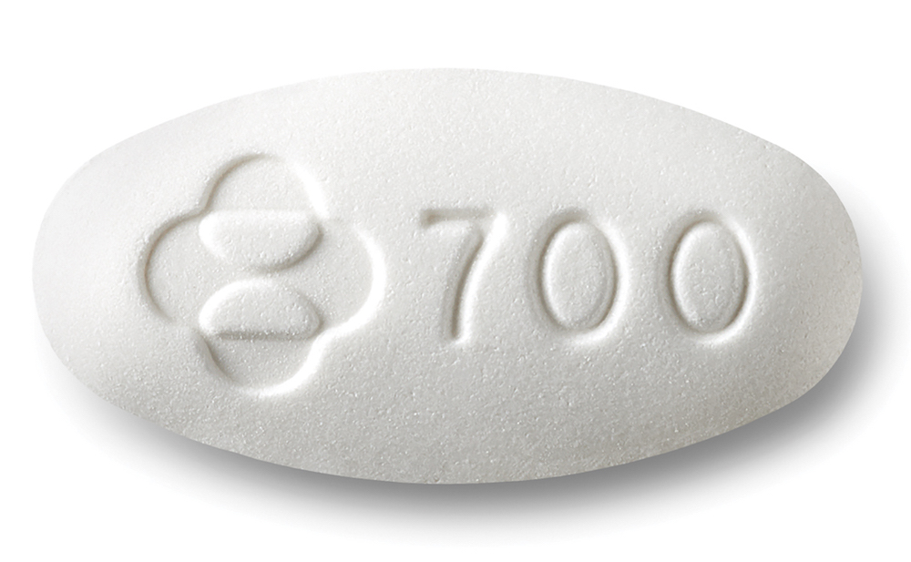
Doravirine (Pilfeltro)
Pifeltro [pih-FEL-tro]
100 mg
NNRTI
Dose: 1 tablet once daily with or without food

Slide 3
Doravirine
Dosage Form: 100 mg tablet
Dosing: 1 pill daily with or without food
With Renal Impairment
No adjustment with mild, moderate, or severe impairment
With Hepatic Impairment
No dose adjustment for Child-Pugh A or B
insufficient data for Child-Pugh C
Pregnancy
Inadequate data
Common Adverse Effects (≥5%)
Nausea, dizziness, headache, fatigue, diarrhea, abdominal pain, and abnormal dreams.

Slide 4
DOR + 2 NRTIs vs. DRV + RTV + 2 NRTIs DRIVE FORWARD

Slide 5
Doravirine + 2 NRTIs vs. Darunavir + Ritonavir + 2 NRTIs DRIVE FORWARD: Design
DRIVE FORWARD: Study Design
Background: Randomized, double-blind, phase 3 study evaluating the efficacy of doravirine versus ritonavir-boosted darunavir, both with 2NRTIs in antiretroviral-naïve adults with HIV. Inclusion Criteria - Age ≥18 years - Antiretroviral-naïve - HIV RNA ≥1,000 copies/mL - No resistance to any study drug - Chronic HBV or HCV allowed Regimens (all once daily) - Doravirine (100 mg) + 2 NRTIs - Darunavir (800 mg) + Ritonavir (100 mg) + 2 NRTIs
Doravirine + 2 NRTIs
(n = 385)
Darunavir + RTV + 2 NRTIs
(n = 384)
Source: Molina J-M, et al. Lancet HIV. 2018;5:e211-20.

Slide 6
Doravirine + 2 NRTIs vs. Darunavir + Ritonavir + 2 NRTIs DRIVE FORWARD: Results
DRIVE FORWARD Baseline Characteristics
Characteristic | DOR + 2 NRTI’s (n = 383) | DRV + RTV + 2 NRTI’s (n = 383)
Age (years), median | 34.8 | 35.7
Male, % | 83.3 | 85.1
White, % | 73.1 | 73.1
CD4 count (cells/mm³), mean | 432.6 | 411.9
HIV RNA, mean (log₁₀) | 4.4 | 4.4
HIV RNA >100,000 copies/mL, % | 24.3 | 24.5
NRTI backbone TDF-FTC, % | 86.9 | 87.5
NRTI backbone ABC-3TC, % | 13.1 | 12.5
Source: Molina J-M, et al. Lancet HIV. 2018;5:e211-20.

Slide 7
Doravirine + 2 NRTIs vs. Darunavir + Ritonavir + 2 NRTIs DRIVE FORWARD: 48 Week Results
Week 48 Virologic Response (Intention-to-Treat Analysis)
321 383
306 383
256 285
251 282
64 79
55 72
Source: Molina J-M, et al. Lancet HIV. 2018;5:e211-20.

Slide 8
Doravirine + 2 NRTIs vs. Darunavir + Ritonavir + 2 NRTIs DRIVE FORWARD: 48 Week Results
Treatment Related Adverse Events in DRIVE FORWARD Through Week 48
 | Doravirine + 2 NRTIs (n = 383) | DRV + RTV + 2 NRTIs (n = 383)
Any adverse drug-related event % | 31 | 32
Discontinued due to drug-related AE, % | 1 | 2
Upper abdominal pain, % | 2 | 1
Diarrhea, % | 5 | 13
Nausea, % | 7 | 8
Headache, % | 6 | 3
Dizziness, % | 3 | 2
Fatigue, % | 5 | 2
Rash, % | 2 | 3
Neuropsychiatric, % | 6 | 5
Source: Molina J-M, et al. Lancet HIV. 2018;5:e211-20.

Slide 9
Doravirine + 2 NRTIs vs. Darunavir + Ritonavir + 2 NRTIs DRIVE FORWARD: Results
Change in Baseline Fasting Lipids at Week 48
Source: Molina J-M, et al. Lancet HIV. 2018;5:e211-20.

Slide 10
Doravirine + 2 NRTIs vs. Darunavir + Ritonavir + 2 NRTIs DRIVE FORWARD: Summary
Interpretation: “In treatment-naive adults with HIV-1 infection, doravirine combined with two NRTIs might offer a valuable treatment option for adults with previously untreated HIV-1 infection.”
Source: Molina J-M, et al. Lancet HIV. 2018;5:e211-20.

