Slide 1
Dolutegravir-Rilpivirine (Juluca)
Prepared by:
David H. Spach, MD
Brian R. Wood, MD
Last Updated: December 18, 2022

Slide 2
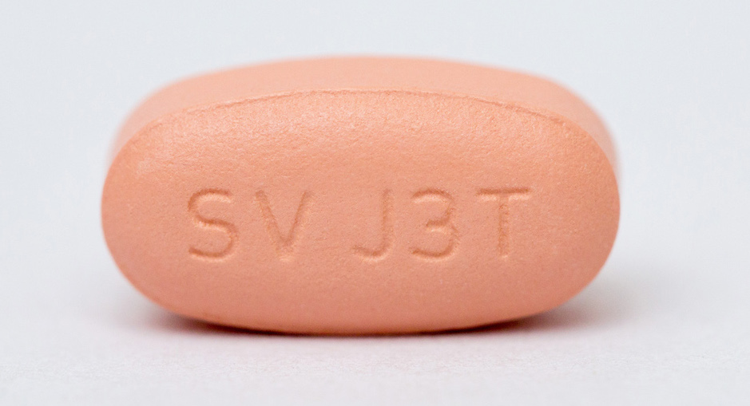
Dolutegravir-Rilpivirine
Dolutegravir-Rilpivirine
50 mg
25 mg
INSTI
NNRTI
Dose: 1 tablet once daily with a meal
Photograph courtesy of ViiV

Slide 3
Dolutegravir-Rilpivirine
Class
Dolutegravir: integrase strand transfer inhibitor (INSTI)
Rilpivirine: non-nucleoside reverse transcriptase inhibitor (NNRTI)
Indication
Complete regimen to replace the current antiretroviral regimen in those who are virologically suppressed (HIV-1 RNA less than 50 copies per mL) on a stable antiretroviral regimen for at least 6 months with no history of treatment failure and no known substitutions associated with resistance to dolutegravir or rilpivirine
Dose (with food):
1 tablet once daily with a meal
Adverse Events: (≥2%)
Headache, diarrhea, nausea
Source: Juluca FDA prescribing information.

Slide 4
Criteria for 2-Drug Maintenance Antiretroviral Therapy
Antiretroviral Therapy (3-Drug Therapy)
Maintenance (2-Drug Therapy)
Time
HIV RNA <50 copies/mL for ≥6 months
No prior virologic failure
No resistance to either maintenance drug
No hepatitis B infection

Slide 5
Dolutegravir-Rilpivirine Summary of Key Phase 3 Studies
Trials in Adults with Virologic Suppression
SWORD 1: Dolutegravir-Rilpivirine vs. continued 3-4 drug ART
SWORD 2: Dolutegravir-Rilpivirine vs. continued 3-4 drug ART
Abbreviations: ART = antiretroviral therapy

Slide 6
Dolutegravir plus Rilpivirine as Maintenance Dual Therapy SWORD-1 and SWORD-2

Slide 7
Dolutegravir plus Rilpivirine as Maintenance Dual Therapy SWORD-1 and SWORD-2: Design
Background: Identical, randomized, multinational, open-label, industry-sponsored, parallel-group, noninferiority studies of dolutegravir (DTG) plus rilpivirine (RPV) to maintain virologic suppression
Inclusion Criteria:
Age ≥18 years of age
On stable 3-drug ART ≥6 months
No history of virologic failure
No resistance to DTG or RPV
Taking 1st or 2nd ART regimen
HIV RNA <50 copies/mL in prior 12 months
HIV RNA <50 copies/mL at screening
No HBV co-infection
Regimen (Once Daily):
Dolutegravir 50 mg + Rilpivirine 25 mg
Early Switch Phase
Late Switch Phase
52 weeks
96 weeks
Early Switch
DTG + RPV
(n = 513)
Continue 3-Drug ART
(n = 511)
Late Switch
DTG + RPV
(n = 511)
*Primary endpoint for early switch phase: week 48 HIV RNA <50 copies/mL by FDA snapshot analysis
Source: Llibre JM, et al. Lancet. 2018;39:839-49.

Slide 8
Dolutegravir plus Rilpivirine as Maintenance Dual Therapy SWORD-1 and SWORD-2: Baseline Characteristics
Baseline Characteristic | DTG + RPV (n = 513) | 3-Drug ART (n = 511)
Age, mean (range) | 43 (21-79) | 43 (22-76)
Age ≥50 years | 147 (29%) | 142 (28%)
Female | 120 (23%) | 108 (21%)
Race, non-White | 92 (18%) | 111 (22%)
CD4 count, median (cells/mm³) | 611 | 638
Baseline PI | 133 (26%) | 136 (27%)
Baseline NNRTI | 275 (54%) | 278 (54%)
Baseline INSTI | 105 (20%) | 97 (19%)
Baseline Tenofovir DF | 374 (73%) | 359 (70%)
Prior ART duration (median) | 51 months | 53 months
Source: Llibre JM, et al. Lancet. 2018;39:839-49.

Slide 9
Dolutegravir plus Rilpivirine as Maintenance Dual Therapy SWORD-1 and SWORD-2: Pooled Results at Week 48
Week 48 Virologic Response
486/513
485/511
240/252
246/256
246/261
239/255
Source: Llibre JM, et al. Lancet. 2018;39:839-49.

Slide 10
Dolutegravir plus Rilpivirine as Maintenance Dual Therapy SWORD-1 and SWORD-2: Pooled Results at Week 48
Week 48 Virologic Response (by FDA Snapshot Analysis)
486/513
485/511
Confirmed virologic withdrawal: 2 (<1%) in each arm
One NNRTI resistance mutation (K101K/E) detected in DTG + RPV arm
No integrase resistance occurred
Source: Llibre JM, et al. Lancet. 2018;39:839-49.

Slide 11
Dolutegravir plus Rilpivirine as Maintenance Dual Therapy SWORD-1 and SWORD-2: Results at Week 48
Week 48 Virologic Response by SWORD-1 and SWORD-2
240/252
246/256
246/261
239/255
Source: Llibre JM, et al. Lancet. 2018;39:839-49.

Slide 12
Dolutegravir plus Rilpivirine as Maintenance Dual Therapy SWORD-1 and SWORD-2: Pooled Results at Week 48
SWORD 1 & 2 Pooled Results: 48-Week Adverse Events (AE)
 | DTG + RPV (n = 513) | 3-Drug ART (n = 511)
Any AE | 395 (77%) | 364 (71%)
Drug-related serious AE | 4 (1%) | 1 (<1%)
Grade 1 drug-related AE | 247 (48%) | 244 (48%)
Grade 2 drug-related AE | 116 (23%) | 116 (20%)
Grade 3 drug-related AE | 27 (5%) | 17 (3%)
Grade 4 drug-related AE | 5 (1%) | 3 (1%)
AE leading to study withdrawal | 17 (3%) | 3 (1%)
CNS AE leading to study withdrawal | 9 (2%) | 1 (<1%)
Source: Llibre JM, et al. Lancet. 2018;39:839-49.

Slide 13
Dolutegravir plus Rilpivirine as Maintenance Dual Therapy SWORD-1 and SWORD-2: Pooled Results at Week 48
Week 48: Change in Plasma Lipids from Baseline
Source: Llibre JM, et al. Lancet. 2018;39:839-49.

Slide 14
Dolutegravir plus Rilpivirine as Maintenance Dual Therapy SWORD-1 and SWORD-2: Pooled Results at Week 48
Week 48: Change in Bone Biomarkers from Baseline
Source: Llibre JM, et al. Lancet. 2018;39:839-49.

Slide 15
Dolutegravir plus Rilpivirine as Maintenance Dual Therapy SWORD-1 and SWORD-2: 48-Week Data Conclusion
Interpretation: “Dolutegravir-rilpivirine was noninferior to current antiretroviral therapy regimen over 48 weeks in participants with HIV suppression and showed a safety profile consistent with its components. Results support the use of this two-drug regimen to maintain HIV suppression.”
Source: Llibre JM, et al. Lancet. 2018;39:839-49.

Slide 16
Dolutegravir plus Rilpivirine as Maintenance Dual Therapy SWORD-1 and SWORD-2: Pooled Results at Week 148
Week 148 Virologic Response (by FDA Snapshot Analysis)
432/513
428/477
1% of all participants (n = 11) met criteria for confirmed virologic withdrawal through week 148
NNRTI resistance-associated mutations detected in 6 total participants (<1%); no INSTI mutations identified
Improvement in bone biomarkers observed; improvement in renal biomarkers occurred for those who switched off TDF
Source: van Wyk J, et al. J Acquir Immun Defic Syndr. 2020;85(3):325-330.

Slide 17
Dolutegravir plus Rilpivirine as Maintenance Dual Therapy SWORD-1 and SWORD-2: 148-Week Data Conclusion
Interpretation: “Switching to the 2-drug regimen dolutegravir plus rilpivirine maintained virologic suppression for a high proportion of participants through 3 years, with low rates of virologic failure and a well-tolerated safety profile.”
Source: van Wyk J, et al. J Acquir Immun Defic Syndr. 2020;85(3):325-330.

