Slide 1
Doravirine-Tenofovir DF-Lamivudine (Delstrigo)
Prepared by:
David H. Spach, MD
Jehan Z. Budak, MD
Last Updated: November 25, 2022

Slide 2
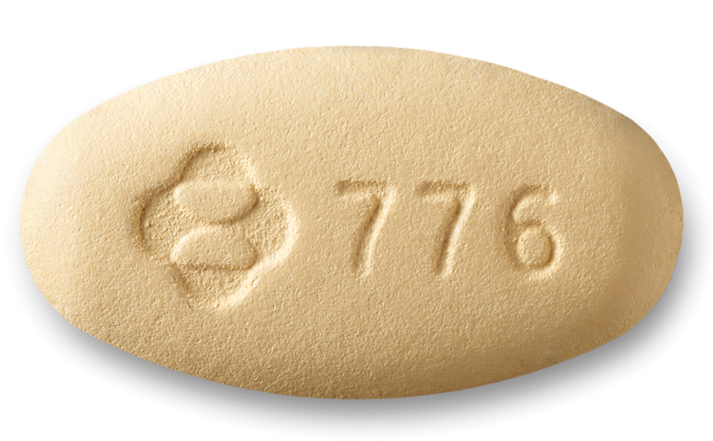
Doravirine-Tenofovir DF-Lamivudine Single-Tablet Regimen
Doravirine-Tenofovir DF-Lamivudine
100 mg
300 mg
300 mg
NNRTI
NRTI
NRTI
Dose: 1 tablet once daily with or without food
Source: Photograph of Delstrigo tablet courtesy of Merck

Slide 3
Doravirine-Tenofovir DF-Lamivudine (DOR-TDF-3TC)
Indications for Adults and Pediatric (weight ≥35 kg)
Treatment-naïve
Replace regimen in virologically suppressed and no failure or resistance to DRV, TDF, or 3TC
Dosing
1 tablet daily with or without food
With Renal Impairment
Not recommended if CrCl less than 50 mL/min
With Hepatic Impairment
No dose adjustment for Child-Pugh A or B; insufficient data for Child-Pugh C
Pregnancy
Inadequate data
Common Adverse Effects (≥5%)
Dizziness, nausea, and abnormal dreams

Slide 4
Doravirine-Tenofovir DF-Lamivudine Summary of Key Phase 3 Studies
Trials in in Treatment-Naïve Adults
DRIVE AHEAD: DOR-TDF-3TC vs. EFV-TDF-FTC as Initial Therapy
Trials in Adults with Virologic Suppression
DRIVE SHIFT: Switch to DOR-TDF-3TC vs. Maintenance Regimen
Abbreviations: DOR-TDF-FTC = doravirine-tenofovir DF-lamivudine; EFV-TDF-FTC = efavirenz-tenofovir DF-emtricitabine

Slide 5
Doravirine-Tenofovir DF-Lamivudine Trials in Treatment Treatment-Naïve Adults

Slide 6
DOR-TDF-3TC vs. EFV-TDF-FTC as Initial Therapy DRIVE AHEAD

Slide 7
Doravirine-TDF-3TC versus Efavirenz-TDF-FTC as Initial Therapy DRIVE AHEAD: Design
Design
Randomized, double-blind, phase 3 study comparing fixed dose doravirine-tenofovir DF-lamivudine with fixed dose efavirenz-tenofovir DF-emtricitabine as initial antiretroviral therapy
Inclusion Criteria
Antiretroviral-naïve
Age ≥18 years
HIV RNA ≥1,000 copies/mL
No resistance to any study drug
Regimens
Doravirine-TDF-3TC (100/300/300 mg) daily
Efavirenz-TDF-FTC (600/300/200 mg) daily
Doravirine-TDF-3TC
(n = 364)
Efavirenz-TDF-FTC
(n = 364)
Source: Orkin C, et al. Clin Infect Dis. 2019;68:535-44.

Slide 8
Doravirine-TDF-3TC versus Efavirenz-TDF-FTC as Initial Therapy DRIVE AHEAD: 48 Week Results
Week 48 Virologic Response (Observed Failure)
307/346
294/331
251/277
235/258
56/69
59/73
Source: Orkin C, et al. Clin Infect Dis. 2019;68:535-44.

Slide 9
Doravirine-TDF-3TC versus Efavirenz-TDF-FTC as Initial Therapy DRIVE AHEAD: Results
Week 48 Virologic Response (FDA Snapshot: All missing data = Failure)
307/364
294/364
39/364
37/364
Source: Orkin C, et al. Clin Infect Dis. 2019:68:535-44.

Slide 10
Doravirine-TDF-3TC versus Efavirenz-TDF-FTC as Initial Therapy DRIVE AHEAD: Adverse Effects
Treatment Emergent Adverse Events in DRIVE AHEAD Through Week 48
Adverse Effects | DOR/TDF/3TC (n = 364) | EFV/TDF/FTC (n = 364)
Drug-related AE’s, % | 31 | 63
Discontinued due to drug-related AE, % | 3 | 7
Headache, % | 13 | 12
Diarrhea, % | 11 | 13
Nausea, % | 8 | 11
Vomiting, % | 4 | 7
Abnormal Dreams, % | 5 | 12
Rash, % | 5 | 12
Source: Orkin C, et al. Clin Infect Dis. 2019:68:535-44.

Slide 11
Doravirine-TDF-3TC versus Efavirenz-TDF-FTC as Initial Therapy DRIVE AHEAD: Adverse Effects
Proportion with Pre-Defined Neuropsychiatric Side Effects at Week 48
p < 0.05
p < 0.05
p < 0.05
Source: Orkin C, et al. Clin Infect Dis. 2019:68:535-44.

Slide 12
Doravirine-TDF-3TC versus Efavirenz-TDF-FTC as Initial Therapy DRIVE AHEAD: Adverse Effects
Change in Baseline Fasting Lipids at Week 48
Source: Orkin C, et al. Clin Infect Dis. 2019:68:535-44.

Slide 13
DOR-TDF-3TC vs. EFV-TDF-FTC as Initial Therapy DRIVE AHEAD: Summary
Conclusions: “In HIV-1 treatment-naive adults, doravirine/lamivudine/tenofovir DF demonstrated non-inferior efficacy to efavirenz/emtricitabine/tenofovir DF at week 48 and was well tolerated, with significantly fewer neuropsychiatric events and minimal changes in LDL-C and non-HDL-C compared with efavirenz/emtricitabine/tenofovir DF.”
Source: Orkin C, et al. Clin Infect Dis. 2019:68:535-44.

Slide 14
Doravirine-Tenofovir DF-Lamivudine Switch Studies in Adults with Virologic Suppression

Slide 15
Switch to DOR-TDF-3TC vs. Continued Baseline Regimen DRIVE SHIFT

Slide 16
Switch to Doravirine-TDF-3TC versus Continued Baseline Regimen DRIVE SHIFT: Design
Design: Open-label, non-inferiority trial in adults with suppressed HIV RNA while taking 2 NRTIs plus anchor drug, randomized (2:1) to immediately switch to fixed-dose doravirine-tenofovir-DF-lamivudine or continue the baseline regimen with delayed switch at 24 weeks
Inclusion Criteria
Age ≥18 years
Suppressed HIV RNA ≥6 months
No history of virologic failure
Baseline Regimen
2 NRTIs + (boosted protease inhibitor, boosted elvitegravir, or NNRTI)
Immediate Switch
Doravirine-TDF-3TC (n = 447)
2x
1x
Delayed Switch
Baseline Regimen to Week 24, then Doravirine-TDF-3TC
(n = 223)
Source: Johnson M, et al. J Acquir Immun Defic Syndr. 2019;81:463-72.

Slide 17
Switch to Doravirine-TDF-3TC versus Continued Baseline Regimen DRIVE SHIFT: Baseline Characteristics
DRIVE SHIFT: Baseline Characteristics
Characteristic | Immediate Switch (n = 447) | Delayed Switch (n = 223)
Age in years, median (range) | 43 (21-71) | 42 (22-71)
Male, n (%) | 372 (83.2) | 194 (87.0)
White, n (%) | 344 (77.0) | 168 (75.3)
Black or African American, n (%) | 56 (12.5) | 34 (15.2)
CD4 count (cells/mm³), median (range), | 633 (82-1,928) | 625 (140-1,687)
CD4 count <200 cells/mm³, n (%) | 13 (2.9) | 4 (1.8)
Median months on prior regimen (range) | 48.4 (7-265) | 50.5 (7-181)
Baseline mutations: K103N, Y181C, +/- G190A, n (%) | 11 (2.5) | 13 (5.8)
HBV and/or HCV coinfection, n (%) | 14 (3.1) | 9 (4.0)
Source: Johnson M, et al. J Acquir Immun Defic Syndr. 2019;81:463-72.

Slide 18
Switch to Doravirine-TDF-3TC versus Continued Baseline Regimen DRIVE SHIFT: Baseline Antiretroviral Regimens
DRIVE SHIFT Baseline Antiretroviral Regimens
Anchor Agent, n (%) | Immediate Switch (n = 447) | Delayed Switch (n = 223)
Boosted PI | 316 (70.7) | 156 (70.0)
Darunavir | 166 (37.1) | 82 (36.8)
Atazanavir | 96 (21.5) | 43 (19.3)
Lopinavir | 54 (12.1) | 31 (13.9)
Elvitegravir-cobicistat | 25 (5.6) | 12 (5.4)
NNRTI | 106 (23.7) | 55 (24.7)
Efavirenz | 78 (17.4) | 36 (16.1)
Nevirapine | 17 (3.8) | 12 (5.4)
Rilpivirine | 11 (2.5) | 7 (3.1)
*Most common NRTI backbone in both arms: TDF/FTC (73.8% in immediate switch, 69.1% in delayed switch)
Source: Johnson M, et al. J Acquir Immun Defic Syndr. 2019;81:463-72.

Slide 19
Switch to Doravirine-TDF-3TC versus Continued Baseline Regimen DRIVE SHIFT: Results
Week 48 Doravirine-TDF-3TC vs Week 24 Baseline Regimen (FDA snapshot)
Source: Johnson M, et al. J Acquir Immun Defic Syndr. 2019;81:463-72.

Slide 20
Switch to Doravirine-TDF-3TC versus Continued Baseline Regimen DRIVE SHIFT: Adverse Effects
Change in Fasting Lipids in Participants Taking a Boosted PI at Baseline
Source: Johnson M, et al. J Acquir Immun Defic Syndr. 2019;81:463-72.

Slide 21
Switch to Doravirine-TDF-3TC versus Continued Baseline Regimen DRIVE SHIFT: Summary
Conclusions: “Switching to once-daily doravirine-lamivudine-tenofovir disoproxil fumarate is a generally well-tolerated option for maintaining viral suppression in patients considering a change in therapy.”
Source: Johnson M, et al. J Acquir Immun Defic Syndr. 2019;81:463-72.

