Slide 1
Darunavir-Cobicistat-Tenofovir Alafenamide-Emtricitabine (Symtuza)
Prepared by:
Brian R. Wood, MD
David H. Spach, MD
Last Updated: December 5, 2022

Slide 2
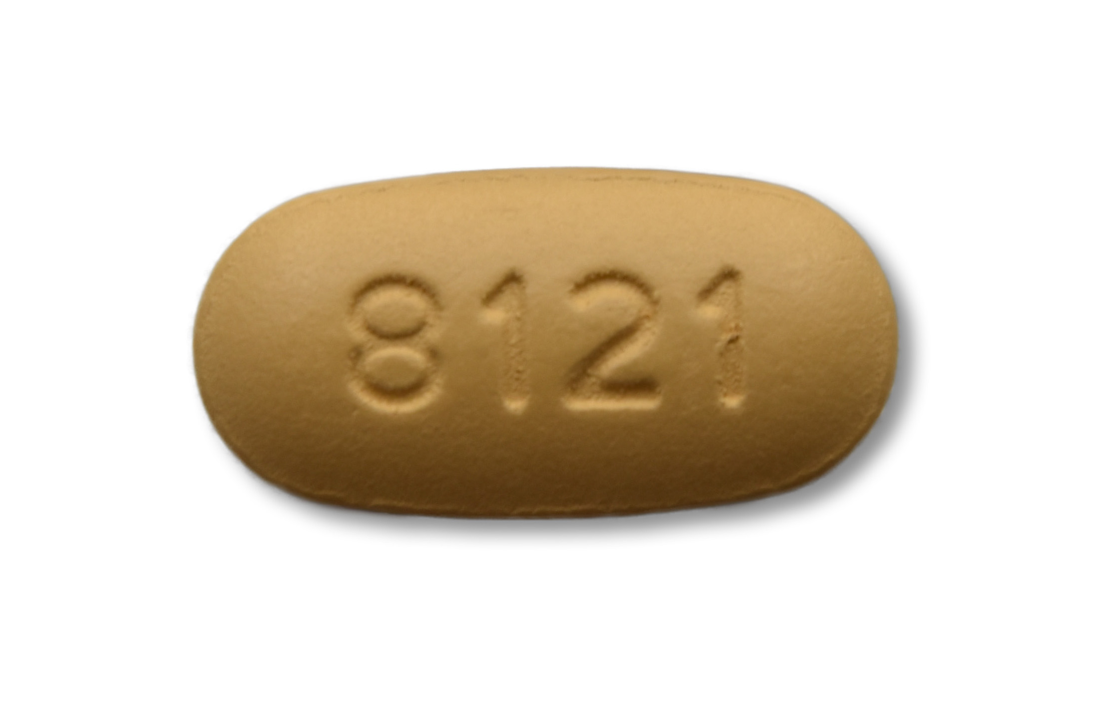
Darunavir-Cobicistat-Tenofovir Alafenamide-Emtricitabine
Darunavir-Cobicistat-Tenofovir alafenamide-Emtricitabine
800 mg
150 mg
10 mg
200 mg
PI
Booster
NRTI
NRTI
Dose: 1 tablet once daily with food
Source: Image courtesy of Janssen Therapeutics, Division of Janssen Products, LP

Slide 3
Darunavir-Cobicistat-Tenofovir Alafenamide-Emtricitabine Single-Tablet Regimen
Indication: Complete regimen for treatment of HIV-1 in persons weighing ≥40 kg:
No prior antiretroviral treatment history, or
Virologically suppressed (HIV-1 RNA < 50 copies/mL) on a stable ART for ≥6 months and have no known resistance to darunavir or tenofovir
Dosing: 1 pill daily with food
With Renal or Hepatic Impairment
Not recommended if estimated CrCl <30 mL/min
Not recommended with severe hepatic impairment (Child-Pugh C)

Slide 4
Darunavir-Cobicistat-Tenofovir alafenamide-Emtricitabine Summary of Key Phase 3 Studies
Trials in Treatment-Naïve Adults
AMBER: DRV-COBI-TAF-FTC versus DRV-COBI + TDF-FTC
Trials in Adults with Virologic Suppression
EMERALD: Switch to DRV-COBI-TAF-FTC or stay on PI + TDF-FTC
Abbreviations: DRV-COBI-TAF-FTC = darunavir-cobicistat-tenofovir alafenamide-emtricitabine; DRV-COBI = darunavir-cobicistat; TDF-FTC = tenofovir DF-emtricitabine

Slide 5
Darunavir-Cobicistat-Tenofovir alafenamide-Emtricitabine Trials in Treatment Treatment-Naïve Adults

Slide 6
DRV-COBI-TAF-FTC vs DRV-COBI + TDF-FTC AMBER

Slide 7
DRV-COBI-TAF-FTC vs DRV-COBI + TDF-FTC as Initial ART AMBER: Design
Background: Randomized, double-blind, active-controlled, international, phase 3 study evaluating the efficacy and safety of the single-tablet regimen DRV-COBI-TAF-FTC compared with DRV-COBI + TDF-FTC for treatment-naïve individuals
Inclusion Criteria (n = 725)
Age ≥18 years
Antiretroviral naïve
CD4 count >50 cells/mm³
HIV RNA ≥1,000 copies/mL
eGFR ≥70 mL/min
Genotypic sensitivity to DRV, TDF, and FTC
No hepatitis B or C
Not pregnant
No AIDS-defining condition within 30 days
DRV-COBI-TAF-FTC + 2 placebo tabs
(n = 362)
DRV-COBI + TDF-FTC + placebo tab
(n = 363)
Source: Eron JJ, et al. AIDS. 2018;32:1431-42.

Slide 8
DRV-COBI-TAF-FTC vs DRV-COBI + TDF-FTC as Initial ART AMBER: Results
Week 48: Virologic Response by FDA Snapshot Analysis, ITT
331/362
321/363
278/303
265/293
53/59
56/70
Source: Eron JJ, et al. AIDS. 2018;32:1431-42.

Slide 9
DRV-COBI-TAF-FTC vs DRV-COBI + TDF-FTC as Initial ART AMBER: Results
Week 48: Change in Serum Creatinine and Estimated GFR
Abbreviations: Cr = creatinine (measured in µmol/L); eGFR = estimated glomerular filtration rate (measured in mL/min/1.73m², calculated using CKD-EPI); Cyst = cystatin C
Source: Eron JJ, et al. AIDS. 2018;32:1431-42.

Slide 10
DRV-COBI-TAF-FTC vs DRV-COBI + TDF-FTC as Initial ART AMBER: Results
Week 48: Change in Urinary Markers of Tubular Dysfunction
Mean Change in Markers of Proximal Tubulopathy at Week 48
 | DRV-COBI-TAF-FTC (n = 362) | DRV-COBI + TDF-FTC (n = 363)
UPCR (mg/g) | -22.42 | -10.34
UACR (mg/g) | -2.45 | -0.58
RBP:Cr (μg/g) | 16.84 | 401.12
β2M:Cr (μg/g) | -100.58 | 837.63
UPCR = urine protein to creatinine ratio; UACR = urine albumin to creatinine ratio
RBP:Cr = retinol binding protein to creatinine ratio; β2M:Cr = beta-2-microglobulin to creatinine ratio
Source: Eron JJ, et al. AIDS. 2018;32:1431-42.

Slide 11
DRV-COBI-TAF-FTC vs DRV-COBI + TDF-FTC as Initial ART AMBER: Results
Week 48: Percentage Change in Bone Mineral Density*
*This is from a bone mineral density substudy (n = 113 participants in TAF arm, 99 in control arm)
Source: Eron JJ, et al. AIDS. 2018;32:1431-42.

Slide 12
DRV-COBI-TAF-FTC vs DRV-COBI + TDF-FTC as Initial ART AMBER: Results
Median Change in Fasting Lipid Parameters at Week 48
 | DRV-COBI-TAF-FTC (n = 362) | DRV-COBI + TDF-FTC (n = 363)
TC (mg/dL) | 28.6 | 10.4
LDL (mg/dL) | 17.4 | 5.0
HDL (mg/dL) | 4.3 | 1.5
TC:HDL ratio | 0.2 | 0.08
Triglycerides (mg/dL) | 23.9 | 14.2
TC = total cholesterol; LDL = low density lipoprotein; HDL = high density lipoprotein
Source: Eron JJ, et al. AIDS. 2018;32:1431-42.

Slide 13
DRV-COBI-TAF-FTC vs DRV-COBI + TDF-FTC as Initial ART AMBER: Results
Conclusions: “Darunavir-cobicistat-emtricitabine-tenofovir alafenamide achieved a high virologic suppression rate (91.4%) and was noninferior to darunavir-cobicistat with emtricitabine-tenofovir DF. Darunavir-cobicistat-emtricitabine-tenofovir alafenamide also demonstrated the bone and renal safety advantages of tenofovir alafenamide in combination with darunavir-cobicistat.”
Source: Eron JJ, et al. AIDS. 2018;32:1431-42.

Slide 14
Darunavir-Cobicistat-Tenofovir alafenamide-Emtricitabine Switch Studies in Adults with Virologic Suppression

Slide 15
DRV-COBI-TAF-FTC vs Continue Boosted PI + TDF-FTC EMERALD

Slide 16
DRV-COBI-TAF-FTC vs Continue Boosted PI + TDF-FTC EMERALD: Design
Background: Randomized, open-label, active-controlled, international, phase 3 study evaluating the efficacy and safety of switching to the single-tablet regimen DRV-COBI-TAF-FTC versus continuing a boosted PI + TDF-FTC
Inclusion Criteria (n = 1,141)
Age ≥18 years
Antiretroviral experienced
HIV RNA ≤50 copies/mL for >2 months*
Taking a PI plus ritonavir or cobicistat
Regimen stable for ≥6 months
eGFR ≥50 mL/min
No prior virologic failure on a DRV-based regimen
Virologic failure on non-DRV-based regimen allowed
Not pregnant or breastfeeding
Switch Group DRV-COBI-TAF-FTC
(n = 763)
2x
1x
Continue Group Boosted PI + TDF-FTC
(n = 378)
*One HIV RNA 50-200 copies/mL within prior 12 months allowed
Source: Orkin C, et al. Lancet HIV. 2018;5:e23-e34.

Slide 17
DRV-COBI-TAF-FTC vs Continue a Boosted PI + TDF-FTC EMERALD: Baseline Characteristics
EMERALD Study: Baseline Characteristics
 | DRV-COBI-TAF-FTC Switch Group (n = 763) | Boosted PI + TDF-FTC Continue Group (n = 378)
CD4 Count (cells/mL) | 630 | 624
Time since HIV diagnosis (years) | 9.3 | 8.9
Time since first ART (years) | 6.2 | 5.8
Previous use of >5 ARV’s | 59 | 58
Previous virologic failure | 15 | 14
Boosted darunavir at screening (%) | 70 | 70
Boosted atazanavir at screening (%) | 22 | 22
Boosted lopinavir at screening (%) | 8 | 8
Source: Orkin C, et al. Lancet HIV. 2018;5:e23-e34.

Slide 18
DRV-COBI-TAF-FTC vs Continue a Boosted PI + TDF-FTC EMERALD: Results
Week 48: Virologic Response by FDA Snapshot Analysis, ITT
724/763
354/378
Source: Orkin C, et al. Lancet HIV. 2018;5:e23-e34.

Slide 19
DRV-COBI-TAF-FTC vs Continue a Boosted PI + TDF-FTC EMERALD: Results
Week 48: Virologic Outcomes
EMERALD Study Virologic Outcomes
 | DRV-COBI-TAF-FTC Switch Group (n = 763) | Boosted PI + TDF-FTC Continue Group (n = 378)
Virologic rebound rate through 48 weeks* | 2.5% | 2.1%
HIV RNA <50 copies/mL at 48 weeks | 94.9% | 93.7%
HIV RNA >50 copies/mL at 48 weeks | 0.8% | 0.5%
No virologic data at 48 weeks | 4.3% | 5.8%
724/763
354/378
*HIV RNA ≥50 copies/mL or premature discontinuation with last HIV RNA ≥50copies/mL
Source: Orkin C, et al. Lancet HIV. 2018;5:e23-e34.

Slide 20
DRV-COBI-TAF-FTC vs Continue a Boosted PI + TDF-FTC EMERALD: Results
Week 48: Change in Serum Creatinine and Estimated GFR
Cr = creatinine (measured in µmol/L)
eGFR = estimated glomerular filtration rate (measured in mL/min/1.73 m², calculated using CKD-EPI)
Cyst = cystatin C
Source: Orkin C, et al. Lancet HIV. 2018;5:e23-e34.

Slide 21
DRV-COBI-TAF-FTC vs Continue a Boosted PI + TDF-FTC EMERALD: Results
Week 48: Change in Urinary Markers of Tubular Dysfunction
Mean Change in Markers of Proximal Tubulopathy at Week 48
 | DRV-COBI-FTC-TAF Switch Group (n = 763) | Boosted PI + TDF-FTC Continue Group (n = 378)
UPCR (mg/g) | -33.9 | -6.43
UACR (mg/g) | -3.2 | 1.3
RBP:Cr (mg/g) | -630.5 | 1037.1
β2M:Cr (mg/g) | -1454.7 | 1371.3
UPCR = urine protein to creatinine ratio; UACR = urine albumin to creatinine ratio
RBP:Cr = retinol binding protein to creatinine ratio; β2M:Cr = beta-2-microglobulin to creatinine ratio
Source: Orkin C, et al. Lancet HIV. 2018;5:e23-e34.

Slide 22
DRV-COBI-TAF-FTC vs Continue a Boosted PI + TDF-FTC EMERALD: Results
Week 48: Change in Bone Mineral Density
This is from a bone mineral density substudy (n = 209 participants in switch arm, 108 in control arm)
Source: Orkin C, et al. Lancet HIV. 2018;5:e23-e34.
Notes:
**Substudy – 209 pts study drug, 108 control

Slide 23
DRV-COBI-TAF-FTC vs Continue a Boosted PI + TDF-FTC EMERALD: Results
Median Change in Fasting Lipid Parameters at Week 48
 | DRV-COBI-FTC-TAF Switch Group (n = 763) | Boosted PI + TDF-FTC Control Group (n = 378)
TC (mg/dL) | 19.7 | 1.3
LDL (mg/dL) | 15.7 | 1.9
HDL (mg/dL) | 3.0 | -1.0
TC:HDL ratio | 0.2 | 0.1
Triglycerides (mg/dL) | 6.0 | 5.0
TC = total cholesterol; LDL = low density lipoprotein; HDL = high density lipoprotein
Source: Orkin C, et al. Lancet HIV. 2018;5:e23-e34.

Slide 24
DRV-COBI-TAF-FTC vs Continue a Boosted PI + TDF-FTC EMERALD: Conclusions
Conclusions: “Our findings show the safety and efficacy of single-tablet darunavir, cobicistat, emtricitabine, and tenofovir alafenamide as a potential switch option for the treatment of HIV-1 infection in adults with viral suppression.”
Source: Orkin C, et al. Lancet HIV. 2018;5:e23-e34

