Slide 1
Ibalizumab (Trogarzo)
Prepared by:
Brian R. Wood, MD
David Spach, MD
Last Updated: July 9, 2020

Slide 2
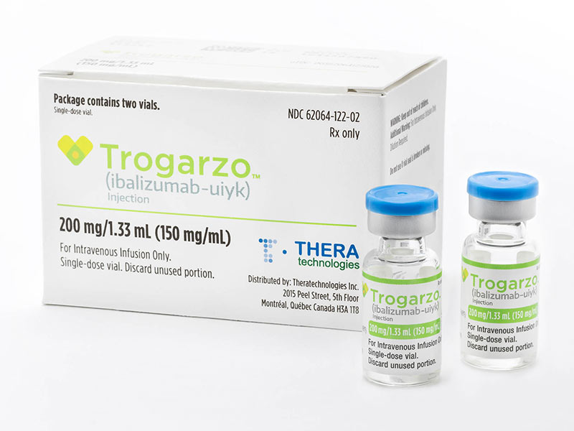
Ibalizumab (Trogarzo)
Trogarzo [tro-gar-zo]
Entry Inhibitor
Intravenous Infusion: Loading Dose followed by Dosing Every 2 Weeks
Source: Photograph courtesy of Theratechnologies, Inc.

Slide 3
Ibalizumab (Trogarzo)
Indication: - Heavily treatment-experienced adults with multidrug resistant HIV-1 failing their current antiretroviral regimen
Dosing (Intravenous): - Loading dose: 2,000 mg IV - Maintenance dose: 800 mg IV every 2 weeks
Contraindications - None
Use During Pregnancy - Insufficient data
Common Adverse Events (≥5%)
Diarrhea (8%), dizziness (8%), nausea (5%), and rash (5%)

Slide 4
Host Receptors and HIV Entry
HIV
Host Receptors
HIV
CD4
CCR5
CXCR4
CD4 Cell

Slide 5
HIV Cell Entry: Binding to Host Cell CD4 Receptor
HIV
gp41
CD4 binding site
gp120
CD4
Intracellular Space
Host Cell
CCR5
CCR5

Slide 6
HIV Cell Entry: Binding to Host Cell CD4 Receptor
HIV
CD4 binding site
CD4
Intracellular Space
Host Cell
CCR5
CCR5

Slide 7
HIV Cell Entry Binding to Host Cell CD4 Receptor
HIV
CD4
Extracellular Space
Intracellular Space
Host Cell
CCR5
CCR5

Slide 8
HIV Cell Entry Binding to Host CCR5 Co-Receptor
HIV
CD4
V3
V3
Extracellular Space
Intracellular Space
Host Cell
CCR5
CCR5

Slide 9
CD4 Receptor
CD4 Receptor
D1
Extracellular Region (370 aa) D1-D4 Domains
D2
D3
D4
Transmembrane region (25 aa)
Cytoplasmic tail (38 aa)
Source: Bour S, et al. Microbiol Rev. 1995:59:63-93.

Slide 10
CD4 Receptor and Ibalizumab Binding
Ibalizumab
D1
D2
CD4 Receptor
D3
D4
Intracellular Space
Host Cell
Host Cell

Slide 11
Ibalizumab CD4 Directed Post-Attachment HIV Inhibitor
HIV
Ibalizumab
D2
CD4 Receptor
Extracellular Space
Intracellular Space
Host Cell
CCR5
CCR5

Slide 12
Ibalizumab Summary of Key Studies
Salvage Antiretroviral Therapy - TMB-301: Ibalizumab plus OBR for Adults Failing ART

Slide 13
Ibalizumab

Slide 14
Ibalizumab for Antiretroviral Salvage TMB-301: Study

Slide 15
Ibalizumab Added to OBR for Adults Failing ART TMB-301: Study Design
TMB-301: Study Design
Study design: - Single-arm, open label study of ibalizumab (IBA) added to optimized background therapy (OBR) for individuals failing ART - Primary endpoint: proportion achieving ≥0.5 log₁₀ decrease in HIV RNA 7 days after initiating IBA therapy (day 14 of study) - Secondary endpoints: virologic outcomes, safety, and tolerability at 24 weeks Inclusion Criteria: - Adults with HIV, on ART for ≥6 months, HIV RNA >1,000 copies/mL, and ≥3 class drug resistance (but ≥1 remaining active drug)
Days 1-7
Failing ART
(n = 40)
Day 7
IBA IV 2,000 mg loading dose
Day 14
Add OBR with ≥1 active agent
Day 21
IBA 800 mg IV q2 weeks
Source: Emu B, et al. N Engl J Med. 2018;379:645-54.

Slide 16
Ibalizumab Added to OBR for Adults Failing ART TMB-301: Study Design
Baseline Characteristics of the 40 Participants in TMB-301
Characteristic | N = 40
Median age (range)—years | 53 (23-65)
Male | 34 (85%)
Non-white | 18 (45%)
Mean duration since HIV diagnosis—years | 20±8
Mean CD4 count—cells/mm³ | 150±182
Mean HIV RNA—copies/mL) | 100,287
Participants with HIV RNA >100,000 copies/mL | 7 (18%)
Source: Emu B, et al. N Engl J Med. 2018;379:645-54.

Slide 17
Ibalizumab Added to OBR for Adults Failing ART TMB-301: Efficacy at Day 14
IBA Monotherapy = after 7 days of IBA added to failing ART (functional monotherapy) Control = after 7 days of baseline failing ART
Source: Emu B, et al. N Engl J Med. 2018;379:645-54.

Slide 18
Ibalizumab Added to OBR for Adults Failing ART TMB-301: Efficacy at Week 24
Optimized background regimen (OBR) added at day 14
Source: Emu B, et al. N Engl J Med. 2018;379:645-54.

Slide 19
Ibalizumab Added to OBR for Adults Failing ART TMB-301: Efficacy at Week 25, by Baseline CD4 Cell Count
Week 25 Virologic Response (Intention-to-Treat Analysis)
17/40
20/40
3/17
4/17
14/23
16/23
Source: Emu B, et al. N Engl J Med. 2018;379:645-54.

Slide 20
Ibalizumab Added to OBR for Adults Failing ART TMB-301: Efficacy at Week 24
Conclusions: “In patients with multidrug-resistant HIV-1 infection who had advanced disease and limited treatment options, ibalizumab had significant antiviral activity during a 25-week study. Evidence of the emergence of diminished ibalizumab susceptibility was observed in vitro in patients who had virologic failure.”
Source: Emu B, et al. N Engl J Med. 2018;379:645-54.

