Slide 1
Fostemsavir (Rukobia)
Prepared by:
David H. Spach, MD
Brian R. Wood, MD
Last Updated: December 30, 2020

Slide 2
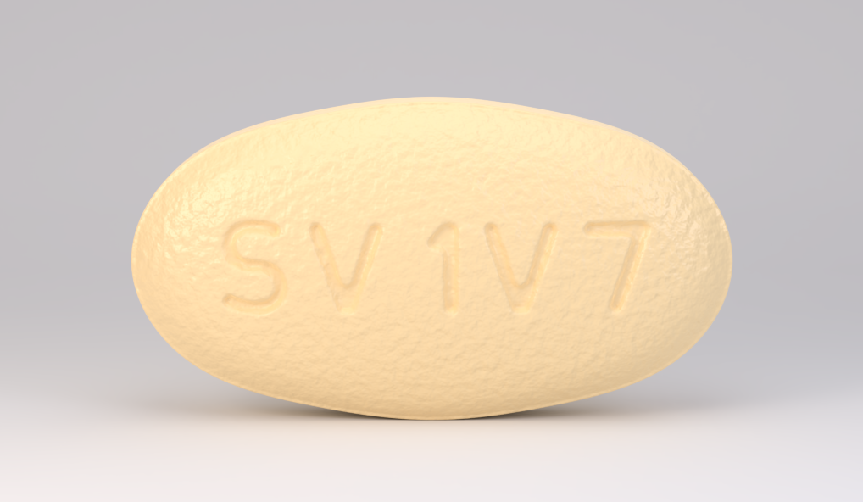
Fostemsavir (Rukobia)
Rukobia [rue-KOH-bee-ah]
Source: Photograph courtesy of ViiV Healthcare

Slide 3
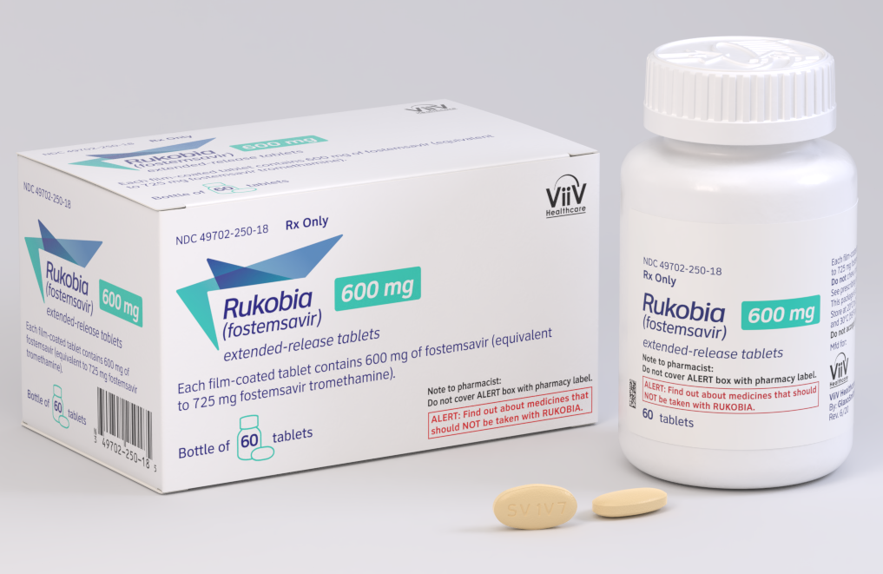
Fostemsavir (Rukobia)
Rukobia [rue-KOH-bee-ah]
Source: Photograph courtesy of ViiV Healthcare

Slide 4
Fostemsavir (Rukobia)
Indication:
Heavily treatment-experienced adults with multidrug resistant
HIV-1 failing their current antiretroviral regimen
Dosing:
600 mg orally twice daily, with or without food
Contraindications
Hypersensitivity to fostemsavir
Coadministration with strong cytochrome P450 (CYP) 3A inducers
Use During Pregnancy
Insufficient data
Common Adverse Events (≥5%)
Nausea (10%)
Source: Rukobia Prescribing Information

Slide 5
HIV Cell Entry
HIV
gp120
gp120
CD4 binding site
CD4
CD4
Intracellular Space
Host Cell
CCR5
CCR5

Slide 6
HIV Cell Entry HIV gp120 Attachment to Host Cell CD4 Receptor
HIV
gp120
gp120
CD4
Intracellular Space
Host Cell
CCR5
CCR5

Slide 7
HIV Entry Inhibitors: Attachment Inhibitors Fostemsavir—prodrug converted to Temsavir
HIV
HIV
Temsavir
Binds near CD4 binding site and prevents gp120 conformational change required for attachment
gp120
gp120
CD4 binding site
CD4
CD4
Intracellular Space
Host Cell
CCR5
CCR5

Slide 8
Fostemsavir in Treatment-Experienced Patients BRIGHTE Study (Week 48 Data)

Slide 9
Fostemsavir (FTR) for Heavily Treatment Experienced BRIGHTE Study (Week 48): Background
Study Design: BRIGHTE
Background: - Phase 3, randomized, multicenter, placebo-controlled, non-inferiority trial evaluating attachment inhibitor fostemsavir (FTR) in salvage ART Enrollment Criteria: - Highly ART-experienced adults - Failing current ART regimen - HIV RNA >400 copies/mL - Multiclass ART resistance - At least one fully active agent - Unable to construct viable regimen
Day 8
Week 96
Randomized Cohort
FTR 600 mg BID + failing regimen (n = 203)
FTR 600 mg BID + OBR (n = 272)
3:1 Randomization
Placebo BID + failing regimen (n = 69)
Nonrandomized Cohort
FTR 600 mg BID + OBR (n = 99)
*Also a cohort with 0 remaining active agents; all given Fostemsavir 600 mg BID + OBR (n = 99)
*OBR = optimized background regimen
Source: Kozal M, et al. N Engl J Med. 2020;382:1232-43.

Slide 10
Fostemsavir (FTR) for Heavily Treatment Experienced BRIGHTE Study (Week 48): Baseline Characteristics
Baseline Characteristics | Randomized (n = 272) | Non-Randomized (n = 99)
Age, years, median (range) | 48 (18-73) | 50 (17-72)
Male sex, n (%) | 200 (74) | 89 (90)
White, n (%) | 184 (68) | 74 (74)
Black/African American, n (%) | 60 (22) | 23 (23)
HIV RNA 1,000-100,000 copies/mL, n (%) | 161 (59) | 75 (76)
HIV RNA >100,000 copies/mL, n (%) | 80 (29) | 15 (15)
CD4 count—cells/mm³, median (range) | 99 (0-1160) | 41 (0-641)
2 fully active agents in OBR, % | 42 | 0
1 fully active agent in OBR, % | 52 | 19
0 fully active agents in OBR, % | 6 | 81
*Most common ARV’s in OBR: dolutegravir, darunavir, tenofovir DF, etravirine, maraviroc, enfuvirtide, ibalizumab
Source: Kozal M, et al. N Engl J Med. 2020;382:1232-43.

Slide 11
Fostemsavir (FTR) for Heavily Treatment Experienced BRIGHTE Study (Week 48): Results
Baseline to Day 8 Change in HIV RNA Level
Source: Kozal M, et al. N Engl J Med. 2020;382:1232-43.

Slide 12
Fostemsavir (FTR) for Heavily Treatment Experienced BRIGHTE Study (Week 48): Results
Virologic Response Through Week 48 (HIV RNA <40 copies/mL)
Source: Kozal M, et al. N Engl J Med. 2020;382:1232-43.

Slide 13
Fostemsavir (FTR) for Heavily Treatment Experienced BRIGHTE Study (Week 48): Results
Adverse Events
Source: Kozal M, et al. N Engl J Med. 2020;382:1232-43.

Slide 14
Fostemsavir (FTR) for Heavily Treatment Experienced BRIGHTE Study (Week 48): Conclusion
Conclusion: “In patients with multidrug-resistant HIV-1 infection with limited therapy options, those who received fostemsavir had a significantly greater decrease in the HIV-1 RNA level than those who received placebo during the first 8 days. Efficacy was sustained through 48 weeks.”
Source: Kozal M, et al. N Engl J Med. 2020;382:1232-43.

Slide 15
Fostemsavir in Treatment-Experienced Patients BRIGHTE Study (Week 96 Data)

Slide 16
Fostemsavir (FTR) for Heavily Treatment Experienced BRIGHTE Study (Week 96): Results
Virologic Response Through Week 96 (HIV RNA <40 copies/mL)
Source: Lataillade M, et al. Lancet HIV. 2020;7:e740-51.

Slide 17
Fostemsavir (FTR) for Heavily Treatment Experienced BRIGHTE Study (Week 96): Results
Mean Change in CD4 T-Cell Count Through Week 96
Source: Lataillade M, et al. Lancet HIV. 2020;7:e740-51.

Slide 18
Fostemsavir (FTR) for Heavily Treatment Experienced BRIGHTE Study (Week 96): Results
Adverse Events (AEs) | Randomized (n = 272) | Non-Randomized (n = 99)
Any AE, n (%) | 249 (92) | 98 (99)
Drug-related grade 2-4 AEs, n (%) | 57 (21) | 22 (22)
Nausea | 9 (3) | 5 (5)
Diarrhea | 6 (2) | 3 (3)
Headache | 6 (2) | 1 (1)
Vomiting | 4 (1) | 2 (2)
Fatigue | 3 (1) | 2 (2)
Asthenia | 2 (<1) | 2 (2)
Drug-related AE leading to discontinuation, n (%) | 7 (3) | 7 (3)
Drug-related serious AE, n (%) | 9 (3) | 3 (30)
Source: Lataillade M, et al. Lancet HIV. 2020;7:e740-51.

Slide 19
Fostemsavir (FTR) for Heavily Treatment Experienced BRIGHTE Study (Week 96): Conclusion
Interpretation: “In heavily treatment-experienced individuals with advanced HIV-1 disease and limited treatment options, fostemsavir-based antiretroviral regimens were generally well tolerated and showed a distinctive trend of increasing virological and immunological response rates through 96 weeks; these findings support fostemsavir as a treatment option for this vulnerable population.”
Source: Lataillade M, et al. Lancet HIV. 2020;7(11):e740-51.

Slide 20
Fostemsavir (BMS-663068) Dose-Ranging Study AI438-006 Study

Slide 21
Fostemsavir (BMS-663068) Dose-Ranging Study AI438-011: Results
GS-US-141-1219: Study Design
Background: Randomized, open-label, multiple-dose, parallel phase IIa study Inclusion Criteria (n = 50) - Adults with subtype B HIV-1 - Treatment-naïve or experienced, - If treatment experienced, off ART ≥8 weeks - HIV RNA >5,000 copies/mL - CD4 count ≥200 cells/mm³ - Not pregnant; no hepatitis B or C - No prior exposure to an HIV attachment inhibitor Treatment Arms - 8 days of fostemsavir (BMS-663068) +/- ritonavir - Participants randomized to various dosing arms
FTR 600 mg q12h + RTV 100 mg q12h (n = 10)
FRT 1200 mg qhs + RTV 100 mg qhs (n = 10)
FTR 1200 mg q12h + RTV 100 mg q12 hrs (n= 10)
FTR 1200 mg q12h + RTV 100 mg qam (n = 10)
FTR 1200 mg qhs (n = 10)
Source: Nettles RE, et al. Ray N, et al. J Infect Dis. 2012;206:1002-11.

Slide 22
Fostemsavir (BMS-663068) Dose-Ranging Study AI438-011: Results
Baseline to Day 8: Change in Baseline HIV RNA Level
Fostemsavir Dosing
Source: Nettles RE, et al. Ray N, et al. J Infect Dis. 2012;206:1002-11.

Slide 23
Fostemsavir (BMS-663068) Dose-Ranging Study AI438-011: Conclusions
Interpretation: “Administration of BMS-663068 for 8 days with or without ritonavir resulted in substantial declines in plasma HIV-1 RNA levels and was generally well tolerated. Longer-term clinical trials of BMS-663068 as part of combination antiretroviral therapy are warranted.”
Source: Nettles RE, et al. Ray N, et al. J Infect Dis. 2012;206:1002-11.

Slide 24
Fostemsavir in Treatment-Experienced Patients AI438-011 Study

Slide 25
Fostemsavir in Treatment-Experienced Patients AI438-011: 24 Week Results
Fostemsavir 400 mg BID + Raltegravir + Tenofovir DF (n = 50)
Study Design
Randomized, international, active controlled, phase 2b study comparing different doses of fostemsavir in treatment experienced with ART failure HIV RNA ≥1,000 copies/ml CD4 ≥50 cells/mm³ HIV susceptible to: - Raltegravir - Tenofovir - Temsavir
Fostemsavir 800 mg BID + Raltegravir + Tenofovir DF (n = 49)
Fostemsavir 600 mg QD + Raltegravir + Tenofovir DF (n = 51)
Fostemsavir 1200 mg QD + Raltegravir + Tenofovir DF (n = 51)
Atazanavir + RTV 300/100 mg qd + Raltegravir + Tenofovir DF (n = 51)
Source: Lalezari JP, et al. Lancet HIV. 2015;2:e427-37.

Slide 26
Fostemsavir in Treatment-Experienced Patients AI438-011: 24 Week Results
Proportion with HIV RNA <50 copies/mL at 24 weeks (FDA snapshot analysis)
Source: Lalezari JP, et al. Lancet HIV. 2015;2:e427-37.
40/50
34/49
39/51
36/50
38/51
All regimens given in combination with a backbone of raltegravir + tenofovir DF
Source: Lalezari JP, et al. Lancet HIV. 2015;2:e427-37.

Slide 27
Fostemsavir in Treatment-Experienced Patients AI438-011: 24 Week Conclusions
Interpretation: “In a comparison with ritonavir-boosted atazanavir, efficacy and safety of BMS-663068 up to the week 24 analysis support continued development of BMS-663068, which is being assessed in a phase 3 trial in heavily treatment-experienced individuals.”
Source: Lalezari JP, et al. Lancet HIV. 2015;2:e427-37.

Slide 28
Fostemsavir in Treatment-Experienced Patients AI438-011 Study: Week 48 Results

Slide 29
Fostemsavir in Treatment-Experienced Patients AI438-011: 48 Week Results
Proportion with HIV RNA <50 copies/mL at 48 weeks (FDA snapshot analysis)
40/50
34/49
39/51
36/50
38/51
All regimens given in combination with a backbone of raltegravir + tenofovir DF
Source: Thompson M et al. Antivir Ther. 2017;22:215-23.

Slide 30
Fostemsavir in Treatment-Experienced Patients AI438-011: 48 Week Conclusions
Interpretation: “Through week 48, fostemsavir continued to be well tolerated and showed similar efficacy to ATV/r. These results support the ongoing Phase III trial in heavily treatment-experienced adults with limited therapeutic options (≤2 classes of active antiretrovirals remaining).”
Source: Thompson M et al. Antivir Ther. 2017;22:215-23.

