Slide 1
Cabotegravir, Long-acting Injectable
Prepared by:
David H. Spach, MD Brian R. Wood, MD
Last Updated: October 6, 2023

Slide 2
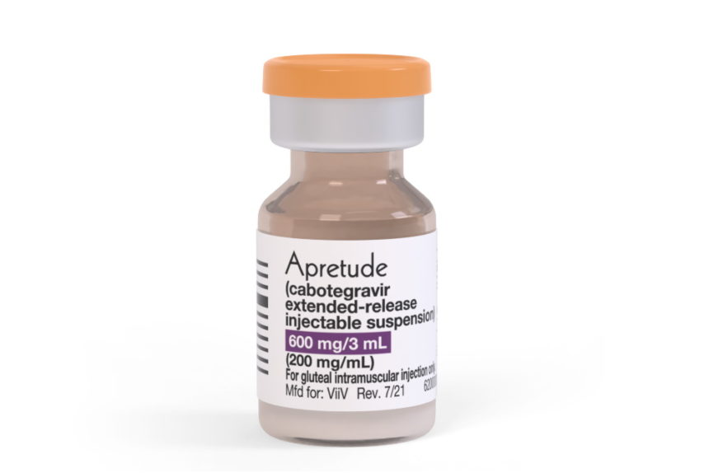
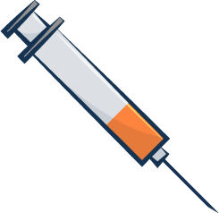
Cabotegravir for HIV PrEP
Oral Cabotegravir (Optional)
Cabotegravir Injectable (IM)
Oral Cabotegravir
Cabotegravir (200 mg/mL)
30 mg
600 mg (3 mL)
INSTI
INSTI
December 2021: FDA approved as HIV PrEP for at-risk adults and adolescents weighing ≥35 kilograms (77 pounds)
Source: Cabotegravir Prescribing Information.

Slide 3
Cabotegravir Dosing with Renal or Hepatic Impairment
Dosing with Renal Insufficiency
Mild (CrCl ≥60 to <90 mL/min): no adjustment
Moderate (CrCl ≥30 to <60 mL/min): no adjustment
Severe (CrCl 15 to <30 mL/min) or ESRD (<15 mL/min): increased monitoring for adverse effects is recommended
Dialysis: not expected to alter cabotegravir levels
Dosing with Hepatic Impairment
Mild-to-Moderate (Child A or B): no dose adjustment
Severe (Child C): unknown
Source: Cabotegravir Prescribing Information.

Slide 4
Cabotegravir for HIV PrEP: Prescribing Information
Lead-In
Cabotegravir Injections
OPTIONAL
≥28 days
1 Month
2 Months
2 Months
2 Months
2 Months...
Cabotegravir 30 mg daily
Cabotegravir 600 mg (3 mL) IM
Source: Based on Cabotegravir Prescribing Information. Illustration: David H. Spach, MD

Slide 5
Prescribing Information Cabotegravir for HIV PrEP: Tail Phase Recommendations
Lead-In
Cabotegravir Injections
Tail Phase
OPTIONAL
≥28 days
1 Month
2 Months
2 Months
2 Months…
? Duration
Consider alternative forms of PrEP after stopping cabotegravir if at continuing risk of acquiring HIV-1
Start within 2 months of the final cabotegravir injection
Oral Cabotegravir 30 mg daily
Cabotegravir 600 mg (3 mL) IM
Source: Based on Cabotegravir Prescribing Information. Illustration: David H. Spach, MD

Slide 6
2021 CDC PrEP Guidelines Cabotegravir for HIV PrEP: Tail Phase Recommendations
Lead-In
Cabotegravir Injections
Tail Phase
OPTIONAL
≥28 days
1 Month
2 Months
2 Months
2 Months…
? Duration
If PrEP indicated, prescribe TDF-FTC or TAF-FTC^ within 8 weeks of stopping cabotegravir
Continue follow-up visits quarterly for 12 months
Cabotegravir 30 mg daily
Cabotegravir 600 mg (3 mL) IM
*TDF-FTC = tenofovir DF-emtricitabine; TAF-FTC = tenofovir alafenamide-emtricitabine ^Note that TAF-FTC is not approved as HIV PrEP for individuals at risk from receptive vaginal sex
Source: CDC Preexposure Prophylaxis for the Prevention of HIV Infection in the U.S.– 2021 Update Clinical Practice Guideline

Slide 7
Cabotegravir Baseline Laboratory Monitoring
Baseline Laboratory Tests Indicated Prior to Starting Cabotegravir:
HIV RNA (within 1 week prior to initiation visit)
HIV-1/2 antigen-antibody assay
STI testing (syphilis, gonorrhea, chlamydia)
Baseline Laboratory Tests NOT Indicated Prior to Starting Cabotegravir:
Serum creatinine (eCrCl)
Hepatitis B serology (HBsAg, anti-HBs, anti-HBc)*
Lipid panels
Liver function tests
*Note: if person has not previously received HBV immunization, obtaining hepatitis B serologic testing should be done as general health management to determine if hepatitis B vaccine series indicated and to screen for active hepatitis B infection..
Source: CDC Preexposure Prophylaxis for the Prevention of HIV Infection in the U.S.– 2021 Update Clinical Practice Guideline

Slide 8
2021 CDC PrEP Guidelines Cabotegravir for HIV PrEP: Monitoring on Cabotegravir
Cabotegravir Injections
Month 1
Month 3
Month 5
Month 7
Month 9
1 Month
2 Months
2 Months
2 Months
2 Months...
HIV Ag/Ab HIV RNA
HIV Ag/Ab HIV RNA STI Screen*
HIV Ag/Ab HIV RNA
HIV Ag/Ab HIV RNA STI Screen*^
HIV Ag/Ab HIV RNA
*Bacterial STI screening for men who have sex with men and transgender women who have sex with men (every 4 months) ^Bacterial STI screening for heterosexually active women and men (syphilis, gonorrhea, chlamydia every 6 months)
Source: CDC Preexposure Prophylaxis for the Prevention of HIV Infection in the U.S.– 2021 Update Clinical Practice Guideline

Slide 9
Cabotegravir (long-acting injectable) for HIV PrEP Summary of Key Phase 3 Studies
HPTN 083: Cabotegravir versus TDF-FTC for MSM and TGW
HPTN 084: Cabotegravir versus TDF-FTC for Cisgender women
Abbreviations: HPTN -= HIV Prevention Trials Network; TDF-FTC = tenofovir DF-emtricitabine; MSM = men who have sex with men; TGW = transgender women

Slide 10
IM Cabotegravir versus TDF-FTC for HIV PrEP for MSM and TGW HPTN 083

Slide 11
IM Cabotegravir versus TDF-FTC for HIV PrEP for MSM and TGW HPTN 083: Study Design
Background: Phase 2b/3, double-blind, randomized, multinational trial to assess efficacy of long-acting IM cabotegravir (CAB) compared to daily oral tenofovir DF-emtricitabine (TDF-FTC) for HIV PrEP for men who have sex with men (MSM) and transgender women
Setting
43 global sites
Inclusion Criteria
Adult (≥18 years) cisgender MSM and transgender women who have sex with men
Substantial HIV risk*
Negative HIV serologic test at enrollment and negative HIV RNA ≤14 days before trial entry
Generally good health and CrCl 60 mL/min
HBsAg negative and HCV antibody negative
No contraindications to gluteal injections
No injection drug use within 90 days of trial entry
*Condomless receptive anal intercourse; >5 sex partners, stimulant use, rectal/urethral STI or syphilis ≤6 months; SexPro Score <16 (U.S. only)
Source: Landovitz RJ, et al. N Engl J Med. 2021;385:595-608.

Slide 12
IM Cabotegravir versus TDF-FTC for HIV PrEP for MSM and TGW HPTN 083: Study Design
Step 1
Step 2
Step 3
5 Weeks
3 Years
1 Year
Oral CAB 30 mg Daily
IM CAB 600 mg
Weeks 5, 9, and every 8 weeks thereafter
Oral TDF-FTC Daily
Oral TDF-FTC Placebo Daily
Oral TDF-FTC Placebo Daily
Participants Randomized n = 4,570
1:1
Oral TDF-FTC Daily
Oral TDF-FTC Daily
Oral CAB Placebo Daily
IM CAB Placebo Weeks 5, 9, and every 8 weeks thereafter
Source: Landovitz RJ, et al. N Engl J Med. 2021;385:595-608.

Slide 13
IM Cabotegravir versus TDF-FTC for HIV PrEP for MSM and TGW HPTN 083: Study Population
HPTN 083: Selected Baseline Demographics
Characteristic | Total (n = 4,566) | Cabotegravir (n = 2,282) | TDF-FTC (n = 2,284)
Cisgender MSM, n (%) | 3,992 (87.4) | 2,013 (88.2) | 1,979 (86.6)
Transgender women, n (%) | 570 (12.5) | 266 (11.7) | 304 (13.3)
Median age (IQR), years, n (%) | 26 (22-32) | 26 (22-32) | 26 (22-32)
Black race, United States, n (%) | 845 (49.8) | 411 (48.4) | 434 (51.1)
Geographic region, n (%)
United States, n (%) | 1,698 (37.2) | 849 (37.2) | 849 (37.2)
Latin America, n (%) | 1,964 (43.0) | 980 (42.9) | 984 (43.2)
Asia, n (%) | 752 (16.5) | 375 (16.5) | 377 (16.5)
Africa, n (%) | 152 (3.3) | 78 (3.4) | 74 (3.2)
*Abbreviations: MSM = men who have sex with men; IQR = interquartile range
Source: Landovitz RJ, et al. N Engl J Med. 2021;385:595-608.

Slide 14
IM Cabotegravir versus TDF-FTC for HIV PrEP for MSM and TGW HPTN 083: Results
Number of HIV Infections (After Enrollment)
P = 0.0005
Source: Landovitz RJ, et al. N Engl J Med. 2021;385:595-608.

Slide 15
IM Cabotegravir versus TDF-FTC for HIV PrEP for MSM and TGW HPTN 083: Results
Risk Reduction in HIV Infections (After Enrollment)
⇓ 66%
Source: Landovitz RJ, et al. N Engl J Med. 2021;385:595-608.

Slide 16
IM Cabotegravir versus TDF-FTC for HIV PrEP for MSM and TGW HPTN 083: Results
Cumulative HIV Incidence (After Enrollment)
P <0.001
Source: Landovitz RJ, et al. N Engl J Med. 2021;385:595-608.

Slide 17
IM Cabotegravir versus TDF-FTC for HIV PrEP for MSM and TGW HPTN 083: Results
When did incident HIV infections occur in CAB arm?
3 during oral lead-in
5 after “prolonged hiatus” from IM CAB
5 during continuous CAB administration
Were drug levels adequate in TDF-FTC arm?
Random sample of 372 participants:
87% detectable plasma tenofovir level
75% levels correlated with high-level protection
≈70% levels suggestive of >4 doses/week (by dried blood spot)
Source: Landovitz RJ, et al. N Engl J Med. 2021;385:595-608.

Slide 18
IM Cabotegravir versus TDF-FTC for HIV PrEP for MSM and TGW HPTN 083: Cabotegravir Injection Site Reactions
Type and Severity of Injection-Site Reactions
Most common: pain and tenderness
2.4% chose to discontinue study due to injection reaction
Onset
Reactions typically began 1 day after injection
Duration
Reactions typically lasted 3-4 days after injection
Source: Landovitz RJ, et al. N Engl J Med. 2021;385:595-608.

Slide 19
IM Cabotegravir versus TDF-FTC for HIV PrEP for MSM and TGW HPTN 083: Cabotegravir Injection Site Reactions
Source: Landovitz RJ, et al. N Engl J Med. 2021;385:595-608.

Slide 20
IM Cabotegravir versus TDF-FTC for HIV PrEP for MSM and TGW HPTN 083: Results: Resistance with Cabotegravir
INSTI Resistance in Cabotegravir Group
1 at baseline; 4 with incident HIV infections
No resistance documented after last injection during “tail phase”
Source: Landovitz RJ, et al. N Engl J Med. 2021;385:595-608.

Slide 21
IM Cabotegravir versus TDF-FTC for HIV PrEP for MSM and TGW HPTN 083: Weight Gain
P < 0.001
P < 0.001
P = 0.93
Source: Landovitz RJ, et al. N Engl J Med. 2021;385:595-608.

Slide 22
IM Cabotegravir versus TDF-FTC for HIV PrEP for MSM and TGW HPTN 083: Conclusions
Conclusions: Long-acting cabotegravir was superior to daily oral Tenofovir DF–emtricitabine in preventing HIV infection among men who have sex with men and transgender women.
Source: Landovitz RJ, et al. N Engl J Med. 2021;385:595-608.

Slide 23
IM Cabotegravir vs. TDF-FTC for PrEP in Cisgender Women HPTN 084

Slide 24
IM Cabotegravir versus TDF-FTC for PrEP in Cisgender Women HPTN 084: Study Design
Background: Phase 3, double-blind, randomized, multinational trial to assess efficacy of long-acting IM cabotegravir (CAB) compared to daily oral tenofovir DF-emtricitabine (TDF-FTC) for HIV PrEP for cisgender women (assigned female sex at birth)
Setting
20 sites in 7 countries in Sub-Saharan Africa
Inclusion Criteria
Cisgender women (assigned female sex at birth) 18-45 years of age
Sexually active (e.g vaginal sex on ≥2 separate days in the 30 days prior to screening)
HBsAg-negative and willing to receive hepatitis B vaccination
HCV antibody negative
No contraindications to gluteal injections
Creatinine clearance of greater than or equal to 60 mL/min
ALT <2 x upper limit of normal (ULN) and total bilirubin ≤ 2.5 x ULN
Excluded if pregnant or breastfeeding
Source: Delany-Moretlwe S, et al. Lancet. 2022;399:1779-89.

Slide 25
IM Cabotegravir versus TDF-FTC for PrEP in Cisgender Women HPTN 084: Study Design
Step 1
Step 2
Step 3
5 Weeks
Up to 185 weeks (3.5 Years)
48 weeks
Oral CAB 30 mg Daily
IM CAB 600 mg
Weeks 5, 9, and every 8 weeks thereafter
Oral TDF-FTC Daily
Oral TDF-FTC Placebo Daily
Oral TDF-FTC Placebo Daily
Participants n = 3,224
Oral TDF-FTC Daily
Oral TDF-FTC Daily
Oral CAB Placebo Daily
IM CAB Placebo Weeks 5, 9, and every 8 weeks thereafter
Source: Delany-Moretlwe S, et al. Lancet. 2022;399:1779-89.

Slide 26
IM Cabotegravir versus TDF-FTC for PrEP in Cisgender Women HPTN 084: Baseline Characteristics
HPTN 084: Selected Baseline Characteristics
Baseline Characteristics | Cabotegravir (n = 1,614) | TDF-FTC (n = 1,610)
Median age, years | 25 | 25
Age <25 years, n (%) | 814 (50.4%) | 816 (50.7%)
Black/African race, n (%) | 1,569 (97.2%) | 1,554 (96.5%)
Sexual activity in past month (reported)
>2 sex partners, n (%) | 878/1,609 (54.5%) | 877/1,609 (54.8%)
Transactional sex, n (%) | 658/1,609 (40.9%) | 655/1,600 (40.9%)
Partner HIV(+) or unknown, n (%) | 542/1,609 (33.7%) | 558/1,600 (34.9%)
Anal sex, n (%) | 90/1,609 (5.6%) | 95/1,600 (5.9%)
Source: Delany-Moretlwe S, et al. Lancet. 2022;399:1779-89.

Slide 27
IM Cabotegravir versus TDF-FTC for PrEP in Cisgender Women HPTN 084: Results
Number of HIV Infections: Risk Reduction
P < 0.0001
⇓88%
Source: Delany-Moretlwe S, et al. Lancet. 2022;399:1779-89.

Slide 28
IM Cabotegravir versus TDF-FTC for PrEP in Cisgender Women HPTN 084: Results
Number of HIV Infections
P < 0.0001
Source: Delany-Moretlwe S, et al. Lancet. 2022;399:1779-89.

Slide 29
IM Cabotegravir versus TDF-FTC for PrEP in Cisgender Women HPTN 084: Results
Number of HIV Infections: Risk Reduction
⇓88%
Source: Delany-Moretlwe S, et al. Lancet. 2022;399:1779-89.

Slide 30
IM Cabotegravir versus TDF-FTC for PrEP in Cisgender Women HPTN 084: Results
HIV Incidence
P < 0.0001
4/1956
36/1942
Source: Delany-Moretlwe S, et al. Lancet. 2022;399:1779-89.

Slide 31
IM Cabotegravir versus TDF-FTC for PrEP in Cisgender Women HPTN 084: Conclusions
Interpretation: Although both products for HIV prevention were generally safe, well tolerated, and effective, cabotegravir was superior to TDF-FTC in preventing HIV infection in women.
Source: Delany-Moretlwe S, et al. Lancet. 2022;399:1779-89.

Slide 32
IM Cabotegravir Tail-Phase Safety, Tolerability, and Pharmacokinetics HPTN 077

Slide 33
Cabotegravir Levels After Last Dose of Cabotegravir
Source: Landovitz RJ, et al. Lancet HIV. 2020;7:e472-81.

